Slide 1

Well hub
Client:
Dr. Rhonda Beemer
MSACS GDP II 2019-21

Slide 2
Agenda
Problem Statement
Project Description
Benefits of WELL HUB
Project Requirements Specifications(User Roles and Features)

Slide 3

Problem Statement
Between 2017 and 2018, the National Health and Nutrition Examination Survey observes 1 out of every 4 children are suffering from Obesity, also obesity is linked to more than 60 chronic diseases and there is epidemic of obesity around the world.
In the U.S., childhood obesity alone is estimated to cost $14 billion annually in direct health expenses. Unhealthy lifestyle and eating habits has direct impact on physical health causing damage to metabolism, which has impact on mental well-being too.

Slide 4
Project Description
Well Hub is a digital technology that helps people eat better, get fitter and lose weight. The primary solution is delivered via a smartphone app (iOS, Android, PC) with a team of qualified diet/ fitness expert’s available in-app.
Our application will help users to:
Track users health and wellness progress using user activity(Step Count, Water Intake, Sleep Hours, Food Intake, Physical Activity, and Mindful Minutes)
Ability to set personal goals and track progress
Allow users to participate in various challenges(workout/diet)
Communication features, such as a forum for sharing user’s experiences, recipes, etc.

Slide 5
Project Requirements Specifications
The Functional Requirements include:
Track the user information - Step Count, Water Intake, Sleep Hours, Food Intake, Physical Activity, and Mindful Minutes
Marks the user progress and generate reports
Create challenges and maintains score
Help reach-out personal goal
Guide user to pursue Mindful minutes for peace and stability

Slide 6
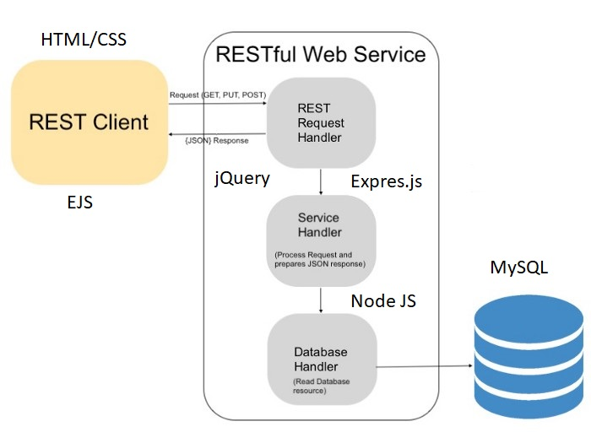
Project Architecture

Slide 7









Software technologies

Slide 8
Database design

Slide 9
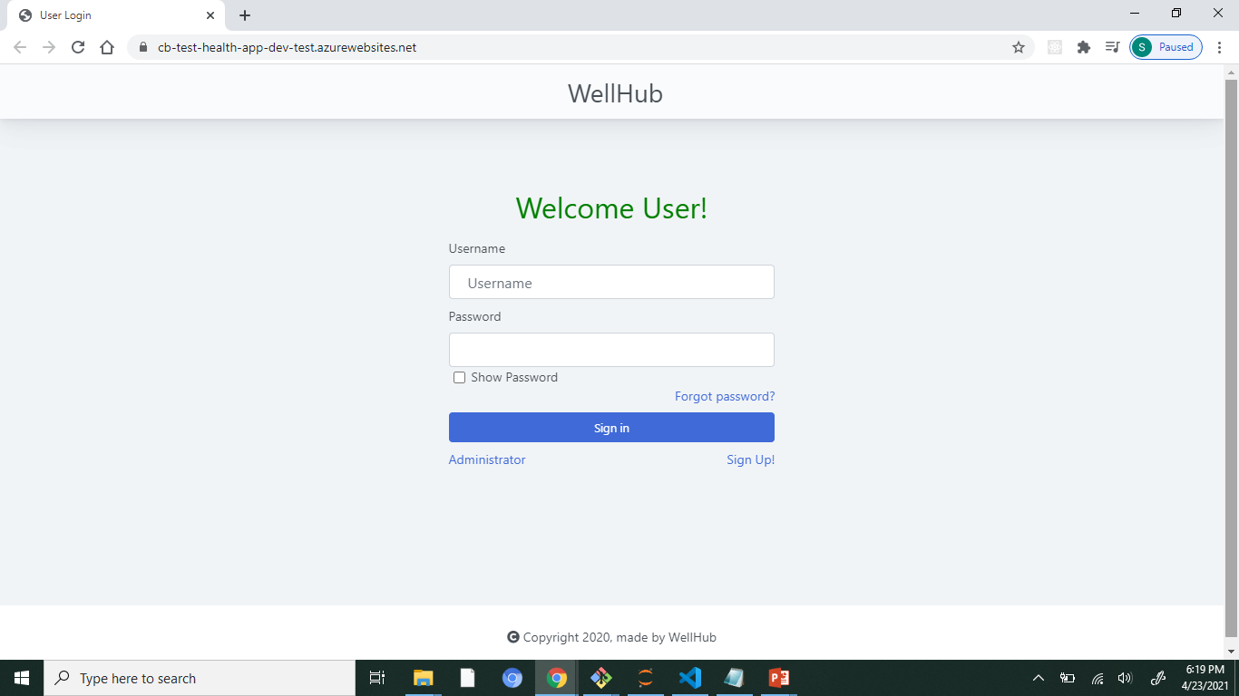
Application walkthrough
Home Screen

Slide 10
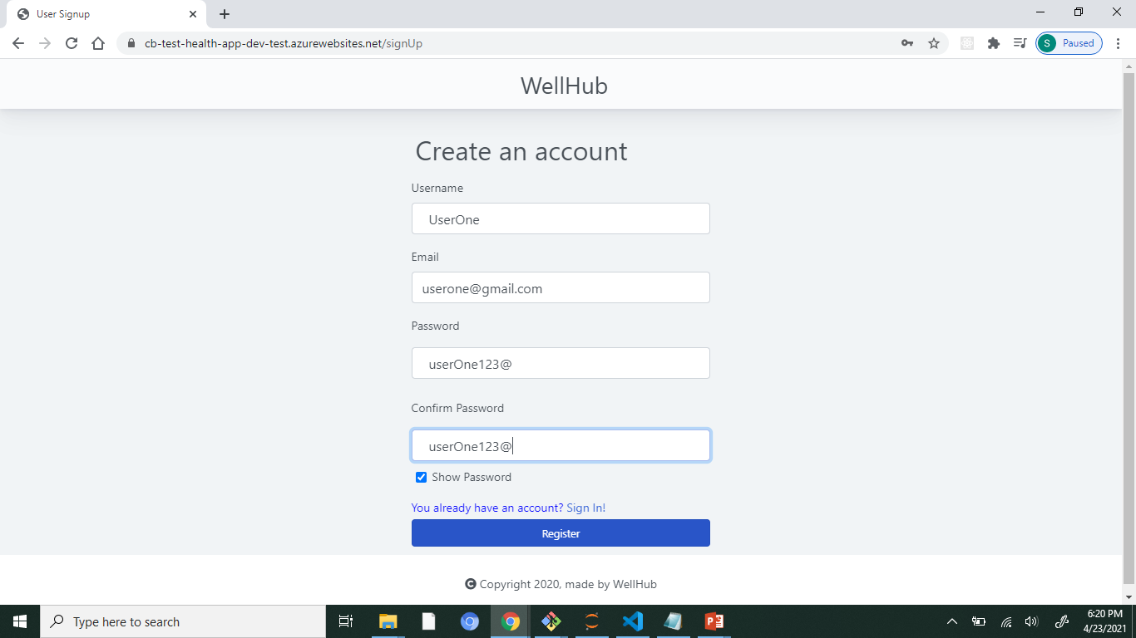
Create an Account

Slide 11
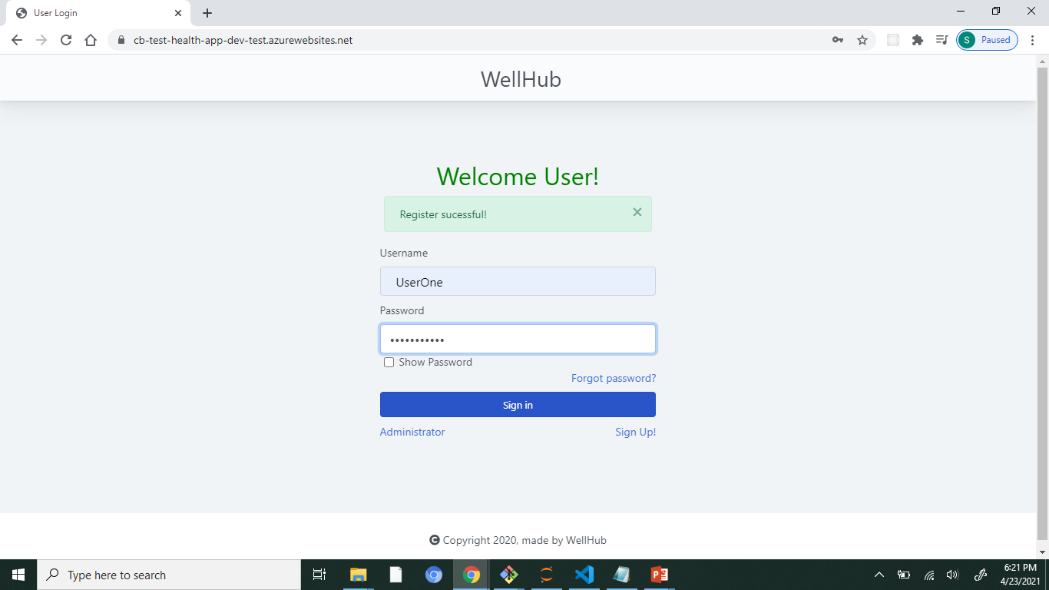
User login

Slide 12
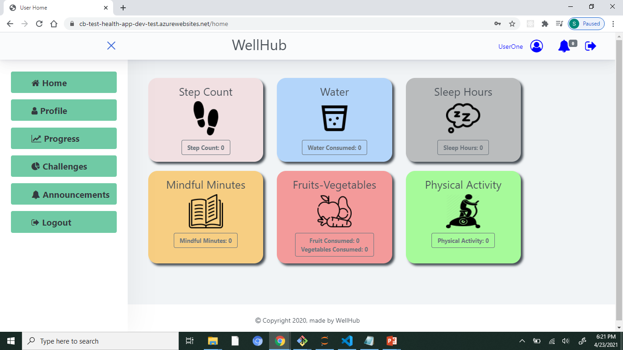
User dashboard

Slide 13
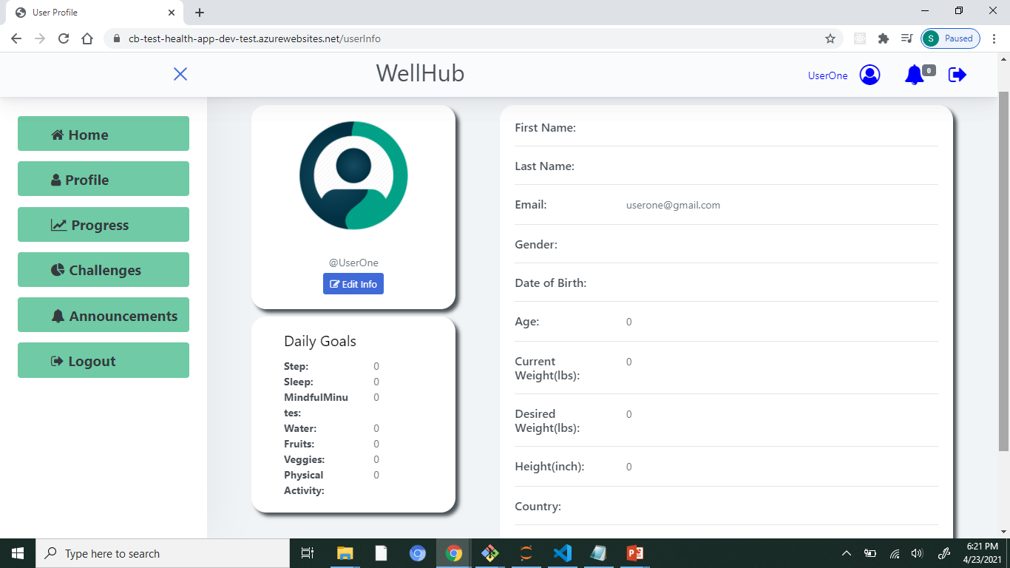
User profile

Slide 14
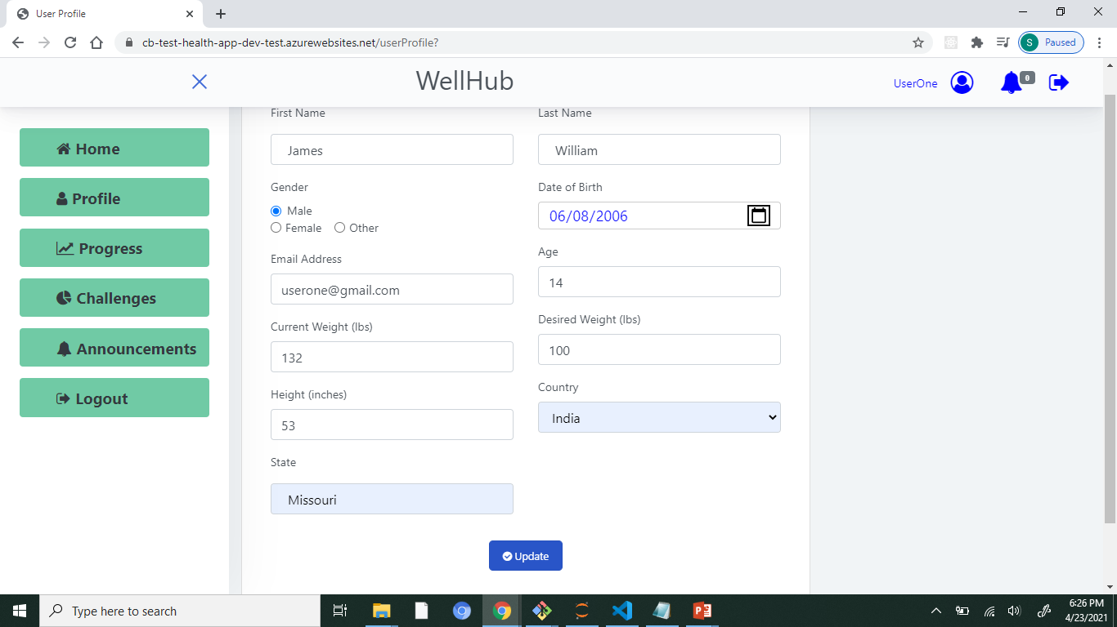
Update user profile

Slide 15
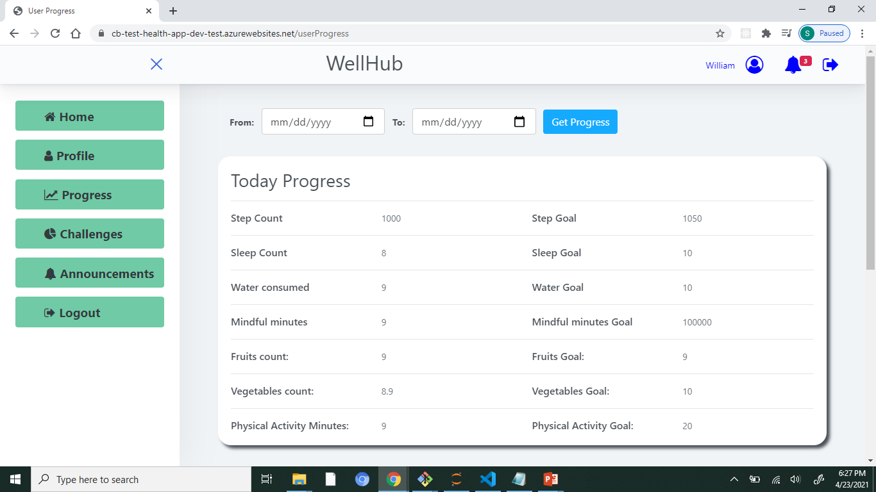
User progress

Slide 16

User progress-timeline

Slide 17
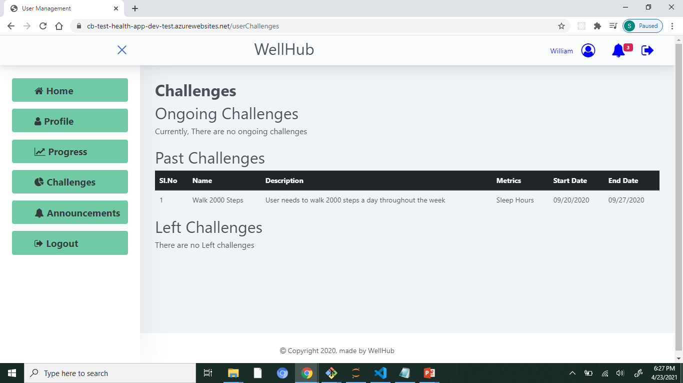
User Challenges

Slide 18
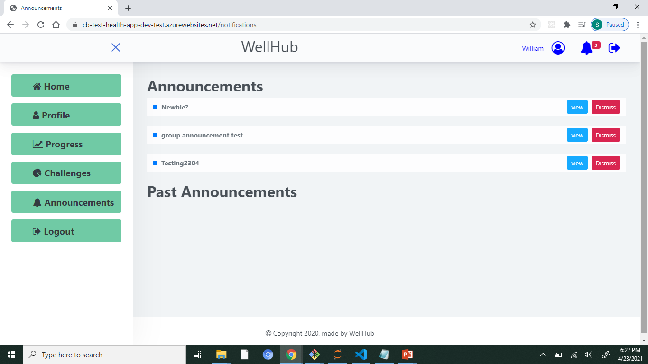
User announcements

Slide 19
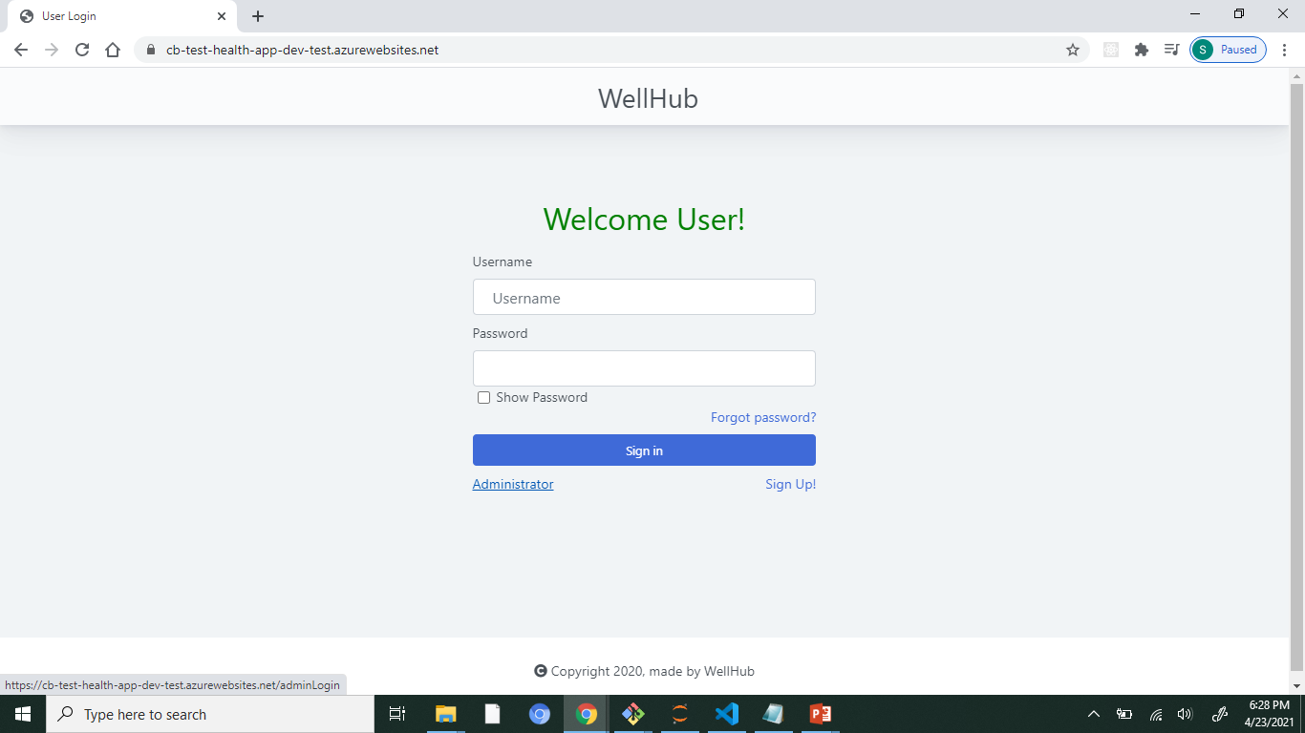
User-logout

Slide 20
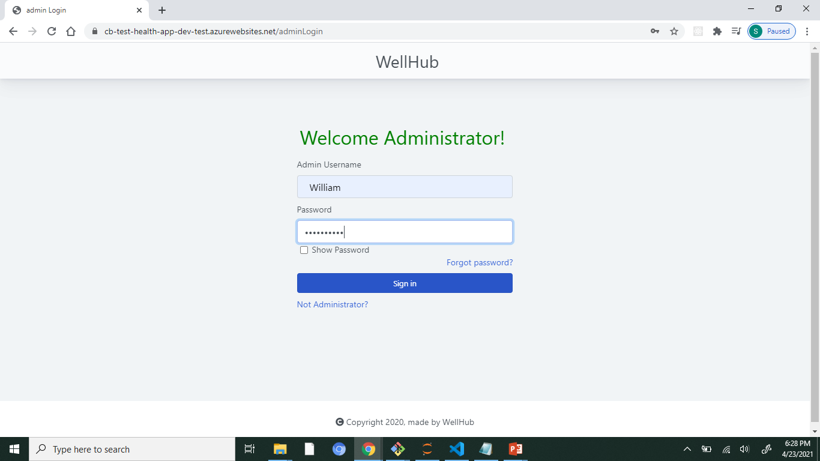
Admin login

Slide 21
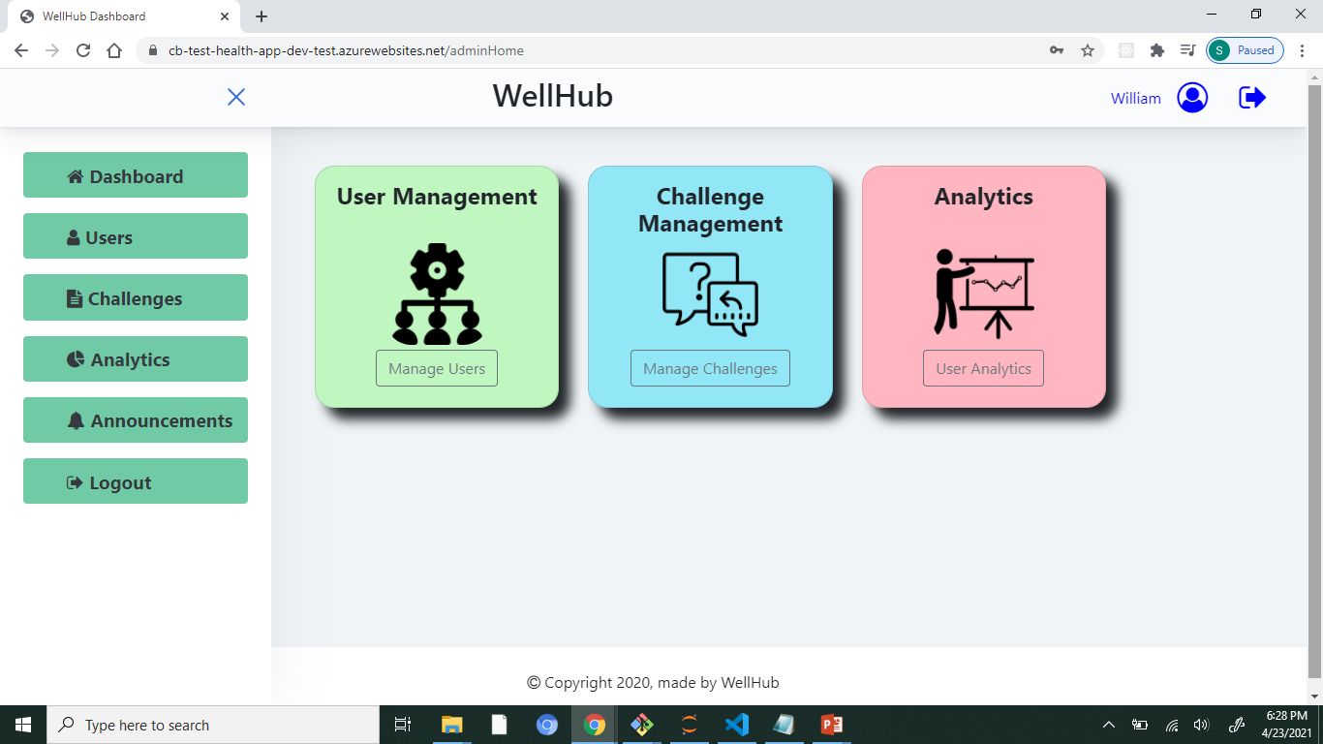
Admin dashboard

Slide 22
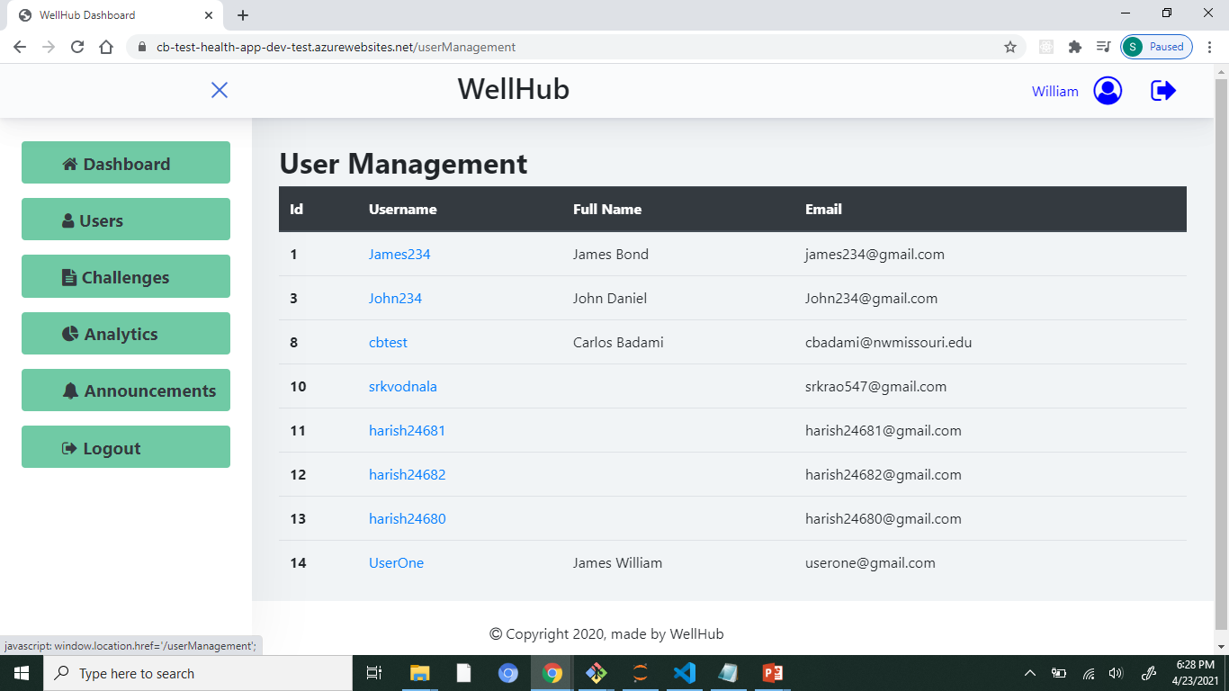
Admin – users management

Slide 23
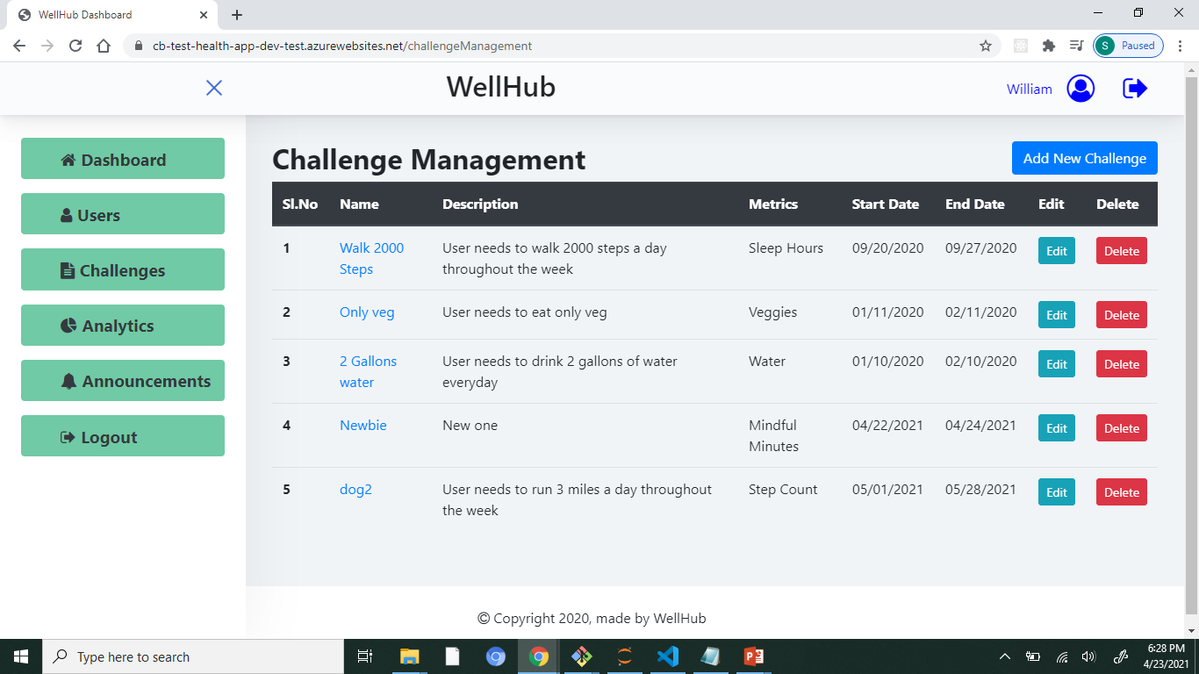
Admin Challenge management

Slide 24
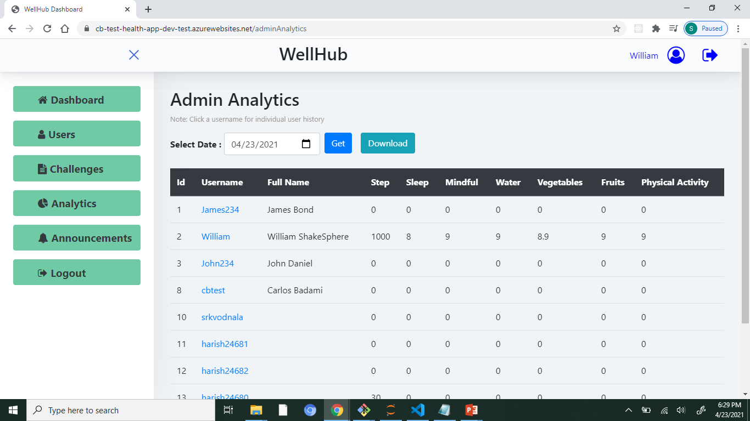
Admin Analytics

Slide 25
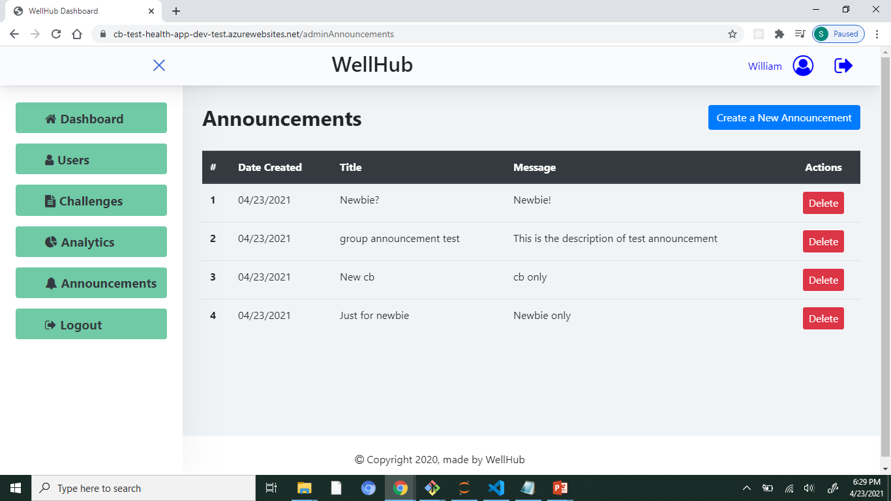
Admin announcements

Slide 26
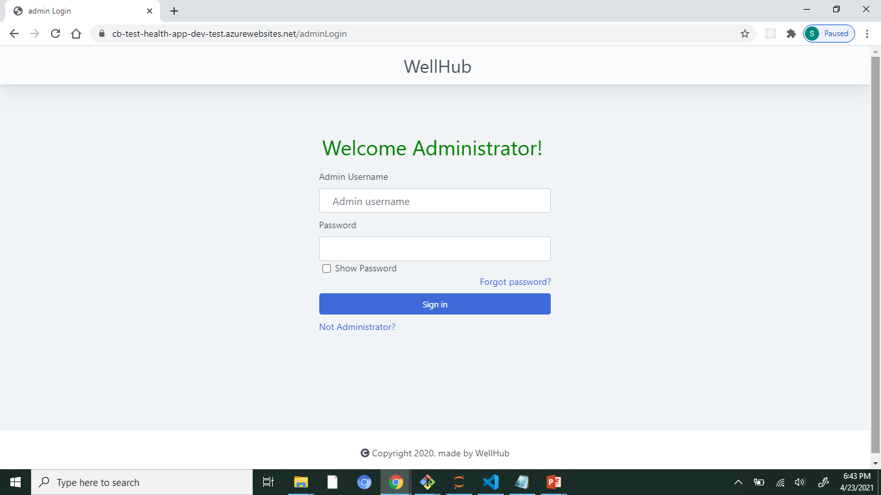
Admin- logout

Slide 27

Make your idea success
Github Repository: https://github.com/cbadami/happyHealth
Hosted URL: https://cb-test-health-app.azurewebsites.net/

Slide 28


