Slide 1

Well hub
Client:
Dr. Rhonda Beemer
Guided By:
Dr. Charles Badami
MSACS GDP II
44692 - 01
2019-21

Slide 2
Agenda
Statement of Purpose
Overview
Benefits of Well Hub
Project Architecture
Software Technologies
ER – Diagram
ER – Entities
Project Requirements Specifications
Application Walkthrough
References and Links

Slide 3
Statement of Purpose
The popularity of mobile technology is used to provide a health promotional service assisting others in tracking their health and wellness progress. Thus, we have developed an application that uses mobile devices to encourage users to provide health-related data through fun group health and wellness challenges, while also being able to view the results. This would in-turn motivate by cultivating healthy competitive spirit and encourage others to pursue a healthy lifestyle.
The app developed can be accessed on different mobile devices, as well as web browsers. Initial data categories include:
Step count
Hydration level
Amount of sleep
Servings of fruit & vegetables consumed
Mindful Minutes
Amount of physical activity

Slide 4
Overview
Our application helps Users to track their health and wellness progress using various metrics like Step Count, Water Intake, Sleep Hours, Food Intake, Physical Activity, and Mindful Minutes. They can set personal goals and track progress and participate in various group challenges.
Participating users would be assigned to group challenges by an administrator, which would include daily wellness targets. An administrator would also be able to access and monitor the data of all participants, create and modify challenges, and share certain challenge results among group members by sending announcements.
Additionally, all users would have the ability to view their previous data and administrators can also download this data into CSV files. Email notifications will be sent for every announcement, challenge invitations and password verification codes.

Slide 5
Project Requirements Specifications
The Functional Requirements include:
Track the user information - Step Count, Water Intake, Sleep Hours, Food Intake, Physical Activity, and Mindful Minutes
App should be responsive, and it should support different devices.
User and Admin should have separate logins.
Need to record all the user metrics for future references. Once the metrics are updated by the user they get updated in the database.
Current goal should be next the day goal automatically.
Marks the user progress and generate reports
Admin should be able to create and edit challenges to the users.
Admin should be able to post announcements/notifications which would help user to know about any new updates from the admin.
Announcements and notifications should also be sent to user email.

Slide 6
Benefits of well hub
Well Hub is progressive web app, which means it can be accessed on any device(Windows, Mac, Mobile, tablet etc.).
Using our app users can track their health and wellness progress using user activity which are Step Count, Water Intake, Sleep Hours, Food Intake, Physical Activity, and Mindful Minutes.
Along with the challenges set by the admin, users can also set their personal daily goals.
Users will be able to track their progress over a period using user progress. They can also view their progress in particular date ranges.
Users can participate in various challenges(workout/diet).

Slide 7
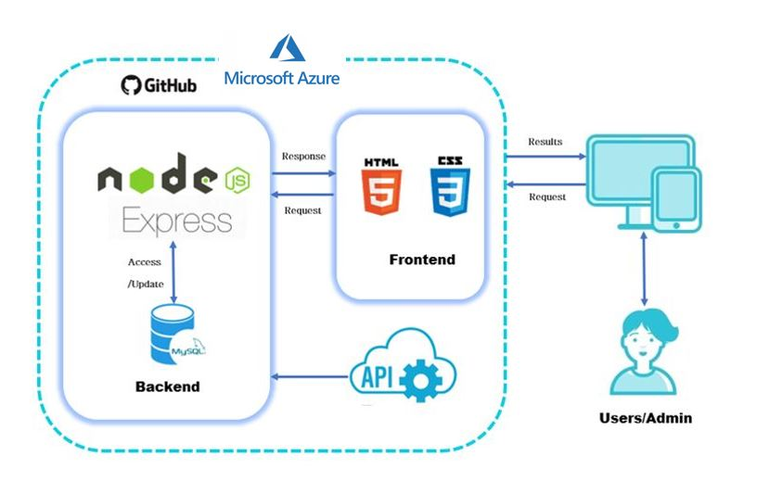
Project Architecture

Slide 8









Software Technologies

Slide 9
Software technologies
Backend: Node.js , Express.js
Frontend: HTML, CSS, JavaScript, jQuery.
Database: MySQL
Cloud: Azure
Version Control: GitHub

Slide 10
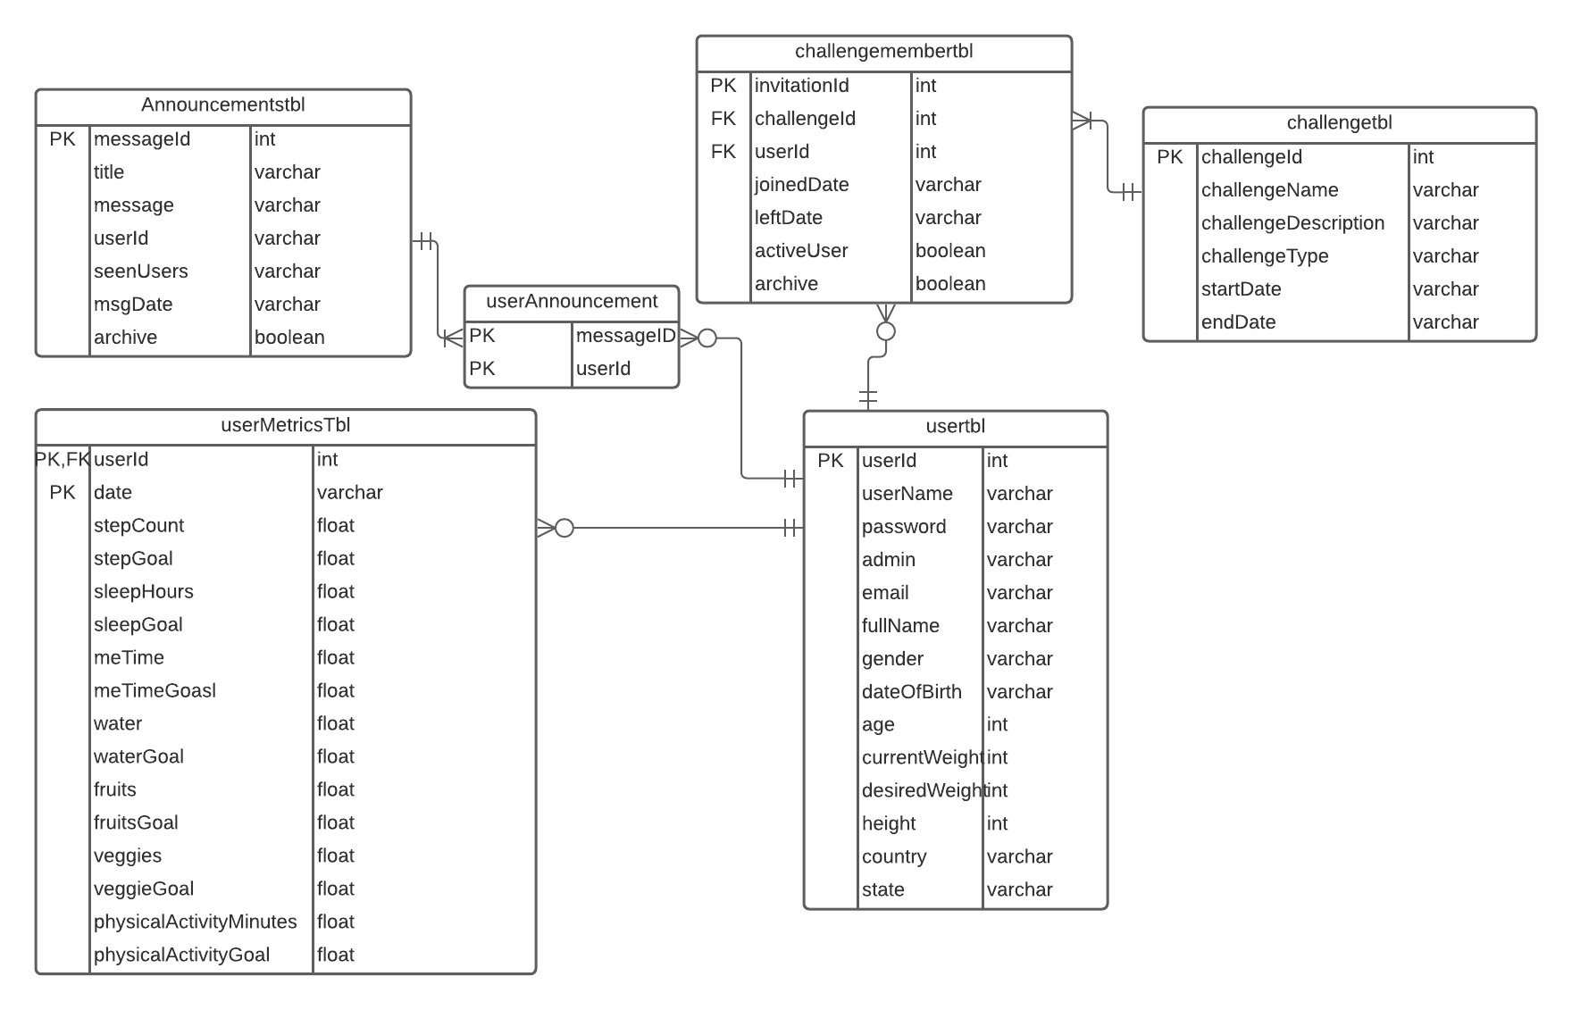
ER - Diagram

Slide 11
ER- entities
The five entities are:
Usertbl : This entity stores user personal details.
userMetricsTbl: This entity stores the metrics of the user like userId, date, stepCount, sleepCount, mindfulMinutes, fruits & veggies consumed and, also physical activity he/she performed on that particular day. It also changes day to day. Note: userId, date acts as composite primary to retrieve the users specified date metrics.
challengeTbl: this entity records the challenge details like challengeTitle, challengeDescription, metrics involved in the challenge, start date and end date.
challengeMemberTbl: This is the associative entity of challengetbl and usertbl which stores the userId, challengeId, joinedDate, leftDate, activeUser and archive.
announcementsTbl: This entity stores the details of the announcements which are posted by the admin. It includes messageId, title, message, userId , SeenUsers msgDate and archive
Note: In userId we are concatenating all the recipients userIds and storing it in userId column and when the user views that announcement the userId of particular user will be shifted to the seenUsers. seenUsers is same as userId but these are the ids of the users who viewed it.

Slide 12
Application Walkthrough

Slide 13
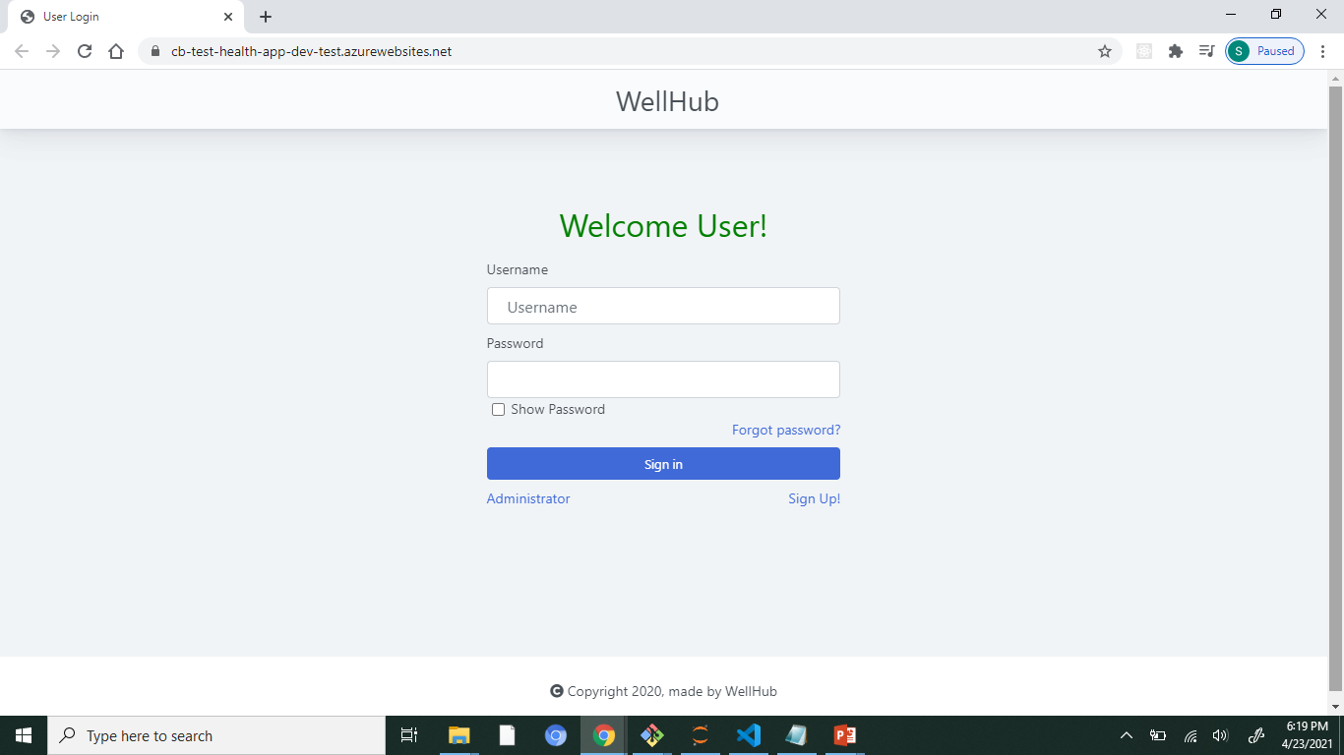
User Login
The user can login using their credentials. They can also sign-up if they don’t have an account. An option see your password is also present with an addition to reset their password which is connected to their registered NWMSU email address. If the user is an admin, they can be redirected to a different login page.
Notes:
The user can login using their credentials. They can also sign-up if they don’t have an account. An option see your password is also present with an addition to reset their password which is connected to their registered NWMSU email address. If the user is an admin, they can be redirected to a different login page.

Slide 14
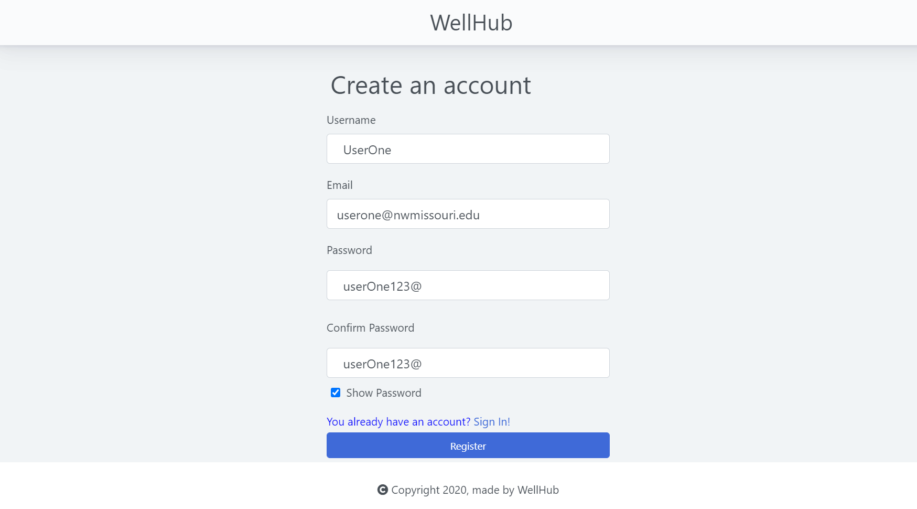
Create an Account
Sign-up page: where a new user can create a new account by creating a unique username and password. The email registered must be the NWMSU email address as OTP, notification and challenge notification emails will be send to that email.
Notes:
Sign-up page: where a new user can create a new account by creating a unique username and password. The email registered has to be the NWMSU email address as OTP, notification and challenge notification emails will be send to that email.

Slide 15
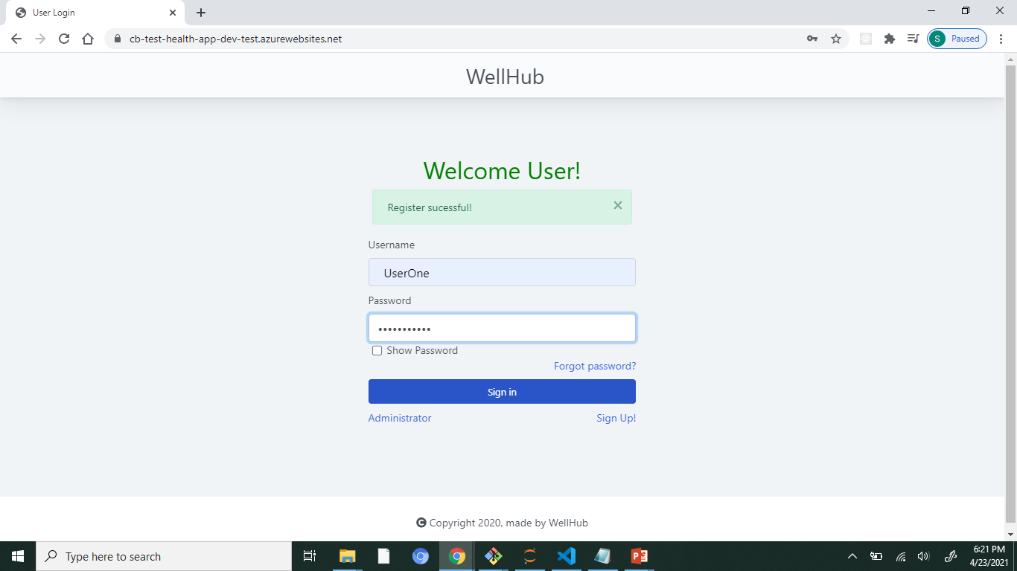
User login
Appropriate alert boxes are added for better clarity.
Notes:
Appropriate alert boxes are added for better clarity.

Slide 16
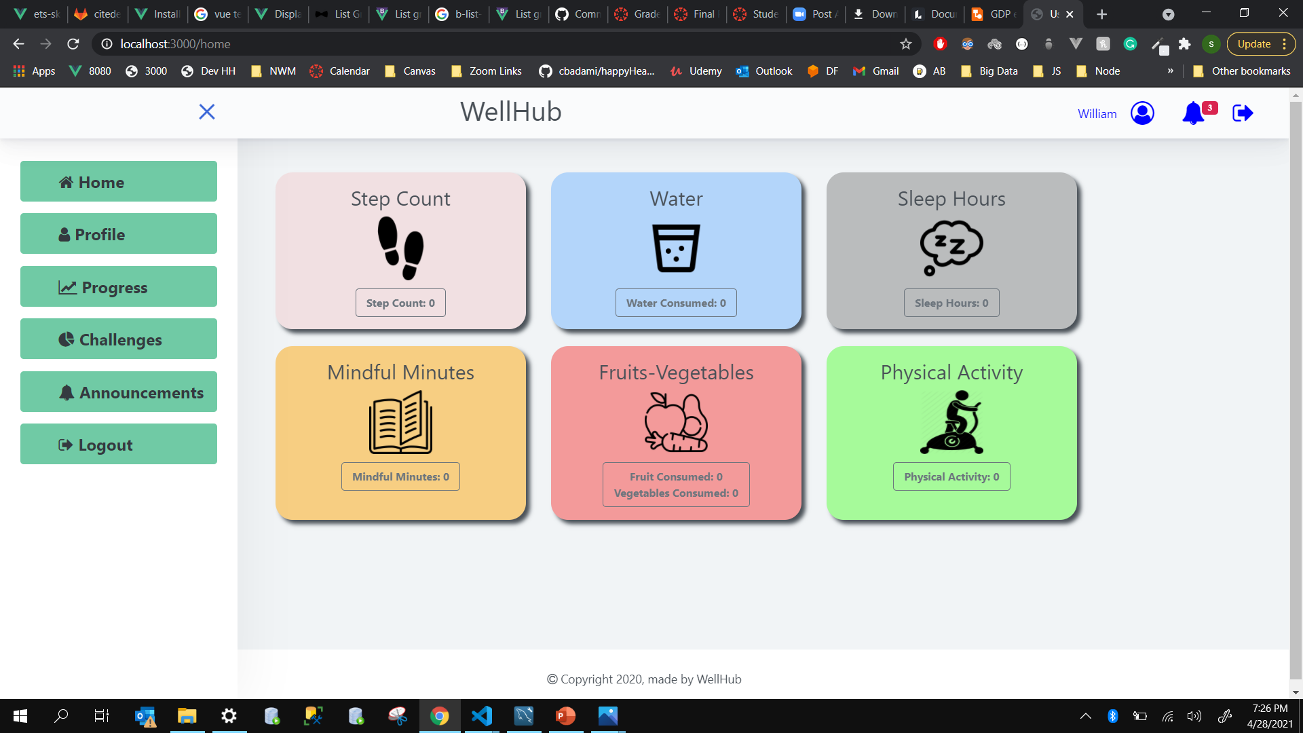
User dashboard
User home page where all the user metrics are displaying the most recent entries for current date. On the left, we have added a menu and, on the top, a header containing quick links to user profile, announcements and log-out buttons.
Notes:
User home page where all the user metrics are displaying the most recent entries for current date. On the left, we have added a menu and on the top, a header containing quick links to user profile, announcements and log-out buttons.

Slide 17
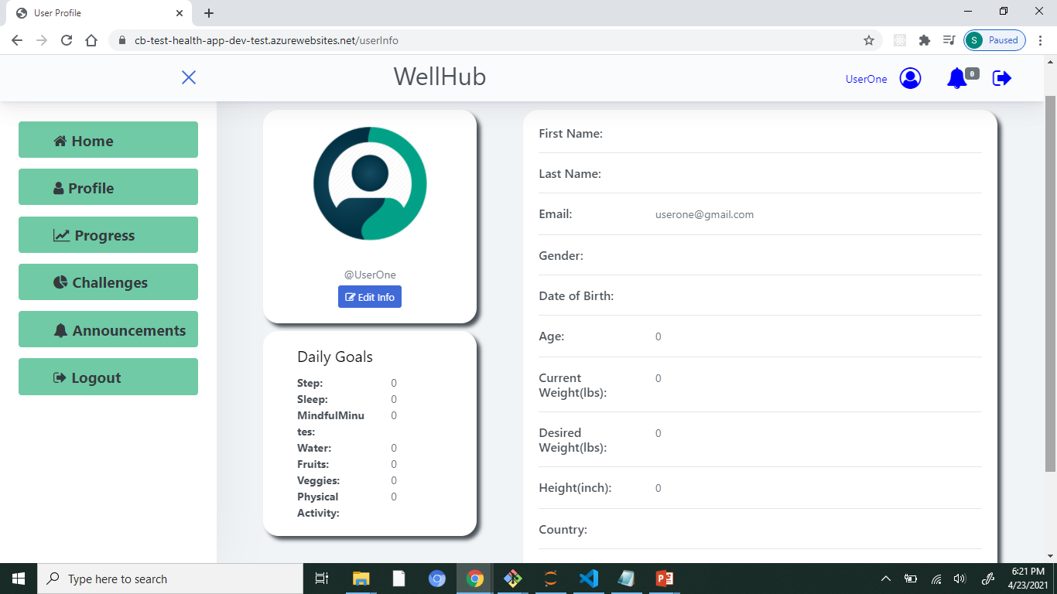
User profile
User profile page which displays the user details and goals set for each metrics. One can also edit their profile.
Notes:
User profile page which displays the user details and goals set for each metrics. One can also edit their profile.

Slide 18
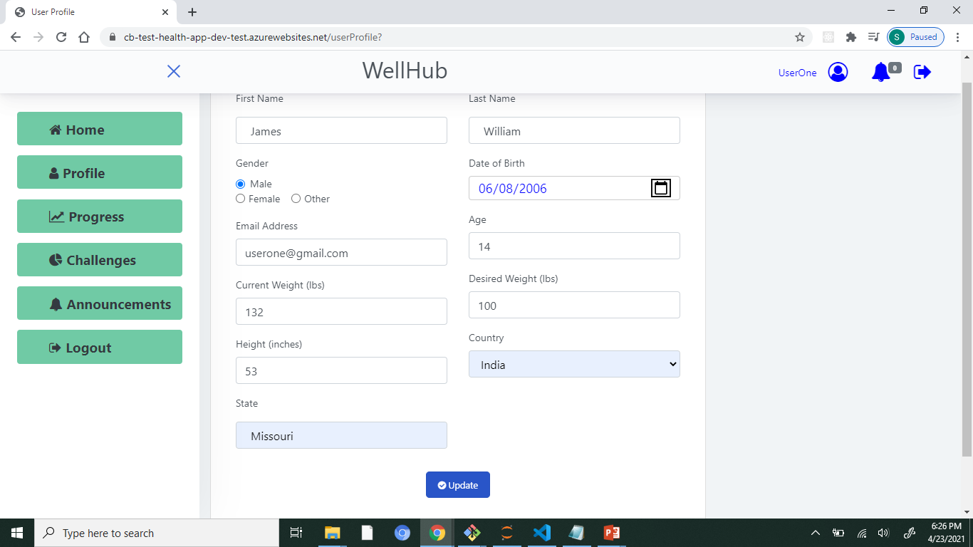
Update user profile
Editing user profile, where the age is calculated by giving the DOB and everything will be updated and displayed in the previous page.
Notes:
Editing user profile, where the age is calculated by giving the DOB and everything will be updated and displayed in the previous page.

Slide 19
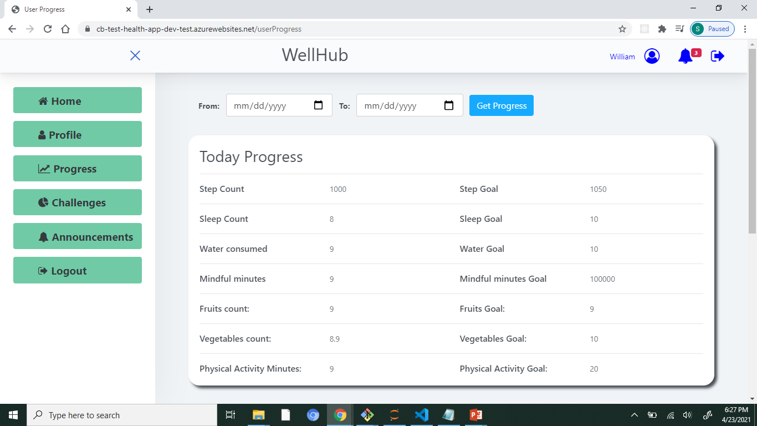
User progress
User can see their personal progress for current date by default. They can also select a date range which displays cumulative values of the metrics.
Notes:
User can see their personal progress for current date by default. They can also select a date range which displays cumulative values of the metrics.

Slide 20
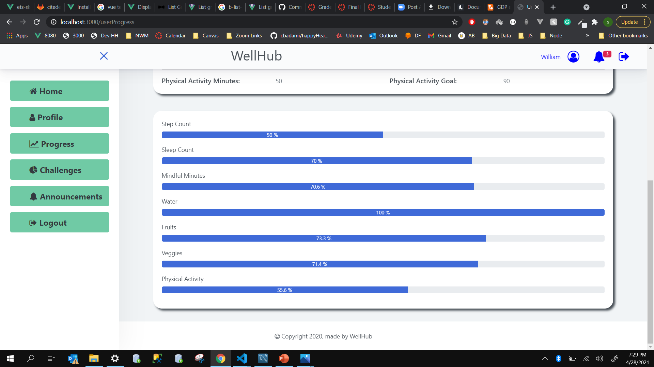
User progress bar
This is the graphical representation of the current values vs the goals set.
Notes:
This is the graphical representation of the current values vs the goals set.

Slide 21
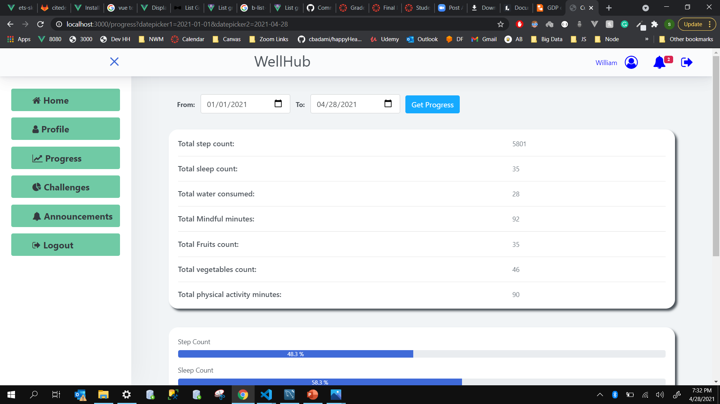
User progress-Date Range
Once the user selects a date range, they will be redirected to this page which represents the cumulative values from the first date till the last date selected. Both numeric and graphical values are displayed below.
Notes:
Once the user selects a date range, they will be redirected to this page which represents the cumulative values from the first date till the last date selected. Both numeric and graphical values are displayed below.

Slide 22
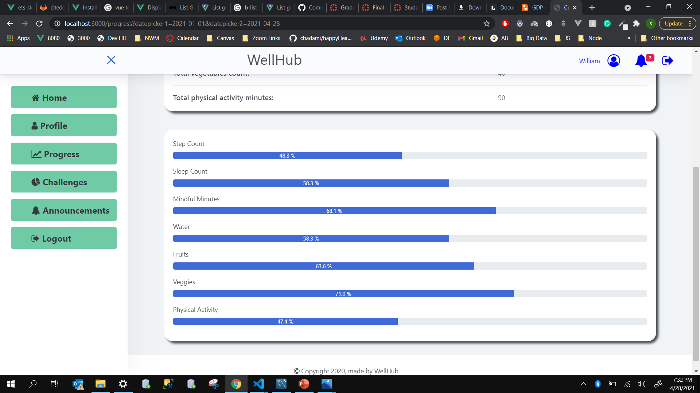
User progress-Date Range
Graphical representation of the cumulative values vs goal set.
Notes:
Graphical representation of the cumulative values vs goal set.

Slide 23
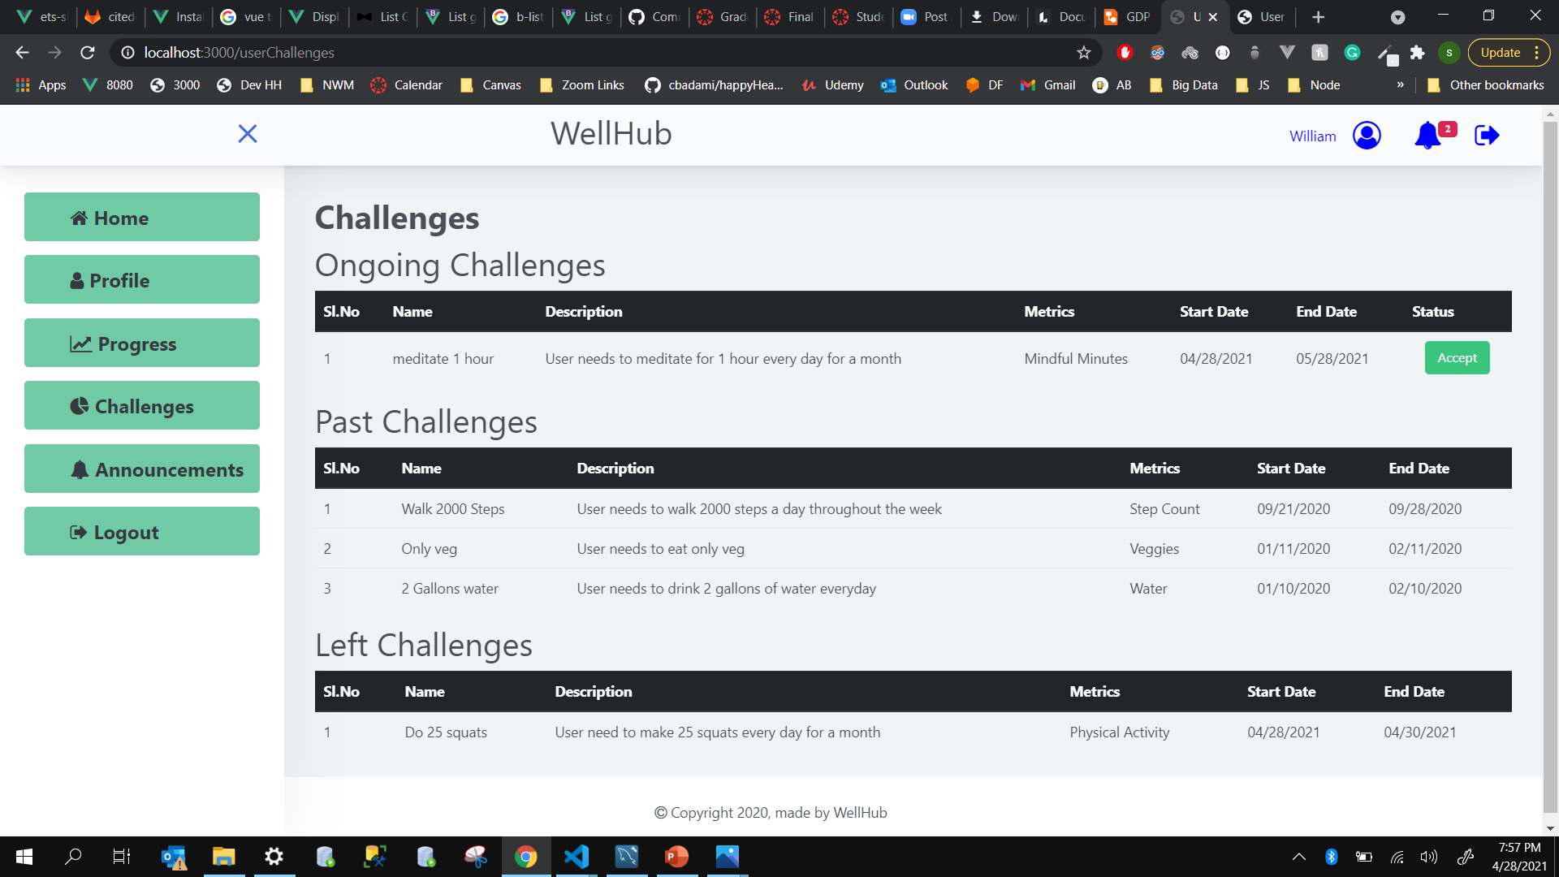
User Challenges
The user can view all the challenge details that are recorded since they started using the app.
Ongoing Challenges: The user receives invitations to challenges created by the admin. They can join by accepting or leave an accepted challenge.
Past Challenges: Once the challenge deadlines are over, the challenges will automatically be shifted to past challenges.
Left Challenges: The challenges which the user chooses to leave will be displayed under this column.
NOTE: Emails will be sent to the registered email address when a user is invited to a challenge by the admin.
Notes:
The user can view all the challenge details that are recorded since they started using the app.
Ongoing Challenges: The user receives invitations to challenges created by the admin. They can join by accepting or leave an accepted challenge.
Past Challenges: Once the challenge deadlines are over, the challenges will automatically be shifted to past challenges.
Left Challenges: The challenges which the user chooses to leave will be displayed under this column.
NOTE: Emails will be sent to the registered email address when a user is invited to a challenge by the admin.

Slide 24
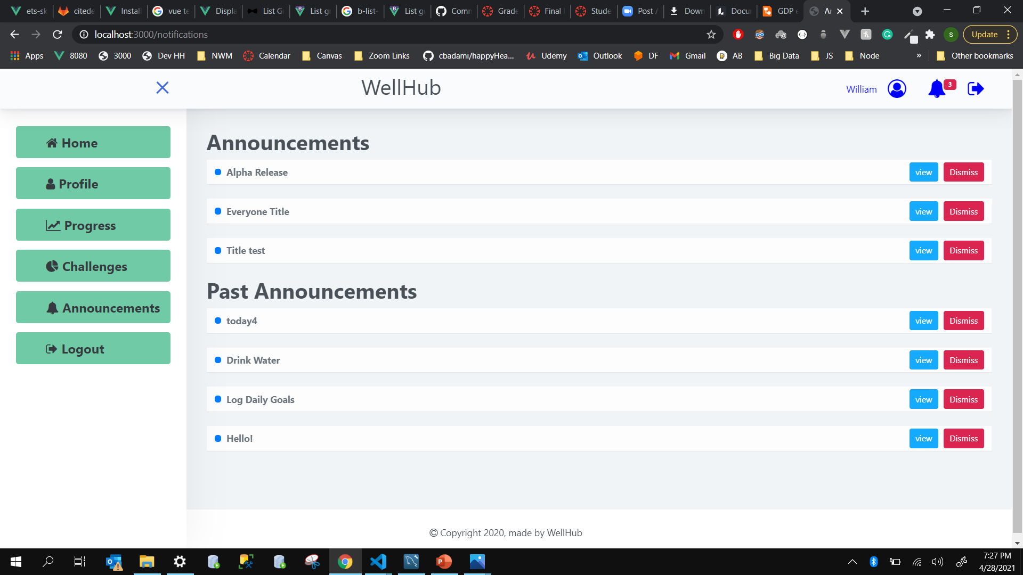
User announcements
All the announcements will be displayed in this page. Once the user clicks the view button, the count on the bell button will reduce by 1. As the announcements are arranged by the most recent date and time of release, the old announcements which are read will be displayed under this column automatically.
NOTE: All the data is archived and not deleted from the database.
Notes:
All the announcements will be displayed in this page. Once the user clicks the view button, the count on the bell button will reduce by 1. As the announcements are arranged by the most recent date and time of release, the old announcements which are read will be displayed under this column automatically.
NOTE: All the data is archived and not deleted from the database.

Slide 25
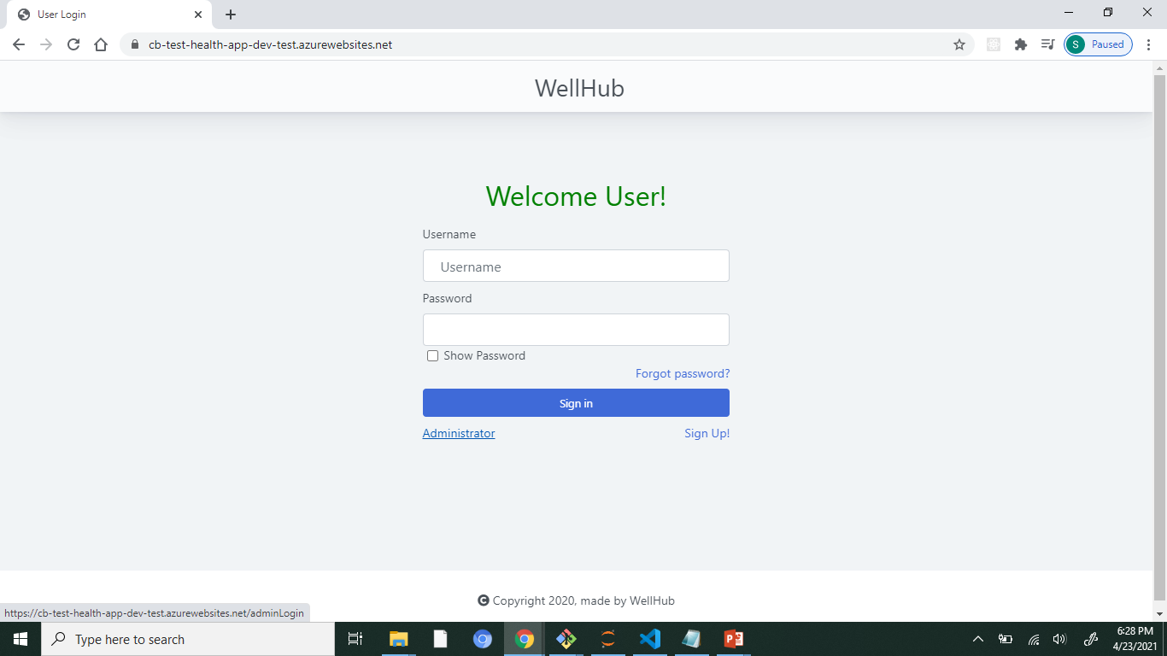
User-logout
The user logs out they will be redirected to the user login page.
Notes:
The user logs out they will be redirected to the user login page.

Slide 26
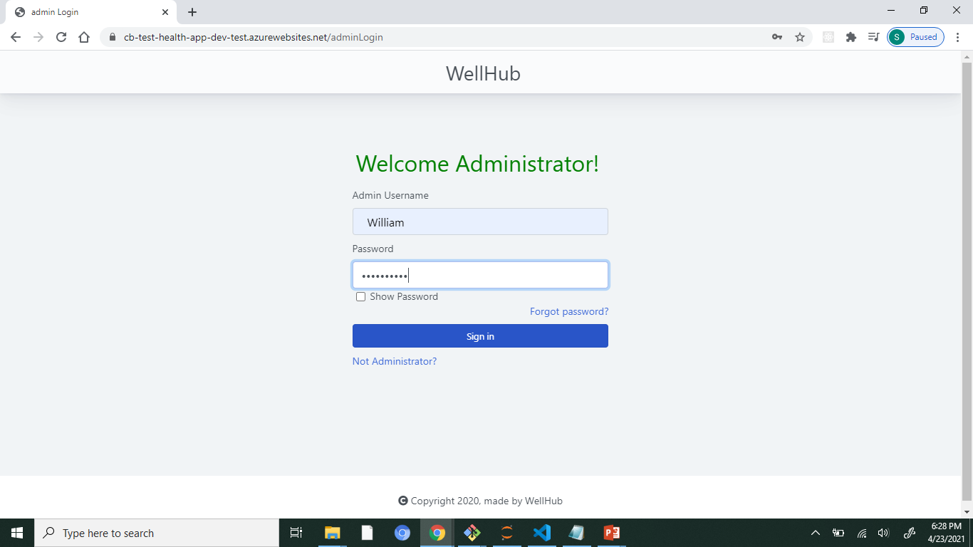
Admin login
This page is for the administrator login.
Notes:
This page is for the administrator login.

Slide 27
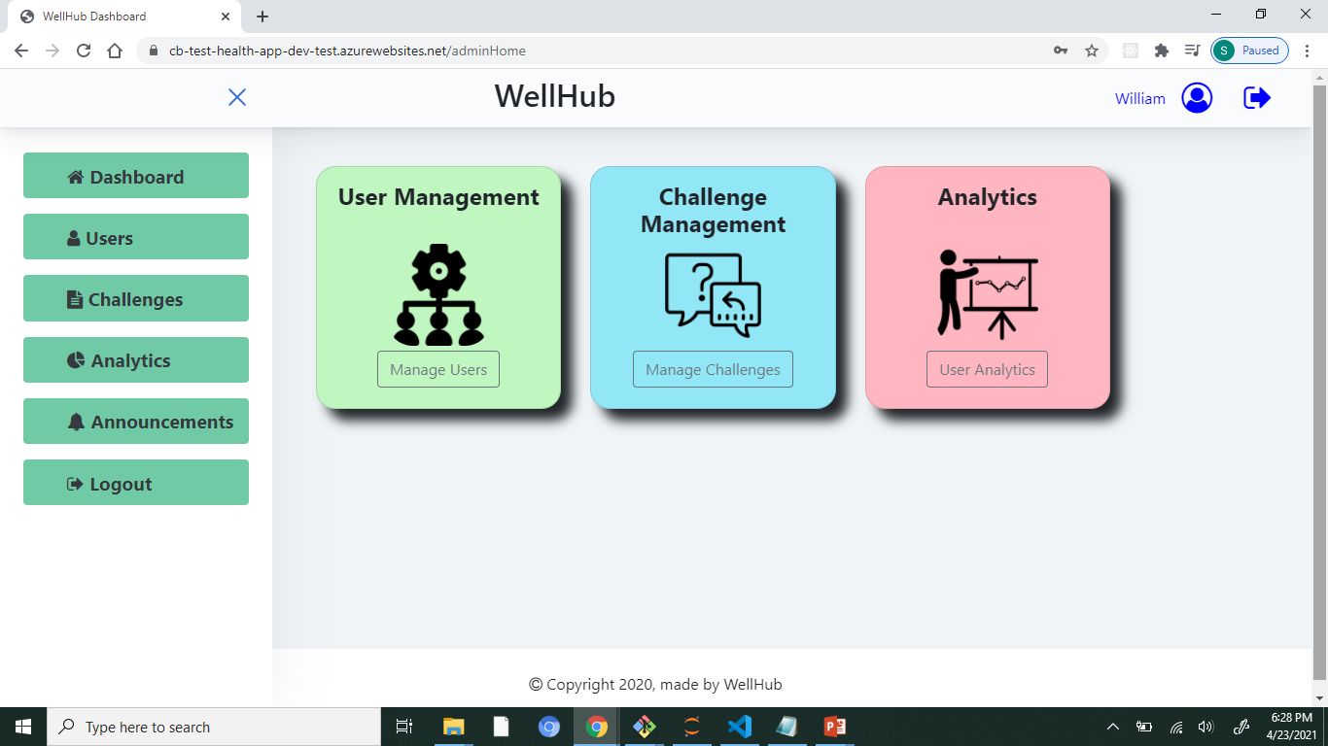
Admin dashboard
Admin on logging in will be redirected to the admin home page. The dashboard has user management, user challenges and user analytics options. On the left, we have added a menu and, on the top, a header containing quick links to admin profile page and log-out buttons.
Notes:
Admin on logging in will be redirected to the admin home page. The dashboard has user management, user challenges and user analytics options. On the left, we have added a menu and, on the top, a header containing quick links to admin profile page and log-out buttons.

Slide 28
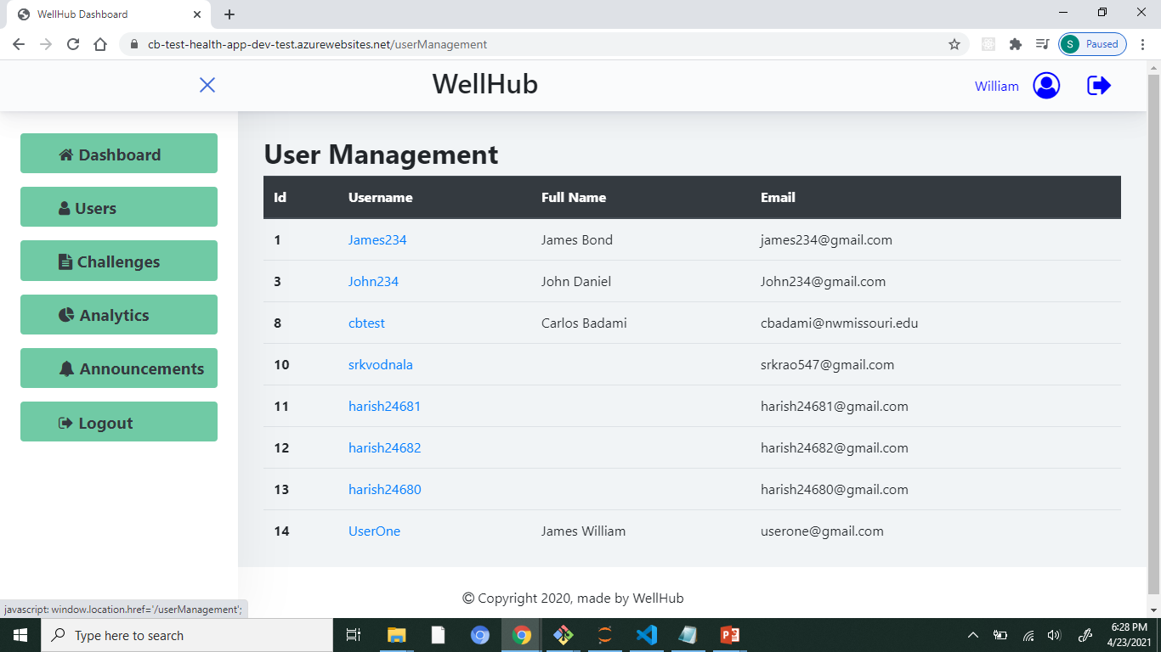
Admin – users management
In the admin-user management page, the admin will be able to access the user information. When the admin clicks on individual username, he/she will be redirected to the user profile page with all details which are not editable. The user passwords will be hidden from the admin to provide privacy to the users.
Notes:
In the admin-user management page, the admin will be able to access the user information. When the admin clicks on individual username, he/she will be redirected to the user profile page with all details which are not editable. The user passwords will be hidden from the admin to provide privacy to the users.

Slide 29
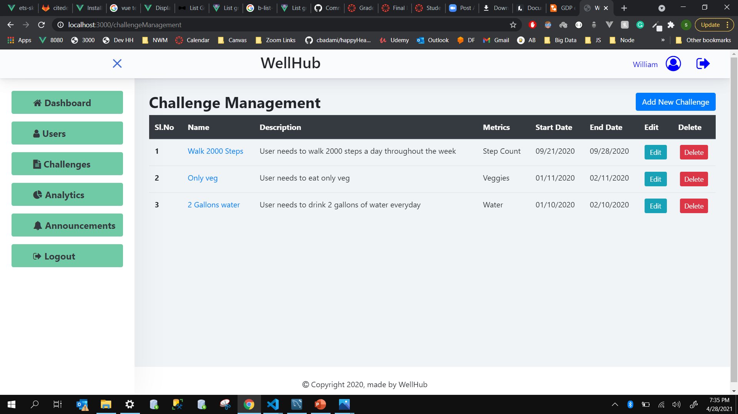
Admin Challenge management
This is where admin manages the challenges. These are challenges created by the admin when he/she clicks on challenge name he/she will be redirected to page where he/she can manage the users in that particular challenge.
Notes:
This is where admin manages the challenges. These are challenges created by the admin when he/she clicks on challenge name he/she will be redirected to page where he/she can manage the users in that particular challenge.

Slide 30
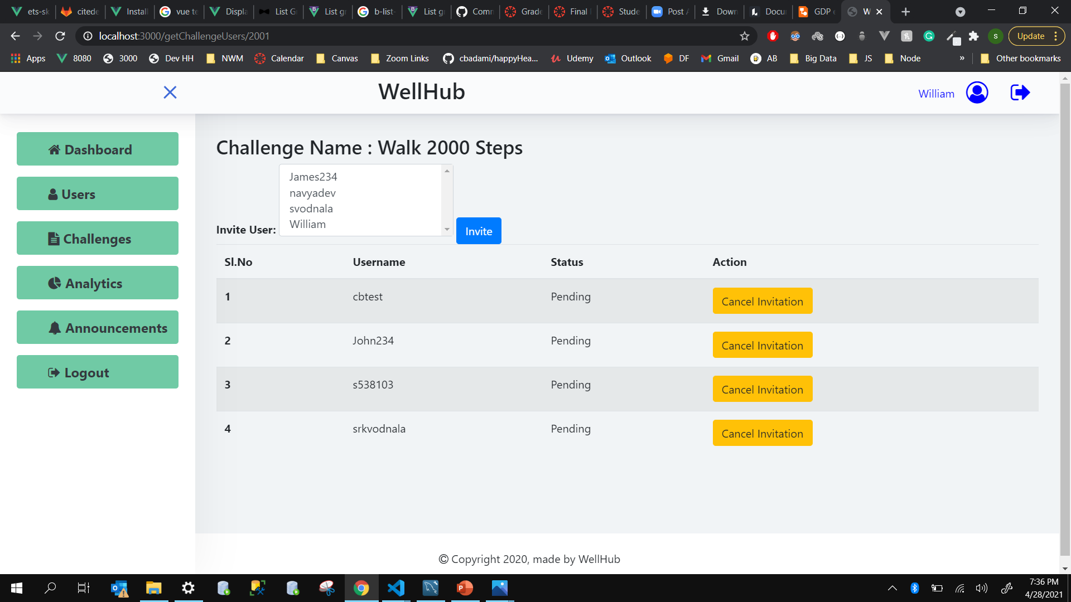
Challenge management – Manage users
This is where admin manages the users. He/She can add new users or remove the user from the challenge.
Notes:
This is where admin manages the users. He/She can add new users or remove the user from the challenge.

Slide 31
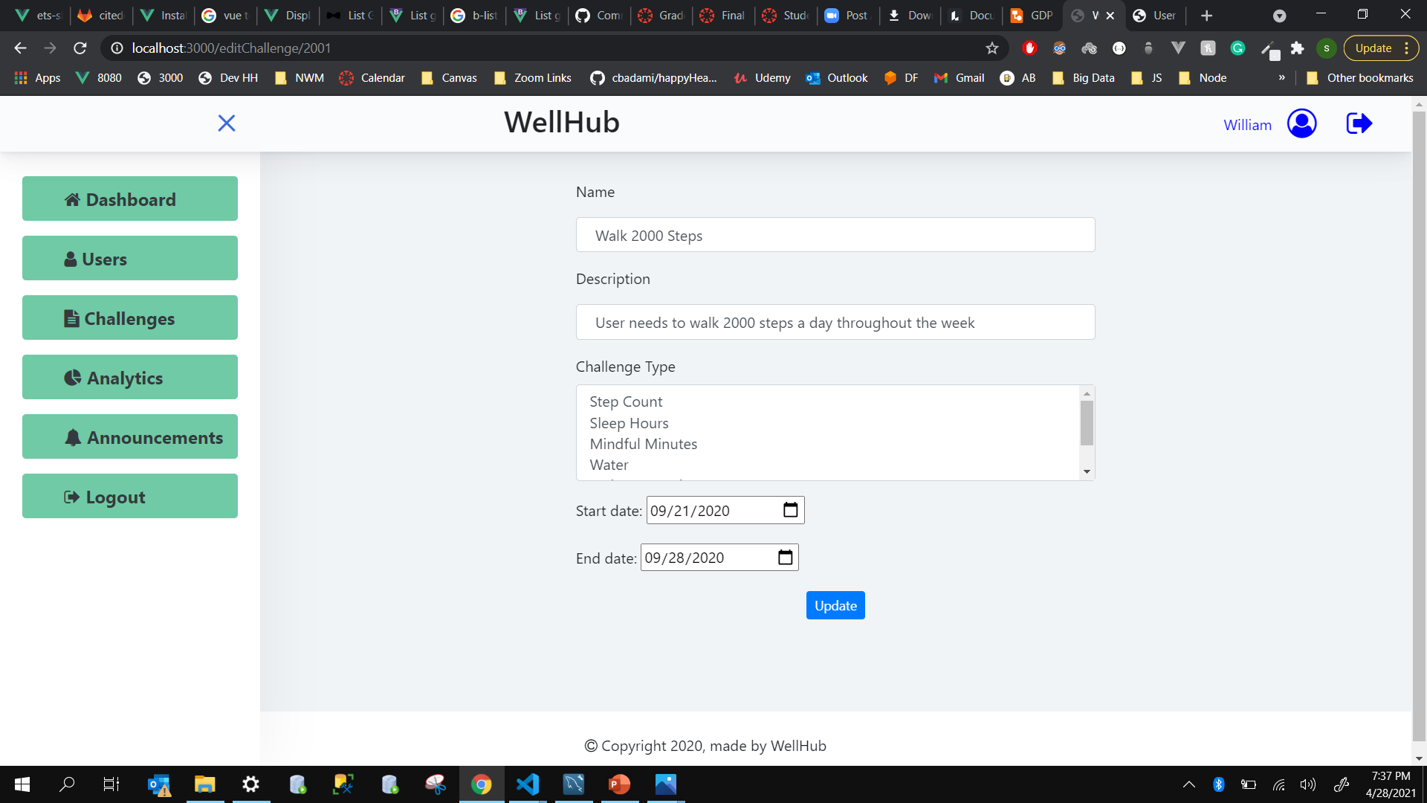
Challenge management – edit challenge
After clicking on edit button in challenge page it will redirects to this page and here admin can modify the challenge.
Notes:
After clicking on edit button in challenge page it will redirects to this page and here admin can modify the challenge.

Slide 32
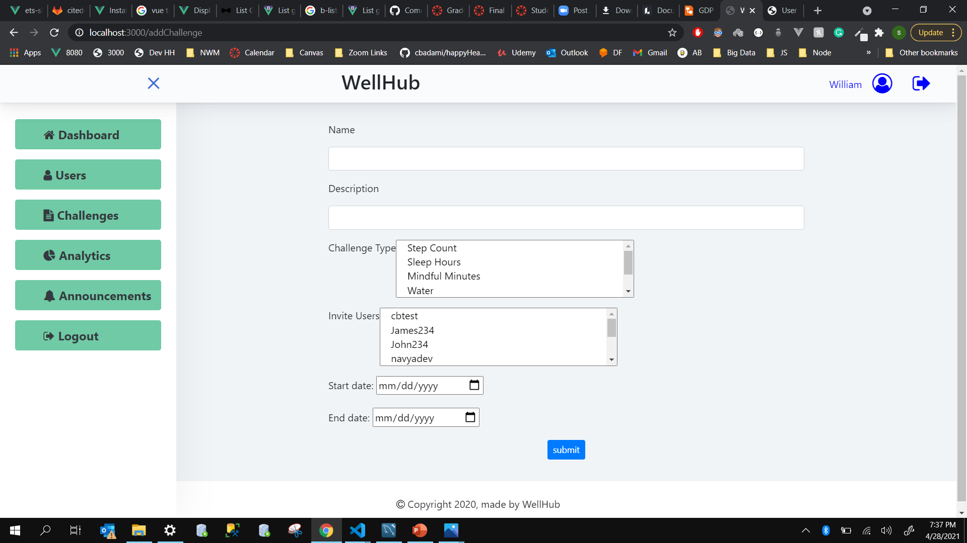
Challenge management – Add challenge
When the admin clicks on the add challenge button he/she will be redirected to this page, here admin can create a new challenge with multiple metrics and also invite multiple users to the challenge these invitation will be sent to the user email and also user can view the new challenge in his challenge page.
Notes:
When the admin clicks add challenge button he redirects to this page, here admin can create a new challenge with multiple metrics and also invite multiple users to the challenge these invitation will be sent to the user email and also user can also view the new challenge in his challenge page.

Slide 33
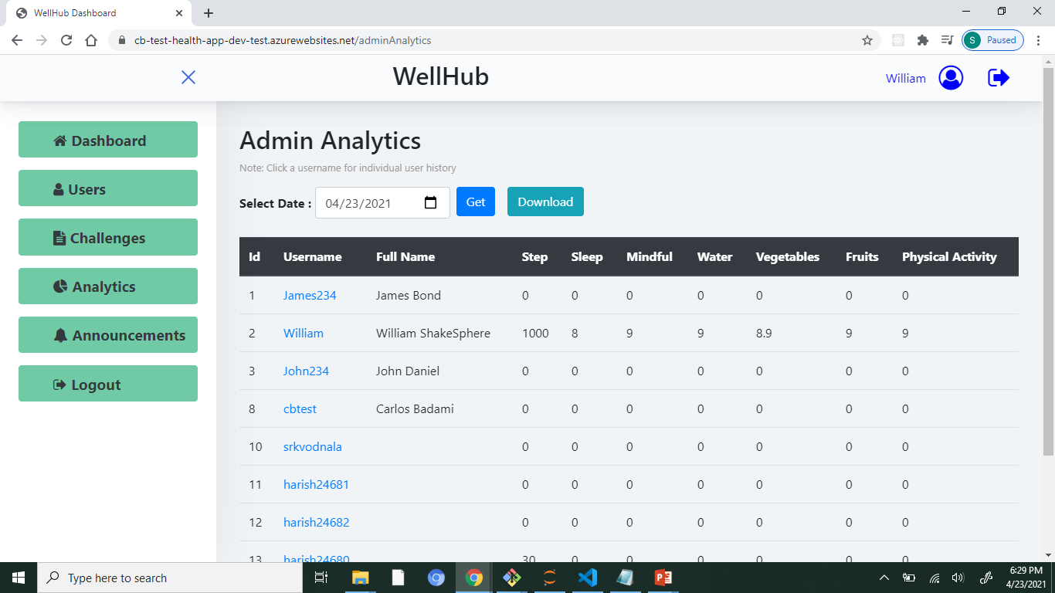
Admin Analytics
Here the admin can track progress of all the users.
Notes:
Here the admin can track progress of all the users.

Slide 34
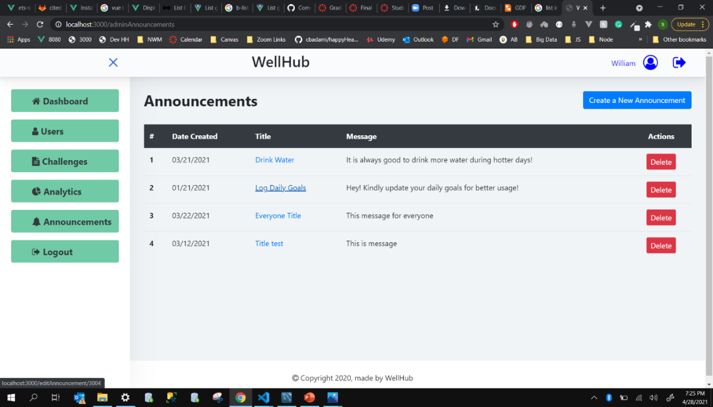
Admin announcements
When admin clicks on announcements page it takes to this image where he/she can view the announcements created. When admin clicks on announcement name it redirects to the image on next side where admin can view all the users who received this announcement and if he/she wants to they can also send same announcement to other users. User can view this announcement in his homepage and will also receive a mail when he/she was added to the announcement list.
Notes:
When admin clicks on announcements page it takes to this image where he/she can view the announcements created. When admin clicks on announcement name it redirects to the image on next side where admin can view all the users who received this announcement and if he/she wants to they can also send same announcement to other users. User can view this announcement in his homepage and will also receive a mail when he/she was added to the announcement list.

Slide 35
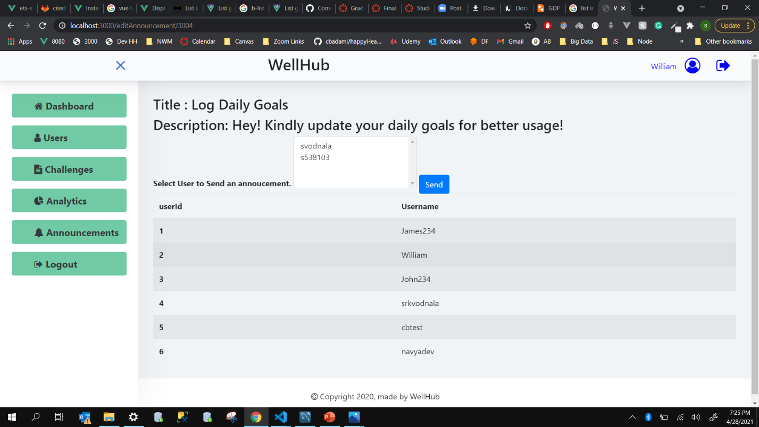
Admin announcements
Notes:
When admin clicks on announcements page it takes to left image where he can view the announcements created. When admin clicks on announcement name it redirects to right side image where admin can view all the uses who received this announcement and if he wants he can also send same announcement to other users. User can view this announcement in his homepage and also he receives a mail when he was added to the announcement list.

Slide 36
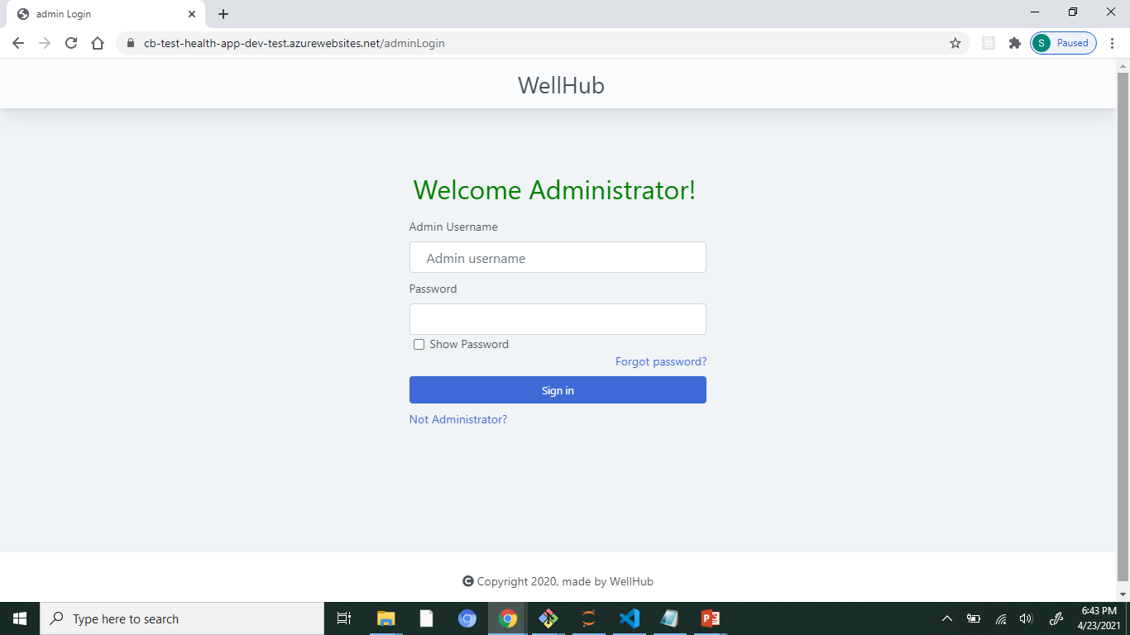
Admin- logout
On clicking the logout button, the admin will be redirected to the admin login page.
Notes:
On clicking the logout button, the admin will be redirected to the admin login page.

Slide 37
References and Links
Github Repository: https://github.com/cbadami/happyHealth
Hosted URL: https://cb-test-health-app.azurewebsites.net/
Original RFP: https://github.com/cbadami/rfp-health-and-wellness/blob/master/rfp-health-and-wellness.md
Demo Video Link: https://use.vg/qx4Zzc

Slide 38
Thank you.

