Slide 1
HW4
Steamship ChatBot

Slide 2
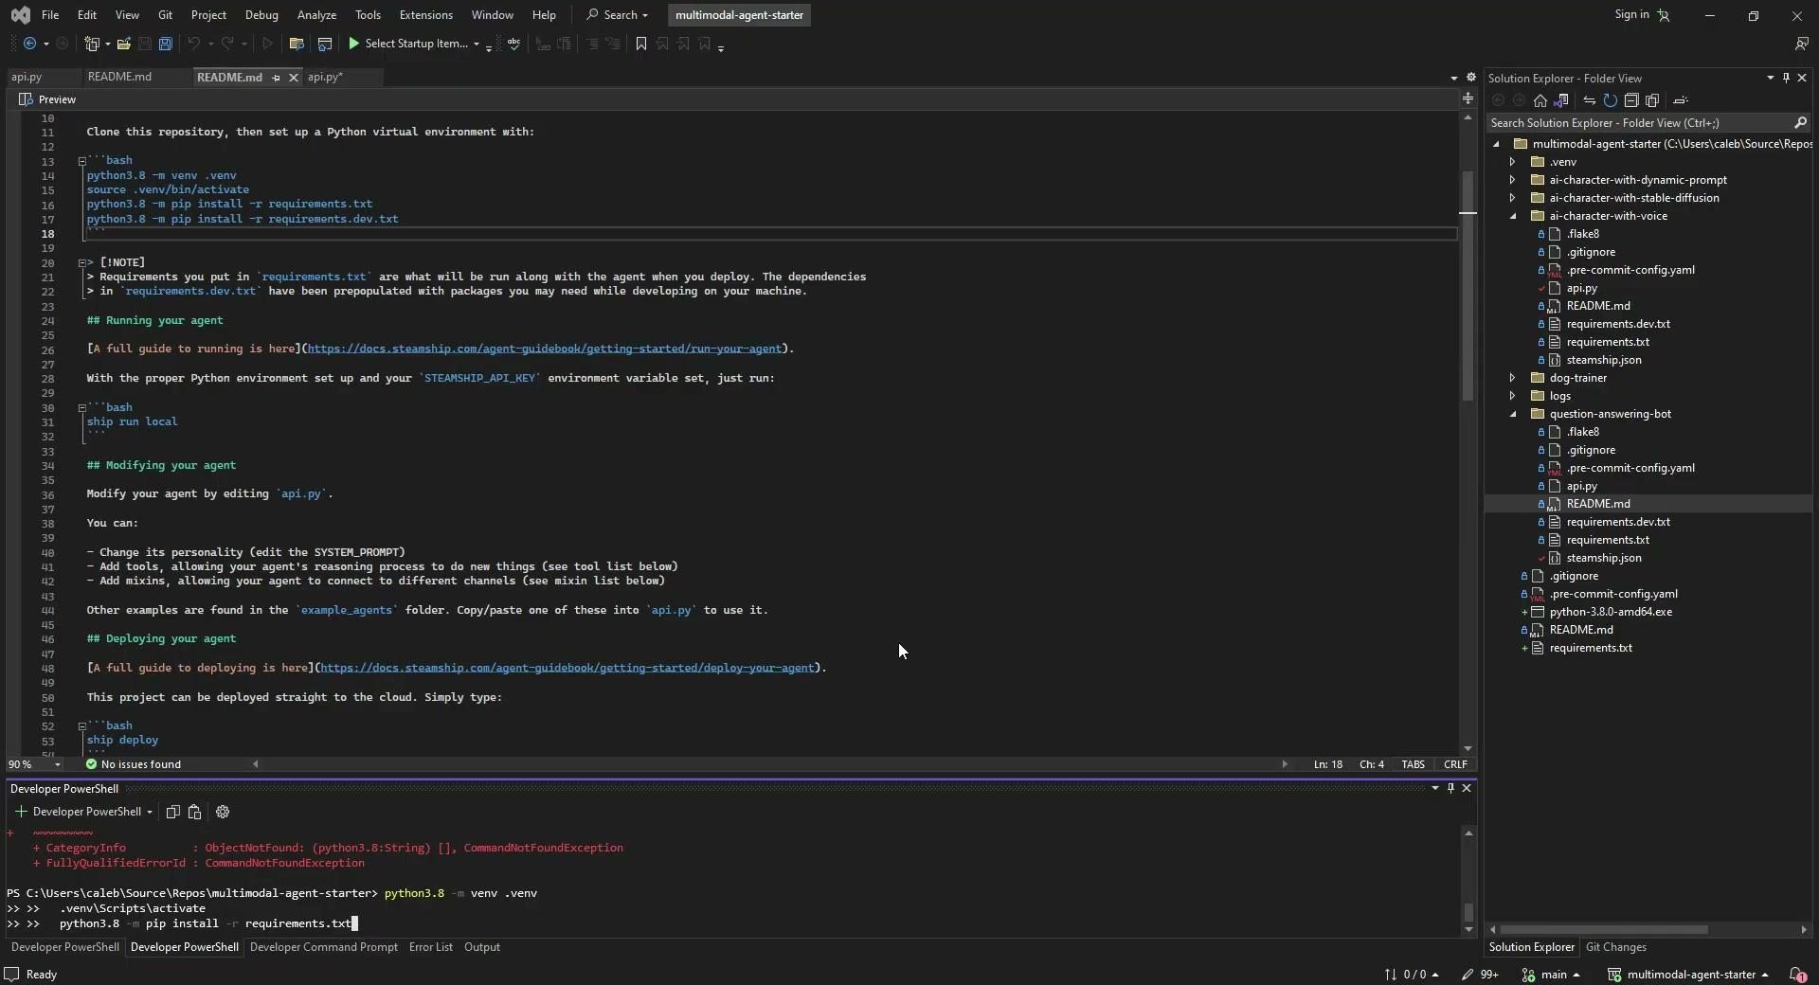
Setup
To set up my chat bot I followed the steps on steamship to initially set up my bot
Clone repository
Install python and run virtual environment. Make sure you have the correct version of python, python is in your project folder(chatbot), and you install the requirements texts
Ship login
Ship run local (create ngrock account first)
This will complete the initial set up of the bot if done correctly you should be able to chat with the bot
Create your Agent – Steamship
These are the steps I followed.

Slide 3

Setup Cont
From this point you need to access https://www.steamship.com/dashboard/agents
Add(Learn from PDFs on the Web – Steamship) to your agent this allows for /index_text and /index_url
For text all you need to do is copy and paste some text and your agent will read and learn it.
For url you need a link to a pdf for it to read and learn

Slide 4
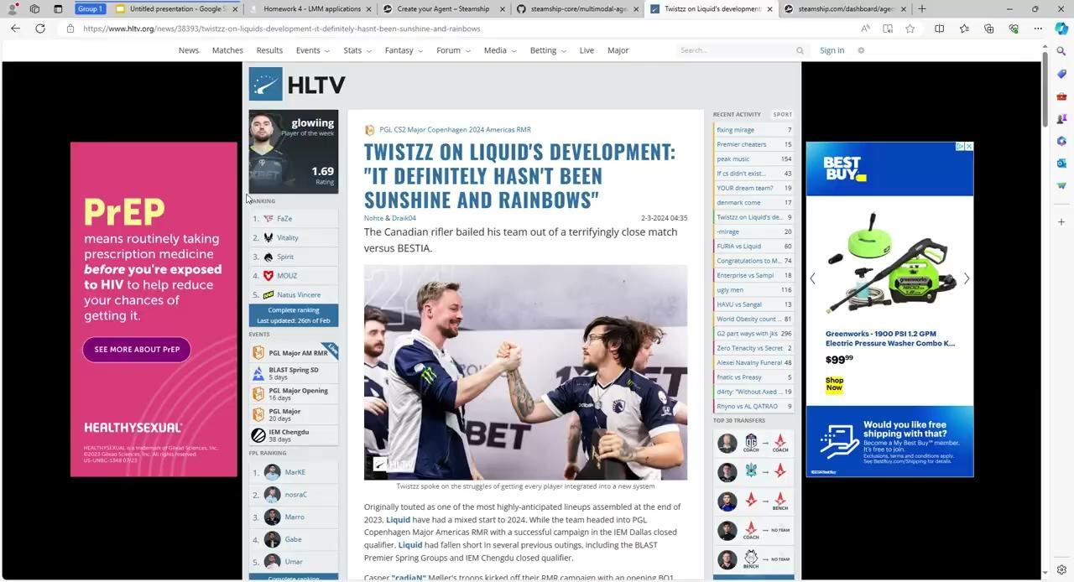
Documents
Preliminary: Counter-Strike is a competitive video game that has been around for over 20 years. Im a huge CS fan. CS has pro tourneys and interviews after games, One player in particular Twistzz was interviewed after joining newly formed Team Liquid. I trained the bot based on the text from this article from HLTV a news reporting agency on Counter Strike.
Twistzz on Liquid's development: "It definitely hasn't been sunshine and rainbows" | HLTV.org

Slide 5
Interaction
Once preliminary steps are complete (follow Run Your Agent – Steamship) you will be able to talk to your chatbox either from the website or inside your virtual system.
Using my HLTV article I asked the bot How did Liquid do vs Bestia?
The bot responded with Team Liquid narrowly won against Bestia with a scoreline of 13-11. Which came straight from the article. So cool!

