Slide 1

DigiPaint
CSCI 3030
Software Engineering 1
Christian Grandy, Tylege Hall, George Iglehart, Tyler Braxton, Caleb Badour
10/19/2023

Slide 2

Introduction
This is a digital paint selling website named DigiPaint. The website will present customers with paint options that the store provides and allow them to sort, search and find complementary colors of provided paints. The website will also handle order processing, payment, and order history, as well as admin access for handling stock. Lastly it will allow accounts to be made by customers for saving paints and viewing order history. The paint stock will be handled by a database.

Slide 3
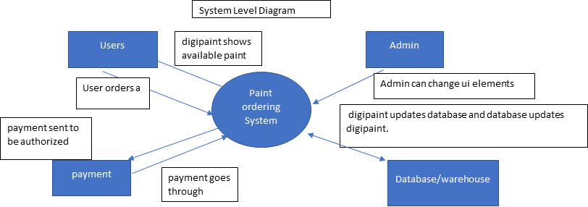
System Level Diagram

Slide 4
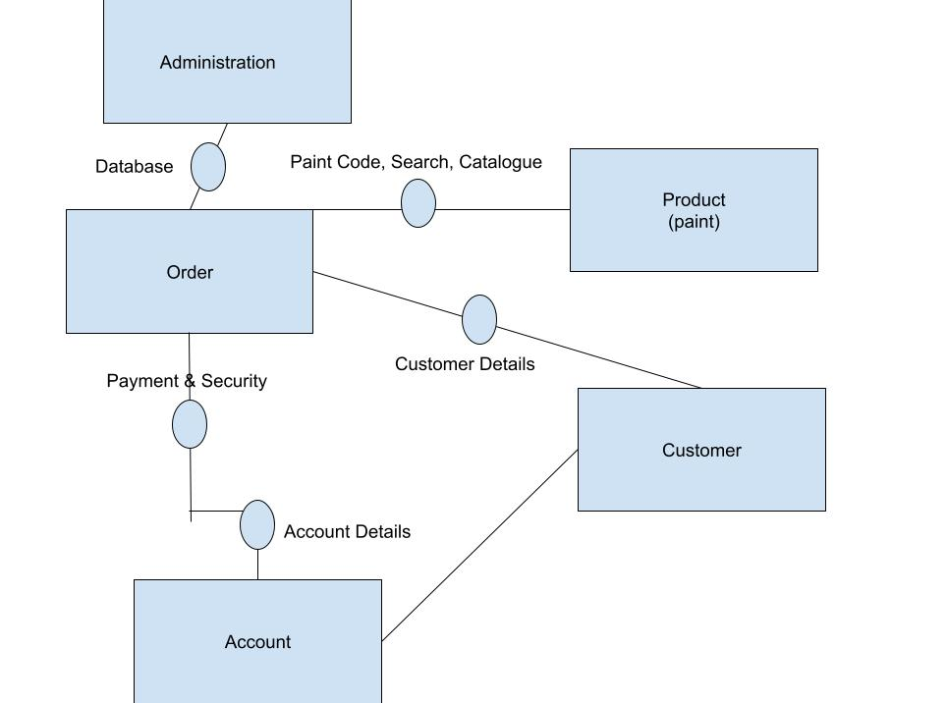
Component Diagram

Slide 5
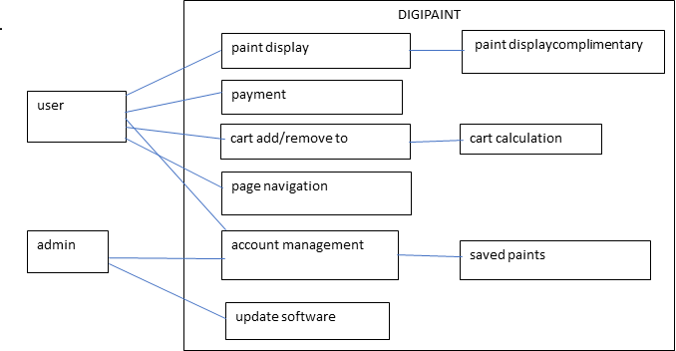
Use Case Diagram

Slide 6
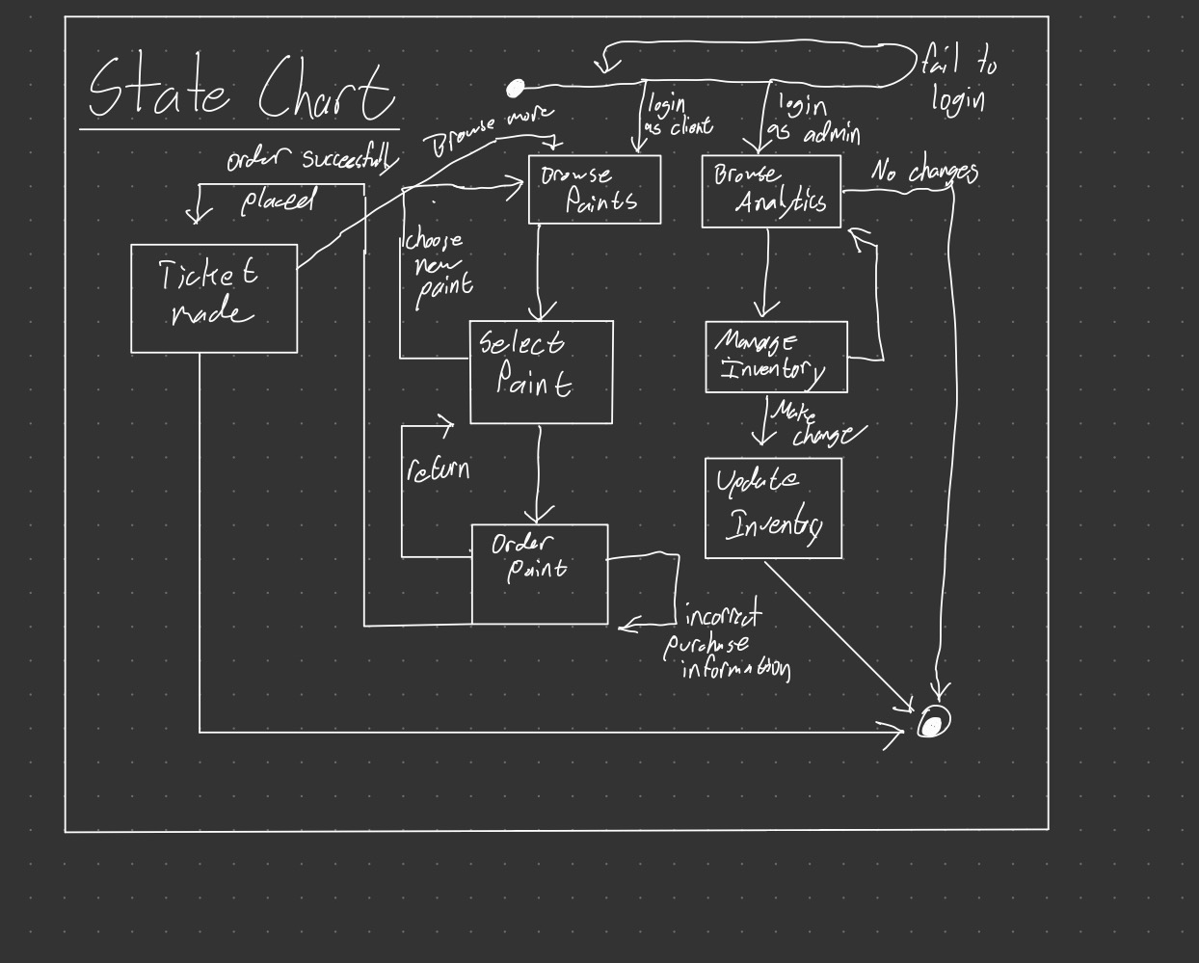
State Chart

Slide 7
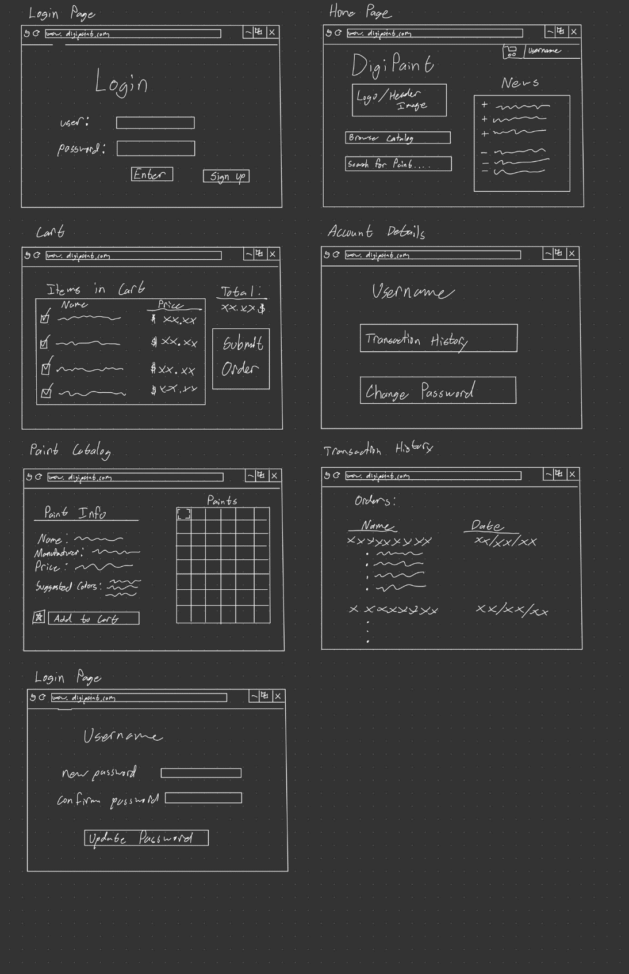
UI Mockups

Slide 8
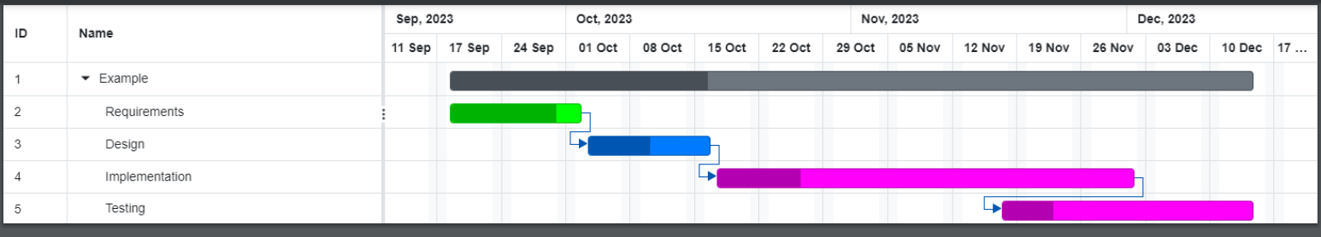
Gantt Chart

Slide 9

Overall Description
The website is part of a larger ecosystem of the physical paint store. The paint website will allow a physical paint store to sell its paint through the website to customers online. The store will provide the physical storage for the paint as well as the server for the website.
The intended user for this website is divided into two categories, customers, and the website admin. The website admin is less important to give amenities to but is necessary to provide proper functions for their role as well as ensuring consistent operation. The customer is going to need more focus on making the website appealing and easy to use.
The operating environment will be a computer that runs on windows 7 or above. The computer will need at least 1Gb of ram. It will need to be connected to a local internet network. The web search browser will be Firefox.
Security, programming standards, a database, SQL and memory requirements are all implementations to watch out for.
This website will include a FAQ page with necessary information for customers use, such as accessing account information and navigating the website. The admin will receive an annual on the functions of the website and the operations that can be done by the admin.

Slide 10
Reinstating Requirements…
Page navigation
Be able to navigate between pages whether that’s account, payment, or shopping
Complimentary color display
When on a paint display, display complimentary paints
Add/remove from cart
Adding and removing from cart
Cart calculation
Cart calculating total cost
Payment
Paying for cart
Saved paints/account management
Navigating through account, whether that is saved paint or previously bought paint, user information.
Admin operations
Things that allow the admin to upkeep the program

Slide 11

Non-functional Requirements
Performance Requirements
The login will not take more than 10 seconds
The pages will not take more than 5 seconds to load
Payment processing will not take more than 10 seconds
The complementary colors selector will not take more then 10 seconds
The search function will not take more than 10 seconds to load
Safety and Security Requirements
Secure Socket Layer (SSL) is a widely used protocol to help meet security requirements of Authentication, encryption, and integrity. Secure Electronic Transaction (SET) is another requirement to protect the customer's information. These are the major requirements to ensure the integrity and authenticity of Digipaint.
Software Quality Attributes
Reliability, Usability
Maintainability, Fast Load Times
Efficient Shopping Cart, Secure Payment Network
This Photo by Unknown author is licensed under CC BY-NC-ND.

Slide 12

Summary
Our overall goal at Digipaint is to create a way for our customers to browse various paints through a search system and a catalog. As well as to safely checkout, where their information will be stored in a database.
This Photo by Unknown author is licensed under CC BY-ND.

