Slide 1

DigiPaint
3030 CS Department
Members:
Christian Grandy, Tylege Hall, George Iglehart, Tyler Braxton, Caleb Badour
11/2/2023

Slide 2
DigiPaint Overview
The Purpose of this project is to make a paint web application for use by a brick and mortar paint shop. The web application will allow users to browse, buy and save to wishlist paints. The web application will allow the user to make a profile with security. The application will allow the admin to see sales records and add and remove paint stock.

Slide 3
Adopted Technologies
Java – Used to connect database and website
PHP – Used to create website
MySQL – Used for the database
Xamp – Used to connect the database and the website

Slide 4
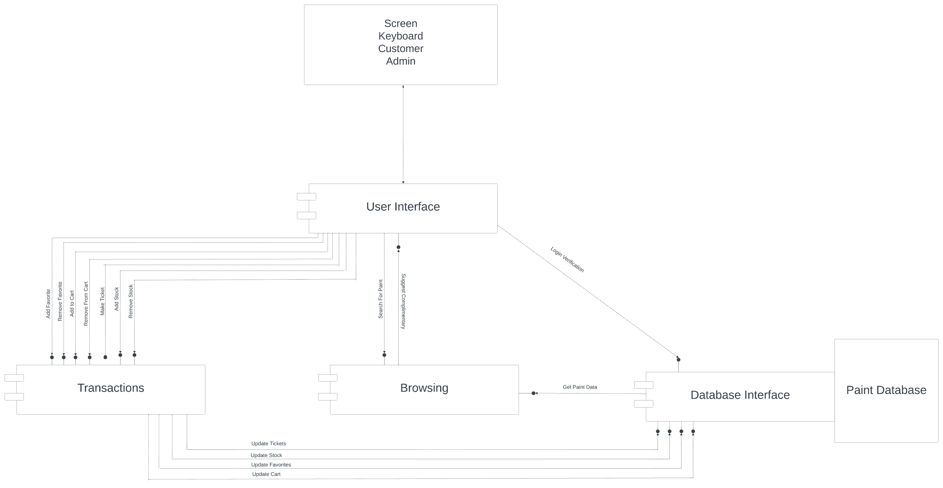
High Level View

Slide 5
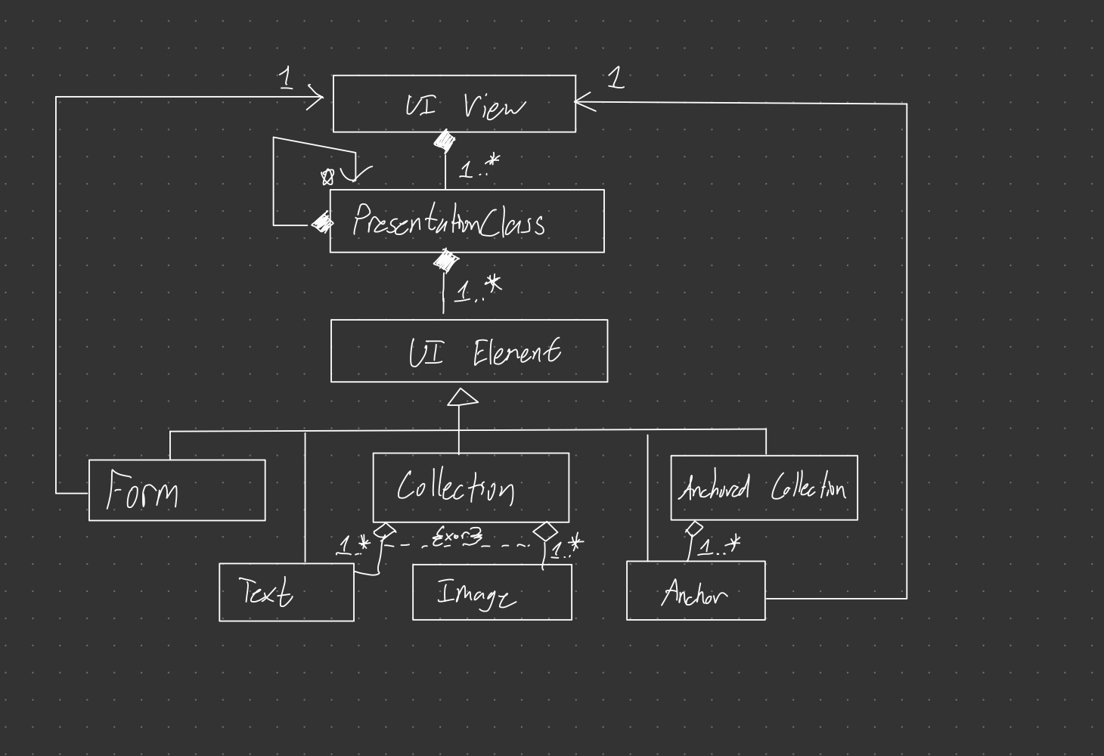
User Interface Class Diagram

Slide 6
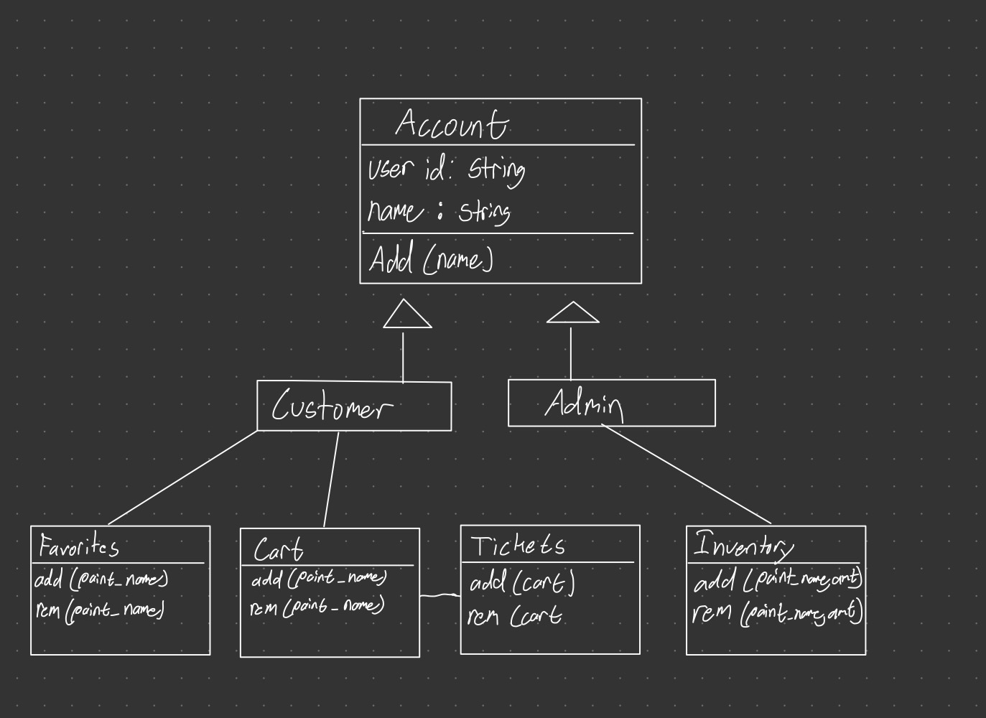
Transactions Class Diagram

Slide 7
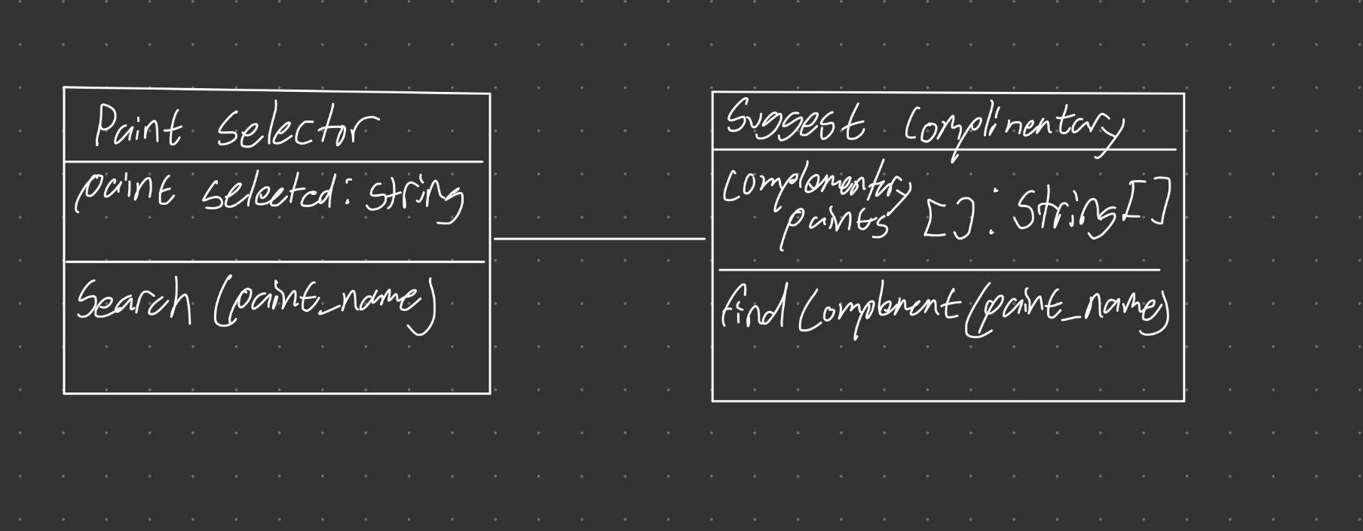
Browsing Class Diagram

Slide 8
Other Features
Complementary color selector
Payment Security

Slide 9
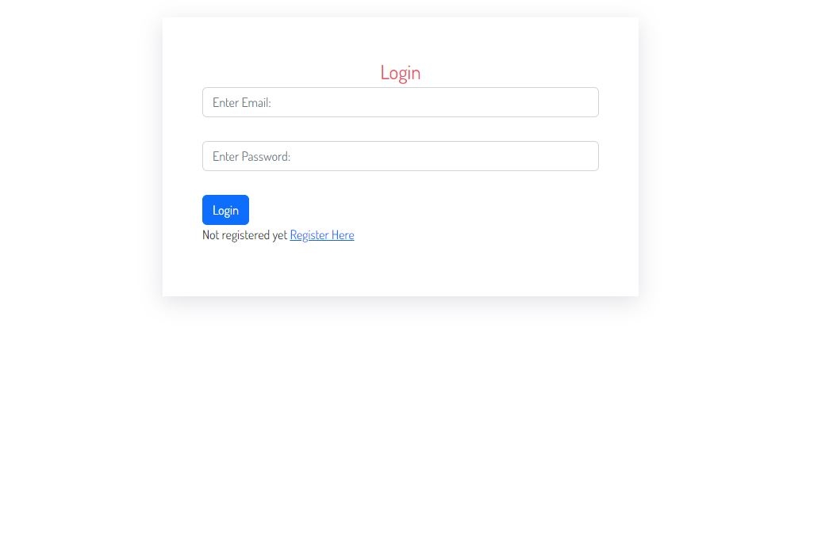
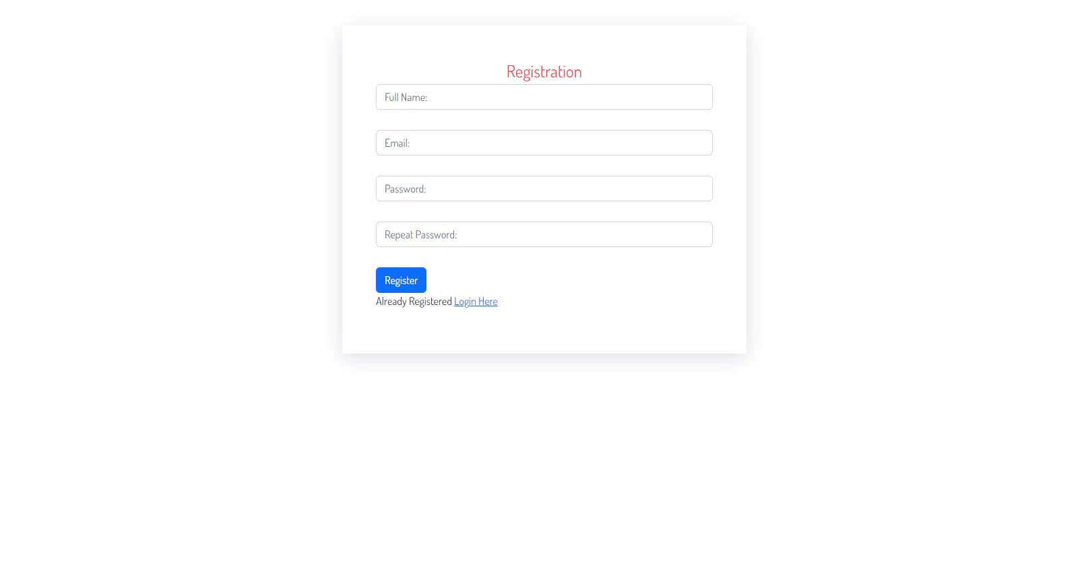
Prototype

Slide 10
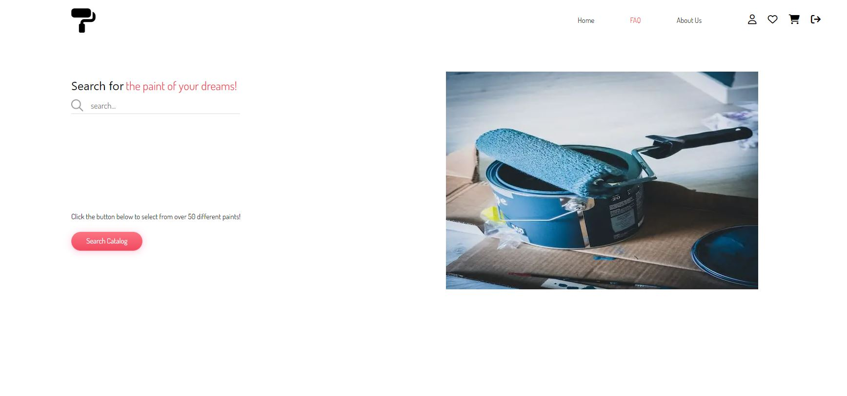
Prototype continued

Slide 11
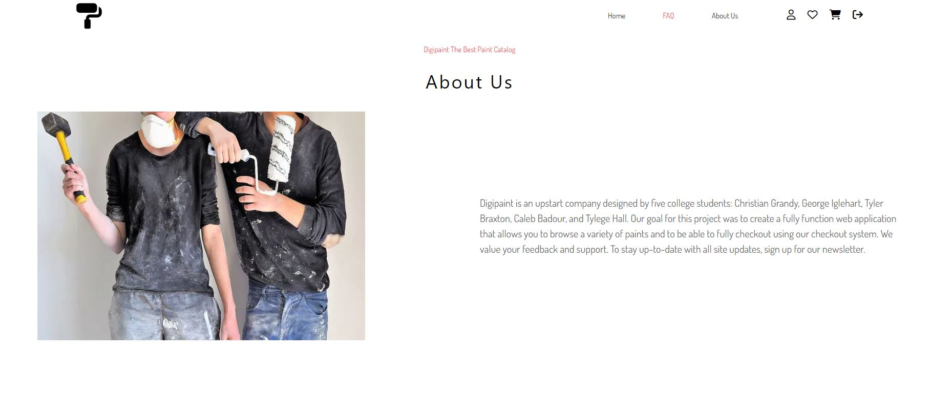
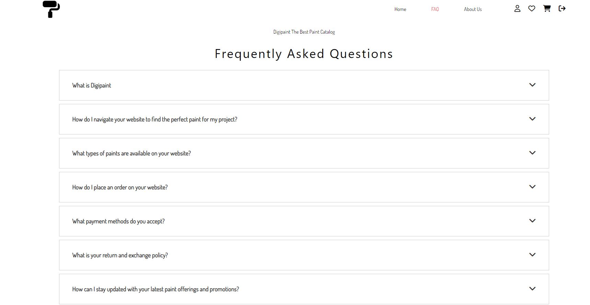
Prototype continued

Slide 12
Conclusion
In conclusion Digipaint will use PHP for website front end, MySQL as the database technology, XAMPP for the local development environment. All together they allow for web focus, relational structure, and simplicity.
The High Level View and Class Diagram of Components displays a coherent way of how Digipaint will operate
The prototype is a test of the software

