Slide 1
Jungle
By Eric Becker, Jason Bae, Brendon Edward Rouse, Ammiel Maynard, and Juan Barraza.

Slide 2
Meet our team
Eric Becker : Team Lead, Backend SQL Developer
Juan Barraza : Middleware Developer
Jason Bae : Front End Developer
Brendan Rouse : Front End Developer
Ammiel Maynard : Front End Developer

Slide 3
Overview
Shopping Web Application
Purchase Item
Check inventory
Look up your account
Look at your cart

Slide 4
What did we use
Languages
SQL, HTML, JavaScript, CSS
Framework
React, ASP. Net, Rest API, Azure, Bootstrap, Swagger
IDE
Microsoft SQL Server, Visual Studio, Visual Studio Code

Slide 5
Back End Development
Transforming Data

Slide 6
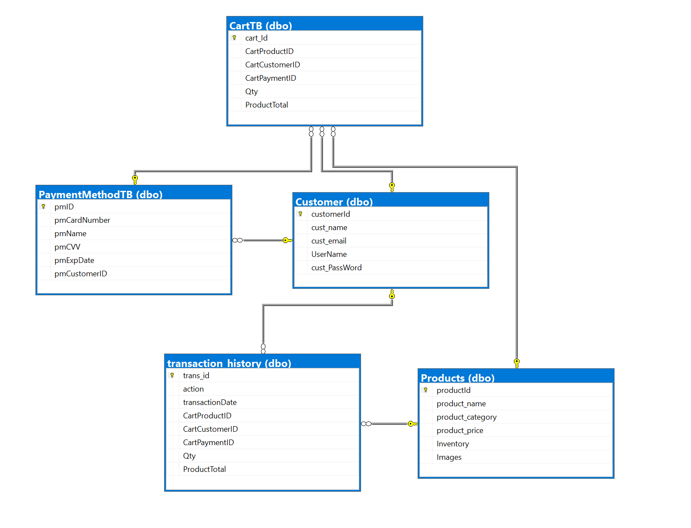
What we made
5 tables
Cart
Products
Customer
Transaction History
Payment Method

Slide 7

Mechanisms within the database
Triggers
For insert: Will add a record to the transaction history after a shopping cart record is made
After insert: Subtracts quantity from Product table when you add a quantity to the shopping cart table

Slide 8
Middleware
Let’s meet in the middle

Slide 9
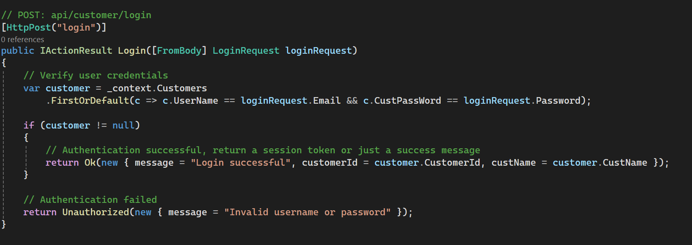
What we did
To interact with backend database from SQL Server Management Studio, we backend scaffolded database, which in turn, developed Models that we can create Controllers for afterwards
We included additional functions for each Controller, based on required tasks of Frontend (E.g.Category function to filter through search result, Login customer information, retrieve Cart information, based on Customer number, etc.)
Utilized Swagger to develop and to describe our REST API as we tested whether each completed function in each Controller behaves appropriately

Slide 10
Front - end
Front and Center

Slide 11
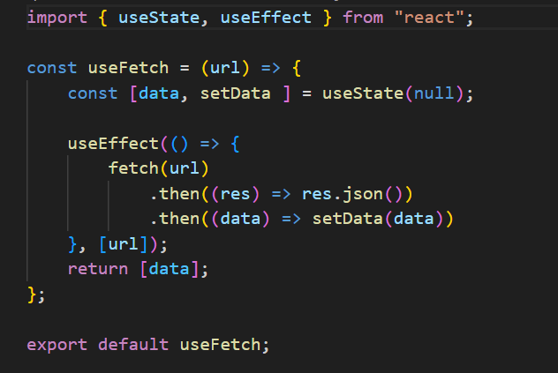
Over view
Frontend Requirements
Display Products
Authentication
Filtering (Search, filter through product list)
Cart Operations (Adding Products, Remove Products)
Display Account Information
Beautify Frontend (Bootstrap)
Concepts Utilized
Functional Component
Hooks (useState, useContext,useEffect, Custom Hooks, etc.)
Bootstrap (Card, Navbar, Button, Form, Container, Alert, Grid, Modal, NavDropdown)
Routing (Link, Error Page)

Slide 12
Important front-end components
Login Credential/Account/Payment Information/Register
Allow Account information to be displayed after Logging in with correct Credential for Authentication
Include Payment Information that can be interacted with any changes in Product ordering
Product/Product Detail/Cart
Display every Product from the Home Page and grants users access to detailed information for a Product once they clicked on the name.
Displays list of Products in Cart and remove function per Product
Allows Searching capabilities by the user whenever wishing to Search for a specific Product at any given time
has context menu

Slide 13
Thank you
Eric : edbecker1819@gmail.com
Jason : jason782@revature.net
Ammiel : ammiel784@revature.net
Juan : juan798@revature.net
Brendan : brendanedward754@revature.net

