Slide 1
Jungle
By Eric Becker, Jason Bae, Brendon Edward Rouse, Ammiel Maynard, and Juan Barraza.

Slide 2
Meet our team
Eric Becker : Team Lead, Backend SQL Developer
Juan Barraza : Middleware Developer
Jason Bae : Front End Developer
Brendan Rouse : Front End Developer
Ammiel Maynard : Front End Developer

Slide 3
What did we use
Languages
SQL, HTML, JavaScript, CSS
Framework
React, ASP. Net, Rest API, Azure, Bootstrap
IDE
Microsoft SQL Server, Visual Studio, Visual Studio Code

Slide 4
Back End Development
Transforming Data

Slide 5
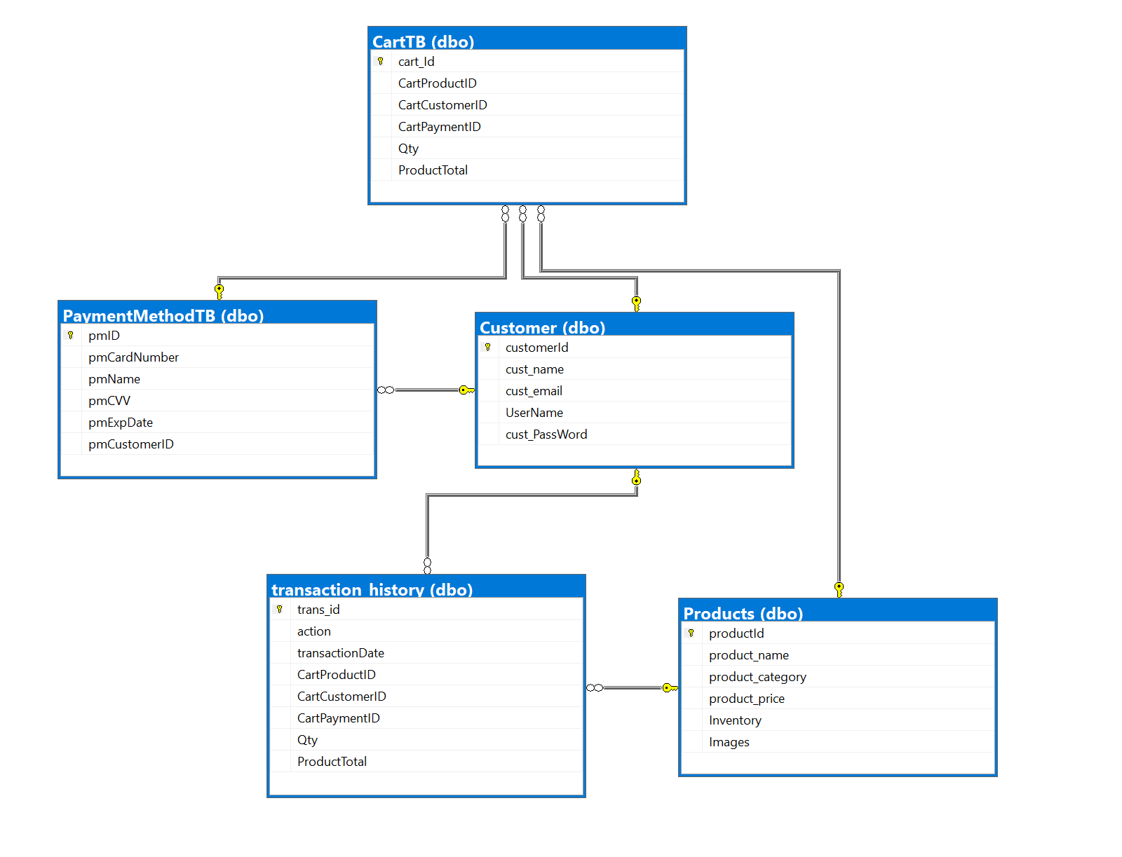
What we made
5 tables
Cart
Products
Customer
Transaction History
Payment Method

Slide 6

Mechanisms within the database
Triggers
For insert: Will add a record to the transaction history after a shopping cart record is made
After insert: Subtracts quantity from Product table when you add a quantity to the shopping cart table

Slide 7
Middleware
Let’s meet in the middle

Slide 8
What We Did
(Insert your material)

Slide 9
Details
(You can go into detail here)

Slide 10
Front - end

Slide 11
What I did Jason

Slide 12
What I Did Ammiel

Slide 13
What I did Brendon

Slide 14
Thank you

