Slide 1
Devops AND cloud

Slide 2
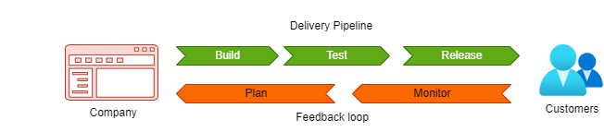
What is Devops
Traditional IT – less collaboration, working in silos, resulting in delayed software release cycles and inefficient over all application/product development
With DevOps model the development and operations teams are never siloed.
Both these teams work hands-in-hands resulting in early bugs detection, shorter development cycles, reduced time-to-market

Slide 3
Demand for Devops engineer
Organizations and embracing DevOps to keep pace with modern IT development
DevOps helps companies to provide software solutions rapidly, resolve production issues earlier in process and release of efficient product
What doesn’t exist a separate profile, is now a most in-demand job across industry
As growing number of companies, seek to implement DevOps, the need for DevOps engineers is soaring
One of the greatest challenge today is, finding good DevOps talent and demand for good DevOps engineers is constantly soaring
Global Market Insights
In 2020, DevOps market size valued to be at $6.78B and projected is $58B in 2030
25% of software engineers, would like to acquire DevOps skills
Fresh DevOps talent will always be in demand in coming decade

Slide 4
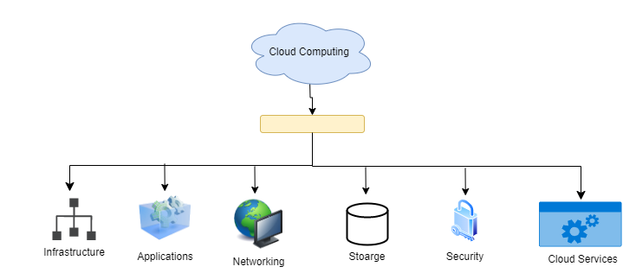
Cloud
The cloud computing is rapidly growing as more and more organizations are now offloading their workloads to cloud
The obvious benefits of moving to cloud are – Cost Effective, Reliability, Scalability, Security, Ease of access and lot others
Cloud engineering is associated with concepts of cloud computing, which is using the tools and methods of engineering to maximize advantages of cloud resources
Because of the demand for cloud computing services, more people are getting interested in cloud computing jobs.
Cloud engineers are in great demand

Slide 5
Our journey
Node JS
Node JS is not DevOps. But with demand in scripting languages, it always good to have all DevOps studied with latest scripting language
Added advantage
Docker
Docker is containerization technology, that packages all your applications and its dependencies together, to ensure running of application seamlessly anywhere
DevOps targets to easy building, testing and release
With Docker, there are no distinct packaging, installations or testing efforts. Once packaged, same is shipped across environments and tested and released
Docker is perfect fit for DevOps ecosystem
Dockerizing a application reduce time to develop and release a solution
Docker helps to overcome challenges between Dev and Operations teams

Slide 6
Our journey
Kubernetes
Kubernetes is open-source platform for managing containerized workload and services
In prod env, you need to ensure less downtime of your application. Docker alone won’t help this
That’s where kubernetes comes in picture
Kubernetes is orchestration platform, to run distributed system resiliently
Jenkins
Jenkins is opensource CI/CD automation software DevOps tools
Jenkins is used to implement CICD workflows
It takes care of Continuous Integration – Build, Test
And also, Continuous Deployment
Argo CD
Argo CD is open-source, declarative GitOps continuous delivery tools for K8 applications
It automates the deployment of application in target env
It also tracks to ensure the existing state to be desired state

Slide 7
Our journey
Cloud - AWS
Organizations moving their workloads to cloud is not an exception today
But managing workloads on cloud requires good knowledge on working of clouds, clouds services, optimizations, cost factors and lot other
In our journey, we will learn AWS cloud
Most widely used cloud today and having highest market share
AWS Cloud engineers are in highly demand today
Terraform
IAC – Infrastructure as Code
Will work through few terraform pieces to create infrastructure on AWS

Slide 8
Q & A

