Slide 1
jenkins

Slide 2
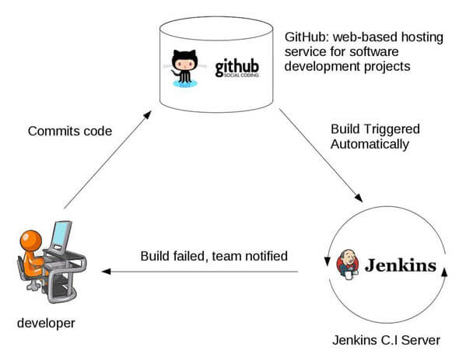
Continuous integration
Continuous Integration is a DevOps software development practice where developer regularly merge their code changes, after which automated builds and tests runs
Key goal is to find and address bugs quicker, improve software quality and reduce time to validate and release new softwares
Improve system integrations and avoids surprises at end of development life cycle

Slide 3
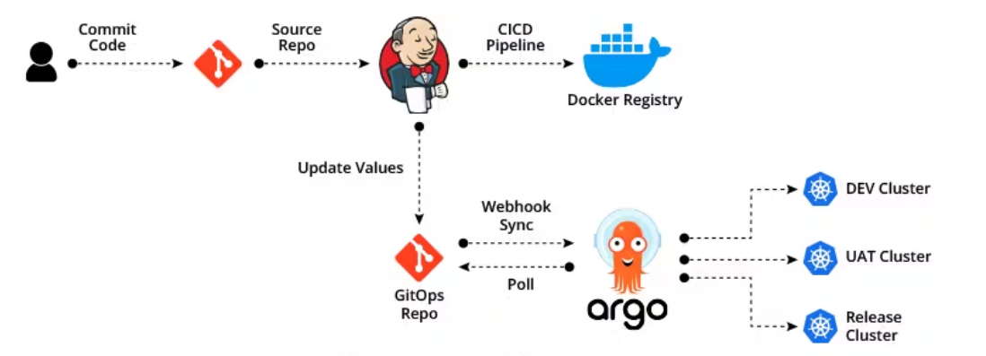
Continuous Delivery and continuous deployment
Continuous Delivery is extension to CI where builds are auto deployed into testing/staging environment
Continuous deployment is automated deployment on production environment, where software is made available to customer for usage
The work is always released in stages/phases instead of complete 100% software. This improves feedback cycle and software quality

Slide 4
Jenkins
Jenkins is opensource CI/CD automation software DevOps tools
Jenkins is used to implement CICD workflows, called as pipelines
Jenkins comes with lots of plugins, that extends its capability and helps integrating Jenkins with other softwares like Git, Maven, Node, Docker, Kubernetes and lot others

Slide 5
Installation
Can be installed on windows, linux, macOS, docker container
For this demonstration, we will be using installing it as docker container
This installation is done/tested on wsl ubuntu
Ensure, the host system has docker installer
mkdir jenkins_mnt
sudo chown -R 1000:1000 jenkins_mnt/
sudo chmod 666 /var/run/docker.sock
docker container run -d -p 8080:8080 -p 50000:50000 -v /home/chandra/jenkins_mnt:/var/jenkins_home -v /var/run/docker.sock:/var/run/docker.sock --name jenkins-local cbagade/jenkins:v1
docker ps -a
http://localhost:8080 -→ hit this in browser and get initial password from following command
docker exec -it <container_id> bash -c 'cat /var/jenkins_home/secrets/initialAdminPassword'

Slide 6
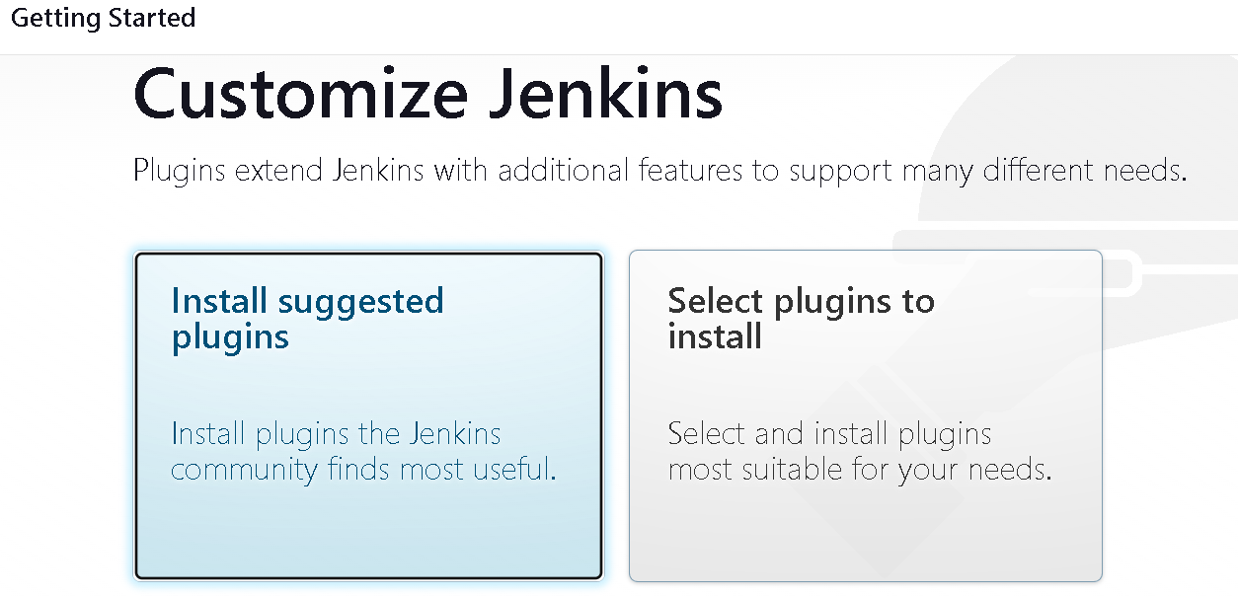
Jenkins setup - plugins installation selection

Slide 7
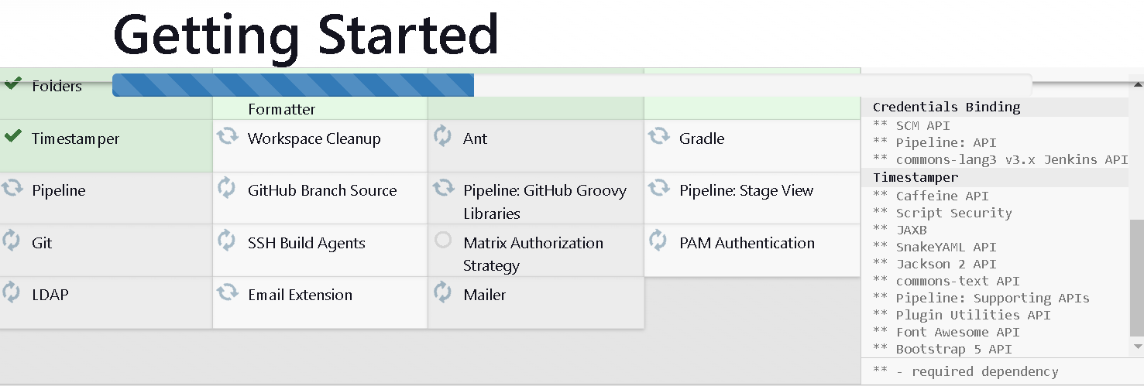
Jenkins setup – plugins installation

Slide 8
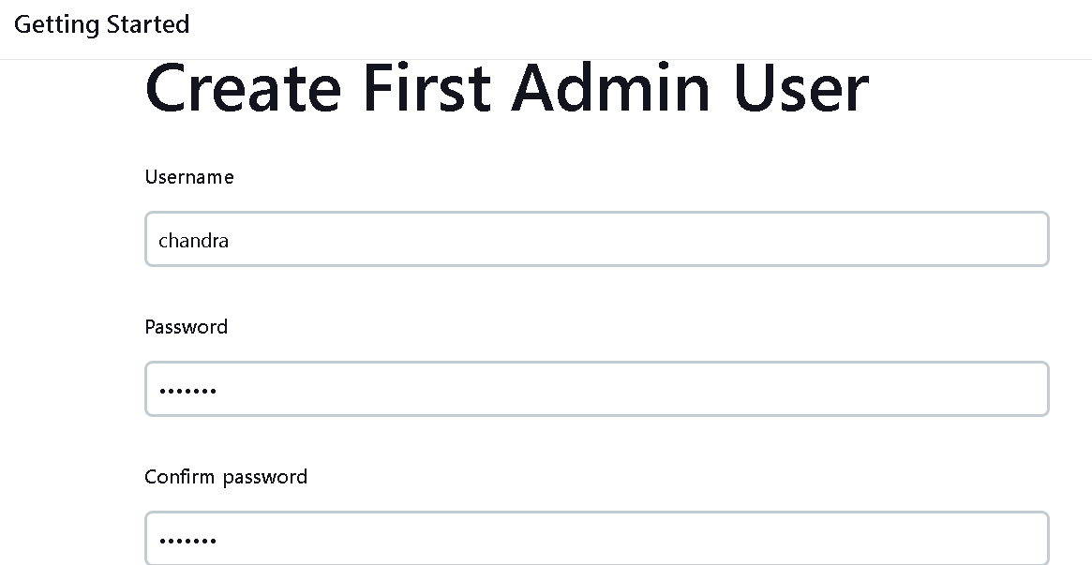
Jenkins setup – First user

Slide 9
First job - freestyle
On Dashboard -> New Item -> Freestyle Project
Add build Steps -> Execute shell and type
echo "Hello DevOps Guys“
Build now
Nothing fancy (as of now), but let's discuss pipelines

Slide 10
First pipeline
Jenkins pipeline allows us to define a complete list of events that happen in the code lifecycle i.e., build, test and deployment
Pipeline can be coded using groovy language, to define stages that would be run in the pipeline
Pipeline can be defined in Jenkinsfile and can be committed on GitHub
Node Program Test
cd jenkins-learnings/continuous_integration
npm install
node index.js
On second terminal run npm test

Slide 11
First pipeline - jenkinsfile
If pipeline needs to define these steps, then those would be –
Checkout git code
Run npm install
Run npm test
Build docker image
Push docker image to repository
This will form the continuous integration process with Jenkins
Credentials for GitHub and Docker Hub
This will form the continuous integration process with Jenkins
Go to following path and click Add Credentials
Add Credentials. Fill in details with kind as Username and password , and for password put git personal token and not password , for id say ‘git_creds’
Repeat same process to define credentials for Docker hub
Token for Docker hub can be generated , from Docker Hub – My Account – Security – New Access Token
Dashboard Manage Jenkins Credentials System Global credentials (unrestricted)

Slide 12
First pipeline - jenkinsfile
Node JS env
For node js prog demonstration, Jenkins should have node js installed in its workspace
Go to following path and search and install Node Js plugins under heading Available plugins (Plugin Manager is available under Manage plugins)
Search for node js plugin and select option Download now and install after restart
This step will stop container. Restart container (container will be in Exited state , start same container)
Sign in with user , you created
Go again to plugin manager and ensure the plugin is installed under Installed Plugin menu
Go to following path and Add NodeJS (may be at bottom)
Note the name (will be needed on pipeline) ( The name will be line NodeJS)
Dashboard Manage Jenkins Plugin Manager
Dashboard Manage Jenkins Global Tool Configuration

Slide 13
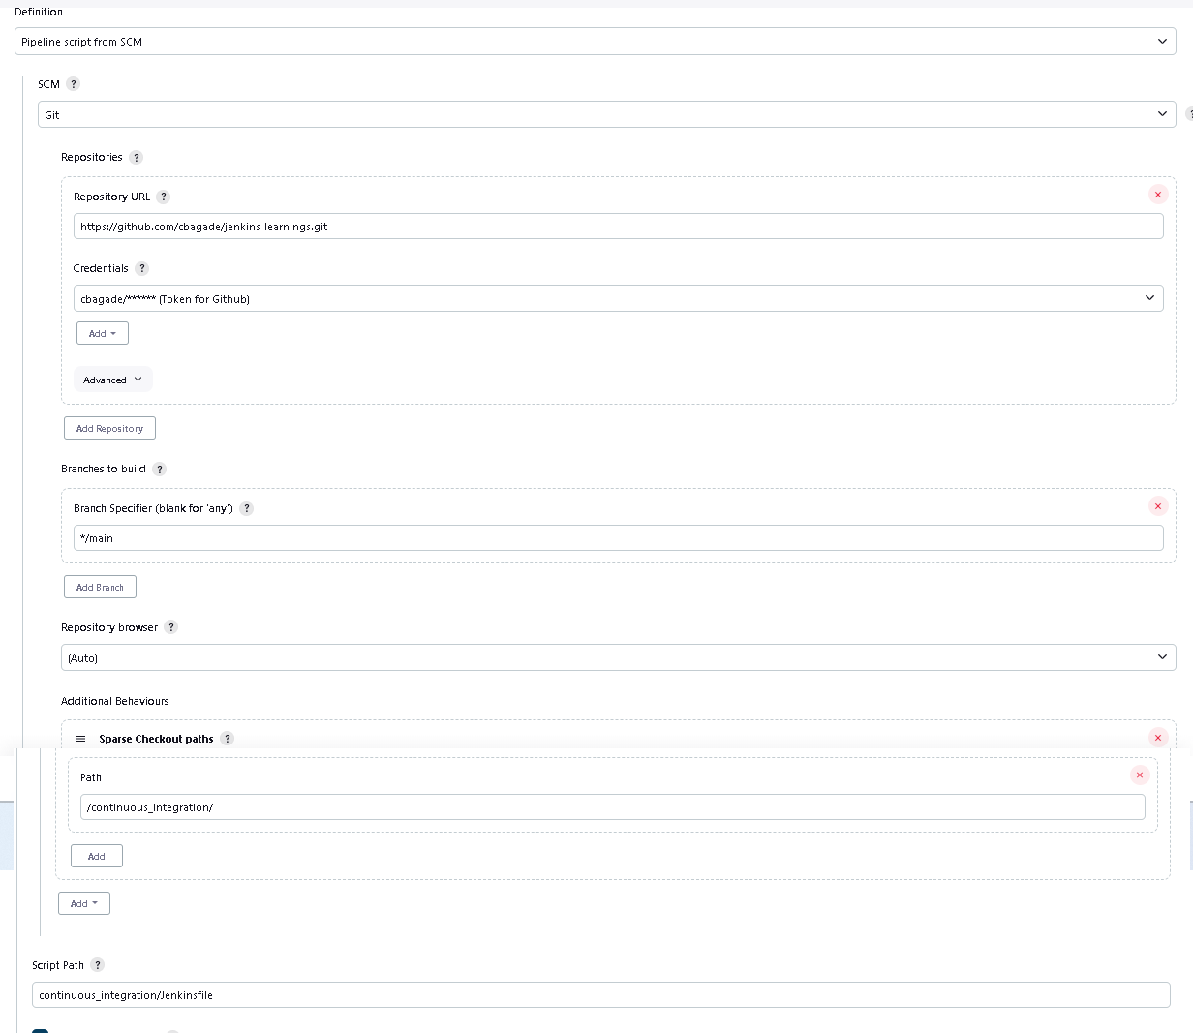
First pipeline - jenkinsfile
The pipeline is coded at
<git_hub>/jenkins-learnings/tree/main/continuous_integration/Jenkinsfile
Create a new item of type pipeline on Jenkins UI

Slide 14
First pipeline - jenkinsfile
Jenkinsfile
There are different stages in pipeline
/jenkins-learnings/continuous_integration/Jenkinsfile
On Jenkins, hit build now and observe console output

Slide 15
First pipeline – Continuous integration
ngrok
A utility ‘ngrok’ helps putting local dev setup over internet
Can be downloaded from -
https://ngrok.com/download
Set your token from -
https://dashboard.ngrok.com/get-started/setup
If Jenkins is running on port 8080 then run following cmd, to make Jenkins URL public
ngrok http 8080
Access the public URL on browser

Slide 16
First pipeline – Continuous integration
Github Webhook
A webhook is kind of hook between GitHub account and pipeline running on Jenkins
Once established, this will trigger pipeline automatically, when user push his code to GitHub
Onto GitHub account – GoTo – Setting -> Webhooks and Add Webhook
<Jenkins_NGROK_URL>/github-webhook/
Content-Type – application/json
Disable SSL verification
Events – Let me select individual events -> Pull Request and Pushes
Add Webhook
Onto Jenkins – Click on your Pipeline -> Configure -> Build Triggers section -> enable option GitHub hook trigger for GITScm polling -> Save
Any code changes pushed to GitHub will trigger pipeline automatlically
Continous deployment will be covered in ArgoCD

Slide 17
Further learning
Plugins wrt to languages like Java , Node etc.,
Other types of pipeline items
Other details regarding pipeline
Docker pipelines, Kubernetes and Docker setup as cloud provider

Slide 18
SUMMARY
We have learnt continuous integration in Jenkins. We will further learn continuous deployment.
Jenkins is widely used as CICD tools in industry. Try and learn more features, plugins.

