Slide 1
Node js

Slide 2
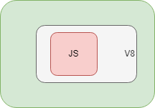
Introduction
Is JavaScript runtime, built on Google's opensource JavaScript engine
Is kind of container, inside which JavaScript code get executed, outside browser
NodeJS got lot of libraries, which makes development easier
Is JavaScript on server
Can be extended as WebServer suitable for web deployment

Slide 3
Installation and tools
Instructions available for installations on Windows or Linux flavor
Visual Studio Code can be used for development
NodeJS got lot of libraries, which makes development easier
Terminal demo on VSC and command line
\home\chandra\nodejs-learnings\first_prog.js
Documentation available at -
https://nodejs.org/en/docs/
Installation on wsl ubuntu via node version manager (nvm)
curl -o- https://raw.githubusercontent.com/nvm-sh/nvm/v0.39.3/install.sh | bash
source ~/.bashrc
nvm list-remote
nvm install v20.11.1
node -v
npm -v
npm install -g npm@latest
npm -v

Slide 4
modules
Simple/Complex functionality organized in single/multiple JavaScript files which can be reused across applications
This program demonstrate a module, which embed managing files specific functionality
\home\chandra\nodejs-learnings\file_operations.js
A Note about UTF
Machine understands 0 and 1 and Human understands characters
ASCII is some standard established where each character is represented by combination of 0 and 1 –
A = 01000001
B = 01000010
ASCII couldn’t cover all characters
Unicode Transformation Format - UTF is latest standard which covers everything

Slide 5

Synchronous vs. Asynchronous
Synchronous calls, will process code lines one after another
Each line blocks execution of next line and hence code is called as blocking code
Can be issue when heavy task is running or task taking time
Desired way is, the heavy task should run in background and other code be executing in parallel
Such execution is non-blocking and is called as Asynchronous calls

Slide 6
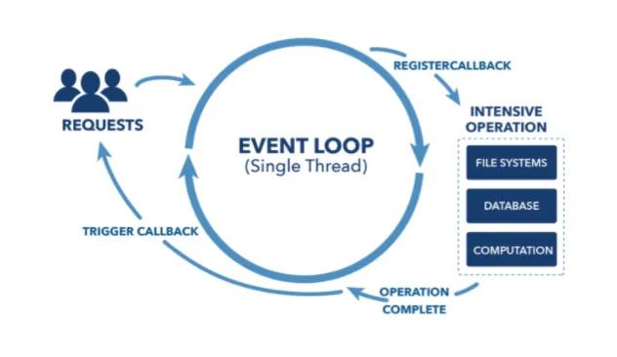
How it works
Callback is piece of code, a function, which gets called, when task is done
NodeJS is Single threaded, event driven, non-blocking IO
NodeJS Is light weighted and efficient
NodeJS Is perfect for super fast application
NodeJS Is not suitable to CPU intensive applications
\home\chandra\nodejs-learnings\file_operations_async.js

Slide 7
WEB SERVER

Slide 8
WEB server
Http Server
Works on Request-Response paradigm
\home\chandra\nodejs-learnings\http_server.js
Will work on various details or req, res object in subsequent demos
Routing and headers
JSON is JavaScript Object Notation, a way in which client and server can exchange information
JSON is collection of key and values
A URL can be parsed, and different actions can be initiated on different request (path)
Headers will allow client/servers to know what is coming their way
\home\chandra\nodejs-learnings\routing.js
Will work on better routing solution in subsequent demos
Meanwhile a better and efficient program
\home\chandra\nodejs-learnings\efficient_prog.js

Slide 9
JSON parsing
There are parsers/objects available in almost all languages to parse JSON
JSON.parse will convert string object to JSON (string should be in JSON format)
JSON.stringify will convert JSON object to string representation
\home\chandra\nodejs-learnings\parsing_json.js

Slide 10
WEB server contd…
URL parsing
Object in NodeJS got properties and functions
The ‘url’ module got one such object i.e., url which got properties and functions to do useful operations with URL
‘parse’ function gives us important properties, to write meaningful operations
\home\chandra\nodejs-learnings\url_parsing.js
\home\chandra\nodejs-learnings\url_parsing_efficient.js
\home\chandra\nodejs-learnings\response_on_url_parsing.js
\home\chandra\nodejs-learnings\optimizing_url_parsing.js

Slide 11
MORE into nodejs

Slide 12
Own modules
In NodeJS a file can contain useful functions to be used across
Such file can be treated as module and can be exported to be used across
\home\chandra\nodejs-learnings\own_module.js

Slide 13
Node package manager (NPM)
Library/Registry for JavaScript software packages
Got CLI, included in nodejs install, which helps to install different packages and manage their dependencies
Command, `npm init`, creates package.json, which is configuration file for project that maintains packages information
mkdir npm_demo; cd npm_demo; npm init ; npm install slugify; npm install nodemon --save-dev; npm i nodemon --global
Suppose to upgrade with ^ (but not working at moment, with my install)
nodemon \home\chandra\nodejs-learnings\first_prog.js
Notes:
package-lock.json maintains tree of installs , locations, dependent packages
Following is not working
The goal of package-lock.json file is to keep track of the exact version of every package that is installed so that a product is 100% reproducible in the same way even if packages are updated by their maintainers.
This solves a very specific problem that package.json left unsolved. In package.json you can set which versions you want to upgrade to (patch or minor), using the semver notation.

Slide 14
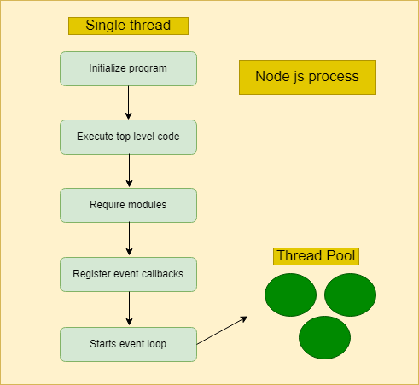
Node js process
\home\chandra\nodejs-learnings\node_process.js
Notes:
package-lock.json maintains tree of installs , locations, dependent packages
Following is not working
The goal of package-lock.json file is to keep track of the exact version of every package that is installed so that a product is 100% reproducible in the same way even if packages are updated by their maintainers.
This solves a very specific problem that package.json left unsolved. In package.json you can set which versions you want to upgrade to (patch or minor), using the semver notation.

Slide 15
Event driven architecture
Event is some notification, issues by someone. Listeners are the ones who listen to that event
const server = http.createServer(); -> This command of starting server emits an event, called as request
nodemon \home\chandra\nodejs-learnings\http_events.js
nodemon \home\chandra\nodejs-learnings\event-emitter-demo.js
Notes:
package-lock.json maintains tree of installs , locations, dependent packages
Following is not working
The goal of package-lock.json file is to keep track of the exact version of every package that is installed so that a product is 100% reproducible in the same way even if packages are updated by their maintainers.
This solves a very specific problem that package.json left unsolved. In package.json you can set which versions you want to upgrade to (patch or minor), using the semver notation.

Slide 16
Asynchronous calls – Cleaner Way
Callback is one way , but bit messy
Promise is cleaner way
Promise is object, which is immediately available, and it promise us to return some data In future
Eventual completion (or failure) of asyn operation
Promise is in resolved state, when the operation is completed
Resolved promise might have error and thus can be in rejected state
nodejs-learnings\promise_demo\callback_hell.js
nodejs-learnings\promise_demo\read_promise.js
nodejs-learnings\promise_demo\write_promise.js
nodejs-learnings\promise_demo\promise_demo.js
Notes:
package-lock.json maintains tree of installs , locations, dependent packages
Following is not working
The goal of package-lock.json file is to keep track of the exact version of every package that is installed so that a product is 100% reproducible in the same way even if packages are updated by their maintainers.
This solves a very specific problem that package.json left unsolved. In package.json you can set which versions you want to upgrade to (patch or minor), using the semver notation.

Slide 17
Async-await
Mostly Promise would be consumed more than produced
async, as the word suggest will process code in background allowing other things to be processed simultaneously
async function will return Promise (will see in demo)
Inside async function, there will be one or more await expressions
await will wait till promise is resolved, so there is no need to ‘then’ keyword (which again seen like callback hell)
await works only inside async function
nodejs-learnings\async_await_demo\asy_awa_pro_pend_demo.js
nodejs-learnings\async_await_demo\asy_awa_pro_res_demo.js
nodejs-learnings\async_await_demo\asy_awa_pro_avoid_then.js
nodejs-learnings\async_await_demo\asy_awa_pro_anon_way.js
nodejs-learnings\async_await_demo\asy_awa_pro_multi_promise.js
Notes:
package-lock.json maintains tree of installs , locations, dependent packages
Following is not working
The goal of package-lock.json file is to keep track of the exact version of every package that is installed so that a product is 100% reproducible in the same way even if packages are updated by their maintainers.
This solves a very specific problem that package.json left unsolved. In package.json you can set which versions you want to upgrade to (patch or minor), using the semver notation.

Slide 18
Express

Slide 19
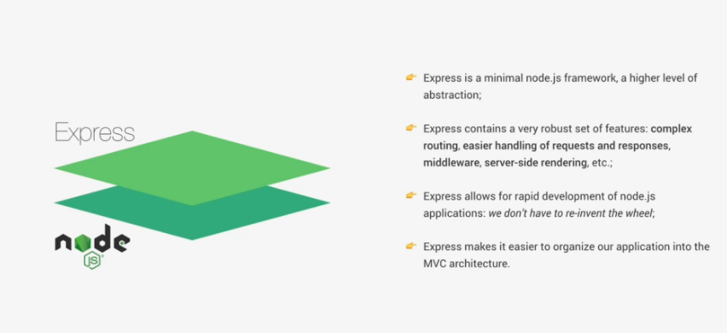
Express
Build on top of node js, makes easier to write node js applications
nodejs-learnings\express_demo\app_1.js (postman – GET app_1/, GET app_1/json, POST app_1)
Notes:
package-lock.json maintains tree of installs , locations, dependent packages
Following is not working
The goal of package-lock.json file is to keep track of the exact version of every package that is installed so that a product is 100% reproducible in the same way even if packages are updated by their maintainers.
This solves a very specific problem that package.json left unsolved. In package.json you can set which versions you want to upgrade to (patch or minor), using the semver notation.

Slide 20
REST APIs
Express helps to quickly implement REST apis
Demo for GET and POST request, with JSON object
Express middleware are functions, which have access to request and response objects (app demonstrate a usage to plug request json to middleware)
nodejs-learnings\express_demo\app_2.js (postman – GET app_2/api/v1/fruits, GET app_2/api/v1/fruits/id, POST app_2/api/v1/fruits)
Assignments – PUT and DELETE requests
Notes:
package-lock.json maintains tree of installs , locations, dependent packages
Following is not working
The goal of package-lock.json file is to keep track of the exact version of every package that is installed so that a product is 100% reproducible in the same way even if packages are updated by their maintainers.
This solves a very specific problem that package.json left unsolved. In package.json you can set which versions you want to upgrade to (patch or minor), using the semver notation.

Slide 21
Refactoring - routes
Separate out routes from methods
nodejs-learnings\express_demo\app_3.js and
nodejs-learnings\express_demo\app_4.js (postman – GET app_2/api/v1/fruits, GET app_2/api/v1/fruits/id, POST app_2/api/v1/fruits) (postman requests for app_2 should work here)
Assignments – PUT and DELETE requests
Notes:
package-lock.json maintains tree of installs , locations, dependent packages
Following is not working
The goal of package-lock.json file is to keep track of the exact version of every package that is installed so that a product is 100% reproducible in the same way even if packages are updated by their maintainers.
This solves a very specific problem that package.json left unsolved. In package.json you can set which versions you want to upgrade to (patch or minor), using the semver notation.

Slide 22
middlewares
Middleware function has access to request and response object
Can execute any code
Can make changes to request/response object
Call next middleware in stack (must call next() to pass control to next middleware)
Order matters, always get called in order
nodejs-learnings\express_demo\app_5.js (postman – GET app_2/api/v1/fruits, GET app_2/api/v1/fruits/id, POST app_2/api/v1/fruits) (postman requests for app_2 should work here) (additionally , GET app_2/api/v1/fruitspath/id for middleware demo to specific path)
‘morgan’ is middleware(3rd party), which logs the request with some other information
nodejs-learnings\express_demo\app_6.js (postman – GET app_2/api/v1/fruits, GET app_2/api/v1/fruits/id, POST app_2/api/v1/fruits) (postman requests for app_2 should work here)
Notes:
package-lock.json maintains tree of installs , locations, dependent packages
Following is not working
The goal of package-lock.json file is to keep track of the exact version of every package that is installed so that a product is 100% reproducible in the same way even if packages are updated by their maintainers.
This solves a very specific problem that package.json left unsolved. In package.json you can set which versions you want to upgrade to (patch or minor), using the semver notation.

Slide 23
User defined routes
Add few more routes
nodejs-learnings\express_demo\app_7.js (postman – GET app_2/api/v1/fruits, GET app_2/api/v1/users)
This file is mess now , will all routes and methods at one place
Let's Organize
First create routers as middleware and mount those on paths
nodejs-learnings\express_demo\app_8.js (postman – GET app_2/api/v1/fruits, GET app_2/api/v1/users)
Separate router functionality in diff files now
nodejs-learnings\express_demo\app_9.js (postman – GET app_2/api/v1/fruits, GET app_2/api/v1/fruits/id)
The main app files looks like having middleware only
Still route files got handlers. Let's separate those out in controller
Let's also separate out server
nodejs-learnings\express_demo\server_1.js (postman – GET app_2/api/v1/fruits, GET app_2/api/v1/fruits/id)
Notes:
package-lock.json maintains tree of installs , locations, dependent packages
Following is not working
The goal of package-lock.json file is to keep track of the exact version of every package that is installed so that a product is 100% reproducible in the same way even if packages are updated by their maintainers.
This solves a very specific problem that package.json left unsolved. In package.json you can set which versions you want to upgrade to (patch or minor), using the semver notation.

Slide 24
Redefining further
Have middleware (routerParam) , operational when id is supplied as parameter
nodejs-learnings\express_demo\server_2.js (postman – GET app_2/api/v1/fruits and pass param as 5)
Clear separated logic here as routerParam is only defined for fruits and not for users
Note addition of patch and delete methods in fruit_controller_1.js. These are incomplete methods, but the id check is seen repeated
Fruit_controller_2.js is now having validation , exports.checkId
nodejs-learnings\express_demo\server_3.js (postman – GET app_2/api/v1/fruits and pass param as 51)
Notes:
package-lock.json maintains tree of installs , locations, dependent packages
Following is not working
The goal of package-lock.json file is to keep track of the exact version of every package that is installed so that a product is 100% reproducible in the same way even if packages are updated by their maintainers.
This solves a very specific problem that package.json left unsolved. In package.json you can set which versions you want to upgrade to (patch or minor), using the semver notation.

Slide 25
Middleware chaining
Middlewares can be chained, note exports.checkBody middleware which is chained in fruit_routes_5.js
nodejs-learnings\express_demo\server_4.js (postman – POST app_2/api/v1/fruits and ignore price or fruitName from body)
Notes:
package-lock.json maintains tree of installs , locations, dependent packages
Following is not working
The goal of package-lock.json file is to keep track of the exact version of every package that is installed so that a product is 100% reproducible in the same way even if packages are updated by their maintainers.
This solves a very specific problem that package.json left unsolved. In package.json you can set which versions you want to upgrade to (patch or minor), using the semver notation.

Slide 26
Environmental variables
The NODE_ENV is already defined for you and environmental variable can be passed via, command line
COURSE=DEV_OPS node nodejs-learnings\express_demo\server_5.js
But defining on command line can only use for development purpose
Instead, these should be placed in some configuration file
Run - npm i dotenv
nodejs-learnings\express_demo\server_6.js (also note use of env variable in server_6.js)
Notes:
package-lock.json maintains tree of installs , locations, dependent packages
Following is not working
The goal of package-lock.json file is to keep track of the exact version of every package that is installed so that a product is 100% reproducible in the same way even if packages are updated by their maintainers.
This solves a very specific problem that package.json left unsolved. In package.json you can set which versions you want to upgrade to (patch or minor), using the semver notation.

Slide 27
MONGO

Slide 28
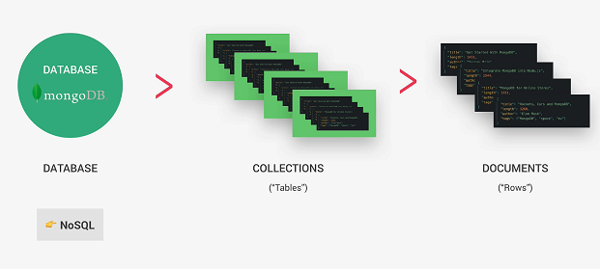
Mongo
Free and Opensource
Highly used DB with node
Was developed by Atlas
Google for atlas mongo, create account, create a free shared cluster, explore on your own, get connection string, user , password
Put information in config.env
Notes:
package-lock.json maintains tree of installs , locations, dependent packages
Following is not working
The goal of package-lock.json file is to keep track of the exact version of every package that is installed so that a product is 100% reproducible in the same way even if packages are updated by their maintainers.
This solves a very specific problem that package.json left unsolved. In package.json you can set which versions you want to upgrade to (patch or minor), using the semver notation.

Slide 29
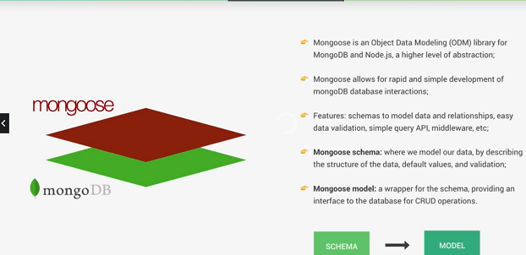
mongoose
npm i mongoose
COURSE=DEV_OPS node nodejs-learnings\express_demo\server_6.js
Just check connection to mongo
Nodemon nodejs-learnings\express_demo\server_7.js
Notes:
package-lock.json maintains tree of installs , locations, dependent packages
Following is not working
The goal of package-lock.json file is to keep track of the exact version of every package that is installed so that a product is 100% reproducible in the same way even if packages are updated by their maintainers.
This solves a very specific problem that package.json left unsolved. In package.json you can set which versions you want to upgrade to (patch or minor), using the semver notation.

Slide 30
Mongoose in action
Schema defines data, datatypes, validate data, default values etc.,
Models are created out of schema
nodejs-learnings\express_demo\server_8.js (verify on atlas)
Notes:
package-lock.json maintains tree of installs , locations, dependent packages
Following is not working
The goal of package-lock.json file is to keep track of the exact version of every package that is installed so that a product is 100% reproducible in the same way even if packages are updated by their maintainers.
This solves a very specific problem that package.json left unsolved. In package.json you can set which versions you want to upgrade to (patch or minor), using the semver notation.

Slide 31
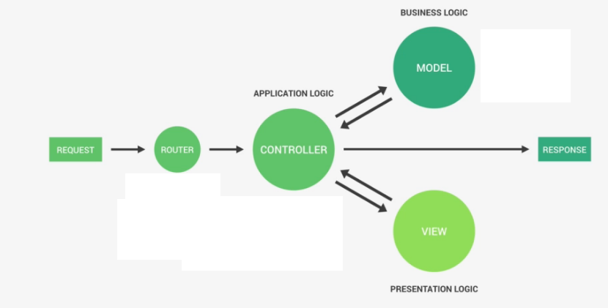
MVC
Model – Layer constitute of data and business logic
Controller – Interact with business layer and send response back
View – Display like web-pages
Notes:
package-lock.json maintains tree of installs , locations, dependent packages
Following is not working
The goal of package-lock.json file is to keep track of the exact version of every package that is installed so that a product is 100% reproducible in the same way even if packages are updated by their maintainers.
This solves a very specific problem that package.json left unsolved. In package.json you can set which versions you want to upgrade to (patch or minor), using the semver notation.

Slide 32
Let’s organize in CRUD operations
Also see next slide for initial data creation
Let’s create model first and use it in controller
nodejs-learnings\express_demo\server_9.js (POST app_2/api/v1/fruits and check Atlas, GET app_2/api/v1/fruits)
Verify and try other methods like patch , delete
Notes:
package-lock.json maintains tree of installs , locations, dependent packages
Following is not working
The goal of package-lock.json file is to keep track of the exact version of every package that is installed so that a product is 100% reproducible in the same way even if packages are updated by their maintainers.
This solves a very specific problem that package.json left unsolved. In package.json you can set which versions you want to upgrade to (patch or minor), using the semver notation.

Slide 33
Bulk import
Might require for initial data creation
nodejs-learnings\express_demo\import_data\import_data_data.js --import
nodejs-learnings\express_demo\import_data\import_data_data.js --delete
Notes:
package-lock.json maintains tree of installs , locations, dependent packages
Following is not working
The goal of package-lock.json file is to keep track of the exact version of every package that is installed so that a product is 100% reproducible in the same way even if packages are updated by their maintainers.
This solves a very specific problem that package.json left unsolved. In package.json you can set which versions you want to upgrade to (patch or minor), using the semver notation.

Slide 34
Further learning
Filtering – how to filter data when say price is greater than or less than
Atlas mongo features
Views with java script
Tool for mongo db, like Mongo Compass

Slide 35
SUMMARY
We learnt few features of node js, which enables us to design a MVC application where middleware interacts with backend.
We user atlas mongo db as our database, which is primarily used for node js
Always prefer node js for faster applications and not for CPU intensive applications

