Slide 1
cloud

Slide 2
AWS Account
We will learn AWS Cloud
Create your AWS Account.
Mostly services required for this course are within free tier
So, no cost
Is JavaScript on server
Can be extended as WebServer suitable for web deployment
Download putty, puttyGen, WIN-SCP tools

Slide 3
Create few useful things
You logged in as root user
Your account is <5abc691cyz46>
On top right menu, click on Security Credentials and assign MFA device
Click on ‘account’ on top right menu
Check if ‘IAM user and role access to Billing information’ is activated
Set Billing Preferences from left menu setting email id for notification
Also click on Budget on left menu and set monthly budget
Get IAM -> on right box create account alias for easy URL to sign in

Slide 4
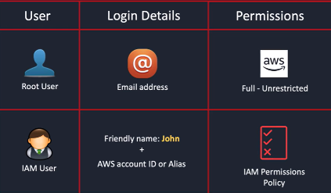
Root vs iam (identity access mgmt) user
Get IAM -> User -> Create User -> provide name and also console access -> select I want to create an IAM user -> give custom password -> create user without any permission yet
At this point this user don’t have any permission
Create a user group ‘admin’ , with AdministratorAccess and add user created above
Logout and go to aws.amazon.com and select IAM user to login
Put credentials and login
IAM -> Users -> click <user> -> Security credentials -> Assign MFA device

Slide 5
AWS CLI
IAM -> Users -> click <user> -> Security credentials -> Create AccessKeys for cli -> and keep the values saved somewhere
Follow on ubuntu
curl "https://awscli.amazonaws.com/awscli-exe-linux-x86_64.zip" -o "awscliv2.zip"
unzip awscliv2.zip
sudo ./aws/install
aws version
aws configure
( input keys, default region)
On console , there is symbol of cloud shell, where aws commands can be executed

Slide 6
Cloud computing

Slide 7
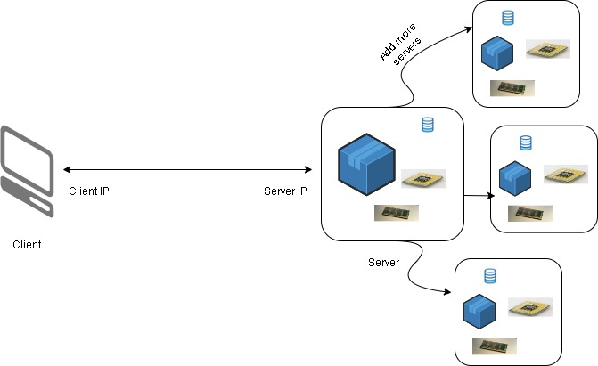
Cloud computing
Client communicate with server within network , say with IP addresses
Server might have CPU,RAM , database to store data, files systems etcs.,
As site grows, we may add more servers

Slide 8

Cloud computing
At some point the office building might not be enough, so companies might build datacenters
These will have all servers , resources and everything to run application softwares
But this will need its own power supply , cooling and maintenance
What if, in case of disaster ?

Slide 9
Cloud computing
All this can be externalized with an entity called as CLOUD
Cloud is on-demand delivery of computer power, database storages and other resources
Best part is you get when you need , you get what you need and you only pay for what you need , if you are not using, so won’t be paying for it
Also, you can get resources according to type and size you need. So, nothing can be over or under utilized
The moment you provision resource, you can access it immediately
Cloud provider (AWS) owns and maintains resource for you
Reduction of cost, since no hardware or maintenance on you
As you use more, you will get more benefits in terms of cost
No need for extensive capacity planning, upfront
Can rapidly develop and launch software applications

Slide 10
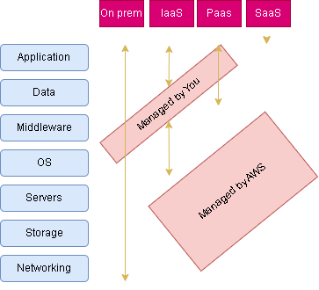
Types of Cloud computing

Slide 11
AWS Terminologies
AWS is truly global , global presence everywhere
AWS Regions
A single AWS region is cluster of datacenters
US East (N. Virginia) us-east-1 → Mostly called us-east-1 region
Asia Pacific (Mumbai) ap-south-1 -> Mostly called ap-south-1 region
Choice of region depends on various factors -
Compliance – legal , that data should never leave regions
Latency – Say most users are in Australia, so deploy application in Australia
Availability of Services – Not all region has all AWS services
Pricing – Varies from region to region

Slide 12
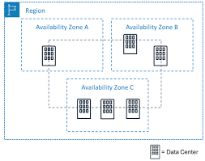
AWS Terminologies
AWS Availability Zones (AZs)
A single AZ is one or more discrete data centers with its own power and networking and connectivity
Each region got multiple AZs ( min 3, max 6)
Each AZ is isolated from each other, to take care of
disaster
In Mumbai , we have 3 AZs, physically isolated from
each other
The AZs are connected with high bandwidth and low
latency network

Slide 13
AWS Console
KEEP TRACK ON YOUR BILLING DASHBOARD, ALWAYS
Click on your Account ID, to get billing details

Slide 14
EC2

Slide 15
Amazon Elastic compute cloud – ec2
Most popular services
What is it ?
VM (EC2)
Virtual drives (EBS)
Load balancer (ELB)
Scaling (ASG)
Not to worry, we will see everything
Bootstrapping – Launching commands when machine starts, script which run once when instance is starting first time and never again – will be useful latter
There are different types of ec2 instances choices varies in terms of cpu, ram, storage, network performance
For demo purpose , we will be using t2.micro, is part of free tier (upto 750 hours /month)

Slide 16
EC2 – IP Address notations
IP address can be 10.0.0.0, and each number separated by dot is 8 bit (8+8+8+8)
So, IP Address is of 32 bits
On cloud, the IP address range will be represented by a slash (/) notation (10.0.0.0/16)
The number after / notation indicate how many addresses are network address (fixed) and how many remaining can be assigned to devices within that IP Range
Consider 10.0.0.0/24
24 indicates that 8+8+8 are fixed (network range) and only last 8 bits can be assigned – 10.0.0.1 -> 10.0.0.254 (1 or few are reserved , so last digit is 254)
No of Ips = 2 ⁽³²⁻²⁴⁾ = 2⁸ ⁼ 256 IPs
Consider 10.0.0.0/16
16 indicates that 8+8 are fixed (network range) and only last 2, 8 bits can be assigned – 10.0.0.1 -> 10.0.255.254
No of Ips = 2 ⁽³²⁻¹⁶⁾ = 2¹⁶ ⁼ 65536
Consider 0.0.0.0/0
0 bits are fixed, and this range includes all possible IP addresses

Slide 17
EC2 – Hands on
Let’s create EC2 Instance with all defaults in Mumbai (or N Virginia) - (Can be created from search -> EC2)
Lots of flavors to select from, Amazon Linux, Ubuntu , macOS etc.,
Instance type – Select one from free tier
Key Pair – To Login to system (select putty type .ppk). Gets downloaded.
VPC – Virtual Private Cloud, resembles traditional network setup in your own office or data center
Subnet – VPC can be divided in sub networks with fewer IP ranges from VPC. Such individual sub network is termed as Subnet, in which resource can be launched
Public IP – Using which a resource can be accessed publicly
Firewall Security rules – Security groups represent such rules and can define protocol, port as well as who can access the EC2
Storage – Elastic Block Storage (EBS) , for storage attached to EC2
Launch Instance and access with key downloaded and user ec2-user
wget google.co.in, will download a index.html, indicates it has access to outside world
After your operations better to delete the instance

Slide 18
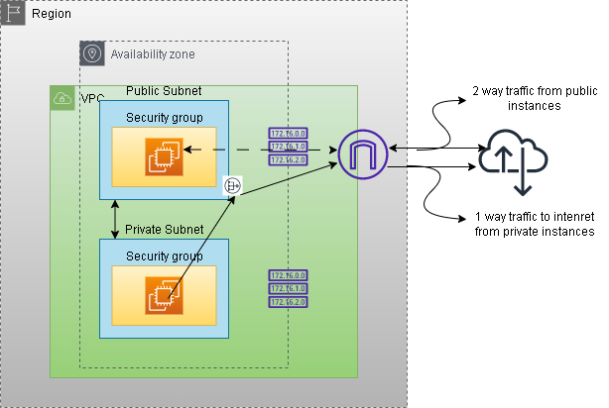
EC2 Traffic flow – Architecture

Slide 19
EC2 – Hands on from scratch
Let’s create everything involved in creation of EC2 instance
VPC (Can be created from search -> VPC)
IPv4 CIDR - 10.0.0.0/16 -> The ec2 instances withing this VPC will get a IP address from this range
A default route table is created
A route table contains a set of rules, called routes, that determine where network traffic from your subnet or gateway is directed
Subnet (Can be created from search -> VPC)
IPv4 CIDR - 10.0.0.0/24 -> cl-public-subnet-1 (should not get overlap) (accessible from internet)
IPv4 CIDR - 10.0.1.0/24 -> cl-public-subnet-2 (accessible from internet)
IPv4 CIDR - 10.0.2.0/24 -> cl-private-subnet-1 (no access from internet)
IPv4 CIDR - 10.0.3.0/24 -> cl-private-subnet-2 (no access from internet)
Subnets are labelled with private or public but at moment they are all private by default
IPv4 CIDR(24 means first 3 bits are fixed) | From | To
10.0.0.0/24 | 10.0.0.0 | 10.0.0.254
10.0.1.0/24 | 10.0.1.0 | 10.0.1.254
10.0.2.0/24 | 10.0.2.0 | 10.0.2.254
10.0.3.0/24 | 10.0.3.0 | 10.0.3.254

Slide 20
EC2 – Hands on from scratch
Route table (Can be created from search -> VPC)
With VPC, there is a default route table created.
Route table is responsible for how traffic is routed inside that of VPC (when a request is made to or from a device inside VPC)
Look at Routes (Rules) -> Destination is 10.0.0.0/16 and Target is local -> suggests, any traffic towards this destination should routed locally , like, if say traffic comes for one of the IP from destination ip range and say an ec2 instance within that VPC got an IP attached from this range, then traffic should move to that ec2 instance
Every route table is also associated with subnets. Route table by default is associated with all the subnets, within that VPC. But an explicit association can be made
Now there is one rule, for VPC IP address range , where all subnets falls. So, all subnets know how to route traffic locally and can reach other. There is one rule for target local and not internet and hence all subnets are private (as of now)
These subnets can talk to each other and so all devices within that subnet can talk to each other

Slide 21
EC2 – Hands on from scratch
How to make subnets as public subnet
Internet Gateway (Can be created from search -> VPC)
Internet Gateway is device, attached to VPC and provides 2-way connectivity to the devices within that VPC or to be precise within subnets
We have one internet gateway for default VPC, lets create one for our demo VPC - cl-internet-gateway (and attach to our vpc) (Can be created from search -> VPC)
Also create a new route table – cl-route-table (so we have 2 route tables , 1 is default with vpc and another is this one) (Can be created from search -> VPC)
New route table need modification for non-internal traffic to internet gateway. Create rule to have destination as 0.0.0.0/0 (everything) and target as internet gateway
So, Internet gateway will now accept all requests and from internet and forward them to respective device
This route table now address both internal and internet traffic and should be associated with subnets which are supposed to be connected to the internet (Associate public subnets)
The private subnets are still left and should now be associated with default route table created with VPC
Default route table don’t have any route to internet and subnets associated with it are all private

Slide 22
EC2 – Hands on from scratch
Launch EC2 instance ((Can be created from search -> EC2)
Name - ec2-instance-in-public-subnet
Select created VPC and a public subnet
Enable public IP
Create security group (cl-sec-group) with 3 rules , SSH-22 , HTTP-80, ICMP
Put code/ec2-bootstrap.sh as bootstrap script
Create similar instance but in private subnet (ec2-instance-in-private-subnet), with same security group
Try to ssh private instance – Not allowed
Try to ssh public instance – Allowed
Try http://public_ip_of_public_instance - Allowed
Try http://public_ip_of_private_instance – Not Allowed
Try to ping private_ip_of_private_instance from public instance - Allowed, internal traffic

Slide 23
EC2 – Hands on from scratch
Nat Gateway (Can be created from search -> VPC)
To enable instance within private subnet to communicate with outside world – 1 Way
Would be needed to download security patches or updates
Nat gateway need to be launched in public subnet only, since systems should talk to internet
Allocate an elastic public IP (The IP which can be attached to any device, got limits/account)
It takes few min for nat gateway to be in state of ‘Available’ after its creation
Open puttyGen -> Load private Key -> From Menu -> Conversion -> Export Open SSH Key -> Save file with .pub extension
ssh to public instance and copy the .pub file and chmod 400 .pub file
ssh to private IP of private instance from public instance (ssh –i **.pub ec2-user@private_ip_of_private_instance)
wget refiff.com -> Not allowed to connect to internet
Now attached nat gateway to default route table with 0.0.0.0/0 as destination and target as nat gateway
wget refiff.com -> Allowed as traffic routed from nat gatway

Slide 24
EC2 Traffic flow – Architecture - REVISIT
Don’t forget to delete things you created – EC2, NAT Gateway (wait till completion), Internet Gateway, Release Elastic IP, VPC, Security Group

Slide 25
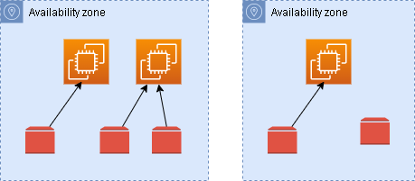
Elastic block storage - EBs
EBS is not physical drive
EBS is network drive and can be attached to EC2 instance
The communication to EC2 instance happens via network and is bit slow
1 EBS volume can be attached to 1 EC2 instance at a time, though 1 EC2 instance can have multiple EBS volumes attached
EBS is scoped to AZ. EBS created in 1 AZ can’t be attached to EC2 instance of another AZ
EBS volume can be preserved even after deletion of instance , can be seen in storage section of EC2 instance
EBS volume can be provisioned and remain unattached. Can be attached on demand
EBS volumes are charged above free tier, based on provisioned capacity and IOPs

Slide 26
EBS – hands-on
Provision a EC2 instance
EC2 instance -> Elastic Block Store -> Volume can be seen
Provision another volume of type gp2 and capacity 1 GB (supply tag). Once volume state is Available, Action -> Attach to EC2 instance
Volume need to be formatted, to use on linux machine. Instructions are available on net to format
Again, on EC2 instance -> Storage section, the newly provisioned volume can be visible
Scrolling extreme right on volume, can see delete on termination behavior. For root volume, its Yes
Try to Launch EC2 instance (don’t create). On Storage -> Advance -> Delete on Termination option is available
Delete EC2 instance and see that root volume is gone

Slide 27
EBS Snapshots
EBS Snapshots are a point-in-time copy of your data, and can be used to enable disaster recovery, migrate data across regions and accounts
The snapshots can be taken when volume is attached to EC2 instance but recommended to detach it
The snapshot can be copied across AZs and Regions and then can be restored to EBS volume in another AZ or Region, to attach to EC2 instance there
Thus, the data can be transferred to another AZ or regions. Useful for Disaster Recovery
Hand-ON
Volume -> Action -> Create Snapshots
Can be visible on Snapshot menu, beneath volume
Selection Snapshot -> Copy Snapshot and can be copied to another region
Snapshot -> Action -> Create Vol from snapshots. Now 2 vols can be visible. While creating vol from snapshots all the AZs for that region where snapshot exists, are visible

Slide 28
AMI – Amazon machine image
Machine image is like a blueprint of machine, from which machine, specifically ec2 instances can be recreated
When you create ec2 instances , you are already creating those from images
You can customize ec2 instance and can image it and save it, to latter creating ec2 instances from it
The image can again be transferred across regions
Hand-ON
Create an ec2 instance, with user data bootstrapping by only installing Apache Server (ignoring last line from code/ec2-bootstrap.sh)
Wait for ec2 instance to be in running state and then launch public IP. It will display home page of Apache or a massage displaying – ‘It works!’ (can take bit of time)
Select ec2 instance -> Action -> Image and templates -> Create Image
On left Menu -> AMI and AMI will be listed. Wait for status to be in ‘Available’. Then Launch instance from AMI. While launching paste the first and last line from code/ec2-bootstrap.sh (#!/bin/bash and last line)
After ec2 comes in Running state, launch public IP in browser and see the index page. The apache server installation was available on AMI, and we didn’t install it on ec2

Slide 29
Instance store (no hands-on)
EBS is network storage and has limited performance
For high performance, we need physical storage (hardware disk) , attached to ec2
Such hardware disks are available with AWS, and can be attached to instance (mostly ec2 flavors comes with instance storage) (Launch Instance -> Select AMI -> Community AMI -> on left menu choose Root Device type as Instance Store)
These deliver better I/O , throughput, better performance
But they are ephemeral in nature and are lost when instance is stopped
These are good for caching , huge computations which require temp space , buffer
Its user responsibility to back it up and replicate

Slide 30
EFS
Elastic file system is managed Network File System (NFS), which can be mounted on 100s of EC2 instances
EFS is Shared network filesystem
EFS only works with linux
Instance from multi AZs can be attached to same EFS
Highly available and scalable, you don’t have to do capacity planning in advance, will scale as per need
All instances attached to a EFS can see same files across
Follow notes for lab
Notes:
# Working with Files on EFS
## Launch EC2 instances
1. Create a security group
aws ec2 create-security-group --group-name chandra-sg-efs --description "chandra-sg-efs“
Copy SG Id - sg-063da776c9bc097c7
2. Add a rule for SSH inbound to the security group
aws ec2 authorize-security-group-ingress --group-id sg-063da776c9bc097c7 --protocol tcp --port 22 --cidr 0.0.0.0/0
3. Add rule to the security group to allow the NFS protocol from group members
aws ec2 authorize-security-group-ingress --group-id sg-063da776c9bc097c7 --protocol tcp --port 2049 --source-group sg-063da776c9bc097c7
Suggest members of this SG will receive traffic on NFS port
View SG on AWS Console now
4. Launch instance in US-EAST-1A
aws ec2 run-instances --image-id ami-0dfcb1ef8550277af --instance-type t2.micro --placement AvailabilityZone=us-east-1a --security-group-ids sg-063da776c9bc097c7
5. Launch instance in US-EAST-1B
aws ec2 run-instances --image-id ami-0dfcb1ef8550277af --instance-type t2.micro --placement AvailabilityZone=us-east-1b --security-group-ids sg-063da776c9bc097c7
View EC2 on AWS Console now and ensure those in running state
## Create an EFS File System (on AWS Console)
Create an EFS file system , ensure same VPC as that of Instance and click on Customize option, mostly default option , click Next
Keep only us-east-1a and us-east-1b , remove default security group and put the one created above to allow NFS traffic
Create file System by clicking Next (…)
Click on EFS and On Network tab, the mount target id is displayed. Wait till those become Available
Copy DNS Name of fs (fs-05863d17abb40830e.efs.us-east-1.amazonaws.com)
## Mount using the NFS Client (perform steps on both instances)
1. Go to both EC2 instance, Connect, EC2 Instance Connect
2. Create an EFS mount point (run on both)
mkdir ~/efs-mount-point
3. Install NFS client (non both)
sudo yum -y install nfs-utils
4. Mount using the EFS client (replace dns in below line) (on both instances)
sudo mount -t nfs4 -o nfsvers=4.1,rsize=1048576,wsize=1048576,hard,timeo=600,retrans=2,noresvport fs-05863d17abb40830e.efs.us-east-1.amazonaws.com:/ ~/efs-mount-point
5. Create a file on the file system, on 1 instance , by going inside efs-mount-point (cd efs-mount-point , sudo touch chandra.txt)
6. This file should be visible on other system

Slide 31
Scalability
Ability to handle more load , 2 types of scalability on cloud -
Vertical – Increase size of instance, like from t2.micro to t2.large
Most common in use cases like older generation databases, which were kind of operating from one machine
But there is limit to which a hardware can scale
Horizontal – Instead of size, the number of instances are increased.
This is more common for modern applications and super easy to achieve on AWS.
Horizontal scaling is also called as elasticity, but elasticity is more towards auto scaling based on load. It can scale out and scaled in as well based on load

Slide 32
High availability
This means application is available maximum time and downtime is very less or none
This goes hands-in-hands with horizontal scaling
For AWS, application is deployed and running across multiple AZs
So even if one AZ is down (due to say power-cut or natural disaster), application would continue to serve from another AZ

Slide 33
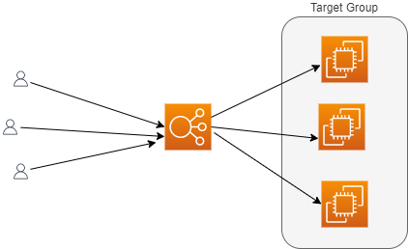
Load balancing
Load balancer forward traffic to multiple downstream ec2 instance
Based on load of ec2 instance (and also on other factors) , load balancer chose which ec2 instance can serve further request
The application would be accessed by single domain of load balancer, though traffic is served by multiple downstream ec2 instances
Imagine an ec2 instance is down, the load balancer would take out that instance out of service and application would continue to serve from other healthy instances
Load balancer can provide SSL termination
Even load balancer can be deployed in multi-AZ mode, to make application highly available
Managed by AWS, all its maintenance, upgrades
4 types of Load Balancer – Can be explained latter

Slide 34
ALB – Hands on
Create 2 ec2 instances with user data script and verify the webpage on accessing public IP of instances
Create an application load balancer
On security group of ALB, only allow http traffic, from anywhere
Add target group with both instances
Once provisioned, hit the URL of ALB and see traffic moving from one ec2 to another
Check target group and both ec2 will be healthy
Stop one instance and it will be unhealthy on target group
Now ALB will send request to healthy instance only
If stopped instances is started again, the traffic would again resume normally to both instances from ALB

Slide 35
Auto scaling group (ASG)
Auto scaling deals with horizontal scaling of ec2 servers on the backend.
It makes EC2 instances grow or reduced based on the load
It ensures max and min capacity based on load
Cost savings as we always run with optimal capacity
This works hand in hand with ALB. As instances are added or reduced from ASG, the instances are either registered or deregistered with ALB

Slide 36
ASG Hands-on
Create a EC2 instance , with bootstrap script (except last line) with SG allowing ssh , http, https and then create AMI from that instance
Create a target group with no instances and security group allowing http:80 from anywhere
Create an ALB with target group and security group created
Will create ASG. First let’s create launch template with AMI created above and also instance type as t2.micro. Put user data bootstrap script with ec2 (only first and last line)
Launch template determine how the ec2 instances should be created.
Back to ASG , attach this launch template
Select existing LB with target group and select the target group we created
For health checks select both EC2 and ALB, reduce time of first health check to 60s
Put desired capacity as 2
Once ASG is created, you should be able to see 2 instances (desired capacity on EC2 dashboard)
On ASG , under activities tabs , activities are listed
Under Instance mgmt. tabs , instances can be seen (healthy)
Hitting ALB DNS will show response
Try deleting one ec2 and another will come up in some time automatically (desired capacity is 2)
Assignment – Under Automatic scaling of ASG, try creating dynamic scaling policy , target tracking and with CPU Avg utilization say 70 , put instances as 3 .
Do something to increase load on one EC2 instance and see instances growing
Scaling can also be scheduled one, say reduce capacity over weekend
Delete ALB , ASG, Target group, Launch Template

Slide 37
IAM

Slide 38
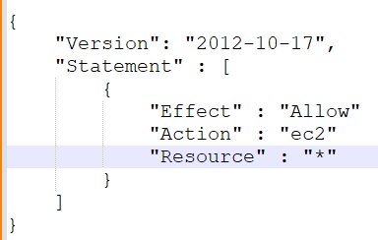
Identity access management – IAM
IAM is global service
Some part of it you are already using, like your account which is your root account
Never share root account, but create users for them to access AWS
Users can be grouped together, based on their roles, in groups
The users are assigned permissions by something called as policies
A policy is JSON doc, describing the resource and permissions on resource
User can exist without group or can belong to multiple group
In AWS, always apply principal of least privilege, i.e., never allow permissions more than needed

Slide 39
IAM – Hands on
Search IAM and click on that
You can see on top that this is global service
Add User, Provide user access to the AWS Management Console, I want to create an IAM user, don’t force to change password on next login, Add User to a Group, Create Group, Assign Administrator Access Policy
Once created, explore Groups and Users from left menu
Click on Dashboard and on right, Create Account Alias
Copy Sign-in URL and open in Firefox private window and sign in
Can do anything since this is Admin user
Click on the name on right top and along with account id now IAM user label would be visible, indicating IAM user and not root account

Slide 40
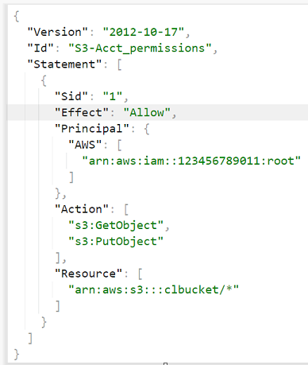
IAM policies
If a policy is applied to a group, it is inherited by all members of that group
A policy structure is like shown in picture
Id is id of policy , optional
Sid is statement Id , optional
Effect can be allowing actions or deny action
Actions are what actions are allowed on Resource, which is
S3 bucket ARN in this case
Principal is who can perform (or cannot perform), these actions,
in this case, root account
Login to account with root user and see policy for role AdministratorAccess

Slide 41
IAM Roles
AWS services might need to perform actions on your behalf
Like say you are creating some AWS database which will be storing data on S3. So here a AWS service which is database would need access to S3
In this case, permissions to database to access S3, are assigned via AWS Roles
The IAM roles will be demonstrated throughout the course, here onwards

Slide 42
S3

Slide 43

Simple storage service – s3
Infinitely scaling storage
Many applications, web-sites uses S3 as their backend storage.
Lot of AWS services are also integrated with S3
S3 can be used for
Backups, disaster recovery
Archive
On prem storage can be extended to cloud using S3
Storing Images, Videos and all media files
Hosting static websites
Big data
Amazon S3 stores files in buckets (top level directories)
Files are called as objects
S3 services is global service. The buckets created are accessible across all regions of a geo
But bucket itself is regional resource
Objects can be nested like directories. There are no directories there, but UI will look like

Slide 44
S3 – hands on
Try to create bucket with name mybucket, will show error about name, should be globally unique
Chose region close to you
Keep everything default, and create bucket
Upload an image , keep everything else default
Click on image name, to see details
Copy object URL and try opening in another browser tab, access denied
Click on Open button, image will be visible. The URL here is having my encoded signature in URL and hence access is granted
Create folder, everything else default
Can upload image inside folder
Delete the objects

Slide 45
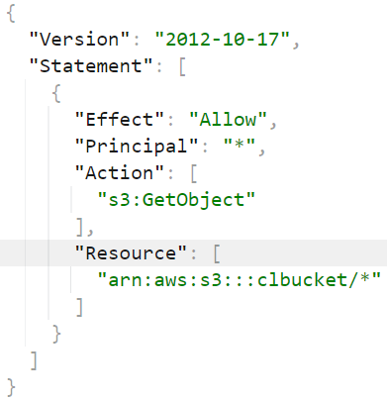
S3 – Security
Access to the S3 can be via IAM Policies, assigned to user, as to which API call is allowed for that user
Or can be via Resource based policies, attached to bucket itself and to what actions are allowed on that bucket
So S3 can be assessed if IAM permission allows it or S3 bucket itself allows that
This policy allows getting object on S3, for all the objects on mentioned bucket
to everyone (Principal is *)
Setting public read on all objects, inside that bucket

Slide 46
S3 – policies
The bucket we created was not accessible via URL
Click on bucket -> Permissions :: Uncheck block public access
:: Edit bucket Policy :: Policy generator :: -> Actions = GetObject and ARN = <bucket_arn>/*
:: Add Statement :: Generate Policy :: Copy that in bucket policy and Save
Try image via URL , can be accessed now.
So, objects are accessible via public URLs

Slide 47
S3 – IAM Role
Create a EC2 instance
Connect via EC2 instance Connect
Try aws s3 ls – Error about not configured (don’t configure anything)
Create a IAM role with policy AmazonS3ReadOnlyAccess
Attach that to instance (Action -> Security -> Modify IAM Role)
And now run aws s3 ls –> things will be accessible
Try making bucket - aws s3 mb s3://buk0617 -> Access denied
Create a role with policy S3 full access
Attach that to instance
Now try aws s3 mb s3://buk0617
aws s3 rb s3://buk0617

Slide 48
S3 – Static websites
S3 can host static websites and have them accessible over internet (not dynamic websites)
Create a bucket and add index.html and aws.png, from code folder
Buckets should be public – uncheck ‘Block all public access’ and also add policy for public access. Generate policy via policy generator for ‘GetObject’ and ARN appended with /* (sample policy is in Notes)
:: Properties :: Static Web Site Hosting :: Enable :: Index Document -> Index.html -> Save
:: Properties :: Static Web Site Hosting :: -> Copy URL and Open in browser window
Notes:
{
"Version": "2012-10-17",
"Id": "Policy1703230336135",
"Statement": [
{
"Sid": "Stmt1703230335218",
"Effect": "Allow",
"Principal": "*",
"Action": "s3:GetObject",
"Resource": "arn:aws:s3:::static-bucket0617/*"
}
]
}

Slide 49
S3 – versioning
In case of overwrite an object, better to enable versioning at bucket level
Its helps rollback to previous versions
It helps to recover from unintended deletes
All files before versioning will have version as null
:: Properties :: Versioning :: -> Enable
Open static website URL on a browser tab
Upload one more aws image from code/aws_another_logo folder
Refresh static website url and notice the changes
Object :: toggle on Show Versions, to see versions
For Rollback -> Select latest version of index.html and Delete
Refresh static website url and notice the changes

Slide 50
S3 – Replication
Say a bucket in one region need to be replicated to another region, asynchronously
Versioning must be enabled in both buckets
Replication can be in same region or different and can also be in same account or across
This case be for having a test environment or also for access s3 with lower latency
Create new bucket , say in same region, with versioning enabled
On origin bucket :: Management :: Create replication rule :: For Source bucket -> Apply to all object , then chose destination bucket. IAM Role -> Create a new role (to access destination bucket for read/write) Save
Prompt for replicate existing object, this is different to replication and existing objects would be replicated via a batch job , say No
Upload a file and see it getting replicated in destination bucket (might take 2-3 min)
Versions will match for replicated objects

Slide 51
S3 – storage classes
Saving and accessing objects from S3 are charged
So based on your storage and access requirements there are different storage classes for S3
S3 storage class
Amazon S3 standard–General purpose | For frequently access data gaming application
Amazon S3–Infrequent access | Data for less frequently accessed but require instant access when needed Lower cost for storage than standard but bit high for access Backup, Disaster Recovery
Amazon S3 One Zone–Infrequent access | Same as above but withing one zone , access cost will be slight lower than above one Secondary backup of data or data which can be easily recreated, since data would loss with loss of AZ
Amazon S3 Glacier Instant retrieval | Lost cost object storage, access cost bit higher. Data is accessible within mill seconds Min storage duration - 90 days
Amazon S3 Glacier Flexible retrieval | 1-5 min, 3-5 hours, 5-12 hours , less duration more cost of access Min storage duration - 90 days
Amazon S3 Glacier Deep Archive | For long term storage, like compliance to store data for specific number of years 12 hours and 48 hours retrieval Min storage duration - 180 days
Amazon S3 Glacier Intelligent tiering | Objects are automatically moved between classes based on usage patterns Object not accessed for 30 days moved to Infrequent Access Tier Objects not accessed for 90 days moves to Archive Access Tier and so on

Slide 52
S3 storage classes - hands on
Try creating bucket
Try Uploading Object :: While uploading :: Properties :: Various Storage classes to chose from
Reduced Redundancy is deprecated
Upload object
Click on object :: Properties :: Edit , can change storage class
Bucket :: Management :: Lifecyle Rules :: Create Lifecycle Rule -> Apply to all objects , Move current versions of objects between storage classes
Can create rules like –
Standard-IA | 30
Intelligent Tiering | 60
Glacier Deep Archive | 180

Slide 53
S3 - Encryption
All objects within buckets are encrypted by default for security purpose. This is called server side encryption
User can also encrypt before uploading object
Bucket :: Properties :: Encryption

Slide 54
Other compute services

Slide 55

AWS Lambda – truly serverless
EC2 | Lambda
Virtual Servers | Virtual functions
Boundaries are RAM and Memory | Short term execution
Continuously running and if not in free tier, will be charged for the time it is running | Run on demand, only when needed. Charged only when running
Scaling is with ASG, based on metrics or otherwise | Scaling is automatic
 | Free Tier includes 10,00000 AWS lambda request/month and then 20 cents / 10,0000 requests thereafter. Very cheap
 | Integrated with lot AWS services
 | Event Driven - Lambdas are invoked on some events
 | Can be written in many programming languages, Nodejs, Python, Java, C#, Golang, Ruby and others

Slide 56
lambda – hands on
On Lambda Home, Run button can be clicked to see lambda running
Also, there is button – Lambda responds to event, which shows power of serverless lambda getting invoked in events
Create a node js lambda. To test we would need event. Test it
No need to manage an servers. We don’t even know where node js was deployed
Edit Configuration , Options are memory , timeout and role created by lambda
Monitor tab will show some useful metrics like how many times it was invoked, duration to execute and others
Create a bucket, demo-for-lambda
Create a lambda, with code at code/lambda_int_s3_code.js file (ensure region for s3 client, in code)
Create a trigger from Configuration tab of lamba, for the s3 bucket , for all objects events
Observe logs from Cloudwatch, will show access denied error
Create a policy , to allow access from lambda to s3 and CloudWatch – (available at code/lambda_s3_policy.txt) and then create role from this policy
Lambda -> Configuration -> Permissions and change role to one crated above
Upload file again on s3 bucket and observe Cloudwatch logs again. This time it will be success.

Slide 57
Elastic container service - ecs
Elastic container service launch containers on AWS, without worrying about underlying infrastructure (no worry for installing docker, managing containers and all)
The infrastructure specification need to be specified by user, rest all will be taken care by AWS. (Like the OS , instance type need to be specified by user)
AWS fargate can be used with ECS, without having to manage servers or clusters of Amazon EC2 instances. User don’t specify anything.

Slide 58
ECS – Hands on WITH Fargate
Create a security group with ping and http traffic allowed
Create a role as directed at - https://docs.aws.amazon.com/AmazonECS/latest/developerguide/task_execution_IAM_role.html#create-task-execution-role
Try creating ECS cluster with Infrastructure as Fargate. (At this time, you can also select Infrastructure as EC2 along with Fargate, this will be useful while you want to deploy your task definition service as launch type EC2) (For this demo, we will use everything as serverless)
After cluster, create new task definition with Launch type as Fargate. For Container Spec chose OS as Linux/X86_64, CPU as .25 vCPU and memory .5 GB. Keep Task role as blank and Task execution role as one we created above
Mention image as cbagade/cl-first-prog:v1, Container Port as 3000
Select task definition and Deploy as service. Set Launch type as Fargate. Under Networking section, select VPC , where security group above is created, keep only 2 public subnets and select security group created above. Public IP should be turned on.
Create Service and watch events in Cloud Formation stack. Wait till CFT events go in CREATE_COMPLETE state.
Cluster -> Tasks (click) -> copy public IP
To test image, hit http://<public_ip>:3000 on browser tab
Delete the task definition and cluster

Slide 59
Databases

Slide 60
AWS Databases
EBS, S3, EFS are technologies to store unstructured data
To store in structured way, there are databases. This will allow indexing and faster searching through data
The first kind of database which AWS offers is Relational Databases
One can establish links between tables and can use SQL Queries to perform operations on data
The other kind of database which AWS offers is NoSQL Database
Non relational database, build for modern applications
Flexible Schema, Scalable, High Performance
Examples – Mongo DB, Document DB, in-memory and so on
Data is always in JSON format
emp_id | emp_name | dept_id | emp_skills
1 | Sonia | 1 | Technical
2 | Vishal | 2 | Accounting
dept_id | dept_name
1 | Finance
2 | Cloud

Slide 61
Advantages of AWS Managed DB
Faster provisioning and available within few minutes to use
Highly Scalable and Available
AWS will take care of upgrade to db and OS patching
Monitoring, Logging, Alerting all can be configured

Slide 62
AWS RDS – Relational database service
AWS Managed DB service
Along with the advantages already mentioned, one can set up read replicas and also do multi-AZ setup
Following are the database engines, provided by RDS
Postgres
MYSQL
MariaDB
Oracle
Microsoft SQL Server
Along with these there is one more AWS proprietary kind RDS DB is Aurora
Aurora also comes with 2 flavors
Postgres (3x faster than RDS postgres)
MYSQL (5x faster than RDS MYSQL)
Aurora comes with auto growing storage (in chunks of 10 GB till 128 TB)
Bit more expensive than RDS, but AWS claims faster performance for Aurora

Slide 63
AWS RDS – Hands ON
Requires PGAdmin to access DB
Over RDS, Create database, select Engine as Postgres, Free Tier, Latest version, put Storage as 10GB, put password, Uncheck Enable Autoscaling, Enable Public Access, Create new Security Group, Port 5432, Turn off performance insight, Disable automated backups and Encryption
Let Status be Available, meanwhile change Security Group to put Source as Allow from anywhere for existing PostgreSQL rule and also add one more rule to allow All TCP traffic from anywhere (this is just for demo)
Once database status is available , click on connect info and put in PGAdmin to see database
Over RDS, select database and Action, Take snapshot
Let the snapshot be available and try options as Action ->, Restore and Copy Snapshots
Restore will create new DB (no need to create), say with bigger capacity
Copy can copy snapshot across regions
Delete snapshot
Delete DB (don’t create final snapshot while deleting)
Delete security group

Slide 64
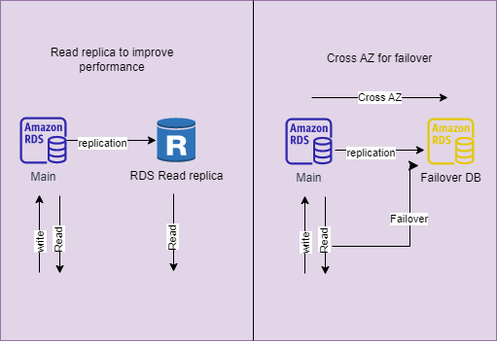
AWS RDS – Deployment types
Read replicas to improve read performance
Cross AZ replication for AZ failover
Same things can be setup across region for disaster recovery

Slide 65
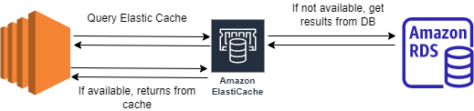
Elastic cache
While RDS was created there was add on for Elastic Cache
Generally heavy query put lot of pressure on DB. Repeated execution of such query hampers DB performance
Caching is mechanism, to cache frequently used queries and return from cache
This improves DB performance
AWS got Elastic cache , in 2 flavors – Redis and Memcached
These are in-memory databases, with high performance and low latency, which helps reducing load on DB

Slide 66
Dynamo DB
Part of NoSQL family
Fully managed and replication is across 3 AZs
Serverless, no need to provision any server (database)
Single digit millisecond latency , extreme fast and scales to massive workloads
This is key-value database
DAX – Dynamo DB Accelerator is in-memory cache for DynamoDB (exclusively)
DAX improve performance 10x times

Slide 67
Dynamo DB – hands on
Create table, no need to create any database as this Is serverless
Keep Default Settings
Once Status is Active, Click on table and Create Items
Create 1 more item with different attributes, flexible with schema
Delete table along with Cloud Watch Alarms

Slide 68
Infrastructure

Slide 69
Cloud formation template - CFT
Deploy and manage infrastructure at scale
Declarative way to create infra, the infra need to be created via code and not manually
All the AWS resources can be created via CFT
The changes to code are tracked
CFT is smart enough to decide which resource need to be created in what order
A good documentation is available

Slide 70
Cft – hands on
Create stack and upload existing template file – code\ec2-template.yaml
Watch the events
Update same stack with – code\ec2-and-other-template.yaml
The change set can be viewed to see what all changes
Delete the CFT to delete all resources

Slide 71
Global applications
Global applications would be deployed in multi regions or at edge locations (close to users)
This produce decreased latency; things have less distance to travel towards users
Also helps in DR, in case one region goes down
Also ensure high availability, as presence of application is in across regions

Slide 72
Route-53
Route-53 is managed DNS service
Route-53 is collection of rules and records, which help client understand how to reach servers through URLs
Record types –
Domain | Mapped to | Record Type
chandra-learnings.com | 10.0.0.1 (IPv4) | A record
chandra-learnings.com | 2001:0dgb:85rg:0000:0000:6rg5:9876:3456 (IPv6) | AAAA record
chandra-learnings.com | search. chandra-learnings.com (another hostname) | CNAME record
chandra-learnings.com | ALB (AWS resource) | Alias record

Slide 73
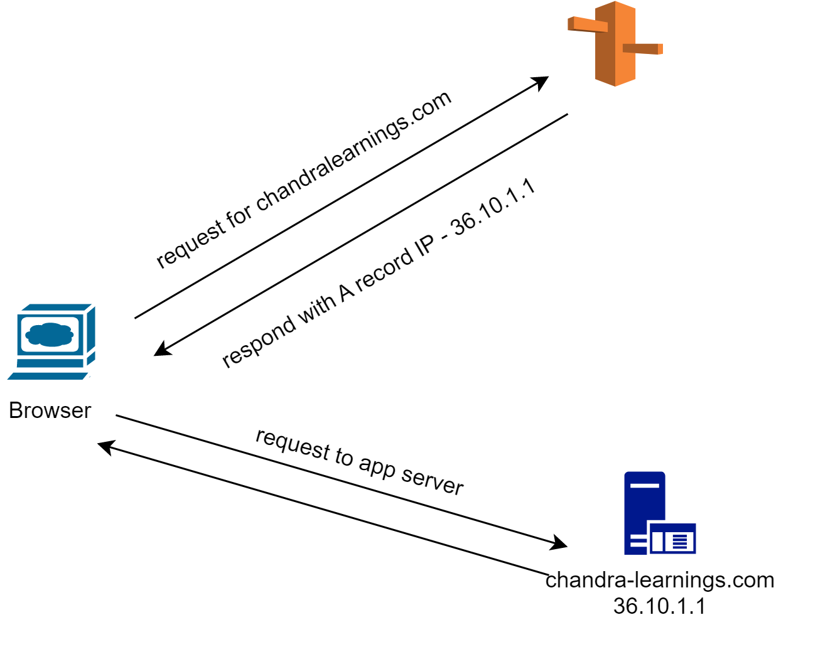
Route-53 working

Slide 74
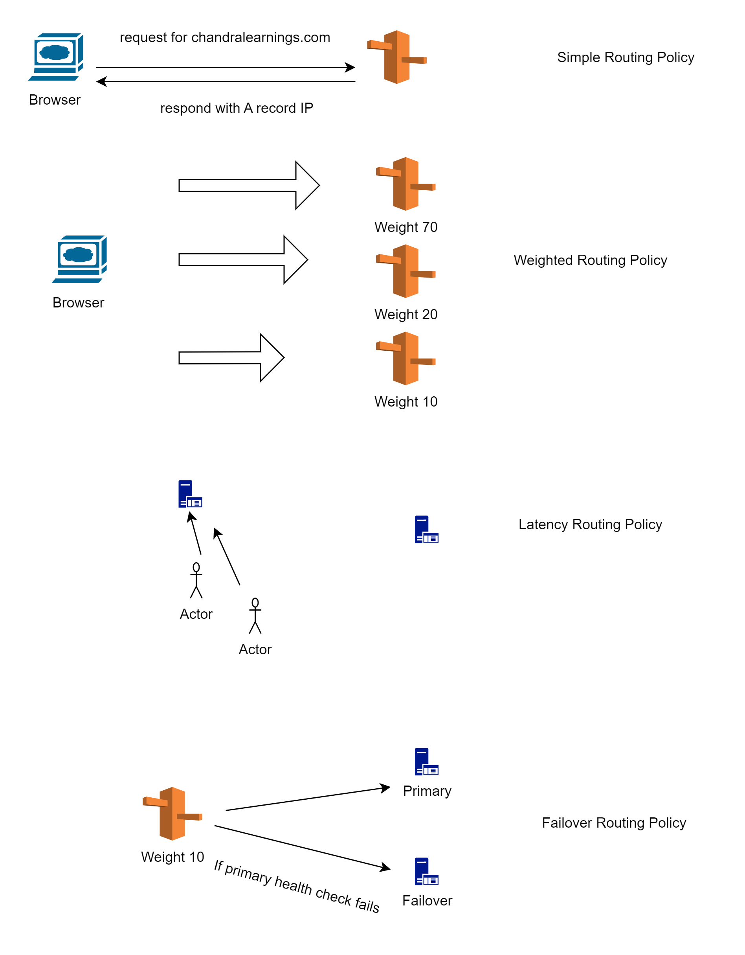
Route-53 policies

Slide 75
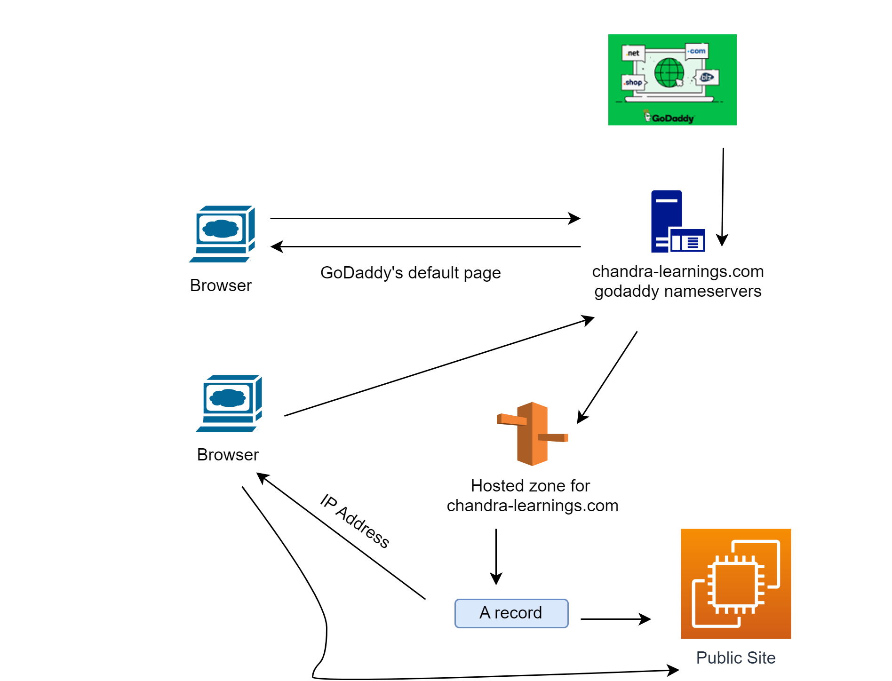
Route-53 demo
Notes:
-> Register domain on GoDaddy
-> Create hosted zone on Route-53
-> Change Nameservers on GoDaddy to AWS ones
-> Create EC2 instance with bootstrap script to have apache
-> Ensure http://<public_ip_of_ec2> gives site
-> Create A record in Route53, and value should be public IP of EC2
-> After some time , hit http://<domain_name>
-> Should display site on EC2

Slide 76
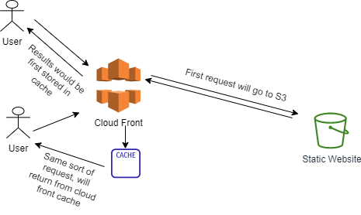
CloudFront
Cloud front is content distribution network (CDN)
This improves performance by caching the content at different edge locations
Users will get lower latency and improved performance
AWS keeps increasing edge locations (till this write there are 216 edge locations)
Cloud Front can work with
S3 - distributes files and cache at edge location and also uploading files to s3
Http Endpoints – ALB , EC2, Static S3 website

Slide 77
CloudFront – hands on
Create S3 bucket, upload index.html and an image
The index.html can be accessed by Open button, but image won’t display as it is not public
The Object URL anyways won’t work
Create CloudFront distribution, chose origin domain as S3 bucket
Origin access public is NA, as bucket is not public. Also, legacy is old
Create Origin Access Control (will require a policy update on S3)
Among all other settings, keep defaults and for Default root object mention, index.html
After creation, last modified will be deploying (wait for this to change)
On distribution -> Origins -> Edit -> Copy Policy and paste on S3
Once deploying status is changed, copy distribution domain name and paste on browser
First time request will tale bit of time to display content but a refresh on browser latter will fetch content faster, as the content is cached
To Delete -> Disable distribution -> Wait for status to change from deploying and then delete distribution
On left menu -> Origin Access -> Delete
Delete S3 bucket

Slide 78

S3 transfer acceleration
S3, though global, but is location in a region
The user all around regions might want to upload content on S3
To speed up process, S3 transfer acceleration can help
User can upload file to nearest edge location, and file will be transferred to S3 via AWS private network
This will reduce latency for user
To test if accelerator can help -
https://s3-accelerate-speedtest.s3-accelerate.amazonaws.com/en/accelerate-speed-comparsion.html

Slide 79
Communication

Slide 80
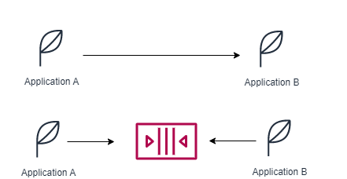
Application communication
Application can communication synchronously or asynchronously via some queue
With async way, the applications are decoupled and can process things as per their own capacity, can be scaled independently
AWS got SQS (Queue) , SNS (pub-sub) , Kinesis (near real time) services to process things in async manner
These services can also be scaled independently

Slide 81
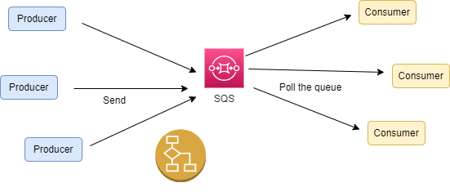
Simple queue service - sqs
Multiple producers can send messages
Multiple consumers can request messages form queue (polling)
Same message can’t be seen by 2 consumers
Once processed, message can be deleted from queue
Producers, Consumers are decoupled and along with SQS , can be scaled independently
Messages should be processed in max 14 days
No limits on volume of messages in queue

Slide 82
SQS – hands on
Create Queue -> Standard,
Click on Send and Receive Messages button
Write some hello message and click Send message. Send few more messages
Under Receive Message section, the Message available will be updated (might take time)
Poll Messages will show 3 messages, Click on message to see body
Once seen delete the messages, to simulate deletion
Delete Queue
There will be SDK available, to send and poll messages from SQS

Slide 83
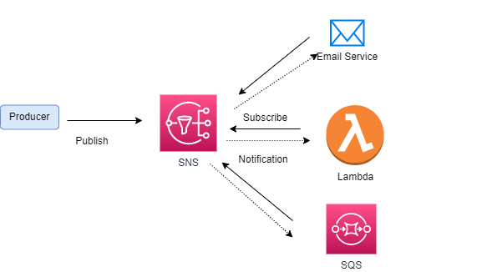
Simple notification service - SNS
What is a single message need to be delivered to multiple consumer at same time
Say you made purchase on ecom site and now this need to be notified to store owner, billing dept and courier service
There can be one service (topic) , to which consumers can be subscribed
Once message is published to that topic, all consumers will be notified with same message
SNS works in same fashion

Slide 84
SNS – Hands on
Create topic -> Standard , leave other fields default
Now on AWS , after topic creation, Create Subscription , protocol as Email, Endpoint as <user>@email
Once created, go to left menu subscription and request confirmation
A confirmation mail will be sent to your email account , click confirm subscription
On Left Menu , topics, Publish Message
Message will be available on inbox

Slide 85
Other services

Slide 86
CloudWatch
CloudWatch provides metrics for lot of services
Like for EC2 , it will provide CPUUtilization, network metrics etc.
For Disks, it will provide disk read/writes etc.
For S3, no of objects , requests etc.,
Based on metrics Alarms can also be created to trigger some actions
Like say when a CPUUtilization is exceeding 80%, do trigger a mail
Billing metrics is only available in us-east-1 region
CloudWatch logs are also available for almost all services

Slide 87
CloudWatch – Hands on
Create a EC2 instance (for its metrics to appear)
Meanwhile CloudWatch – Metrics – All Metrics will show metrics available for all AWS Services
Click on SQS , to see metrics available, Query tab besides Browse tab will enable users to run queries to see metrics
EC2 instance created will also show up in the list
Left Menu -> Create Alarm -> Metrics -> EC2 -> CPUUtilization > 80% -> In Alarm -> Create Topic -> Put email (Over email , click on confirm subscription) -> Create Alarm
Change region to us-east-1 and billing metrics will be available
Clean up – Delete Alarm and topics created. Delete also the EC2 instance
For CloudWatch logs , a lambda cloud watch logs can be demoed
For EC2, a agent need to be installed on EC2 agent. Documentation is available to follow

Slide 88
AWS Security
DDoS – Distributed Denial-of-Service attach
Attacker may hit lots of requests to your application via automated bots and application freezes at some point of time and become nonresponsive
AWS Shiels Standard protects applications from such attacks and is free
AWS Advance Shield comes with loads of other features to give premium protection 24/7 and is not free
AWS Web Application Firewall (WAF) filters request based on IP Address, Http Header , Http Body etc., Can protect against SQL and CSS attack
CloudFront and Route53 coupled with AWS Shield can protect at edge itself

Slide 89
AWS Security- Attacks
DDoS – Distributed Denial-of-Service attach
Attacker may hit lots of requests to your application via automated bots and application freezes at some point of time and become nonresponsive
AWS Shiels Standard protects applications from such attacks and is free
AWS Advance Shield comes with loads of other features to give premium protection 24/7 and is not free
AWS Web Application Firewall (WAF) filters request based on IP Address, Http Header , Http Body etc., Can protect against SQL and CSS attack
CloudFront and Route53 coupled with AWS Shield can protect at edge itself

Slide 90
AWS Security- Encryption
When data is stored in S3 or RDS, that data is sitting on disk/database and Is called as data at rest
When data is being passed from say browser to application, is called data in transit
To project data, that need encryption by some keys
Data at rest can be protected by AWS Key management service, which got keys to encrypt data
The keys are managed by AWS or even can be managed by customers
AWS provide a hardware in AWS infrastructure called as Cloud-HSM (hardware security module) which contains customer managed keys
Someone if got access to data won’t be able to see, unless key is available with him to decrypt
AWS certificate manager manage SSL/TLS certificates to make site accessible over https
https ensure data is encrypted in-flight
AWS secret manager holds sensitive data like password and can be integrated with RDS (MYSQL, Postgres, Aurora), to generate secrets
Secrets can be rotated after X days
Applications can use SDK to retrieve secrets

Slide 91
Machine learning services
Amazon Rekognition – Analyze text, faces, objects within images/videos
Can be used in face detection softwares like to determine gender, age or to label images
Amazon Transcribe – Converts Speech to Text
Removed Personally Identifiable Information (PII) like age, phone number using Redaction
Helpful in customer service calls
Amazon Polly – Converts Text to Speech, useful in examination for our visually impaired brothers
Amazon translate – Localize content of website or application for international users

Slide 92
AWS Command line interface (aws-cli)
AWS CLI is tool to manage aws services from command line
Installation –
https://docs.aws.amazon.com/cli/latest/userguide/getting-started-install.html
Once installed, run
aws configure
And fill in values for access_key, secret_key, region
S3 command
aws s3 mb s3://bucket-stroing-tfstate
aws s3 ls
aws s3 rb s3://bucket-stroing-tfstate --force
Notes:
while using cli you might get An error occurred (AuthFailure) when calling the RunInstances operation: AWS was not able to validate the provided access credentials
this is time clock issue
run following command
sudo hwclock -s

Slide 93
AWS Command line interface (aws-cli)
EC2 command
aws ec2 create-key-pair --key-name tf-key-pair --key-type rsa --key-format pem --query "KeyMaterial" --output text > tf-key-pair.pem
(--query "KeyMaterial" prints the private key material to the output.)
aws s3 ls
aws ec2 describe-key-pairs --key-name tf-key-pair
aws ec2 describe-subnets (get vpc id and subnet id)
aws ec2 create-security-group --group-name cli-sg --description "CLI security group" --vpc-id <vpc_id>
aws ec2 authorize-security-group-ingress --group-id <sg_id> --protocol tcp --port 22 --cidr 0.0.0.0/0
aws ec2 describe-security-groups --group-ids <sg_id>
aws ec2 run-instances --image-id ami-049a62eb90480f276 --count 1 --instance-type t2.micro --key-name tf-key-pair --subnet-id <subnet_id> --security-group-ids <sg_id> --tag-specifications 'ResourceType=instance,Tags=[{Key=Name,Value=ec2-by-cli}]' --region ap-south-1
aws ec2 describe-instances --filters 'Name=tag:Name,Values=ec2-by-cli' | grep InstanceId
aws ec2 terminate-instances --instance-ids <instance_id>
aws ec2 delete-security-group --group-id <sg_id>
Notes:
while using cli you might get An error occurred (AuthFailure) when calling the RunInstances operation: AWS was not able to validate the provided access credentials
this is time clock issue
run following command
sudo hwclock -s

Slide 94
Further learning
Filtering – how to filter data when say price is greater than or less than
Atlas mongo features
Views with java script
Tool for mongo db, like Mongo Compass

Slide 95
SUMMARY
We learnt few features of node js, which enables us to design a MVC application where middleware interacts with backend.
We user atlas mongo db as our database, which is primarily used for node js
Always prefer node js for faster applications and not for CPU intensive applications

