Slide 1
Common lisp and the (or 'magic 'madness)
of macros
(A tale of too many parens)

Slide 2
A brief walk through the history of lisp
an intro to the common lisp dialect
and an exposition on macros
Notes:
Welcome
- tonight I will be shouting at you about common lisp
- lisps are odd
- separate evolutionary path
- show of hands for lisp users
- lisp is odd because it's still here!
- many features now in all major languages
- except macros

Slide 3

Me
https://github.com/cbaggers
Notes:
Me
- apparently I have to have one of these
- always loved programming
- got into lisp 3 years ago

Slide 4

Notes:
Fuse
- Background in GPU tech, demoscene, oil industry, app & game dev
- 19 people. Offices in Oslo and Palo Alto
- What we actually do though is
- make compilers & programming languages
- tons of clever frameworks for UI, animation, graphics...
- low-level platform integration
- High-level WYSIWYG design tools

Slide 5
Let's Begin

Slide 6

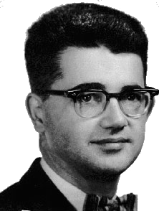
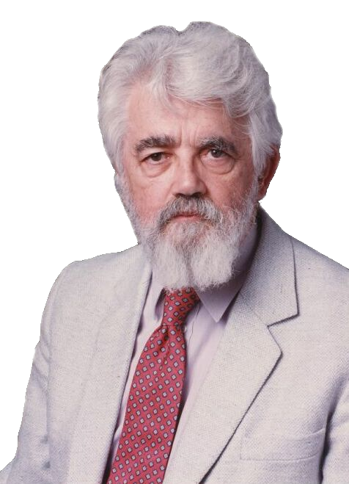
1956
Notes:
Summer 1956
- Hanover
- This guy
- Well then he was this guy
- John McCarthy
- 29 years old assistant professor
- The first organized study of Artificial Intelligence
- He saw IPL2
- list processing language for the JOHNNIAC

Slide 7
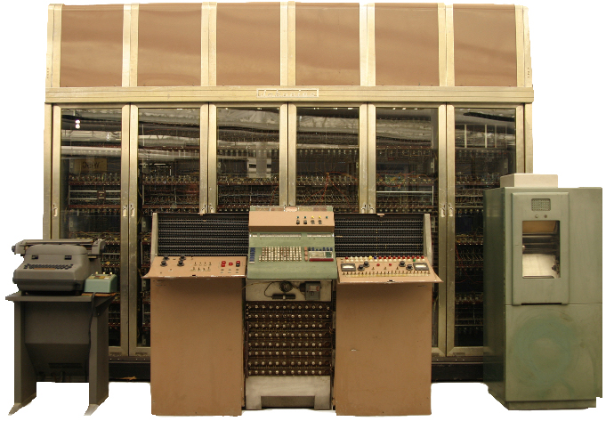
Notes:
- JOHNNIAC 2.5 tonne
1024 x 40bit words selectron vacuum tube,
Air cooled!
no index register so loops were implemented by modifying instructions as they ran
- john didnt take IPL design
- but immediately saw the values of being able to extract and recompose data
- He was working on the advise taker (possibly first logic being use as information in computer)
- talk about lists of knowledge about world and inference engine
- sentences stored as lists
- another reason not to take design was FORTRAN
- but not clear where Fortran was going .. would need a new language
- ooh random fact, mccarthys' use of prefix is from advice taker, easier to do differentiation
he compared to change from digital computers to binary

Slide 8
IBM 704
36 bit
address
prefix
decrement
tag
15
3
15
3
CAR CPR CDR CTR
Notes:
- sense to start thinking about new langiage
- IBM was good choice
- setting up computation center at MIT, which dartmouth could use
- ibm wanted to make program proving geometric theorums
- mccarthys was consultant on that project
- IBM were a good bet for future projects
- So how to make lists on the 704?
- Well the word of the 704 was laid out like we see here
- 4 functions were defined for extracting data
- And you may well ask...who fucking cares

Slide 9
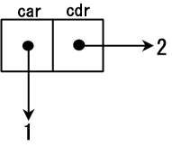
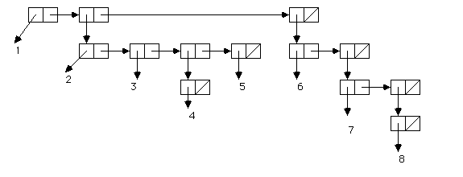

Cons Cell
Notes:
- This next one you may recognise CONS
- cons to construct words and pack em with data
- cons in haskell is : in f#, scala and ML it's ::
- car and cdr can be used in scheme and CL to get slots
- Nowerdays we in CL we prefer first and rest
- So under McCarthy they wrote FLPL, the Fortran list processing language
- and in the process of this McCarthy invented conditional if-then expressions
- Gave the idea to the algol folks but they didnt implement it

Slide 10
1958
Notes:
1958
- this point stuff we recognise starts appearing through their work
- recursive functions using conditions
- maplist
- church notation for functions
- the need for garbage collection was recognised and a solution start being conceived
- Couldnt be made in FLPL though were fully formulated
- IBM thought that recursive and conditional were unnecessary :)
- So time for a new languag
- So McCarthy reached into a bucket of parentheses
- McCarthy and Minsky (another associate professor) get started
- funny to see on the requisition for supplies were two programmers
- A compiler was considered to be 10 man years of work so that idea was ignored
- so did what was normal
- designing the various systems in the language
- compiling the functions by hand
- They beasted away and in 1959 McCarthy releases the paper "recursive functions of symbolic expressions"
- Now for the first time we can see what lisp looks like...the glorious parens!

Slide 11
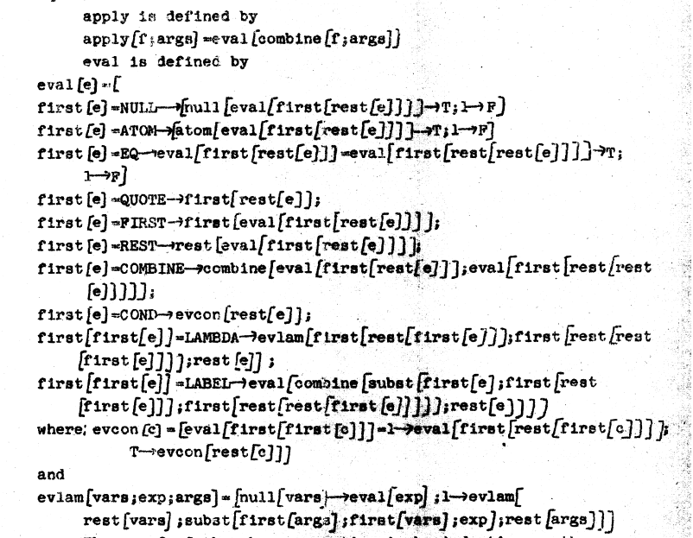
Notes:
<SHOW OLD EVAL>
- The fuck is that?
- sure its got lots of braces
- expound on oddness.
- designed to look like fortran
- explain M-Expressions mention S-Expressions
- even S expressions had commas
- despite that it isnt as recognisable as a lisp now there is one awesome thing about this slide
- This is lisp written in lisp
- 7 fundamental operations 3 of which we have seen already
- maxwell
- more elegant that turing machines
- referential transparency was a stated goal
- garbage collection - designed
- note that writing a language was not the norm, designing and proving a language
- much more academic, made sense as the didnt have a computer yet
- after the paper was released S.R Russell noticed eval was interperator
- Eval got made...this had a massive effect on this language as suddenly trivial choices are in stone
- The language was real...hadnt expected that
- Eval worked on S-Expressions

Slide 12
"The project of defining M-expressions precisely and compiling them or at least translating them into S-expressions was neither finalized nor explicitly abandoned. It just receded into the indefinite future, and a new generation of programmers appeared who preferred internal notation to any FORTRAN-like or ALGOL-like notation that could be devised."
Notes:
- Also a machine readable M-notation would have required redefinition, because used characters not on the IBM 026 key punch.

Slide 13
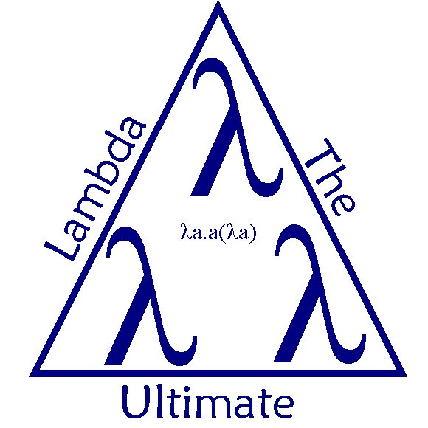
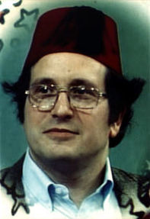
Notes:
- Lisp proliferated
- simple & powerful core
- so easy to implement
- McCarthy explicitly tried not to 'be the boss'
- Many dialects appear
- Most important was scheme
- Gerald Sussman, Guy Steele
- 'lambda the ultimate' papers
- understand actor model, made tiny lisp on MacLisp
- implemented actor model
- removed redundent stuff
- discovered this very clean lisp
- first lisp with lexical scoping

Slide 14
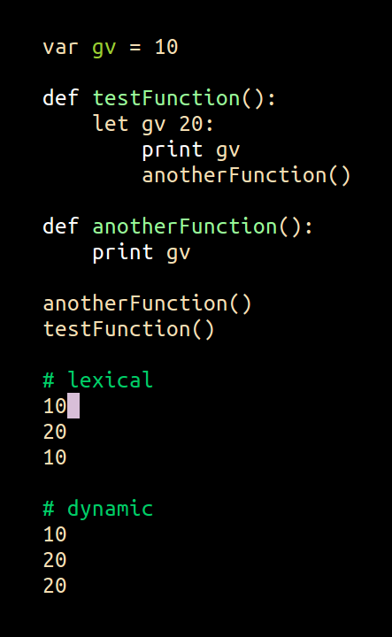
Notes:
- Dynamic scoping
- show code
- can choose perl & common lisp
- bash is dynamic
- easy to implement, horrifying to reason about

Slide 15

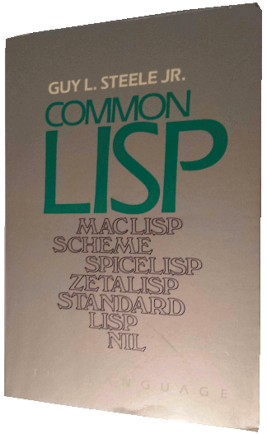
1970
Notes:
- 1970 crazy rate of change
- All of this change great for researchers
- ARPA wanted to connect up programs from it's funded research
- Leaning towards interlisp until maclisp folks pushed
- 1982/3 - interested parties started the design process
- 1984 - Guy Steel releases CLTL
- CLTL was written in a non-confrontational
- A meeting was needed

Slide 16
Notes:
Monterey
- In the time since the CLTL book came out it had kind of worked
- It had become a sort of defacto standard
- The users had turned up!
- Guy Steele turned up with a couple of pages of 'obvious' issues to fix
- Nothing is obvious
- No clear voting rules
- A mid all the crazy it felt like maybe using existing rules would make sense
- Time to talk to ANSI

Slide 17

Notes:
- I guess they hoped ansi would simplify things
- but first thing folks from standards board said was that
the primary business was to “not be sued,”
and that their secondary business, was to make standards.
- Depressing for academic endevour
- dealing with posturing between companies and commitees
- Work divided up and began
- I have so skip A LOT of things here as the level of back and forth was crazy
- remember it started in 1983? I wasnt finished until over a decade later!
- in the meantime the industry was changing

Slide 18

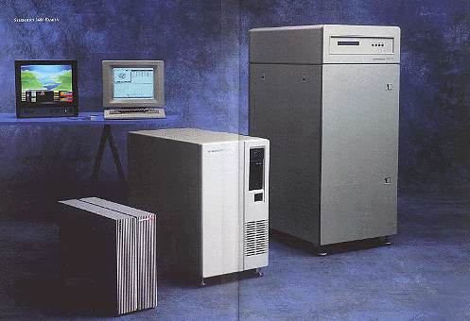
AI Winter is coming
"It is not my aim to surprise or shock you – but the simplest way I can summarize is to say that there are now in the world machines that think, that learn and that create. Moreover, their ability to do these things is going to increase rapidly until – in a visible future – the range of problems they can handle will be coextensive with the range to which the human mind has been applied. "
Notes:
AI Winter
- Since the late 50s AI had been a hot topic
- was getting lots of investment
- VERY over abitious
<QUOTE>
- In the mean time the LispMachine had been made
- Could be a talk in themselves, system level GC, type tagged memory, lisp all the way down
- AI research group at MIT started comercial operation, Lisp Machines INC
- massive interal differences caused split and only two of the team remained at the AI lab
- Stallman suplicates all the code from symbolics to stop it getting upper hand
- Eventually programmers would have to sign NDAs
- This sparked the Free Software movement
- The number of failure in the eyes of investors, the rise of the microcomputer, the arival of C & C++
All fed in to the burst of the bubble.

Slide 19
1994 – Standard Finalized
11 years
$425000
Shame as the process was a success
Unified
Strong Standard
Powerful Language
Notes:
- The common-lisp spec wasnt actually printed until 1994/5
- decade
- $425,000
- industry coming appart around it
- which is a shame as the project was actually a success
- many versions unified
- a strong standard
- A powerful language that was already being used in a good number of systems

Slide 20
What exists today?
Implementations Running On:
x86, amd64, ARM, PPC, etc...
For the OS
Linux, Windows, OSX, BSD(various), Solaris
Compiling to
Assembly, C, JVM
Notes:
What did we get?
- <slide>
- Fast
- small but decent community – better than past
- Bit of a resurgence
- quicklisp
- transactional memory
- functional, persistent data structures
- for frp folks maybe check out cells
- the bad
-inconsistant
-mid ground between extensible and low level – sequences for example

Slide 21


Slide 22
The Language
Notes:
Gonna go through this fast, shout if I go too fast
Only covering what we need to use macros

Slide 23
A Little Terminology
Object – Any lisp datum
Form – Any object meant to be evaluated
Evaluation – Forms are executed, returning zero or more values
Notes:
A little Terminology
work from slide

Slide 24
Evaluation Model
Lists
Symbols
Everything Else :)
Notes:
to know what a language will do we need to understand the evaluation model
list, symbols, everything else

Slide 25
Self Evaluating Objects
Evaluate it and they return the same object
1 → 1 ;; Integers
1/2 → 1/2 ;; Rationals
“jeff” → “jeff” ;; Strings
#(1 2 3 4) → #(1 2 3 4) ;; Array Literal
Notes:
- self evaluating objects
- number, string, array literals

Slide 26
Symbols
An object used for naming things
Not a pointer
The value of the variable named by the symbol is returned
pi → 3.141592653589793
a → The variable A is unbound.
[Condition of type UNBOUND-VARIABLE]
Not Case Sensitive
Notes:
- symbols
- a symbol is an object used for naming things
- explain in terms of normal languages, beginners etc
- use slide

Slide 27
Symbols 2
Two special symbols
t - True
nil – False (also the empty list)
Keywords – All evaluate to themselves
:a → :a
:odd-syntax → :odd-syntax
Packages – Kinda like namespaces but only for symbols
common-lisp:pi → 3.141592653589793
Notes:
- two special symbols
- t & nil
- keywords
- packages

Slide 28
Lists
Chain of cons-cells
  (1 cat “video”)
First element of the the list must be a symbol naming a function
Evaluate the rest of the list 1 by 1 and pass results to function
(sqrt 81) → 9.0
(sqrt (* 9 9)) → 9.0
Notes:
- lists
- very syntactically simple
- two parens
- stuff (elements) seperated by whitespace
- so whats the evaluation rule?
- first thing in list mustt be a symbol naming a function
eval the arguments left to right and call the function with the results as arguments
- (sqrt 81)
- (sqrt (* 9 9))
- <IN EMACS> (print "hi")
- talk about side effects
- everything is expression
{TODO} ADDRESS SYNTAX ISSUE - editor

Slide 29
Dat syntax though...
(
Subsec 1 2 3)
, ,
Notes:
Behold the madness!
Easier to stomach syntax change once you see what it gives you
But by then you dont care
This is how we see parens
You feel them not see them

Slide 30
The End
Notes:
- Thats it! You know evalutation
- Not actually much of a lie

Slide 31
Special Forms
Don't obey the normal rule of evaluation
Normally related to flow control or scope
if let let* labels quote function progn
2 have syntax sugar
Notes:
- Special forms
- control flow or modify environment
- if, variable & function binding, error handling
- 25 defined by the spec
- 7 used regularly
- 2 of those have syntactic sugar

Slide 32
Quote
(quote pi) →
PI
(typeof (quote pi)) → SYMBOL
(quote (+ 1 2 3)) → (+ 1 2 3)
(type-of (quote (+ 1 2 3))) → CONS
(type-of (first (quote (+ 1 2 3)))) → SYMBOL
(first (quote (+ 1 2 3))) → +
Notes:
- quote is our first special form
<SLIDE>
- quote returns the code unevaluated
- code is data

Slide 33
Quote Sugar
(quote a) == 'a
(quote (1 2 3)) == '(1 2 3)
(eval '(+ 1 2 3)) → 6
Notes:
- quote syntactic sugar '
- syntax makes code clearer
- 'a '(+ 1 2 3)
- of course if we (eval '(+ 1 2 3)) etc etc

Slide 34
Function
(function sqrt) → #<FUNCTION SQRT>
Returns the function named by the symbol
Common lisp has multiple namespaces
Feels ugly at first
(function sqrt) == #'sqrt
(sqrt 89) → 9.0
(funcall #'sqrt 89) → 9.0
Notes:
Returns the function object that is named by the symbol
- function called funcall
- like with quote this would be ugly so we have #'
- why a different quote? Namespaces.

Slide 35
if
(if (the-russians-are-invading?)
(fire-ze-missiles)
(have-a-sleep))
Notes:
- clearly cant use normal model
- again we see everything is an expression

Slide 36
let & let*
Let is how we make local variables
(let ((legs 8)
(eyes (random 20)))
(make-spider legs eyes))
(let* ((legs 8)
(shoes legs))
(make-weird-spider legs shoes))
Notes:
- list of binding forms
- symbols in the binding-forms are bound to the result of evaluating their respective expression

Slide 37
labels
Like let for functions
(labels ((three-of-these (x) (list x x x)))
(three-of-these 'crushing-defeat))
↓
(CRUSHING-DEFEAT CRUSHING-DEFEAT CRUSHING-DEFEAT)
Notes:
- define local functions
- let for functions

Slide 38
progn
Makes iterative programming possible
Why have this in a functional talk?
(progn
(print (+ 1 2))
(* 10 20))
Notes:
- Evaluates the expressions in order and returns the value of the last
- allows imperative programming.
- haskell, clojure -do scala for (kinda) f# ?
- Only useful if using side effects.
- progn is implicit
- almost never write progn
Check people are ok

Slide 39
Ways to make functions
defun
lambda
(defun pwr2 (x)
(expt 2 x))
(lambda (x) (expt 2 x))
Notes:
- Cant be functional without functions
- well of course we have lambda
- (lambda (x) (expt 2 x))
- result is same style as #'print
- defun
- (defun pwr2 (x)
(expt 2 x))
- (pwr2 8)
- #'pwr2
- pwr2 will give error
CAN DO ALL THE GOOD STUFF MAPPING
REDUCING HIGHER ORDER EVERYWHERE

Slide 40
Function Arguments
(defun test (a &optional b (c 1))
(list a b c))
(test 1 2 3) → (1 2 3)
(test 1) → (1 nil 1)
(defun test (a &key b c)
(list a b c))
(test 1 :b 2 :c 3) → (1 2 3)
(test 1) → (1 nil nil)
(defun test (a &rest b)
(list a b))
(test 1 2 3) → (1 (2 3))
(test 1) → (1 nil)
Notes:
- while the pure syntax is good often optional or named arguments are wanted
- the argument lists have special syntax for that
- (defun test (a &optional b (c 1))
(list a b c))
- (test 1 2 3) -> (1 2 3)
- (test 1) -> (1 nil 1)
- (defun test (a &key b c)
(list a b c))
- (test 1 :b 2 :c 3) -> (1 2 3)
- (test 1) -> (1 nil nil)
- (defun test (a &rest b)
(list a b))
- (test 1 2 3) -> (1 (2 3))
- (test 1) -> (1 nil)

Slide 41
Generic Functions
Functions where we can specialize on the type of the arguments
Multiple Dispatch
Dumb name
(defmethod test ((x string))
(print "x is a string"))
(defmethod test ((x float))
(print "x is a float")
Notes:
Generic functions
- Common lisp also has generic functions
- no more visitor pattern
- these let us specialise of type of the arguments
- (defmethod test ((x string))
(print "x is a string"))
(defmethod test ((x float))
(print "x is a float"))
Haskell via Multi-parameter type classes[14]
Scala[citation needed], also via multi-parameter type classes
Clojure
- multiple dispatch
- just want to mention the object system in CL

Slide 42
Too much stuff?
Let's make some lists
Backquote
(defvar x 'some-symbol)
(defvar y '(1 2 3))
`(1 "test" b ,x 2 ,@y)
↓
(1 "test" B SOME-SYMBOL 2 1 2 3)
Notes:
<IN EMACS>
> (list 1 2 3)
> '(1 2 3)
> (defvar a :hi)
> a
> (list 1 2 a)
> '(1 2 a)
> `(1 2 ,a)
(defvar x 'some-symbol)
(defvar y '(1 2 3))
`(1 "test" b ,x 2 ,@y)

Slide 43
MACROS
(at last)
Notes:
Warn context is a bugger when you have spent 20 minutes looking at a language

Slide 44
Macros have a bad name
Notes:
- Macros have a terrible name, it's used for too many things
- due to c-macros they are associated with very unsafe coding
-- So what are macros? <NEXT SLIDE>

Slide 45
Macros are Functions
That's it
Notes:
- Macros are functions
- this is a boring answer but it's true..they are just functions
- what matters is WHEN these functions are called.
- That requires knowing roughly how things are compiled

Slide 46
(defun group (source n)
(assert (and (> n 0)
(= (mod (length source) n) 0)))
(labels ((helper (data)
(if data
(cons (subseq data 0 n)
(helper (subseq data n))))))
(helper source)))
Notes:
We write our code as a data struct
Pretend not text
Editors help
<MAYBE SHOW IN EMACS>
But obviously it is text
- Good check for yourself, when your language asks you to do something. Ask whether it lets you benefit from it
So lets think about compilation

Slide 47
Read time
↓
Transform AST
↓
Compile Time
↓
Runtime
Notes:
Very roughly speaking
Explain each step
Macros allow us to hook onto these stages

Slide 48
Read time - reader-macros
↓
Transform AST - macros
↓
Compile Time - compiler-macros
↓
Runtime
Notes:
A macro type for each stage
Transform ast known as macroexpansion time

Slide 49
Example Macro
Here is the case expression
(case (random-elt '(a b c))
(a "is 0")
(b "is 1")
(c "is 2"))
What is this really?
(let ((tmp (random-elt '(a b c))))
(if (eql tmp 'a)
"is 0"
(if (eql tmp 'b)
"is 1"
(if (eql tmp 'c)
"is 2"
nil))))

Slide 50
Let's write a dumb macro
Notes:
<Go to emacs> file m1.lisp
To get a feel for how this works lets look at a really dumb macro
- never do this!
- (defmacro dumb-add-1 (x)
`(+ ,x 1))
- ok so this is a terrible use of a macro but
- here it is used in the repl
- here is the expansion
- Notice how backquote makes result look like the code
- explain why this sucks

Slide 51
Something a little more useful
(defun test (n &optional (start 0))
(when (< start n)
(cons start (test n (+ start 1)))))
(test 10) → (0 1 2 3 4 5 6 7 8 9)
What if we wanted to write this as a lambda?
Notes:
- Lets look at a better example
- One thing we do in functional languages is to generally prefer recursion
- For example this function lists numbers 0 to n (Yeah this is a silly example)
- (defun test (n &optional (start 0))
(when (< start n)
(cons start (test n (+ start 1)))))
- but if we made a lambda we couldnt make it recursive
- cant call something with no name

Slide 52
Recursive Lambda v1
(lambda (n &optional (start 0))
(labels ((this (n start)
(when (< start n)
(cons start (this n (+ start 1))))))
(this n start)))
Notes:
Do it like this
- we have a local function with a name an use that for the recursion
- bit rubbish
- what should it look like? <CHANGE SLIDE>

Slide 53
Possible syntax
(rlambda (n &optional (start 0))
(when (< start n)
(cons start (this n (+ start 1)))))
(defun test (n &optional (start 0))
(when (< start n)
(cons start (test n (+ start 1)))))
Notes:
Well exactly like the named function version

Slide 54
Let's make the rlambda macro
Notes:
File m2.lisp
What are the implications? Funcs with long names?

Slide 55
User Extensible Pattern
C# IDisposable
using
using (Font font1 = new Font("Arial", 10.0f))
{
byte charset = font1.GdiCharSet;
}
Notes:
Another Macro - c# using
- picking on c# :)
- explain standard use
- c# programmers know how to write it
- but cant abstract the pattern
<Show example>
(defmacro using ((var-name var-form) &body body)
`(let ((,var-name ,var-form))
(unwind-protect
(progn ,@body)
(dispose ,var-name))))
File m3.lisp

Slide 56
When shouldn't we use macros?
Notes:
- not normally used for optimization
- <explain>
- In cases where we can optimize a function we should instead use compiler macros

Slide 57
Compiler Macros
Can have the same name as function
Compiler doesn't have to use them
(defun dumb-add-2 (x)
(+ x 2))
(define-compiler-macro dumb-add-2 (x)
(if (numberp x)
(+ x 2)
`(+ ,x 2)))
Trust the compiler
PROFILE ALL THE THINGS
Notes:
- can have same name as function
- are optionally expanded
- How does this compare?
- probably best macro
- ONLY good with profiling
M4.lisp

Slide 58
Reader Macros
A means of extending the reader
You define a character pattern that triggers your macro
You get the stream to the file being read
More complicated as your code isn't data yet.
Notes:
- And now the beautiful monster that is reader-macros
- reader macros are sweet
- expanded at read time
- work on your code when it is still text
- define character pattern that when hit will give control
to your function
- passed stream

Slide 59
Reader Macro Example
Common Lisp does not have syntax for hash-table primitives
Let's add this
Notes:
M5,lisp
(defun ht-reader (stream subchar arg)
(declare (ignore subchar arg))
(let* ((elements (read stream t nil t))
(pairs (group elements 2)))
`(gen-hash-table ',pairs)))
(defmethod print-object ((object hash-table) stream)
(let ((key-val-pairs (apply #'append (map-hash #'list object))))
(format stream "#H~s" key-val-pairs)))
After expample
- hashtables are now fundamental
- allows use to package up and ship syntax
- nothing weird or incompatible..just lisp code
- Extreme example – swap out readtable
For Example how about ebnf -> parser?
Config files..ugly syntax, parsed at runtime

Slide 60
Real World Macro Examples

Slide 61
Regular Expressions
PERL
CL-PPCRE
(cl-ppcre:all-matches-as-strings
"../../...." "The date is 12/03/1987")
↓
("12/03/1987")

Slide 62
String Formatting
You can probably guess what happens here :)
(format nil "some things ~{~a~^, ~}"
'(1 2 3))
↓
"some things 1, 2, 3"

Slide 63
Pattern Matching (optima)
Pattern Matching is a DSL
(defun js2ps (txt)
(labels
((r (x)
(match x
(`(:toplevel ,stms) `(progn ,@(mapcar #'r stms)))
(`(:stat ,s) `(progn ,(r s)))
(`(:assign :+ ,left ,right) `(incf ,(r left) ,(r right)))
(`(:call ,func ,args) `(,(r func) ,@(mapcar #'r args)))
(`(:name ,name) (js2ps-name name))
(`(:num ,n) n)
(`(:sub ,array ,index) `(aref ,(r array) ,(r index)))
(eck (error "TBD ~S" eck)))))
(r (parse-js txt))))
(js2ps "a[3] += f(x,y)")
↓
(progn (progn (incf (aref a 3) (f x y))))

Slide 64
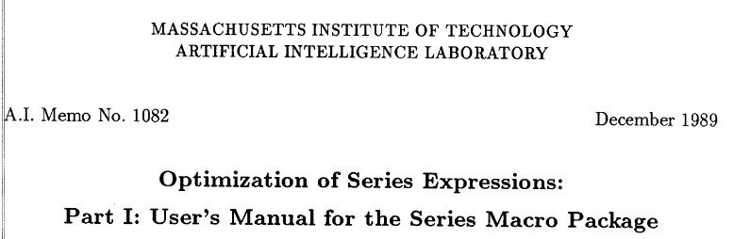
Series

Slide 65
Promises
Asynchronous Let
(alet ((x (promise-gen (lambda () 5) :delay .2))
(y (promise-gen (lambda () 2) :delay .2)))
(print (+ x y)))

Slide 66
Realtime Graphics
(defstruct-g pos-col ()
(position :vec3)
(color :vec4))
(defun-g vert ((vert pos-col))
(values (v! (position vert) 1.0)
(:smooth (color vert))))
(defun-g frag ((col :vec4))
col)
(defpipeline prog-1 ()
(g-> vert frag))
(defun step-demo ()
(gl:clear :color-buffer-bit)
(map-g #'prog-1 *stream*)
(update-display))

Slide 67
Similar concepts in other languages

Slide 68
Clojure
Macros
Non extensible reader macros
No compiler macros
(let [mystr "hello"]
(case mystr
"" 0
"hello" (count mystr)))
(a b c)
[1 2 3]
{:a 1 :b 2}
#{:a :b :c}

Slide 69
Haskell
Nothing extensible but cool to see where a pure language chooses less purity
do putStrLn "one"
putStrLn "two"
→
putStrLn "one" >>
putStrLn "two"
[1,2,3]
→
1:2:3:[]
→
(:) 1 ((:) 2 ((:) 3 []))
"abc"
→
→
→
['a','b','c']
'a':'b':'c':[]
(:) 'a' ((:) 'b' ((:) 'c' []))
Less cases where macros are necessary
Notes:
Syntactic herioin
Cons page is awesome
Pros page is empty

Slide 70
Rust
AST Transforming Macros
macro_rules! vec {
( $( $x:expr ),* ) => {
{
let mut temp_vec = Vec::new();
$(
temp_vec.push($x);
)*
temp_vec
}
};
}

Slide 71
Scala
Scala.Meta
Handles types so one to keep an eye on
Fairly Clean syntax
object Asserts {
def raise(msg: Any) = throw new AssertionError(msg)
def assertImpl(c: Context)
(cond: c.Expr[Boolean], msg: c.Expr[Any]) : c.Expr[Unit] =
if (assertionsEnabled)
<[ if (!cond) raise(msg) ]>
else
<[ () ]>
}

Slide 72
So What Are Macros ?
Notes:
- Macros are compilers
- Macros allow us to do to syntax what we do with functionality
- apis are languages
- We make things better with programming..programs too!
- Personalize.
- Programming is fun, doesnt always need to scale
- Macros are a what if tool

Slide 73
Thankyou for listening

