Slide 1
Dice group
Knowledge graph fusion
Advisor : Dr. Rer. Nat. Mohamed Sherif
Notes:
Hello Everyone. My name is Chaitali Bagwe and today me and my colleagues are going to present to you our project, Knowledge Graph Fusion. The advisor for our project is Dr. Mohamed Sherif.

Slide 2

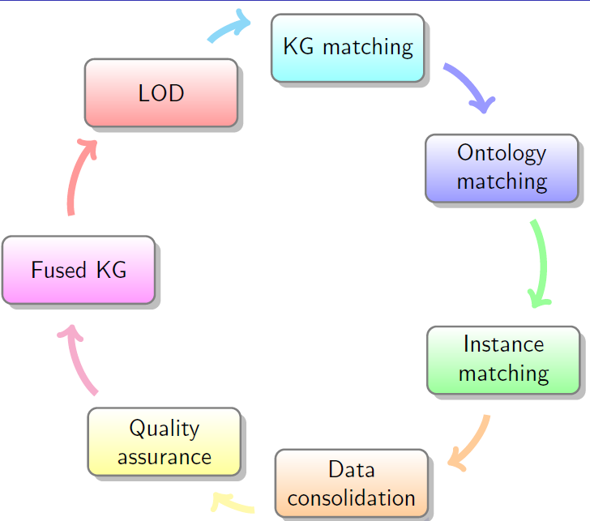

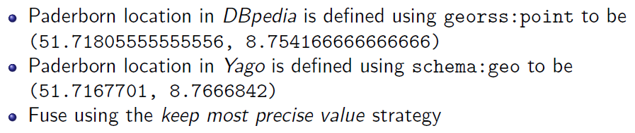
What is KG Fusion?
Notes:
So, what is Knowledge Graph Fusion? Well, its simply fusing of Knowledge graphs. But how to do it? First, we must find knowledge graphs which are closely related to each other. This is done in our KG matching phase. For, example let the two KGs be dbpedia and yago. After finding out the matching KGs, the problem of classes having different labels, structure and ontologies exist. As shown here, the ontology Town and the resource City are same but differently named. This problem is solved by our next phase of Ontology Matching. The third phase i.e. Instance matching applies link discovery techniques to further solve this problem with the KG instances. In the data consolidation phase, automatic fusion strategies are employed to fuse KGs.

Slide 3
Overview
KG Matching
Ontology Matching
Instance Matching
Data Consolidation
Summary
Notes:
Each phase of our project is divided among us. Today, we will go through the first four phases and then conclude this presentation with a quick summary.

Slide 4
Overview
KG Matching
CHAITALI SUHAS BAGWE, RAVITEJA KANAGARLA
Ontology Matching
Instance Matching
Data Consolidation
Summary
Notes:
Starting with KG Matching phase. Me and my colleague Raviteja Kanagarla worked on this phase.

Slide 5
Goals
Find out the similar Knowledge Bases
Using LIMES for Linked Open Data Metadata for link matching
Using various document matching techniques for datasets in Hobbit
Create a KG Matching operator using DEER
Give output to the next group i.e., Ontology Matching
Notes:
As stated earlier, the main goal of our phase is to find out similar Knowledge Bases. This was done using LIMES Framework and various document matching techniques. We successfully created an operator in Deer Framework which matched the KGs. The output from the operator was forwarded to the next group of Ontology Matching.

Slide 6
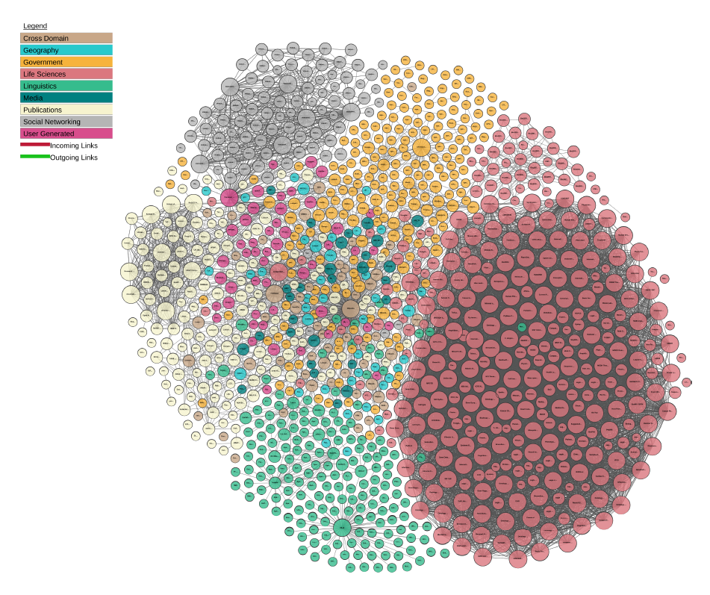
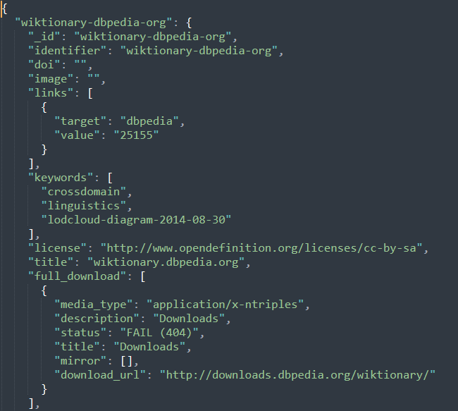
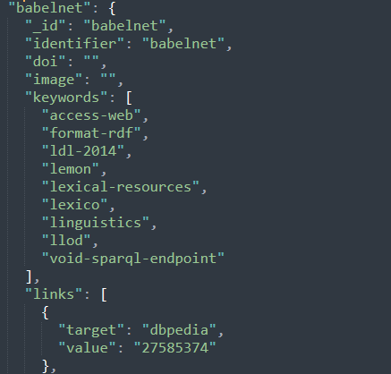
Steps to match KGs using LIMES
Collect the metadata from Linked Open Data
Identify the metadata to be used for KG matching
Notes:
To match Knowledge Graphs using Limes Framework, we first collected the metadata of various Knowledge Graphs from Linked Open Data or LOD Cloud. LOD Cloud is a linked data structure which is under open license. We then analysed and identified the metadata ta to be used for KG Matching. In the two pictures below, we have two datasets Wiktionary and babelnet. With their metadata. Like links, keywords, identifier,etc. One of the parameter that we used for KG matching is this keywords parameter and the other one being Domain. Here we see that the keyword linguistic is present in the metadata of both the dataset.

Slide 7

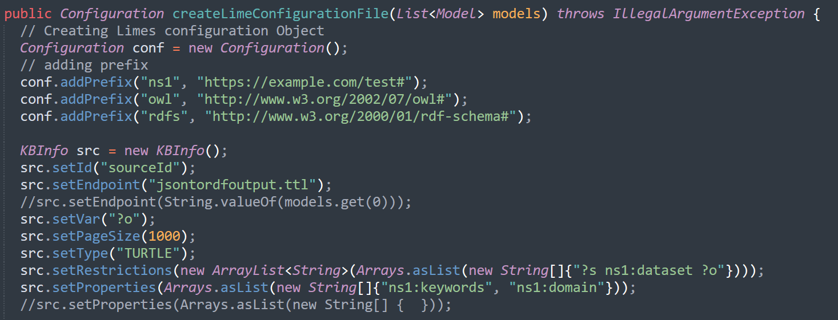
Steps to match KGs using LIMES
Create a DEER Operator
Pass the collected metadata to LIMES framework via DEER Operator
Store the matched KGs in a RDF model
Notes:
Next we analysed the working of LIMES framework and Created a Deer Operator. In order to match KGs using LIMES, we needed to create a configuration in our DEER operated to sent to LIMES framework . The created configuration passed the metadata parameter to be used for matching to the LIMES framework. Here, we have use keywords and domain metadata parameters to find similar KGs in source and target data. The matched KGs from the LIMES framework are stored in an RDF model and forwarded to next group.

Slide 8
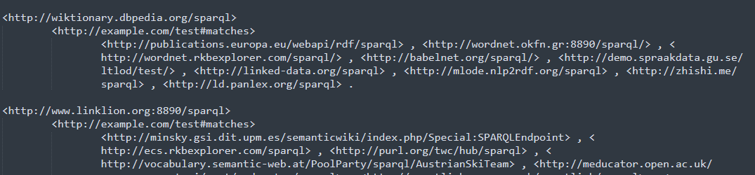
Limes Output
Notes:
Here, we see the dataset wikitionary.dbpedia matched with several other datasets from LOD cloud. We can see that the babelnet dataset is also included in this list.

Slide 9

Steps to match KGs using Document Similarity
Pre-processing hobbit datasets
Find and split all literals in the dataset into 1-gram token
Remove all stopwords, spaces, numbers and special characters
Count the frequency of each token
Sort the tokens according to their frequency and store them in a list
Apply Document Similarities
Matching each datasets against all datasets present
Creating RDF model to store the matched similarities
Notes:
Now how to find matched KGs from datasets in Hobbit platform. For this we first preprocessed all the datasets. This included splitting the literals into 1-gram token, removing stopwords, spaces, number, etc. Counting the frequency of each token and storing them in a list in the sorted manner.
Next, we applied Document Similarity algorithms on each of these datasets against all the other datasets present. An RDF Model was created to store the matched similarities and forwarded to the next group i.e. Ontology matching.

Slide 10
Document Similarities Algorithms
Jaccard Similarity
Weighted Jaccard Similarity
Dice Similarity
TF-IDF with Cosine Similarity
Bert Similarity
Notes:
We made use of several document similarities algorithms such as Jaccard Similarity, cosine similarity, bert, dice

Slide 11
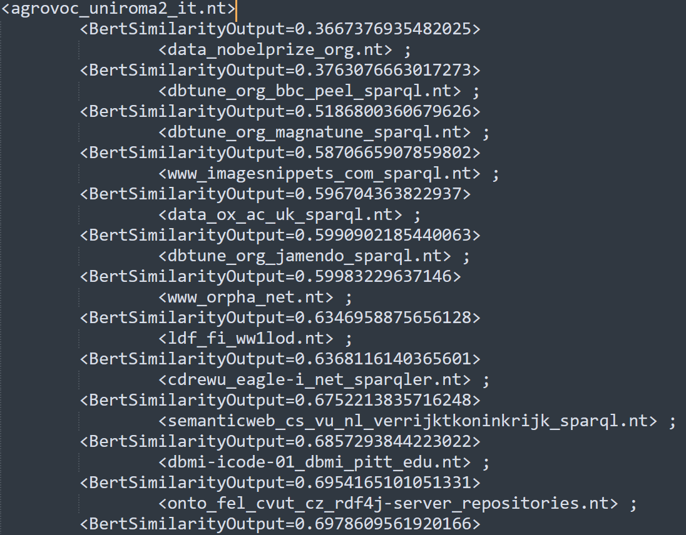
Output – Bert Similarity
Notes:
Here, we see output of Bert Similarity. The KG agrovoc_uniroma is the source KG and it is matched with dbmi-icode with a bert similarity value of 0.685.

Slide 12


Benchmarking
Dataset Pairs | A1 | A2 | A3 | A4 | A5 | Mutual Agreement
(dbtune_org_jamendo, data_nobel)
(dbtune_org_jamendo, data_ox_ac)
(cdrewu_eagle, imagesnippets)
(cdrewu_eagle, dbtune_org_magna)
A1, A5 – Software Engineers
A2 – Mechanical Engineer
A3 – Civil Engineer
A4 – Electrical Engineer
Notes:
Since we don’t have the gold standard for the datasets in hobbit. So, we have asked a group of annotators from various backgrounds to check the datasets are getting matched or not. Assume in the first case dbtune_org_jamendo and Data nobel are matched. There is an opinion disagreement with Anotator 4. In this way, we came to mutual agreement of all the datasets that we took from hobbit.

Slide 13
Benchmarking
Algorithms | Precision Score | Recall Score | F1 Score
Tf-idf with Cosine Similarity | 0.94 | 0.85 | 0.892
Jaccard Similarity | 0.94 | 0.80 | 0.863
Weighted Jaccard Similarity | 0.97 | 0.87 | 0.884
Dice Similarity | 0.97 | 0.69 | 0.804
Bert Similarity | 0.97 | 0.80 | 0.874
LIMES Framework | 100 | 0.73 | 0.843
Notes:
These are the respective Precision, Recall and F1 scores of all the approaches with respect to gold standard

Slide 14
Future works
More Document Similarities can be added
Trying the approaches on bigger datasets ( > 1GB)
Using dedicated Knowledge Graph matching approach like Tapioca
Notes:
More work can be done in this phase in future. Firstly, more document similarity can be added other than the one previously used. Currently we are not able to run our approaches on bigger datasets locally. If a machine with large space is provided, one can try these approaches on bigger datasets. Finally, dedicated Knowledge graph matching approaches can be used, like Tapioca.

Slide 15
Overview
KG Matching
Ontology Matching
SOWMYA KAMARTH RAMESH, KRISHNA MADHAV
Instance Matching
Data Consolidation
Summary
Notes:
Thank you. That’s it from my side. Now my colleagues will take over to explain other phases.

Slide 16
Goals
Integrating with DEER framework
Implementation of another matching system (FCA)
Benchmarking our Operator
Technologies
JAVA
DEER
Notes:
The goals we had set for the project was to run our ontology operator with DEER frame work which was not implemented before. We have implemented another matching operator called FCA, which is based on Formal Concept analysis. And finally, to benchmark our operator.
Since our project is in Java ,Technologies used are Java and Deer as ETL tool.

Slide 17
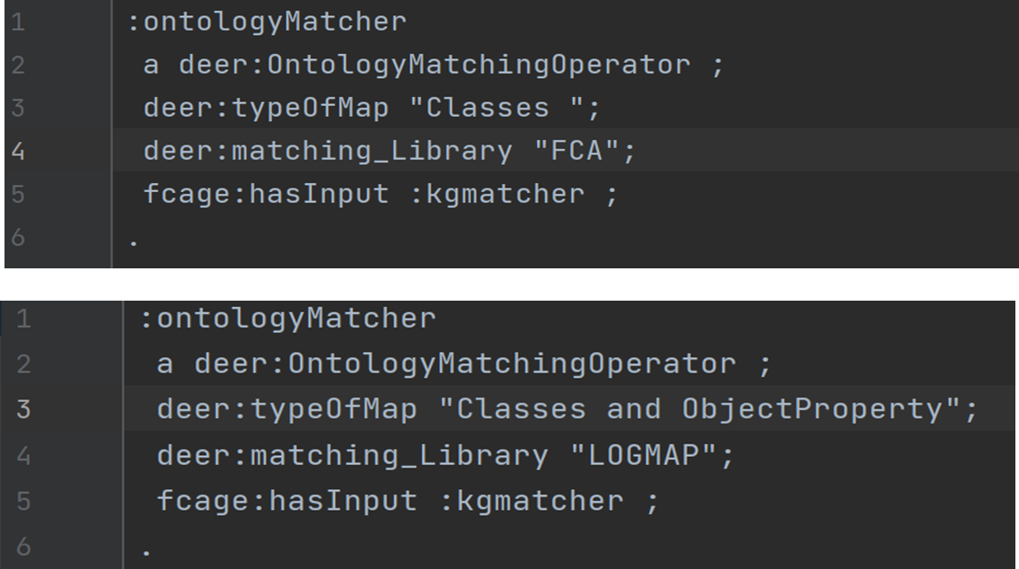
Configuration File
Notes:
This is the snippet of our operator’s configuration file. We have added 2 parameters, one to specify which type of mapping user can retrieve for example classes or objectproperty or combination of these types. Another parameter, to spectify which matcher user wants to use whether LOGMAP matcher or FCA matcher.

Slide 18


Overview of our Operator
Source
dataset
LogMap or FCA
Matcher
Output
RDF dataset
Target
dataset
Notes:
So to give an overview of our Ontology operator, once we recieve datasets from KGmatching group for ontology matching, we send these matched KG pairs to our ontology matcher either LogMap or FCA, as source and target datasets. And the output i.e the matched ontologies, from either of the matcher is passed on to the next group instance matchiing.

Slide 19
Ontology Matching Operator
Dynamically fetching RDF datasets
Accessing SPARQL endpoints
Storing Ontologies in local file
Generating Matched Mappings
Reificated Output
Notes:
Thanks Sowmya.
I am Krishna Madhav and will be giving a detailed working of our operator.
This operator dynamically fetches dataset from KG Matching Team.
These dataset consist of triples in which subject and object are SPARQL endpoints.
These SPARQL endpoints are used to fetch ontologies and these ontologies are stored in our local file.
These ontologies are send in an iterative manner to one of our operator i.e Logmap or FCA.
They generate matched mappings for a given pair of ontologies For eg. In LogMap we fetch over Estimation of Mappings which comprises of different values of confidence like confidence 1 as anchor mapping, Discarded as 0.6 and hard Discarded as 0.4.
These mappings are used for creating a reificated model .
This model is sent to next team Instance matching.

Slide 20
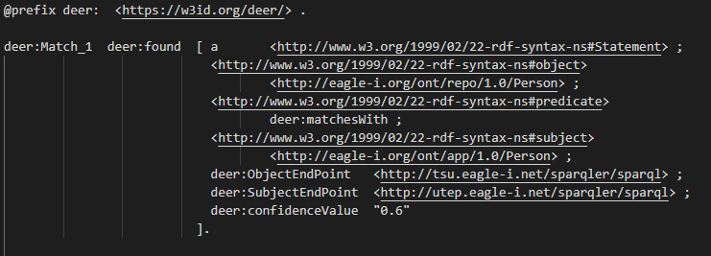
Output
Notes:
Moving on to our Output file
As we can see that the output file states matched ontologies corresponding to a subject and object endpoint . We are matching the URL 1…. And URL 2…
They also give confidence value for the matched ontologies.

Slide 21
Benchmarking
Dataset Pairs | A1 | A2 | A3 | Mutual Agreement
NCI_overlapping_fma.owl, FMA_overlapping_nci.owl
SNOMED_overlapping_fma.owl, FMA_overlapping_snomed.owl
Conference.owl, Ekaw.owl
A1, A2 – Software Engineers
A3 – Mechanical Engineer
Notes:
Moving onto Benchmarking For benchmarking we have used 3 datasets and 3 different Annotators to get a gold standard. Here, we have used similar approach as KG Matching group.

Slide 22
Benchmarking
Dataset Pairs | Matcher | Precision | Recall | F1
NCI_overlapping_fma.owl, FMA_overlapping_nci.owl | LogMap Matcher | 0.94 | 0.92 | 0.93
 | FCA Matcher | 0.91 | 0.93 | 0.92
SNOMED_overlapping_fma.owl, FMA_overlapping_snomed.owl | LogMap Matcher | 0.92 | 0.91 | 0.91
 | FCA Matcher | 0.93 | 0.86 | 0.89
Conference.owl, Ekaw.owl | LogMap Matcher | 0.94 | 0.87 | 0.90
 | FCA Matcher | 0.92 | 0.87 | 0.89
Notes:
This slide presents the Precision, Recall and F-Measure based on the Gold Standard for the respective Matcher LogMap and FCA.

Slide 23
Future Work
Improving timeout for SPARQL query execution
Working with dataset having triples pointing to invalid OWL files
Handling bigger dataset
Notes:
We are currently using QueryExecutionFactory for querying the SPARQL endpoints.
This could be improved with different method which could handle this.
There are certain datasets where triples point to invalid IRIs which in gives Null error.
This can be handled better with different approach using different approach in OWL Apis and further be improvised.
It can be improved to Handle bigger datasets

Slide 24
Overview
KG Matching
Ontology Matching
Instance Matching
KHALID KHAN, KHALID BIN HUDA
Data Consolidation
Summary

Slide 25
GOAL
Implement a technique for Instance Matching
Creating a DEER Operator
Technologies
JAVA
DEER
LIMES
Notes:
The Goal was to implement a technique for Instance Matching.
What is Instance Matching. • The degree of similarity of different pair of different Knowledge bases to determine whether they present same real-world entity in given domain[1]. • For example, we have to compare the similarities between the instances of two classes.
-------------------------------------------------------------
We use Java as Programming Language.
Now what is DEER? DEER is an RDF Dataset Enrichment Framework, which is an RDF-native ETL tool implemented on top of FARADAY-CAGE.
What is LIMES? LIMES is a link discovery framework (for the Web of Data). It has various approaches for large-scale link discovery. It also has state of-the-art machine learning algorithms for link specifications
Notes:
FARADAY-CAGE is the Framework for Acyclic Directed Graphs Yielding Parallel Computations of Great Efficiency.
LIMES Various approaches: Jaccard, cosie, qgram, etc

Slide 26
Instance Matching Operator
Named: InstanceMatchingOperator
Highlights:
Creating prefixes dynamically
Calculate coverage of the properties
Dynamically creating LIMES configuration
Use Wombat simple algorithm
Introducing Type-driven wombat simple
Notes:
We have created a deer plugin InstanceMatchingOperator, which takes input from Ontology operator and forwards output to Consolidation Operator.
Some of the main highlight of this operator is that it creates prefixes dynamically according to the datasets(url, datafiles). Calculate coverage of the properties present in the datasets. And Creating configuration object to Limes and getting the mappings of the result.
It uses WOMBAT Simple, which is an unsupervised matching learning technique.

Slide 27
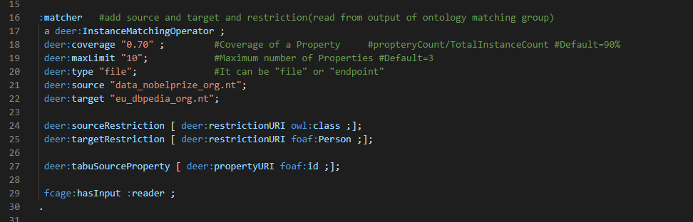
Configuration File
Notes:
Here is a quick screenshot of the configuration file. We can see the coverage value or maxLimit for number of properties the type of dataset and restrictions etc. Also, we can see the tabu properties which are those properties which we don’t want to use in the matching process.

Slide 28
Example
Data File source: dbmi-icode-01_dbmi_pitt_edu.nt
Data File target: agrovoc_uniroma2_it.nt
Source Restrictions: "?s rdf:type owl:Class"
Target Restrictions: "?t rdf:type skos:Concept"
Properties matched:
Properties matched:
puob156:IAO_0000115
gefor191:hasOBONamespace
gefor335:id
w3200488:label
w3200541:prefLabel
pudc237:created
pudc20:modified
w3200302:altLabel
wombat simple
OUTPUT:

Slide 29
Benchmarking
For benchmarking we slightly modified simple wombat
Added a step to classify properties based on data type
Use this classification while matching
For example:
Product Name | Price | Manufacturing Date
Floppy disk | 223 | 11-02-1997
Mouse | 250 | 10-05-1998
Vector Measure = [ euclidean, manhattan]
String Measures = [ jaccard, qgrams]
Temporal Measure = [ tmp_predecessor, tmp_successor]
String
Vector
Temporal
Label | Retail Price | Production Date
Disk | 250 | 12-05-2000
Screen | 500 | 19-01-2020
Notes:
For benchmarking we modify simple wombat by adding additional step in which we classify properties based on data types.
And on basis on this classification, we specify which properties of src dataset should be matched against of properties of target dataset.
For example, a property of datatype “date” should only be matched against the property of a datatype “date”.
NOTE:
List of Atomic measure 1- vector, 2- temporal. 3- pointwise.
We have overridden a method called “findInitialClassifiers()” that returns list of Classifier.

Slide 30
Benchmarking Result
Dataset | Execution Time Wombat Simple (ms) | Execution Time Type-Driven Wombat Simple (ms) | F-Measure Wombat Simple | F-Measure Type-Driven Wombat Simple | Accuracy Wombat Simple | Accuracy Type-Driven Wombat Simple
Amazon and Google | 27821 | 16006 | 0.415 | 0.423 | 0.999 | 0.999
Abt-Buy | 3969 | 2693 | 0.104 | 0.028 | 0.987 | 0.986
DBLP-ACM | 64038 | 53567 | 0.889 | 0.900 | 0.999 | 0.999
Person 1 | 6985 | 6181 | 0.803 | 0.805 | 0.997 | 0.997
Restaurants | 8944 | 8053 | 0.447 | 0.467 | 0.999 | 0.999
Notes:
As we can see the result shown in the table that when we run wombat simple and wombat simple one on different datasets.
The execution time of simple wombat one is slightly better than simple wombat.
Before running the benchmarking, we did data pre-processing. Like(Removing $ sign from the price) ( German price to )

Slide 31
Future Work
Implementing a more sophisticated Data type classifier. Use this classification while matching
For a better performance use parallel programming

Slide 32
Overview
KG Matching
Ontology Matching
Instance Matching
Data Consolidation
PHILIP COUTINHO DE SOUSA
Summary

Slide 33
Goal
Merge Data
Flexible Usage
Technologies
JAVA
DEER
Notes:
As Last in our pipeline the Data Consolidation is done.
The goal was to merge found data. Here it is important that you are only told which entities from the target correspond to those from the target KG.
There are several ways to merge data and therefore the 2nd goal was a possible flexible use of different fusion strategies.
Like all before, everything is written in Java and especially in DEER.

Slide 34
Consolidation Operator
Name: ConsolidationOperator
Idea:
Source sameAs Target
MatchableProperties
Use FusionStrategies on Properties
Highlights
Easily expandable
Notes:
to achieve the goals I have created a ConsolidationOperator. this expects as input a Model, and a Configuration.
The idea is that the passed model contains a list of all matched instances of source and target.
Then these subjects are searched in the original KG and the properties that are marked as matchable are picked out.
Then, based on the fusion strategies specified in the config, the matchable properties are merged.
The biggest strength of this approach is that it is relatively easy to add new fusion strategies outside of this operator.

Slide 35
Consolidation Strategies
Strategy | String | Integer | Date | Boolean | Fallback
Standard | Max | Avg | / | And | Take Source
Precise | Min | / | / | And | Take Source
Expertise Source | / | / | / | / | Take Source
Expertise Target | / | / | / | / | Take Target
Min/Max/Average/Union | Min/Max/Avg/Union | Min/Max/Avg/ - | Min/Max/Avg/ - | And | Take Source
Voting | Max Voting | Max Voting | Max Voting | Max Voting | Take Source
Notes:
To have a starting point, I created several very simple strategies.
For each of them you store a hashmap in an extra class with properties and function on literal level.
Now you can define per property ("http://www.w3.org/2001/XMLSchema#string") which consolidation method you want to use per hashmap.
You can also specify a fallback method that will be executed if no method is found for a property.
In the table you can see how the different strategies work.
In the standard case for example the longer input is used for string, in the more precise case the shorter one.
If we come across something that we have not added to a function, then in most cases the entry from the source dataset is used.
The strength of the fallback variant can be seen in the expertise variants, since everything can be mapped via the fallbacks.

Slide 36
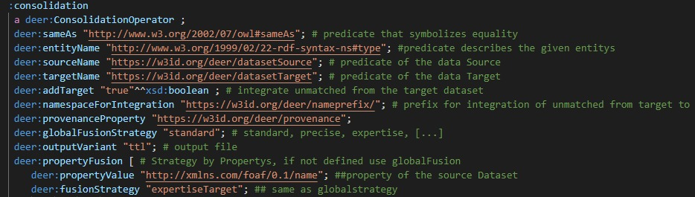
Configuration File
Notes:
Here is a brief overview of the config,
the globalFusionStrategy and the Property Fusion list are the most important.
Here you can say how you want to merge in the general case, but for specific properties proceed differently

Slide 37
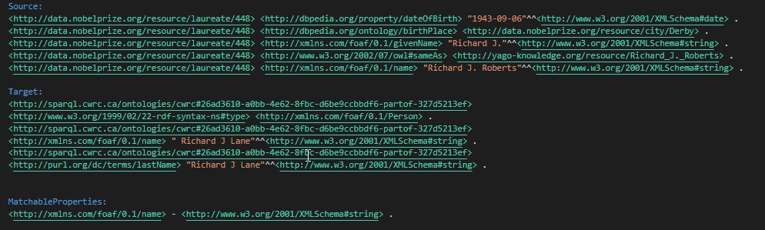
Example
Notes:
Let's take a look at this in a small example.
As input I got that the subject 448 from the source and the too long to pronounce string in the target are identical.
Now we look for both which identical properties they have. In this minimal example we see that we have name as a direct matching. So we match on name, the type of the objects is string.

Slide 38
Example
<http://data.nobelprize.org/resource/laureate/448> <http://xmlns.com/foaf/0.1/name> "Richard J. Roberts"^^<http://www.w3.org/2001/XMLSchema#string> .
<http://sparql.cwrc.ca/ontologies/cwrc#26ad3610-a0bb-4e62-8fbc-d6be9ccbbdf6-partof-327d5213ef> <http://xmlns.com/foaf/0.1/name> " Richard J Lane"^^<http://www.w3.org/2001/XMLSchema#string> .
Strategy | Result
Standard | Roberts
Precise | Lane
ExpertiseSource | Roberts
ExpertiseTarget | Lane
Min/Max/Average/Union | Lane/Roberts/ - / RJ Roberts RJ Lane
Voting | Not Applicable -> Source -> Roberts
Notes:
If we then only look at the names in comparison, we can now see how the operator works.
It takes the two and then decides what the result is based on the selected strategy
Small description of the table
... End: since we have no entries so far to perform the voting approach, it would go via fallback to the TakeSource and therefore choose Roberts as last name.

Slide 39
Future Work
Matchable Properties from Previous Groups
More Advance Fusion Strategies
Different Output Formats
New Output format
Reification - Configuration
Notes:
What should be done in the future:
The MatchableProperties are only due to the same names, which is more than unlikely that they are called identically in Source and Target. Such data could be passed by previous operators and thus extend the properties or replace the routine.
Strategies are very basic, in the future other more intelligent strategies would have to be added.
to the output format at the moment it is only written to a file. after additional testing one could reload the result to the endpoint.
The input is currently still stuck at a SubjectS sameAs SubjectT variant, through reification more information is encoded to this pair (e.g. also the MatchableProperties would be possible) and this is already available in basic form.

Slide 40
Overview
KG Matching
Ontology Matching
Instance Matching
Data Consolidation
Summary

Slide 41
Summary
LIMES Framework
Document Similarity Algorithms i.e. Bert, Dice, Jaccard, Weighted Jaccard, Tfidf-Cosine.
LogMap
FCA-Map
Type-driven Wombat Simple
Simple Wombat
Strategy Dispatchmap
Notes:
So to summarise we saw matching of KGs using Limes framework and various document similarity algorithms. Ontology Matching made use of LogMap and FCA-map to match a pair of ontologies.
Similarly, in instance matching, the use of Type-drive Wombat simple and simple wombat helped to overcome the matching of instances in two KGs.
Lastly, the introduction of dispatch maps per strategy for data consolidation.
As we have laid the foundation for the KGFusion project, we would like to see it continue in the future with Quality assurance, on the matched data, and the automated integration in the lod cloud.

Slide 42
THANK YOU FOR LISTENING
QUESTIONS?

Slide 43

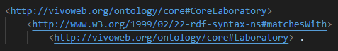

Summary
KG Matching
Ontology Matching
Instance Matching
Data Consolidation

