Slide 1
Dice group
Knowledge graph fusion
Advisor : Dr. Rer. Nat. Mohamed Sherif

Slide 2

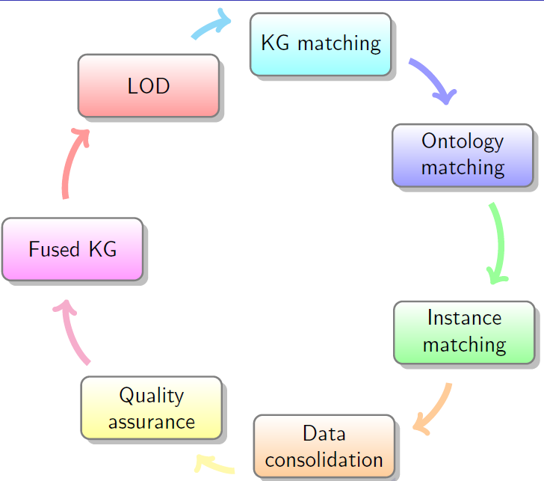

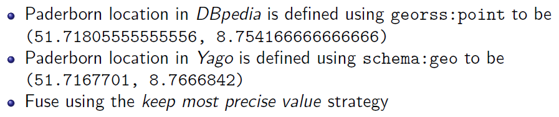
What is KG Fusion?

Slide 3
Overview
KG Matching
Ontology Matching
Instance Matching
Data Consolidation
Summary

Slide 4
Overview
KG Matching
CHAITALI SUHAS BAGWE, RAVITEJA KANAGARLA
Ontology Matching
Instance Matching
Data Consolidation
Summary

Slide 5
Goals
Find out the similar Knowledge Bases
Using LIMES for Linked Open Data Metadata for link matching
Using various document matching techniques for datasets in Hobbit
Create a KG Matching operator using DEER
Give output to the next group i.e., Ontology Matching

Slide 6
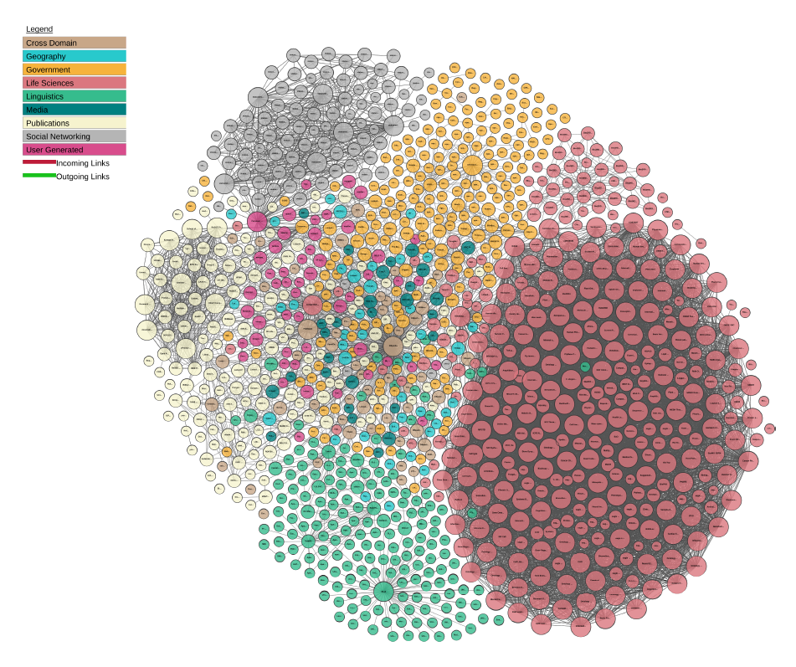
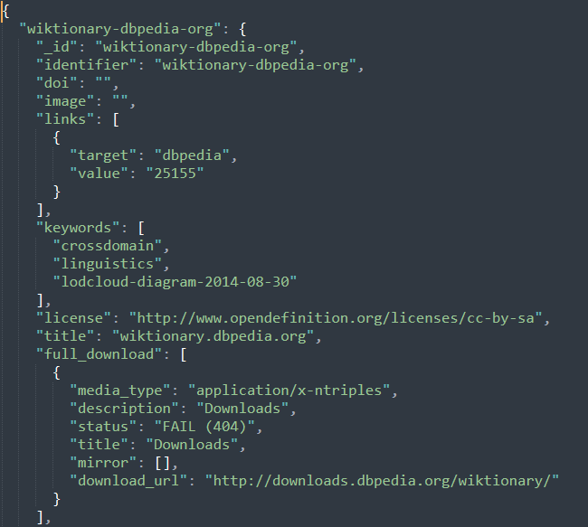
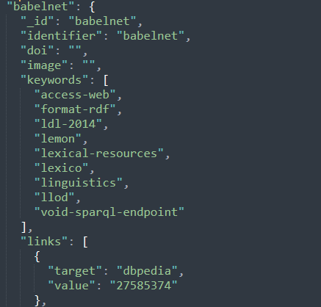
Steps to match KGs using LIMES
Collect the metadata from Linked Open Data
Identify the metadata to be used for KG matching

Slide 7

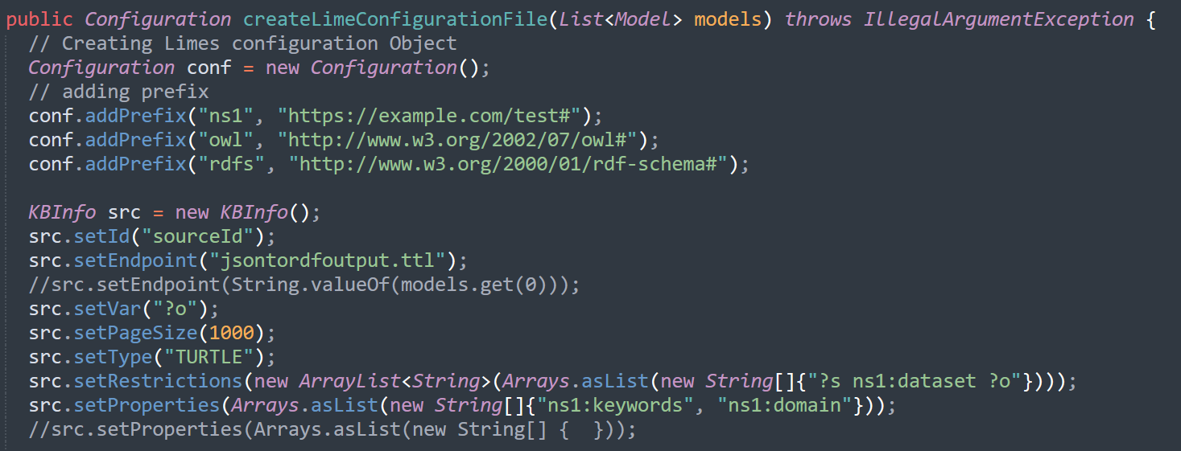
Steps to match KGs using LIMES
Create a DEER Operator
Pass the collected metadata to LIMES framework via DEER Operator
Store the matched KGs in a RDF model

Slide 8
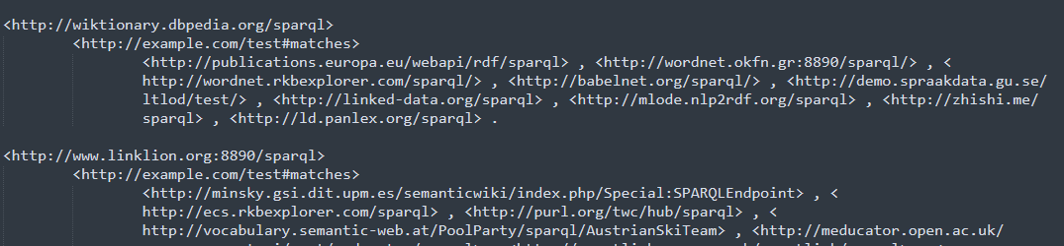
Limes Output

Slide 9

Steps to match KGs using Document Similarity
Pre-processing hobbit datasets
Find and split all literals in the dataset into 1-gram token
Remove all stopwords, spaces, numbers and special characters
Count the frequency of each token
Sort the tokens according to their frequency and store them in a list
Apply Document Similarities
Matching each datasets against all datasets present
Creating RDF model to store the matched similarities

Slide 10
Document Similarities Algorithms
Jaccard Similarity
Weighted Jaccard Similarity
Dice Similarity
TF-IDF with Cosine Similarity
Bert Similarity

Slide 11
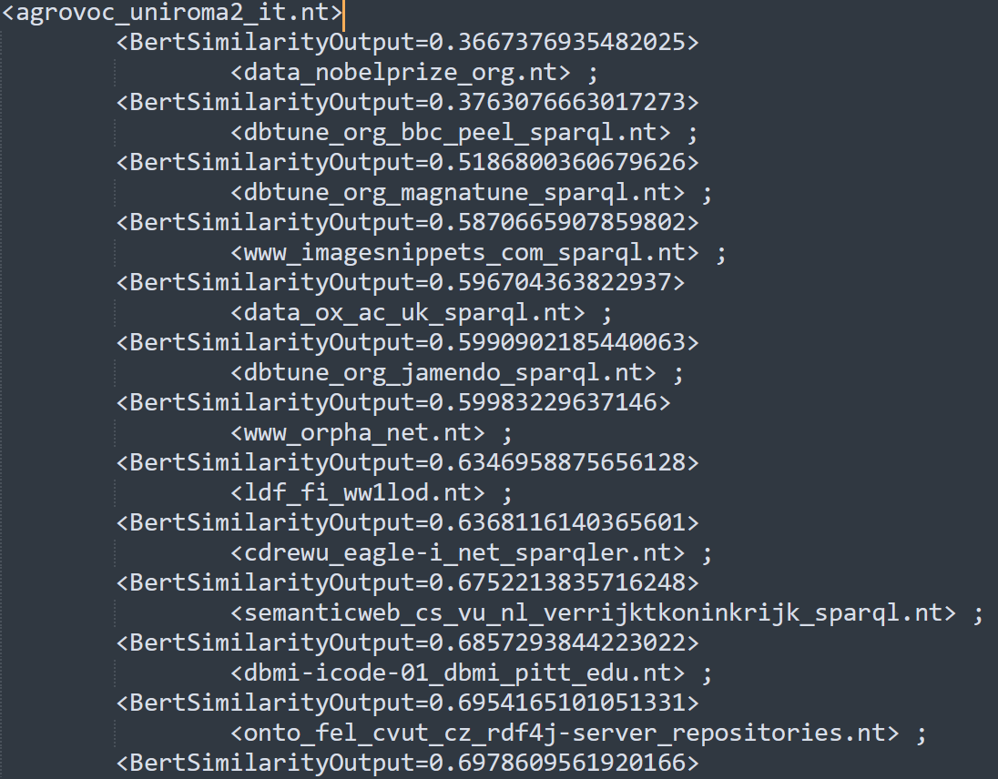
Output – Bert Similarity

Slide 12


Benchmarking
Dataset Pairs | A1 | A2 | A3 | A4 | A5 | Mutual Agreement
(dbtune_org_jamendo, data_nobel)
(dbtune_org_jamendo, data_ox_ac)
(cdrewu_eagle, imagesnippets)
(cdrewu_eagle, dbtune_org_magna)
A1, A5 – Software Engineers
A2 – Mechanical Engineer
A3 – Civil Engineer
A4 – Electrical Engineer

Slide 13
Benchmarking
Algorithms | Precision Score | Recall Score | F1 Score
Tf-idf with Cosine Similarity | 0.94 | 0.85 | 0.892
Jaccard Similarity | 0.94 | 0.80 | 0.863
Weighted Jaccard Similarity | 0.97 | 0.87 | 0.884
Dice Similarity | 0.97 | 0.69 | 0.804
Bert Similarity | 0.97 | 0.80 | 0.874
LIMES Framework | 1 | 0.73 | 0.843

Slide 14
Future works
More Document Similarities can be added
Trying the approaches on bigger datasets ( > 1GB)
Using dedicated Knowledge Graph matching approach like Tapioca

Slide 15
Overview
KG Matching
Ontology Matching
SOWMYA KAMARTH RAMESH, KRISHNA MADHAV
Instance Matching
Data Consolidation
Summary

Slide 16
Goals
Integrating with DEER framework
Implementation of another matching system (FCA)
Benchmarking our Operator
Technologies
JAVA
DEER

Slide 17
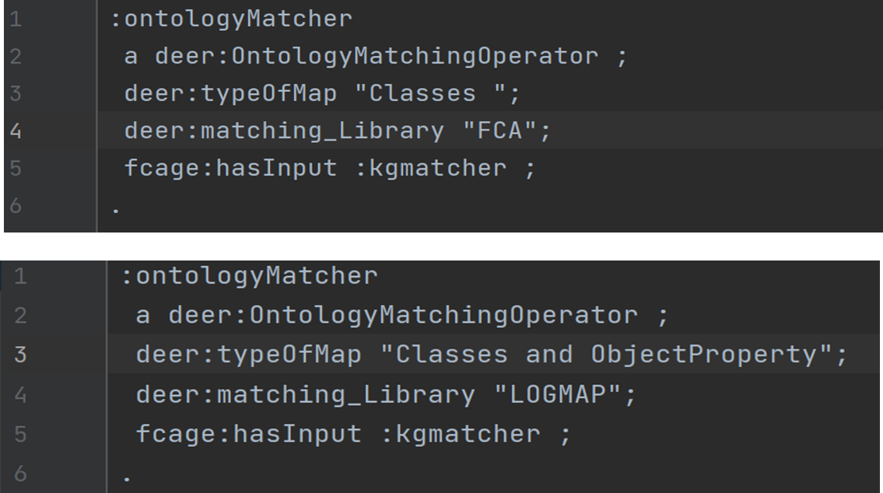
Configuration File

Slide 18


Overview of our Operator
Source
dataset
LogMap or FCA
Matcher
Output
RDF dataset
Target
dataset

Slide 19
Ontology Matching Operator
Dynamically fetching RDF datasets
Accessing SPARQL endpoints
Storing Ontologies in local file
Generating Matched Mappings
Reificated Output

Slide 20
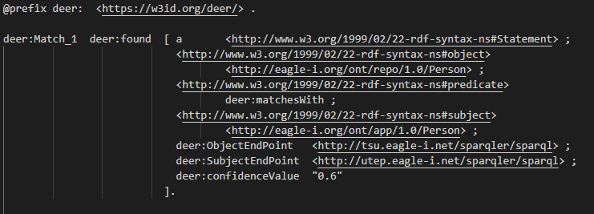
Output

Slide 21
Benchmarking
Dataset Pairs | A1 | A2 | A3 | Mutual Agreement
NCI_overlapping_fma.owl, FMA_overlapping_nci.owl
SNOMED_overlapping_fma.owl, FMA_overlapping_snomed.owl
Conference.owl, Ekaw.owl
A1, A2 – Software Engineers
A3 – Mechanical Engineer

Slide 22
Benchmarking
Dataset Pairs | Matcher | Precision | Recall | F1
NCI_overlapping_fma.owl, FMA_overlapping_nci.owl | LogMap Matcher | 0.94 | 0.92 | 0.93
 | FCA Matcher | 0.91 | 0.93 | 0.92
SNOMED_overlapping_fma.owl, FMA_overlapping_snomed.owl | LogMap Matcher | 0.92 | 0.91 | 0.91
 | FCA Matcher | 0.93 | 0.86 | 0.89
Conference.owl, Ekaw.owl | LogMap Matcher | 0.94 | 0.87 | 0.90
 | FCA Matcher | 0.92 | 0.87 | 0.89

Slide 23
Future Work
Improving timeout for SPARQL query execution
Working with dataset having triples pointing to invalid OWL files
Handling bigger dataset

Slide 24
Overview
KG Matching
Ontology Matching
Instance Matching
KHALID KHAN, KHALID BIN HUDA
Data Consolidation
Summary

Slide 25
GOAL
Implement a technique for Instance Matching
Creating a DEER Operator
Technologies
JAVA
DEER
LIMES

Slide 26
Instance Matching Operator
Named: InstanceMatchingOperator
Highlights:
Creating prefixes dynamically
Calculate coverage of the properties
Dynamically creating LIMES configuration
Use Wombat simple algorithm
Introducing Type-driven wombat simple

Slide 27
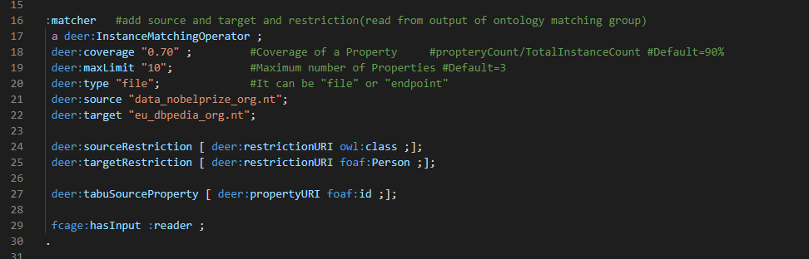
Configuration File

Slide 28
Example
Data File source: dbmi-icode-01_dbmi_pitt_edu.nt
Data File target: agrovoc_uniroma2_it.nt
Source Restrictions: "?s rdf:type owl:Class"
Target Restrictions: "?t rdf:type skos:Concept"
Properties matched:
Properties matched:
puob156:IAO_0000115
gefor191:hasOBONamespace
gefor335:id
w3200488:label
w3200541:prefLabel
pudc237:created
pudc20:modified
w3200302:altLabel
wombat simple
OUTPUT:

Slide 29
Benchmarking
For benchmarking we slightly modified simple wombat
Added a step to classify properties based on data type
Use this classification while matching
For example:
Product Name | Price | Manufacturing Date
Floppy disk | 223 | 11-02-1997
Mouse | 250 | 10-05-1998
Vector Measure = [ euclidean, manhattan]
String Measures = [ jaccard, qgrams]
Temporal Measure = [ tmp_predecessor, tmp_successor]
String
Vector
Temporal
Label | Retail Price | Production Date
Disk | 250 | 12-05-2000
Screen | 500 | 19-01-2020

Slide 30
Benchmarking Result
Dataset | Execution Time Wombat Simple (ms) | Execution Time Type-Driven Wombat Simple (ms) | F-Measure Wombat Simple | F-Measure Type-Driven Wombat Simple | Accuracy Wombat Simple | Accuracy Type-Driven Wombat Simple
Amazon and Google | 27821 | 16006 | 0.415 | 0.423 | 0.999 | 0.999
Abt-Buy | 3969 | 2693 | 0.104 | 0.028 | 0.987 | 0.986
DBLP-ACM | 64038 | 53567 | 0.889 | 0.900 | 0.999 | 0.999
Person 1 | 6985 | 6181 | 0.803 | 0.805 | 0.997 | 0.997
Restaurants | 8944 | 8053 | 0.447 | 0.467 | 0.999 | 0.999

Slide 31
Future Work
Implementing a more sophisticated Data type classifier. Use this classification while matching
For a better performance use parallel programming

Slide 32
Overview
KG Matching
Ontology Matching
Instance Matching
Data Consolidation
PHILIP COUTINHO DE SOUSA
Summary

Slide 33
Goal
Merge Data
Flexible Usage
Technologies
JAVA
DEER

Slide 34
Consolidation Operator
Name: ConsolidationOperator
Idea:
Source sameAs Target
MatchableProperties
Use FusionStrategies on Properties
Highlights
Easily expandable

Slide 35
Consolidation Strategies
Strategy | String | Integer | Date | Boolean | Fallback
Standard | Max | Avg | / | And | Take Source
Precise | Min | / | / | And | Take Source
Expertise Source | / | / | / | / | Take Source
Expertise Target | / | / | / | / | Take Target
Min/Max/Average/Union | Min/Max/Avg/Union | Min/Max/Avg/ - | Min/Max/Avg/ - | And | Take Source
Voting | Max Voting | Max Voting | Max Voting | Max Voting | Take Source

Slide 36
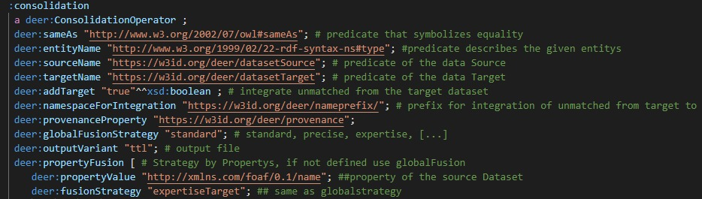
Configuration File

Slide 37
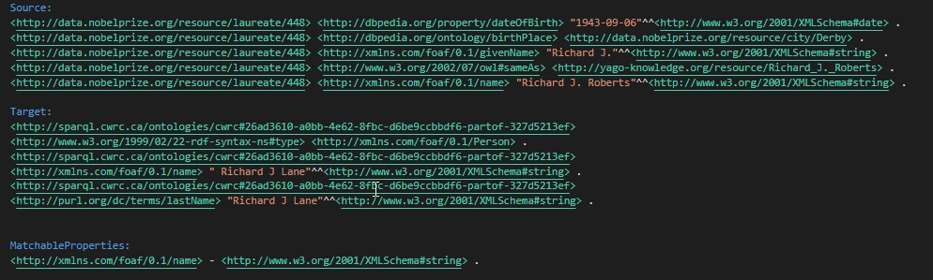
Example

Slide 38
Example
<http://data.nobelprize.org/resource/laureate/448> <http://xmlns.com/foaf/0.1/name> "Richard J. Roberts"^^<http://www.w3.org/2001/XMLSchema#string> .
<http://sparql.cwrc.ca/ontologies/cwrc#26ad3610-a0bb-4e62-8fbc-d6be9ccbbdf6-partof-327d5213ef> <http://xmlns.com/foaf/0.1/name> " Richard J Lane"^^<http://www.w3.org/2001/XMLSchema#string> .
Strategy | Result
Standard | Roberts
Precise | Lane
ExpertiseSource | Roberts
ExpertiseTarget | Lane
Min/Max/Average/Union | Lane/Roberts/ - / RJ Roberts RJ Lane
Voting | Not Applicable -> Source -> Roberts

Slide 39
Future Work
Matchable Properties from Previous Groups
More Advance Fusion Strategies
Different Output Formats
New Output format
Reification - Configuration

Slide 40
Overview
KG Matching
Ontology Matching
Instance Matching
Data Consolidation
Summary

Slide 41
Summary
LIMES Framework
Document Similarity Algorithms i.e. Bert, Dice, Jaccard, Weighted Jaccard, Tfidf-Cosine.
LogMap
FCA-Map
Type-driven Wombat Simple
Simple Wombat
Strategy Dispatchmap

Slide 42
THANK YOU FOR LISTENING
QUESTIONS?

