Slide 1
Drying fruit tower
TSTI3+4
Clément + Evann + Tendry

Slide 2
agenda
Presentation of the project
Synoptic
SIN part

Slide 3
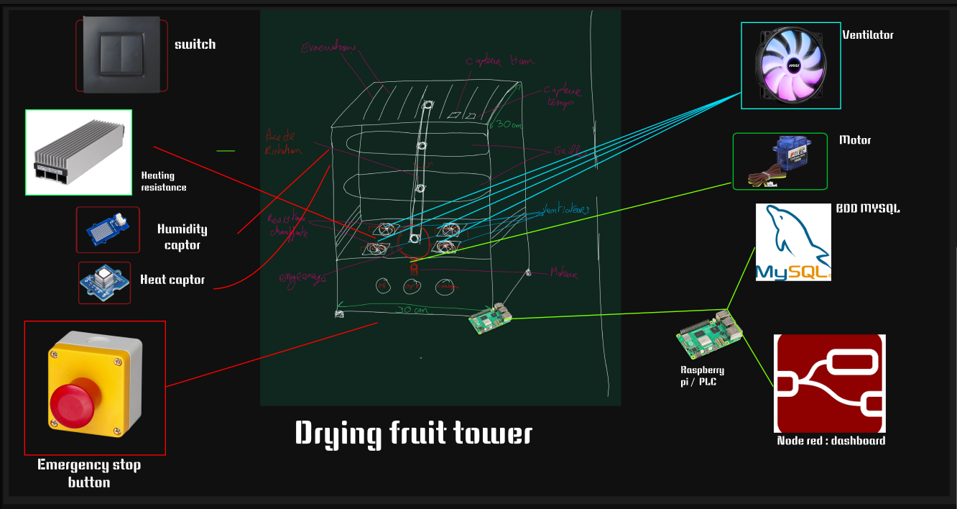
Synoptique of the project :
Beta :

Slide 4
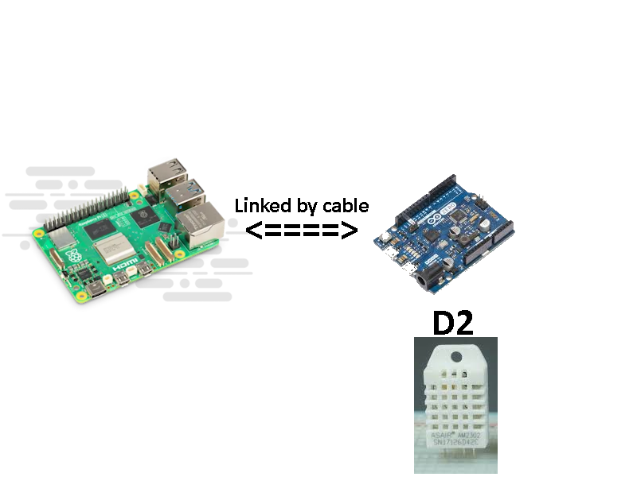
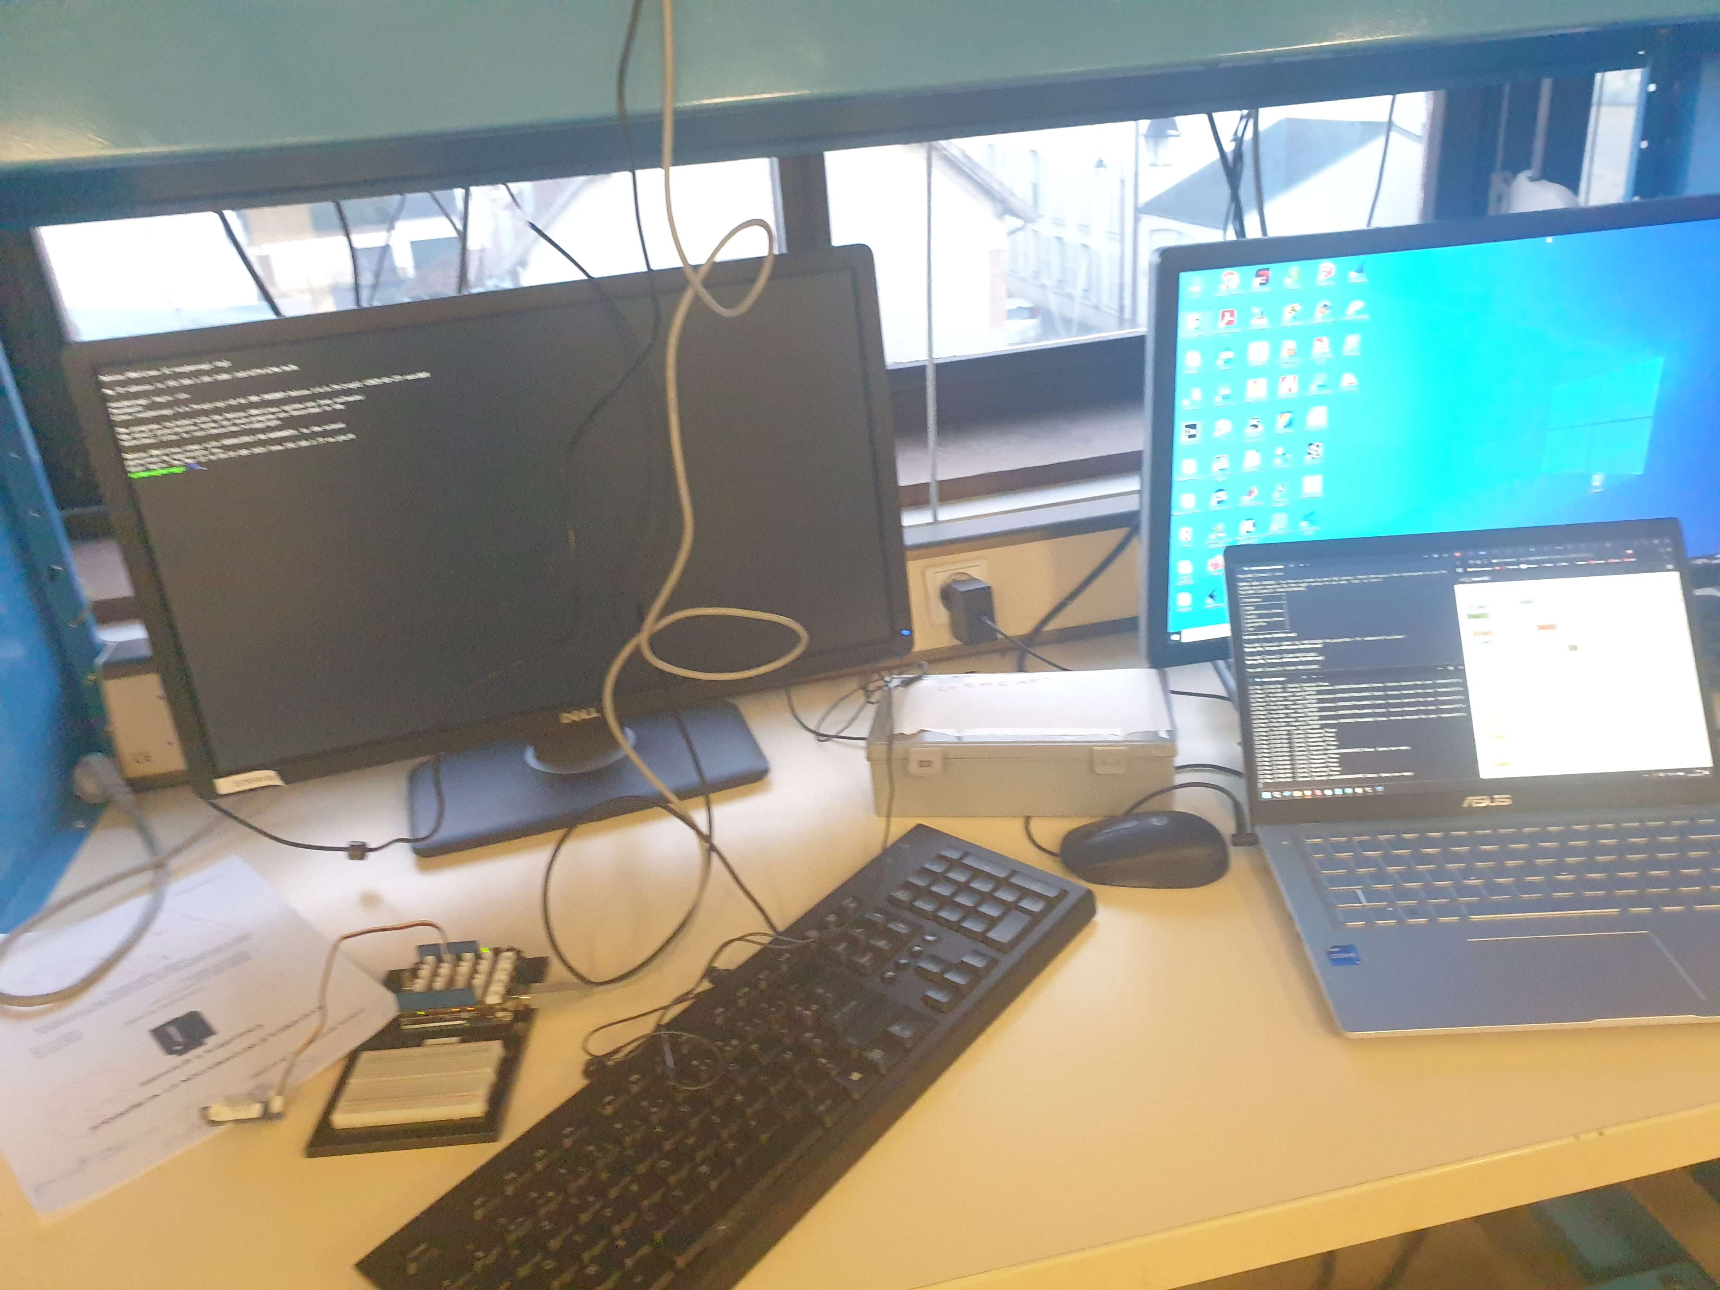
SIN part

Slide 5
Thank
For listening to me

