Slide 1
Natural Gas Consumption − Seasonaly Adjusted
in USA (1973 − July, 2023)
2500
Billion Cubic Feet
2000
1500
1980 Jan
1990 Jan
2000 Jan
2010 Jan
2020 Jan
Month

Slide 2
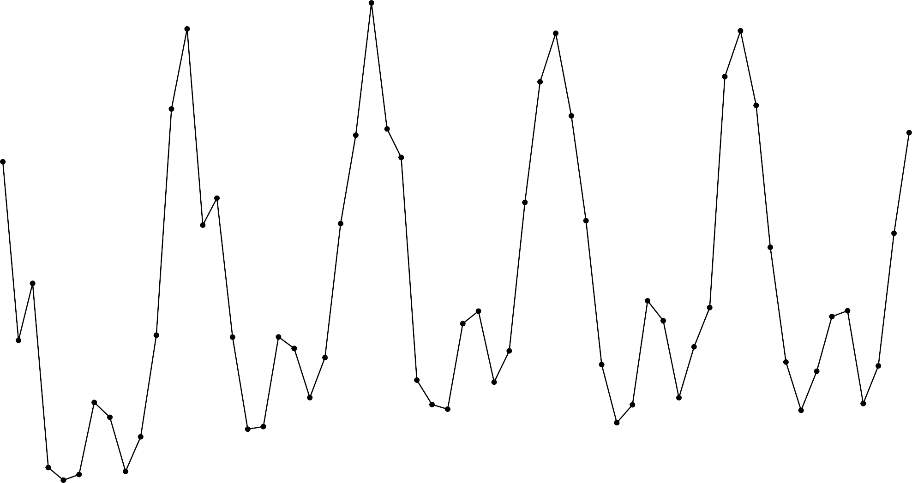
Time−Series of Natural Gas Consumption
in USA (2017−2021)
3500
3000
Billion Cubic Feet
2500
2000
2018 Jan
2020 Jan
2022 Jan
Month

Slide 3
US Natural Gas − Export Market
Time Series of Exports (Qty) and Henry Hub Price Index (1997−2022)
10
10
Exports (10 Billion Cubic Feet)
Price ($ per Million Btu
Price
5
5
Exports
0
0
2000 Jan
2005 Jan
2010 Jan
Month
2015 Jan
2020 Jan

Slide 4
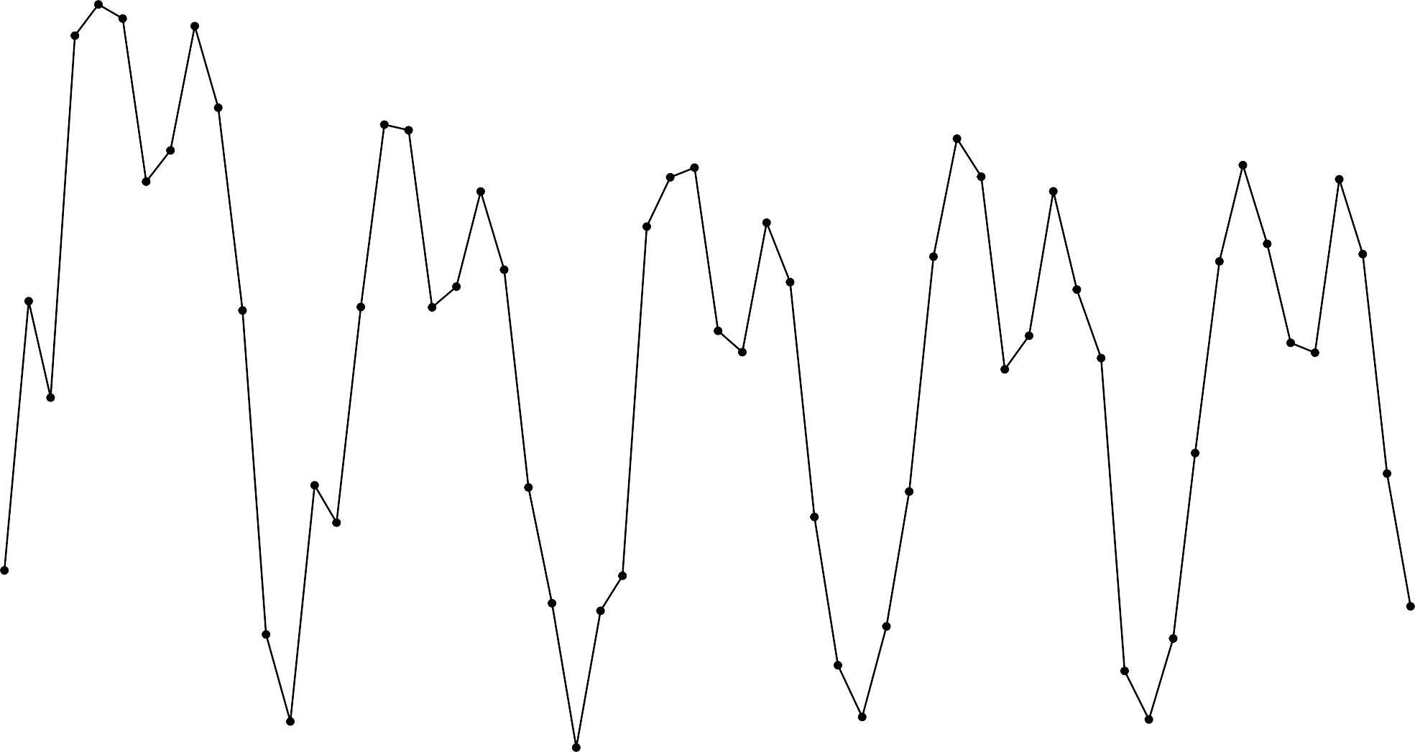
Time−Series of Natural Gas Consumption
in USA (2017−2021)
0.012
0.011
Transformed Cubic Feet
0.010
0.009
2018 Jan
2020 Jan
2022 Jan
Month

Slide 5
Residuals for All Models
0.000050
0.000025
.model
ARIMA ENSEMBLE ETS
LM
Residuals
0.000000
−0.000025
2017 Jan
2018 Jan
2019 Jan
YearMonth [1M]
2020 Jan
2021 Jan

Slide 6
ACF for All Models
0.50
0.25
0.00
−0.25
0.50
0.25
0.00
−0.25
0.50
0.25
0.00
−0.25
0.50
0.25
0.00
−0.25
ARIMA
ENSEMBLE
ACF
ETS
LM
6
12
lag [1M]

Slide 7
Regression Model Forecast
0.0006
Transformed Natural Gas Consumption
0.0005
level
0.0004
80
95
0.0003
0.0002
2018 Jan
2020 Jan
2022 Jan
Month

Slide 8
ETS Model Forecast
0.0006
Transformed Natural Gas Consumption
0.0005
level
0.0004
80
95
0.0003
0.0002
2018 Jan
2020 Jan
2022 Jan
Month

Slide 9
ARIMA Model Forecast
0.0006
Transformed Natural Gas Consumption
0.0005
level
0.0004
80
95
0.0003
0.0002
2018 Jan
2020 Jan
2022 Jan
Month

Slide 10
Aggregate Model Forecast
0.0006
Transformed Natural Gas Consumption
0.0005
level
0.0004
80
95
0.0003
0.0002
2018 Jan
2020 Jan
2022 Jan
Month

