Slide 1
Enhancing AWS Security Compliance
GSU Cybersecurity Governance & Risk Team:
Briana Benton
Courtney Baker
Djanna Myrie
Kailey Harris
Nooreen Mahamood
Notes:
Hello everyone! My name is _______ and we are the GSU Cybersecurity Governance and Risk Team.

Slide 2
Agenda
Compliance Frameworks Overview
NIST 800-171 & Its Control Families
Assessing Risk and Mitigation Types
Detailed Analysis of Compliance Failures
Mitigation Strategy
Project Overview
Notes:
Here’s a quick look at our agenda for today:
We’ll begin with an a brief overview of our project
After that, we will have an introduction to compliance frameworks, that will then shift into a more focused overview on NIST 800-171 and its control families.
Next, we will talk about how we define risk, the ways is which we assess risk, and the different types of risk mitigation.
Following that, we will analyze 10 different compliance failures we identified after conducting the risk assessment along with recommended mitigations.
And we’ll close out with our mitigation strategy plan.

Slide 3

Project Overview:
Objectives:
Risk Assessment: Identify and analyze potential vulnerabilities in the AWS environment using compliance frameworks like NIST 800-171 rev 2, NIST 800-53, ISO 27001:2013, and SOC2.
Prowler Tool: Utilize the Prowler tool to perform compliance checks specifically in the us-east-1 AWS region.
Key Tasks:
Set Up Security Measures: Ensure multi-factor authentication (MFA) is enabled for all team members' AWS accounts.
AWS Access and Setup: Log into the GSU AWS Sandbox Management Console and CloudShell, then install and configure the Prowler tool.
Compliance Evaluation: Perform assessments focused on NIST 800-171 rev 2 and gather findings to report risks, their likelihood, impact, and recommended mitigations.
Mapping Controls: Match Prowler findings to specific compliance frameworks and determine if findings align with NIST 800-53, ISO 27001:2013, and SOC2.
Notes:
Our project focuses on conducting a risk assessment of the AWS environment using compliance frameworks.
We aim to identify vulnerabilities and provide recommendations to mitigate risks while ensuring the AWS environment complies with NIST 800-171 rev 2, NIST 800-53, ISO 27001:2013, and SOC2.
The goal is to identify vulnerabilities and provide recommendations to reduce risks while ensuring the AWS environment aligns with all the mentioned frameworks.
All team members (both Teams Alpha and Beta) must enable multi-factor authentication (MFA.
We logged into the GSU AWS Sandbox and used AWS CloudShell to run the Prowler tool.
Prowler was used to analyze 10 specific findings related to frameworks compliance.
For each finding, we answered key questions:
What is the risk?
How likely is it to occur, and what’s the potential impact?
What mitigation or remediation steps are recommended?
TO Conclude
This project emphasized understanding compliance requirements and using tools like Prowler to strengthen cloud security.
By addressing risks and aligning findings to compliance frameworks, we developed actionable recommendations to improve AWS security posture.

Slide 4

What is a Compliance Framework?
A set of guidelines, standards, and practices that an organization follows to ensure it meets regulatory, legal, and industry requirements
Purpose: They help organizations safeguard sensitive data, mitigate risks, and reduce vulnerabilities.
Examples: NIST, ISO27001, SOC 2
Notes:
So, what exactly is a compliance framework? We define a compliance framework as a structured set of guidelines, standards, and practices that an organization follows to ensure it meets regulatory, legal, and industry requirements. Compliance frameworks are crucial as they help organizations safeguard sensitive data, mitigate risks, and reduce vulnerabilities. By adhering to these frameworks, organizations can ensure a consistent approach to security, gain customer trust, avoid legal penalties, and improve resilience against threats. Frameworks, such as NIST, ISO 27001, and SOC 2, serve as essential benchmarks for best practices in protecting information and maintaining operational integrity.

Slide 5
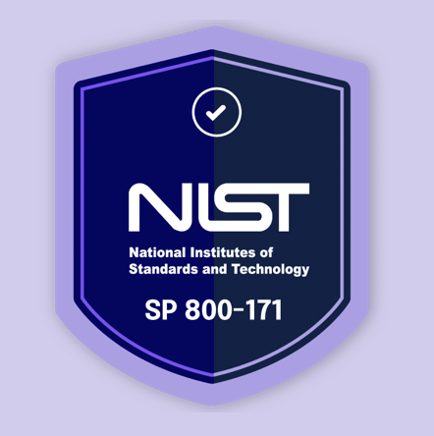
NIST 800-171
FOCUS ON PROTECTING CUI
REGULATORY COMPLIANCE
COMPREHENSIVE YET ACHIEVEABLE
FLEXIBLE AND ADAPTABLE
GOVERNMENT-ENDORSED CREDIBILITY
Notes:
The main compliance framework that we used for our project and will be discussing today is NIST 800-171.
NIST 800-171 provides a standardized framework for securing Controlled Unclassified Information, or CUI, in non-federal information systems and organizations. It was developed by the National Institute of Standards and Technology (NIST) to help businesses protect sensitive government-related information.
Some key reasons why the NIST 800-171 framework is so highly respected and widely used are due to it’s focus on Protecting CUI, its compliance is often mandatory for various organizations, it is comprehensive yet achievable, it is adaptable to many types of organizations, and lastly because it was developed by the National Institute of Standards and Technology, it benefits from the credibility and research backing of a respected government institution.

Slide 6
NIST 800-171 Control Families
Access Control (AC)
Awareness and Training (AT)
Audit and Accountability (AU)
Configuration Management (CM)
Identification and Authentication (IA)
Incident Response (IR)
Maintenance (MA)
Media Protection (MP)
Personnel Security (PS)
Physical Protection (PE)
Risk Assessment (RA)
Security Assessment (CA)
System and Communications Protection (SC)
System and Information Integrity (SI)
Notes:
The NIST 800-171 framework contains 110 security controls organized into 14 control families, each addressing specific areas of security. For example, Access Control defines who can access resources, while Incident Response covers protocols for responding to security events. Each family plays a unique role in overall security, and our assessment targeted specific controls within these families to evaluate our compliance and identify potential gaps.

Slide 7
Defining Risk
Risk is the potential for loss or damage to an organization due to threats exploiting vulnerabilities in systems, leading to unauthorized access, data breaches, or operational disruptions.
Why is understanding what risk is important?
Informed Decision-Making
Proactive Defense
Compliance and Legal Protection
Minimized Financial Impact
Enhanced Trust and Reputation
Notes:
Risk in cybersecurity refers to the potential for security breaches that could lead to data loss, financial damage, or reputational harm. In our assessment, we evaluated risks by considering both the likelihood of a vulnerability being exploited and the impact it would have on our AWS environment. This approach helps us prioritize which findings to address based on their potential impact on our security posture.

Slide 8
Assessing Risk
Risk = Likelihood x Impact
Likelihood = f(vulnerabilities, exposure, threats, mitigating controls)
Impact = g(business criticality)
Notes:
To assess risk, we applied a simple equation: likelihood multiplied by impact. Likelihood is the probability of a threat occurring—such as increased risk from weak password policies—while impact is the potential damage from an incident, like financial loss or reputational harm from a data breach. This calculation helps prioritize risks, focusing resources on high-likelihood, high-impact vulnerabilities, such as weak access controls in sensitive systems, ensuring that critical security gaps are addressed first.

Slide 9
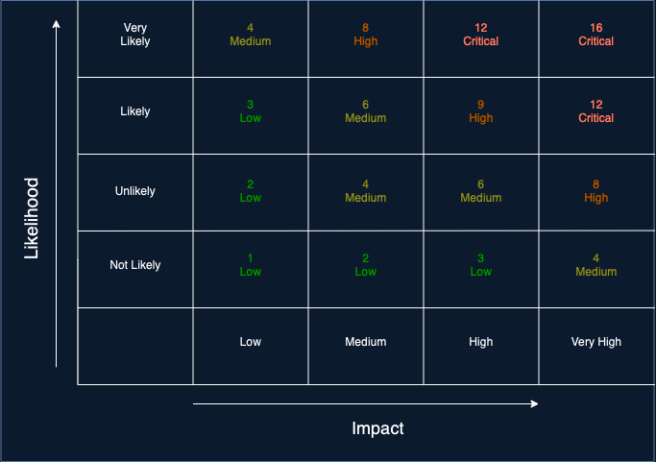
Risk Matrix
Notes:
This is the risk matrix we designed to categorize findings by their risk level. It shows how combining likelihood and impact results in low, medium, high, or critical risk ratings. We used this matrix to assess the failed findings in our AWS environment and to guide us in prioritizing our remediation actions.

Slide 10
Risk Mitigation and the Four Types
Avoidance
A company might avoid using certain software if it’s known to have security vulnerabilities
Reduction
enhancing firewall protections to reduce the chance of unauthorized access
Transference
an organization might use cloud storage providers to handle data security responsibilities
Acceptance
a minor risk with low likelihood and impact might be accepted as is
Notes:
Risk Mitigation is the process of reducing the likelihood of an event occurring and minimizing the impact of potential risks.
There are four main types of risk mitigation strategies: avoidance, reduction, transference, and acceptance. In our assessment, we focused on risk reduction by implementing security controls that directly lower the likelihood or impact of potential threats. Each failed finding has a recommended mitigation strategy aligned with these principles to enhance our security posture and bring us closer to compliance.

Slide 11

Analyzing our Findings
Notes:
Now, let’s take a look at our findings. We conducted a comprehensive security assessment of our AWS environment using the Prowler tool, which is an open-source security tool that scans AWS environments for compliance and security issues based on industry frameworks - And for this assessment we used the Prowler tool against the NIST 800-171 framework. We’ll go through the 10 failed findings, examining each finding’s risk, severity, and recommended actions to improve our compliance and security.

Slide 12
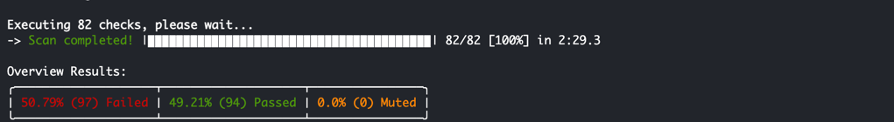
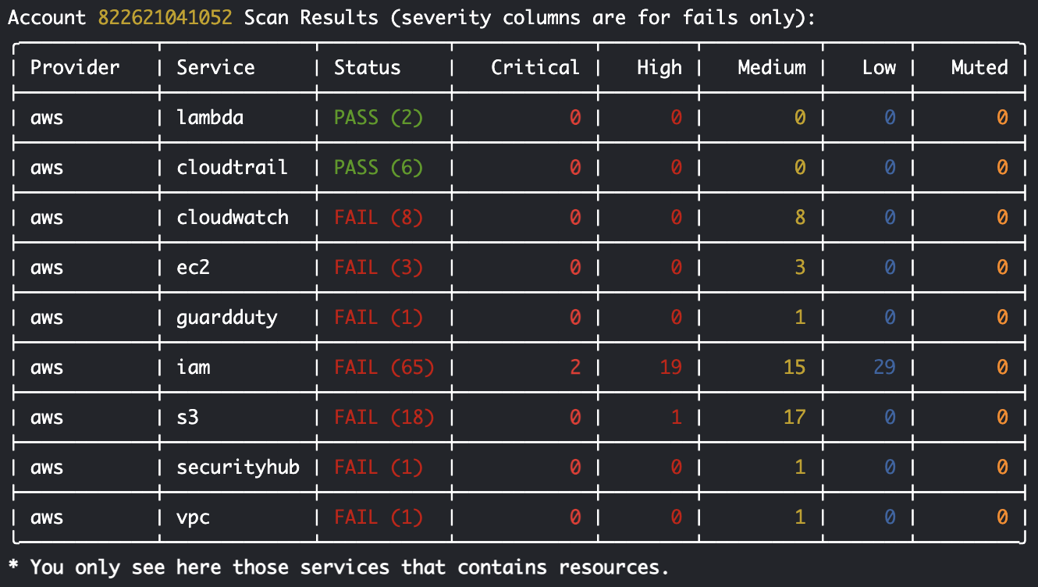
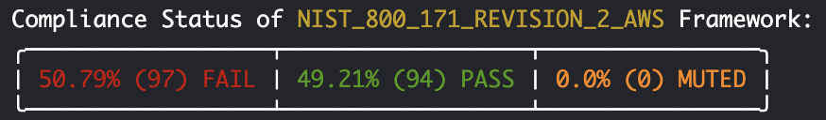
NIST 800-171 Assessment Findings Overview
Notes:
Here’s a snapshot of the Prowler assessment summary output from Cloud Shell. This output provides an at-a-glance overview of the compliance status across the NIST 800-171 controls. In this report, each control is checked against best practices within our AWS environment, and findings are categorized by status and severity. These results allow us to quickly pinpoint areas where security measures are lacking, making it easier to prioritize high-risk findings

Slide 13
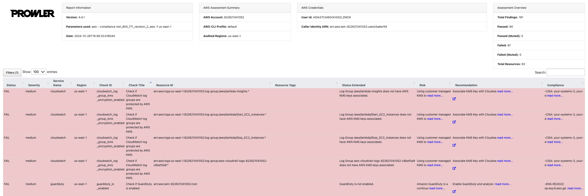
NIST 800-171 Assessment Findings Overview
Notes:
This is the summary results screen from the HTML output of our Prowler assessment. The HTML report provides a detailed view, including failed checks, resources affected, recommended actions, and compliance alignment with NIST 800-171. This level of detail is crucial for mapping each finding to specific risk categories and determining the likelihood and impact of each risk. It also shows mappings to other frameworks, like ISO 27001 and SOC2, providing a holistic compliance perspective.

Slide 14

AWS Security Assessment Finding 1: Root Account MFA Not Enabled
Risk
Cross Framework Mapping
Unauthorized access to root account due to lack of MFA.
High potential for account takeover.
Likelihood and Impact:
Likelihood: Very Likely
Impact: Very High
Risk Priority: Critical
Recommended Mitigation Type
Type: Avoidance
Reason: Enabling MFA will completely eliminate the chance of an unauthorized user accessing the root account through this vulnerability.
Remediation Recommendation
Use the IAM console to navigate to the dashboard and activate MFA for the root account.
Use a dedicated MFA device.
NIST 800-171 Family & Control
Access Control and Identification & Authentication
Mapped to NIST 800-53: Yes
Mapped to ISO 27001:2013: Yes
Mapped to SOC2: Yes
Notes:
Our first finding highlights a critical security risk where Multi-Factor Authentication, or MFA, is not enabled for the root account.
The root account is the most privileged user in an AWS environment, meaning that a security breach here could have severe consequences. Enabling MFA provides an additional layer of protection by requiring not only a username and password but also an authentication code from an AWS MFA device, making unauthorized access more difficult.
Here you can see how we utilized our 4x4 risk matrix by multiplying the likelihood and impact of the risk occurring to determine the Risk priority or severity level. The likelihood of this risk occurring is very high due to the privilege level of the root account. Combined with the critical impact of potential damage, this results in a Critical risk priority.
To mitigate this risk, risk avoidance is recommended. By enabling MFA, we can completely eliminate the chance of an unauthorized user accessing the root account through this vulnerability.
The remediation recommendation is straightforward: Use the IAM console to navigate to the dashboard and activate MFA for the root account. This action will significantly reduce the likelihood of unauthorized access.
For compliance mapping, we found that the NIST 800-171 Revision 2 ID numbers are mapped to the Access Control and Identification and Authentication control families.
This finding is also mapped to NIST 800-53, ISO 27001:2013, and SOC2.

Slide 15
AWS Security Assessment Finding 2: S3 Account Level Public Access Block Not Configured
Risk
Cross Framework Mapping
Public access policies may inadvertently expose sensitive data in S3 buckets.
Likelihood and Impact:
Likelihood: High
Impact: High
Risk Priority: High
Recommended Mitigation Type
Type: Avoidance
Remediation Recommendation
Navigate to the S3 console in AWS, go to Account Settings, and enable "Block Public Access" for all S3 buckets
NIST 800-171 Family & Control
Families: Access Control (AC), Media Protection (MP)
Mapped to NIST 800-53: Yes
Mapped to ISO 27001:2013: Yes
Mapped to SOC2: No
Reason: Enabling the Block Public Access feature at the account level prevents any public access to S3 buckets, which eliminates the possibility of accidental exposure.
Controls:
Notes:
Our second finding addresses a high-severity risk regarding S3 Account Level Public Access Block configuration in the AWS console. The risk identified is that public access policies may inadvertently expose sensitive data in S3 buckets. The likelihood of this risk materializing is high, given the popularity and vulnerability of S3 buckets, and the impact of data exposure is high as well. According to our risk equation, this makes the overall risk level high.
To mitigate this risk, we recommend using the avoidance strategy by enabling the Block Public Access feature at the account level, which prevents any public access to S3 buckets, thereby eliminating the possibility of accidental exposure.
Our remediation Recommendation is to Navigate to the S3 console in AWS, go to Account Settings, and enable "Block Public Access" for all S3 buckets.
For compliance, this finding maps to NIST 800-171 Revision 2 Access Control (AC) and Media Protection (MP) control families.
Controls: 3.1.1, 3.1.2, 3.1.3, 3.1.14, 3.1.20, 3.3.8, 3.4.6, 3.13.2, 3.13.5.
This finding is is also mapped to NIST 800-53 and ISO 27001:2013 but is not mapped to SOC2.

Slide 16
AWS Security Assessment Finding 3: IAM User MFA Not Enabled for Console Access
Risk
Cross Framework Mapping
Unauthorized access to a critical account
Likelihood and Impact:
Likelihood: High
Impact: High
Risk Priority: High
Recommended Mitigation Type
Type: Reduction
Remediation Recommendation
Enable MFA for the user using either a virtual or, preferably, a hardware MFA device
Hardware keys are recommended over virtual MFA for enhanced security.
NIST 800-171 Family & Control
Families: Access Control and Identification and Authentication
Mapped to NIST 800-53: Yes
Mapped to ISO 27001:2013: Yes
Mapped to SOC2: No
Reason: Enabling MFA will significantly reduce the risk by adding an extra layer of security, ensuring that access requires more than just the password.
Controls:
Notes:
Our third finding indicates that one of the IAM users has console access enabled with a password, but multi-factor authentication (MFA) is not enabled. This increases the risk of unauthorized access to a critical account, especially if the password is compromised or exposed.
Based on our 4x4 risk matrix, the likelihood of unauthorized access without MFA is considered High due to potential password vulnerabilities. The impact of a security breach on this admin account is High, leading to a high overall risk severity.
Recommended Mitigation: The recommended mitigation type is Risk Reduction. Enabling MFA will significantly reduce the risk by adding an extra layer of security, ensuring that access requires more than just the password.
Our remediation Recommendation is to enable MFA for the user using either a virtual or, preferably, a hardware MFA device. Hardware keys are recommended over virtual MFA for enhanced security.
The NIST 800-171 Revision 2 ID numbers are mapped to the Access Control and Identification and Authentication families. NIST 800-53 and ISO 27001:2013 are also mapped while SOC2 is not.

Slide 17
AWS Security Assessment Finding 4: IAM Inline Policies with Full “:” Privileges
Risk
Cross Framework Mapping
Excessive access could lead to unauthorized or unintended actions that compromise the security of the system.
Likelihood and Impact:
Likelihood: High
Impact: High
Risk Priority: High
Recommended Mitigation Type
Type: Reduction
Remediation Recommendation
Remove the full administrative access ('*:*') from the IAM policy.
Restrict permissions to only those necessary for the role to perform specific tasks
NIST 800-171 Family & Control
Family: Access Control
Mapped to NIST 800-53: Yes
Mapped to ISO 27001:2013:Yes
Mapped to SOC2: Yes
Reason: Reducing the scope of administrative privileges and implementing least-privilege access significantly minimizes potential exposure and protect sensitive resources.
Controls: AC-2 (Account Management), AC-3 (Access Enforcement), AC-5 (Separation of Duties), AC-6 (Least Privilege), AC-7 (Unsuccessful Logon Attempts)
Implement periodic audits and continuous monitoring of IAM policies.
Notes:
The identified risk of our 4th finding is the presence of an inline IAM policy attached to the "OrganizationAccountAccessRole" that grants full administrative privileges ('*:*'), which violates the principle of least privilege. This excessive access could lead to unauthorized or unintended actions that compromise the security of the system.
The Likelihood is High. Since the inline policy grants broad access, the likelihood of it being misused or exploited is significant.
The impact is high as well. The potential damage from this misconfiguration could result in unauthorized access, data breaches, or critical system disruptions. With a high likelihood and high impact, we have placed this as a high-level severity risk.
We determined that the best risk mitigation type is Reduction. By reducing the scope of administrative privileges and implementing least-privilege access, we can significantly minimize potential exposure and protect sensitive resources.
Our remediation Recommendation is to remove the full administrative access ('*:*') from the IAM policy, restrict permissions to only those necessary for the role to perform specific tasks and Implement periodic audits and continuous monitoring of IAM policies.
This finding is mapped to NIST 800-171 Revision 2 Control Family: Access Control and Controls: Account Management, Access Enforcement, Separation of Duties, Least Privilege and Unsuccessful Logon Attempts.
We also found that this finding is mapped to NIST 800-53, ISO 27001:2013 and SOC2

Slide 18
AWS Security Assessment Finding 5: Network ACL Allows Ingress from 0.0.0.0/0 to Any Port
Risk
Cross Framework Mapping
Allowing unrestricted access to all ports opens the network to potential scans and intrusions from malicious users or malware, especially from known and sensitive ports
Likelihood and Impact:
Likelihood: Medium
Impact: High
Risk Priority: Medium
Recommended Mitigation Type
Type: Avoidance
Remediation Recommendation
Implement a process to scan and remediate overly permissive network ACLs by restricting access to only the minimum required ports and applying a Zero Trust approach.
NIST 800-171 Family & Control
Family: Access Control
Mapped to NIST 800-53: Yes
Mapped to ISO 27001:2013: No
Mapped to SOC2: No
Reason: This type of mitigation is appropriate as the ACL should prevent any unnecessary access rather than relying on external controls, aligning with a Zero Trust model.
Controls: 3.1.1, 3.1.2, 3.1.3, 3.1.14, 3.1.2
Notes:
Finding number 5 highlights a network ACL within the EC2 service that is configured to allow ingress from any source IP (0.0.0.0/0) to all ports, which exposes the network to unauthorized access risks.
Allowing unrestricted access to all ports opens up the network to potential scans and intrusions from malicious users or malware, especially from known and sensitive ports.
Likelihood is medium due to external accessibility, and impact is high due to potential exposure of sensitive ports. This results in a medium risk rating according to our 4x4 risk matrix.
The Recommended Mitigation Type is Avoidance. This type of mitigation is appropriate as the ACL should prevent any unnecessary access rather than relying on external controls, aligning with a Zero Trust model.
Our remediation recommendation is to implement a process to scan and remediate overly permissive network ACLs by restricting access to only the minimum required ports and applying a Zero Trust approach.
NIST 800-171 Revision 2 Compliance Mapping falls within the Access Control Family
Control IDs: 3.1.1, 3.1.2, 3.1.3, 3.1.14, 3.1.2
This finding was also able to be mapped to NIST 800-53 but not ISO 27001:2013 or SOC2

Slide 19
AWS Security Assessment Finding 6: VPC Flow Logging Disabled
Risk
Cross Framework Mapping
The absence of VPC Flow Logs means lacking critical visibility into the network traffic within the VPC.
Limited ability to detect potential threats or investigate incidents effectively.
Likelihood and Impact:
Likelihood: Unlikely
Impact: Medium
Risk Priority: Medium
Recommended Mitigation Type
Type: Reduction
Remediation Recommendation
Enable VPC Flow Logs for packet rejects to ensure network activity can be monitored and analyzed
NIST 800-171 Family & Control
Families: Audit and Accountability
Mapped to NIST 800-53: Yes
Mapped to ISO 27001:2013: Yes
Mapped to SOC2: Yes
Reason: Enabling VPC Flow Logs is a feasible step to enhance our security posture and directly addresses the potential threat.
Controls: 3.3.1, 3.3.3, 3.6.1, 3.6.2, 3.13.1, 3.14.6, 3.14.7
Notes:
Our sixth finding shows that VPC Flow Logging is disabled for all VPCs. The absence of VPC Flow Logs means we lack critical visibility into the network traffic within the Virtual Private Cloud (VPC). This missing insight can prevent early detection of abnormal traffic patterns, limiting our ability to detect potential threats or investigate incidents effectively.
The likelihood of encountering security issues without VPC Flow Logs is moderate due to the broad nature of network traffic monitoring, and the impact is also moderate as it hinders proactive threat detection and incident analysis which is why this finding is categorized as Medium risk.
We advise using mitigation type reduction because enabling VPC Flow Logs is a feasible step to enhance our security posture and directly addresses the potential threat.
To remediate this, we recommend to activate VPC Flow Logs, specifically logging packet rejects, to capture and monitor network traffic data. This will support compliance and improve incident detection.
We found that this finding maps to NIST 800-171 Revision 2 control family Audit and Accountability (AU) and controls 3.3.1, 3.3.3, 3.6.1, 3.6.2, 3.13.1, 3.14.6, 3.14.7
Additionally, it also maps to NIST 800-53, ISO 27001:2013, and SOC 2.

Slide 20
AWS Security Assessment Finding 7: Missing WAF ACL on Application Load Balancer
Risk
Cross Framework Mapping
A lack of a Web Application Firewall (WAF) ACL attached to the Application Load Balancer (ALB) increases exposure to potential web-based attacks, which could compromise system integrity and data confidentiality.
Likelihood and Impact:
Likelihood: Moderate
Impact: Medium
Risk Priority: Medium
Recommended Mitigation Type
Type: Reduction
Remediation Recommendation
Configure a WAF ACL in the AWS Management Console and attach it to the ALB to ensure traffic filtering and protection from common web threats.
NIST 800-171 Family & Control
Family: System and Communications Protection (SC)
Mapped to NIST 800-53: Yes
Mapped to ISO 27001:2013: No
Mapped to SOC2: No
Reason: Adding a WAF ACL will directly decrease the chance of successful attacks by filtering malicious traffic.
Controls: 3.13.1, 3.13.5
Notes:
We can see here on our 7th finding that our Application Load Balancer doesn’t have a Web Application Firewall (WAF) ACL attached.
The lack of a Web Application Firewall (WAF) ACL attached to the Application Load Balancer (ALB) increases exposure to potential web-based attacks, which could compromise system integrity and data confidentiality.
The likelihood of encountering a web-based attack is moderate given the nature of web traffic, while the potential impact is high includes unauthorized access and potential data breaches. That’s why we categorize this finding at a medium level severity.
For this finding, risk reduction is advised because adding a WAF ACL will directly decrease the chance of successful attacks by filtering malicious traffic.
Remediation Recommendation: We recommend remediating this risk by configuring a WAF ACL in the AWS Management Console and attach it to the ALB to ensure traffic filtering and protection from common web threats.
This finding maps to the NIST 800-171 Revision 2 Control Family: System and Communications Protection (SC) and Control IDs: 3.13.1, 3.13.5
It also maps to NIST 800-53, but not ISO 27001:2013 or SOC 2

Slide 21
AWS Security Assessment Finding 8: Deleted Protection Disabled on Elastic Load Balancers
Risk
Cross Framework Mapping
Elastic Load Balancer (ELB) does not have deletion protection enabled. This increases the risk of accidental or unauthorized deletion, which could lead to service disruption.
Likelihood and Impact:
Likelihood: Moderate
Impact: High
Risk Priority: Medium
Recommended Mitigation Type
Type: Avoidance
Remediation Recommendation
Enable deletion protection in the AWS console for the ELB, as it is not enabled by default.
NIST 800-171 Family & Control
Family: Configuration Management (CM)
Mapped to NIST 800-53: Yes
Mapped to ISO 27001:2013: No
Mapped to SOC2: No
Reason: Enabling deletion protection will directly prevent unauthorized or accidental deletion of the ELB, ensuring resource stability.
Control IDs: 3.4.1, 3.13.2
Notes:
On the 8th finding, we found that the the Elastic Load Balancer (ELB) does not have deletion protection enabled. This increases the risk of accidental or unauthorized deletion, which could lead to service disruption.
Given the moderate likelihood of accidental deletion and the significant impact on operational continuity, this risk is rated as Medium.
Risk Mitigation type Avoidance is recommended in this case. Enabling deletion protection will directly prevent unauthorized or accidental deletion of the ELB, ensuring resource stability.
We Recommend Enabling deletion protection in the AWS console for the ELB, as it is not enabled by default to mitigate this issue.
We found that this finding is mapped tp NIST 800-171 Revision 2:Control Family: Configuration Management (CM), Control IDs: 3.4.1, 3.13.2
It is also mapped to NIST 800-53, but not ISO 27001:2013 or SOC 2

Slide 22
AWS Security Assessment Finding 9: Route Table Change Monitoring Disabled
Risk
Cross Framework Mapping
Unmonitored changes to route tables could result in unintended network traffic patterns or unauthorized access
Likelihood and Impact:
Likelihood: Moderate
Impact: High
Risk Priority: Medium
Recommended Mitigation Type
Type: Reduction
Remediation Recommendation
Configure CloudWatch metric filters and alarms to monitor specific events, such as route table creation, replacement, deletion, or disassociation. Use an SNS topic to receive alerts for real-time monitoring.
NIST 800-171 Family & Control
Family: Incident Response (IR)
Mapped to NIST 800-53:
Mapped to ISO 27001:2013:
Mapped to SOC2:
Reason: Setting up monitoring and alerts will allow for quick detection and response to changes in route tables, reducing the risk of unauthorized or unintended modifications.
Notes:
The 9th finding shows that no CloudWatch log groups are configured with metric filters or alarms to monitor changes in network route tables. This poses a risk as unmonitored changes to route tables could result in unintended network traffic patterns or unauthorized access.
Given the likelihood of accidental or intentional changes and the potential high impact on network integrity, this risk is rated as Medium.
Risk Mitigation type Reduction is recommended here. Setting up monitoring and alerts will allow for quick detection and response to changes in route tables, reducing the risk of unauthorized or unintended modifications.
The remediation recommendation is to Configure CloudWatch metric filters and alarms to monitor specific events, such as route table creation, replacement, deletion, or disassociation. Use an SNS topic to receive alerts for real-time monitoring.
This finding is mapped to NIST 800-171 Revision 2: Control Family: Incident Response (IR), Control IDs: 3.6.1, 3.6.2, 3.12.4
It is also mapped to NIST 800-53, ISO 27001:2013, and SOC 2

Slide 23
AWS Security Assessment Finding 10: CloudWatch Network Access Control List (NACL) Log Metric Filter and Alarm Configuration
Risk
Cross Framework Mapping
. Without monitoring, unauthorized changes could go undetected.
Likelihood and Impact:
Likelihood: Medium
Impact: Medium
Risk Priority: Medium
Recommended Mitigation Type
Type: Reduction
Remediation Recommendation
Configure a log metric filter and alarm in CloudWatch to monitor for unauthorized changes to NACL
This will help detect malicious or accidental changes to network controls
NIST 800-171 Family & Control
Families: Audit and Accountability (AU), Incident Response (IR)
Mapped to NIST 800-53: Yes
Mapped to ISO 27001:2013: Yes
Mapped to SOC2: Yes
Reason: By implementing log metric filters and alarms, we can reduce the likelihood and response time to unauthorized changes
Controls: 3.6 .1 Audit Events, 3.6.2 Content of Audit Records, Incident Monitoring & Detection
Notes:
The 10th and final finding identifies a lack of log metric filters and alarms in AWS CloudWatch for tracking changes to Network Access Control Lists (NACL). This configuration is essential for detecting unauthorized changes to network controls, which may indicate malicious activity or application errors.
The risk for this finding is classified as Medium. Without monitoring, unauthorized changes could go undetected, posing a security risk.
Using the risk equation, Likelihood x Impact, this issue has a Medium priority. The likelihood is considered moderate due to the possibility of unauthorized changes, and the impact, if undetected, could lead to network breaches or system compromise.
The recommended risk mitigation type is Reduction. By implementing log metric filters and alarms, we can reduce the likelihood and response time to unauthorized changes.
It is recommended to configure a log metric filter and alarm in CloudWatch to monitor for unauthorized changes to NACL. This will help detect malicious or accidental changes to network controls.
This finding maps to the controls under the Audit and Accountability (AU) and Incident Response (IR) families, controls: 3.6.1 (Audit Events), 3.6.2 (Content of Audit Records), 3.12.4 (Incident Monitoring and Detection)
Other mapped frameworks include NIST 800-53, ISO 27001:2013 and SOC2.

Slide 24
Mitigation Strategy
 | Priority | Risk | Recommendation
1 | Critical | High potential for account takeover due to lack of MFA for root account. | Use the IAM console to activate MFA for the root account.
2 | High | Public access policies may expose sensitive data in S3 buckets | Enable Block Public Access for all S3 buckets
3 | High | Unauthorized access to a critical account | Enable MFA for the user
4 | High | Unauthorized actions may compromise the security of the system. | Restrict permissions
5 | Medium | Potential intrusions from malicious users or malware | Restrict access to only the minimum required ports
6 | Medium | Limited ability to detect potential threats or investigate incidents effectively | Enable VPC Flow Logs
7 | Medium | Increased exposure to potential web-based attacks, | Configure a WAF ACL Console and attach it to the ALB
8 | Medium | Accidental or unauthorized deletion could lead to service disruption | Enable deletion protection in the AWS console for the ELB
9 | Medium | Unintended network traffic patterns or unauthorized access | Configure CloudWatch metric filters and alarms to monitor route table events
10 | Medium | Unauthorized changes could go undetected | Configure a log metric filter and alarm in CloudWatch
Notes:
Our strategy to tackle these risks is to organize them by severity level—starting with any critical then high-risk issues to minimize our immediate security exposure. Then medium-risk items follow, allowing us to balance urgent needs with long-term security improvements.

Slide 25

Conclusion
Notes:
In conclusion, our security assessment of the AWS environment against the NIST 800-171 framework identified critical, high and medium level vulnerabilities that we’ve categorized by severity within out mitigation plan. By prioritizing critical and high-risk findings first, we’re ensuring immediate protection for our most sensitive areas.

Slide 26
Q&A
Notes:
Thankyou guys so much for listening! Any questions?

Slide 27
References
https://www.worksoft.com/corporate-blog/risk-likelihood-x- impact#:~:text=For%20businesses%2C%20technology%20risk%20is,of%20an%20unfortunate%20event%20occurring.
https://www.project-risk-manager.com/blog/risk-matrix-sizing/
https://www.youtube.com/watch?v=-E-jfcoR2W0
https://www.youtube.com/watch?v=S_0GWsLyQaM&t=68s
Notes:
Here are some references that we used to assist us in completing this project.

