Slide 1

GSU Fall 2024 Capstone Project: AWS Security Operations
Cloud Operations and Security Team
Notes:
With that overview in mind, let’s move into the details of our work. Welcome to the Cloud Operations and Security Team’s presentation on our Capstone Project for Fall 2024, titled AWS Security Operations.

Slide 2

Cloud Operations and Security Team
Courtney Baker
Fabian Perilla
Naseefah Chowdhury
Tommy Chau
Nefe Osowa

Slide 3

Project Overview
Objective:
Goals:
Ensure high availability and security.
Minimize costs with efficient resource management.
Maintain compliance with key security frameworks.
Build a secure, scalable, and resilient AWS infrastructure to support a three-tier web application.
VPC setup with public and private subnets.
EC2 configuration for web server hosting.
Load balancing for resilience.
Coordinate with Risk Assessment Team
Tasks Undertaken:
Notes:
Our client, the GSU Cybersecurity Team, required us to design a secure, scalable, and resilient AWS infrastructure for a three-tier web application.
The goals included ensuring high availability and strong security while minimizing costs through efficient resource management.
We also aimed to coordinate with the Risk Assessment team to maintain compliance with key security frameworks like NIST.
Our tasks included setting up a VPC with public and private subnets, configuring EC2 instances for hosting, implementing a load balancer, and coordinating running compliance checks using Prowler.

Slide 4
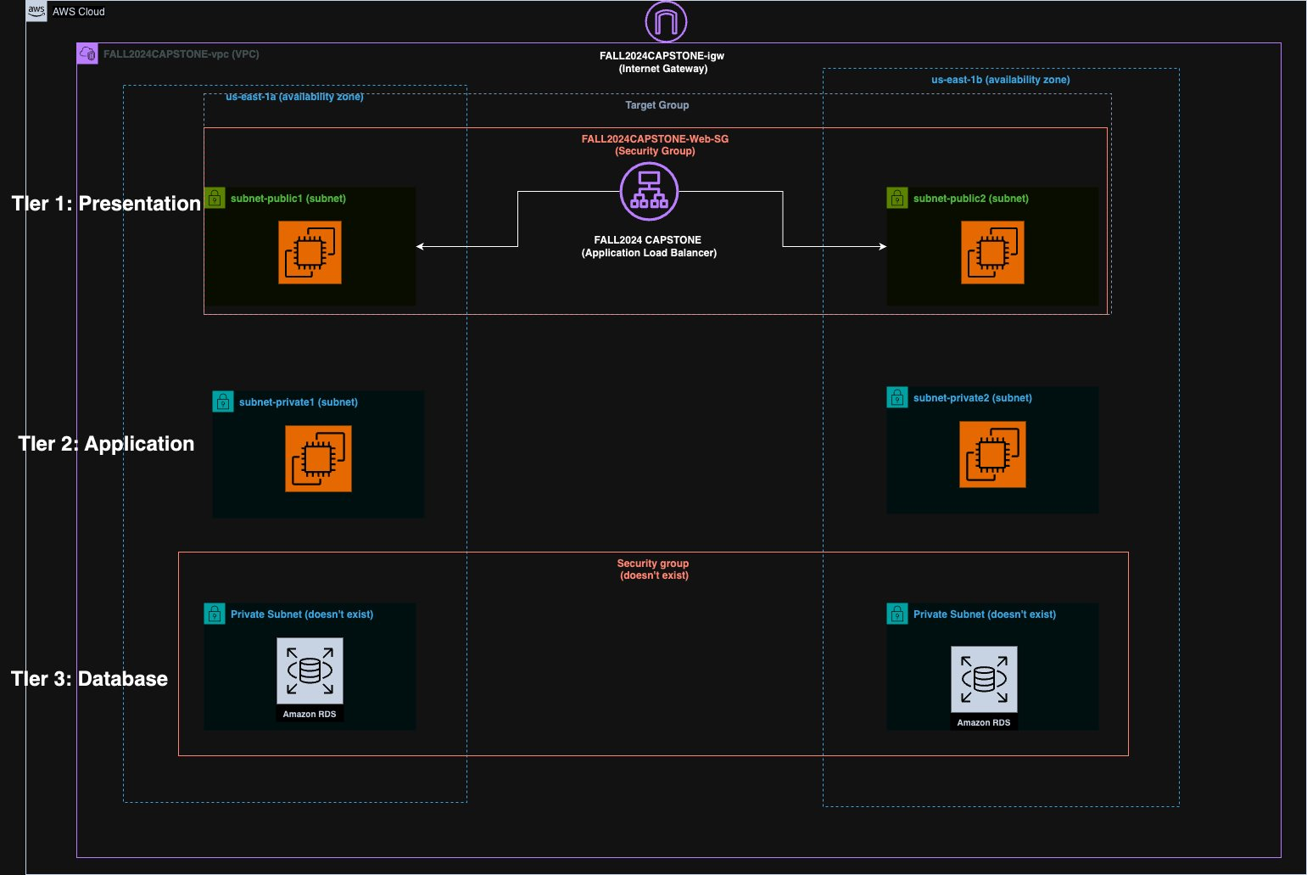
Three Tier Diagram
Data Layer: Manages data storage (e.g., RDS, which was excluded in this project).
Presentation Layer: Handles user interface and requests (e.g., ALB).
Application Layer: Processes business logic (e.g., EC2 instances running application code).
Notes:
To begin, let’s dive into the concept of a three-tier application architecture, which is a well-established software application architecture that organizes applications into three logical and physical computing tiers.
It essentially forms the foundation of modern web applications.
A three-tier architecture separates components into three logical layers:
Tier 1, the Presentation Layer, consists of user-facing resources like the Application Load Balancer (ALB) and the web servers. For this project, we created and tested two EC2 web servers, which form this tier.
Tier 2, the Application Layer, processes business logic and communicates with both the presentation and data layers. While not implemented in this project, in a production environment, this tier would include application servers to handle processing.
Tier 3, the Data Layer, manages storage and retrieval of data. This typically involves a relational database service, like AWS RDS, which we did not create.
In a real-world production environment, user requests are routed through the ALB in Tier 1 to the application servers in Tier 2. These servers process the requests and interact with the database in Tier 3 to retrieve or store data. This architecture ensures scalability, modularity, and ease of maintenance."

Slide 5

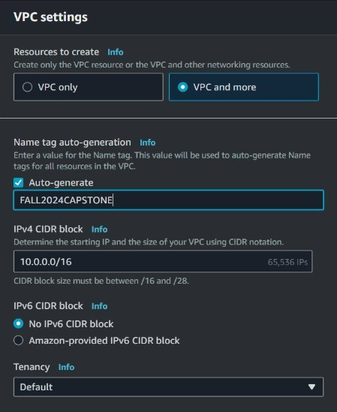
VPC & Network Configuration
Steps for VPC Creation:
Created a new VPC named FALL2024CAPSTONE-VPC with public and private subnets.
Configured a NAT Gateway and internet gateway for secure internet access.
Components Created:
Public and private subnets
Route Tables
Internet Gateway
NAT Gateway
Created a public and private subnet for each availability zones.
Virtual Private Cloud (VPC):
A logically isolated section of the AWS cloud for launching resources in a user-defined virtual network.
Provides full control over the virtual networking environment, including:
Selection of custom IP address ranges.
Creation of subnets.
Configuration of route tables and network gateways.
Notes:
To start, we created a Virtual Private Cloud, or VPC, named FALL2024CAPSTONE-VPC. A VPC is a logically isolated section of the AWS cloud, giving us complete control over networking components like IP address ranges, subnets, route tables, and gateways.
Within the VPC:
Public Subnets were created to host resources that need direct access to the internet, such as the web servers.
Private Subnets were configured for resources requiring enhanced security, isolated from direct internet access.
A NAT Gateway (Network Address Translation) was used to enable instances in private subnets to securely access the internet for updates or external services, without exposing them to inbound internet traffic.
These components work together to ensure secure and efficient traffic flow within the VPC, aligning with industry best practices."

Slide 6
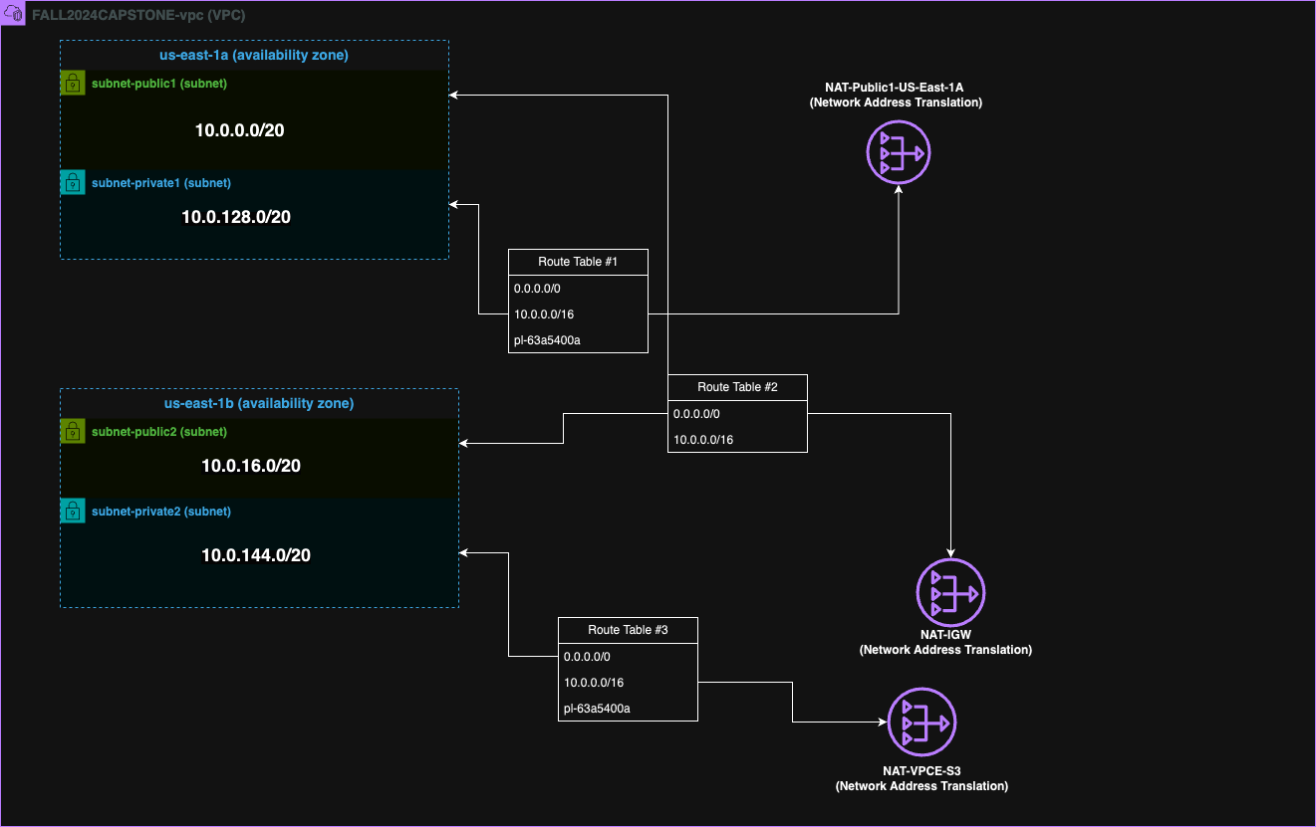
VPC Diagram
Notes:
This diagram illustrates our VPC layout, showing the public and private subnets, route tables, and gateways. Each subnet was designed to handle specific traffic, ensuring both security and functionality for our architecture.

Slide 7
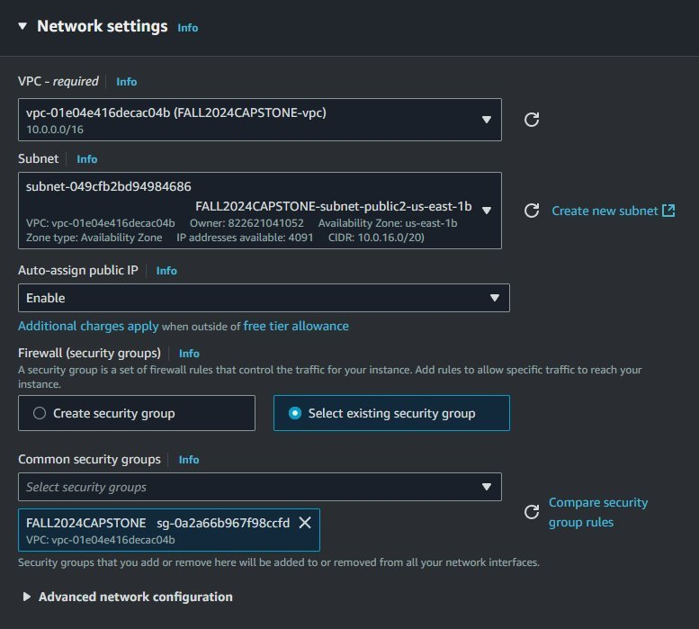
EC2 Instance Creation
What is an EC2 Instance?
Virtual server in Amazon's Elastic Compute Cloud (EC2).
Used for running applications on AWS infrastructure.
Offers scalable computing capacity.
Launch as many or as few virtual servers as needed.
Our EC2 Instance Setup
Launched instances using Amazon Linux 2023 AMI.
Automated httpd installation via user data script.
Notes:
An EC2 instance is a scalable virtual server in Amazon's Elastic Compute Cloud (EC2) used to run applications on AWS infrastructure.
"
For compute resources, we used EC2 instances with Amazon Linux 2023 AMI. A user data script was automated to install the httpd service during instance creation. This allowed us to host the web application seamlessly.

Slide 8
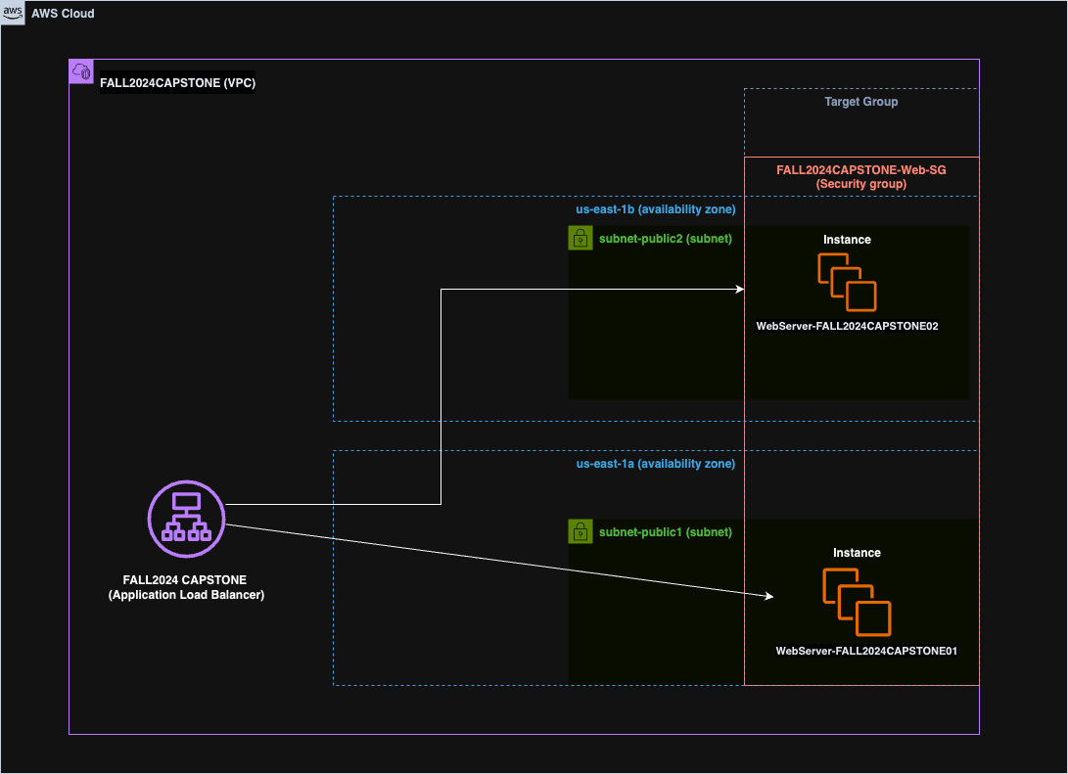
EC2 Diagram
Notes:
This EC2 diagram outlines the deployment of instances across availability zones. This distribution ensures high availability and fault tolerance within our architecture.

Slide 9
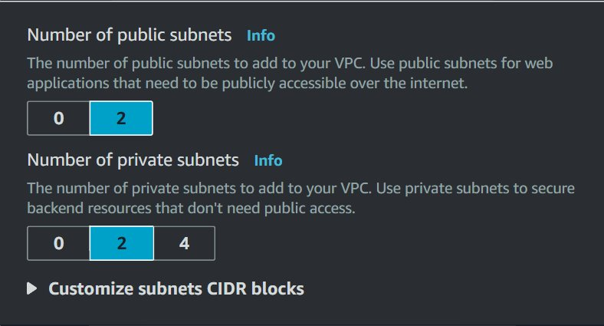
Public and Private Subnets
Public Subnet
Configured for direct internet access.
Associated with a route table that includes a route to an internet gateway.
Resources (e.g., web servers) can communicate directly with the internet.
Accessible from the internet.
Private Subnet
No direct internet access.
Instances communicate with the internet through a NAT gateway in a public subnet.
Enhances security by isolating resources from direct internet exposure.
Notes:
-A public subnet is a subnet within a Virtual Private Cloud (VPC) that is configured to allow direct access to the internet. This is typically achieved by associating the subnet with a route table that has a route to an internet gateway. Resources in a public subnet, such as web servers, can communicate directly with the internet and are accessible from the internet.
A private subnet is a subnet within a VPC that is not directly accessible from the internet. Instances in a private subnet can communicate with the internet only through a Network Address Translation (NAT) gateway in a public subnet. This setup enhances security by isolating resources from direct internet access.

Slide 10
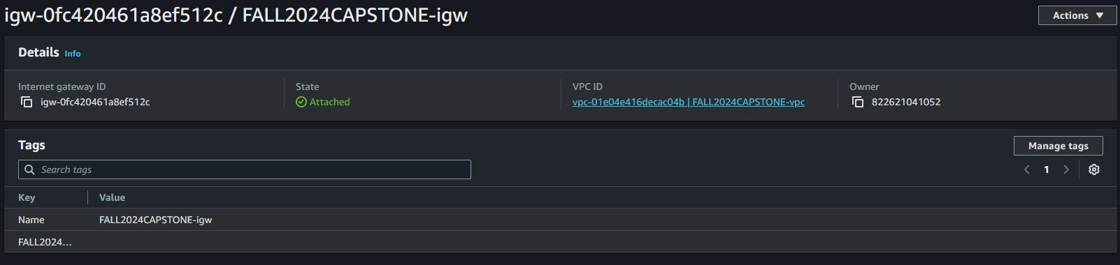
Internet Gateway
An Internet Gateway is a horizontally scaled, redundant, and highly available VPC component that allows communication between instances in your VPC and the internet.
It serves as a bridge between your VPC and the internet, enabling instances in public subnets to send and receive traffic from the internet.
Notes:
"The Internet Gateway is a key component for public subnets, enabling instances to send and receive internet traffic. It serves as the bridge between our VPC and the wider internet." As you can see in the screenshot, it was implemented in our vpc.

Slide 11
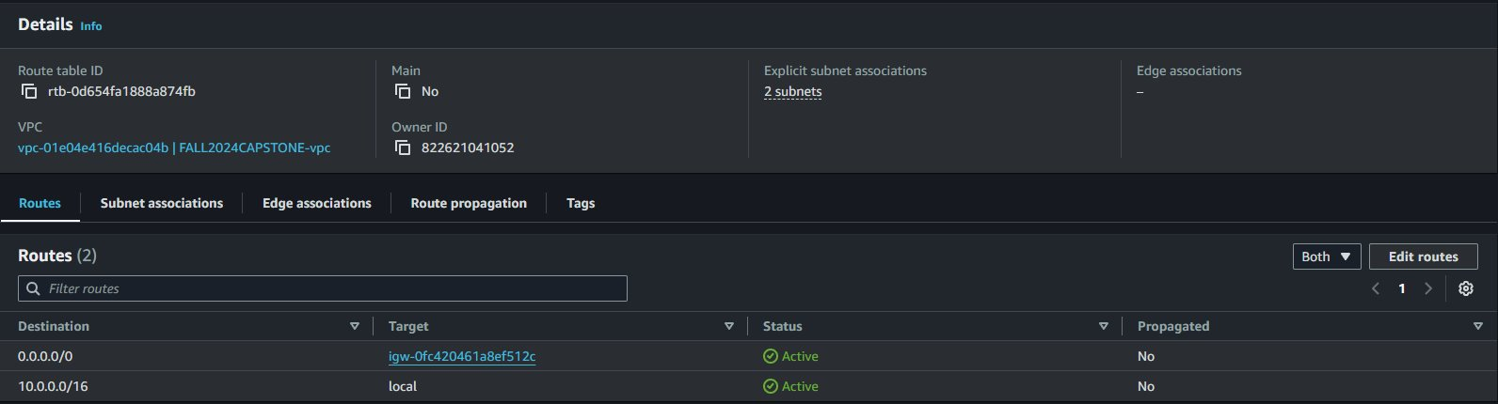
Route Table
A route table is a set of rules, called routes, that are used to determine where network traffic is directed within a Virtual Private Cloud (VPC). Each subnet in your VPC must be associated with a route table, which controls the routing of traffic within the VPC and to external destinations.
To create ours, we:
Configured routes for public and private subnets.
Linked route tables to their respective subnets.
Notes:
"Route tables were configured to direct traffic within the VPC and to external destinations. Public subnets use a route to the Internet Gateway, while private subnets route through the NAT Gateway for outbound traffic." "We configured routes for public and private subnets and linked each route table to its respective subnet."

Slide 12
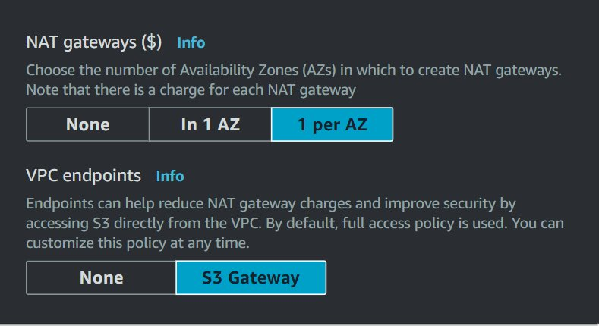
NAT Gateway
Purpose:
Enables instances in a private subnet to connect to the internet or other AWS services.
Blocks inbound internet-initiated connections to private instances.
Key Benefits:
Secure access to external resources for private instances.
Prevents exposure to inbound internet traffic.
Notes:
A NAT Gateway (Network Address Translation Gateway) is a managed service that enables instances in a private subnet to connect to the internet or other AWS services, while preventing the internet from initiating connections with those instances. It provides a secure way for private instances to access external resources without exposing them to inbound internet traffic.

Slide 13
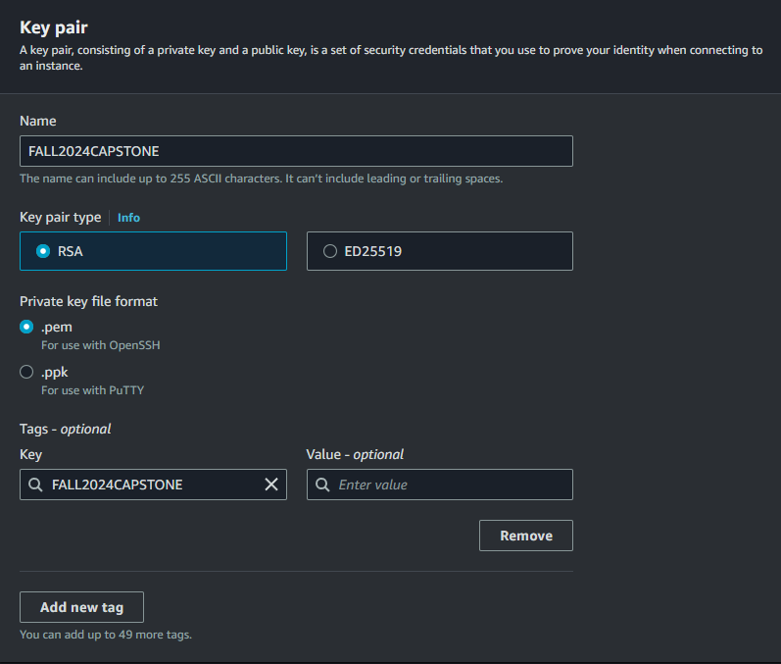
Key Pair Creation
A Key Pair in AWS is a set of security credentials that you use to prove your identity when connecting to an EC2 instance.
It consists of a public key that AWS stores and a private key that you store.
Key pairs are used primarily for SSH access to Linux instances and RDP access to Windows instances.
Notes:
A Key Pair in AWS is a set of security credentials consisting of a public key stored by AWS and a private key stored by the user, used to authenticate connections to EC2 instances.
"Key pairs were created to enable secure SSH access to our Linux EC2 instances. AWS stored the public key, while we retained the private key to authenticate and establish secure connections."

Slide 14
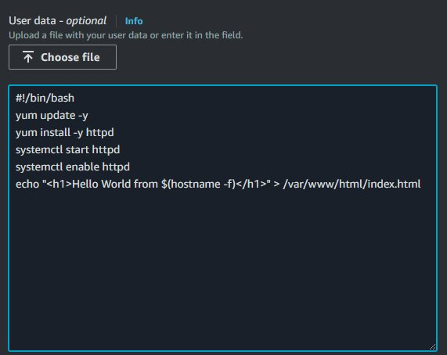
Automating Web Server Setup
Purpose: The User Data field automates EC2 instance setup by running scripts at launch to ensure consistent, efficient, and scalable configurations, such as installing and configuring a web server.
Program turns the EC2 instances into a web server.
This Linux BASH scripts only runs when the EC2 instance is first ever started
#!/bin/bash: Specifies the script runs in BASH shell.
yum update -y: Updates system packages; YUM (Yellowdog Updater, Modified) is a package manager.
yum install -y httpd: Installs Apache HTTP server.
systemctl start httpd: Starts the HTTPd service.
systemctl enable httpd: Ensures the service starts on reboot.
HTML File Creation: Adds a basic webpage to verify server functionality.
Notes:
During the EC2 instance launch, we ran a user data BASH script to automate web server configuration. This Linux BASH scripts only runs when the EC2 instance is first ever started. As you can see in the slide, there is a breakdown of what each command does. They each have a specific role, from updating packages to enabling HTTPd on startup. By creating a simple HTML file, we could verify that the web server was functioning correctly. This automation streamlines deployment and ensures consistency across instances.

Slide 15
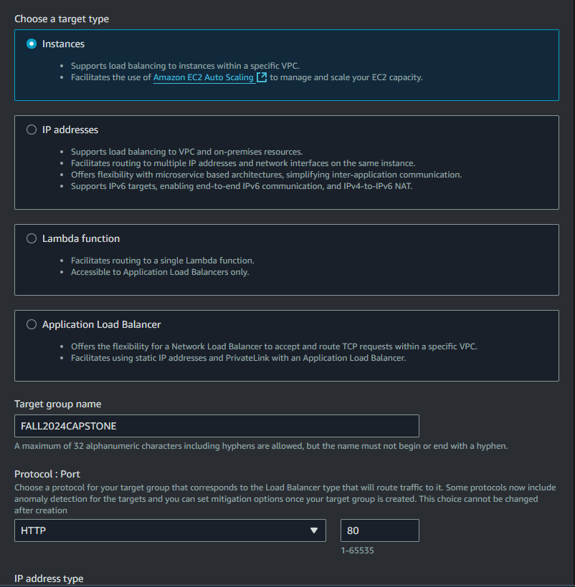
Target Group Creation
A Target Group in AWS Elastic Load Balancing is used to route requests to one or more registered targets, such as EC2 instances, IP addresses, or Lambda functions. Target groups are essential for distributing traffic equally and ensuring high availability and scalability of your applications.
Notes:
A Target Group in AWS Elastic Load Balancing routes traffic to registered targets, such as EC2 instances or Lambda functions, ensuring balanced traffic distribution and high availability.
"We created target groups to manage traffic distribution. Registered targets, including EC2 instances, ensured efficient routing of application traffic and supported load balancing for high availability."

Slide 16
AWS Firewalls
Security Groups:
A stateful firewall controlling inbound and outbound traffic for Elastic Compute Cloud (EC2) instances and load balancers.
Automatically allows return traffic for existing connections.
Network Access Control Lists (NACLs):
A stateless firewall managing traffic at the subnet level.
Requires explicit rules for both inbound and outbound traffic.
Automatically created and associated with the VPC during setup.
Notes:
In AWS, there are two primary types of firewalls to control traffic: Security Groups and Network Access Control Lists, or NACLs.
Security Groups are stateful firewalls, meaning they automatically allow return traffic for any outbound connections. These are applied at the instance level, simplifying rule management for Elastic Compute Cloud (EC2) instances and load balancers.
NACLs are stateless firewalls, which require explicit rules for both inbound and outbound traffic. They operate at the subnet level, providing an additional layer of security.
When a Virtual Private Cloud (VPC) is created, a default NACL is automatically created and associated with it. For this project, we used the default NACL that came with the VPC but did not modify it. By default, this NACL allows all inbound and outbound traffic unless explicitly changed. The key distinction is that Security Groups manage traffic at the instance and load balancer level, while NACLs handle subnet-level traffic.

Slide 17
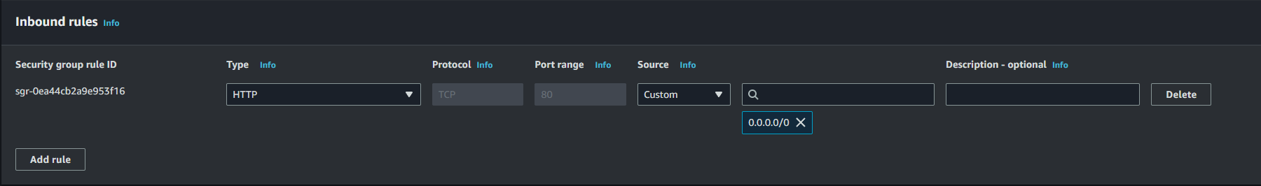
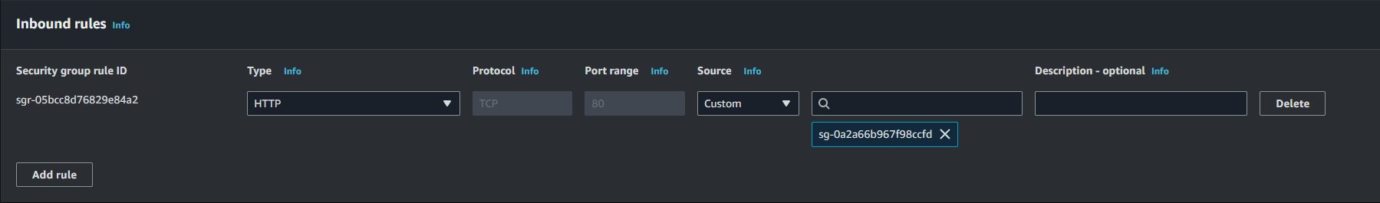
Security Group Creation
Application Load Balancer - a virtual firewall that controls the inbound and outbound traffic to and from the ALB.
The application load balancer security group ensures that only traffic from port 80 is allowed
EC2 - a virtual firewall that controls the inbound and outbound traffic to and from an EC2 instance. The EC2 security group ensures that all traffic goes through the application load balancer.
Notes:
We created two security groups to ensure that the traffic only goes through Application load balancer
The security group for the Application Load Balancer (ALB) acts as a virtual firewall, controlling inbound and outbound traffic to and from the ALB. It is configured to allow traffic only on port 80, ensuring that only HTTP traffic is processed.
The security group for the EC2 instances controls traffic at the instance level, ensuring that all inbound traffic originates exclusively from the ALB.
As a best practice, we modified the configuration to restrict inbound source traffic to the ALB’s security group. This ensures that the targets—our EC2 instances—only receive traffic routed through the ALB, enhancing security and maintaining proper traffic control. Restricting traffic in this way aligns with AWS best practices for securing load balancer targets.

Slide 18
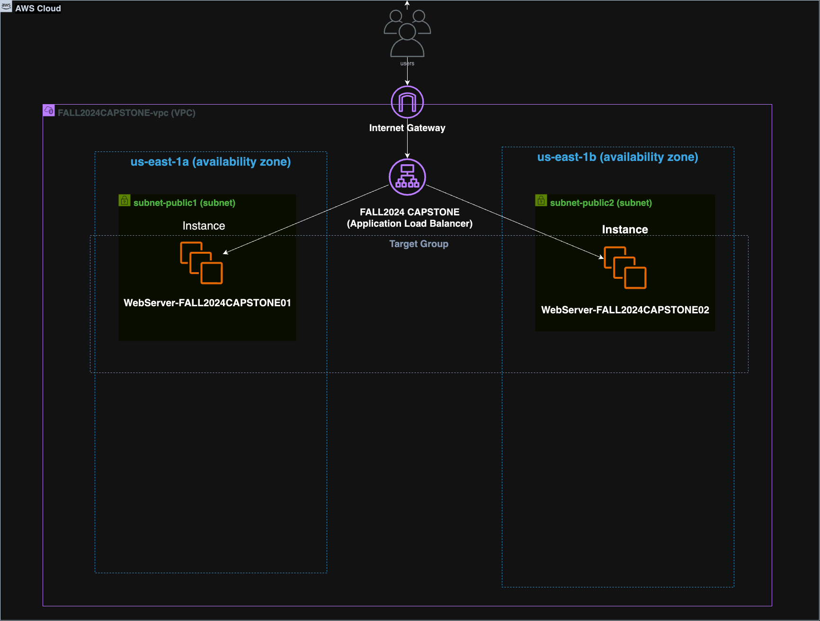
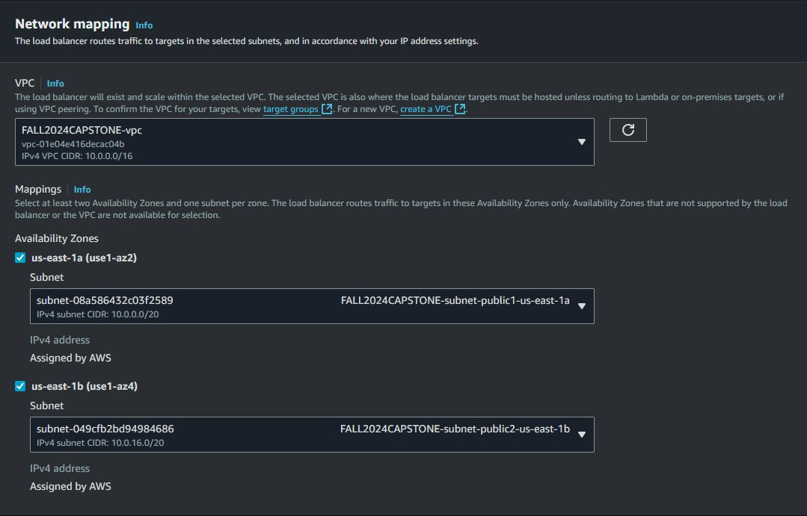
Application Load Balancer Creation
What is an ALB?
A load balancer in AWS Elastic Load Balancing.
Distributes incoming application traffic across multiple targets (e.g., EC2 instances, containers, IP addresses).
Operates at the application layer (Layer 7) of the OSI model.
Designed for web applications.
Notes:
An Application Load Balancer (ALB) is a type of load balancer within the AWS Elastic Load Balancing service that automatically distributes incoming application traffic across multiple targets, such as EC2 instances, containers, and IP addresses. ALBs operate at the application layer (Layer 7) of the OSI model and are ideal for web applications.
An ALB operates at Layer 7 (the Application Layer) of the OSI model. It is designed to distribute incoming application traffic based on various application-level data, like HTTP headers, cookies, and request paths. Here's how it functions at this layer
This slide demonstrates the setup and configuration of our Application Load Balancer (ALB). The diagram shows how the ALB routes traffic from users to EC2 instances, ensuring that no traffic directly accesses the instances. The screenshot provides a view of the ALB configuration, highlighting its integration with the EC2 instances and associated target groups. This setup aligns with best practices for security and high availability, ensuring that the ALB manages all traffic efficiently.

Slide 19
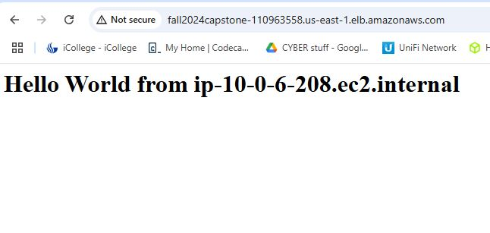
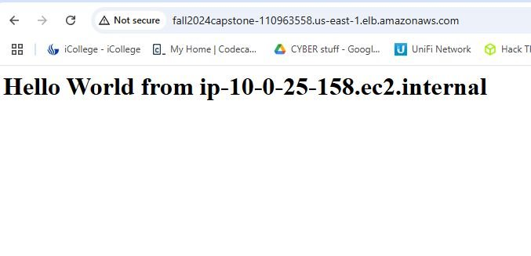
Application Load Balancer
Screenshots demonstrating:
Successful connection to the ALB.
Traffic routed to both EC2 instances (e.g., displaying "Hello World" with each instance’s hostname or IP).
Key Points:
The ALB ensures high availability by evenly distributing traffic across both EC2 instances.
Notes:
"As a best practice, we deployed the Application Load Balancer (ALB) to act as a security layer, ensuring web traffic does not directly access the EC2 instances. To test its functionality, we accessed the ALB’s Domain Name System (DNS) name in a browser. The screenshots show successful connections to the ALB, displaying 'Hello World' along with each EC2 instance's hostname or IP. By refreshing the page, we observed traffic alternating between the instances, confirming the ALB’s load distribution and high availability. This configuration enhances security, ensures redundancy, and routes traffic only to healthy instances, aligning with best practices for reliability and performance."

Slide 20
Project Challenges
Challenge 1: Limited time to complete all tasks and ensure quality.
Solution: Divided tasks efficiently among team members and maintained regular check-ins to track progress.
Challenge 2: Lack of prior experience with AWS tools and services.
Challenge 3: Integrating multiple components (VPC, EC2) into a cohesive system.
Solution: Broke down tasks into smaller steps and validated configurations at each stage to ensure accuracy.
Solution: Utilized AWS documentation, online tutorials, and collaborated as a team to learn and troubleshoot.
Notes:
We faced challenges such as:
Limited time, which required task prioritization and efficient teamwork.
Learning AWS tools, addressed through collaboration and AWS documentation.
Integrating components, solved by breaking tasks into smaller, verifiable steps.

Slide 21
Project Outcomes
Created a secure and resilient AWS environment.
Achieved compliance with NIST, ISO, and SOC2 frameworks.
Ensured seamless failover and load management.
Developed a three-tier architecture for future scalability.
Notes:
We successfully created a secure and resilient AWS infrastructure.
Compliance was achieved with NIST, ISO, and SOC2.
The architecture supports seamless failover, scalability, and resource optimization, ready for future growth.
Our project successfully met the objectives of the GSU Cybersecurity Team by delivering key outcomes:
We created a secure and resilient AWS environment, following best practices for VPC design, EC2 setup, and ALB configuration.
In coordination with the risk assessment team, We ensured compliance with frameworks like NIST, ISO 27001, and SOC2 using Prowler, a CSPM tool.
The architecture supports seamless failover and load management, maintaining high availability.
Lastly, we implemented a scalable three-tier architecture that provides a foundation for future expansion, such as adding a database in a production environment."

Slide 22
Operations & Security Significance
Virtual Private Cloud (VPC): Secure and isolated network environment.
EC2 Instances: Scalable compute capacity with security measures.
Load Balancers: High availability and fault tolerance.
Tagging Strategy: Efficient resource management and cost optimization.
Notes:
Speaker Notes:
Our setup demonstrated the importance of key AWS components:
Virtual Private Cloud (VPC): "The VPC provides a secure and isolated network environment, crucial for protecting sensitive data and ensuring compliance with security standards. It allows for granular control over network traffic and segmentation of resources."
EC2 Instances: "EC2 instances are the backbone of our application, providing scalable compute capacity. Security groups and key pairs ensure that only authorized users can access these instances, protecting against unauthorized access and potential breaches."
Load Balancers: "These services ensure high availability and fault tolerance by automatically adjusting the number of instances based on traffic and distributing incoming traffic across multiple instances. This setup minimizes downtime and enhances the user experience."
Tagging Strategy: "Tags help in organizing and managing resources efficiently, making it easier to track usage and costs. This strategy is essential for maintaining operational efficiency and optimizing resource allocation."

Slide 23
Security Best Practices
Virtual Private Cloud (VPC): Network ACLs, security groups, private subnets
EC2 Instances: Regular updates, IAM roles, logging, and monitoring
Load Balancers: Health checks, TLS, WAF
Tagging Strategy: Consistent and meaningful tags, regular audits
Auto Scaling Groups (ASGs): Dynamic scaling, instance replacement, fault tolerance
Application Load Balancer (ALB): Web traffic routing, preventing direct EC2 access, improving security
Notes:
Speaker Notes:
Although we worked in an AWS Sandbox, if we were working in a real environment, these are the industry’s best practices we would implement:
Virtual Private Cloud (VPC): "To enhance security, implement network ACLs and security groups to control traffic flow. Use private subnets for sensitive data and services, ensuring they are not directly accessible from the internet. Properly configure route tables and gateways to prevent unauthorized access."
EC2 Instances: "Regularly update and patch EC2 instances to protect against vulnerabilities. Use IAM roles to manage permissions securely, ensuring that instances have only the necessary permissions. Enable logging and monitoring with services like AWS CloudTrail and Amazon CloudWatch to detect and respond to security incidents promptly."
Load Balancers: "Configure health checks to ensure that only healthy instances receive traffic, improving the reliability of the application. Use TLS certificates to encrypt data in transit, protecting it from interception and tampering. Implement a Web Application Firewall (WAF) to protect against common web exploits and attacks. A WAF protects applications by filtering and monitoring HTTP and HTTPS requests, shielding them from exploits like SQL injection
ALB: Deploy an Application Load Balancer to route web traffic, ensuring traffic does not connect directly to EC2 instances. This improves security by protecting instances from direct exposure to the internet and enhances availability by distributing traffic across multiple instances. ALBs are ideal for handling complex routing based on content like URL paths or headers."
Tagging Strategy: "Use consistent and meaningful tags to categorize resources by environment, owner, and purpose. This practice helps in identifying and managing resources effectively, ensuring compliance with security policies and optimizing costs. Regularly audit tags to ensure they are up-to-date and accurately reflect the resource usage."
Auto Scaling Groups (ASGs): "Automatically adjust the number of instances based on demand, ensuring consistent application performance and availability. ASGs also replace failed instances to maintain fault tolerance, improving reliability and resilience in production environments."

Slide 24

Thank You
Notes:
We appreciate your attention to our portion of the presentation, where we outlined our approach to building a secure and scalable AWS infrastructure.
Now, our collaborating team, the Risk Assessment Team, will provide a detailed analysis of the risks and compliance measures associated with the AWS environment we created, ensuring its alignment with industry security standards.

