Slide 1
Wine Bot
Cyrus, Freeman, Lee, Van
GWU Data Bootcamp
Final Project

Slide 2
Proposal
Twitter bot that accomplishes the following:
Scores a wine using wine type, RS, pH, & ABV %
Trained and tested using a dataset and KNN model
Gives recommended food pairings for a beverage
Beer, wine, liqour…it doesn’t discriminate
Use LCBO API

Slide 3
*Live Demo*
EXCITING!
(Please direct your attention to the twitter account @Vino_Diezel)

Slide 4
Approach
Training data in .csv format gathered from:
https://archive.ics.uci.edu/ml/datasets/wine+quality
Data prep and preliminary analysis complete using:
Excel: data prep and correlation analysis
Jupyter Notebook: Python, MatPlotlib, Multi Lnr Regr
Determined KNN was most appropriate
Jupyter Notebook: Python, SKLearn, MatPlotLib
Set up twitter bot utilizing Tweepy and Twitter API

Slide 5
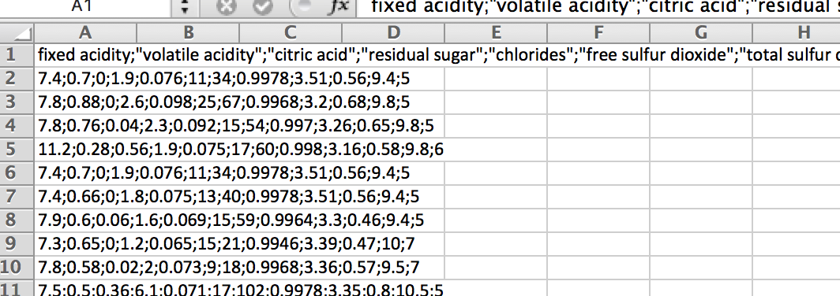
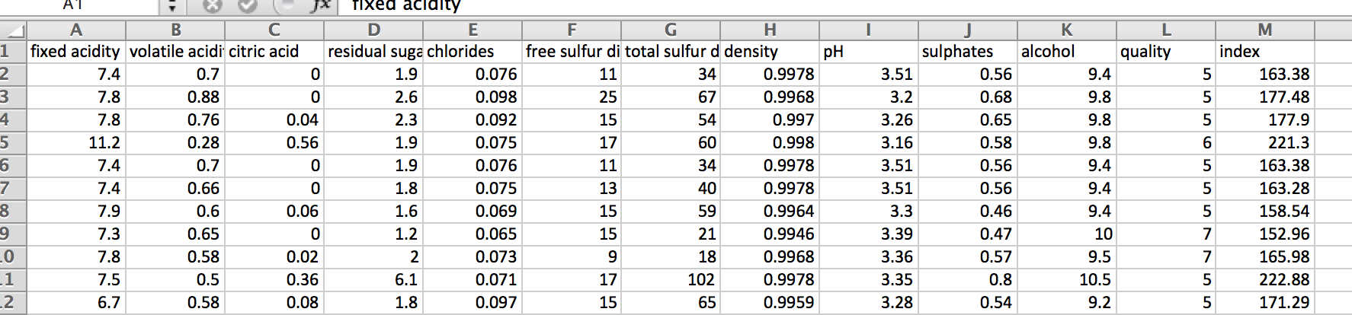
CSV Data

Slide 6
Data
Attributes | Used For Testing | Final Model
Fixed Acidity | MLR | MLR
Volatile Acidity | MLR | MLR
Citric Acid | MLR
Residual Sugar | MLR, KNN | MLR, KNN
Chlorides | MLR
Free Sulfur Dioxide | MLR | MLR
Total Sulfur Dioxide | MLR | MLR
Density | MLR | MLR
pH | MLR, KNN | MLR, KNN
Sulphates | MLR | MLR
Alcohol | MLR, KNN | MLR, KNN
Quality | MLR, KNN | MLR, KNN

Slide 7
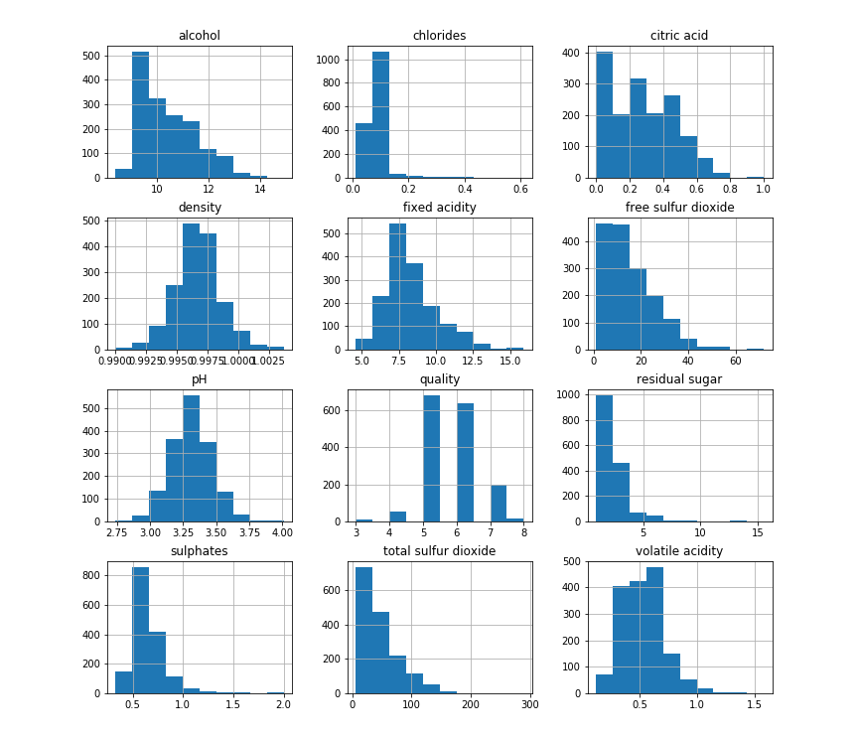
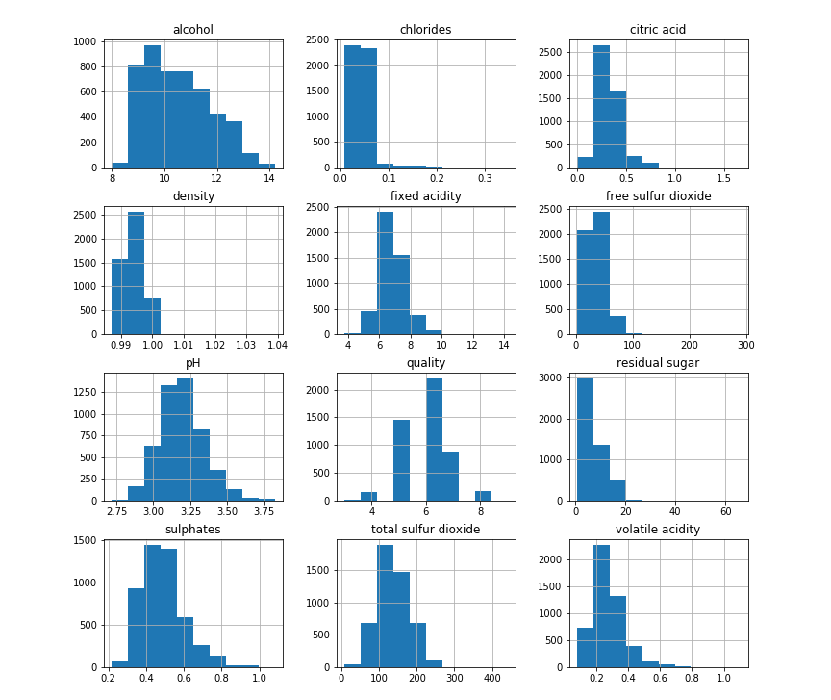
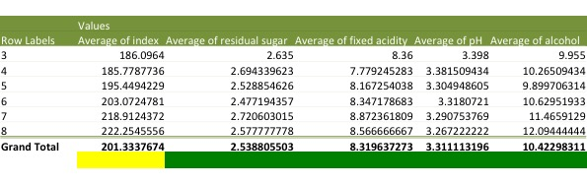
Prelim Data Analysis
Red
White
Correlation analysis

Slide 8
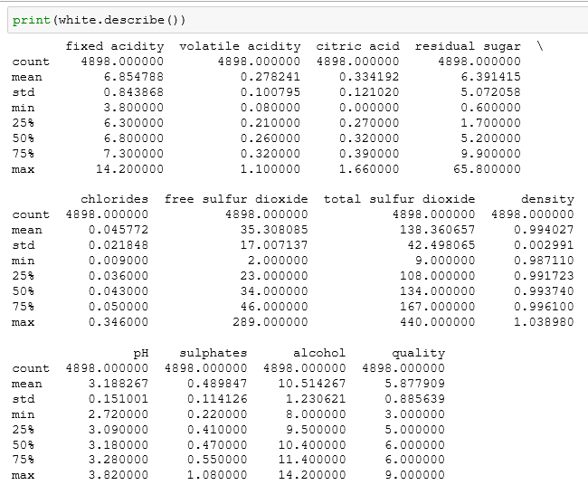
Prelim Data Analysis

Slide 9
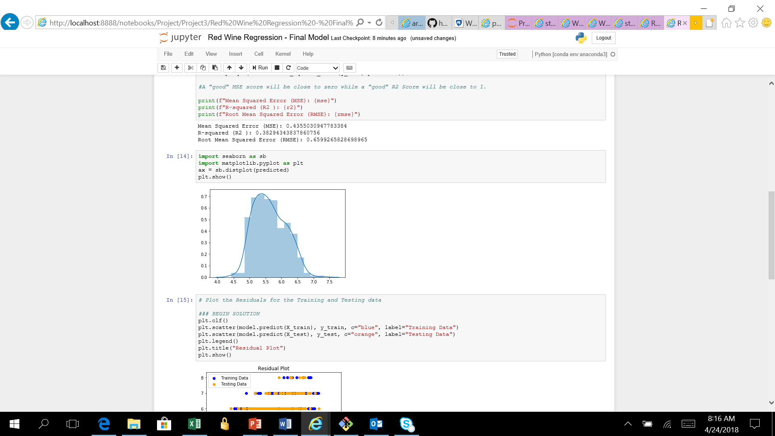
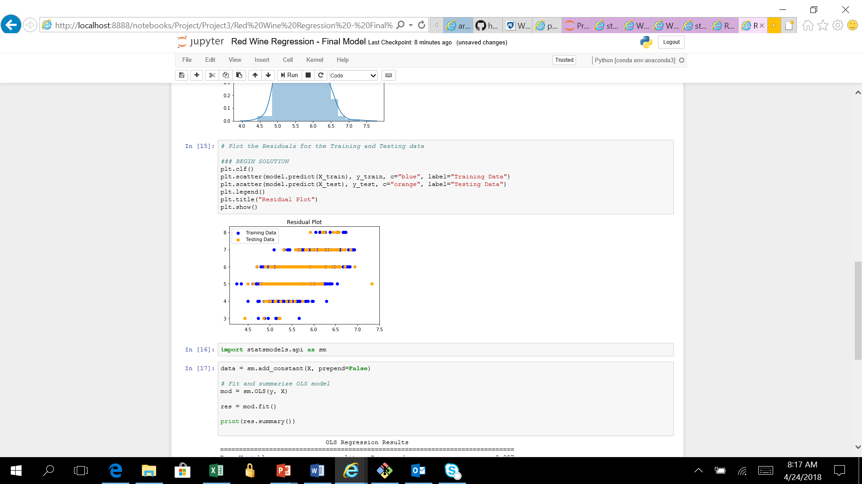
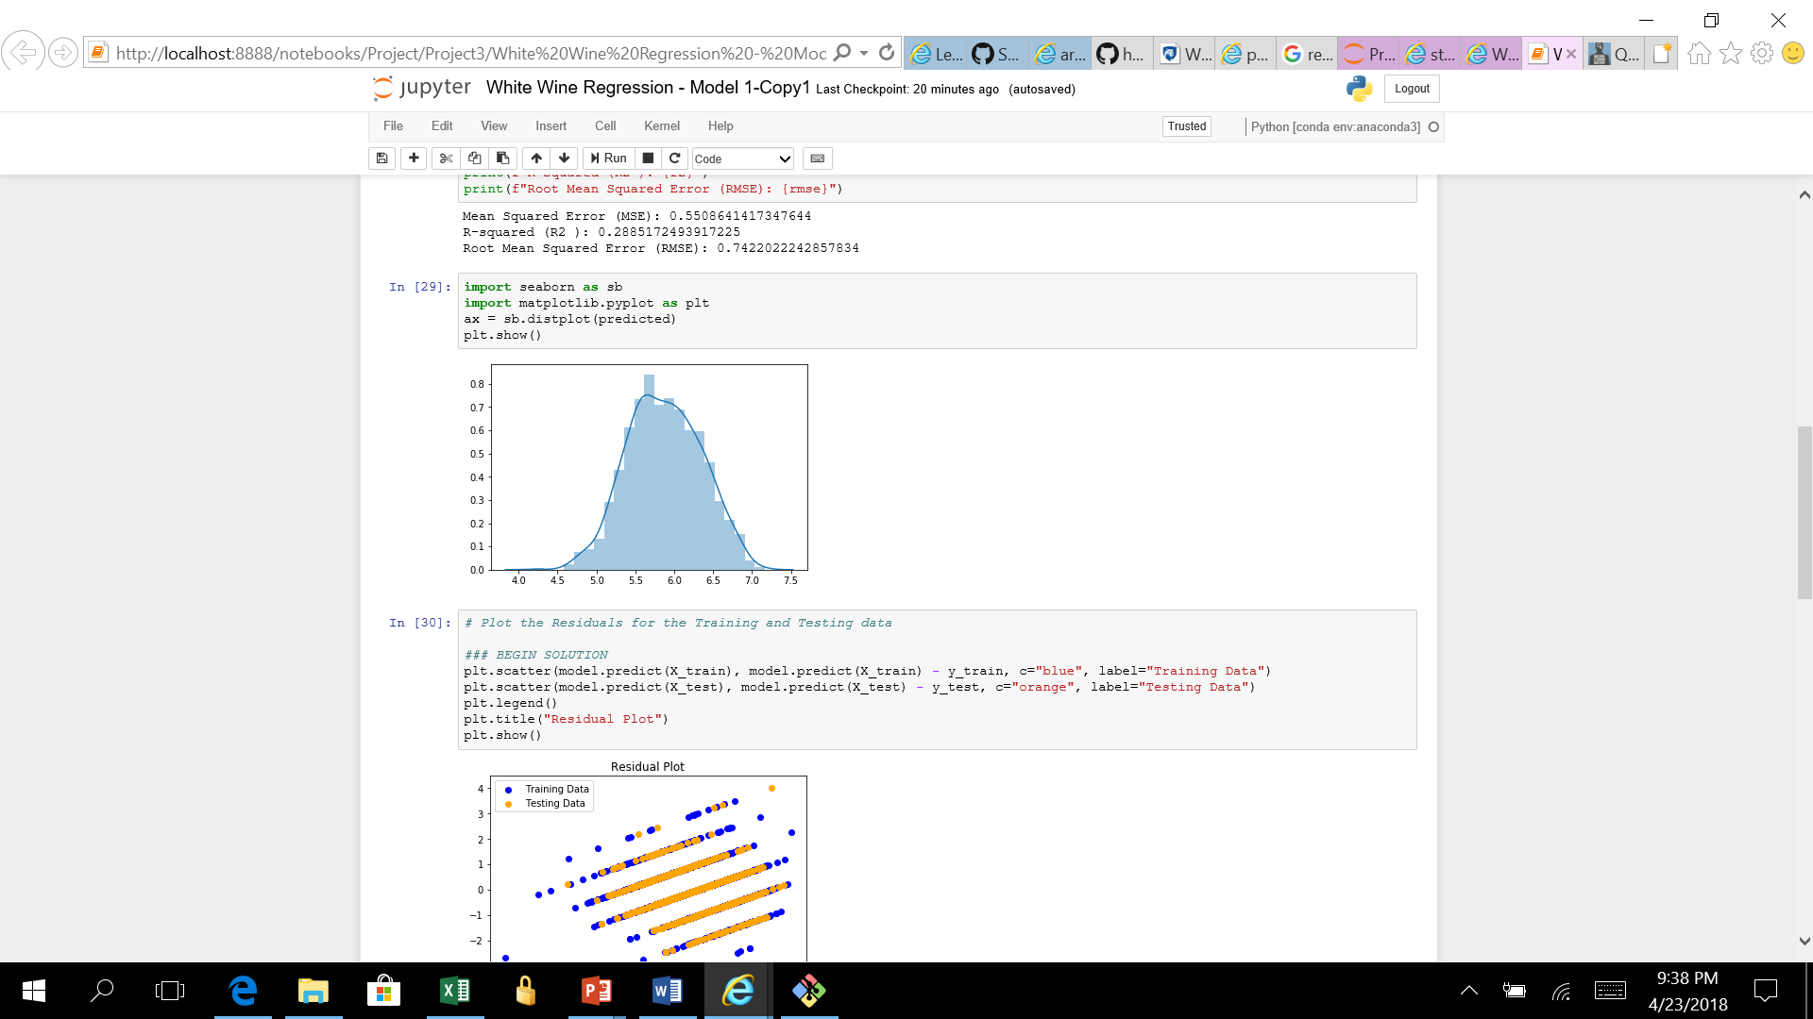
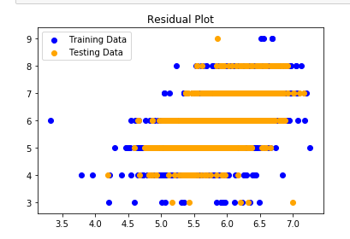
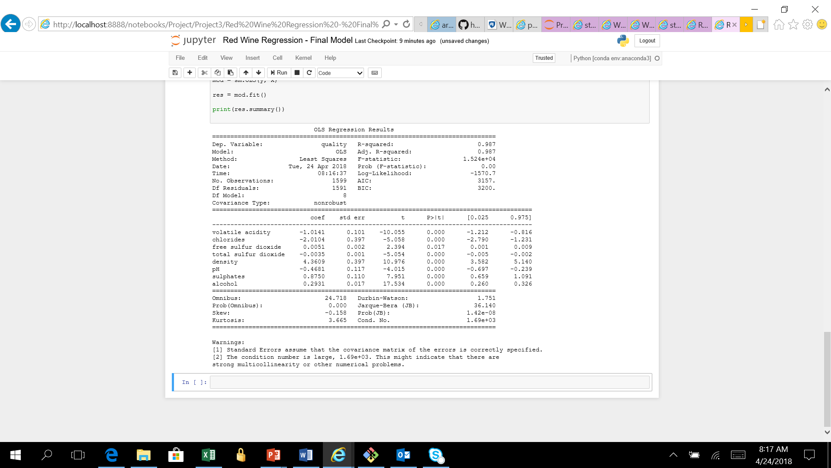
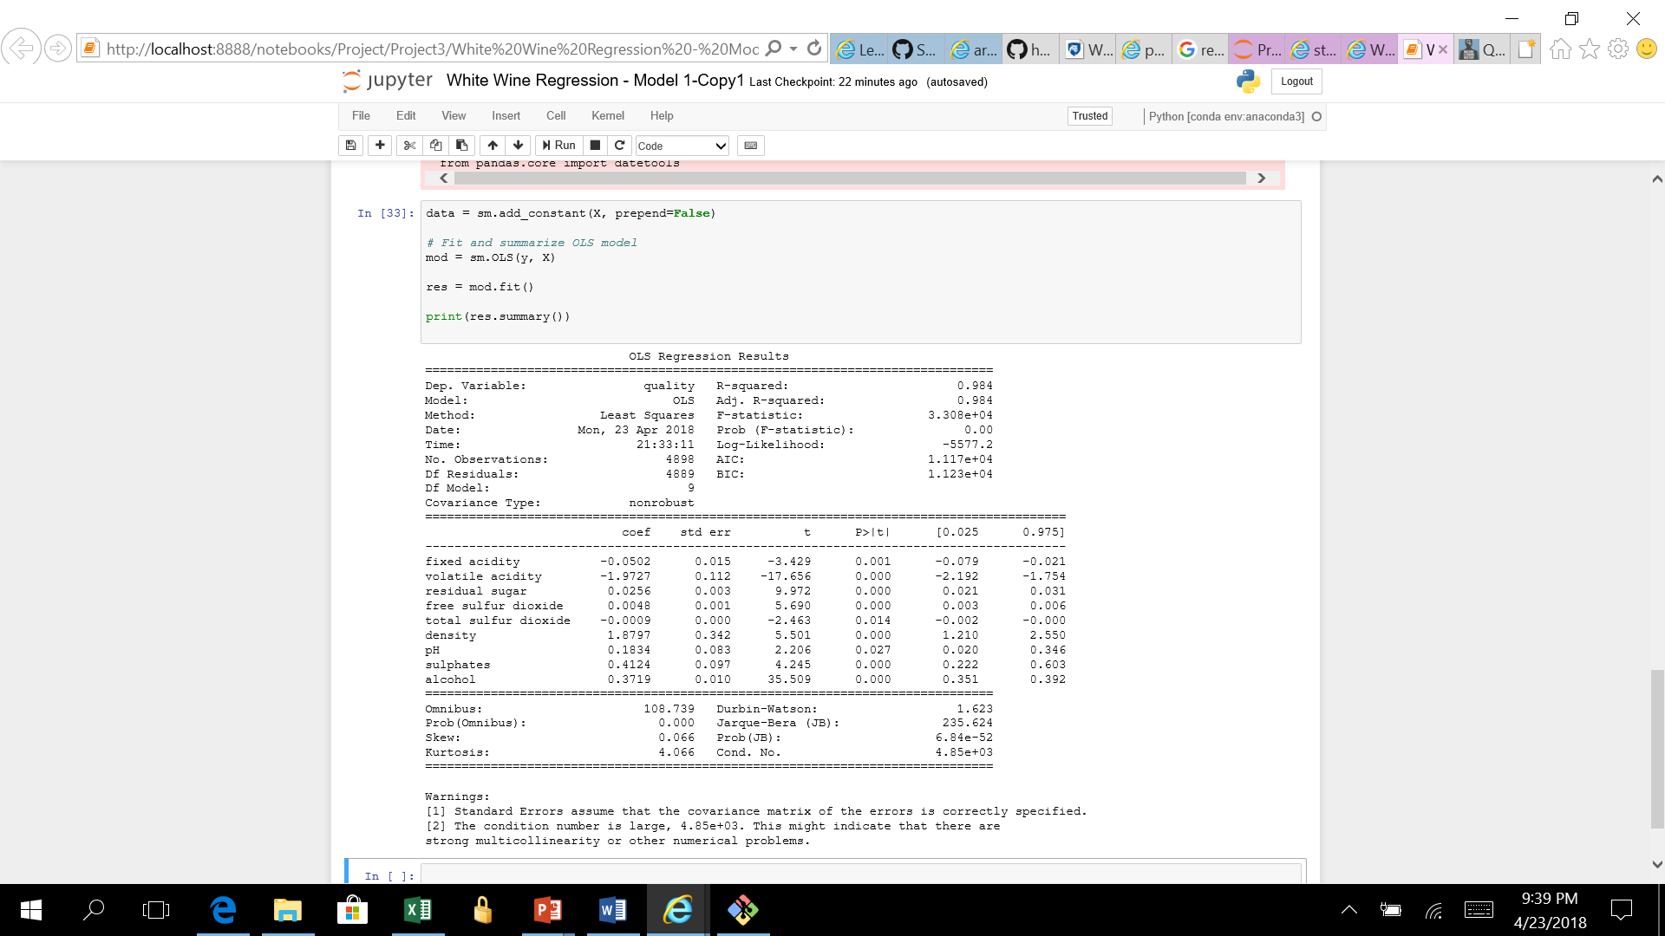
Multiple Linear Regression
Mean Squared Error (MSE): 0.4355
R-squared (R2 ): 0.3829
Mean Squared Error (MSE): 0.5508
R-squared (R2 ): 0.2885

Slide 10
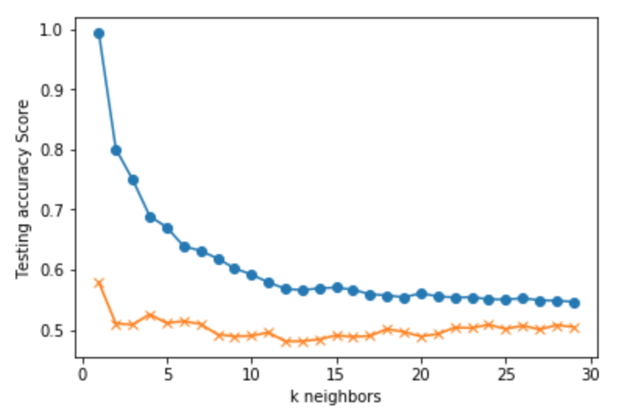
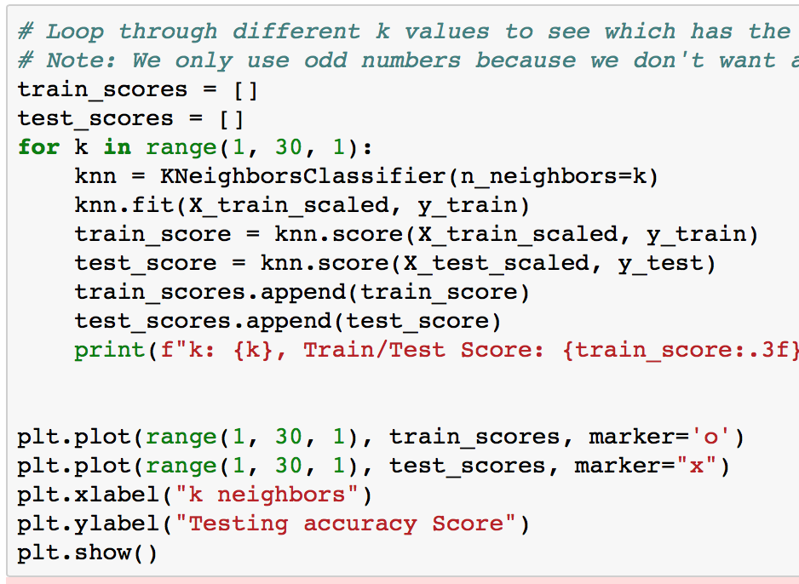
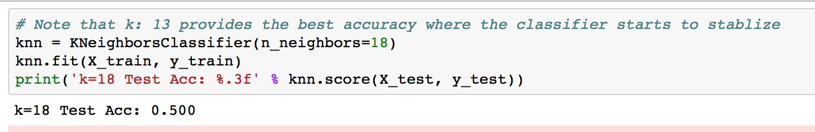
SKLearn + KNN

Slide 11
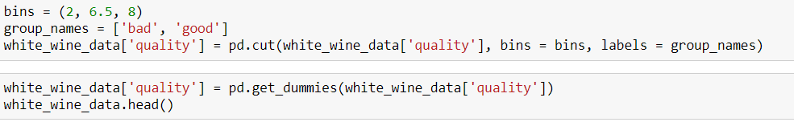
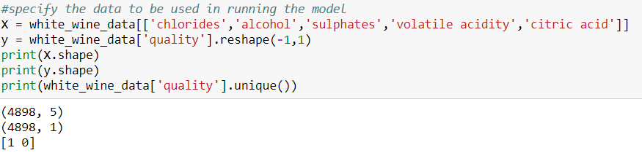
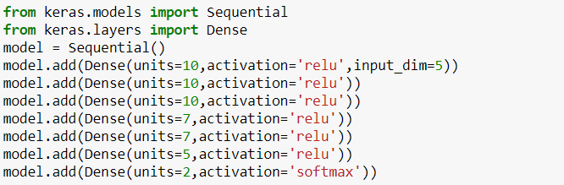
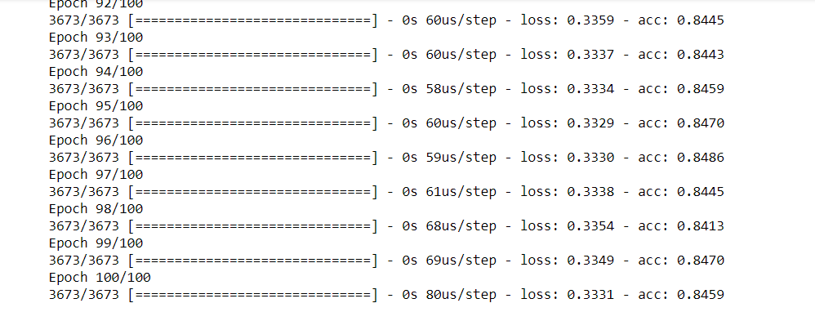

Deep Neural Network Model

Slide 12
Challenges
Accuracy
Choosing which model to use
For KNN: picking k, how many params, which params
Getting it to run properly on Heroku
Error catching

Slide 13
Questions?

Slide 14
Links
Github for Heroku:
https://github.com/cbakhshi/SommBot
Github with initial files:
https://github.com/Lehughes04/SommelierBot
Twitter:
https://twitter.com/Vino_Diezel

