Slide 1
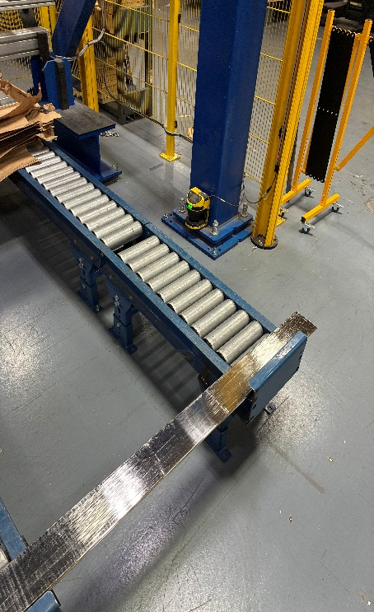
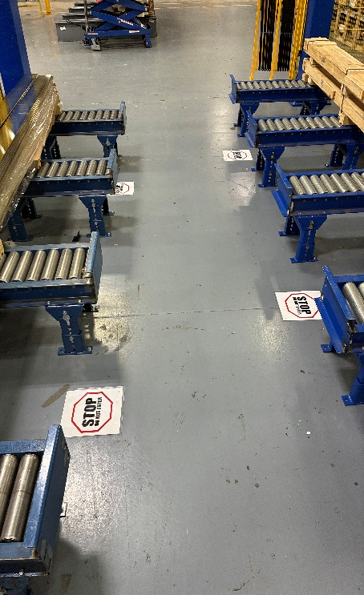
Gantry Slip and Trip – Conveyor Step-Over Fall
August 4, 2026 – Sumter, South Carolina – Fabrication / Copper, A Shift
Plant Manager: Stephen Krajcarski, EHS Site Contact: Charlie Ball
Incident description:
An A-shift operator pushed a load back on the Gantry 2 conveyor behind EHRT 2, saw that interleaving paper had fallen from the stack, and stepped over the conveyor to get it. Stepping back over the outside conveyor he tripped and fell head-first, striking his face. Lip laceration and sutures; returned next shift, no restrictions.
Investigation Findings:
Four conveyors at Gantry 2 — all free rollers. Stacks are pushed back by hand from inside the center aisle.
Paper fell between the rollers. He entered the aisle to get it, then crossed the outside conveyor to exit rather than walking back out. His foot caught; the fall was head-first with no hands out.
Area scanners stop the gantry when someone enters the zone, but are off during loading — the aisle was unguarded.
Interleaving paper is a supplier fix for water spotting; packaging has drifted and it now arrives loose. Receiving inspection is written into the method sheet but is not performed.
Root Causes and Management System Gaps:
Immediate cause — Poor Work Practice; Eyes or Mind Not on Task.
Processes not (continuously) monitored for effectiveness — area scanners guard the aisle only while the gantry runs, not while it is being loaded.
Processes have not been created — receiving inspection is documented but not performed, so packaging drift puts loose paper into the machine aisle.
Where he crossed. Exit was over the outside conveyor.
Containment: aisles closed, signage both ends.
How does this incident apply to you?
Does anyone in your area cross a conveyor, rack, or other structure on foot to reach material or debris? Gantries 1 and 3 have the same layout, the same free rollers and the same hand push-back.
Are your area scanners or light curtains active during loading and setup, or only while the machine is running?
Does packaging debris — paper, plastic, banding — end up inside your machine aisles, and can anyone retrieve it without entering?
Is there a written, trained method for returning material that does not require entering the aisle?
Interim Containment Actions:
STOP / DO NOT ENTER floor signage at both ends of the gantry aisles.
Safety stand-downs held with the affected shifts.
Expandable barrier gate staged across the aisle opening.
Preventive & Corrective Actions:
Method now in force - push from the middle face only and exit the way you came in. Do not cross a conveyor on foot.
6-inch and 8-inch copper is a two-person push, one per outside face.
Do-not-enter signage made permanent at both ends of each aisle.
Environment, Health & Safety Lessons Learned

