Slide 1
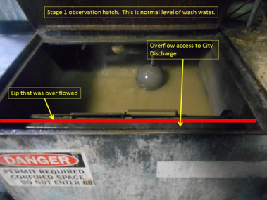
pH Exceedance - City of Nacogdoches Wastewater Permit
September 17, 2018 – Nacogdoches, Texas
Plant Manager: Uzoa Darwichzada, EHS Site Contact: Scott Jacobs
EXAMPLE
Incident description:
Our final wastewater outfall was being tested during our semi-annual wastewater sampling and our 3rd party lab notified us at that time that the pH was higher than our permit limit. An immediate investigation was commenced.
Investigation Findings:
Stage 1 of the 8 stage washer was overflowing into the main drain to the City sewer (in normal operation, stages 3-6 overflow and higher pH stages 1 and 2 do not).
Found spray nozzles spraying from Stage 2 into Stage 1 causing stage 1 to overflow.
Controls to check and document the pH at the beginning of each shift were in place. Process checks were being performed.
The pH had been checked by the operator as per procedure and pH was found to be in compliance.
Exceedance occurred after beginning of shift pH reading.
Root Causes and Management System Gaps:
Processes have not been (continuously) monitored for effectiveness
(Improved) Processes have not been created
Interim Containment Actions:
Maintenance repaired the nozzles to stop the spraying into stage 1
Instituted overflow checks of stages 1 and 2 for overflow every two hours
Monitored pH until it came back into compliance.
Preventive & Corrective Actions:
Installed continuous pH monitor with audible alarm for continuous monitoring of main drain (adding visual alarm as well).
Developed VOP for Stage 1 and 2 alarm/overflow situation and train operators
Create and install instructional signage for visual and audible alarm
Developed calibration and process check in EHS Technician’s Standard Work
How does this incident apply to you?
Are there any risks or incidents occurring between your currently scheduled process checks?
Do you have written and trained procedures on how to react when parameters exceed of trigger points?
Do you have process checks developed for alarming devices to insure they are still working?
Environment, Health & Safety Lessons Learned

