Slide 1
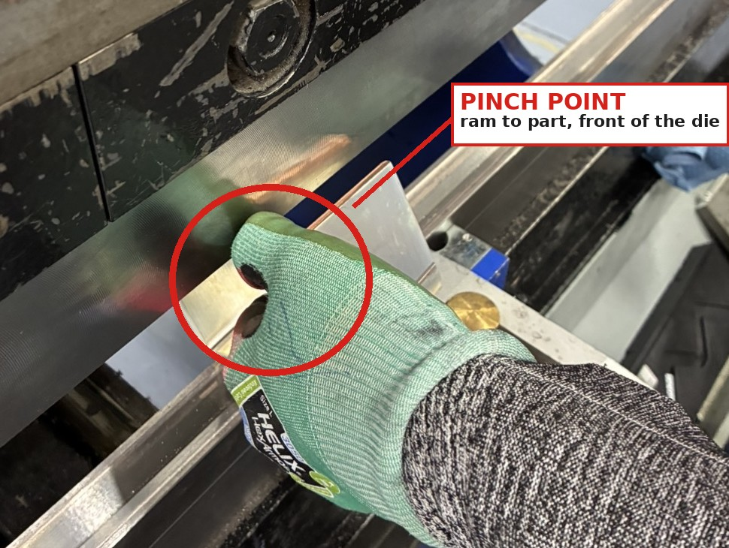
Press Brake Hand Placement — Three Injuries, One Pinch Point
[Date] — Eaton Sumter, SC
Plant Manager: Stephen Krajcarski (Interim) EHS Site Contact: Charlie Ball, Sr. EHS Engineer Page 1 of 2
Incident Description:
Three operators have been injured on Sumter press brakes since 2023, on three different machines and three different shifts.
8/29/2023, PB14 — operator reached in to remove a finished part; his foot contacted the pedal and the upper die traveled down. Right ring finger fracture. Recordable, restricted work.
2/6/2025, PB27 — new operator checked a bend angle during setup using a scrap piece; the scrap bent and pulled his hand into the die. Partial amputation, right middle finger. Recordable, restricted work.
6/26/2026, PB19 — operator’s thumb caught in the same pinch. Treated on site, first aid.
In every event the hand was pinched between the ram and the part at the front face of the die, not at the mouth of the press. The machines were operating as designed.
Investigation Findings:
The laser scanner guards the mouth of the press and covers only the middle of the gap. It does not reach the ram-to-part pinch at the front of the die, which is where all three injuries occurred.
Two of the three injuries occurred during setup or part removal, outside a normal production cycle.
Approved hand tools were installed at the brakes as a corrective action after the 2023 and 2025 events and were present at PB19 on 6/26/2026. They were not in use.
Magnets do not hold copper, which removes one of the approved methods in the copper shop.
Root Causes and Management System Gaps:
Use of the approved methods was never verified. Corrective actions from 2023 and 2025 were closed when tools were installed, not on evidence that operators were using them.
Engineered guarding does not cover the ram-to-part pinch, so the process depends entirely on operator method — and setup and part removal are not treated as point-of-operation work in training or on method sheets.
The hand is inside the pinch. When the ram comes down, it closes on the part right where the fingers are — at the front face of the die, outside anything the laser scanner covers.
Interim Containment Actions:
This lessons learned reviewed with all press brake operators, setup personnel, team leads, and supervisors on all shifts; signed roster returned to EHS.
Approved hand tools verified present at every press brake prior to the review.
Slide 2 (Required Practice) posted at every press brake in Steel Fab and Copper Fab.
Random verification audits by EHS and area supervisors begin on issue of this document.
How does this incident apply to you?
Are there parts in your area still being held by hand because no tool fits them — and has anyone been told?
Do you have a safeguard that covers only part of the hazard, so operators assume they are protected where they are not?
When a corrective action is installed at your workstation, how do you know it is actually being used?
Preventive & Corrective Actions:
No hands within 3 in. of the die, using one of four approved methods (next page) — added to press brake method sheets and operator training.
Random audits of press brake operations on all shifts by EHS and area supervisors; findings logged and tracked to closure in Benchmark.
Continue routing high-risk parts to safe equipment; finalize the high-risk-part list and the routing target.
E·A·T·N
© 2026 Eaton. All Rights Reserved.
Environment, Health & Safety Lessons Learned
Notes:
Lessons learned issued with Required Practice (slide 2). Fill in LL number and date issued before release. Signed roster returned to EHS.

Slide 2
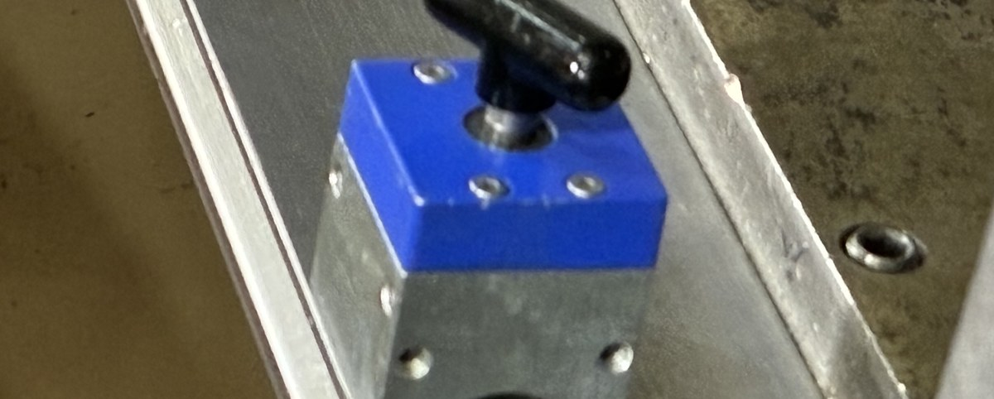
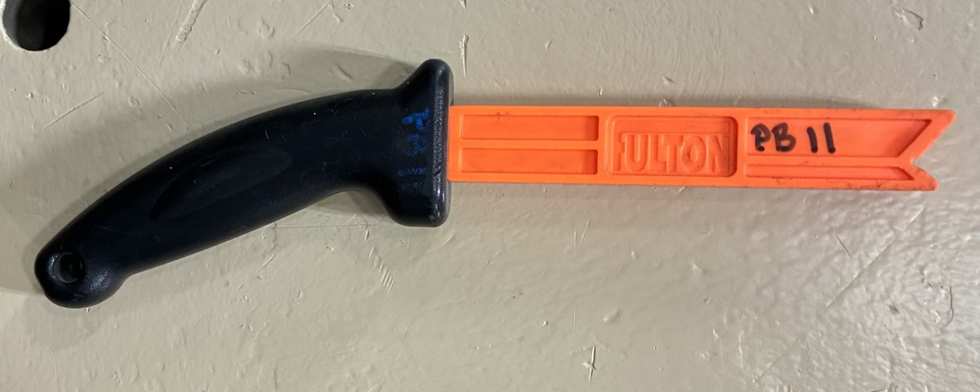
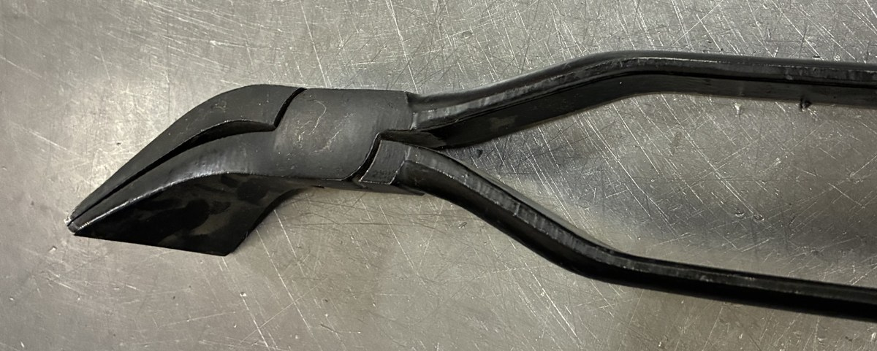
Required Practice — No Hands Within 3 Inches of the Die
[Date] — Eaton Sumter, SC
All Press Brake Operators and Setup Personnel — All Shifts EHS Site Contact: Charlie Ball, Sr. EHS Engineer Page 2 of 2
POST AT EVERY PRESS BRAKE — STEEL FAB AND COPPER FAB, ALL SHIFTS
Keep your hands more than 3 inches from the die. Setup, bend, and part removal.
There are four approved methods for running a part without a hand in the pinch point. Use one of them on every part.
1
2
3
4
Magnet
Orange Push Bar
Tongs
Ram Down First
Set the part on the magnet mounted on the back of the bottom die instead of holding it.
Does not hold copper.
Feed, seat, and position the part with the bar rather than your fingers.
Grip and hold the part. Best method for W-channel and U-channel parts.
Lower the ram until it holds the part against the die, take your hands off, then complete the bend. The press holds the part instead of your hand.
1 · MAGNET
2 · ORANGE PUSH BAR
3 · TONGS
Verification:
EHS and area supervisors will conduct random audits of press brake operations on all shifts to verify that one of the four approved methods is being used.
If a part cannot be run using one of these four methods, stop. Back the ram off, re-fixture the part, or get your supervisor. A part that does not fit the approved methods is a problem to raise before it runs — it is not a reason to run it by hand.
E·A·T·N
© 2026 Eaton. All Rights Reserved.
Environment, Health & Safety Lessons Learned
Notes:
Post at every press brake, Steel Fab and Copper Fab, all shifts. Consequences for running a part by hand are communicated verbally, not on this slide.

