Slide 1
Statistical Modeling for Campaigns
An Intro Into Using Statistics and Data Science Techniques to Answer Campaign Questions
Charlie Ballard · 2026

Slide 2
What Are We Doing Today?
Today we're using statistical modeling to answer three real campaign questions. The techniques are broadly applicable — but the examples are specific.
1
2
3
Linear Models
Clustering and Classification
Machine Learning
Given how much was spent on each ad, how much more or less memorable was it than expected?
How do we identify counties that behave similarly in terms of election results?
How do we build custom audiences?
Ohio Voter Survey + Ad Spending Data
2023 General Election
2024 General Election Results
Ohio Voter Survey
2023 General Election

Slide 3
Part 1
Linear Models
Issue 1 campaign · 2023 General

Slide 4
The Data: Issue 1 Ad Campaign
Creative | Side | Spending | Recall
Protecting Predators | NO | $227,000 | 21%
Women's Health | NO | $927,020 | 25%
Hurt | NO | $581,868 | 22%
After Viability | NO | $1,407,863 | 42%
Martin Haskell | NO | $1,554,932 | 18%
Studied | NO | $3,499,222 | 76%
True Story | YES | $1,998,163 | 62%
Insane | YES | $1,838,141 | 51%
Do Not Judge | YES | $1,653,698 | 44%
Broken | YES | $1,603,698 | 47%
What We Have
Ad spending and voter recall data from the 2023 Ohio Issue 1 campaign. For each ad: how much was spent and what % of voters recalled seeing it.
10
TV ads total
6
NO-side ads (Pro-Life)
4
YES-side ads (Pro-Choice)

Slide 5
The Model: Linear Regression
What It Is
Our Setup
Linear regression finds the single straight line that best describes the relationship between two variables — minimizing the total distance from every data point to the line.
Two regressions: We run Spend → Recall and Recall → Spend separately, to read the relationship in both directions.
No intercept: Both lines are forced through the origin. If you spend nothing, you get zero recall — a deliberate assumption.
What We're Asking
One predictor: Each model uses a single input variable. Simplicity is a feature here, not a limitation.
Is there a meaningful relationship between ad spending and voter recall? If so, which ads over- or under-performed that expectation?
Output: A coefficient, an R², and a residual ("surplus") for every ad.
Think of it as finding the line that best captures the pattern in a scatter plot.

Slide 6
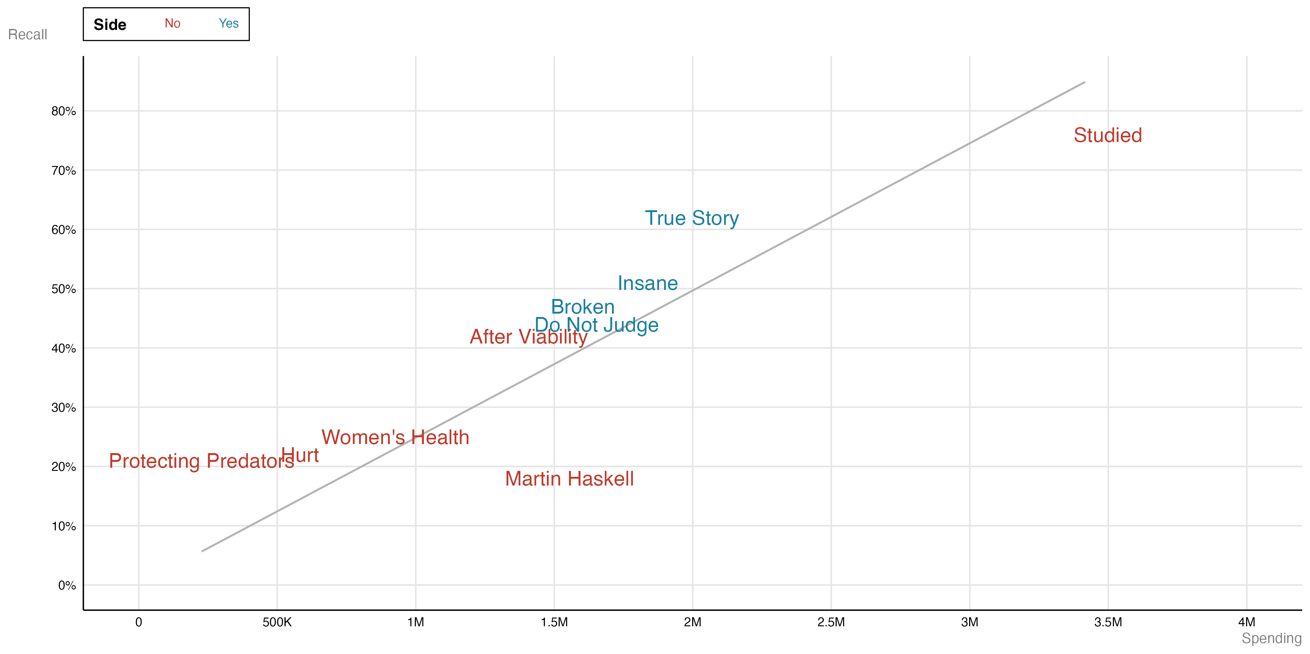
Spending vs. Recall: The Pattern
The Core Question
Is there a relationship between how much an ad spends and how well voters remember it?
The Pattern
Higher spending → higher recall.
Some ads punch above their weight while others underperform — that gap is what we measure.
10 TV ads · YES & NO sides

Slide 7
How the Model Fits: Coefficients
The Concept
The Results
Linear regression draws the best-fit line through the data. We ran TWO regressions (both anchored at the origin — no intercept):
β₁ = 3,797,090 · R² = 0.94
For every +1 pt of recall → ~$38,000 more in spend. 50% recall ~1.89M estimated spend.
Spending = β₁ × Recall
Predict expected spend from recall
β₂ = 0.0000002484 · R² = 0.94
Recall = β₂ × Spending
For every +$100K in spend → ~2.5 more pts of recall. 1M spend ~24.5% recall.
Predict expected recall from spend
If you spend nothing, you get zero recall — built into both models by design.
R² = 0.94 — the model explains 94% of variation. A very strong fit for a single-variable model.

Slide 8
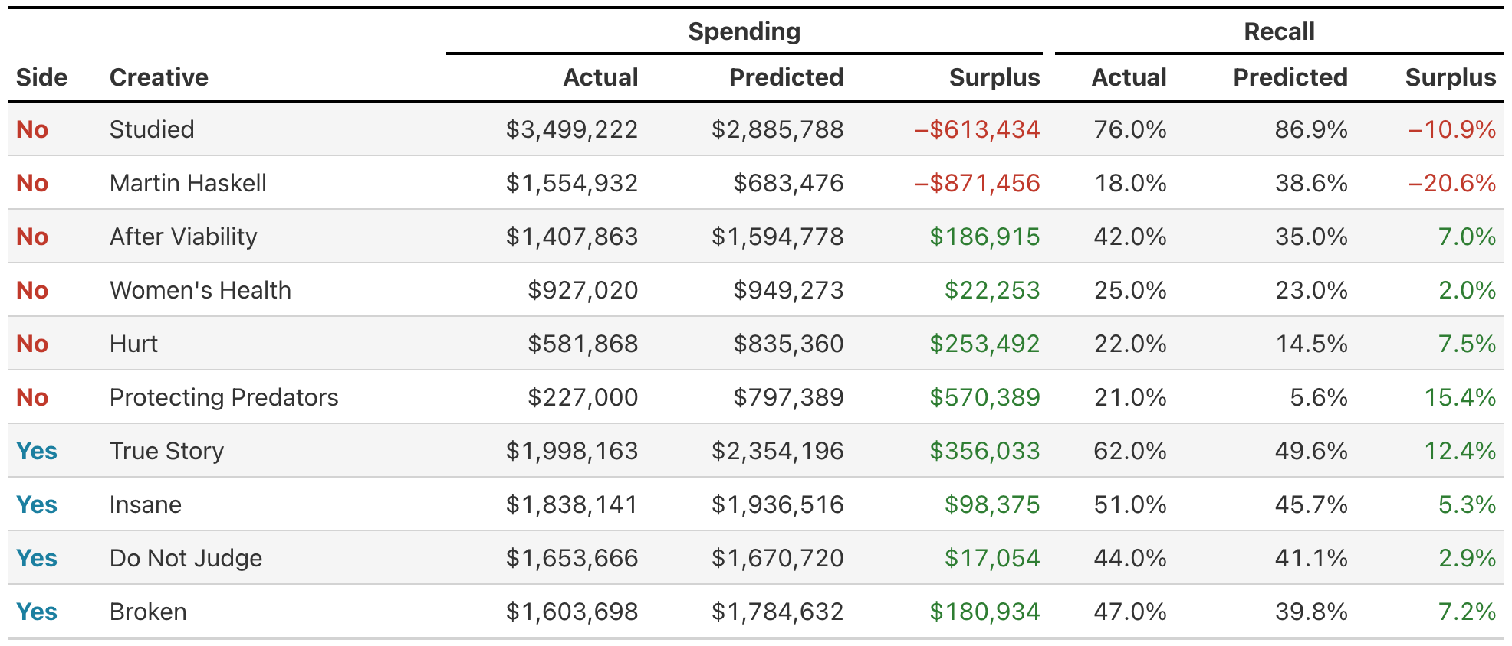
Reading the Results: Surplus Columns
Spend Surplus = actual minus predicted spend. Recall Surplus = actual minus predicted recall. Positive = overperformed; negative = underperformed.

Slide 9
Part 2
Clustering and Classification
2024 General

Slide 10
The Data: 88 Ohio Counties
County | Turnout | Trump Votes | Harris Votes
Adams | 70.9% | 10,269 | 2,098
Allen | 70.8% | 33,201 | 12,754
Ashland | 77.8% | 19,863 | 6,544
Ashtabula | 71.5% | 27,656 | 15,345
Athens | 68.0% | 11,369 | 14,134
Franklin | 66.4% | 214,005 | 335,218
Cuyahoga | 65.2% | 178,900 | 371,256
Warren | 79.2% | 82,503 | 33,409
Delaware | 79.8% | 80,211 | 51,432
… 79 more counties
What We Have
2024 General Election results for all 88 Ohio counties, converted to percentile ranks. Variables are ranked by percentile so each dimension is on the same scale, and for interpretability.
88
Ohio counties
3
input variables
2
Engineered features

Slide 11
The Model: K-Means Clustering
What It Is
How It Works
K-Means is an unsupervised algorithm — it finds natural groupings in data without being told the right answer. You give it a number of clusters k; it figures out which points belong together.
Pick k starting centroids Randomly place k cluster centers in the data space.
1
2
Assign each county Every county joins whichever centroid it's closest to.
What We're Asking
3
Recompute centroids Move each centroid to the average position of its counties.
Do Ohio counties naturally sort into distinct political types based on how Trump-y they lean and how engaged their voters are?
4
Repeat until stable Assignments stop changing — clusters have converged.
Unlike regression, there's no outcome to predict — the algorithm discovers structure that already exists in the data.

Slide 12
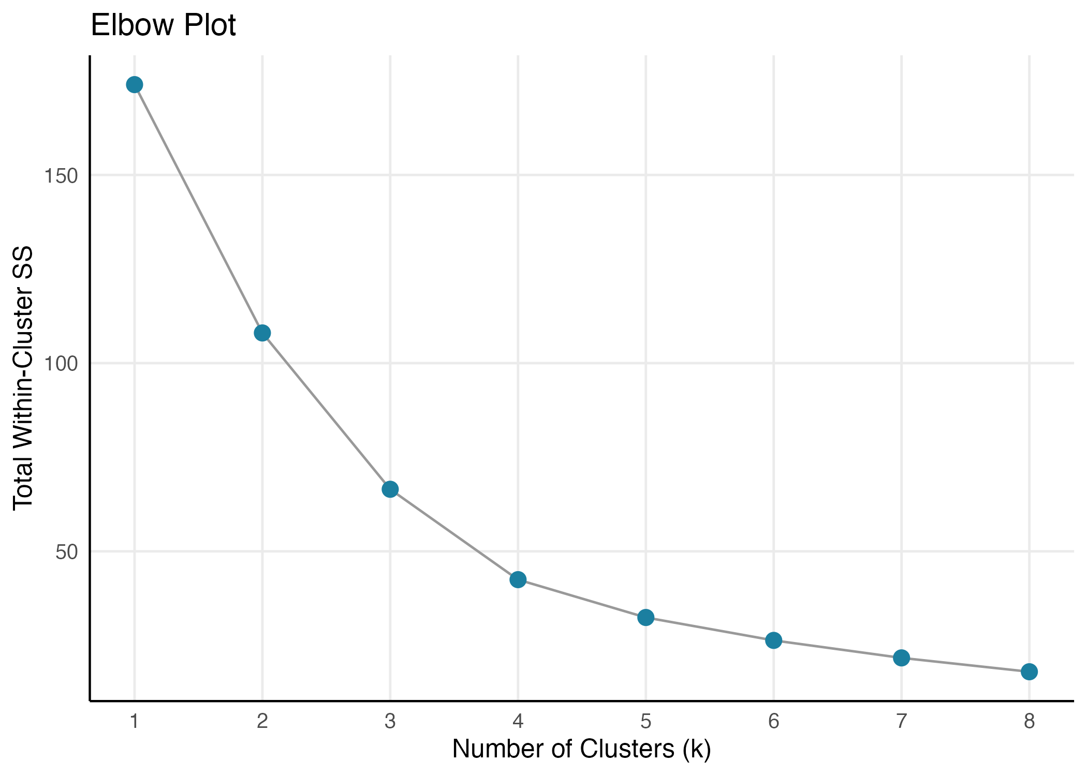
Finding K: The Elbow Plot
How We Pick K
K-Means needs a value for k before it runs. The elbow plot helps us choose wisely.
Each point shows how tight the clusters are — lower is more compact. We look for the elbow: the point where adding more clusters stops giving much benefit.
k = 4 is the sweet spot.
Four clusters give us meaningfully different groups without over-splitting.

Slide 13
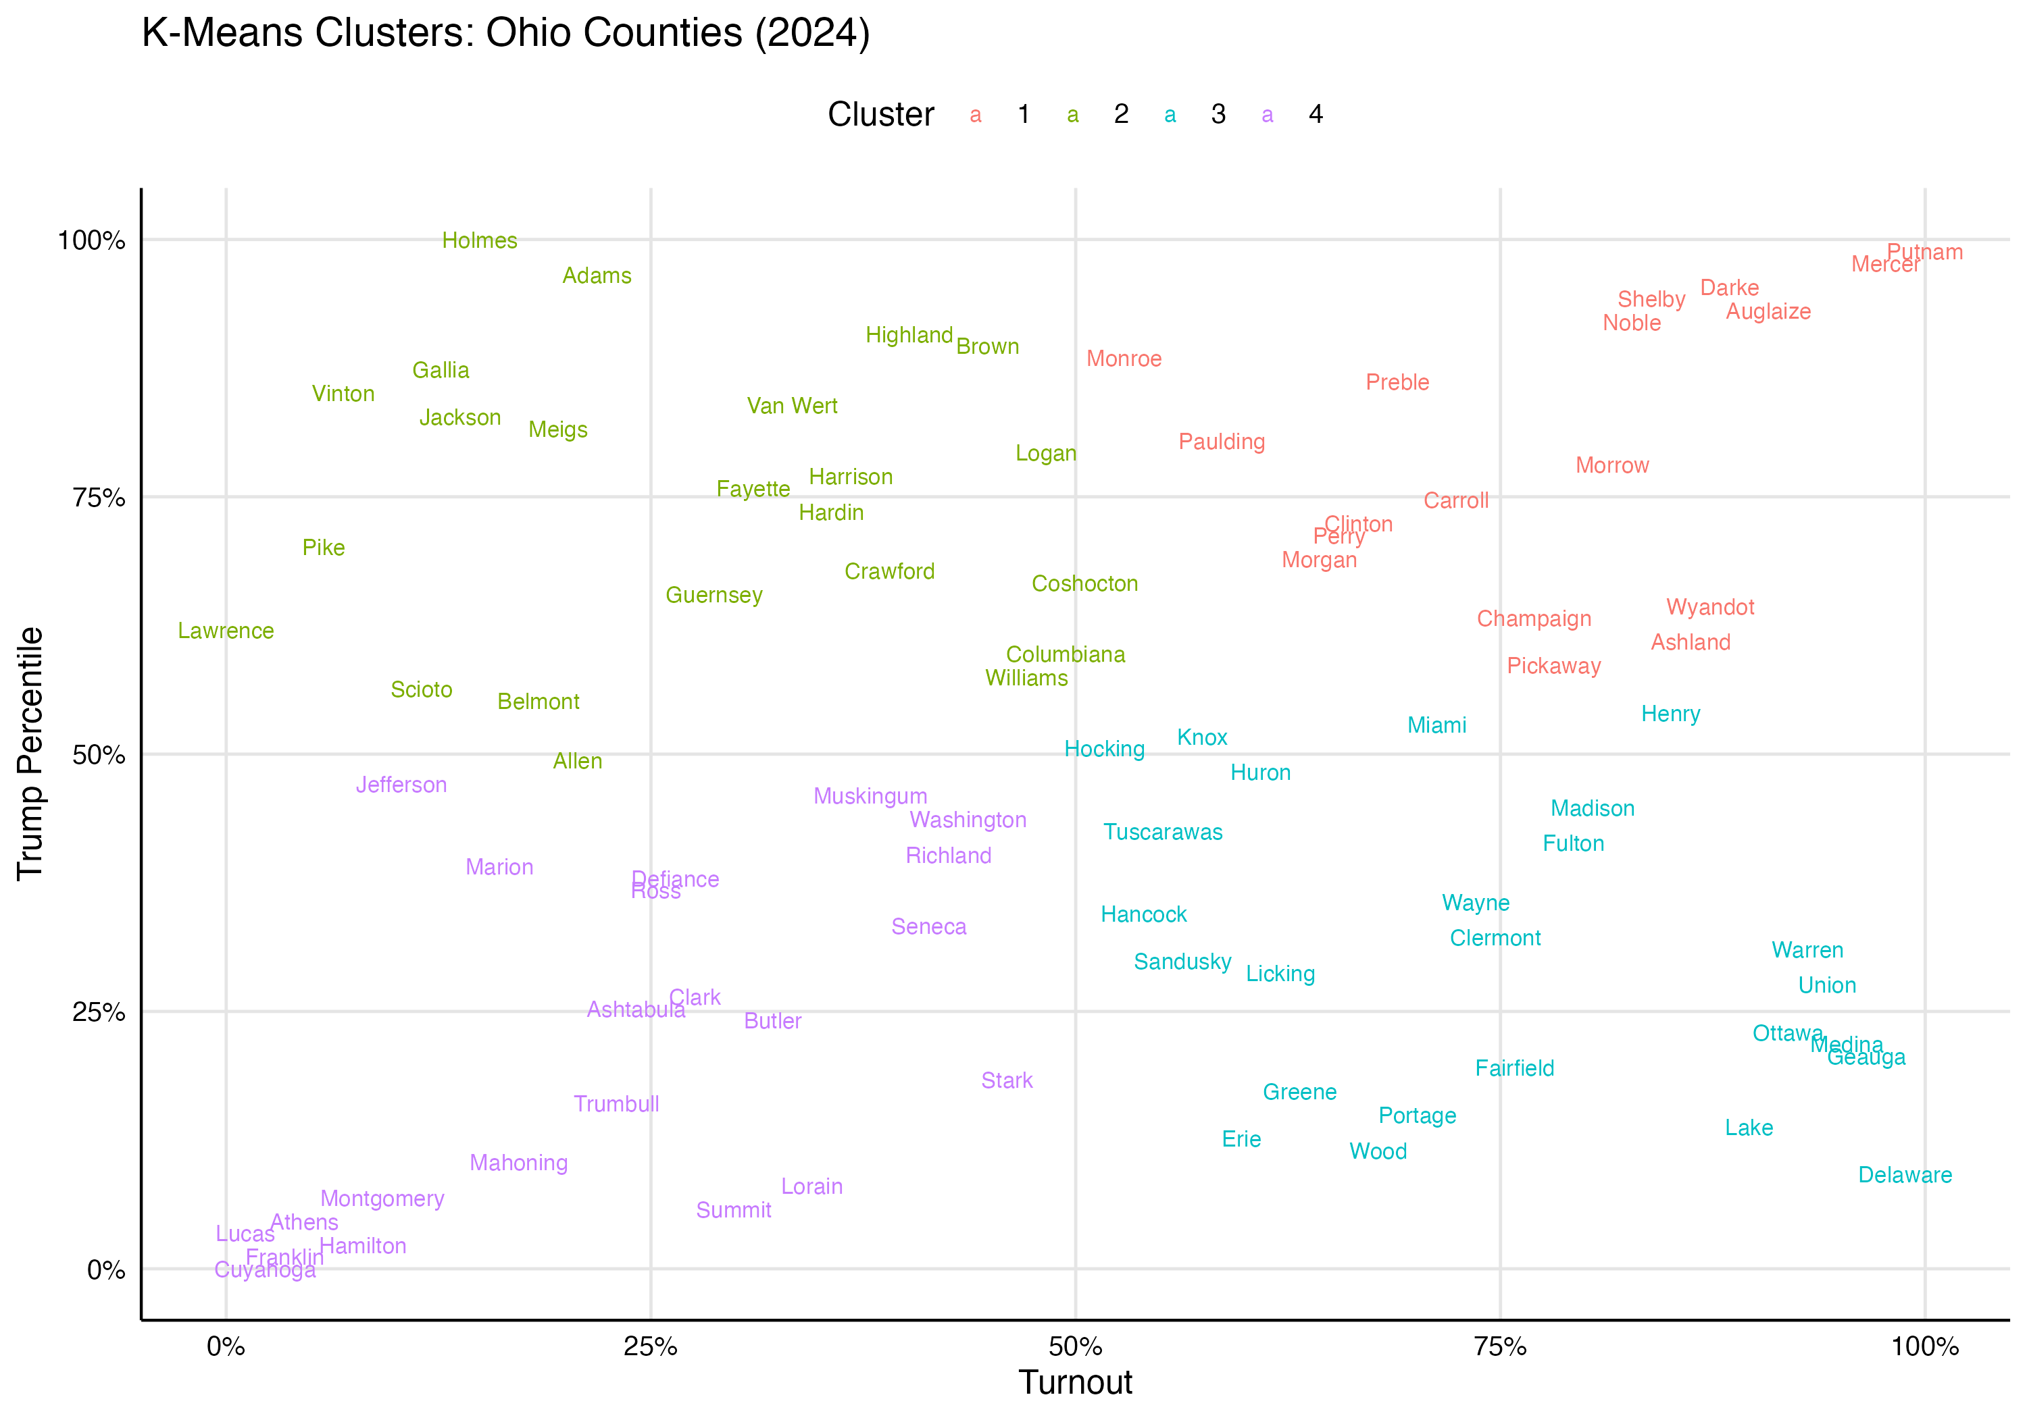
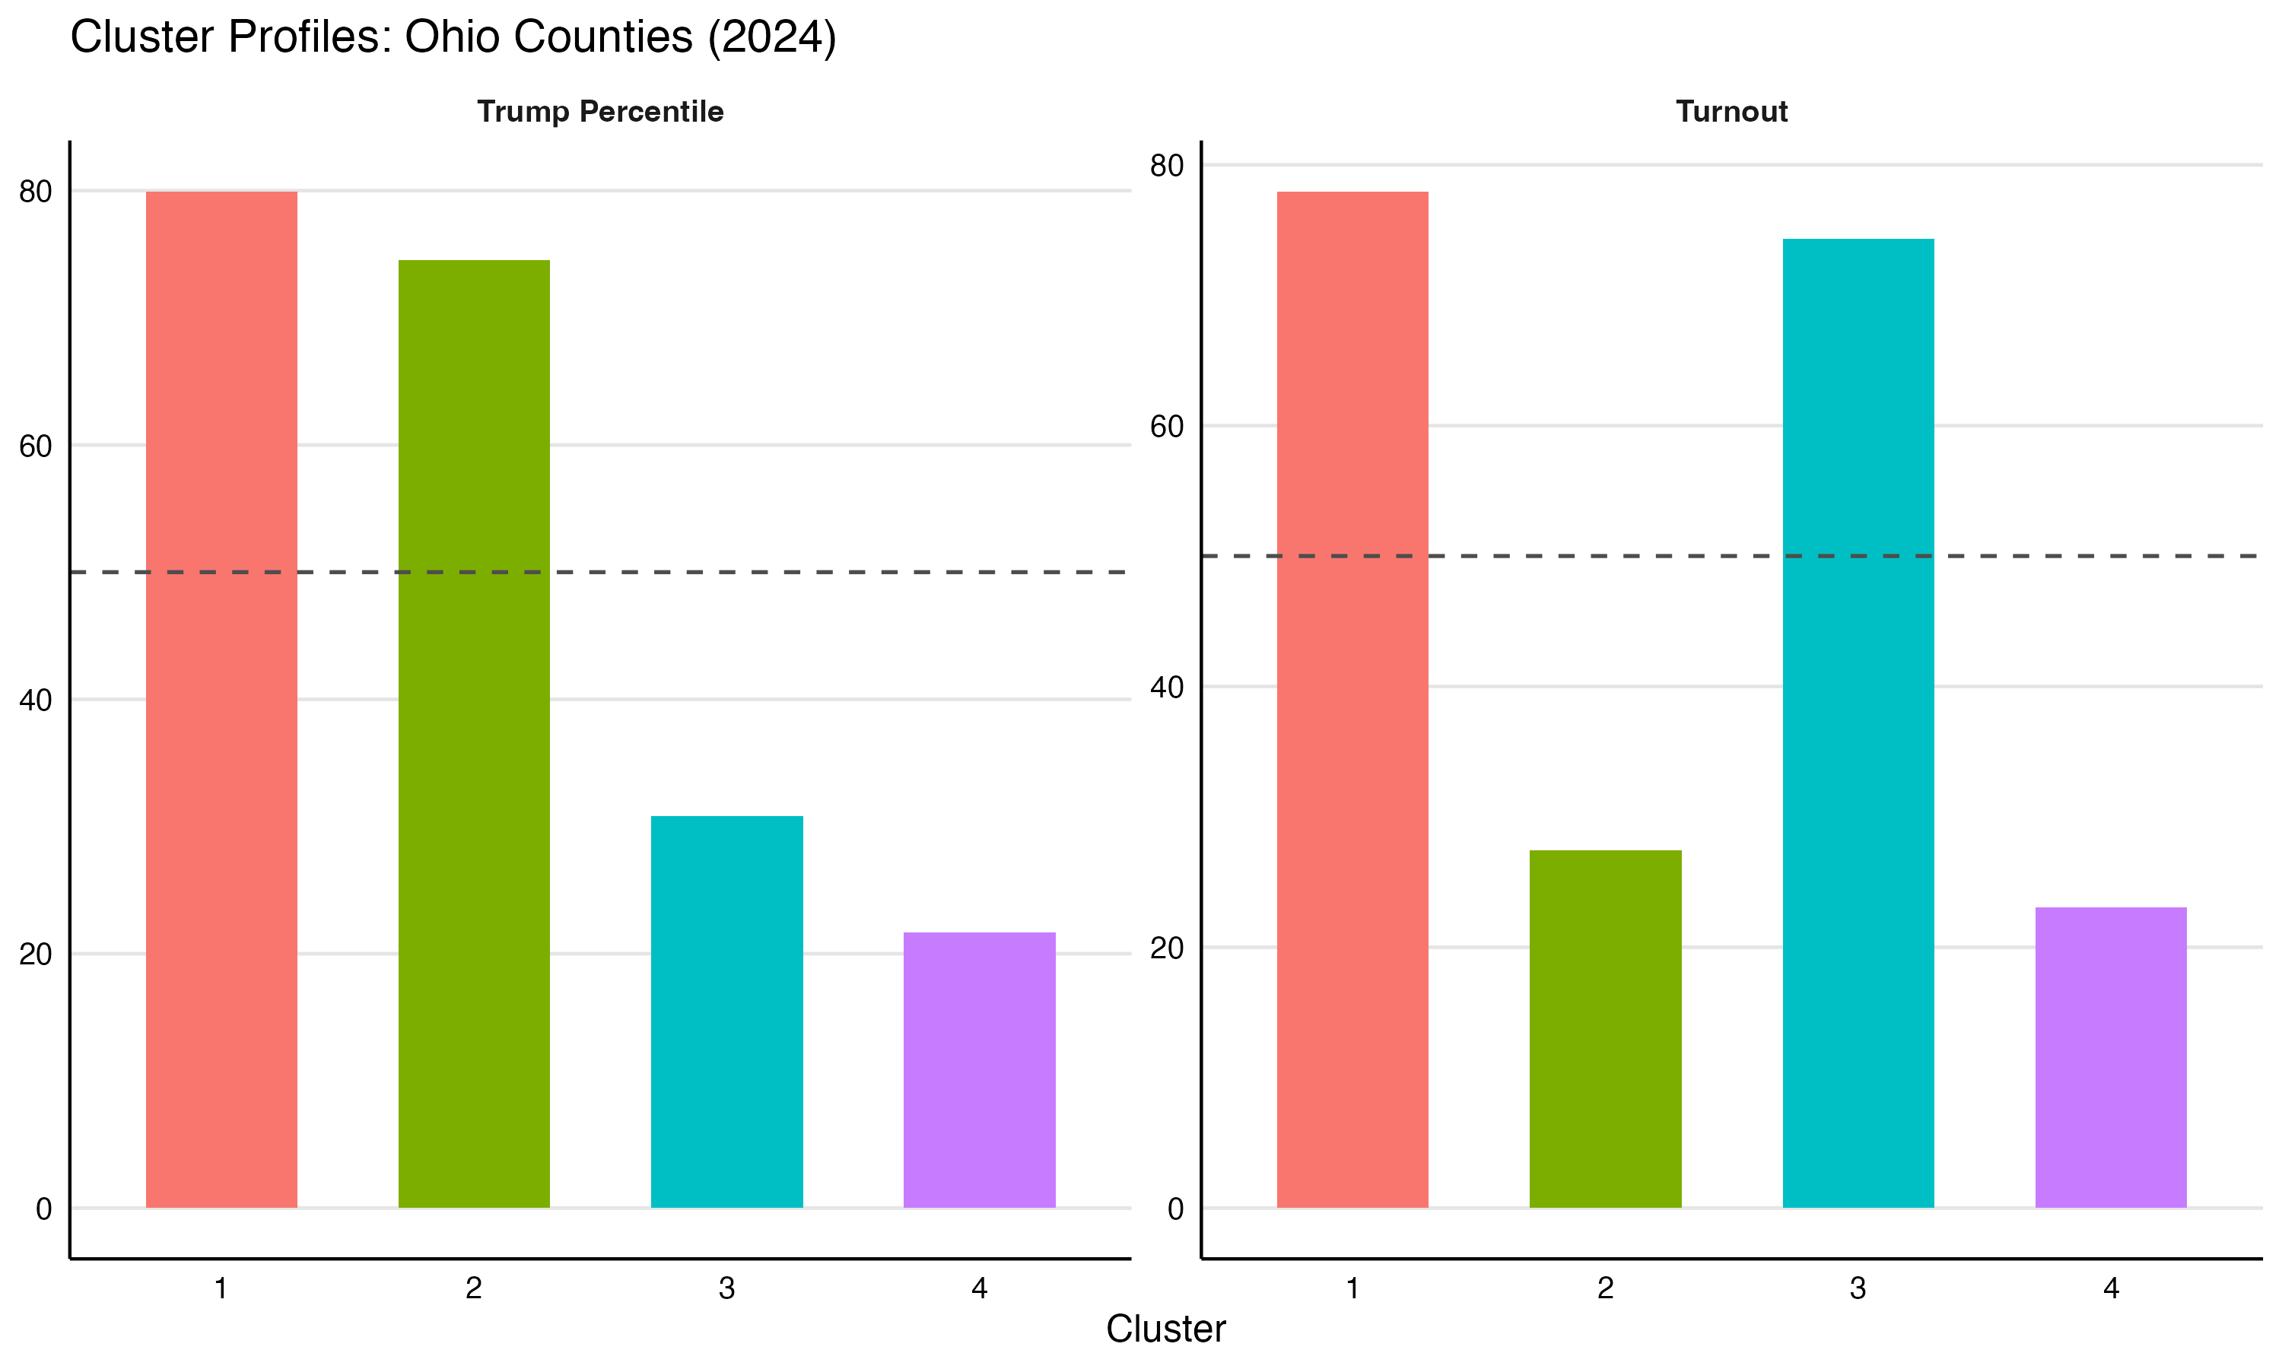
The Four Clusters: Mapped
Left: counties colored by cluster · Right: how each cluster compares to the statewide average on Trump and turnout percentile
(dashed line = 50th percentile)

Slide 14
What Are the Four Clusters?
1
High-Engagement Republican Base
2
Low-Engagement Republican
18 counties · Trump: ~80th pct · Turnout: ~78th pct
23 counties · Trump: ~75th pct · Turnout: ~27th pct
Highest Trump percentiles + above-average turnout. Rural counties that show up and vote reliably Republican — the backbone of statewide margins.
Nearly as red as Cluster 1 but well below average turnout. The clearest mobilization opportunity for a Republican campaign.
3
High-Engagement Democrat Base
4
Low-Engagement Democrat
25 counties · Trump: ~31st pct · Turnout: ~74th pct
22 counties · Trump: ~22nd pct · Turnout: ~23rd pct
Low Trump support combined with high turnout. Suburban counties where Democrats are most competitive — turnout already isn't the problem here.
Lowest Trump percentiles paired with below-average turnout. Ohio's urban cores and Rust Belt cities. The largest upside for a Democratic mobilization effort.

Slide 15
Part 3
Machine Learning
Issue 1 campaign · 2023 General

Slide 16
The Data: Ohio Voter Survey
What We Have
Input Features
Target Variables
A post-election survey of Ohio voters with demographic characteristics and self-reported answers on two political questions: Trump image and Issue 1 Vote.
Party
Trump Image
Gender
Favorable vs. Unfavorable
Age
925
Education
Ohio respondents
Income
Issue 1 Vote
8
Religion
demographic inputs
Area
Voted Yes vs. Voted No
Ethnicity
2
outcomes to predict

Slide 17
The Model: XGBoost
What It Is
How It Works
XGBoost (eXtreme Gradient Boosting) builds a series of decision trees — each one learning from the mistakes of the last. The final prediction combines all the trees.
Tree 1 makes a rough guess A simple decision tree predicts the outcome for each respondent.
1
2
Tree 2 corrects the errors The next tree focuses on where Tree 1 got it wrong.
What We're Asking
Which demographic variables best predict Trump favorability? Which best predict Issue 1 vote? Do those rankings differ — and if so, how?
3
Repeat 100 times Each round refines the model. Errors shrink with every tree.
4
Output: probabilities + importance Final model scores each respondent and ranks which features mattered most.
More powerful than linear regression — handles non-linear relationships and interactions between variables automatically.

Slide 18
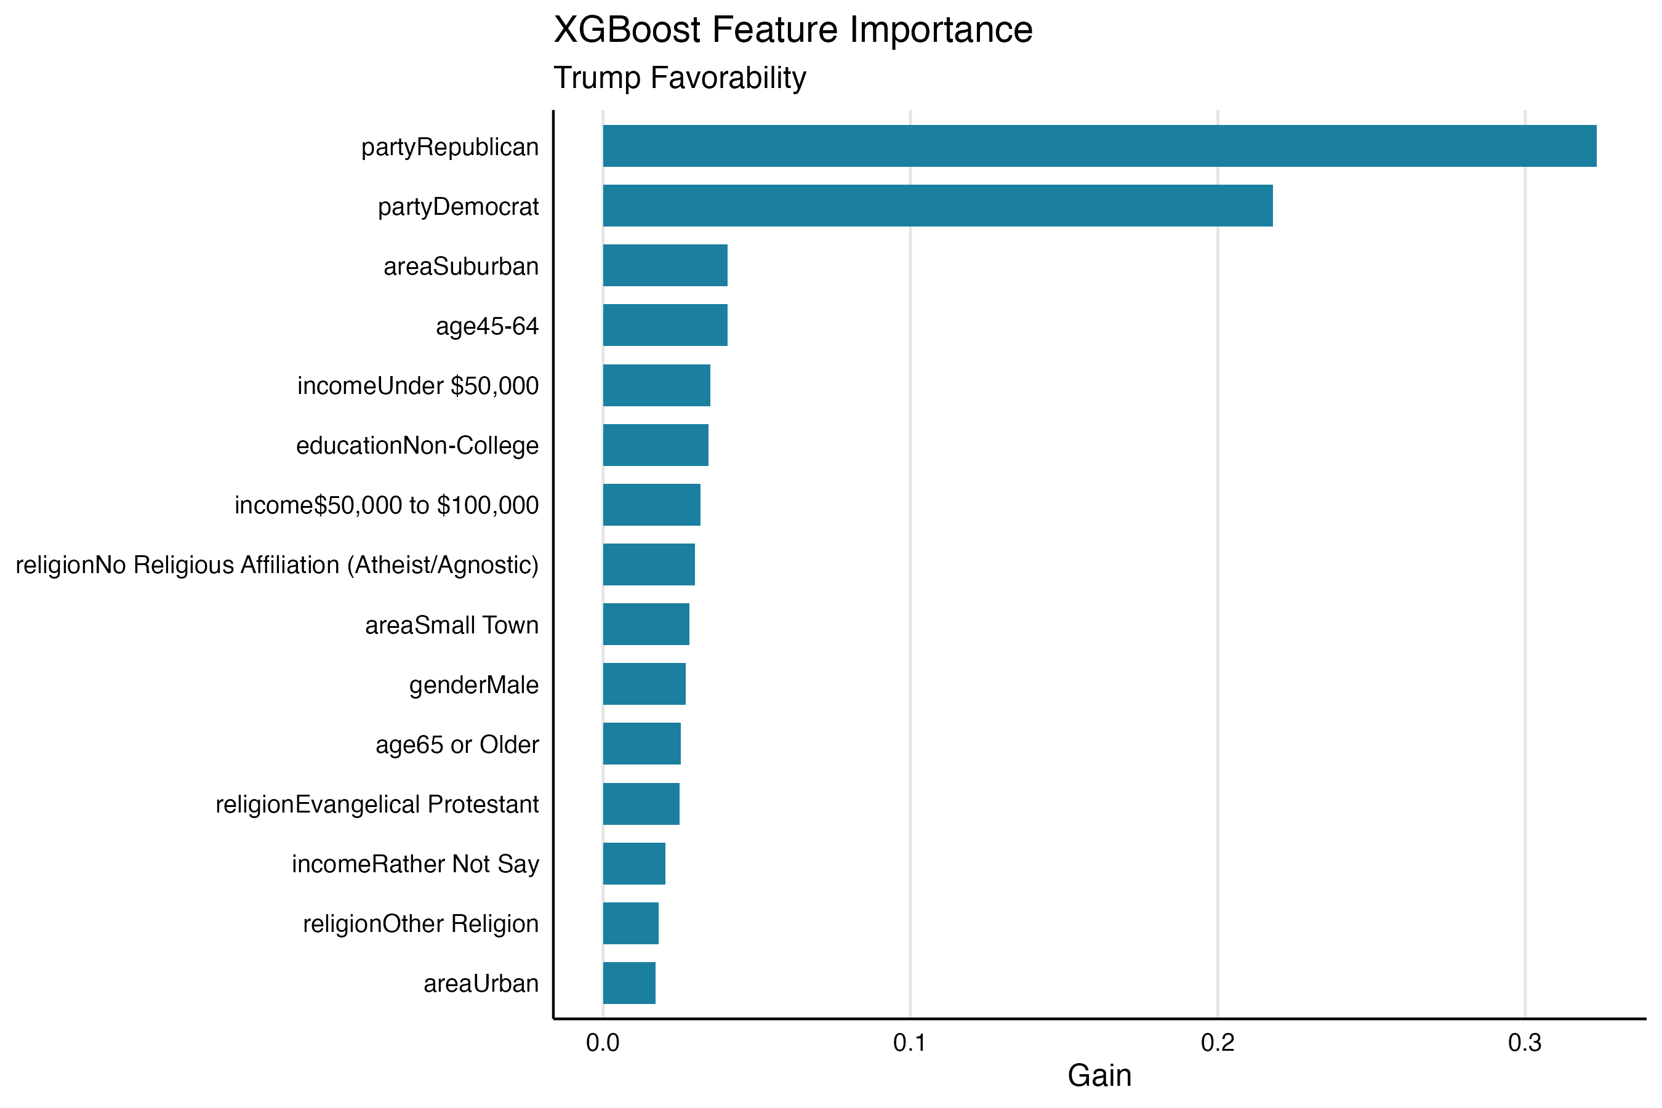
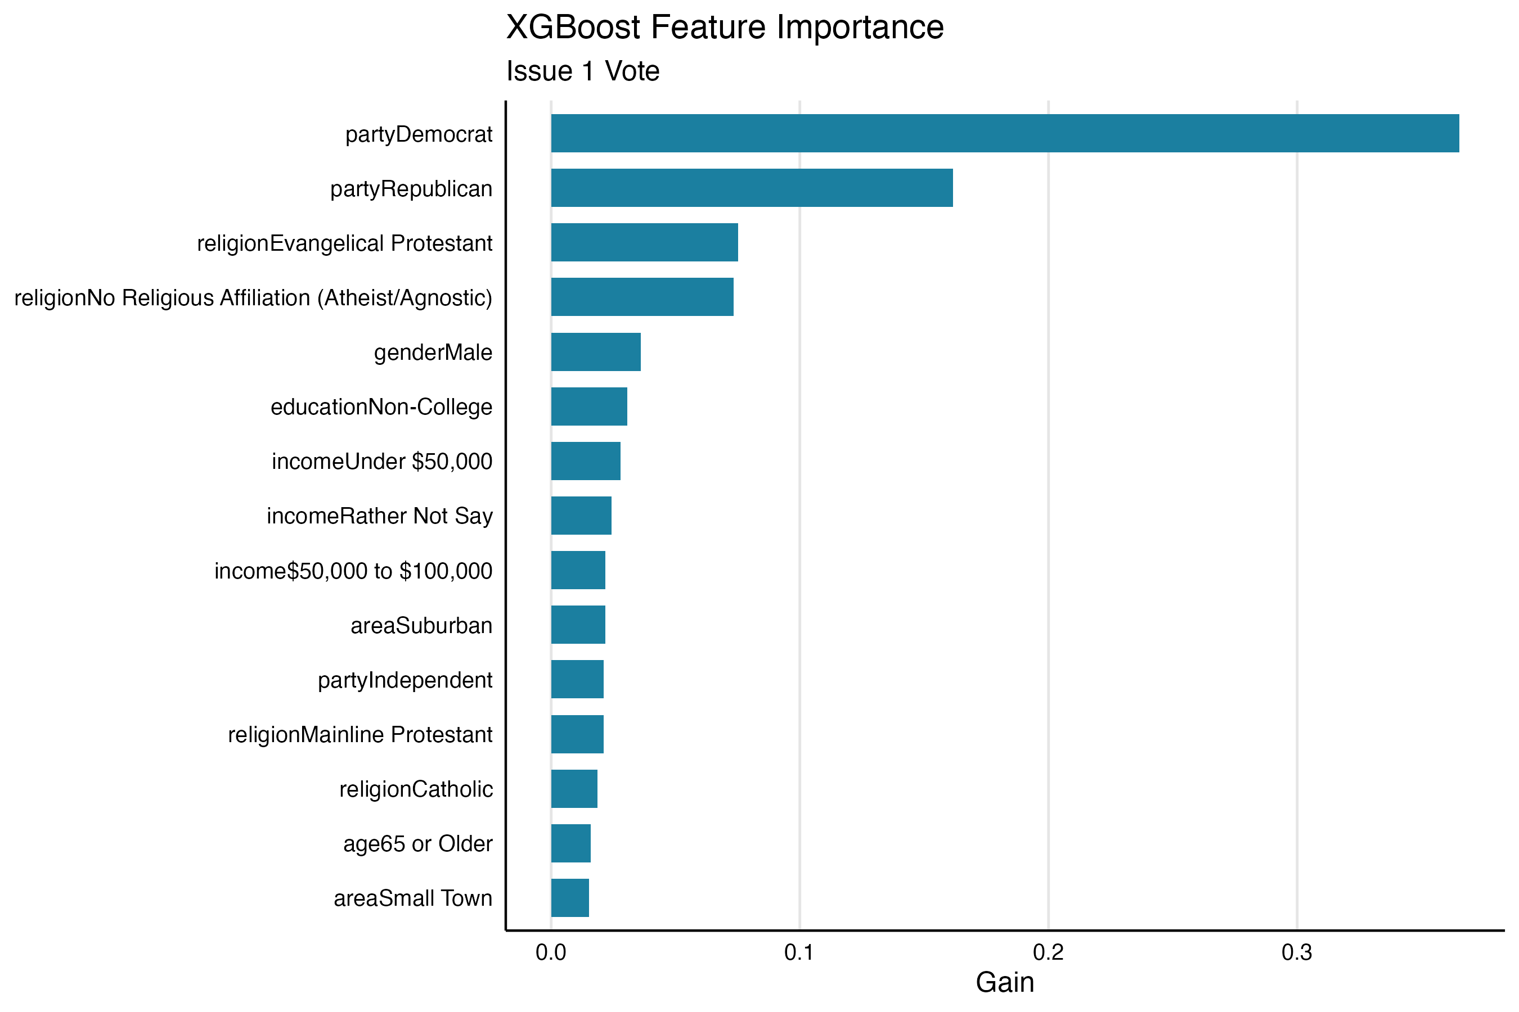
Feature Importance: Trump Favorability vs. Issue 1 Vote
Trump Favorability
Issue 1 Vote
Gain = how much each feature helped make correct predictions. Notice how the feature ranking shifts between the two models

Slide 19
How Well Did the Models Do? (20% Held-Out Test Set)
Trump Favorability
Issue 1 Vote
80%
81%
Overall accuracy
Overall accuracy
87% catch rate — Unfavorable
69% catch rate — Favorable
84% catch rate — Voted Yes
77% catch rate — Voted No
Stronger at identifying unfavorable — the larger, more consistent group. Consider the sample bias towards Trump favorability.
More balanced across both outcomes — slightly more consistent predictor for Issue 1.

Slide 20
Applying the Models: Scoring Every Voter
Sample Predicted Scores
From Model to Action
Party | Gender | Age | Trump Fav Score | Issue 1 Score
Republican | Male | 65+ | 0.85 | 0.18
Independent | Male | 45–64 | 0.76 | 0.26
No Party | Female | 45–64 | 0.58 | 0.37
Democrat | Female | 65+ | 0.09 | 0.89
Democrat | Female | 65+ | 0.11 | 0.86
Once trained, the XGBoost models are applied back to all 925 respondents — not just the held-out test set. Each person gets two scores:
trump_fav_score
Probability the respondent views Trump favorably (0 → 1)
issue1_score
Probability the respondent voted Yes on Issue 1 (0 → 1)
Example target: issue1_score > 0.6 AND trump_fav_score > 0.6 → cross-pressured voters who backed Issue 1 but are pro Trump.
How to use these scores
Scores can be matched to a voter file to build targetable audiences — e.g. rank by issue1_score to prioritize persuasion outreach, or filter by both scores to find cross-pressured voters.

Slide 21
Wrapping Up
Linear Models
K-Means Clustering
XGBoost
Which Issue 1 ads over- or under-recalled relative to their spend?
Grouped Ohio's 88 counties into 4 politically distinct types.
Scored all 925 respondents for Trump approval and Issue 1 propensity.
✓ Strengths
✓ Strengths
✓ Strengths
• R² = 0.94 — spend explains nearly all recall variance
• No labeled data needed — finds natural structure
• 80–81% accuracy from 8 demographic inputs alone
• Coefficients have direct dollar-per-point interpretation
• Cluster profiles immediately actionable for targeting
• Feature importance reveals which variables actually drive each outcome
• Residuals immediately rank each ad's efficiency
• Scales to any number of features or geographies
• Scores usable directly for audience segmentation
✗ Limitations
✗ Limitations
✗ Limitations
• Only captures straight-line relationships
• Choosing k involves judgment; clusters can shift between runs
• Needs labeled outcomes to train; less interpretable at scale
• Can't control for creative quality or ad placement
• Doesn't explain why counties group together
• Requires revalidation for new geographies or election cycles
→ To expand
→ To expand
→ To expand
• Add GRP, markets, flight duration as predictors
• Add more variables like senate/congressional results or census data.
• Push scores to full voter file for targeted outreach
• Extend to digital channels and cross-campaign comparison
• Track cluster drift across election cycles
• Retrain with behavioral data (donation history, contact rates)

Slide 22
Questions?
All code and a write up is available on my GitHub page linked HERE.
Charlie Ballard · 2026

