Slide 1
Carpooling algorithm for decrease the environmental impact
Camila Barona Cabrera
Felipe Sosa Patiño
Medellín, 16/05/2019

Slide 2
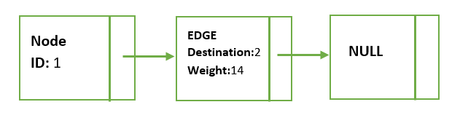
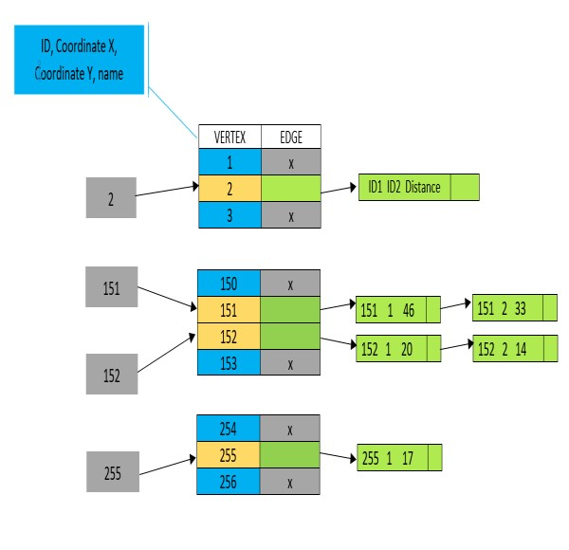
Data Structure
Graph 2: ArrayList of edges. Edges contains destination and weight.
Graph 1: HashMap that contains a key and a pair made by vertex (ID, Coordinate X, Coordinate Y, Name) and a ArrayListof edge (ID1, ID2, Distance)

Slide 3
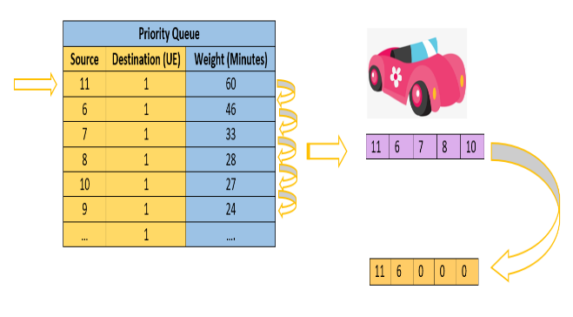
Explanation of the algorithm and its complexity
Sub Problem | Complexity
Creating the graph | O(V)
Get Successors | O(E)
Get Weight | O(E)
Creation and edition of cars | O (V^2* E)
Total complexity | O (V^2*E)
Graph 3: The way the algorithm tooks information and organize it.
Table 1: Complexity of every method in the algorithm and the total complexity.

Slide 4
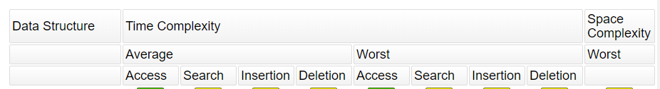
Algorithm design criteria
After the analysis of some possible solutions, we choose the Hash Table because the time complexity of it operations are smaller than other data structures and also because it allow us a big quantity of elements storing a ArrayList that contains the edges of the problem.
The way we designed this algorithm is a coherent form of give a solution, because the travel around the priority queue that sorts the edges from each vertex to the objective vertex takes space for construct the cars with their maximum capacity. After that, the algorithm does an examination above the car with respect to the “p” value. Besides the algorithm is very simple of understanding, the speed of the algorithm is very useful for the data that we are working on, because the algorithm runs over the priority queue taking out vertices and working with an array for visited vertices, avoiding a lot of repetitions that could happen.
Graph 4: Time complexity of HashMap

Slide 5
Time and Memory consumption
 | Data Set 11 cars | Data Set 205 cars
Memory consumption | 146,86 MB | 179,5 MB
Table 4: Memory consumption of the algorithm with different data sets.
 | Data set 11 Cars | Data set 205 Cars
Best case | 64 ms | 359 ms
Average case | 80 ms | 468 ms
Worst case | 106 ms | 596 ms
Table 3: Execution time of the algorithm with differents datasets.

Slide 6
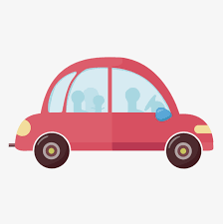
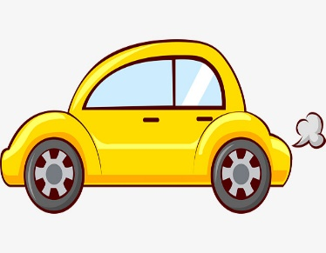
Results
11 cars
205 cars
P 1.1 | P 1.2 | P 1.3
6 Cars | 5 Cars | 5 Cars
P 1.1 | P 1.2 | P 1.3
52 cars | 49 cars | 52 cars

Slide 7
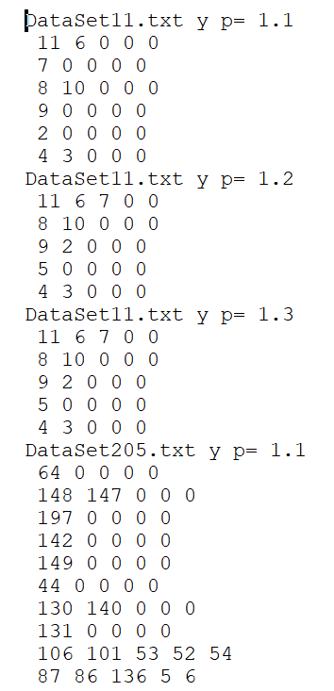
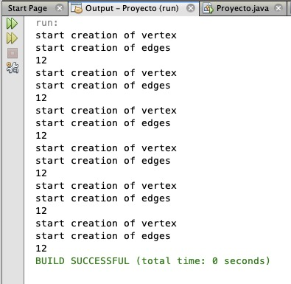
Software working
Graph 4: Carpooling Algorithm and the information that saves

