Slide 1
Carpooling algorithm for decrease the environmental impact
Camila Barona Cabrera
Felipe Sosa Patiño
Medellín, 16/05/2019

Slide 2
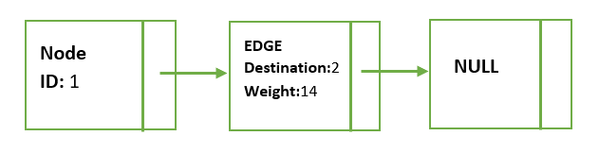
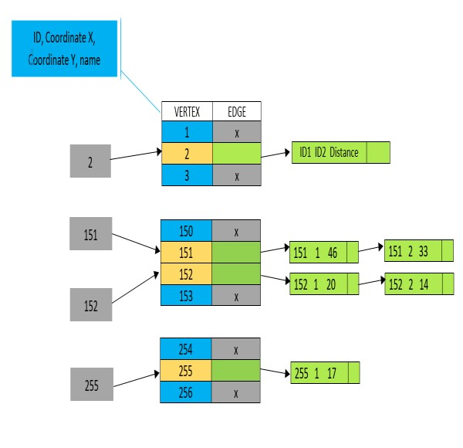
Data Structure
Graph 2: LinkedList of edges. Edges contains destination and weight.
Graph 1: HashMap that contains a key and a pair made by vertex (ID, Coordinate X, Coordinate Y, Name) and a linked list of edge (ID1, ID2, Distance)

Slide 3
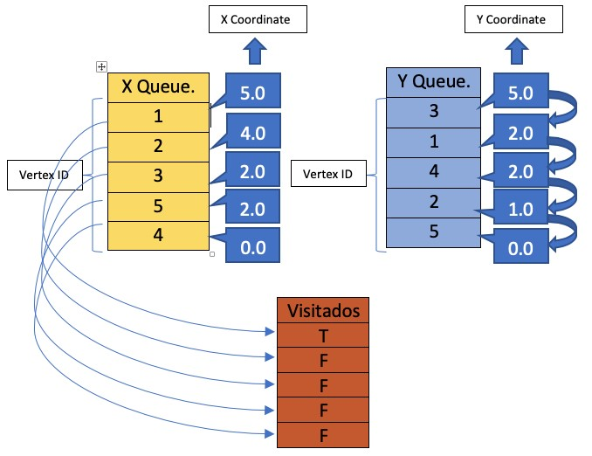
Explanation of the algorithm and its complexity
Sub Problem | Complexity
Creating the graph | O(V)
Get Successors | O(E)
Get Weight | O(E)
Travel | O (V LOG V)
Total complexity | O (V LOG V)
Graph 3: The way the algorithm tooks information and organize it.
Table 1: Complexity of every method in the algorithm and the total complexity.

Slide 4
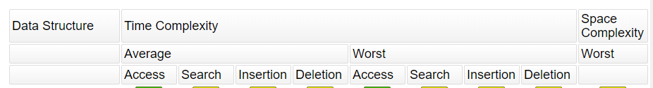
Algorithm design criteria
After the analysis of some possible solutions, we choose the Hash Table because the time complexity of it operations are smaller than other data structures and also because it allow us a big quantity of elements storing a LinkedList that contains the edges of the problem.
We designed that algorithm because the way we’re going to search won’t repite information, because the process made for create paths for 5 people for each extreme vertex, isn’t going to admit another vertex, so those vertexes we’ve visited, won’t be processed again. We think that the previous explanation shows how fast the algorithm can be, doing the hole process around O(n) because it has to visit all the vertexes, without repeat, but we have to count with the speed of the processes made in the priority queues. That is going to make our algorithm a little bit slower.
Graph 4: Time complexity of HashMap

Slide 5
Time and Memory consumption
 | Data Set 1 | Data Set 2 | Data Set 3
Memory consumption | 7,75 MB | 7,21 MB | 7,75 MB
Table 4: Memory consumption of the algorithm with different data sets.
 | Data set 1 | Data set 2 | Data set 3
Best case | 938 ms | 1100 ms | 2014 ms
Average case | 1203 ms | 1774 ms | 2143 ms
Worst case | 2013 ms | 2908 ms | 3159 ms
Table 3: Execution time of the algorithm with differents datasets.

Slide 6
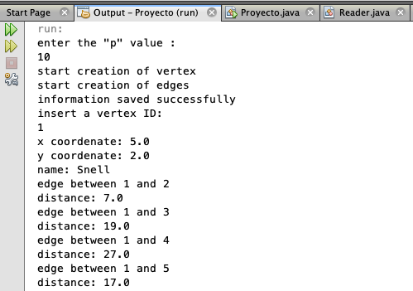
Software working
Graph 4: Carpooling Algorithm and the information that saves

