Slide 1



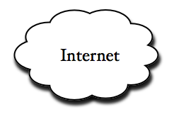

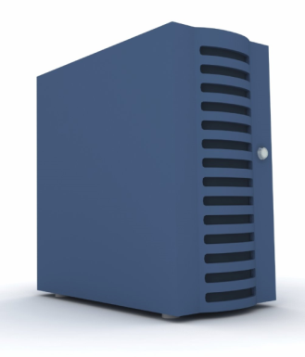





An Openflow Service for Seamless Enhancement of Data Transport Throughput
Aaron Rosen, Kuang-Ching Wang, Jim Pepin, Dan Schmiedt
Electrical and Computer Engineering Department Clemson Computing and Information Technology
Background
Network Configuration
In software defined networks, packet forwarding methods can be changed on the fly to suit different traffic types.
In addition special software agents can be deployed along the forwarding path in order to provide additional services. This allows decoupling end users traffic from the core network’s choice of transport protocols.
In this demo a special service for Openflow was created and called the Steroid Openflow Service (SOS) which aims to provide an enhancement service to the Network Transport Layer.
SOS works by seamlessly exiting a TCP connect to a near agent and then the agent creates a special connection to another agent near the destination host. The last agent creates a TCP connect to the end host. During this process Openflow is used to do packet rewrite completely behind the scene so that the end hosts have no idea this is occurring.
The agent uses a number of parallel connections to over come how TCP handles congestion. Stream Control Transmission Protocol (SCTP) is used as the Application level protocol between the agents.
Client
Server
TCP
High performance connection
TCP
High performance connection
Agent
Controller
Agent
Control Plane
Control Plane
When the Openflow switch gets a TCP packet_in event from a client on the switch the packet is sent to the agent.
The agent gets a message from the controller informing him which is the nearest agent to the endpoint and creates a connection to that agent. The far agent completes the tcp connection to the end host.
In order to make this seamless to the clients packet rewrite needs to done. Since the Openflow enabled switches we are using are unable to do L2 and L3 rewrite at Line rate we have equipped out agents with a software Openflow enabled switch (OpenVswitch) which is able to do the rewrite at near line rate.
Future Research
Results
In the future it is planed to implement a controller that makes use of multipath and is able to use several paths to maximize throughput.
How this service should be applied to different traffic types
Source | Destination | SOS (Mbps) | TCP (Mbps)
Clemson | Wisconsin | 18.6 | 1.21
Wisconsin | Clemson | 18.8 | 1.09
Clemson | Stanford
Stanford | Clemson
Wisconsin | Stanford
Stanford | Wisconsin
Additional Thanks
We would also like to thank the Individuals at BBN who generously provided support in getting the network configured. In addition to Stanford and Wisconsin for participating in this demo.
*All of these results were gather using the Geni Core network across VLAN 3716
This GENI project is sponsored by National Science Foundation
via grant CNS-0944089

