Slide 1
STAMPEDE
STatic Analysis for M Programming in Enterprise Development Environments
Presenter: Chris Barthauer
Email: mumpsstampede@gmail.com

Slide 2
STAMPEDE STatic Analysis for M Programming in Enterprise Development Environments
Calculates metrics not available from existing M tools (e.g., XINDEX, etc.):
Duplicated Lines
Physical Lines
Non-Comment Lines of Code
Provides framework for creating M code quality rules
Integrates results with Sonar GUI
Released under GPL license

Slide 3
STAMPEDE STatic Analysis for M Programming in Enterprise Development Environments
Live results for OSEHRA VistA-FOIA distribution*:
http://stampede-cbarthauer.rhcloud.com/
Scrum-style storyboard:
http://trello.com/board/stampede/5156fd731b8e840f31001285
Source code:
http://github.com/cbarthauer/stampede
Additional downloadable demo**:
http://github.com/cbarthauer/stampede/tree/master/demo
*Live results include Accounts Receivable, Integrated Billing, and Uncategorized packages.
**Downloadable results include Accounts Receivable, Integrated Billing, Order Entry Results Reporting, Toolkit, and Uncategorized packages from VistA-FOIA, as well as the FLAP Fileman Project.

Slide 4
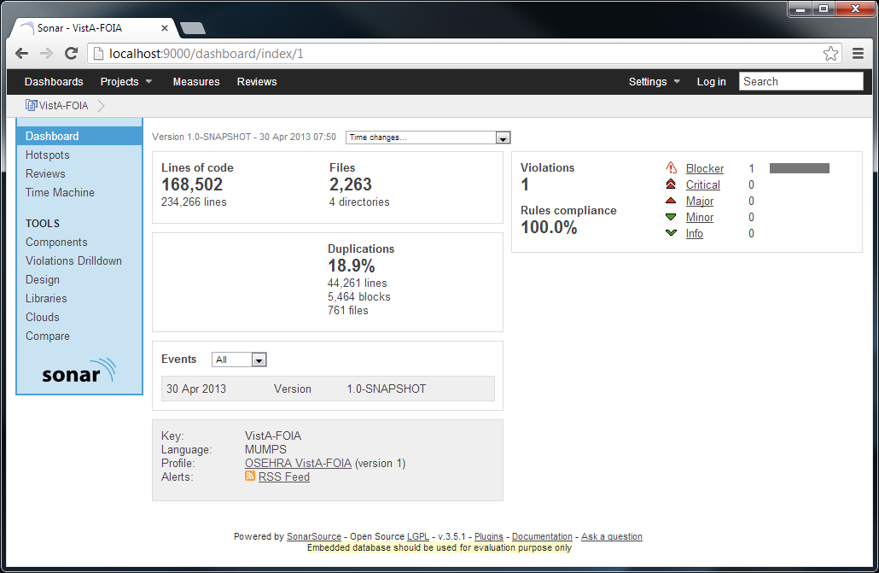
STAMPEDE STatic Analysis for M Programming in Enterprise Development Environments
Support for Lines of Code and File Count Metrics
Detects Duplication Across M Routines
*M metrics generated by STAMPEDE, Copyright (C) 2013 Chris Barthauer.
For more information, visit http://github.com/cbarthauer/stampede.

Slide 5
Demo

