Slide 1
Fraud Detection
DSCI 6007-01 Distributed & Scalable Data Engineering
TERM PROJECT
By- Group #1

Slide 2



Chandrasheker B
(Data Scientist)
Divya Madhuri
(Business Analyst)
Rishitha Ravikumar
(Data Engineer)

Slide 3
Problem Statement
The goal of the project is to build a model to detect the auto insurance fraud. The main challenge in building Machine Learning model is that the data for fraud samples is less compared with the legit insurance claims.

Slide 4
Implementation of Project
01
Identify and collect data with necessary attributes
02
EDA & Perform necessary data cleansing
03
Segregate data into training set and testing set
04
Select appropriate algorithm
05
Execute algorithm with training data
06
Evaluate algorithm with testing data
07
Model Deployment in Cloud

Slide 5
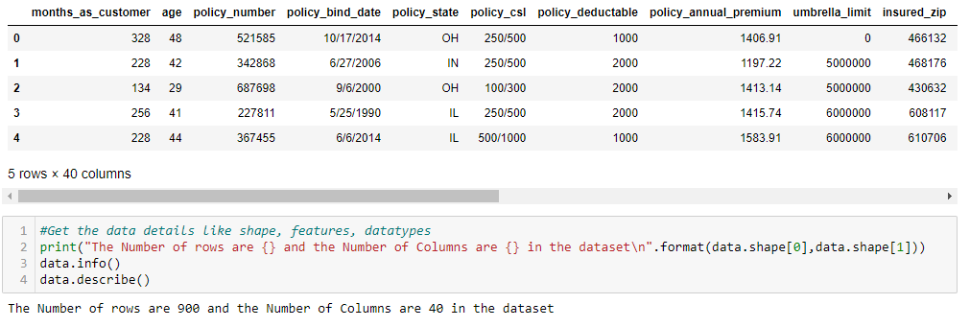
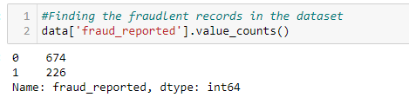
1: Identifying and collecting data with necessary attributes

Slide 6
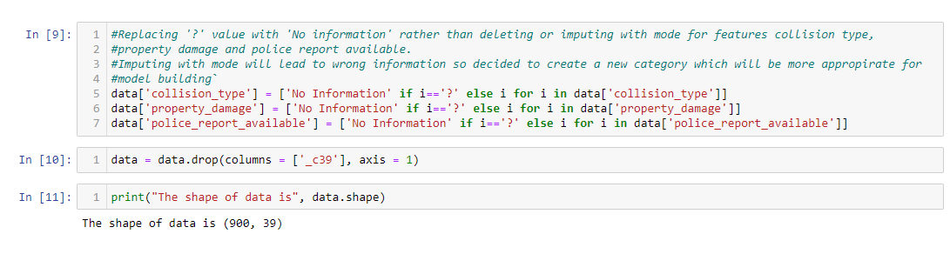
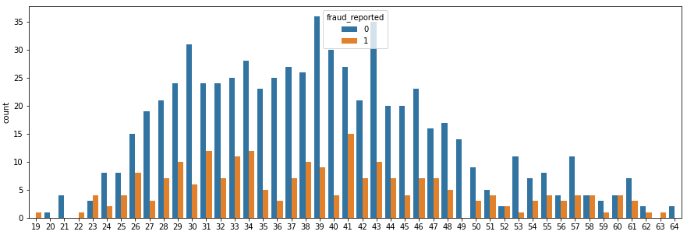
2: EDA & Performing necessary data cleansing

Slide 7
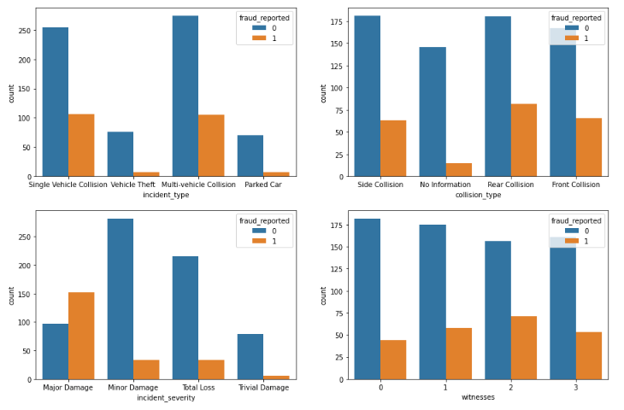
2: EDA & Performing necessary data cleansing

Slide 8
2: EDA & Performing necessary data cleansing
Observations
Most of the Claims involved vehicle collision rather than Theft or in Parking.
Irrespective of the Car Model, claims were reported.
70% of the claims were reported as not fraud.
Most of the Incidents happened in the night time.

Slide 9
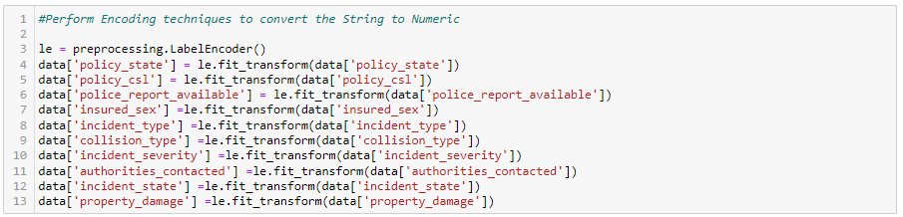
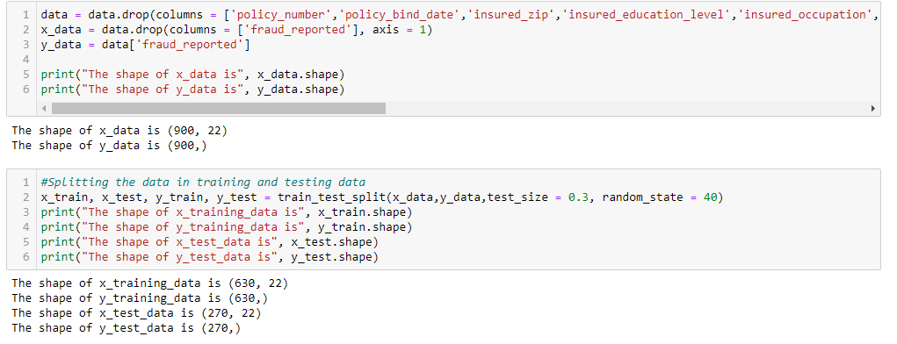
3: Segregating data into training set and testing set

Slide 10
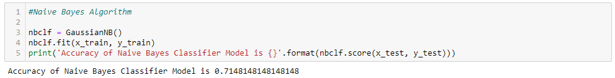
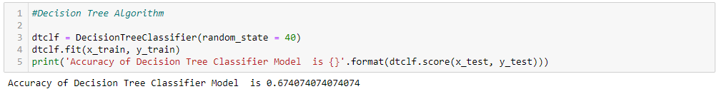
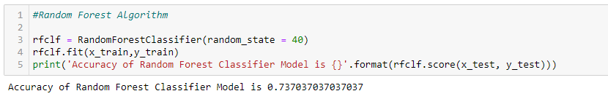
4: Selecting appropriate algorithm

Slide 11
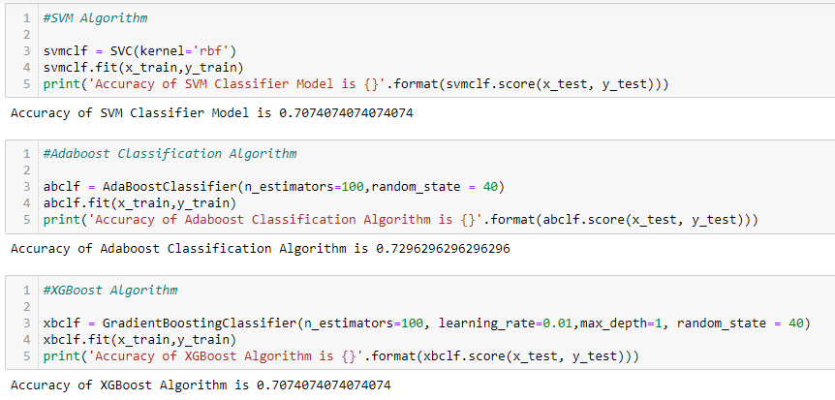
4: Selecting appropriate algorithm

Slide 12
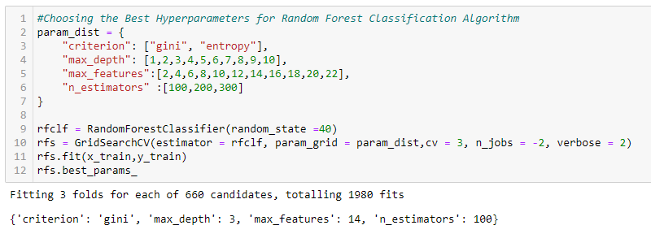
4: Selecting appropriate algorithm
We have considered the Random Forest Model with the best hyperparameters for Training & Evaluating the model performance.

Slide 13
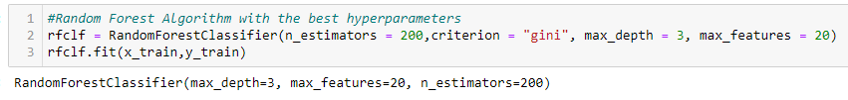
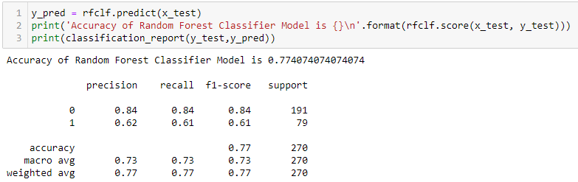
5: Executing algorithm with training data
6: Evaluating algorithm with testing data

Slide 14

7: Model Deployment in Cloud
For model deployment, we are using AWS platform that we have learnt in this course.
We first write a code for the model in the backend and then deploy the best algorithm in cloud.
Once deployment is done, prediction for different type of customers can be made.
Demonstration video would be shown.

Slide 15
Conclusion
Random Forest Model has performed the best in identifying the fraudulent claims.
More Claims registered in NY & SC states.
Most of the Collisions occurred during Night.
Collisions that doesn’t involve police reporting were more of fraudulent claims.
Low level education involved in more claims.

Slide 16

Submissions
Final Project Report
Presentation Video
Jupyter File
App File
Github Link
https://github.com/group1sdb/Final_Project

Slide 17

Thank You

