Slide 1
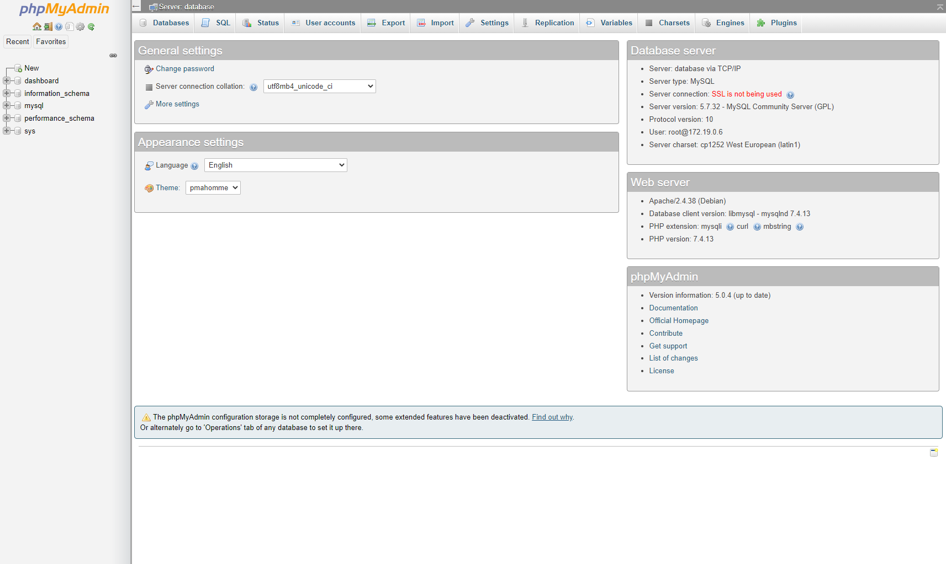
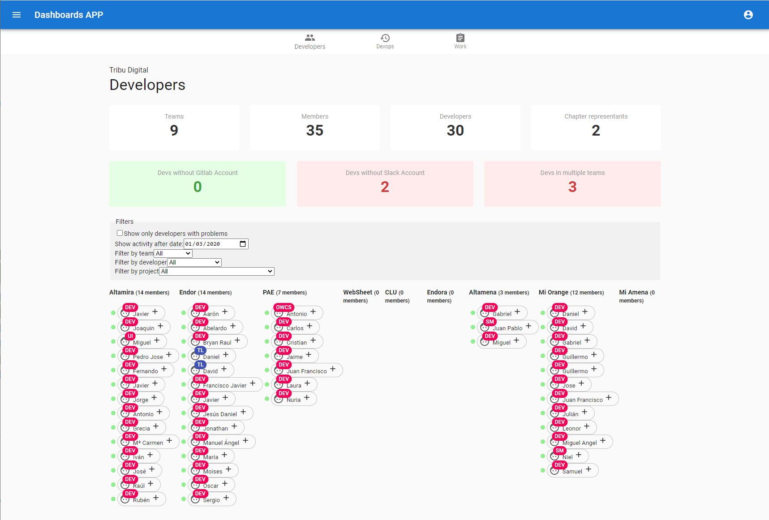

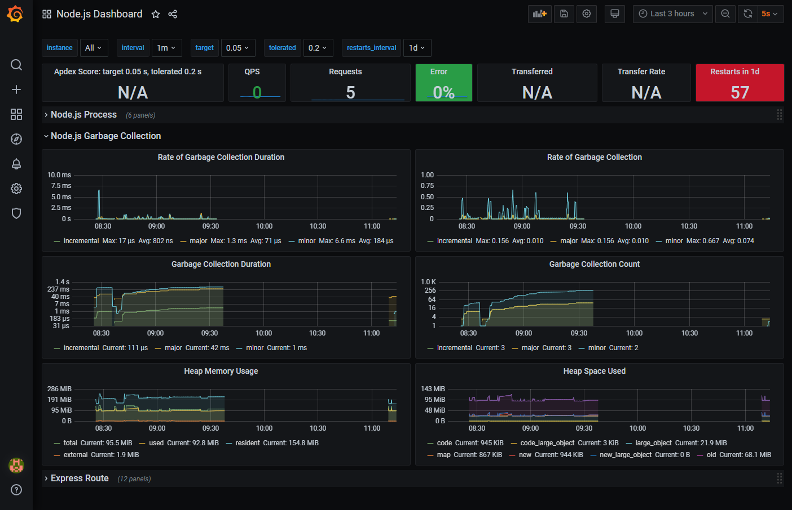






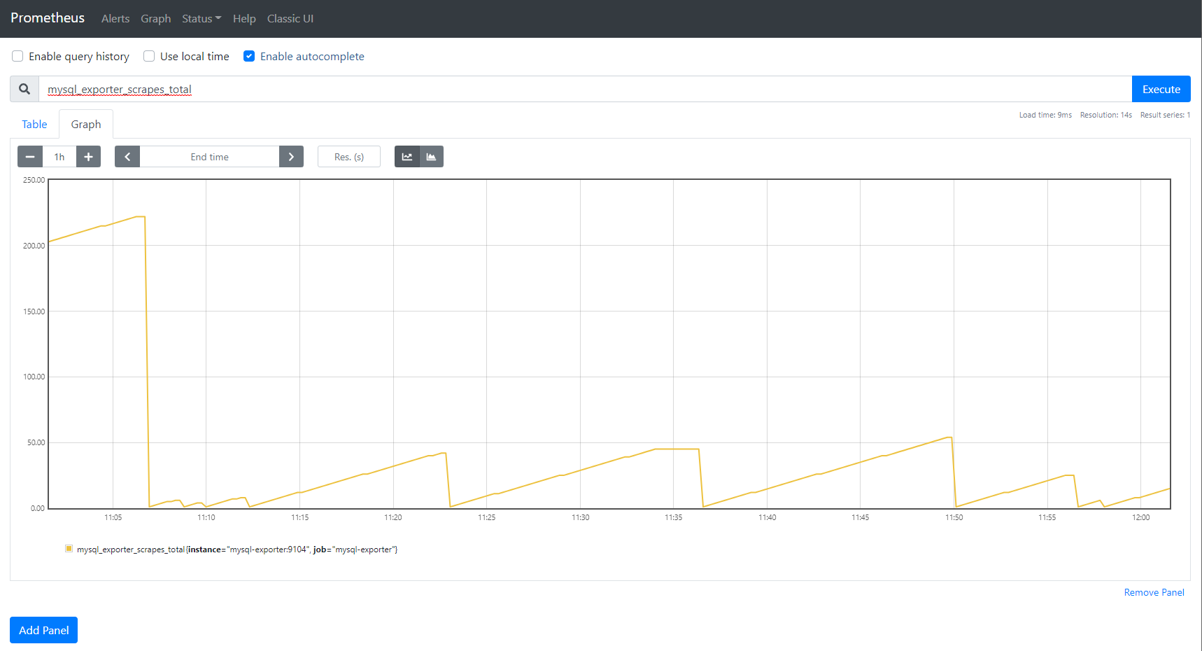



http://localhost:8082
http://localhost:85
http://localhost:85/traces
TRACING
http://localhost:85/metrics/dashboards
DB ADMIN
SPA
METRICS DASHBOARDS
WEBAPI
API EXPORTER
http://localhost:9090/metrics
CACHE
CACHE EXPORTER
METRICS COLLECTOR
DATABASE
DB EXPORTER
DevOps Dashboard Application
Observability
Notes:
Conversor a HTML: https://www.aconvert.com/

