Slide 1
Schema Enforcement in Streaming
Big Data Systems
School of Data Science
University of Virginia

Slide 2
Reminder: What is a Schema?
A schema is a contract between producers and consumers of data.
It is a formal description of:
> Structure (fields, types, relationships)
> Constraints (required vs optional)
> Semantics (what the data means)

Slide 3
Examples of Schema
Database table definitions
API request/response formats
Event payloads
Serialized objects

Slide 4

Motivation
In streaming systems, data is:
Produced by many independent producers
Evolving continuously
Processed in real time, often without human intervention
Schema enforcement is even more critical in streaming systems

Slide 5
Motivation, contd.
Without schema enforcement:
A single malformed event can break downstream consumers
Silent data corruption propagates quickly
Analytics and models degrade before anyone notices

Slide 6
Schema Enforcement in Practice
Defining a formal structure for events
Validating events at ingestion or consumption
Controlling schema evolution over time
Streaming systems generally use schema-on-write
(validate when consuming)

Slide 7
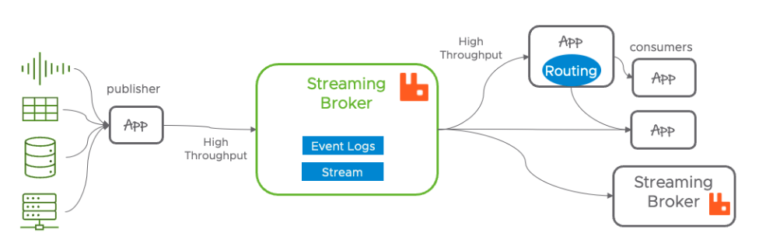
Where Enforcement Happens
Producer-side enforcement
Producers serialize data using a predefined schema
Invalid events never enter the stream

Slide 8
Where Enforcement Happens: Producer
Producer-side enforcement
Pros
> Prevents bad data early
> Less downstream complexity
Cons
> Harder to evolve because:
- Producers must strictly conform to schema before sending data
- Requires tight coordination across teams

Slide 9
Where Enforcement Happens: Broker
Broker / ingestion-layer enforcement
Stream broker or gateway validates events
Rejects or quarantines invalid messages

Slide 10
Where Enforcement Happens: Broker
Broker / ingestion-layer enforcement
Pros
> Centralized control
> Strong guarantees
Cons
> Adds latency
> Can become a bottleneck

Slide 11
Where Enforcement Happens: Consumer
Consumer-side enforcement
Consumers validate schema on read
Pros Cons
> Flexible > Bad data already propagated
> Allows heterogeneous consumers > Failure handling becomes complex

Slide 12

Schema Evolution in Streams
How to let schema change without breaking running pipelines?
Hard because:
> Old and new producers run simultaneously
> Consumers may lag behind
> Data cannot easily be “reprocessed”

Slide 13
Compatibility Models
Compatibility-based versioning is the dominant approach
Backward compatibility
New consumers can read old data
Safe changes include:
> adding optional fields
> providing defaults

Slide 14
Compatibility Models, contd.
Forward compatibility
Old consumers can read new data
Requires new fields to be optional / ignorable
Full compatibility
> works in both directions
> harder to maintain but safest

Slide 15
Versioning Strategies

Slide 16
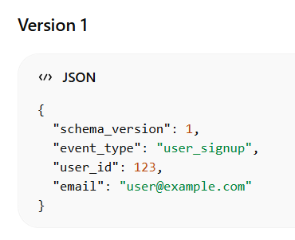
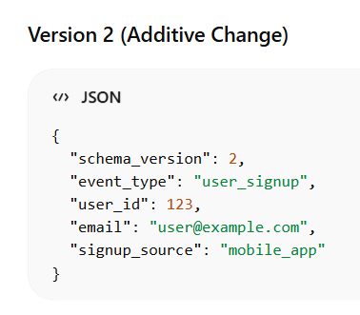
Strategy 1: Embed Schema Version
Embed schema version in each event
> Lightweight, self-describing messages
> Consumers handle multiple versions
> Event includes version

Slide 17
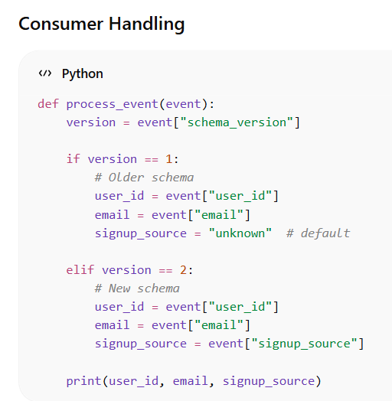
Strategy 1: Embed Schema Version
Embed schema version in each event
> Lightweight, self-describing messages
> Consumers handle multiple versions
> Event includes version

Slide 18
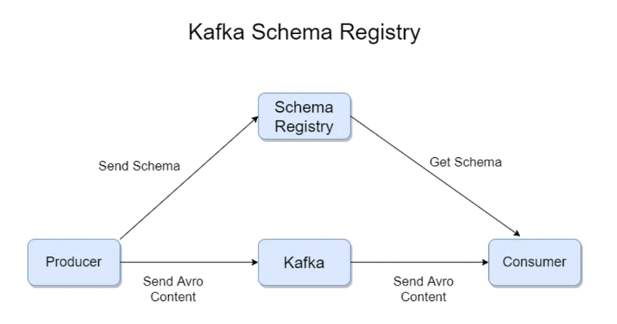
Strategy 2: External Schema Registry
Used by Apache Kafka + Apache Avro
> Centralized schema management and validation
> Enables compatibility checks (backward/forward)

Slide 19
Strategy 2: External Schema Registry
How it works:
1 | Instead of including the full schema in every message,
which adds overhead, producers send a compact schema ID
2 | A centralized repository manages and validate schemas of messages
3 | Consumers use this ID to fetch corresponding schema from
registry to deserialize and process the data correctly

Slide 20
Failure Modes

Slide 21
Failure Mode: Silent Schema Drift
Producers change payloads without coordination
Consumers continue running but produce wrong results
Most dangerous failure: nothing crashes.

Slide 22
Failure Mode: Hard Failures in Consumers
Deserialization errors:
Failure to convert raw bytes or text back into an object or structured data according to expected schema or format.
Consumer crashes or restarts
Backpressure builds:
As consumer/network slows, queue builds and system can run out of memory or crash

Slide 23
Failure Mode: Partial Enforcement
Some producers enforce schemas, others don’t
“Mostly valid” streams are worse than invalid ones

Slide 24
Performance and Scale
> Validation adds latency
> Schema lookups add network overhead
> Binary formats trade readability for throughput
Key tradeoff:
Strong enforcement vs low-latency ingestion

Slide 25
How this Interacts with Analytics & ML
> Feature pipelines assume stable schemas
> Model training breaks silently with schema drift
> Real-time dashboards mislead decision-makers

Slide 26
Design Principles (Takeaways)
> Enforce schemas as early as possible
> Make schema evolution explicit and versioned
> Prefer backward-compatible changes
> Monitor for schema violations continuously
> Treat schemas as APIs, not documentation
(Schema is a contract between producer & consumer, like an interface.)

