Slide 1
SVD Summary
Big Data Systems
School of Data Science
University of Virginia
Last updated: March 15, 2026

Slide 2

Matrix Factorization
SVD factors an m x n rectangular matrix into three matrices w special structure:

Slide 3
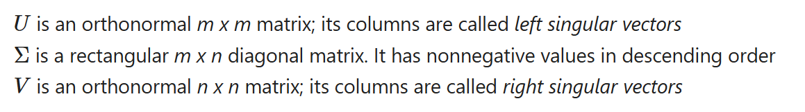

Matrix Factorization
SVD factors an m x n rectangular matrix into three matrices w special structure:
Diagonal elements of called singular values

Slide 4
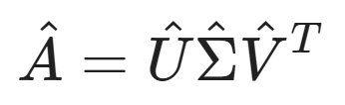
Dimension Reduction
Select top k singular values and associated singular vectors
This yields matrix approximation:

Slide 5
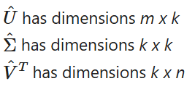

Dimension Reduction
Select top k singular values and associated singular vectors
This yields matrix approximation:
These matrices can be substantially smaller
Only need to store diagonal elements of

Slide 6
SVD in Spark
Dataset stored as RowMatrix, which is distributed across partitions
Large computations (matrix-matrix, matrix-vector products across all data) are distributed
Small computations (eigenvalue, singular value) done on driver

Slide 7


SVD in Spark: Special Cases
Calculation breaks into special cases and general case.
> Special Cases:
1. Compute Gramian in distributed manner
- Feasible since n relatively small
- Each partition of contributes to local
- The dense Gramian is stored on driver (since it’s small)

Slide 8

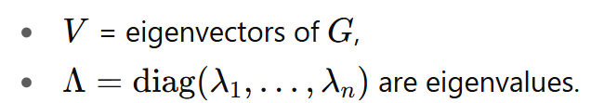



SVD in Spark: Special Cases
Step 2 done on driver
2. Decompose Gramian:
Then
Note diagonal elements of are singular values

Slide 9
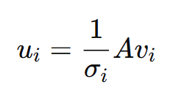
SVD in Spark: Special Cases
Step 3 done on workers
3. Compute left singular vectors
Now we have all of the factors to reconstruct the matrix

Slide 10

SVD in Spark: General Case
Gramian won’t fit in driver memory, so earlier strategy won’t work
Instead, at a high level, start with relationship

Slide 11

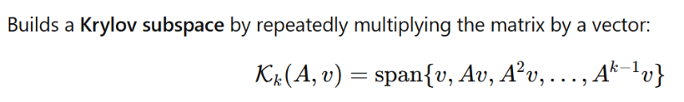
SVD in Spark: General Case
Gramian won’t fit in driver memory, so earlier strategy won’t work
Instead, at a high level, start with relationship
Then compute in a distributed way
Project onto subspace for small tridiagonal matrix T

Slide 12
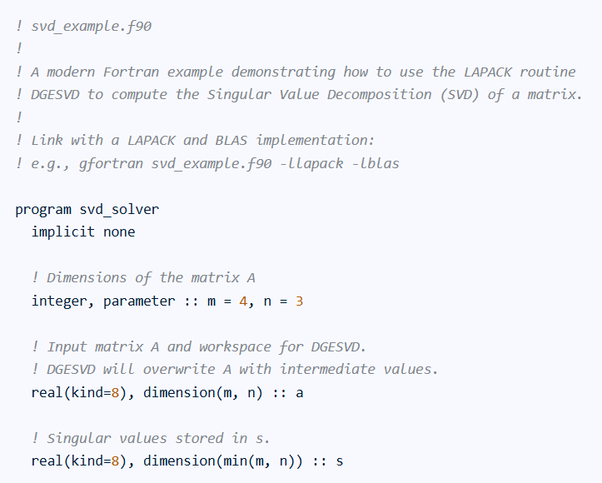
SVD in Spark: General Case
Send T to ARPACK to compute top eigenvalues, eigenvectors on driver
ARPACK:
> FORTRAN software library for solving
large-scale eigenvalue problems
> Highly optimized for sparse and large matrices

