Slide 1
Week 3 : Last steps with Hubo, Python objects

Slide 2
Today’s Topic
More practices on
Conditional expressions, While-loops, and stepwise refinement
Python Interactive Mode & Python objects
Python Shell in Wing IDE
Types, Variables, Methods, Operators, Expressions
New module
cs1media

Slide 3
Practices
Read sections 18~20 doing following tasks.
Rain1
Rain2
Trash1
Trash2
Return
Playing with interactive mode
Introduction to cs1media
Three color poster
When you have done Task Three color poster, let a TA mark you off

Slide 4
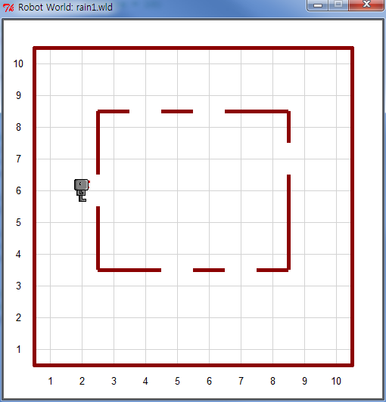
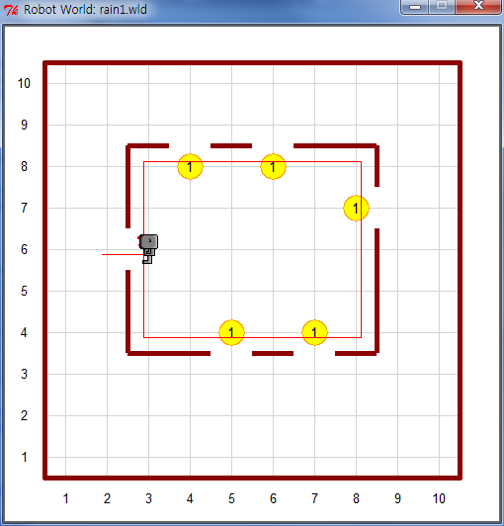
Task | Conditionals, While-loop – Rain 1
Help Hubo close the windows of his house
Use rain1.wld file
To drop a beeper in front of a window means that the window is closed
Before
After

Slide 5
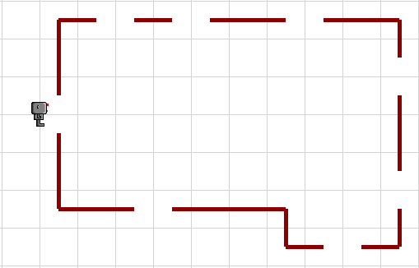
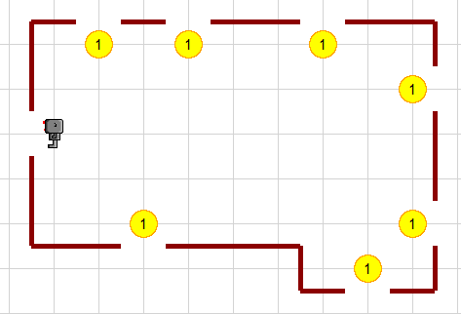
Task | Conditionals, While-loop – Rain 2
Help Hubo close the windows of Amy’s house
Use rain2.wld file
To drop a beeper in front of a window means that the window is closed
※ Note : Your program must work for both rain1.wld and rain2.wld
Before
After

Slide 6
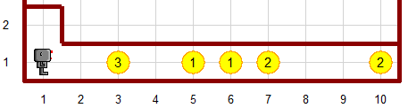
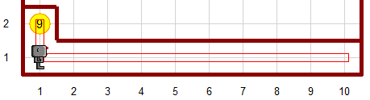
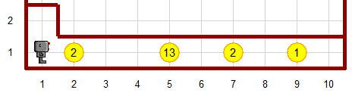
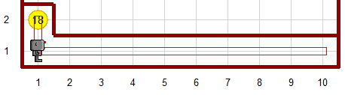
Task | Conditionals, While-loop – Trash 1
Hubo want to collect all the litter, and put it in the garbage can
Use hubo.carries_beepers() to put litter to trash
※ Note : Your program must work for both trash1.wld and trash2.wld
trash1.wld
trash2.wld
Before
After

Slide 7
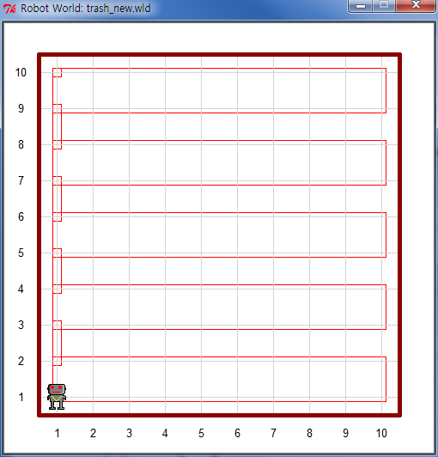
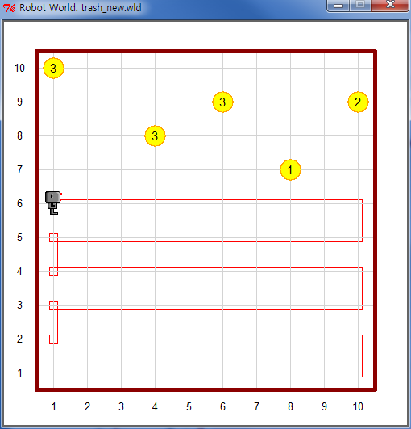
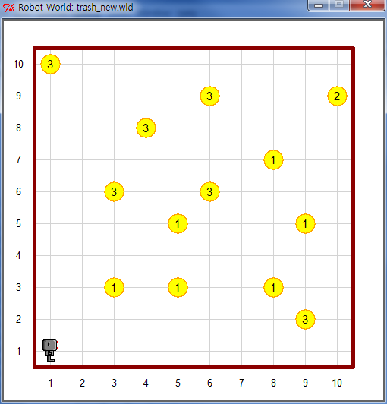
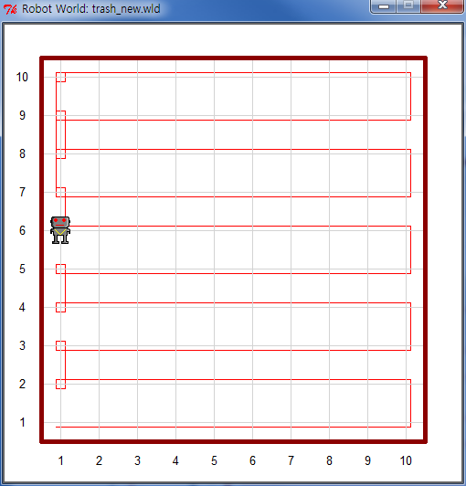
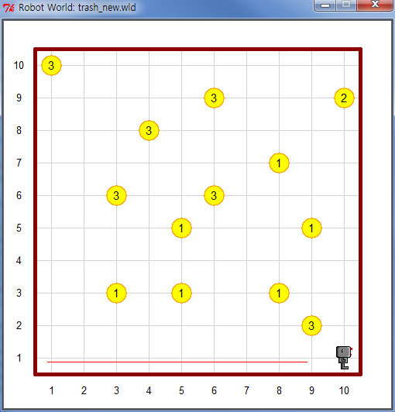
Task | Conditionals, While-loop – Trash 2
Hubo want to collect all the litter in backyard of his house and bring it back to his starting position
Create your own world file like below map
Your solution should not depend on the exact location of the garbage, nor should it depend on the size of the yard
Before
After

Slide 8
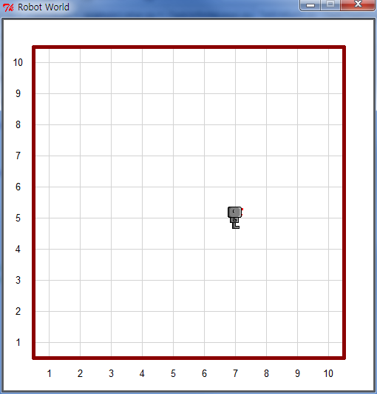
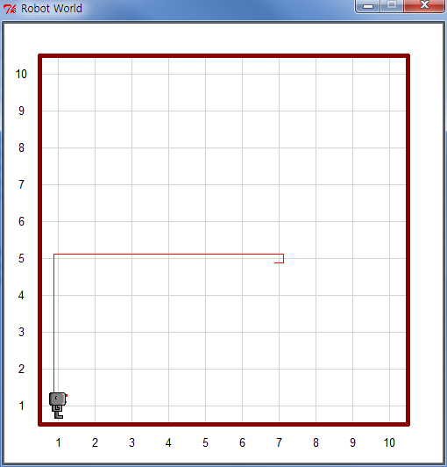
Task | Conditionals, While-loop – Return
Write a program that will allow Hubo to return to his usual starting position (Avenue 1, street 1, facing east)
Initial position : any position and orientation in an empty world
(e.g.) hubo = Robot(orientation = “w”, avenue = 7, street = 5)
Use hubo.facing_north() to check direction of Hubo’s face
Initial Position
Before
After

Slide 9
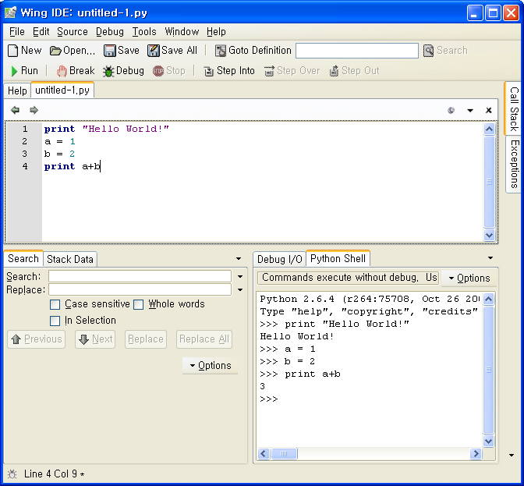
Two modes in Python
There are two modes in Python
Normal mode
Normal mode is the mode where the scripted and finished .py files are run in the Python interpreter.
Interactive mode
Interactive mode is a command line shell which gives immediate feedback for each statement, while running previously fed statements in active memory.
Wing IDE supports both modes!
Editor area for normal mode
Python shell window for interactive mode
Let’s try the interactive mode.
Editor area
Python shell

Slide 10
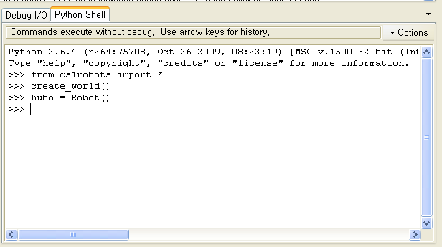
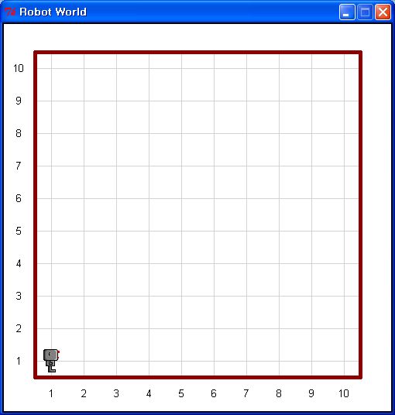
Interactive Mode
To create a new robot named hubo, type in the following line:
hubo = Robot()
Then a robot will appear at the intersection of avenue 1 and street 1

Slide 11
Task | Playing with Interactive Mode (1)
Create objects and check the type of each object
Type the following inputs in the Python Shell and fill in the red box.
If facing errors, fix the problems following the given instructions
 | Input | Expected Result | Instruction
1 | int1 = 13
2 | float1 = 13.5 + 7.1
3 | string1 = 'cs101'
4 | boolean1 = "Cheong" > "Choe"
5 | tuple1 = (int1, float1, string1, boolean1)
6 | none1 = None
7 | robot1 = Robot() |  | Import ‘cs1robots’! Create ‘world’ for the robot!
8 | picture1 = create_picture(10, 10) |  | Import ‘cs1media’!
9 | print type(int1), type(float1), type(string1)
10 | print type(boolean1), type(tuple1), type(none1)
11 | print type(robot1), type(picture1)
12 | print type(string1 * int1)
13 | print picture1.size() | <type 'tuple'> | Use ‘type’ function!
14 | print type(string1 * float1) | <type 'str'> | Remove a variable!
15 | print not type(boolean1) | <type 'bool‘> | Move ‘not’ to the proper place!
16 | print 13 > 15 and "Cheong" < "Choe" | True | Put ‘not’ keyword into the proper place!
17 | print 13 > 15 or "Cheong" > "Choe” | True | Put ‘not’ keyword into the proper place!
(?)
(?)
(?)
(?)

Slide 12

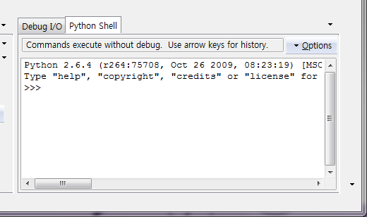
Task | Playing with Interactive Mode (2)
Use the Python shell as a calculator, do the following:
Compute the area and volume of spheres with radius 5.
Convert centimeters to inches and conversely.
27cm -> (?) inch
80cm -> (?) inch
27inch -> (?) cm
180inch -> (?) cm
Compute the result of the following mathematical expression.
※ Note : You must use Python Shell !!!

Slide 13

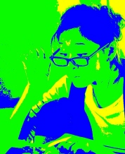
Task | Three color poster
Write a program that takes a photo and converts it into a three color poster
A pixel that is very bright is made yellow.
A pixel that is dark is made blue.
All other pixels are made green.
※ Note : You must start with the code for making a black-and-white photo from the lecture and modify it.
Before
After

Slide 14
Any Questions?

