Slide 1
Week 4 : Basic data types (numbers and strings)

Slide 2
Today’s Topic
Type conversion
Interacting with a user’s input (function ‘raw_input’)
More about function
Function parameters
Function results

Slide 3
Practices
cs1media
Creating sepia image
Interactive programming
being Euclid
being Edmund Gunter
being Gunter Reloaded
being Gunter 3
being Gunter Final
Feel free to do Trash3 in the robot lecture notes.
Caution: Save your python files in C:/cs101/ and clear the directory when you complete the tasks.

Slide 4
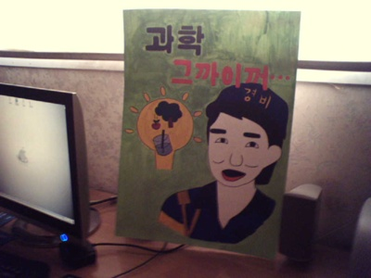
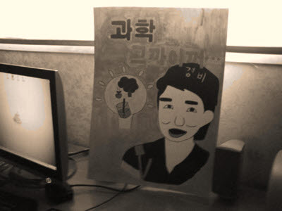
Sepia photo
Sepia - color-toning technique that makes an ancient photo
obtain the luminance using the formula v = int(0.299 * r + 0.587 * g + 0.114 * b)
create a new pixel r, g, b = v, v, v
if v is at most 62, increase red by a factor of 1.1 and decrease blue by a factor of 0.9
if v is between 63 and 191, increase red by a factor of 1.15 and decrease blue by a factor of 0.85
if v is at least 192, then increase red by a factor of 1.08, and decrease blue by a factor of 0.93. (If red becomes larger than 255, set it to 255)
set the pixel to the new (r,g,b) value.
def sepia(img) :

Slide 5
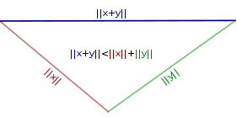
Practice – being Euclid
Given three numbers a, b, and c, it is possible to form a triangle whose sides have length a, b, and c if and only if the triangle inequality holds. That is, every side must be shorter than the sum of the other two sides.
Write a program that asks the user to enter float values, and then outputs YES or NO depending on whether one can form a triangle.
Sample input and output
Side a: 2.3
Side b: 4.3
Side c: 5.6
YES

Slide 6
Practice – being Edmund Gunter
Modify the following program to ask the user for the number of steps (instead of using 40 fixed steps).
import math
sin = math.sin
pi = math.pi
for i in range(41):
x = float(i) / 40.0 * 2 * pi
print sin(x)
Note: why 41 in range? Try this to find out.
for i in range(3)
print i

Slide 7
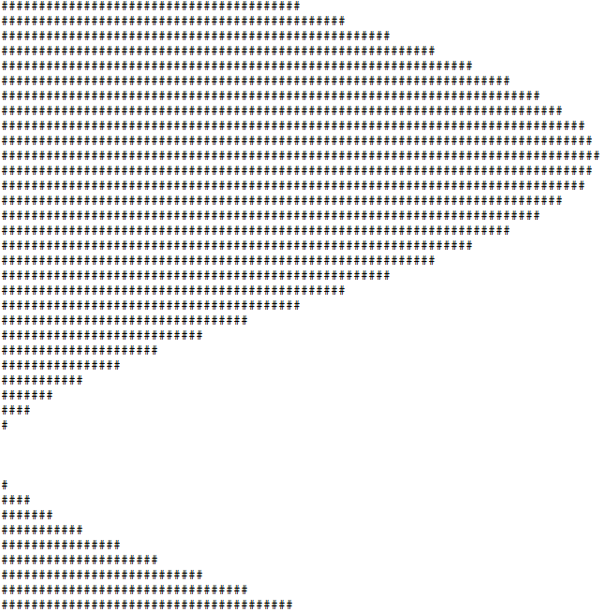
Practice – being Gunter Reloaded
40
Change the program to print a nice curve like this:
sin(x) == -1 -> 0 #
sin(x) == 0 -> 20 #s
sin(x) == 1 -> 40 #s
40

Slide 8
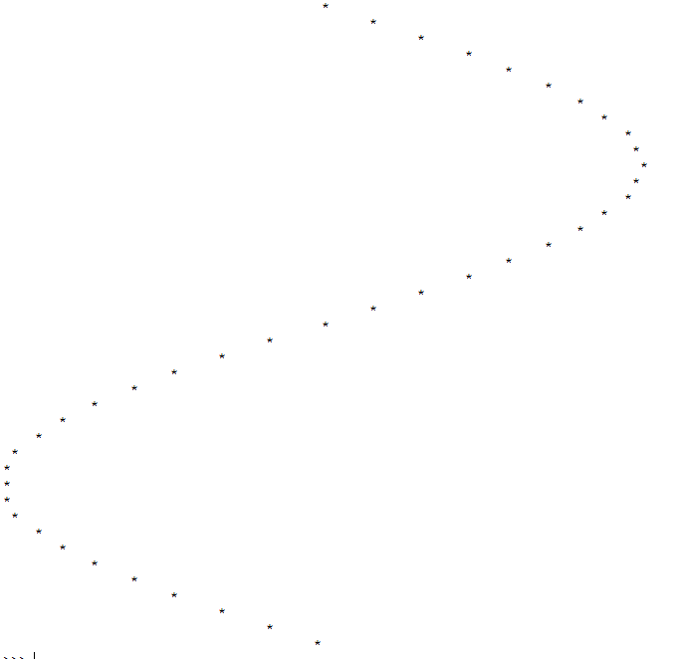
Practice – being Gunter 3
Change the program to print a curve like this instead:
>>>print “ “ * 5 + “!!”
!!
5

Slide 9
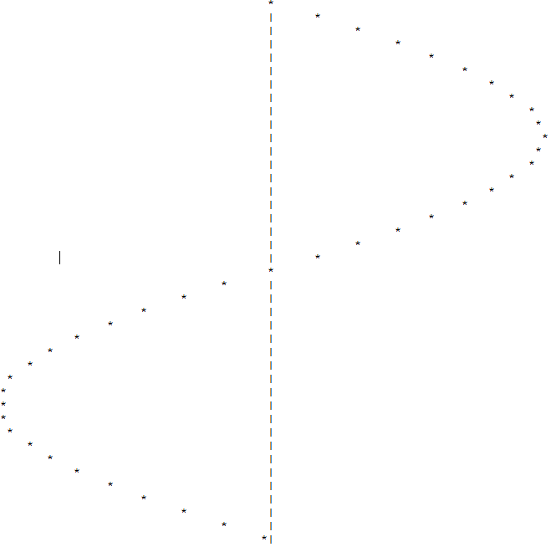
Practice – being Gunter Final
Change the program again to include the x-axis:

Slide 10
Any Questions?

