Slide 1
Week 7 : List and photo processing

Slide 2
Today’s Tasks
Practice list and string
Convert Decimal to any radix base number
Between Binary and Hexadecimal
Practice more photo processing
Crossfading
Include Scaling & Concatenating
Skewing
Caution: Save your python files and image files in C:/cs101/ and clear the directory when the session is over

Slide 3
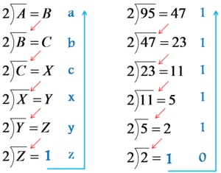
Conversion Decimal (1/2)
How to convert?
Use quotient & remainder
Until quotient is 0
Write remainders in reverse order
As a result, binary equivalent of decimal number 95 is 1011111

Slide 4
Conversion Decimal (2/2)
Define a conversion function
Input a number & radix
Number - positive integer
Radix - between 2 and 16
Output
Just digits, no gap or another character
123 (O) ‘1’ ‘2’ ‘3’ (x)
You should make 2 programs with different type
Use List only
Use String only
def deci_to_any(n, radix) :

Slide 5
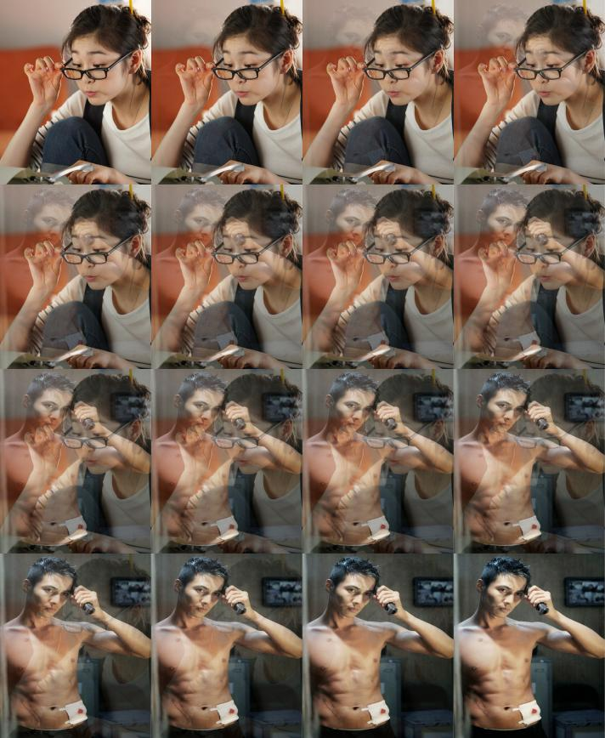


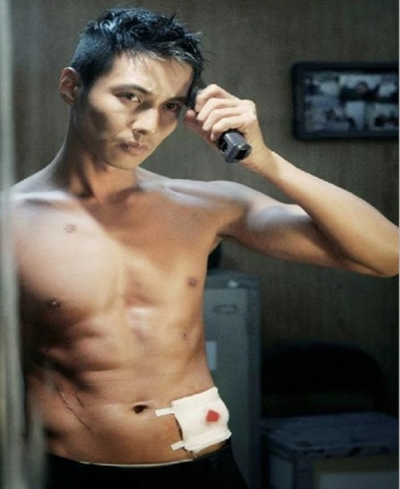
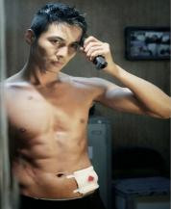
Crossfading (1/2)
Take two photos of the same size
Fade one image out while fading another image in at the same time
Scale down two images and Concatenate the crossfading process into one picture
Scale down
img1
img2
Input
Output

Slide 6
Crossfading (2/2)
Define a crossfading function
Input
Use 2 images – “yuna.jpg” and “wonbin.jpg”
Assume that the two photos have same size
Output
Show the crossfading process
4 X 4 or 5 X 5
You should create a new image
You can use scale_down function and reference concat function in cs1_media note
def crossfade(img1, img2, factor) :

Slide 7
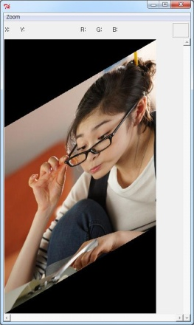
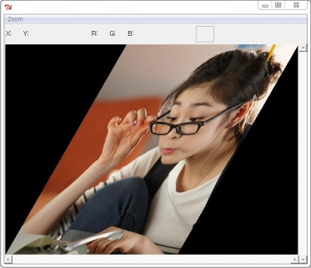
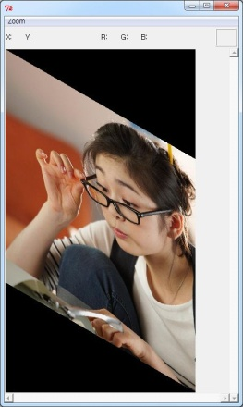
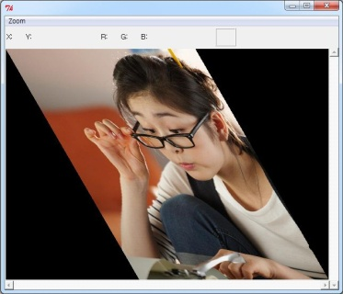
Skewing (1/2)
Create the image skewed on an angle from the vertical or horizontal
Direction
Vertical 30
Horizontal 30
Angle
img
Input
Vertical -30
Horizontal -30
Output

Slide 8
Skewing (2/2)
Define a skewing function
Input a direction & angle
Direction – vertical or horizontal
Angle – between -89 and 89
Output
Create a new skewed image
You can use math function or builtin function
pi, sin, cos, tan, …
abs
Type conversion
def skew(img, …) :
?
30°

Slide 9
Any Questions?

