Slide 1
Last Week: Objects

Slide 2
Today’s Tasks
Upgrade your wonderful animal!

Slide 3
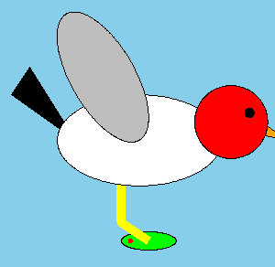
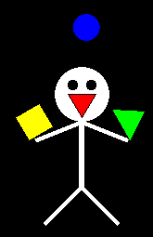

Recall the animal you created
But this time, make it much more elegant
Use Python Objects so that you can make it like Hubo (cs1robots)

Slide 4
Making the animal object
1. it should have parameters for the constructor
E.g.) initial position, colors, size, options, etc.
2. it must have methods that can be used to move it on the canvas, and to move its body parts.
You must not use the graphical objects outside the object
3. it must have at least one event method which can change the animal’s shape or do the special action
E.g.) becoming supermario, laying eggs, transforming etc.

Slide 5

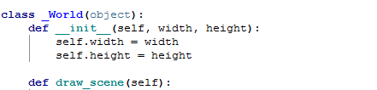
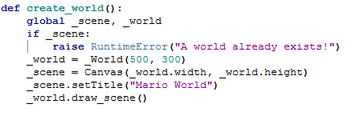
Example – Supermario
name for the Canvas we will use
Background(not moving object) drawing code should be here
Don’t forget adding

Slide 6
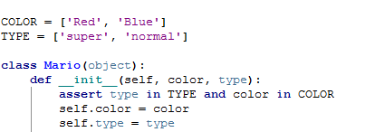

Example - Supermario
Object drawing code should be here
Don’t forget!
If you want to insert any moving object in the scene, you can just make Python object for that

Slide 7
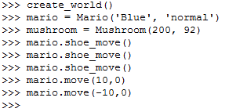


Example - Supermario (graphic and scenario design: TA 연주영)
Let’s see how it works!
I can’t see the mushroom. Where is it?
What if we want to cheat, starting as the supermario?

Slide 8
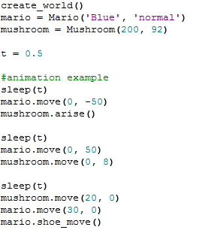
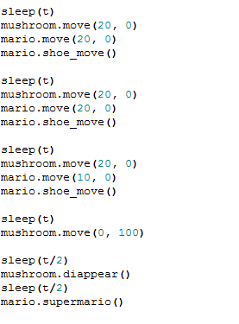
Example - Supermario
Let’s make the animation using Objects

Slide 9
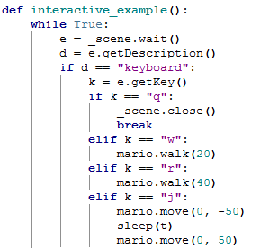
Example - Supermario
Make it interactive!
We want to make kind of game using keyboard input
Let’s see the demo

Slide 10
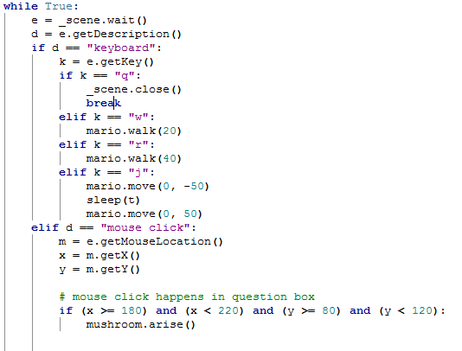
Example - Supermario
What if we want to know what is in the question box in advance?
Using mouse click of question box.

Slide 11
Summary
Using a template file in download board
1. make your own animal (or anything) object which provides following method moving in the canvas (like mario.move(10, 20) )
moving the part of body (like mario.shoe_move() )
special function (like mario.supermario() )
it should have parameters for the constructor and you must not use the graphical objects outside the object
2. make your own background scene (in ‘draw_scene’ method of ‘_World’ object)
3. make animation scenario
4. make interactive program at least one keyboard input and one mouse input

Slide 12
Be Creative! Have fun!

