Slide 1
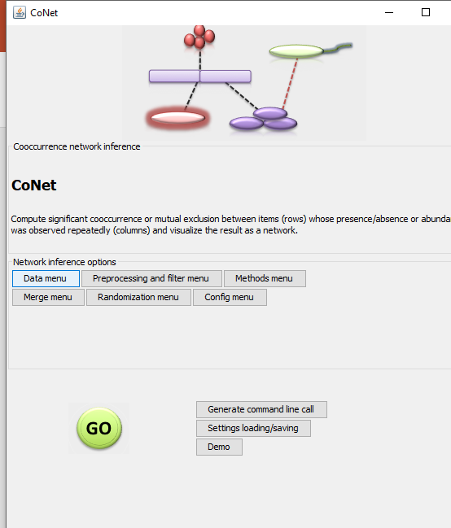
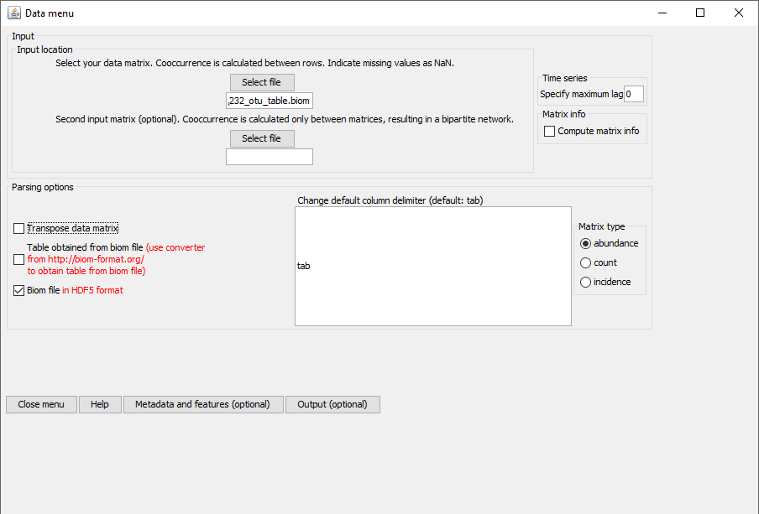
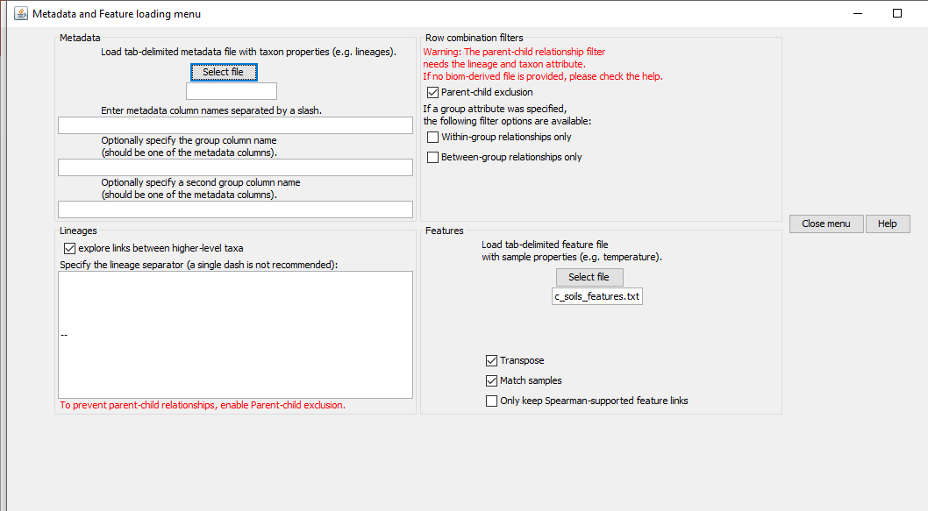
1- use your Qiime OTU table BIOM
2- Mapping file (remove the # from SampleID) it seems that the features can be only numbers (not sure)
Load you biom file
Parent-child exclusion
explore links between higher-level taxa
Load you mapping file

Slide 2
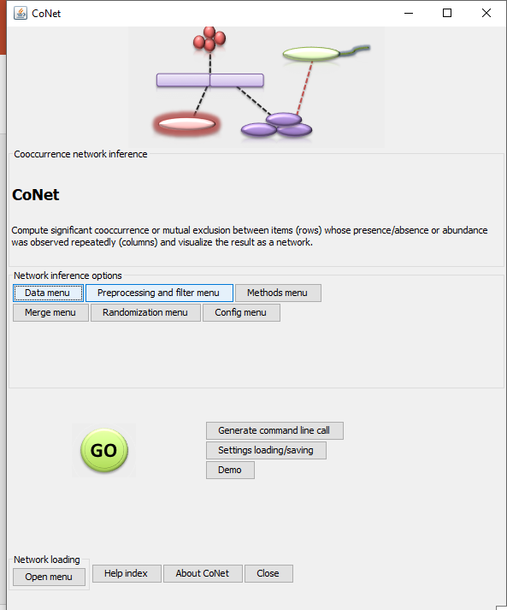
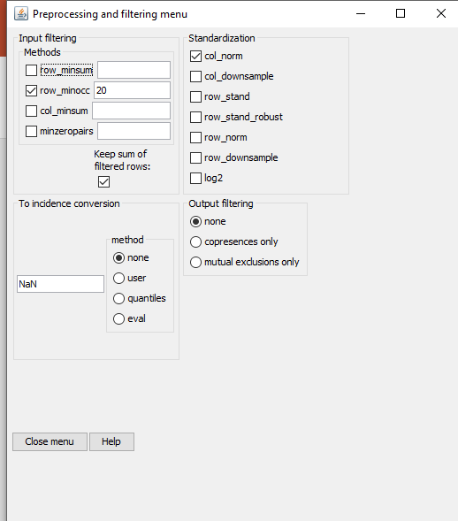
Preprocessing
This number depends on how many sample you have. So choose reasonable number. For example. If you have 6 samples you can choose 3-4.. NOT MORE THAN 6

Slide 3
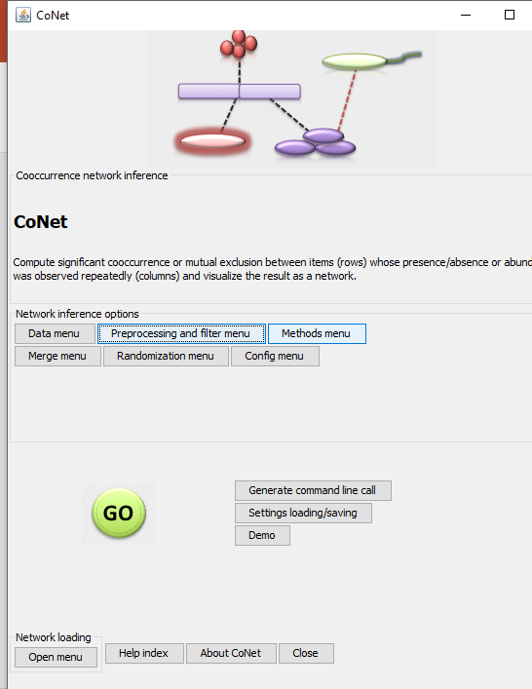
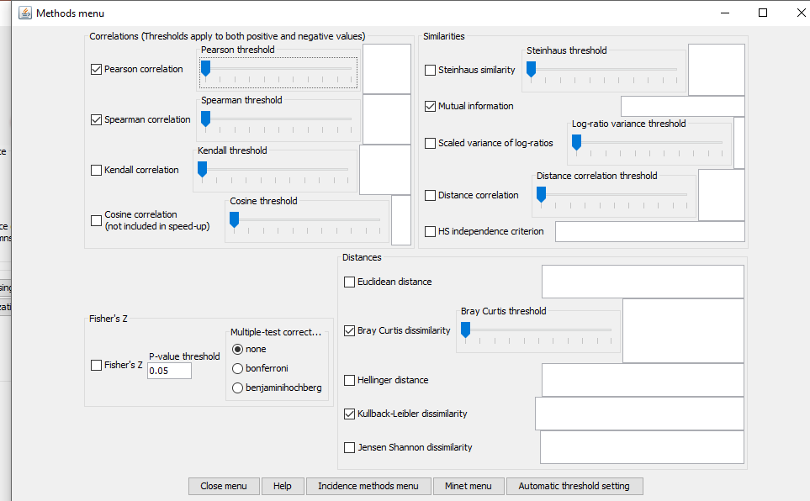
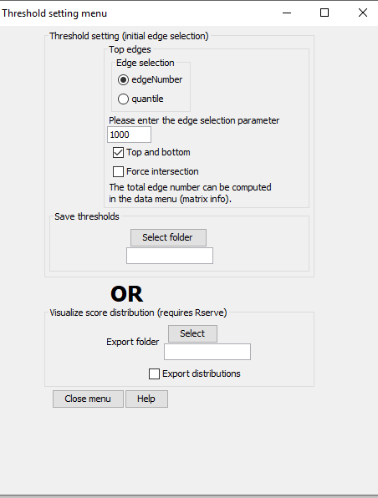
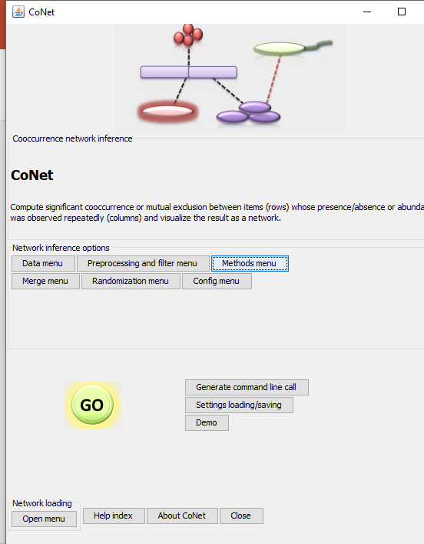
Methods and thresholds
Pearson,
Spearman,
Mutual Information,
Bray Curtis
Kullback-Leibler dissimilarity
This number depends on your otu table

Slide 4
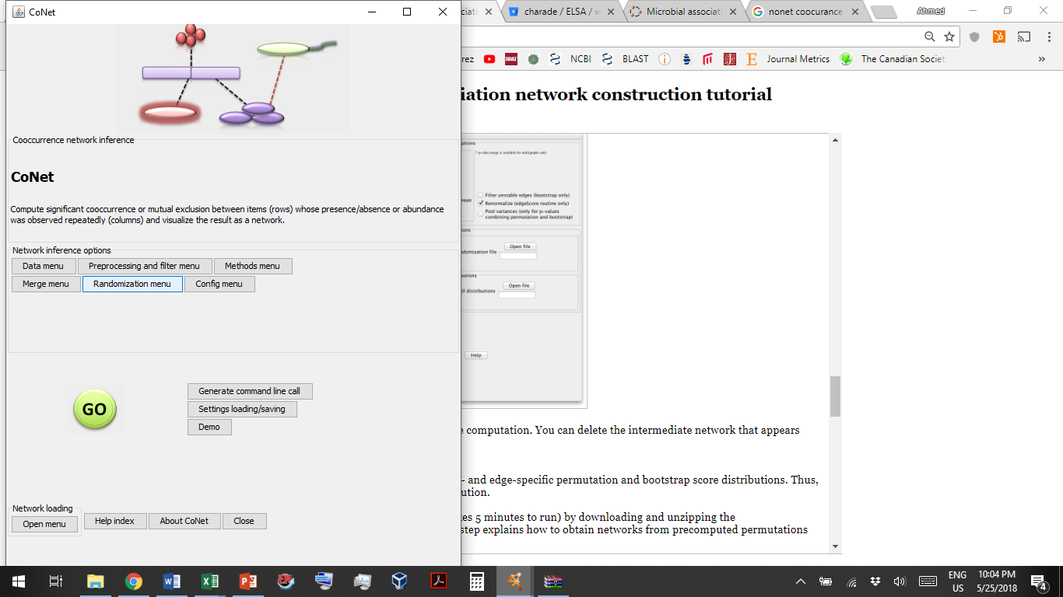
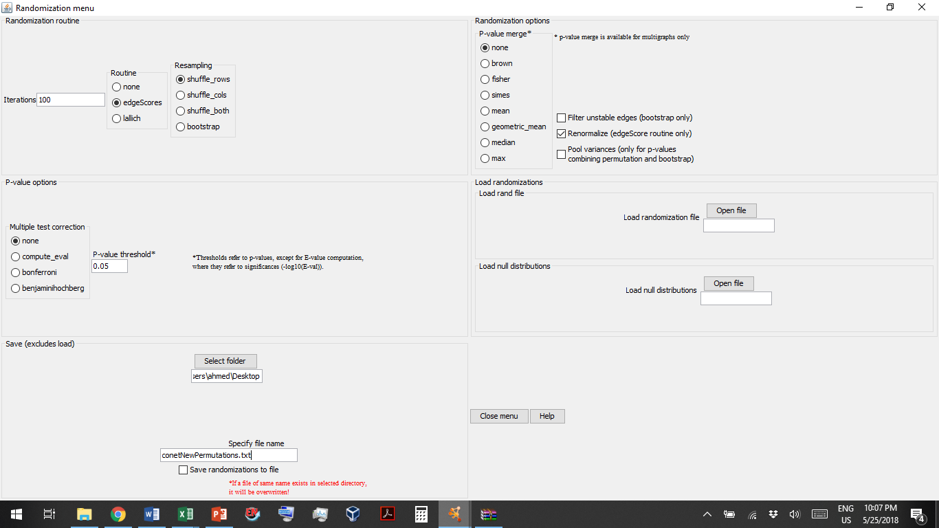
Step 3 - Permutation
Select a folder in which the permutation file will be stored.
Give a name to the file
I just got an error message saying there was a null pointer exception while computing permutations. What can I do? The following exception during the permutation step: java.lang.NullPointerException at be.ac.vub.bsb.cooccurrence.util.ArrayTools.fillJSLOutputArray is caused in some cases by the assignment of higher-level taxa. To avoid it, open the Metadata and features sub-menu in the data menu and switch off "explore links between higher-level taxa" and "parent-child exclusion". Please also restart Cytoscape. Sorry about this.

Slide 5
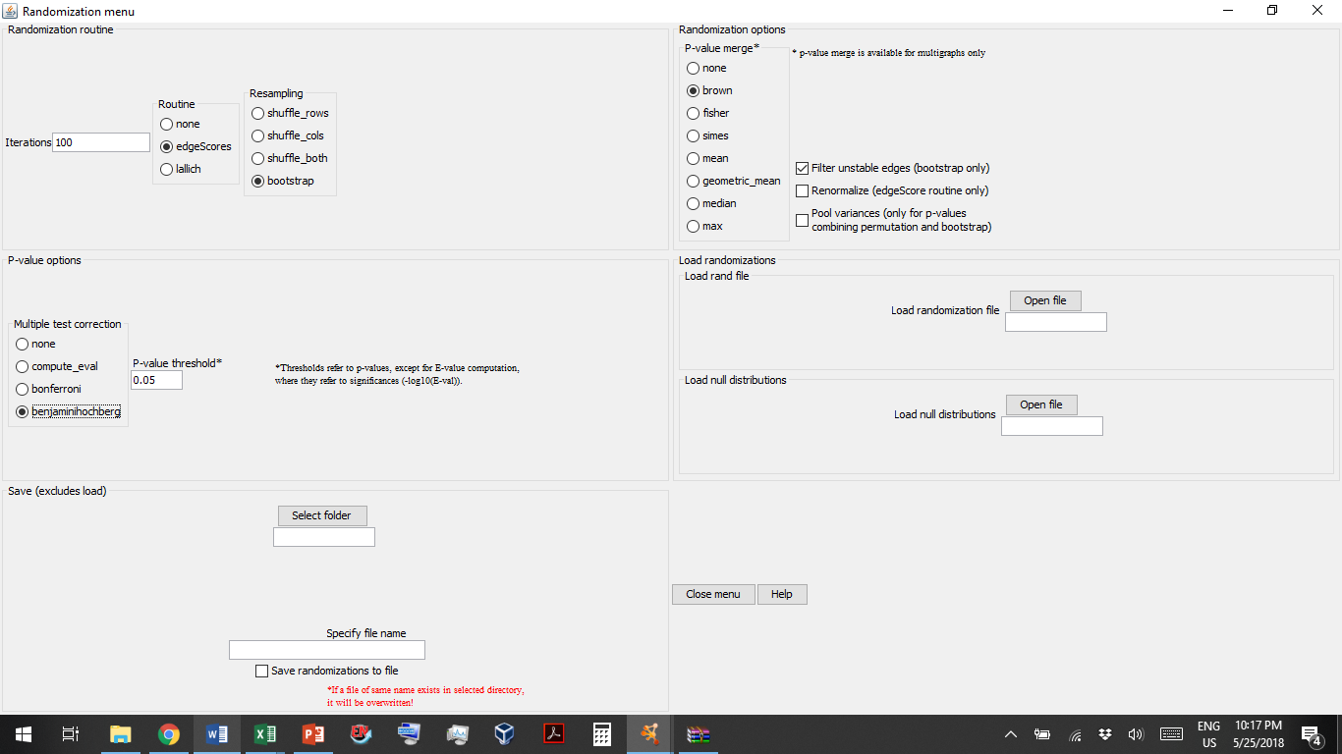
Step 4 - Bootstrapping
Load the permutation (from previous step)
Select a folder in which the bootstrap file will be stored.
Give a name to the file

