Slide 1

3D-COFFEE
Mixing Sequences and Structures
Cédric Notredame

Slide 2



Potential Uses of A Multiple Sequence Alignment?
chite ---ADKPKRPLSAYMLWLNSARESIKRENPDFK-VTEVAKKGGELWRGLKD
wheat --DPNKPKRAPSAFFVFMGEFREEFKQKNPKNKSVAAVGKAAGERWKSLSE
trybr KKDSNAPKRAMTSFMFFSSDFRS----KHSDLS-IVEMSKAAGAAWKELGP
mouse -----KPKRPRSAYNIYVSESFQ----EAKDDS-AQGKLKLVNEAWKNLSP
***. ::: .: .. . : . . * . *: *
chite AATAKQNYIRALQEYERNGG-
wheat ANKLKGEYNKAIAAYNKGESA
trybr AEKDKERYKREM---------
mouse AKDDRIRYDNEMKSWEEQMAE
* : .* . :
Extrapolation
Phylogeny
Multiple Alignments Are CENTRAL to MOST Bioinformatics Techniques.
Motifs/Patterns
Struc. Prediction
Profiles

Slide 3


Why Is It Difficult To Compute A multiple Sequence Alignment?
A CROSSROAD PROBLEM
BIOLOGY:
What is A Good
Alignment
COMPUTATION
What is THE Good
Alignment
chite ---ADKPKRPLSAYMLWLNSARESIKRENPDFK-VTEVAKKGGELWRGLKD
wheat --DPNKPKRAPSAFFVFMGEFREEFKQKNPKNKSVAAVGKAAGERWKSLSE
trybr KKDSNAPKRAMTSFMFFSSDFRS----KHSDLS-IVEMSKAAGAAWKELGP
mouse -----KPKRPRSAYNIYVSESFQ----EAKDDS-AQGKLKLVNEAWKNLSP
***. ::: .: .. . : . . * . *: *

Slide 4
Why Is It Difficult To Compute A multiple Sequence Alignment ?
BIOLOGY
COMPUTATION
CIRCULAR PROBLEM....
Good
Good
Sequences
Alignment

Slide 5
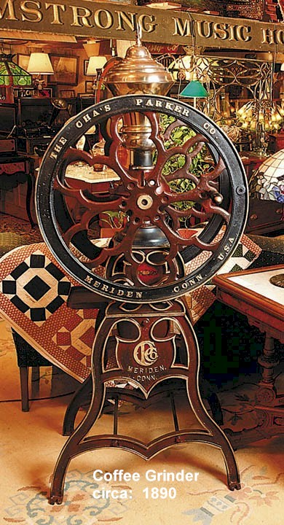
The T-Coffee Algorithm

Slide 6

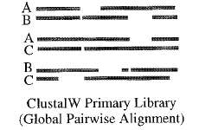
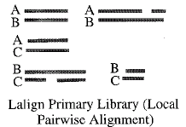
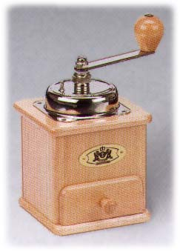
Mixing Local and Global Alignments
Local Alignment
Global Alignment
Extension
Multiple Sequence Alignment

Slide 7
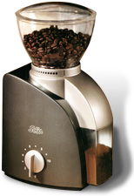
What is a library?
2
Seq1 MySeq
Seq2 MyotherSeq
#1 2
1 1 25
3 8 70
….
3
Seq1 anotherseq
Seq2 atsecondone
Seq3 athirdone
#1 2
1 1 25
#1 3
3 8 70
….
Extension+T-Coffee
Library Based Multiple Sequence Alignment

Slide 8
The Triplet Assumption
SEQ A
X
X
Y
Y
SEQ B
Z
Consistency
Consensus

Slide 9
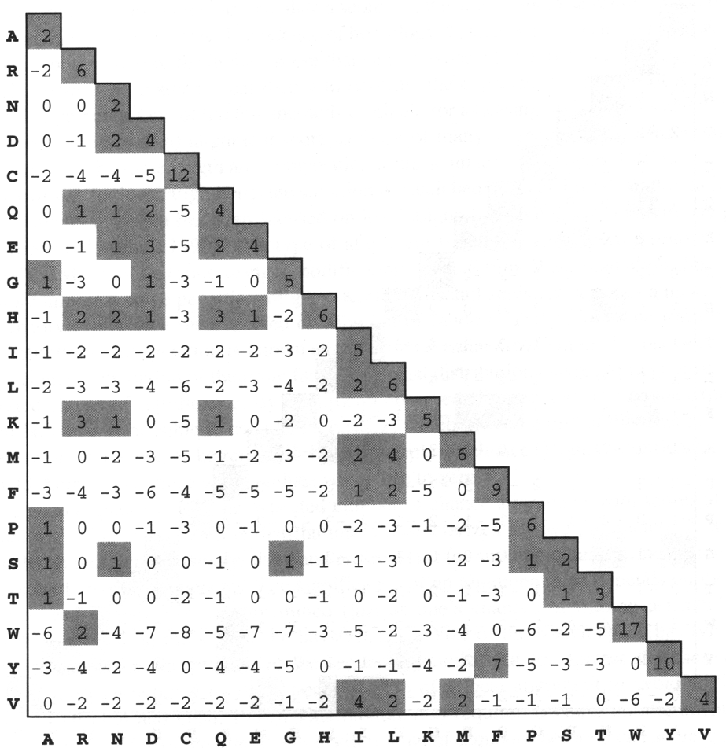
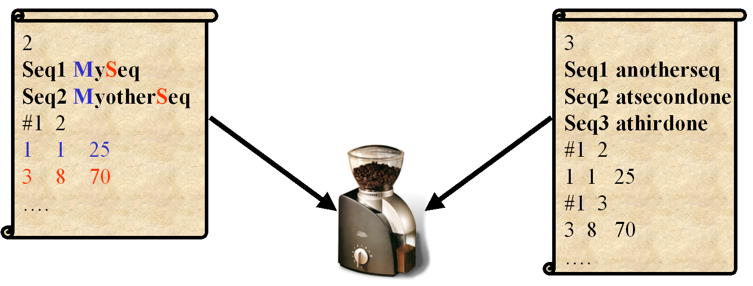
ClustalW
T-Coffee

Slide 10
Progressive Alignment
Dynamic Programming Using An Extended Library

Slide 11

What Is BaliBase
How Good is T-Coffee ???
Best Performing Method on MSA benchmark Datasets
BaliBase
-Notredame
-Sonhammer
Homstrad
-Notredame
Ribosomal RNA
-Katoh (Mafft)
OxBench
-Barton

Slide 12
Mixing Heterogenous Data With
T-Coffee
Local Alignment
Global Alignment
Multiple Alignment
Specialist
Structural
Multiple Sequence Alignment

Slide 13
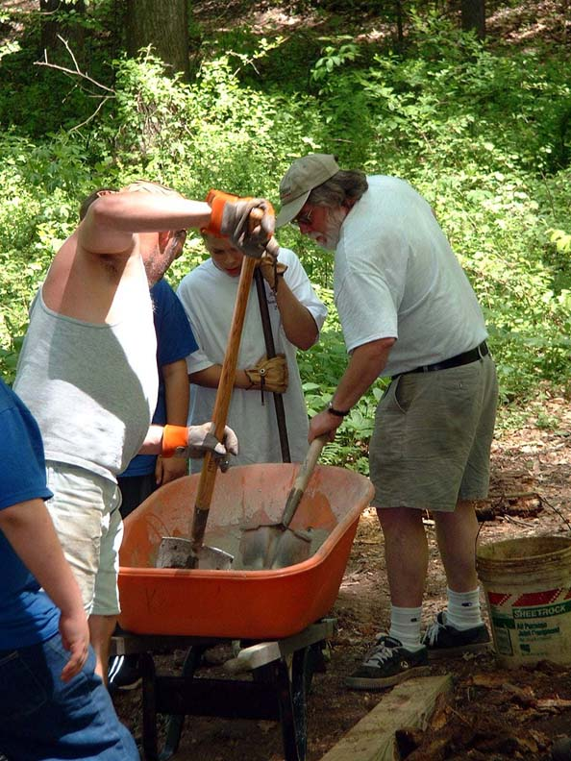
Mixing Sequences and Structures

Slide 14

Why Do We Want To Mix Sequences and Structures?
1-Predicting Sequence Structures
STUCTURE ⬄ FUNCTION

Slide 15
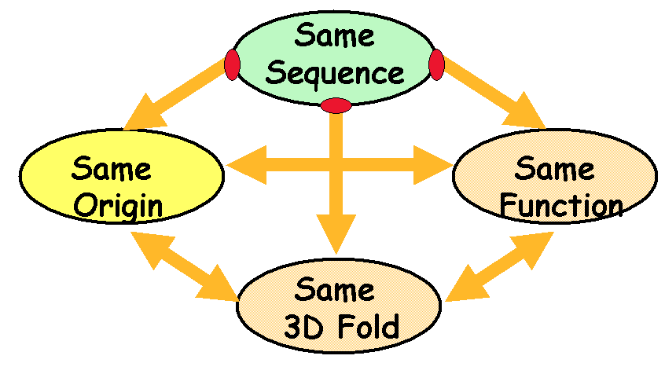
Why Do We Want To Mix Sequences and Structures?
Sequences are Cheap and Common.
Structures are Expensive and Rare.

Slide 16
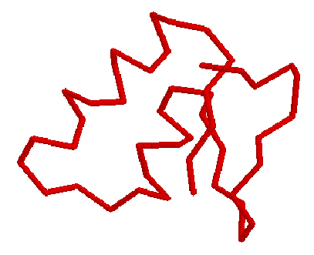
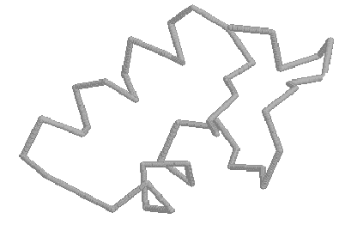
Why Do We Want To Mix Sequences and Structures?
Cheapest Structure determination:
Sequence-Structure Alignment
THREAD
Or
ALIGN
ADKPRRP---LS-YMLWLN
ADKPKRPKPRLSAYMLWLN

Slide 17
Why Do We Want To Mix Sequences and Structures?
THREAD
Or
ALIGN
ADKPRRP---LS-YMLWLN
ADKPKRPKPRLSAYMLWLN
Convincing Alignment
⬄
Same Fold

Slide 18

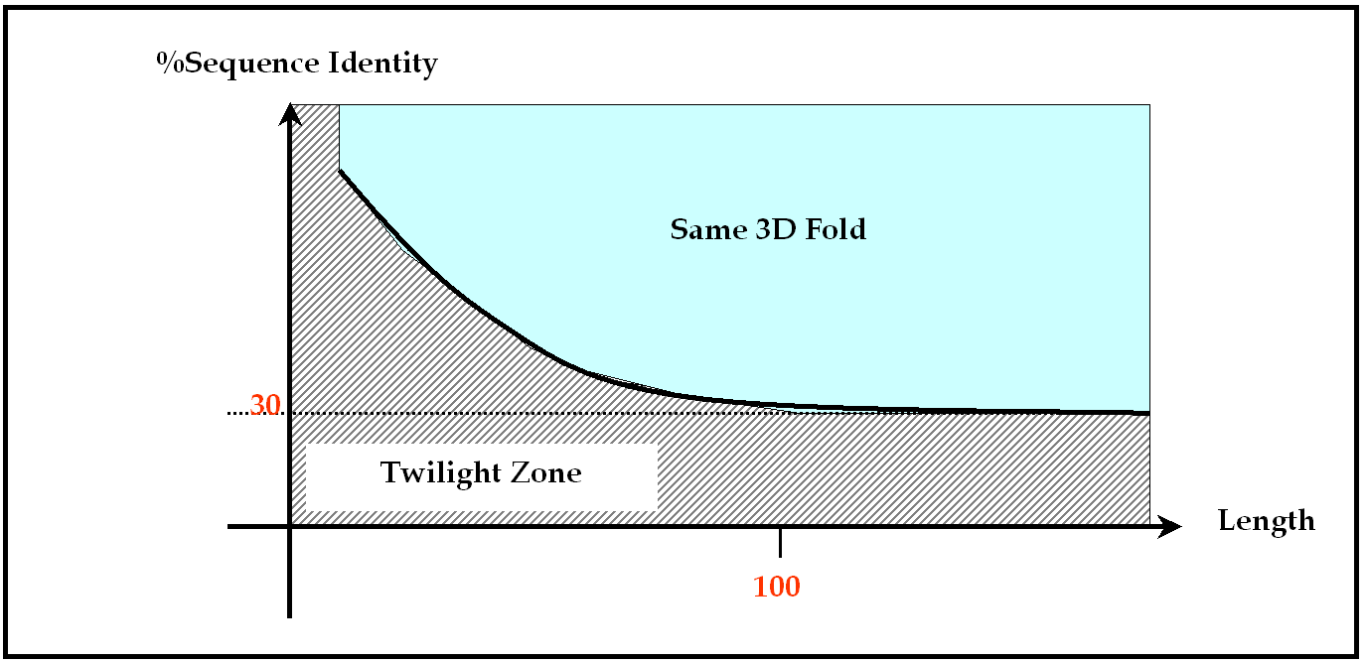
Why Do We Want To Mix Sequences and Structures?
Convincing Alignment
⬄
Same Fold
Distant sequences are hard to align

Slide 19
Why Do We Want To Mix Sequences and Structures?
chite ---ADKPKRPLSAYMLWLNSARESIKRENPDFK-VTEVAKKGGELWRGLKD
wheat --DPNKPKRAPSAFFVFMGEFREEFKQKNPKNKSVAAVGKAAGERWKSLSE
trybr KKDSNAPKRAMTSFMFFSSDFRS----KHSDLS-IVEMSKAAGAAWKELGP
mouse -----KPKRPRSAYNIYVSESFQ----EAKDDS-AQGKLKLVNEAWKNLSP
***. ::: .: .. . : . . * . *: *
Multiple Sequence Alignments
Help
Exploring the Twilight Zone

Slide 20
Why Do We Want To Mix Sequences and Structures?
1-Predicting Sequence Structures
2-Produce Better Alignments

Slide 21
Why Do We Want To Mix Sequences and Structures?
ALIGN
ADKPRRP---LS-YMLWLN
ADKPKRPKPRLSAYMLWLN
Unreliable alignment if %ID <30%

Slide 22
Why Do We Want To Mix Sequences and Structures?
Struc.
Superposition
ADKPRRP---LS-YMLWLN
ADKPKRPKPRLSAYMLWLN
Alignment Unsentitive to %ID
Folds evolve Slower than Sequences

Slide 23
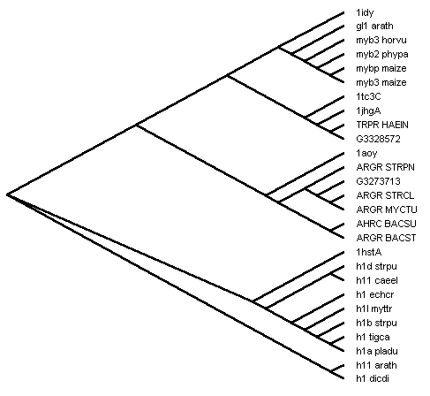
Why Do We Want To Mix Sequences and Structures?

Slide 24
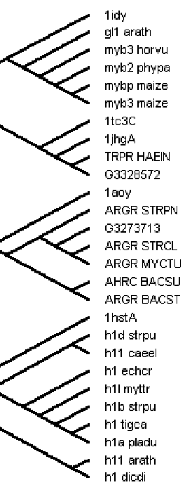
Why Do We Want To Mix Sequences and Structures?
Structure
Superposition

Slide 25
Why Do We Want To Mix Sequences and Structures?
1-Predicting Sequence Structures
2-Produce Better Alignments

Slide 26
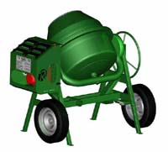
How To Mix Sequences
and
Structures

Slide 27
Mixing Heterogenous Data With
T-Coffee
Local Alignment
Global Alignment
Multiple Alignment
Specialist
Structural
Multiple Sequence Alignment

Slide 28
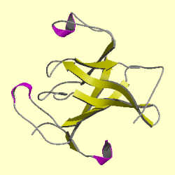
Mixing Sequences and Structures with T-Coffee
Seq Vs Seq
Local
Global
Seq Vs Struct
Struct Vs Struct
Thread
Superpose
Evaluation on Homestrad

Slide 29
The 3D-Coffee Libraries
Methods
Global: Needlman and Wunsch
Local: Sim (lalign)
Threading: Fugue
Superposition: SAP

Slide 30
Threading: Fugue

Slide 31
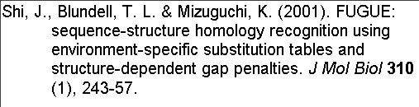
Fugue
Threading: Fugue

Slide 32
Fugue
Threading: Fugue
1-Turn Sequence into a profile:
-lower penalties in loops
-Structure specific matrix
2-
Align Profile
with
Sequence

Slide 33

Evaluating Fugue
Threading: Fugue
1-Select 967 pairs of sequences in HOMSTRAD
⬄
2-Align each pair with T-Coffee and Fugue.
FUGUE
T
-
Coffee
3-Compare the Two
Alignments
Compare

Slide 34
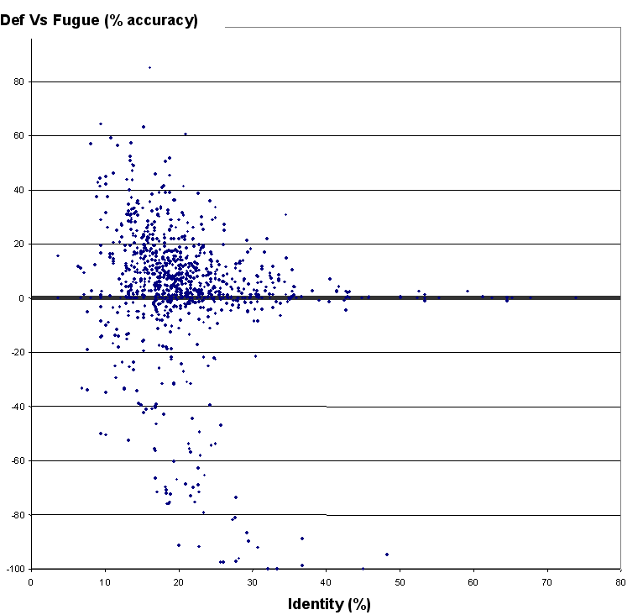
Fugue
Threading: Fugue
1-Select 967 pairs of sequences in HOMSTRAD
Fugue wins
TCdef: 58.81%
Fugue: 61.81%
2-Align each pair with T-Coffee and Fugue.
3-Compare the Two
Alignments
TCdef wins

Slide 35
Superposition:
SAP

Slide 36

Superposition: SAP

Slide 37
Superposition: SAP
Substitution Matrix when doing regular Alignments
1-High Level
Dynamic Programming
2-Low Level DP.
Forcing the aln of two
residues

Slide 38
Superposition: SAP
1-High Level
Dynamic Programming
2-Low Level DP.
Forcing the aln of two
residues
RMSD
1
1
13
14
12
3-Rigid Body Superposition
5
9
8

Slide 39
Superposition: SAP
1-High Level
Dynamic Programming
2-Low Level DP.
Forcing the aln of two
residues
RMSD
1
13
12
1
14
3-Rigid Body Superposition
5
9
8

Slide 40
Superposition: SAP
1-High Level
Dynamic Programming
2-Low Level DP.
Evaluate Every Pair
3-Rigid Body Superposition

Slide 41
Superposition: SAP
1-High Level
Dynamic Programming
Make a DP on the
accumulated traces
⬄
Use Traces like a Substitution Matrix
Structure Based Sequence Alignment

Slide 42
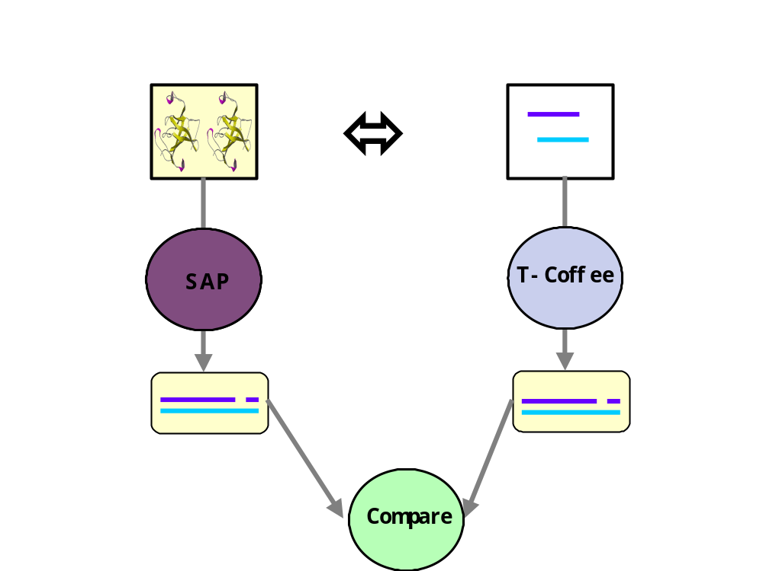
Superposition: SAP
1-Select 967 pairs of sequences in HOMSTRAD
2-Align each pair with T-Coffee and SAP.
3-Compare the Two
Alignments

Slide 43
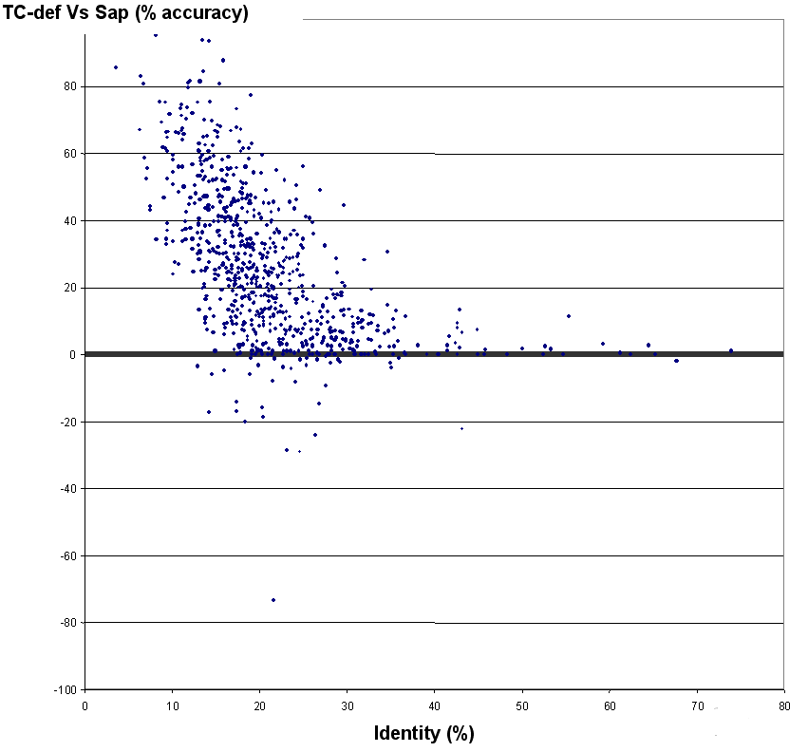
Superposition: SAP
TCdef: 58.81%
SAP: 86.31%
1-Select 967 pairs of sequences in HOMSTRAD
2-Align each pair with T-Coffee and SAP.
3-Compare the Two
Alignments

Slide 44
Fugue
SAP
TCdef: 58.81%
Fugue: 61.81%
TCdef: 58.81%
Fugue: 86.31%

Slide 45

Sequences and Structures:
How Good is The Mixture ???

Slide 46
Our Benchmark:
HOM39
-HOMSTRAD: Structure based MSAs that can be used as References.
-HOM39: The 39 Most difficult datasets (percent ID lower than 25).
-COMPACT and DEMANDING

Slide 47
Our BenchMark:
Using HOM39
BENCHMARKING Strategy:
-re-align HOM39 without using ALL the structures
-Compare the result with the reference

Slide 48
Evaluating 3D-Coffee
1- Can a SINGLE structure Help ?

Slide 49
Using ONE structure with
3D-Coffee
HOM39 with ONE Structure per MSA
Seq Vs Struct
Seq Vs Seq
Local
Global
Thread
Evaluation on HOM39

Slide 50
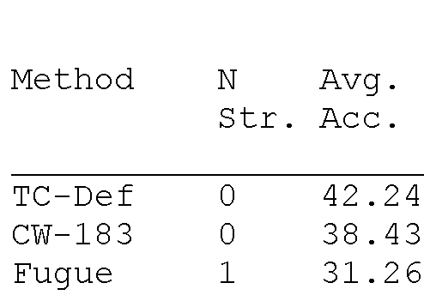
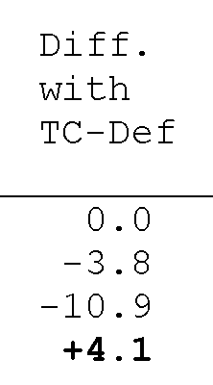


Slide 51
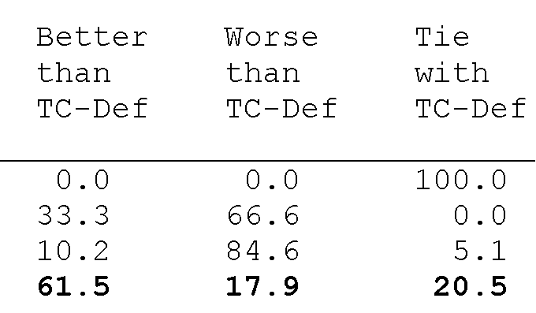

Slide 52
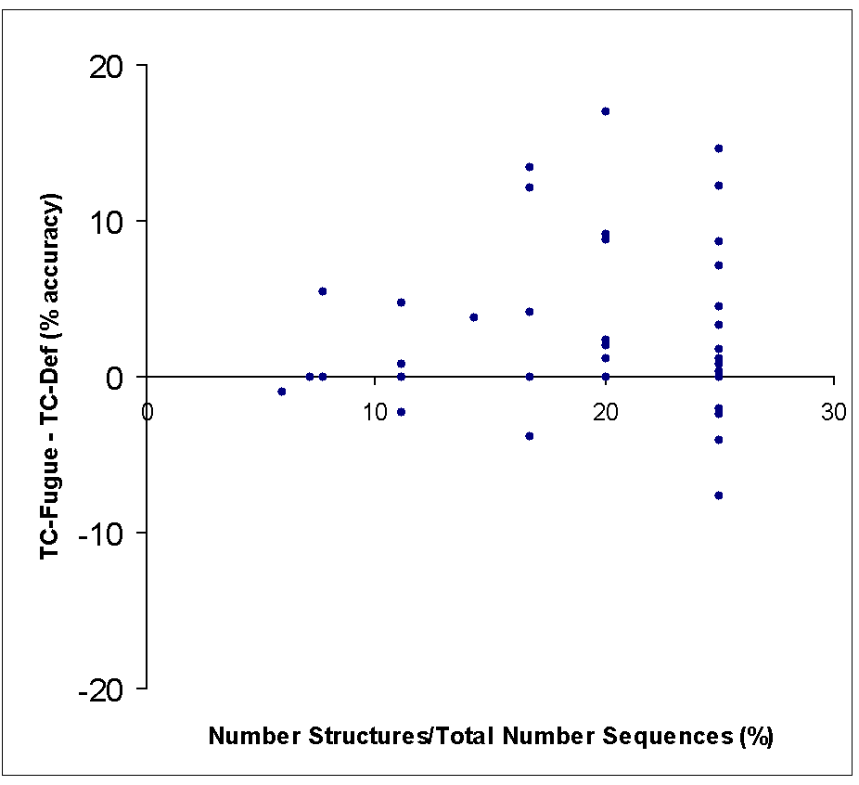

Slide 53
Evaluating 3D-Coffee
1- Can a SINGLE structure Help ?
2- Does it benefit to ALL the Sequences
Is EVERYONE Happier if there is a STAR in the team…

Slide 54
BaliBase
⬄
+
HOM39
TC-Fugue
Remove Provided Structure(s)
Comparison

Slide 55
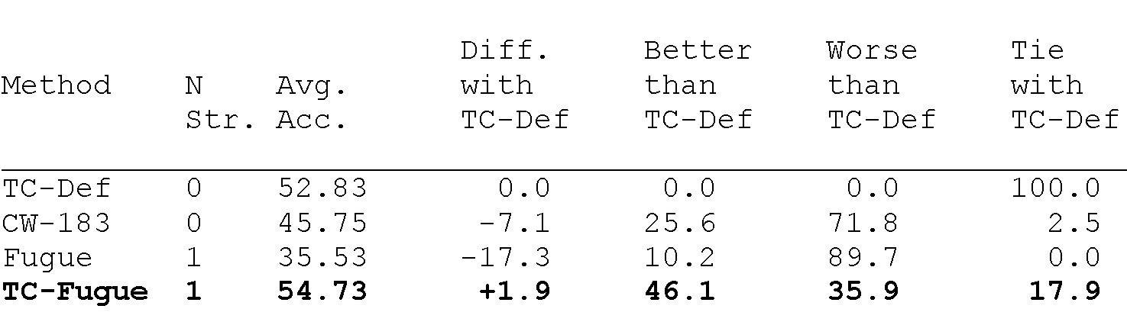

Slide 56
Evaluating 3D-Coffee
1- Can a SINGLE structure Help ?
2-Does it benefit to all the sequences
3- Can We Use Two or More Structures

Slide 57
Mixing Sequences and Structures with 3D-Coffee
HOM39 with TWO Structures/MSA
Seq Vs Seq
Local
Global
Seq Vs Struct
Fugue
Struct Vs Struct
SAP, LSQ
Evaluation on Homestrad

Slide 58
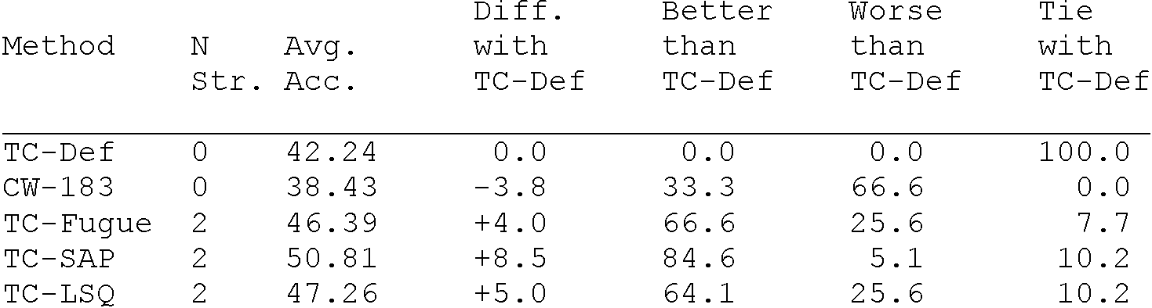
Direct Improvement
Indirect Improvement

Slide 59
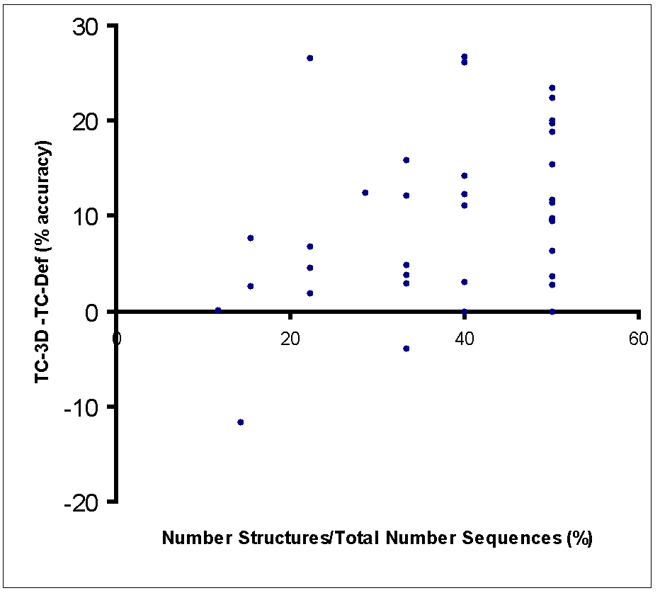

Slide 60
Evaluating 3D-Coffee
1- Can a SINGLE structure Help ?
2-Does it benefit to all the sequences
3-Can we use Two Structures
4-Relation Accuracy/ N-structures ???

Slide 61
Mixing Sequences and Structures with T-Coffee
HOM39 with 1-N Structures per MSA
Seq Vs Seq
Local
Global
Seq Vs Struct
Fugue
Struct Vs Struct
SAP
Evaluation on Homestrad

Slide 62
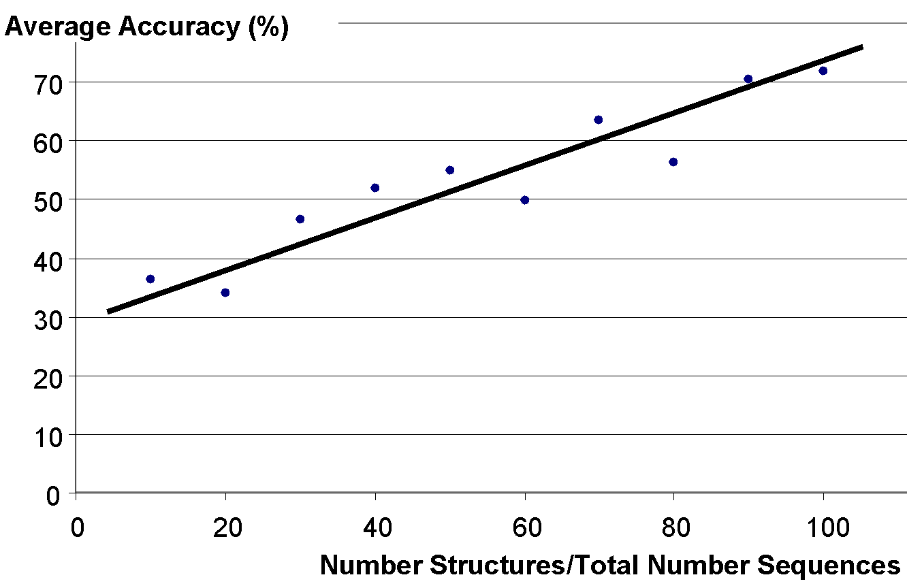

Slide 63
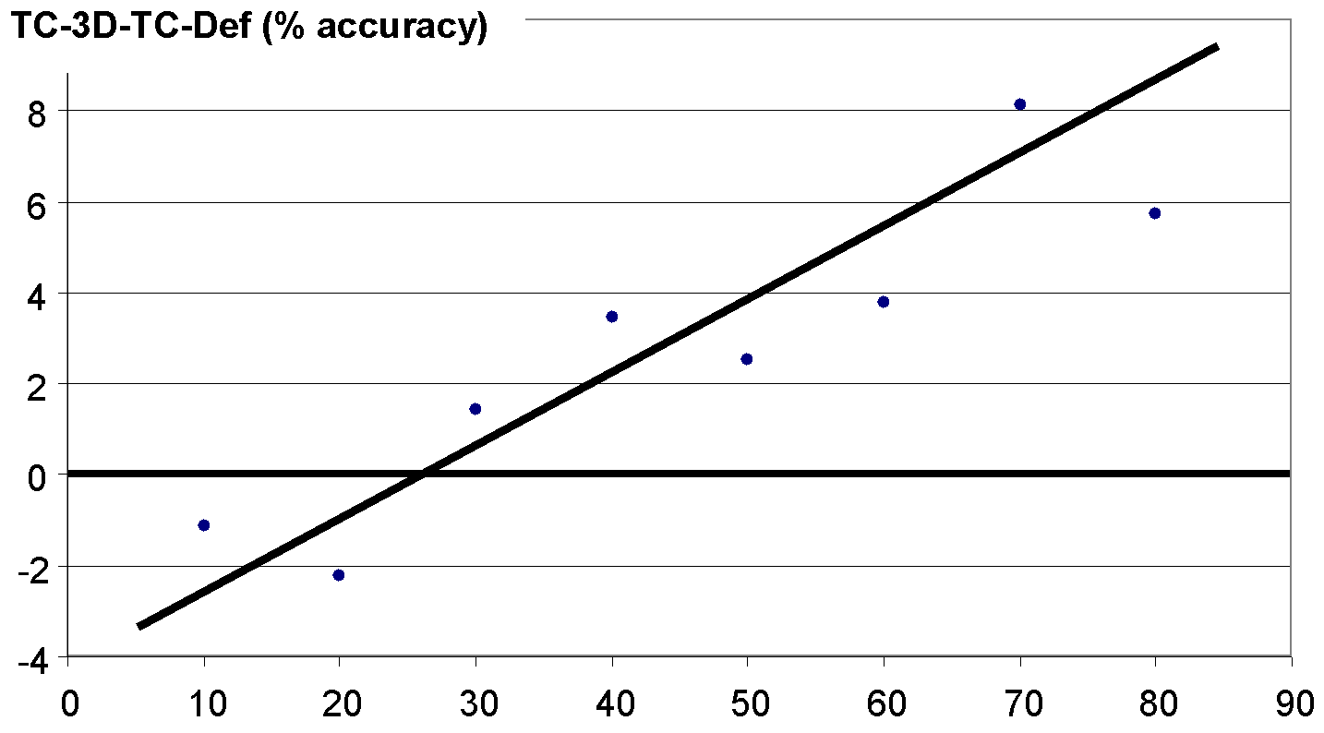
Induced Improvement

Slide 64
Conclusion

Slide 65
-Structures Help
BUT NOT SO MUCH

Slide 66
The More Structures The Merrier

Slide 67
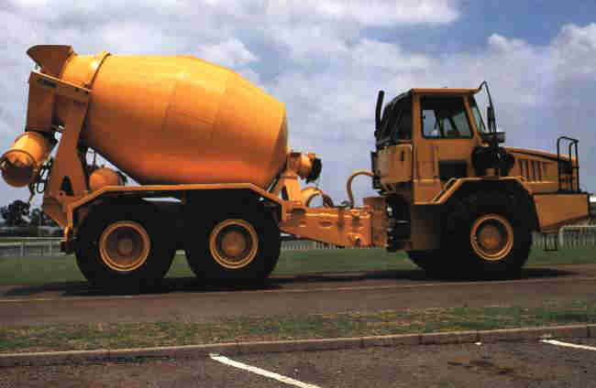
The More Structures The Merrier

Slide 68
Credits
Orla O’Sullivan: University College, Cork, Ireland
Des Higgins: University College, Cork, Ireland
Karsten Suhre: IGS-CNRS, Marseille, France

Slide 69



Conclusion
The program is available on request from:
cedric.notredame@europe.com

