Slide 1
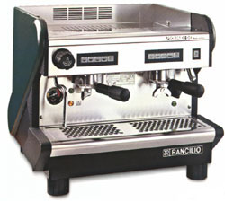
T-COFFEE,
a novel method for Multiple Sequence Alignments
Cédric Notredame

Slide 2



Potential Uses of A Multiple Sequence Alignment?
chite ---ADKPKRPLSAYMLWLNSARESIKRENPDFK-VTEVAKKGGELWRGLKD
wheat --DPNKPKRAPSAFFVFMGEFREEFKQKNPKNKSVAAVGKAAGERWKSLSE
trybr KKDSNAPKRAMTSFMFFSSDFRS----KHSDLS-IVEMSKAAGAAWKELGP
mouse -----KPKRPRSAYNIYVSESFQ----EAKDDS-AQGKLKLVNEAWKNLSP
***. ::: .: .. . : . . * . *: *
chite AATAKQNYIRALQEYERNGG-
wheat ANKLKGEYNKAIAAYNKGESA
trybr AEKDKERYKREM---------
mouse AKDDRIRYDNEMKSWEEQMAE
* : .* . :
Extrapolation
Phylogeny
Multiple Alignments Are CENTRAL to MOST Bioinformatics Techniques.
Motifs/Patterns
Struc. Prediction
Profiles

Slide 3


Why Is It Difficult To Compute A multiple Sequence Alignment?
A CROSSROAD PROBLEM
BIOLOGY:
What is A Good
Alignment
COMPUTATION
What is THE Good
Alignment
chite ---ADKPKRPLSAYMLWLNSARESIKRENPDFK-VTEVAKKGGELWRGLKD
wheat --DPNKPKRAPSAFFVFMGEFREEFKQKNPKNKSVAAVGKAAGERWKSLSE
trybr KKDSNAPKRAMTSFMFFSSDFRS----KHSDLS-IVEMSKAAGAAWKELGP
mouse -----KPKRPRSAYNIYVSESFQ----EAKDDS-AQGKLKLVNEAWKNLSP
***. ::: .: .. . : . . * . *: *

Slide 4
Why Is It Difficult To Compute A multiple Sequence Alignment ?
BIOLOGY
COMPUTATION
CIRCULAR PROBLEM....
Good
Good
Sequences
Alignment

Slide 5

Progressive Alignment
Dynamic Programming Using A Substitution Matrix

Slide 6
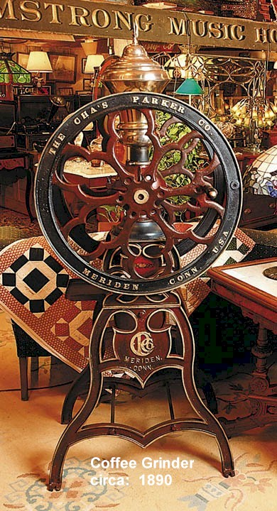
The T-Coffee Algorithm

Slide 7
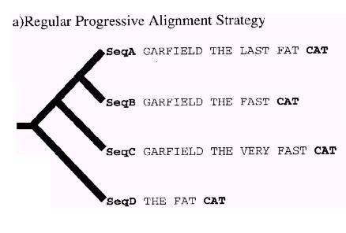
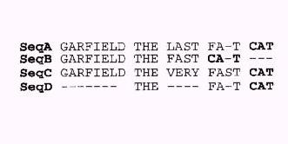
Progressive Alignment Principle and its Limitations…

Slide 8
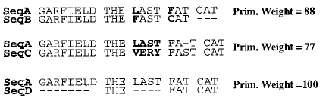
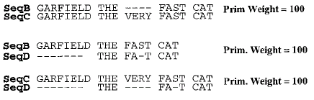
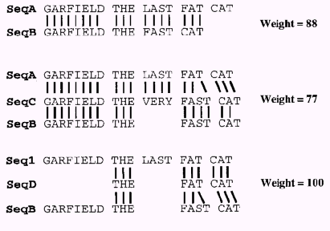
The Extended Library Principle…

Slide 9
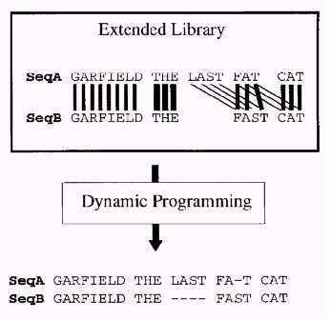
The Extended Library Principle…

Slide 10
The Triplet Assumption
SEQ A
SEQ B

Slide 11
Weighting And Extension
Weighting=Using The surrounding Information (Coffee)
Extension=Using Information from Other Sequences

Slide 12
T-Coffee Progressive Alignment
Notredame, Higgins, Heringa, 2000
Dynamic Programming Using The extended Library

Slide 13
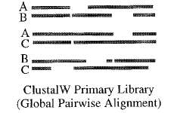
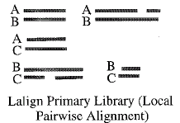
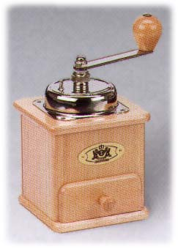
Mixing Local and Global Alignments
Local Alignment
Global Alignment
Extension
Multiple Sequence Alignment

Slide 14
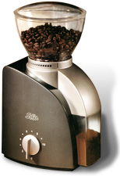
What is a library?
2
Seq1 MySeq
Seq2 MyotherSeq
#1 2
1 1 25
3 8 70
….
3
Seq1 anotherseq
Seq2 atsecondone
Seq3 athirdone
#1 2
1 1 25
#1 3
3 8 70
….
Extension+T-Coffee
Library Based Multiple Sequence Alignment

Slide 15
How Long Does it Take

Slide 16
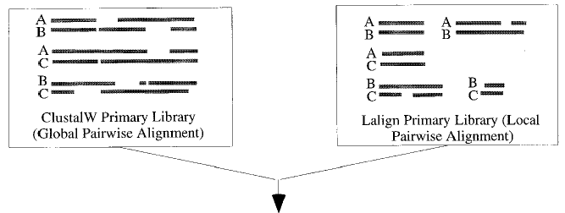
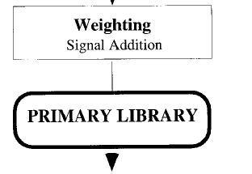
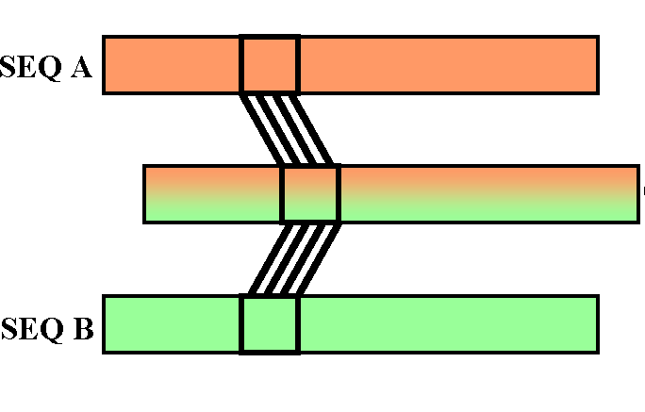
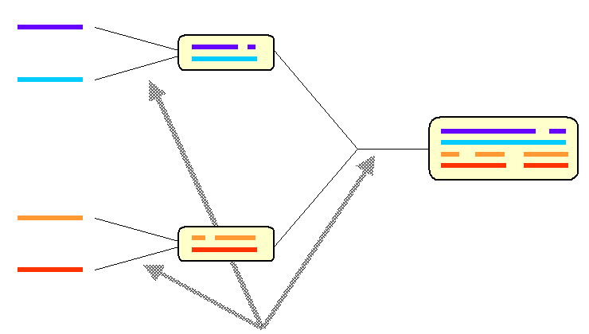
Primary Lib: O(N²L²)
Extension:O(N³L²)
Tree :O(N²L²)+O(N³)
Aln :O(NL²)

Slide 17
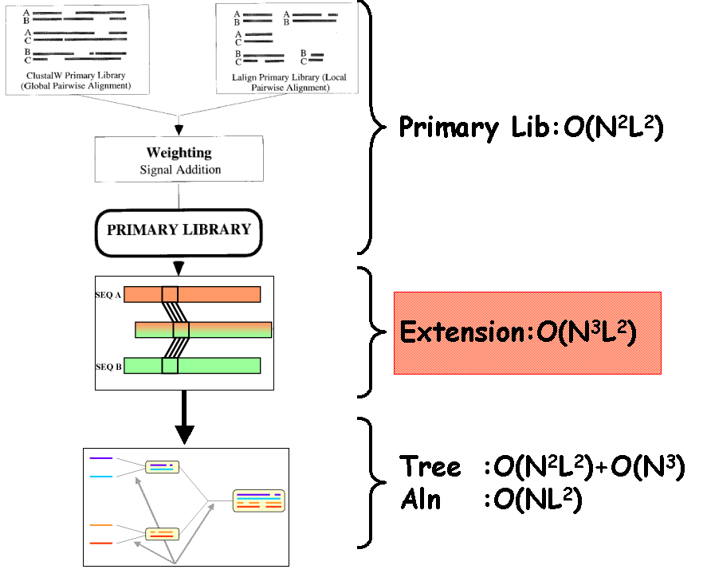
N times slower than
ClustalW

Slide 18
Validating T-Coffee

Slide 19
What Is BaliBase
BaliBase
BaliBase is a collection of reference Multiple Alignments
The Structure of the Sequences are known and were used to assemble the MALN.
Evaluation is carried out by Comparing the Structure Based Reference Alignment With its Sequence Based Counterpart

Slide 20
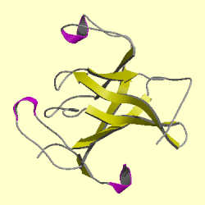
BaliBase
⬄
DALI, Sap …
Method X
Comparison

Slide 21
Validation Using BaliBase
T-Coffee Results

Slide 22
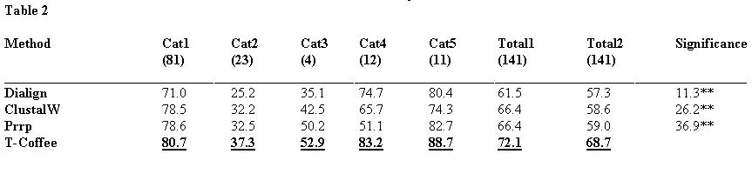
Validation Using BaliBase

Slide 23
Taking T-Coffee Further:
Using Structures

Slide 24
Mixing Heterogenous Information With T-Coffee
Local Alignment
Global Alignment
Multiple Alignment
Specialist
Structural
Multiple Sequence Alignment

Slide 25
Running T-Coffee ONLINE

Slide 26
WHERE ?
Cedric.notredame@europe.com
www.tcoffee.org

Slide 27
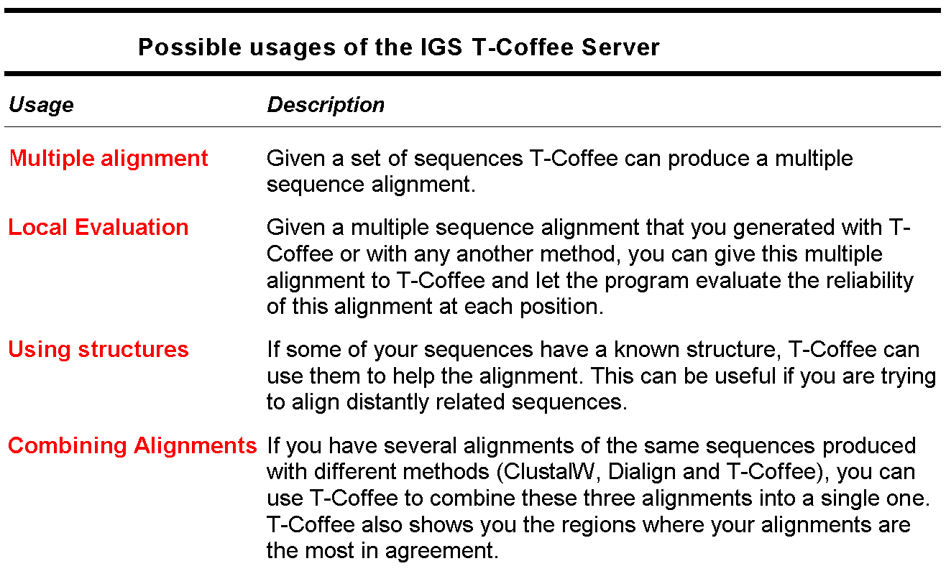
The T-Coffee Server

Slide 28
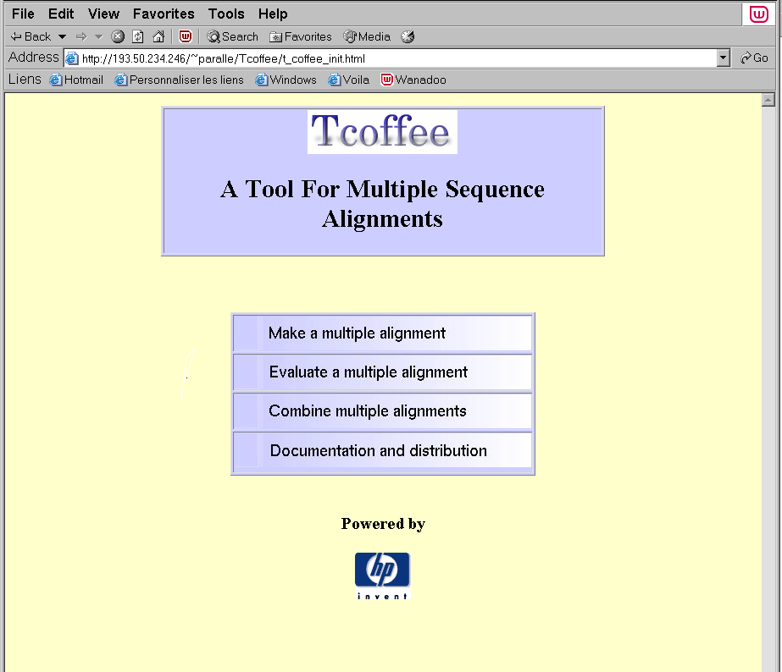
The T-Coffee Server
ES45, 4Proc
1 Gb RAM

Slide 29
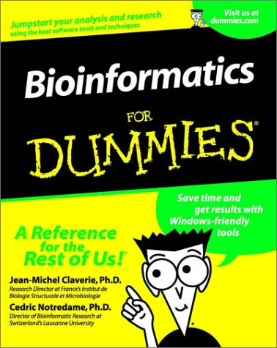

Slide 30
Future…

Slide 31
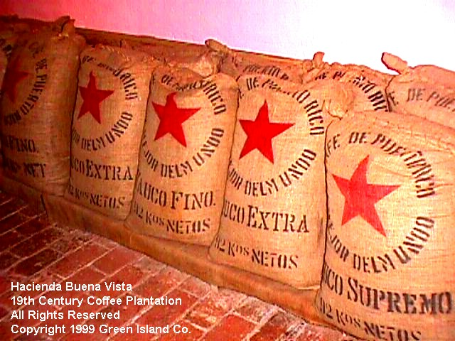
Large Scale…

Slide 32

Tailor Made…

Slide 33
WHERE ?
Cedric.notredame@europe.com
www.tcoffee.org

Slide 34
WHO ?
WHO Makes T-Coffee ?
Cédric Notredame
Des Higgins
Chantal Abergel
Olivier Poirot
Orla O’Sullivan
WHO USES T-Coffee ?
Dali Domain Dictionnary
Pfam
SwissProt

