Slide 1

T-Coffee: What’s New in The Grinder
Mixing MSAs, Sequences and Structures
Cédric Notredame
Information Génétique et Structurale
CNRS-Marseille, France

Slide 2
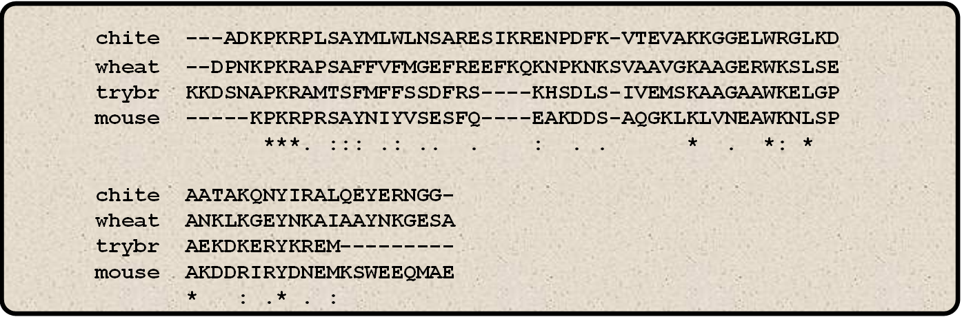
What’s in a Multiple Alignment?
Structural Criteria
  Residues are arranged so that those playing a similar role end up in the same column.
Evolutive Criteria
  Residues are arranged so that those having the same ancestor end up in the same column.
Similarity Criteria
  As many similar residues as possible in the same column

Slide 3
What’s in a Multiple Alignment?
The MSA contains what you put inside…
You can view your MSA as:
  A record of evolution
  A summary of a protein family
  A collection of experiments made for you by Nature…

Slide 4
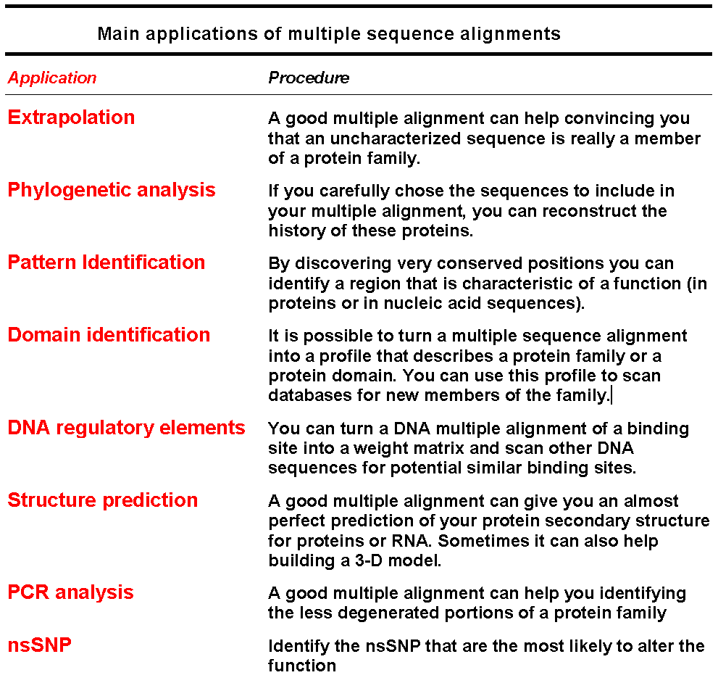
Multiple Alignments:
What Are They Good For???

Slide 5
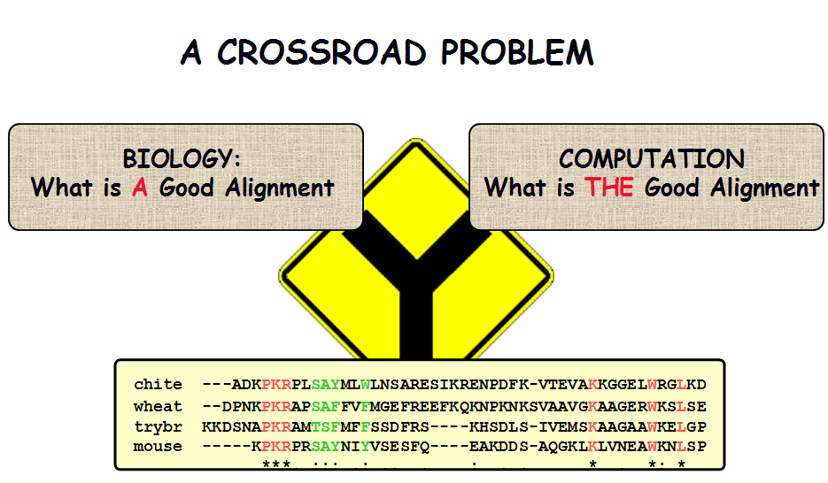
Computing the Correct Alignement is a Complicated Problem

Slide 6
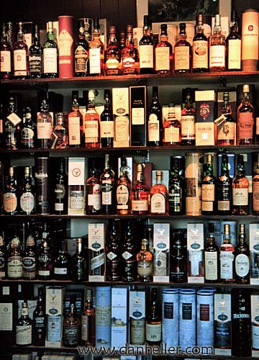
Off the Shelf Methods

Slide 7
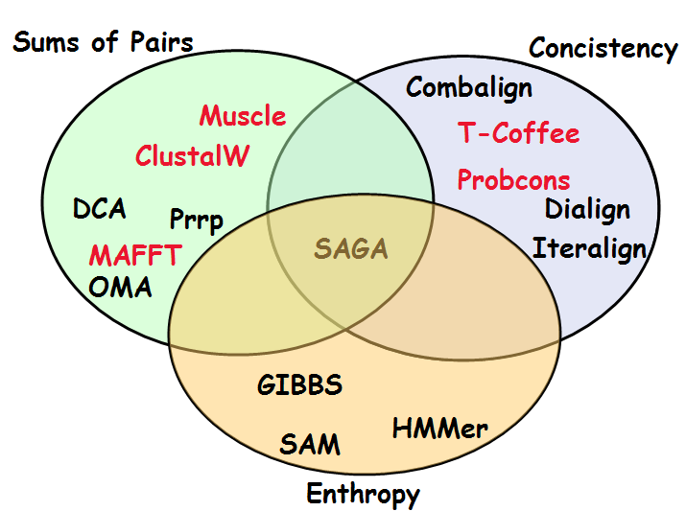
A Taxonomy of Multiple Sequence Alignment Packages
APPROXIMATE
FAST
ACCURATE
SLOW
Entropy

Slide 8
Three Types of Algorithms
Progressive: ClustalW
Iterative: Muscle
Concistency Based: T-Coffee and Probcons

Slide 9
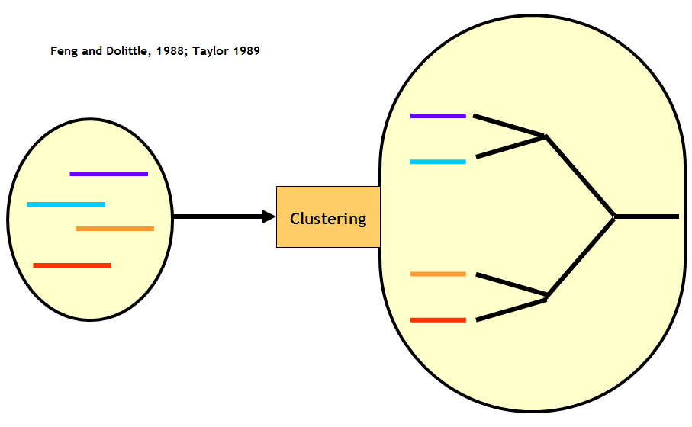
ClustalW

Slide 10
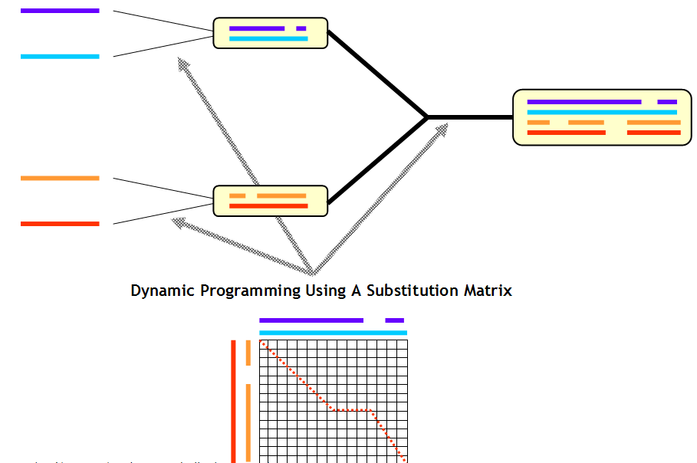
ClustalW

Slide 11
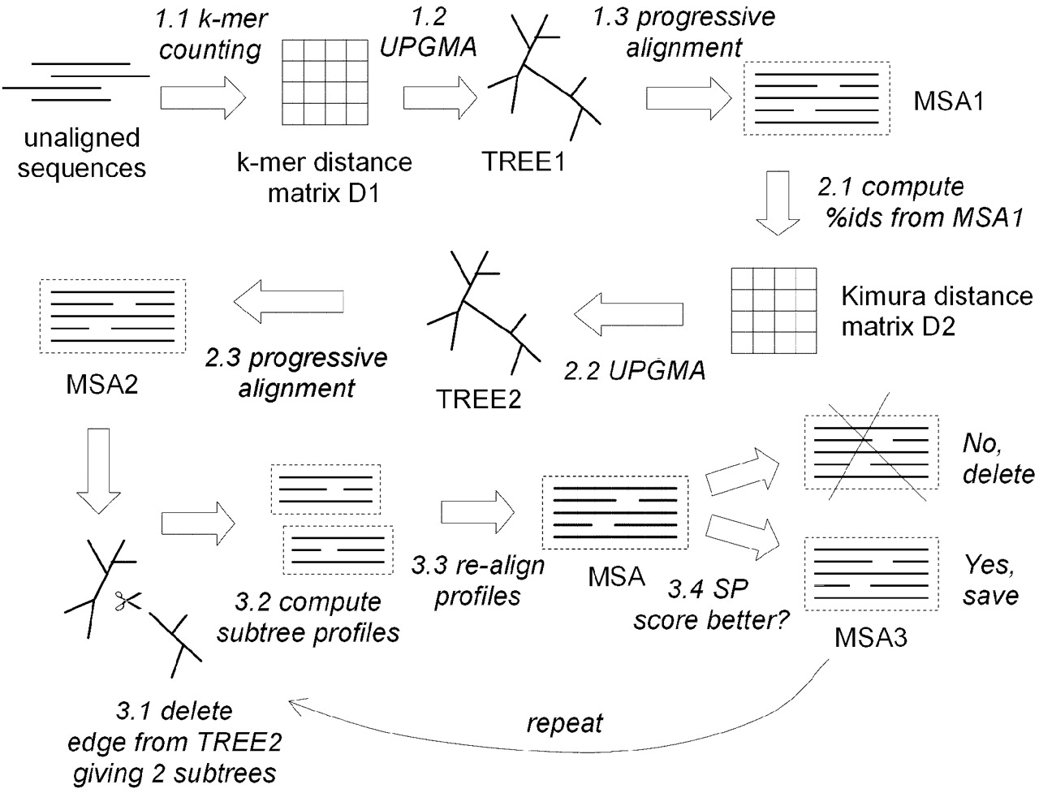
Muscle Algorithm: Using The Iteration

Slide 12
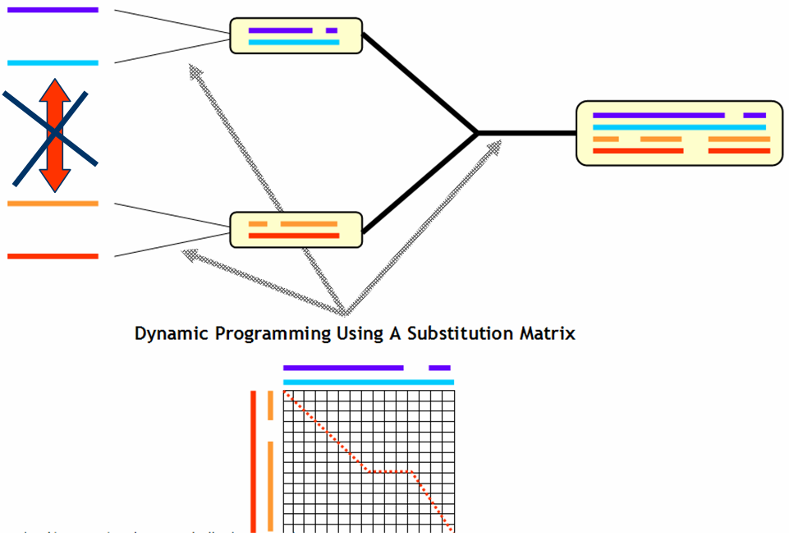
Concistency Based Algorithms:
T-Coffee
Gotoh (1990)
  Iterative strategy using concistency
Martin Vingron (1991)
  Dot Matrices Multiplications
  Accurate but too stringeant
Dialign (1996, Morgenstern)
  Concistency
  Agglomerative Assembly
T-Coffee (2000, Notredame)
  Concistency
  Progressive algorithm
ProbCons (2004, Do)
  T-Coffee with a Bayesian Treatment

Slide 13
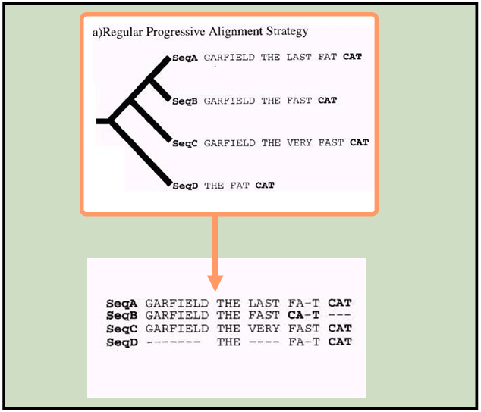
T-Coffee and Concistency…

Slide 14
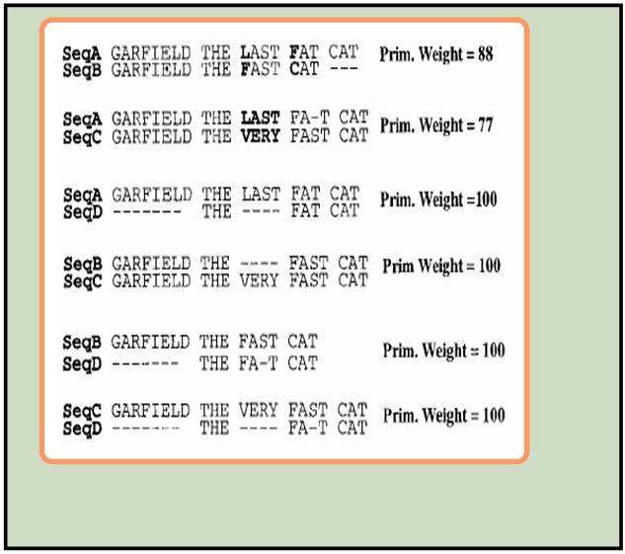
T-Coffee and Concistency…

Slide 15
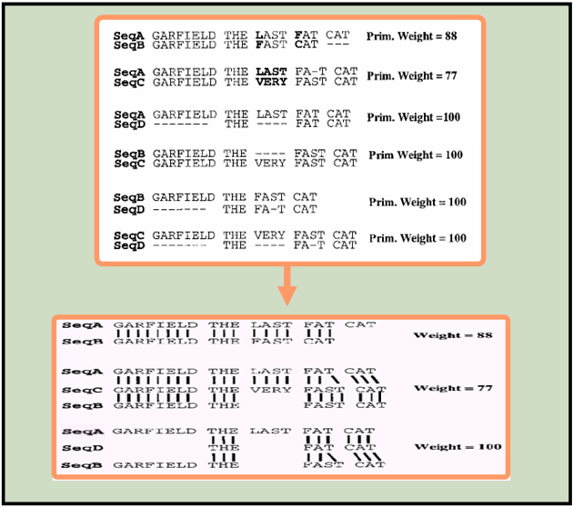
T-Coffee and Concistency…

Slide 16
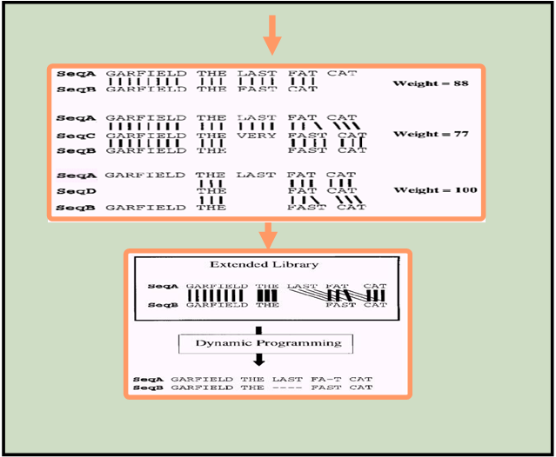
T-Coffee and Concistency…

Slide 17
T-Coffee and Concistency…

Slide 18
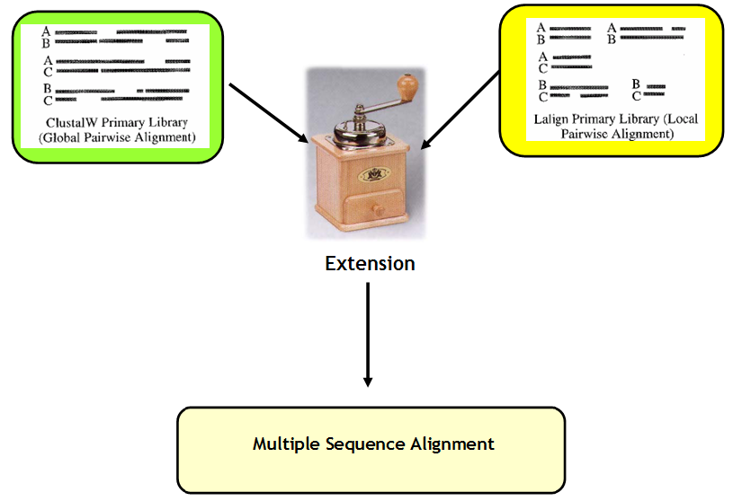
T-Coffee and Concistency…

Slide 19
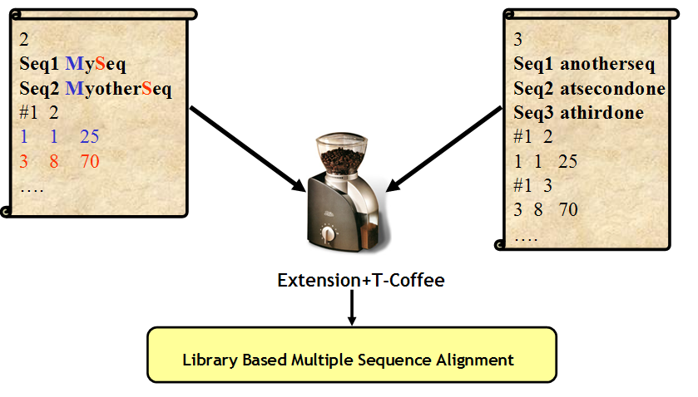
T-Coffee and Concistency…

Slide 20
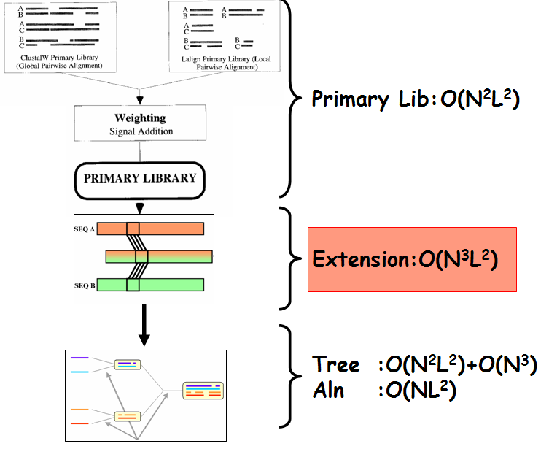
T-Coffee and Concistency…

Slide 21
T-Coffee and Concistency…
Each Library Line is a Soft Constraint (a wish)
You can’t satisfy them all
You must satisfy as many as possible (The easy ones)

Slide 22
Validation Using BaliBase
T-Coffee Results

Slide 23
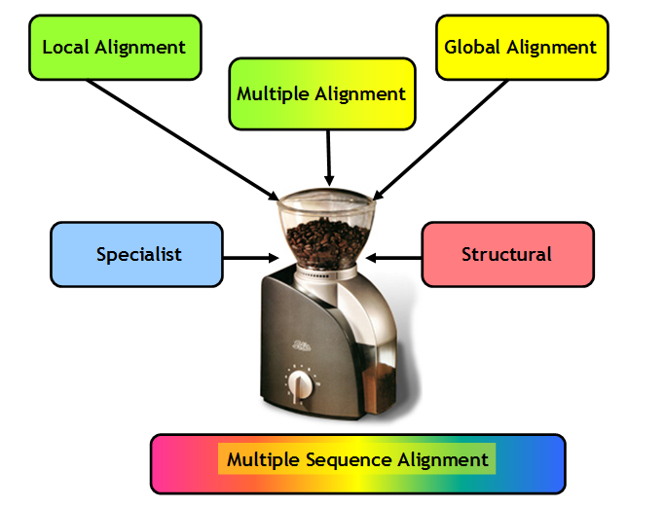
T-Coffee and Concistency…

Slide 24
Evaluating Methods…
Who is the best?
Says who…?

Slide 25
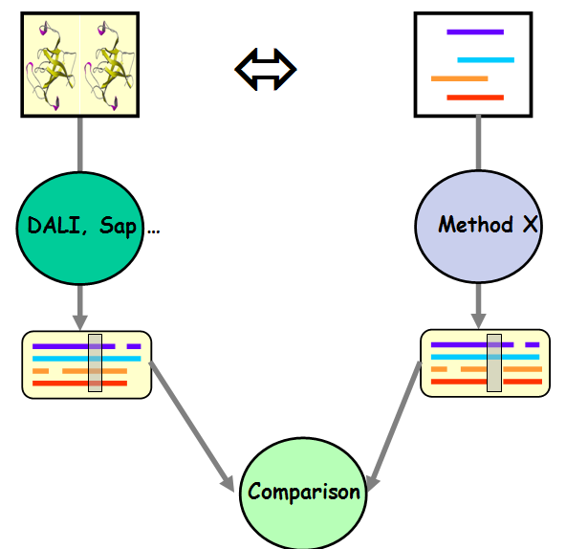
Structures Vs Sequences

Slide 26
Who is the Best ???
 | N | T-Coffee | Probcons | ClustalW | Muscle
Hom+50 | 40 | 49.71 | 51.59 | 36.77 | 46.90
SABs+50 | 209 | 21.85 | 22.53 | 12.34 | 19.61
SABf+50 | 425 | 45.18 | 44.85 | 34.95 | 38.17
Prefab | 1675 | 67.96 | 67.95 | 59.45 | 66.05

Slide 27
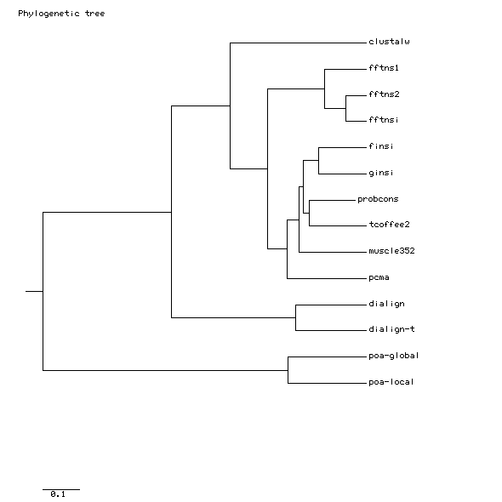
The Alignments Methods
MAFFT

Slide 28
Too Many Methods for ONE Alignment
M-Coffee

Slide 29
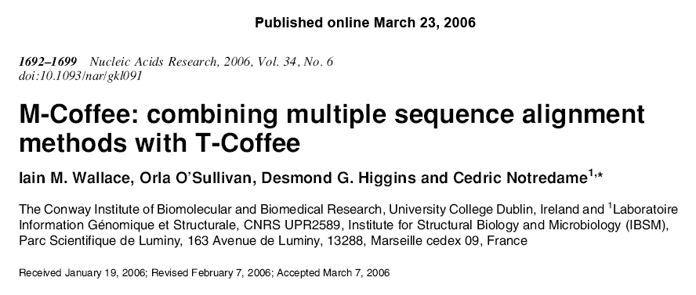
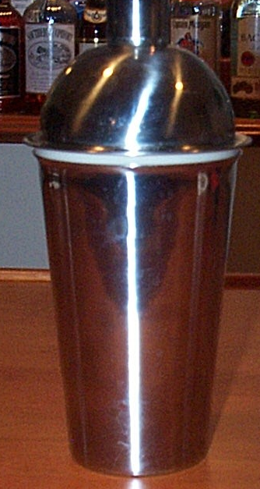

Slide 30
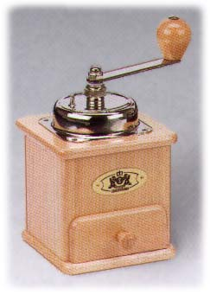
Combining Many MSAs into ONE
ClustalW
MAFFT
T-Coffee
MUSCLE
???????

Slide 31
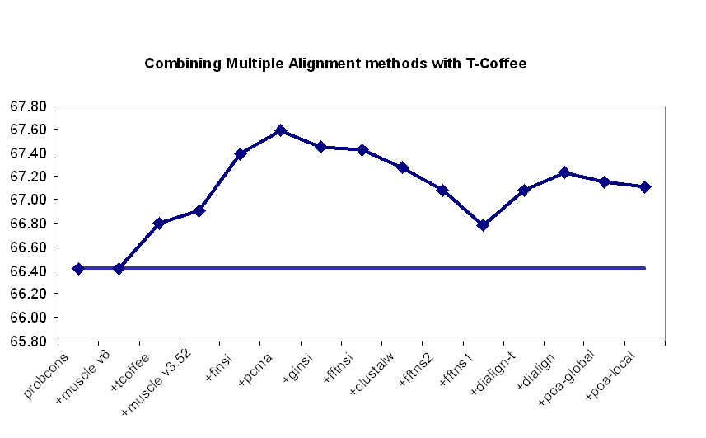
Combining Many MSAs into ONE

Slide 32
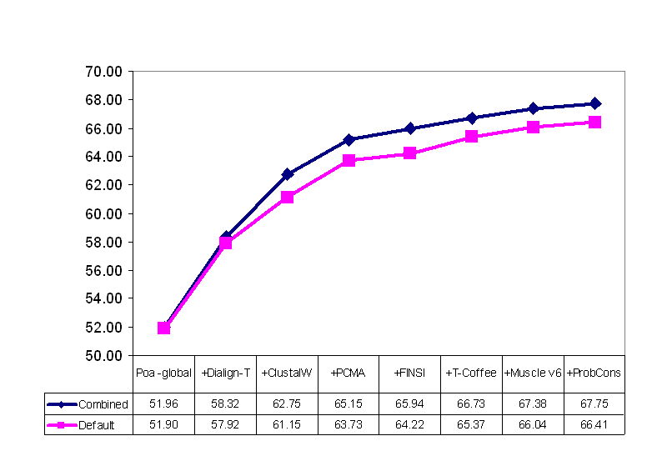
The Right Mixt of Methods

Slide 33
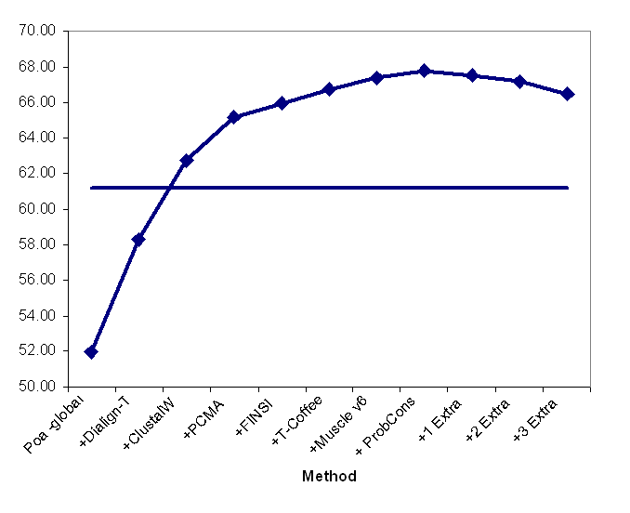
Resisting Noise
M-Coffee8

Slide 34
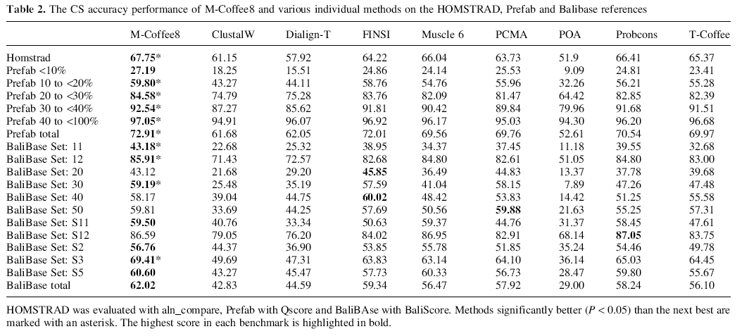
Going Further

Slide 35
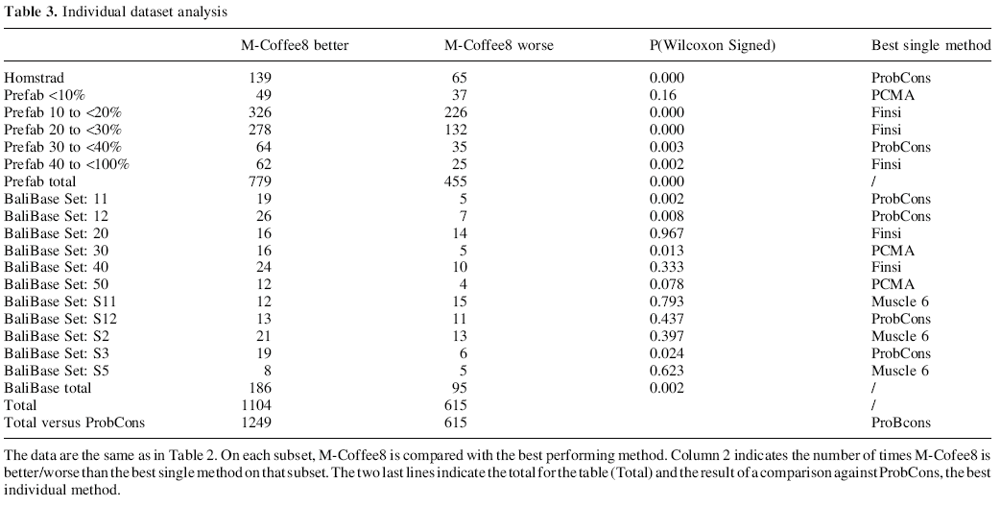
Place your Bets…

Slide 36
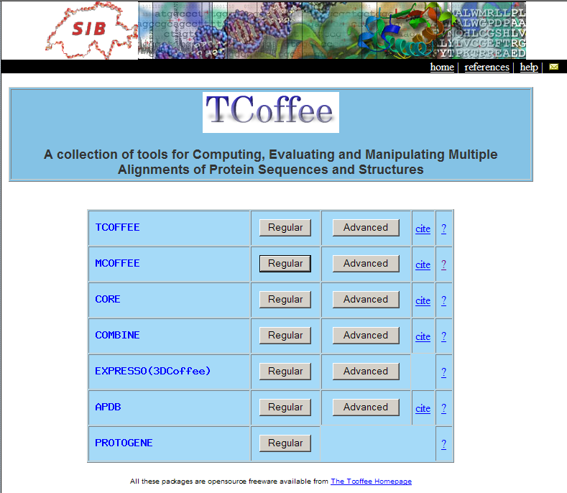
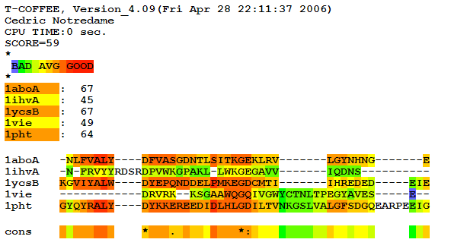
www.tcoffee.org
www.vital-it.ch/prd/smoretti/cgi-bin/Tcoffee/tcoffee_cgi/index.cgi

Slide 37
When Sequences Are not Enough
3D-Coffee and Expresso

Slide 38
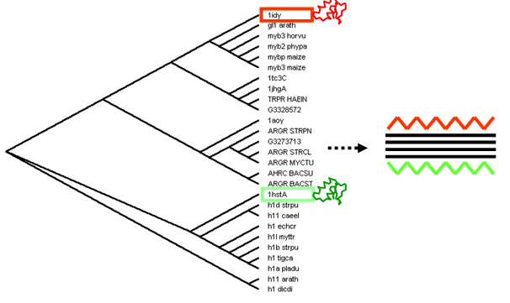
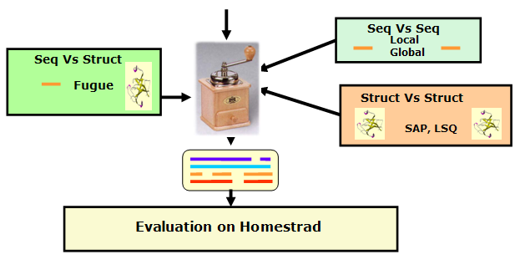
3D-Coffee:
Combining Sequences and Structures Within Multiple Sequence Alignments

Slide 39
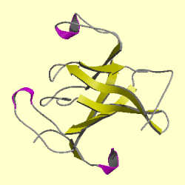
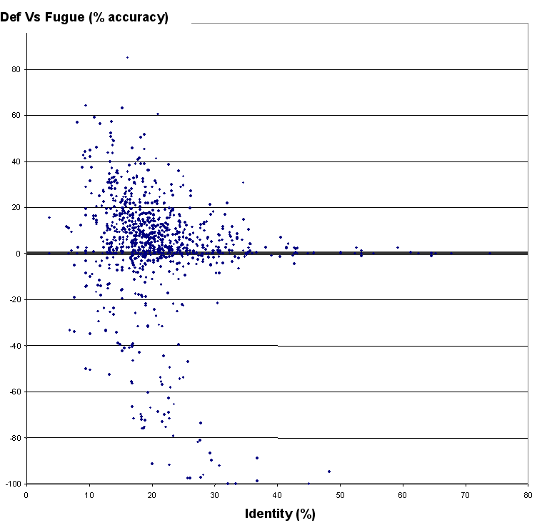
Threading: Fugue
1-Select 967 pairs of sequences in HOMSTRAD
Fugue wins
TCdef: 58.81%
Fugue: 61.81%
2-Align each pair with T-Coffee and Fugue.
3-Compare the Two
Alignments
TCdef wins

Slide 40
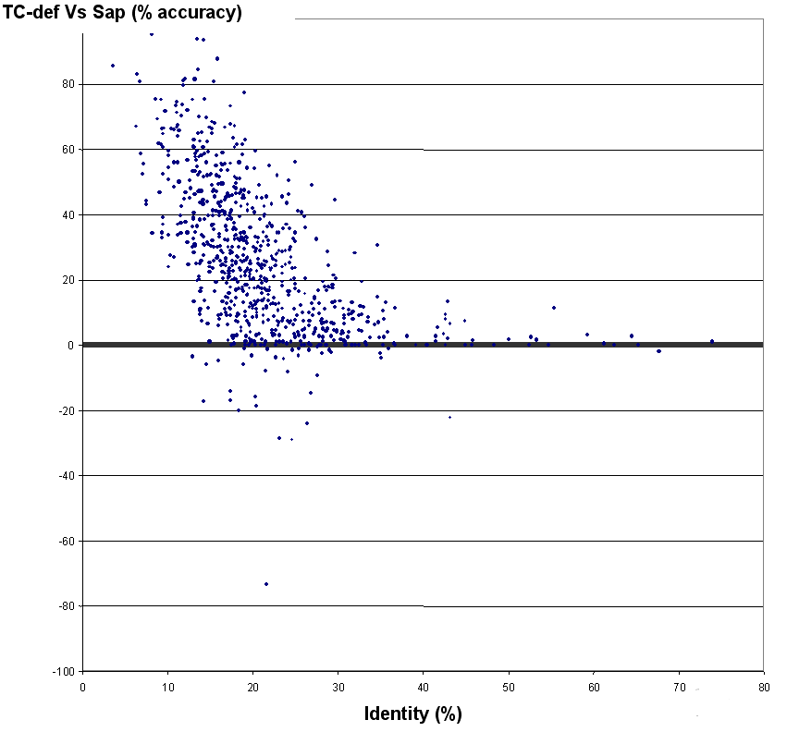
Superposition: SAP
1-Select 967 pairs of sequences in HOMSTRAD
TCdef: 58.81%
SAP: 86.31%
2-Align each pair with T-Coffee and SAP.
3-Compare the Two
Alignments

Slide 41
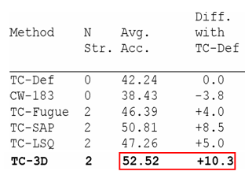
3D-Coffee:
Combining Sequences and Structures Within Multiple Sequence Alignments

Slide 42
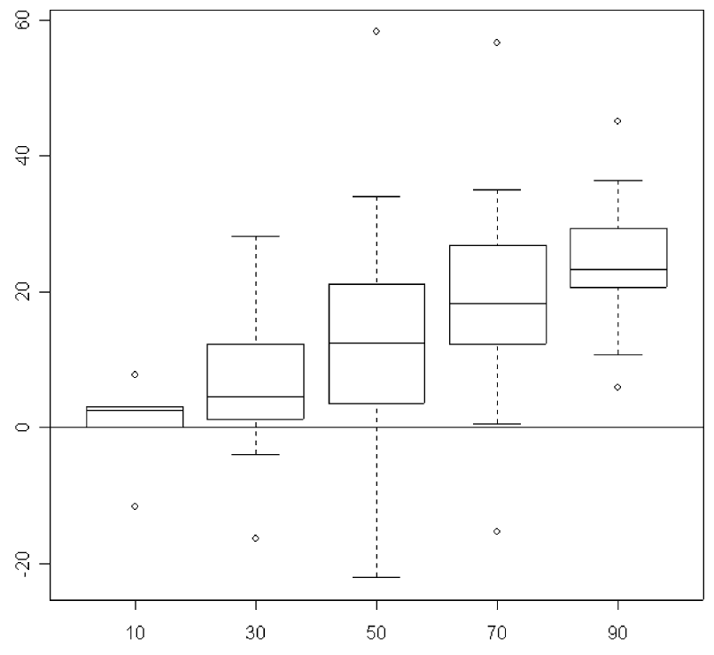


The More Structures The Merrier
Average Improvement over T-Coffee
Struc/Seq Ratio

Slide 43
Expresso: Finding the Right Structure
Template-Source Alignment
Template based Alignment
of the Source Sequences

Slide 44
Expresso: Finding the Right Structure
Why Not Using
Structure Based
Alignments
Template-Source Alignment
Template based Alignment
of the Source Sequences

Slide 45
Expresso: Finding the Right Structure
Sources
BLAST
BLAST
SAP
Templates
Templates
Template Alignment
Source Template Alignment
Remove Templates
Library
Template-Source Alignment
Template based Alignment
of the Source Sequences

Slide 46
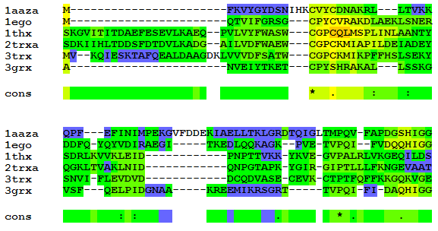
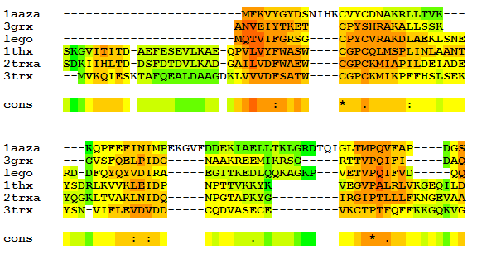
14% Correct
>1aaza ➔ 1DE2A
>1ego ➔ 1EGR
>1thx ➔ 1THX
>2trxa ➔ 2BTOT
>3trx ➔ 4TRX
>3grx ➔ 3GRX
50% Correct

Slide 47
Conclusion
The best Recipy For Good Sequence Alignments
A Better Recipy
Structures!!!
More Structures!!!

Slide 48
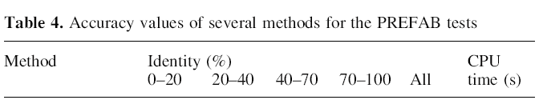
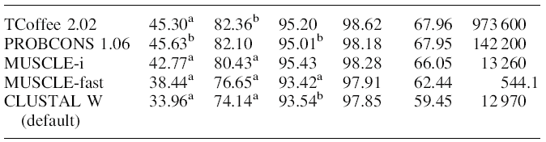
Conclusion
Concistency Based Methods Have an Edge
Hard to tell Methods Apart
Sequence Alignment is NOT solved

Slide 49
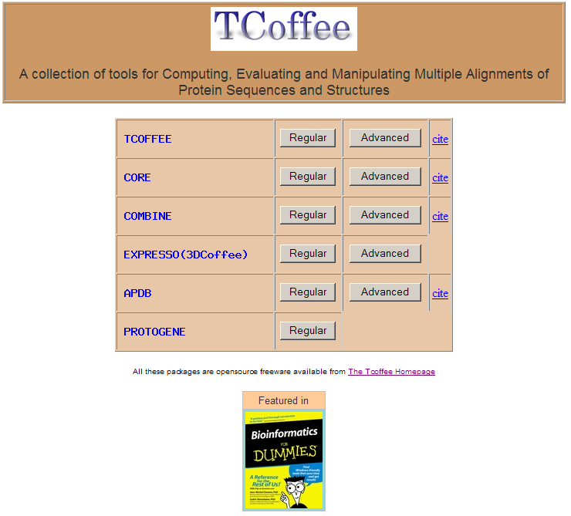
www.tcoffee.org
Fabrice Armougom (CNRS)
Sebastien Moretti (CNRS)
Olivier Poirot (CNRS)
Frederic Reinier (CNRS,CRS4)
Karsten Suhre (CNRS)
Vladimir Saudek (Sanofi-Aventis)
Des Higgins (UCD)
Orla O’Sullivan (UCD)
Iain Wallace (UCD)
Bruno Nyfler (VitalIT)
Victor Jongeneel (SIB, VitalIT)
Roger Hersch (EPFL)
Pierre Dumas (EPFL)
Basile Schaeli (EPFL)
cedric.notredame@europe.com

Slide 50
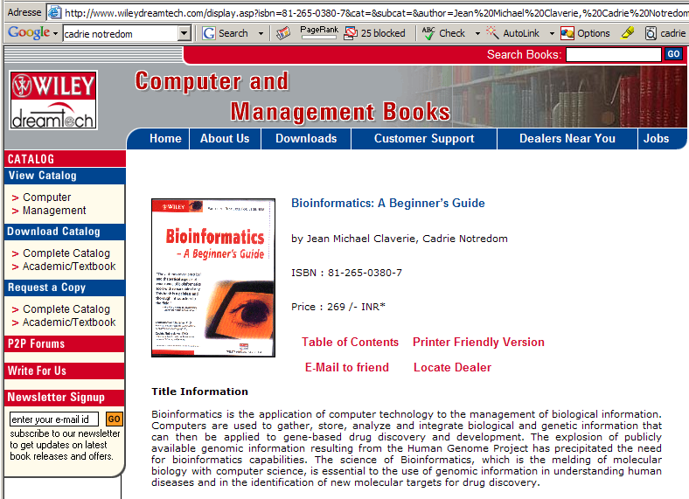
Cadrie Notredom et Michael Claverie

