Slide 1

ncRNA Multiple Alignments with
R-Coffee
Laundering the Genome Dark Matter
Cédric Notredame
Comparative Bioinformatics Group
Bioinformatics and Genomics Program

Slide 2
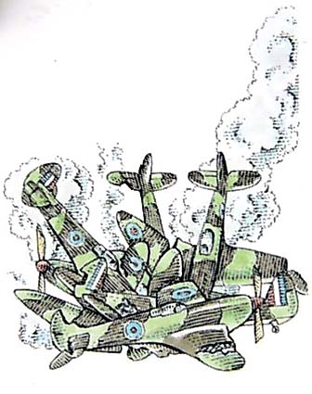
No Plane Today…

Slide 3
ncRNAs Comparison
And ENCODE said…
“nearly the entire genome may be represented in primary transcripts that extensively overlap and include many non-protein-coding regions”
Who Are They?
  tRNA, rRNA, snoRNAs,
  microRNAs, siRNAs
  piRNAs
  long ncRNAs (Xist, Evf, Air, CTN, PINK…)
How Many of them
  Open question
  30.000 is a common guess
  Harder to detect than proteins
.

Slide 4
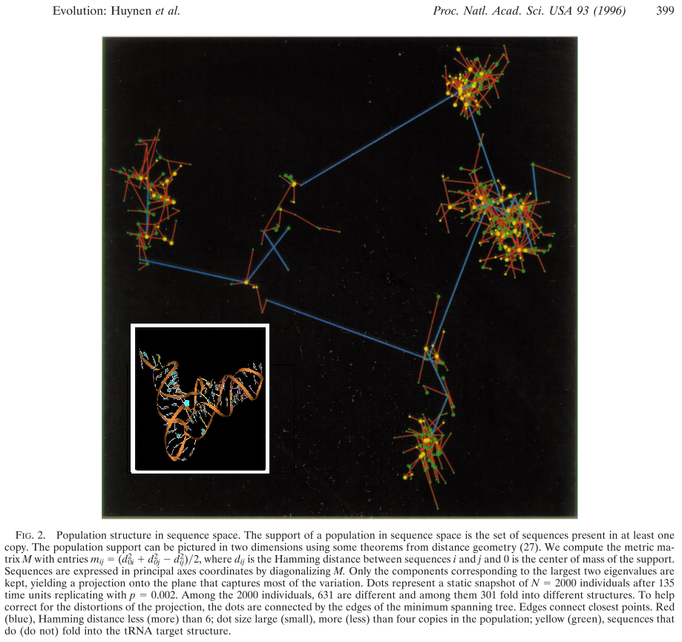
ncRNAs can have different sequences and Similar Structures

Slide 5
ncRNAs Can Evolve Rapidly
C
A
C
A
C
A
C
A
A
A
G
C
G
C
G
G
G
G
A
G
A
G
C
G
A
C
G
A
G
G
GAACGGACC
CTTGCCTGG
CTTGCCTCC
GAACGGAGG
CCAGGCAAGACGGGACGAGAGTTGCCTGG
CCTCCGTTCAGAGGTGCATAGAACGGAGG
**-------*--**---*-**------**

Slide 6
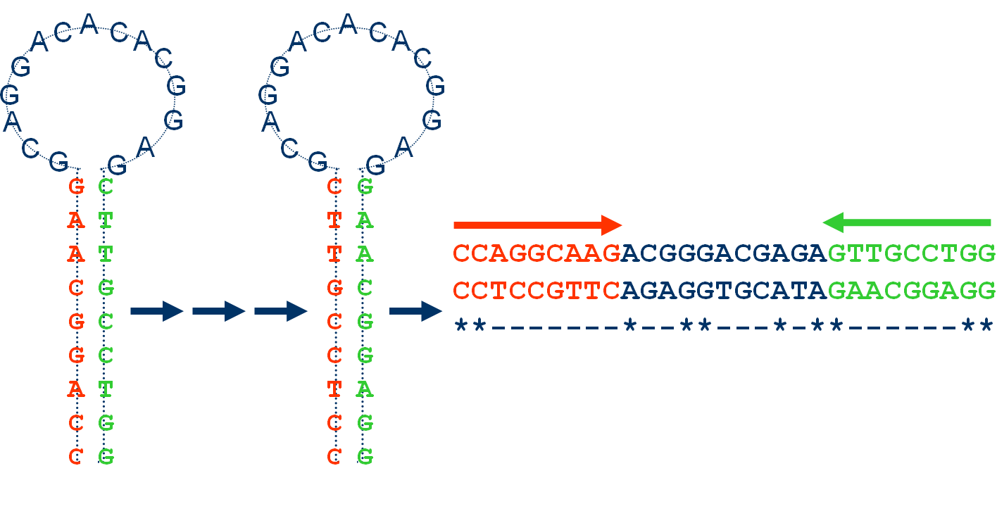
ncRNAs are Difficult to Align
Same Structure ⬄Low Sequence Identity
Small Alphabet, Short Sequences ⬄ Alignments often Non-Significant

Slide 7
Obtaining the Structure of a ncRNA is difficult
Hard to Align The Sequences Without the Structure
Hard to Predict the Structures Without an Alignment

Slide 8
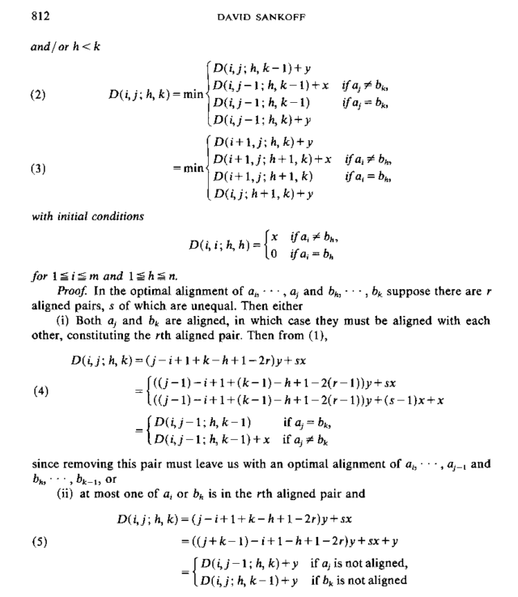
The Holy Grail of RNA Comparison:
Sankoff’ Algorithm

Slide 9
The Holy Grail of RNA Comparison
Sankoff’ Algorithm
Simultaneous Folding and Alignment
  Time Complexity: O(L^{2n})
  Space Complexity: O(L^{3n})
In Practice, for Two Sequences:
  50 nucleotides: 1 min. 6 M.
  100 nucleotides 16 min. 256 M.
  200 nucleotides 4 hours 4 G.
  400 nucleotides 3 days 3 T.
Forget about
  Multiple sequence alignments
  Database searches

Slide 10
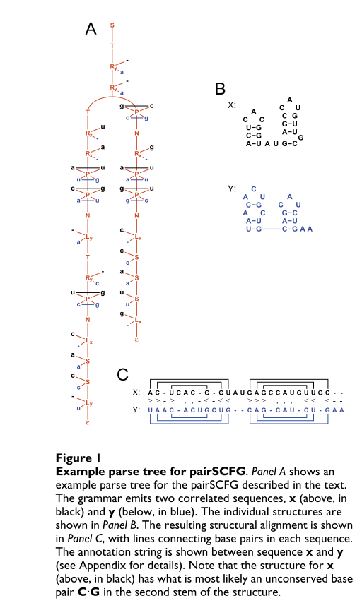
The next best Thing: Consan
Consan = Sankoff + a few constraints
Use of Stochastic Context Free Grammars
  Tree-shaped HMMs
  Made sparse with constraints
The constraints are derived from the most confident positions of the alignment
Equivalent of Banded DP

Slide 11
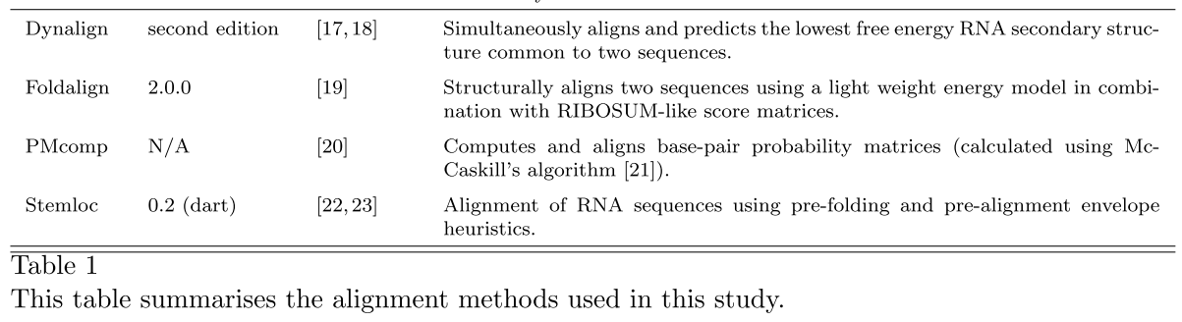
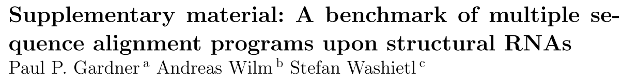
Going Multiple….
Structural Aligners

Slide 12
Game Rules
Using Structural Predictions
  Produces better alignments
  Is Computationally expensive
Use as much structural information as possible while doing as little computation as possible…

Slide 13
Adapting T-Coffee
To
RNA Alignments

Slide 14
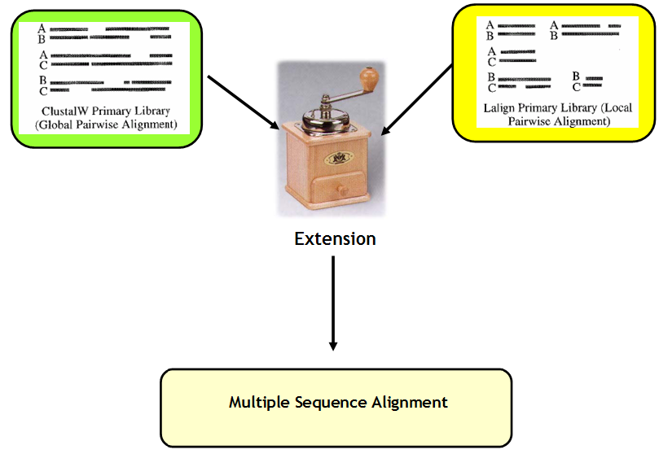
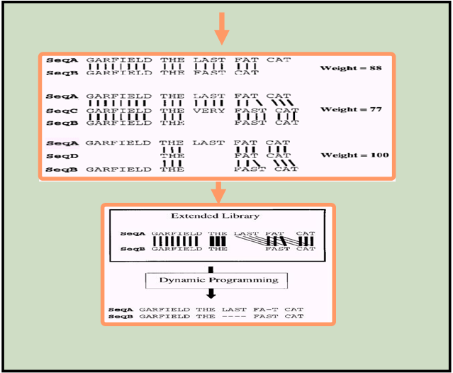
T-Coffee and Concistency…

Slide 15
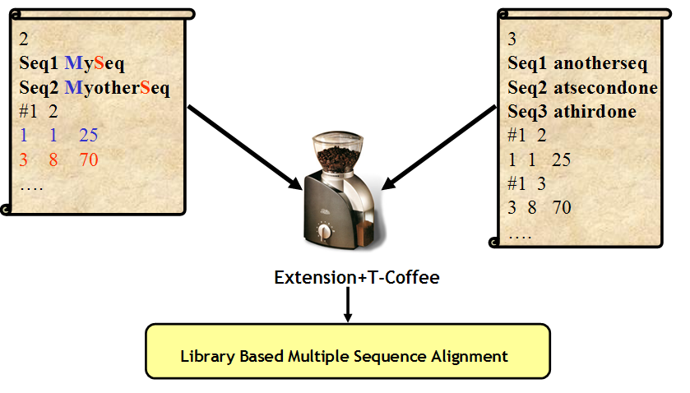
T-Coffee and Concistency…

Slide 16
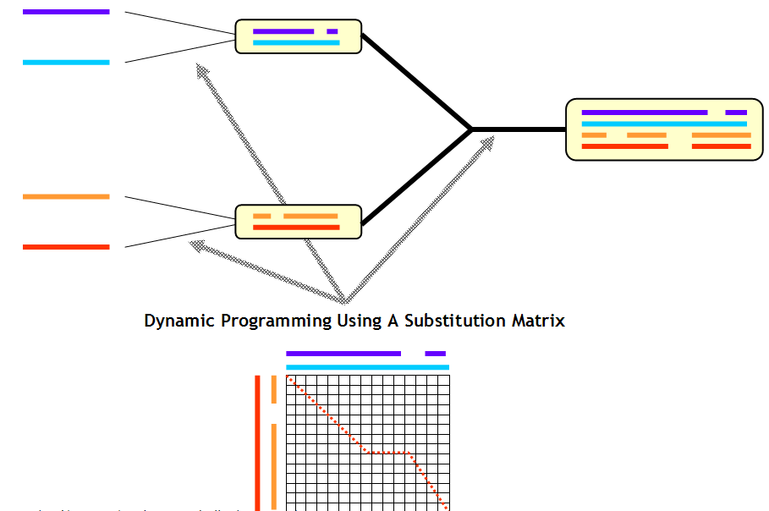
T-Coffee and Concistency…

Slide 17
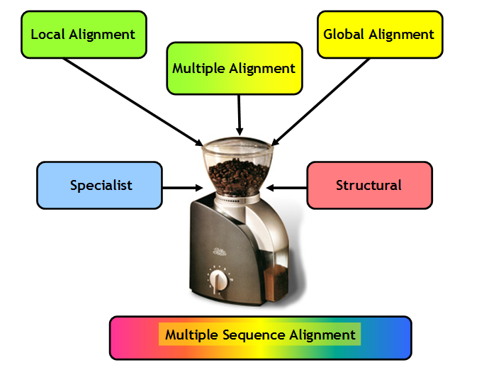
T-Coffee and Concistency…

Slide 18
Consistency: Conflicts and Information
X
X
Y
Y
X
X
Z
Z
Y
Y
W
Z
W
Z
Y is unhappy
X is unhappy
X
X
X
Y
Y
Y
W
Z
W
Z
W
Z
Fully Consistent
⬄
More Reliable
Partly Consistent
⬄
Less Reliable

Slide 19
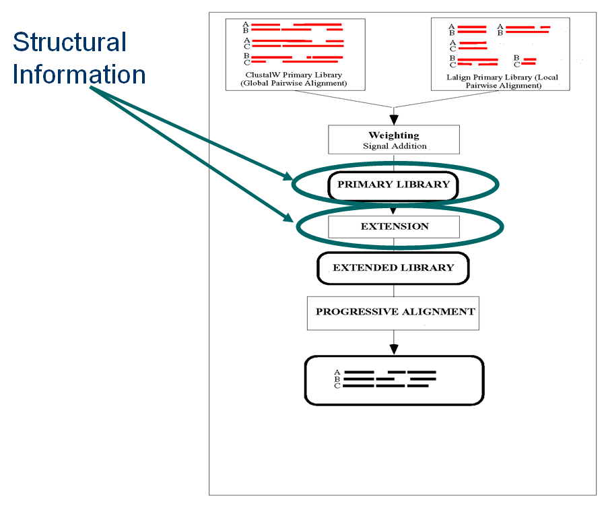
R-Coffee: Modifying T-Coffee at the Right Place
Incorporation of Secondary Structure information within the Library
Two Extra Components for the T-Coffee Scoring Scheme
  A new Library
  A new Scoring Scheme

Slide 20
RNA Sequences
RNAplfold
Consan
or
Mafft / Muscle / ProbCons
Primary Library
Secondary
Structures
R-Coffee
Extension
R-Coffee Extended
Primary Library
R-Score
Progressive Alignment
Using The R-Score

Slide 21
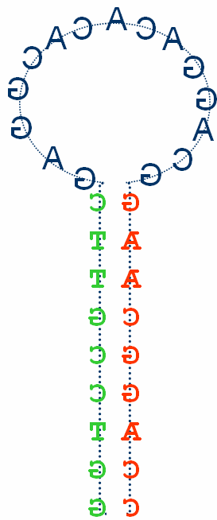
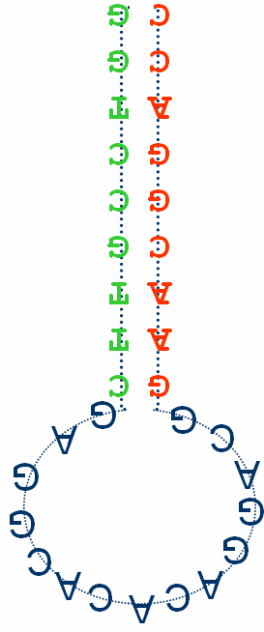
R-Coffee Extension
TC Library
C
G
G G Score X
C C Score Y
C
G
C
G
C
G
Goal: Embedding RNA Structures Within The T-Coffee Libraries
The R-extension can be added on the top of any existing method.

Slide 22
R-Coffee Scoring Scheme
R-Score (CC)=MAX(TC-Score(CC), TC-Score (GG))
C
G
C
G

Slide 23
Validating R-Coffee

Slide 24
RNA Alignments are harder to validate than Protein Alignments
Protein Alignments ⬄ Use of Structure based Reference Alignments
RNA Alignments ⬄No Real structure based reference alignments
  The structures are mostly predicted from sequences
  Circularity

Slide 25
BraliBase and the BraliScore
Database of Reference Alignments
388 multiple sequence alignments.
Evenly distributed between 35 and 95 percent average sequence identity
Contain 5 sequences selected from the RNA family database Rfam
The reference alignment is based on a SCFG model based on the full Rfam seed dataset (~100 sequences).

Slide 26
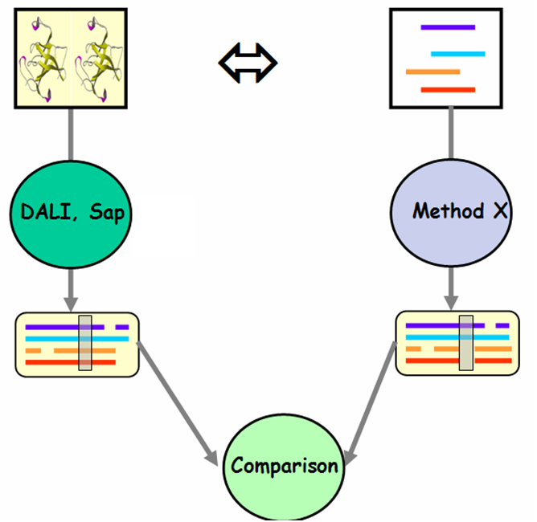
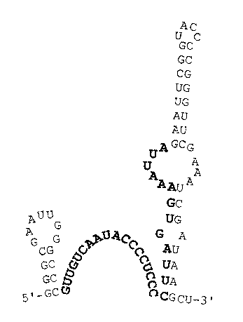
BraliBase SPS Score
RFam
MSA
SPS=
Number of Identically Aligned Pairs
Number of Aligned Pairs

Slide 27
BraliBase: SCI Score
R
N
A
p
f
o
l
d
Covariance
(((…)))…((..)) ΔG Seq1
(((…)))…((..)) ΔG Seq2
(((…)))…((..)) ΔG Seq3
(((…)))…((..)) ΔG Seq4
(((…)))…((..)) ΔG Seq5
(((…)))…((..)) ΔG Seq6
RNAlifold
SCI=
Average ΔG Seq X Cov
(((…)))…((..)) ALN ΔG
ΔG ALN

Slide 28
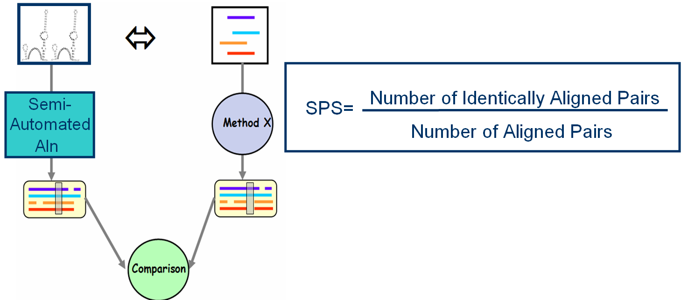
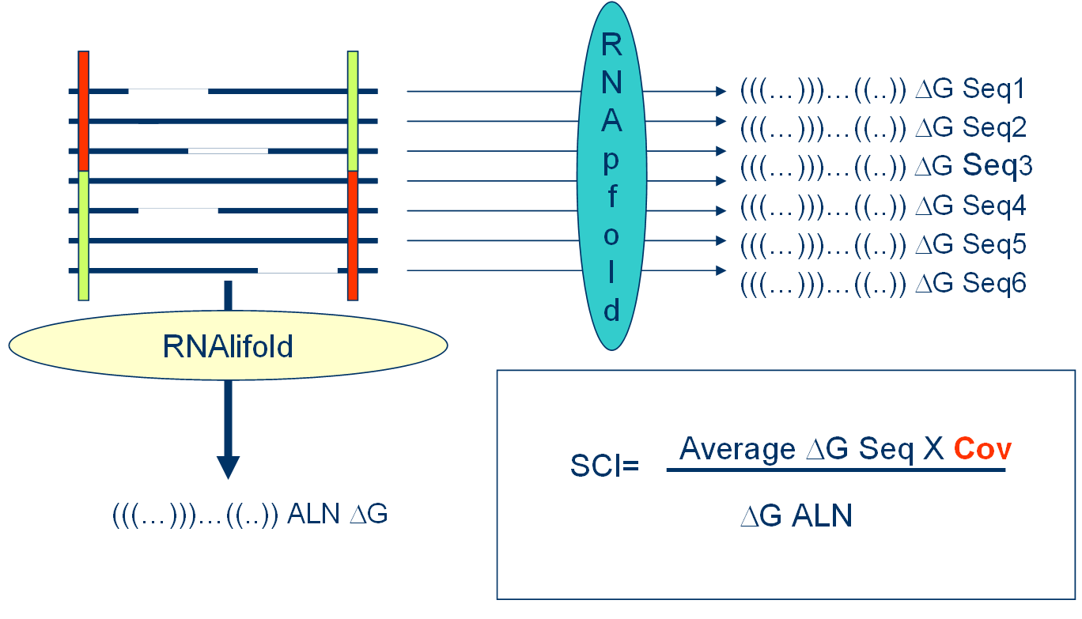
BRaliScore
Braliscore= SCI*SPS

Slide 29
R-Coffee + Regular Aligners
Method Avg Braliscore Net Improv.
direct +T +R +T +R
-----------------------------------------------------------
Poa 0.62 0.65 0.70 48 154
Pcma 0.62 0.64 0.67 34 120
Prrn 0.64 0.61 0.66 -63 45
ClustalW 0.65 0.65 0.69 -7 83
Mafft_fftnts 0.68 0.68 0.72 17 68
ProbConsRNA 0.69 0.67 0.71 -49 39
Muscle 0.69 0.69 0.73 -17 42
Mafft_ginsi 0.70 0.68 0.72 -49 39
-----------------------------------------------------------
Improvement= # R-Coffee wins - # R-Coffee looses

Slide 30
RM-Coffee + Regular Aligners
Method Avg Braliscore Net Improv.
direct +T +R +T +R
-----------------------------------------------------------
Poa 0.62 0.65 0.70 48 154
Pcma 0.62 0.64 0.67 34 120
Prrn 0.64 0.61 0.66 -63 45
ClustalW 0.65 0.65 0.69 -7 83
Mafft_fftnts 0.68 0.68 0.72 17 68
ProbConsRNA 0.69 0.67 0.71 -49 39
Muscle 0.69 0.69 0.73 -17 42
Mafft_ginsi 0.70 0.68 0.72 -49 39
-----------------------------------------------------------
RM-Coffee4 0.71 / 0.74 / 84

Slide 31
R-Coffee + Structural Aligners
Method Avg Braliscore Net Improv.
direct +T +R +T +R
-----------------------------------------------------------
Stemloc 0.62 0.75 0.76 104 113
Mlocarna 0.66 0.69 0.71 101 133
Murlet 0.73 0.70 0.72 -132 -73
Pmcomp 0.73 0.73 0.73 142 145
T-Lara 0.74 0.74 0.69 -36 -8
Foldalign 0.75 0.77 0.77 72 73
-----------------------------------------------------------
Dyalign --- 0.63 0.62 --- ---
Consan --- 0.79 0.79 --- ---
-----------------------------------------------------------
RM-Coffee4 0.71 / 0.74 / 84

Slide 32
How Best is the Best….
Method | vs. R-Coffee-Consan | vs. RM-Coffee4
Poa | 241 *** | 217 ***
T-Coffee | 241 *** | 199 ***
Prrn | 232 *** | 198 ***
Pcma | 218 *** | 151 ***
Proalign | 216 *** | 150 **
Mafft fftns | 206 *** | 148 *
ClustalW | 203 *** | 136 ***
Probcons | 192 *** | 128 *
Mafft ginsi | 170 *** | 115
Muscle | 169 *** | 111
M-Locarna | 234 *** | 183 **
Stral | 169 *** | 62
FoldalignM | 146 | 61
Murlet | 130 * | -12
Rnasampler | 129 * | -27
T-Lara | 125 * | -30

Slide 33
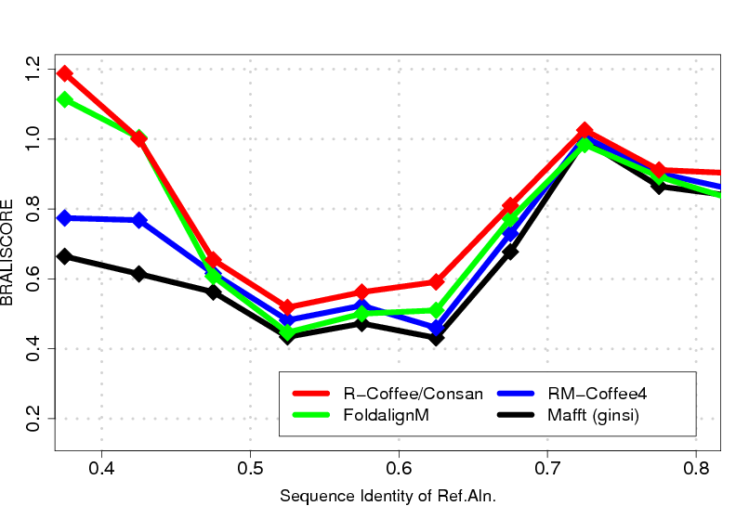
Range of Performances
Effect of
Compensated
Mutations

Slide 34
Conclusion/Future Directions
T-Coffee/Consan is currently the best MSA protocol for ncRNAs
Testing how important is the accuracy of the secondary structure prediction
Going deeper into Sankoff’s territory: predicting and aligning simultaneously

Slide 35
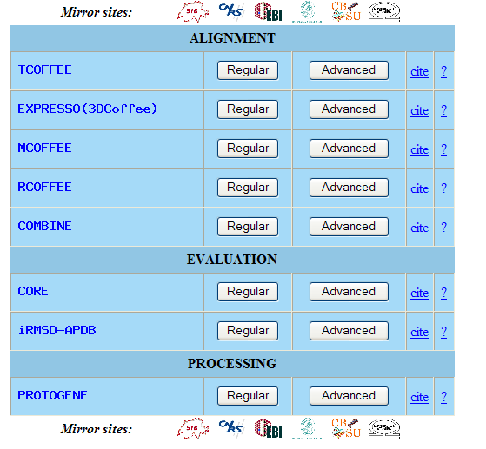
Credits and Web Servers
Andreas Wilm
Des Higgins
Sebastien Moretti
Ioannis Xenarios
Cedric Notredame
CGR, SIB, UCD
www.tcoffee.org
cedric.notredame@europe.com

