Slide 1

An Introduction to
Bioinformatics
Cédric Notredame

Slide 2
Bioinformatics:
What is all the fuss about ?

Slide 3
Our Scope
Demystify Bioinformatics
Bioinformatics is REGULAR BIOLOGY
Demystify Vocabulary
You need a common language to EXPRESS YOUR NEEDS

Slide 4
Outline
-The Big Picture.
-The Building Blocks : What is What ?
-A possible Strategy…

Slide 5
Historical Perspective …
Species, Populations (Line, Darwin, XIX)
Organs, Tissues, Physiology (Early XX)
Cell
Nucleus (2nd Part XX)
Macromolecules

Slide 6
The Big Picture…

Slide 7
Bioinformatics:
Why do we need it ?
We have generated lots of expensive data
Now we must use it !!!

Slide 8
Bioinformatics:
What is it ?
Bioinformatics IS NOT about computers and biology
Bioinformatics IS about
Biology AND Information

Slide 9
Bioinformatics:
What is it ?
Bioinformatics is mostly common sense dressed in some unusual way…

Slide 10

Bioinformatics:
What is it ?
IMAGINE…
-You are a biologist
-You have just received by mail the results of 500 000 experiments.
-Your boss tells you: Use that stuff.
ONLY ONE SOLUTION !
Inventing Bioinformatics.

Slide 11
Bioinformatics:
What is it ?
Inventing Bioinformatics…
-Organizing the Data: Databases
-The simplest Database: a list.
-Searching the Data: A search engine
-To search, one needs to compare…
-To compare one needs a MODEL

Slide 12



What is a Model ?
Making a Model= Observation ⬄ Generalities.
Generalities ⬄Classification ⬄ Comparison.
Comparison=Two Questions, One conclusion.
The models Must tell us two things:
-These two objects are X% identical.
-Trust me (or not) I am a Model…
Can We Compare Them?
Model
Conclusion: How Similar ?

Slide 13
Bioinformatics:
What is it ?
Inventing Bioinformatics…
-Organizing the Data: DataBases
-Searching the Data: A search engine
-To search, one needs to compare…
-Classify New Data: Prediction
-Hunger For New Data: High Throughput
-Looking at things: Visualization

Slide 14
Bioinformatics:
How Can I Use It ?
Asking QUESTIONS
-What is the function of my protein ?
Sequence Comparison
-What does this bacteria look like ?
Genome Comparison, phylogeny
-How can I inactivate this metabolic Pathway ?
Genomics, Structure Analysis
-Which Drug Will Destroy This Tumour ?
DNA Chips, Proteomics

Slide 15
Bioinformatics:
How Can I Use It ?
Sequence Comparison
Genome Comparison, phylogeny
Generating QUESTIONS
Structure Analysis
DNA Chips, Proteomics

Slide 16
Bioinformatics:
The Big Chunks
99% Of Bioinformatics is Carried Out Using a Handful of Tools.

Slide 17



Bioinformatics:
The Big Chunks
YOUR DATA
DATABASES
Domesticated Sequences…
EMBL (nucleotides)
SwissProt (proteins)
A Jungle of wild
Sequences…
PDB (Structures)
Medline (Bibliography)
Search TOOLS
Analysis TOOLS
Prediction TOOLS
ClustalW
(Multiple Sequence
Alignment)
SRS (text search)
BLAST (sequences
search)
GeneMark (genes)
Phylips (Phylogenetic Analysis)
PSI BLAST ( Multiple
Sequences search)
Zuker
(RNA Structure)
PsiPred, PhD
(Protein Structure)

Slide 18
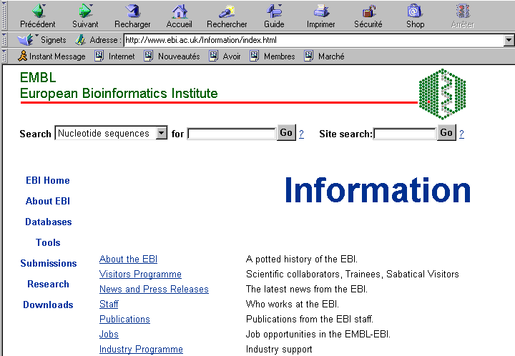
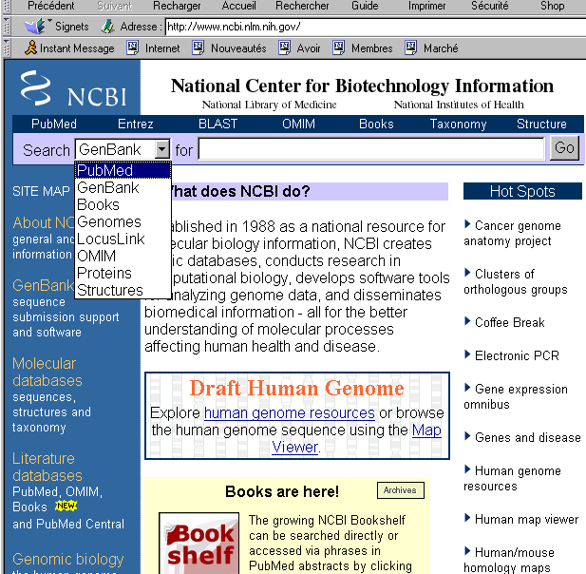
Bioinformatics:
Who Takes Care of it ?

Slide 19
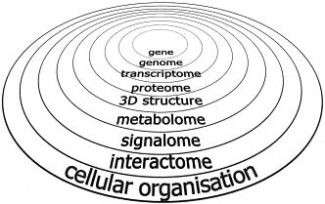
Bioinformatics:
Trendy Concepts
HOT !!!
VERY HOT !!!

Slide 20
The Building Blocks:
What is what ?

Slide 21
DataBase Entries
Most DataBases are collection of Biological Sequences
AGCTGTCGAGGGATAGGACA
TATACATAAATTAATATAAT
1 entry = 1 Sequence
SEQ
1 entry = 1 File = Sequence +Doc
DOC
= Flat File
SEQ
SEQ
Database = Collection of Flat Files
DOC
DOC
SEQ
SEQ
DOC
DOC
SEQ
SEQ
DOC
DOC
SEQ
DOC

Slide 22
DataBase Entries : Formats
The entries of a DataBase Must be easy to read..
-For SMART Humans
-For STUPID Computers
Ask yourself: How would I do ?
-Answer: You would invent a FORMAT

Slide 23
DataBase Entries : Formats
Let us Imagine a format…
-We must know when the sequence starts
-The Sequence starts after ‘>’
-We must know the sequence name
-The first line is the name
-We must know where the sequence finishes
-The Sequence finishes with ‘*’

Slide 24
DataBase Entries : Our Format
>Name
AGGGAATTATTATATTATTATTATATATTC
GATCGTCCATTACCCAAAATATATTATTAT
GTATATATTATTTTATATATTATCTAGTGC
TCT*

Slide 25
DataBase Entries : Our Format
Meetings about Formats are:
-Endless
-Very Very Borrrrrring
-Very Very Very IMPORTANT

Slide 26

A Little Story About the Importance of Formats
Today, UK trains use narrow gauges.
This is not so comfortable
It makes the UK rail system incompatible with Europe and only compatible with parts of India and Australia

Slide 27

A Little Story About the Importance of Formats
Trains were invented in the UK (XIX)
At the time there were few wagons and It was Convenient to put Horse carriages Directly on the rails.
By the time People realized Large gauges were more convenient, the UK already had a complete system.

Slide 28
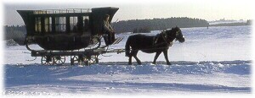
A Little Story About the Importance of Formats
All the horse Carriage had the same width.
The reason is that the dirt road were carved with deep railings made by the wheels.
To use these roads, standard separation between the wheels was needed.
Now, where do you think that spacing came from ?

Slide 29
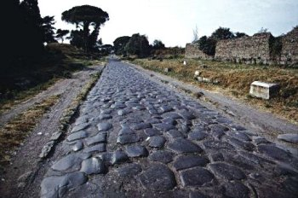
A Little Story About the Importance of Formats
Yes, the spacing was a legacy of the roman empire with its flashy roads!!!

Slide 30
A Little Story About the Importance of Formats
Conclusion:
1-Be careful, when you design a format, chances are that you will be stuck with it;
2-Many formats are not used for their initial Purpose.

Slide 31
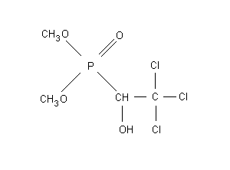
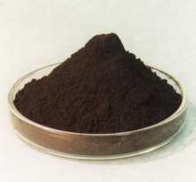
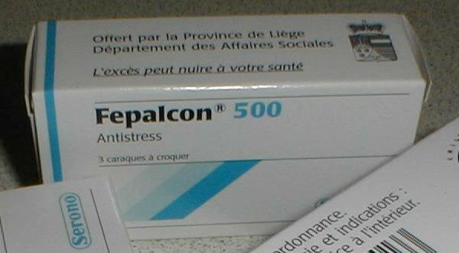

The Tools:
A bit of Vocabulary
Algorithm
Mathematic Formulation of a Computer Program
Program
Implementation (Coding) of the algorithm.
Package,
Software
Distributed version of the program.
Server
Computer Running the Software

Slide 32
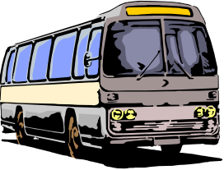


The Tools:
How can you use them
3 Ways to use available Tools
Web
(+)Very Little Requirement.
(-)Not Versatile
Command Line
(+)Very versatile
(-)Must Know Each Tool
(-)Tedious
(+)Very Powerful
(+)Suitable for large scale
(-)Programming
Scripting

Slide 33
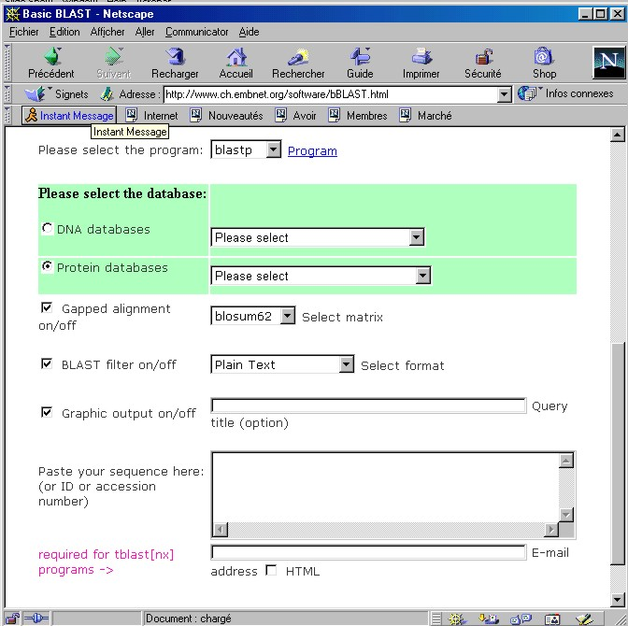
The Tools:
What Do Web Tools Look Like ?
Address
DataBase
Parameters
Format
>Name
AGGGAATTATTATATTATTATTATATATTC
GATCGTCCATTACCCAAAATATATTATTAT
GTATATATTATTTTATATATTATCTAGTGC
Sequence

Slide 34
Do NOT Confuse Tools and Data!

Slide 35

Bioinformatics:
A Possible Strategy ?

Slide 36
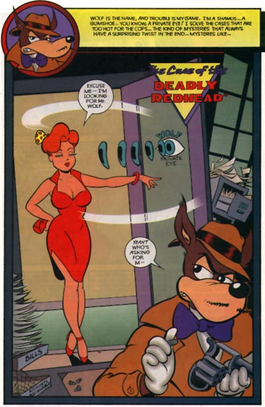

A Private Investigation…
For a few minutes…
-You know every available technique.
-You are Nuc. C. Quencer, the famous Detective.
The Dame walked into my office. She clearly had something else than an Assay in Mind … No prize for guessing see she was tired of the old overnight ligand binding.

Slide 37

A Private Investigation…
Clearly, there was
a job for
C. Quencer …

Slide 38

A Private Investigation:
Looking for a suspect
We got this genetically inherited Cancer susceptibility. Can you help ?
Sure…

Slide 39
1-Get the Sequence !!!
If the data is available, Linkage Analysis to nail down the guilty portion of The Chromosome.
Shot Gun Sequencing

Slide 40
1-Get the Sequence !!!
Shot Gun Sequencing
PHRED
Assembly
PHRAP
http://www.codoncode.com

Slide 41
2-Where Are The Genes ???
ESTs, mRNA
Homology
(Procruste)
http://www.cse.ucsc.edu/software/procustes
Genemark,selfid
http://genemark.biology.gatech.edu
http://igs-server.cnrs-mrs.fr

Slide 42
3-How About This New Protein ???

Slide 43
3-How About This New Protein:
Using Homology
BLAST Vs SwissProt
Pattern Search
Vs PROSITE
http://www.expasy.ch
Pfsearch Vs Pfam
http://pfam.wustl.edu

Slide 44
4-What are the important Residues ?
Important Residues Are not Allowed To Mutate…
⬄
Important Residues Are Conserved…
PROBLEM
So far we have only compared PAIRS of sequences

Slide 45
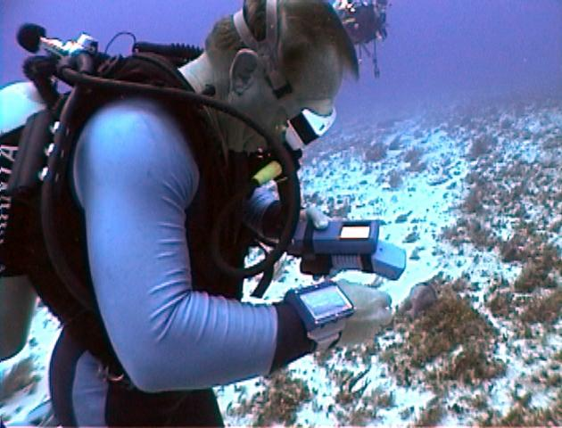
4-What are the important Residues ?
Τηε μαν ωιτη ΤΩΟ ωατχηεσ ΝΕςΕΡ κνοωσ τηε τιμε
Πλατο
The man with TWO watches NEVER knows the time

Slide 46
4-What are the important Residues ?
Homologues Fetched with BLAST
CLUSTAL W
chite ---ADKPKRPLSAYMLWLNSARESIKRENPDFK-VTEVAKKGGELWRGLKD
wheat --DPNKPKRAPSAFFVFMGEFREEFKQKNPKNKSVAAVGKAAGERWKSLSE
trybr KKDSNAPKRAMTSFMFFSSDFRS----KHSDLS-IVEMSKAAGAAWKELGP
mouse -----KPKRPRSAYNIYVSESFQ----EAKDDS-AQGKLKLVNEAWKNLSP
***. ::: .: .. . : . . * . *: *

Slide 47
5-What is our Sequence HISTORY ?
chite ---ADKPKRPLSAYMLWLNSARESIKRENPDFK-VTEVAKKGGELWRGLKD
wheat --DPNKPKRAPSAFFVFMGEFREEFKQKNPKNKSVAAVGKAAGERWKSLSE
trybr KKDSNAPKRAMTSFMFFSSDFRS----KHSDLS-IVEMSKAAGAAWKELGP
mouse -----KPKRPRSAYNIYVSESFQ----EAKDDS-AQGKLKLVNEAWKNLSP
***. ::: .: .. . : . . * . *: *
CLUSTAL W, PHYLIPS
chite
wheat
trybr
mouse

Slide 48
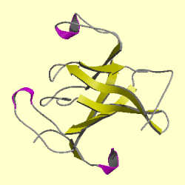
6-What is our Sequence STRUCTURE ?
chite ---ADKPKRPLSAYMLWLNSARESIKRENPDFK-VTEVAKKGGELWRGLKD
wheat --DPNKPKRAPSAFFVFMGEFREEFKQKNPKNKSVAAVGKAAGERWKSLSE
trybr KKDSNAPKRAMTSFMFFSSDFRS----KHSDLS-IVEMSKAAGAAWKELGP
mouse -----KPKRPRSAYNIYVSESFQ----EAKDDS-AQGKLKLVNEAWKNLSP
***. ::: .: .. . : . . * . *: *
BLAST Vs PDB
PHD, PsiPRED

Slide 49
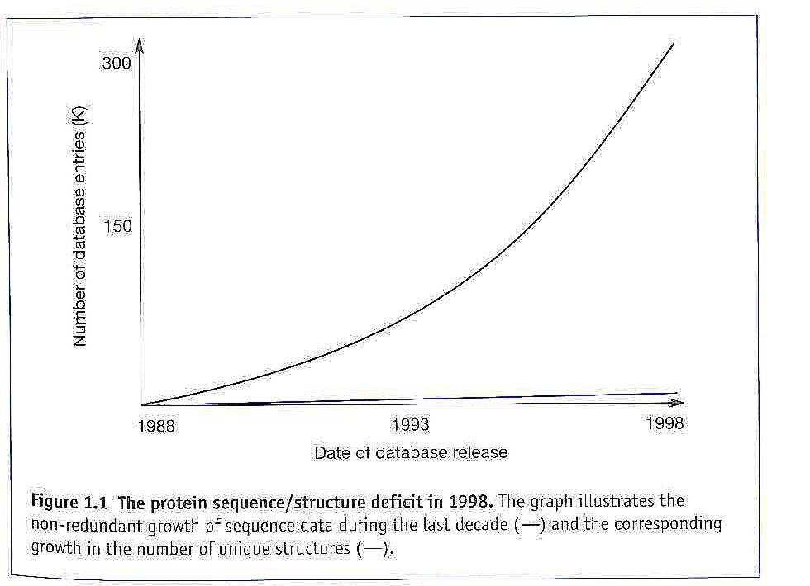
6-What is our Sequence STRUCTURE ?

Slide 50
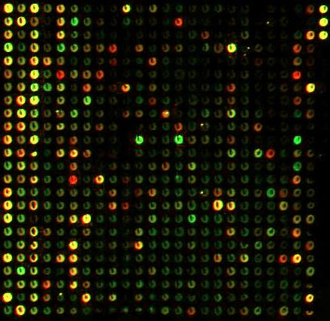
7-When is our protein EXPRESSED ?

Slide 51
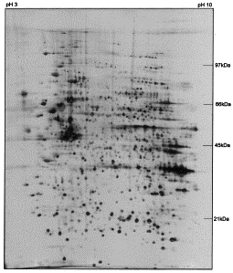
8-Is it MODIFIED, TRANSLATED, TRANSPORTED ?
Full
Digest

Slide 52
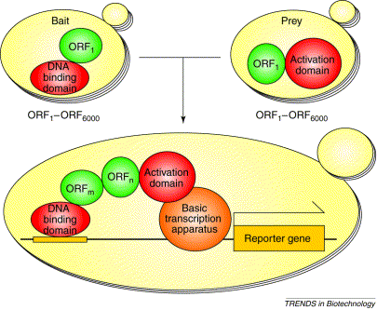
9-Who Does It Interact With ?
TWO HYBRID SYSTEM

Slide 53
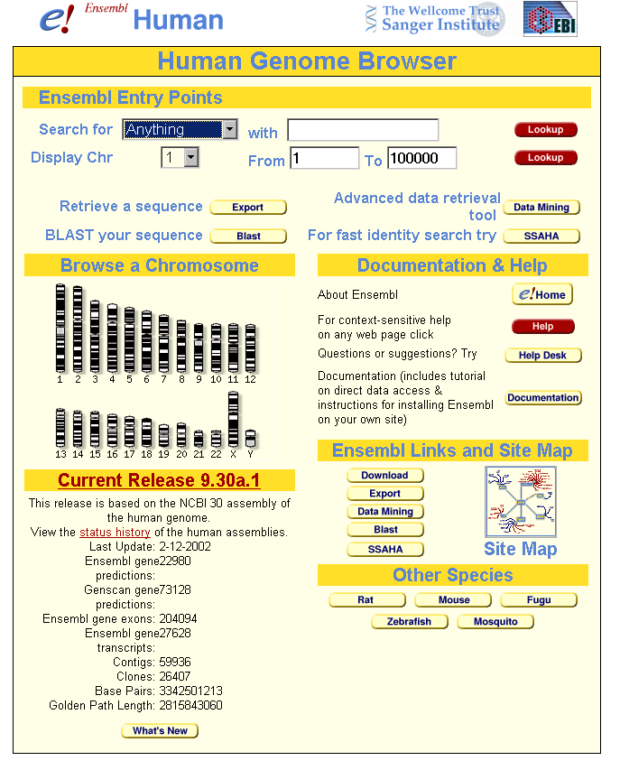
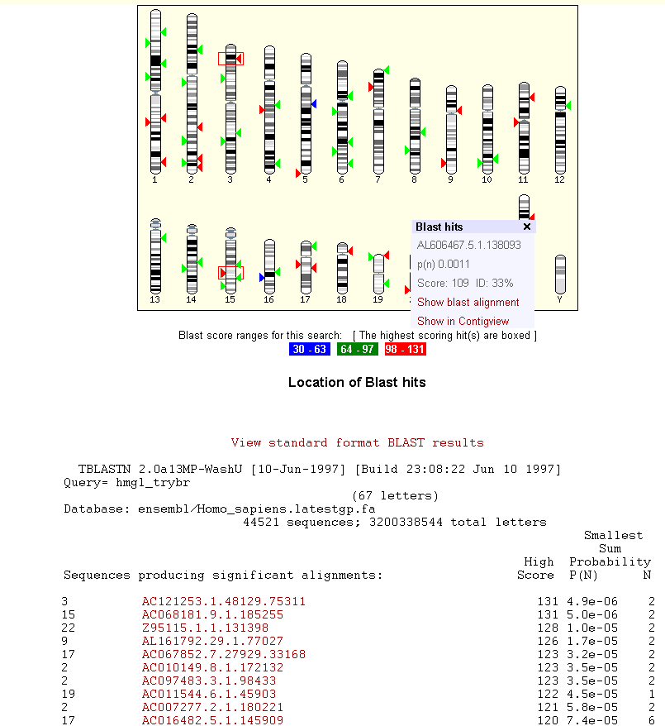
10-What is the Genetic Context of my Protein

Slide 54
11-What Are the Mutations (nsSNPs) associated with my Protein

Slide 55
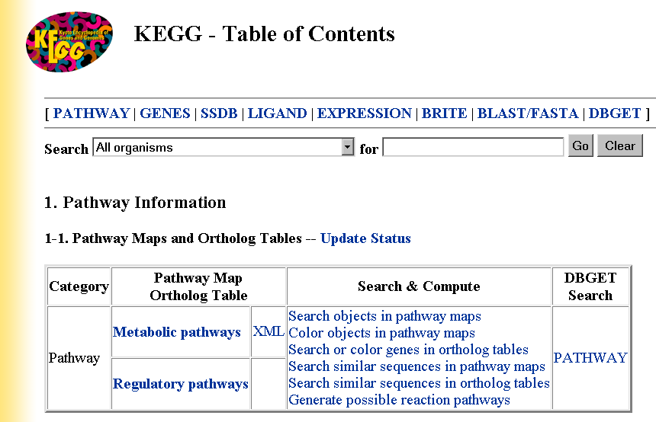
11-Which Metabolic Pathway ?

Slide 56
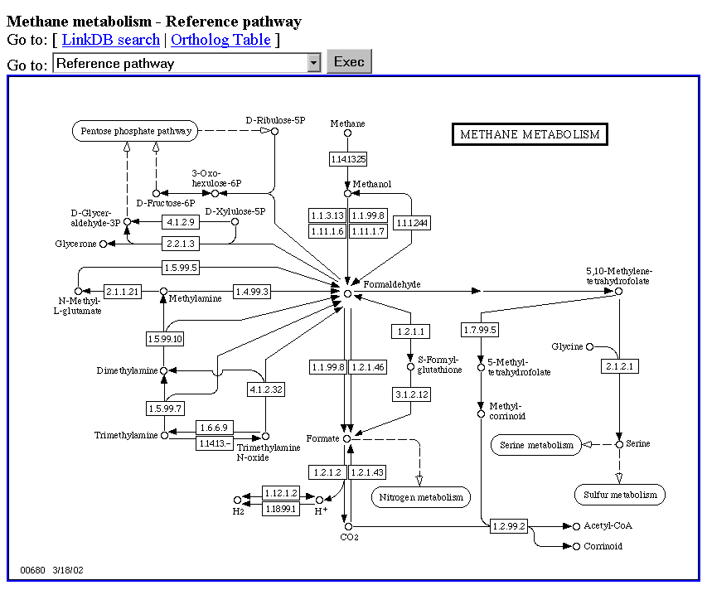
11-Which Pathway ?

Slide 57
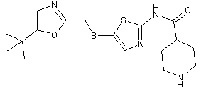
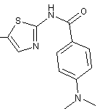
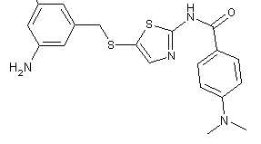
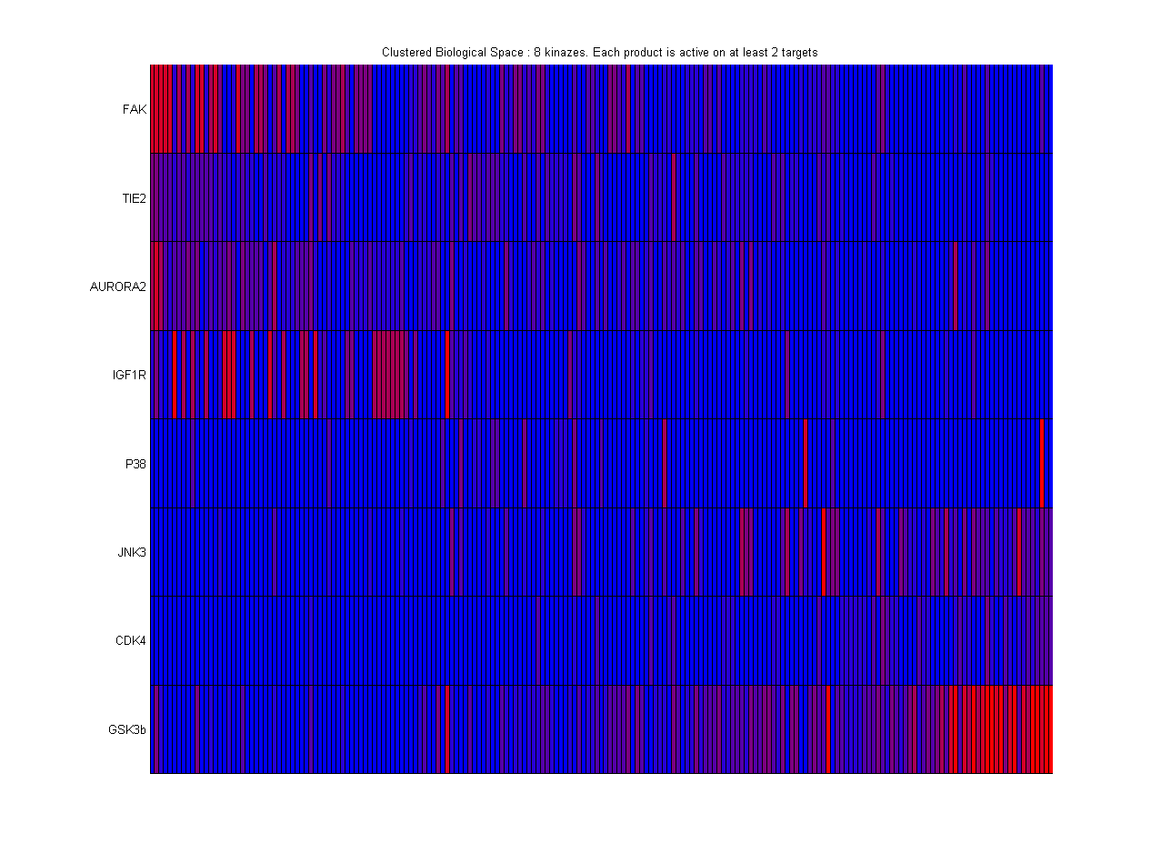
12-How to stop it ?
Chemical Compounds
Protein
Targets
Structure
Activity
Relationship

Slide 58
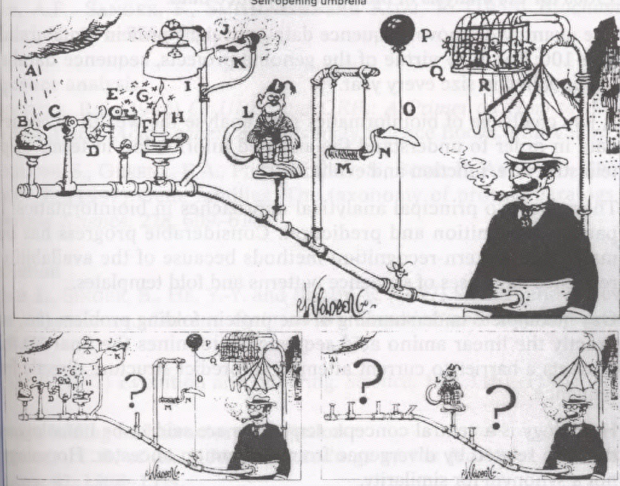
13-How it Really Work

Slide 59
13-How it Really Work
"Nothing in biology makes sense except in the light of evolution."
Theodosius Dobzhansky (1973)
"Nothing is more opportunistic than Evolution."
Russel Doolitle

Slide 60
Patching Everything Up
Bioinformatics Will not write the story for you…
Identifying Interesting things will be the usual combination:
-Work
-Luck
Making sense of INCONSISTENCIES Works fine

Slide 61
Patching Everything Up
Bioinformatics Evidences often rely on Imprecise Statistical models
-Artefacts are easy
To be convinced, one will need several evidences.
If the Computer disagrees with you, YOU are usually right (Sorry HAL that was not meant for you)

Slide 62
In the end…
Bioinformatics is CHEAP
Bioinformatics is FAST
But always remember that:
“ A few weeks at the bench can save you a half day in front of a computer”
Alan Bleasby

Slide 63
A Few Resources

Slide 64
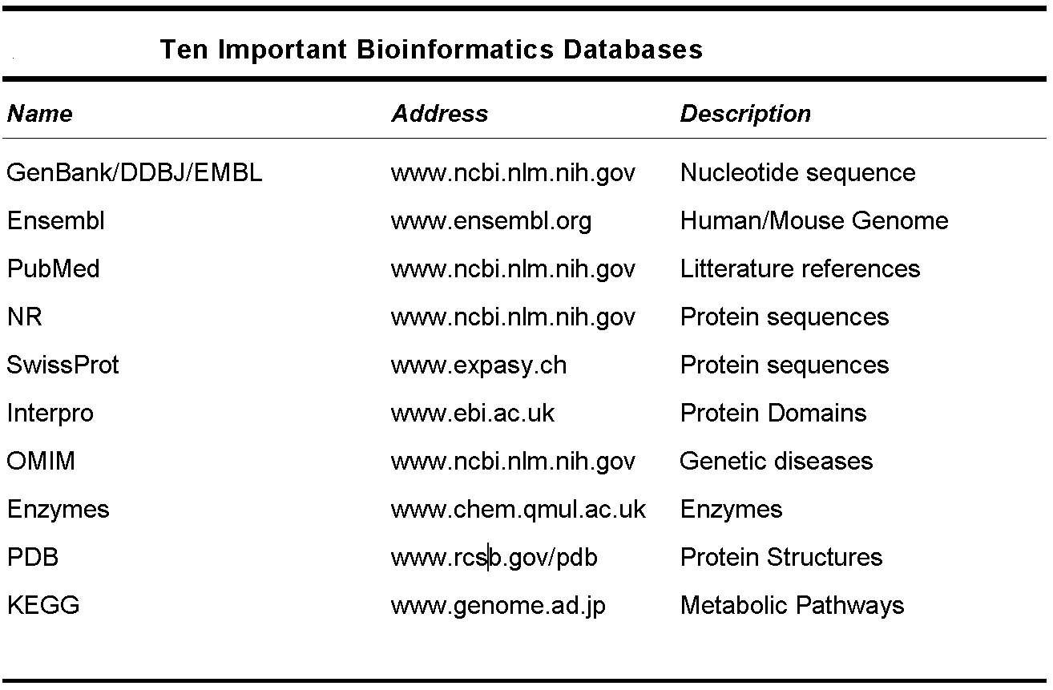
A few Databases

Slide 65
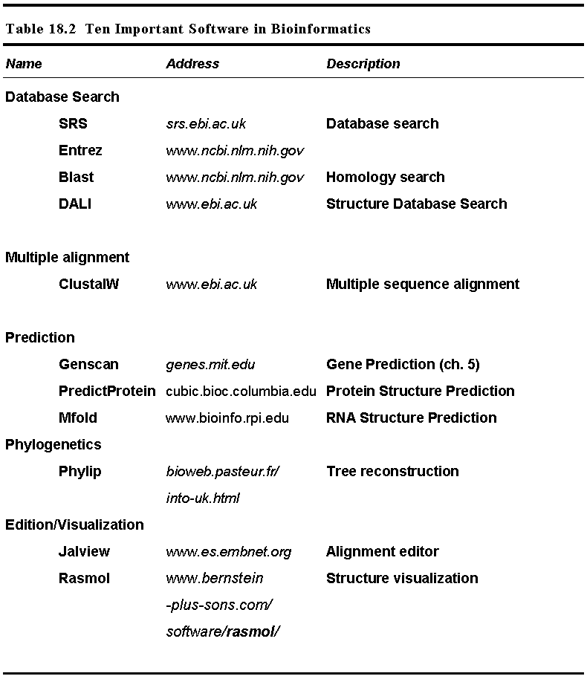
A few Tools

Slide 66
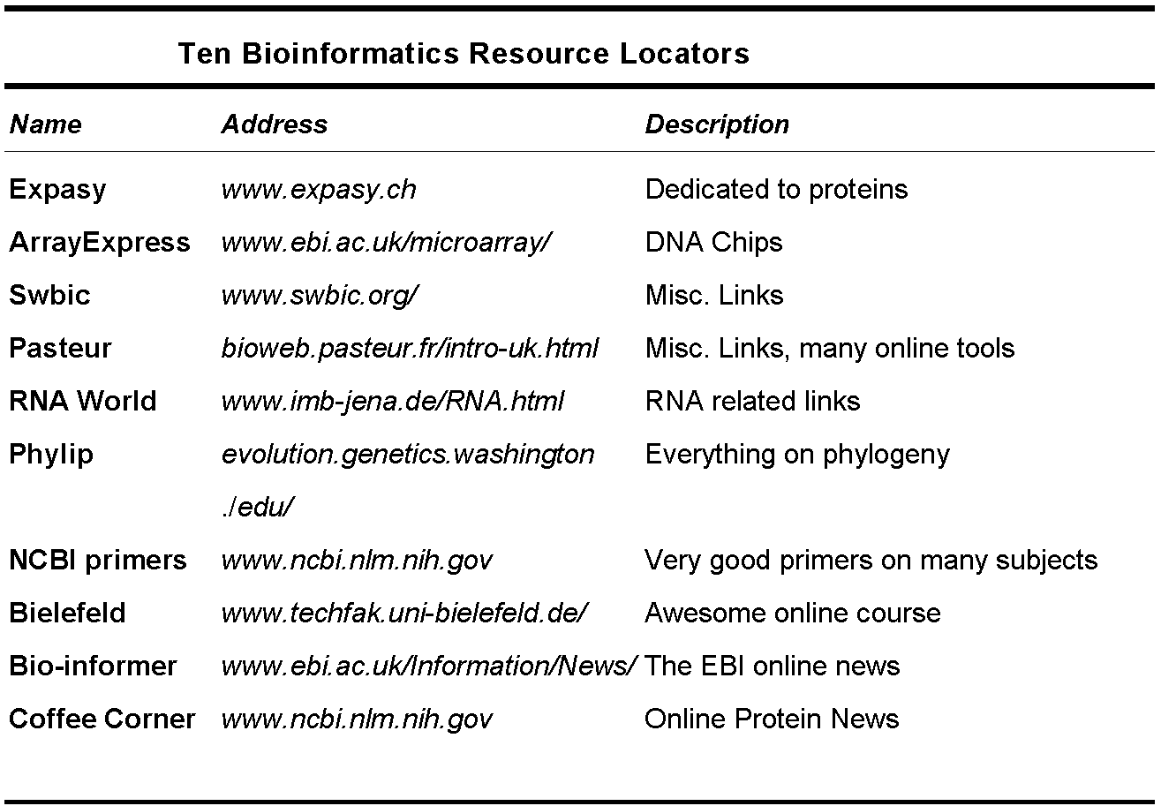
A few Generic Locators

Slide 67
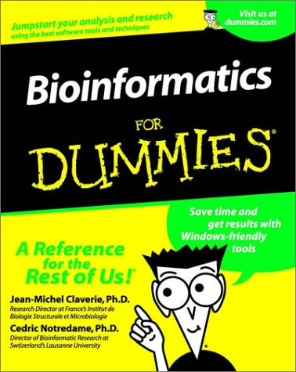

Slide 68
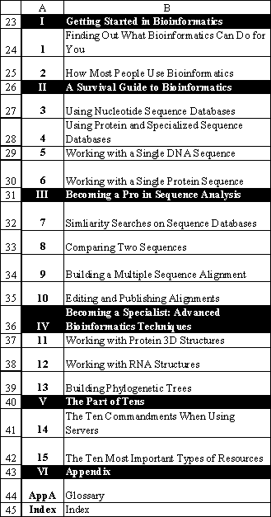

Slide 69
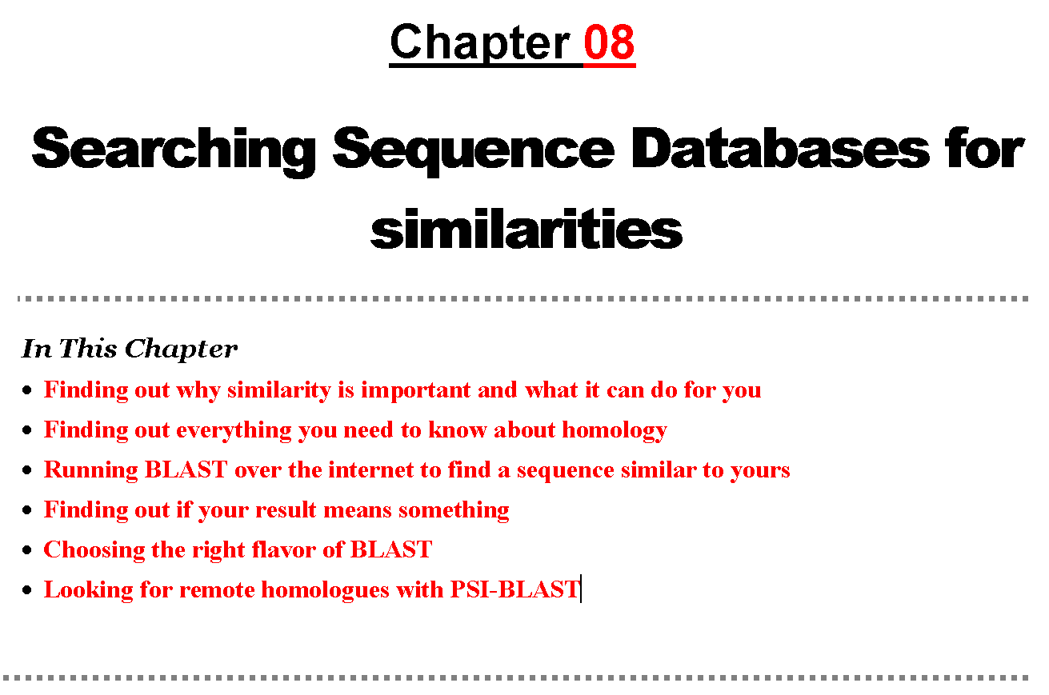

Slide 70
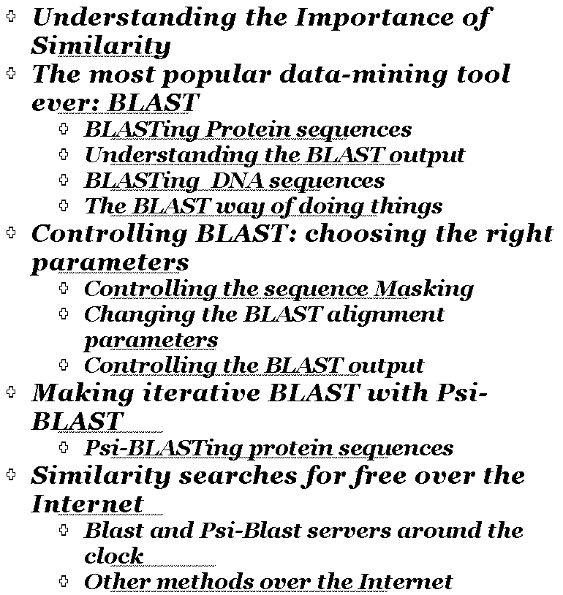

Slide 71
THE END

Slide 72
Genome Sequencing

Slide 73
Overview
Politics
Strategy
Libraries
Production
Sequencing
Assembly
Finishing
Closure
Annotation
Annotation
Release
TIME
MONEY

Slide 74
Cloning Strategies
Genome size (log Mb)
0
1
2
3
4
H.sapiens (3000 Mb)
D.melanogaster (170 Mb)
C.elegans (100Mb)
P.falciparum (30 Mb)
S.cerevisiae (14 Mb)
E.coli (4 Mb)
Whole genome shotgun (WGS)
Clone-by-clone
Whole Chromosome Shotgun (WCS)
Whole Genome Shotgun (WGS)
with Clone ‘skims’

Slide 75
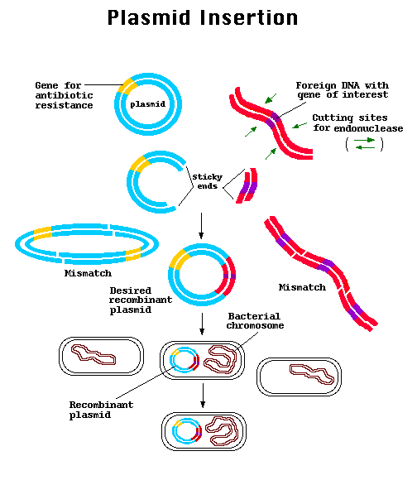
Cloning Strategies

Slide 76
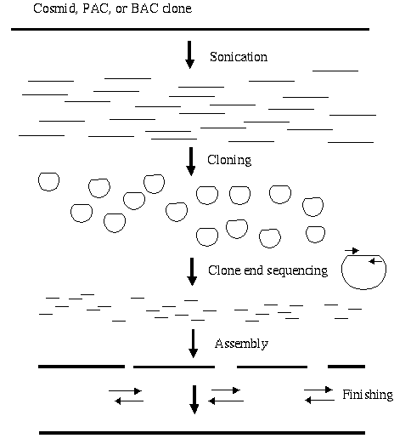
Shot Gun Sequencing

Slide 77
²

Slide 78
DNA chips

Slide 79
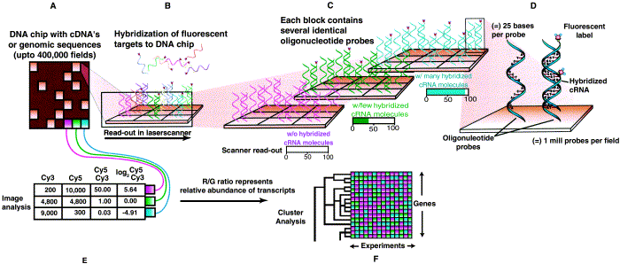
DNA chips

Slide 81
Proteomics

Slide 82
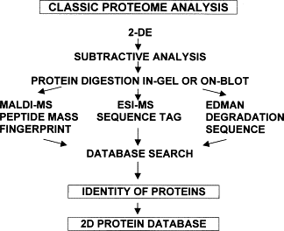
Proteomics

