Slide 1

Chemoinformatics
And
Bioinformatics
Cédric Notredame
Molecular Biology
Bioinformatics
Chemoinformatics
Chemistry

Slide 2
Bioinformatics and Chemoinformatics
Scale
Bioinformatics
Chemoinformatics
Sequences ----------(Structures)-----------Ligands/Lead
Genes
Genomes
Drugs
Proteins

Slide 3
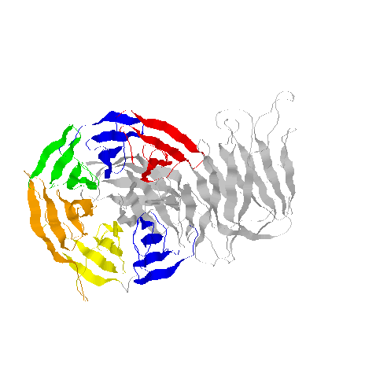
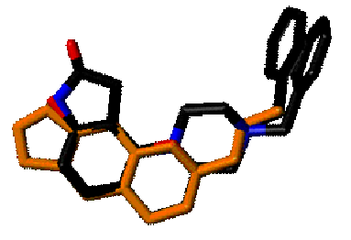
Bioinformatics and Chemoinformatics
Describing the DATA
Bioinformatics
Chemoinformatics
Sequences -----------(Structures)-----------Ligands
Chain
Atom
Each
Atom
Chain
AGCTGTCGAGGGATAGGACA
TATACATAAATTAATATAAT
SMILES, Sybyl,
Matrices…
Structure Descriptors
Strings
3D-Structure

Slide 4
Bioinformatics and Chemoinformatics
Storing the DATA
Bioinformatics
Chemoinformatics
Sequences -------------(Structures)---------------Ligands
Chain
Atom
Each
Atom
Chain
SMILES,
Sybyl,
Matrices,
descriptors
AGCTGTCGAGGGATAGGACA
TATACATAAATTAATATAAT
Strings
3D-Structure
Coordinates
Chemical
Structure
Sequence
GenBank: Genomes
PDB
CAPLUS
REGISTRY
…
Genpep/NR: proteins
SwissProt

Slide 5
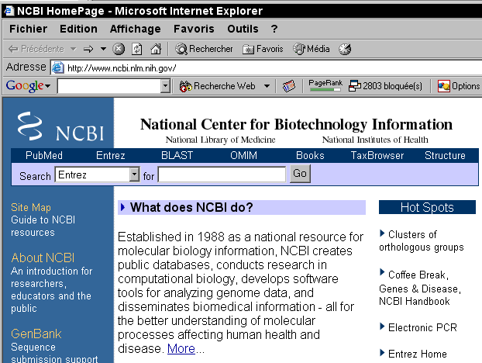
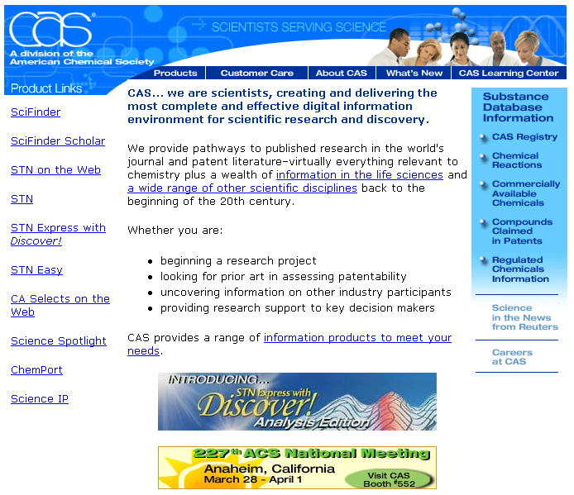
Related Techniques
Databases
Bioinformatics:
NCBI/EBI
Chemoinformatics
CAS/Beilstein/MDL
Finding the right Database
is NOT an issue as most data
are public.

Slide 6
Bioinformatics and Chemoinformatics
Comparing the DATA
Bioinformatics
Chemoinformatics
Sequences -----------(Structures)-----------Ligands
Similarity
Fold
Descriptor
Evolutionary model
3D-Model
Descriptor Similarity
Dynamic Programming
Structure/Structure
Comparison
Backtracking Algorithm
BLAST
LSQman
DALI
SAP
CACTUS
(Cactus.nci.nih.gov)

Slide 7
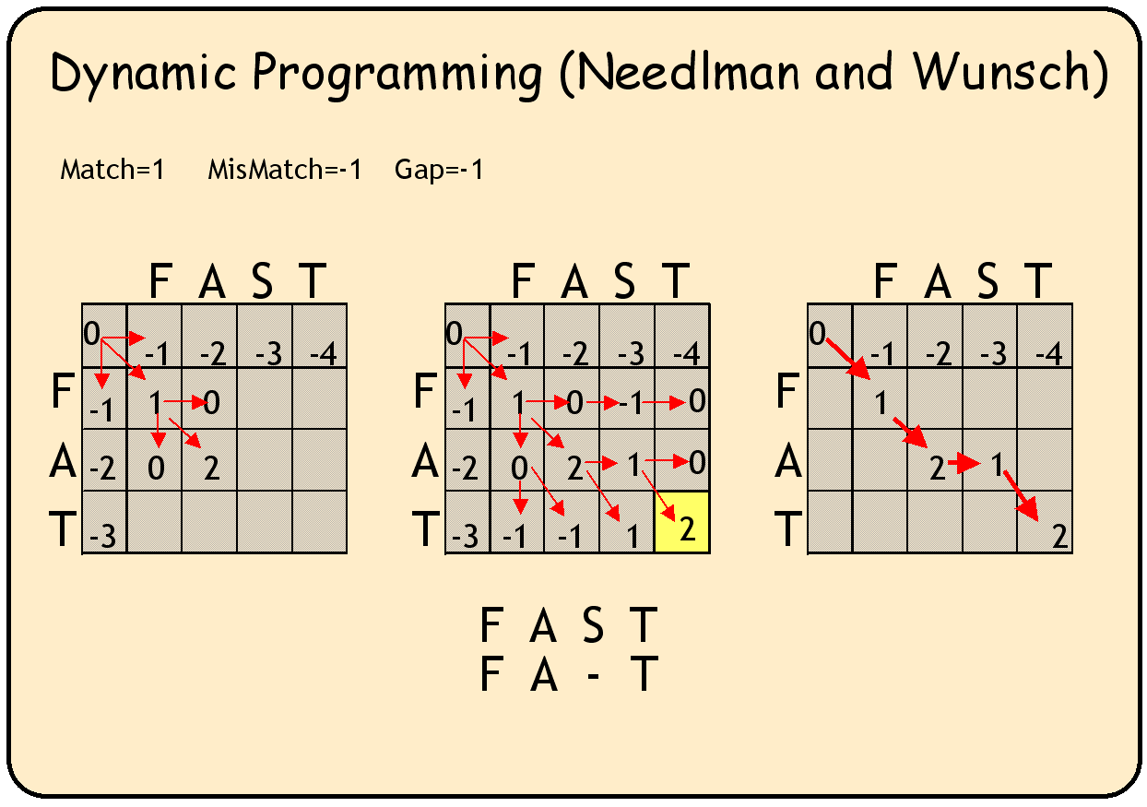
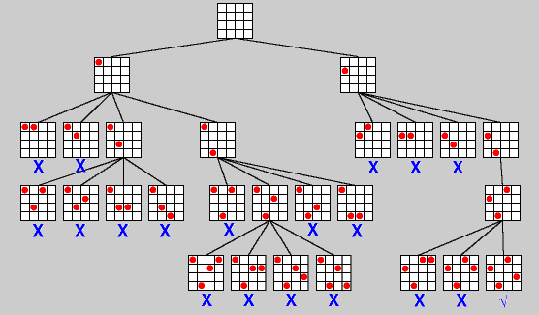
Related Techniques
Searching Databases
Bioinformatics:
Dynamic Programming
Chemoinformatics
Backtracking

Slide 8
Bioinformatics and Chemoinformatics
Building Models
Bioinformatics
Chemoinformatics
Sequences -----------(Structures)-----------Ligands
MSA
Fold
Descriptor
Multiple
Sequence
Alignments
ClustalW, TCoffee
3D-Model
Classifications
Descriptor Computation
DALI
SCOP
CAT

Slide 9
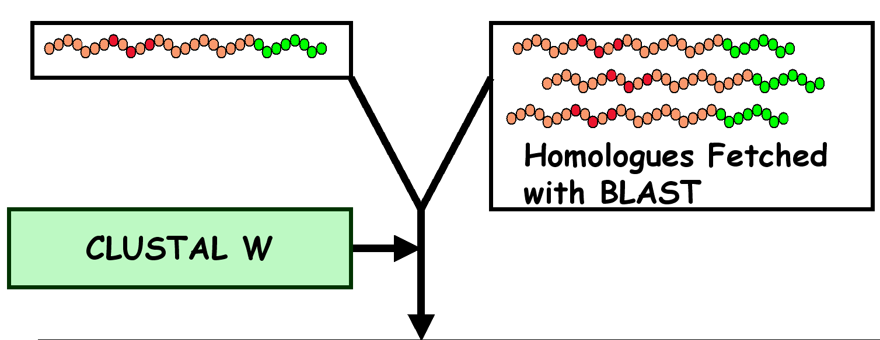
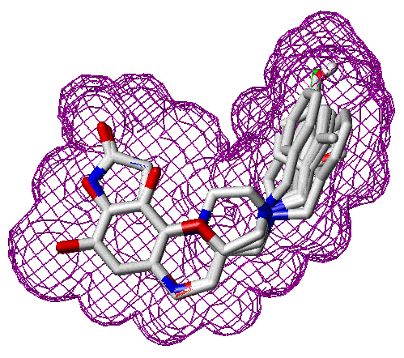
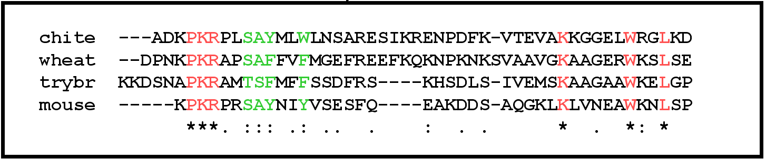
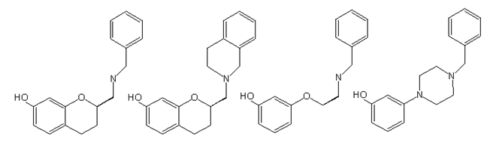
Related Techniques
Profiles
Bioinformatics:
Chemoinformatics

Slide 10
Bioinformatics and Chemoinformatics
Predicting Properties
Bioinformatics
Chemoinformatics
Sequences -----------(Structures)-----------Ligands
Function
Binding
Descriptor
Multiple Comparisons
Docking/Mecanisms
QSAR
Profiles Pfam
Molecular Dynamic
Docking Predictions
Relate descriptors to
Function
Structure
Activity/Toxicity
Phylogeny

Slide 11

Related Techniques
Profiles and Descriptors
Bioinformatics:
Chemoinformatics
Pharmacophore
Database Search
With a Profile
Database Search
With a Profile

Slide 12
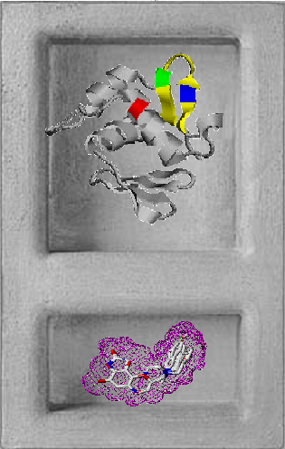
Bioinformatics/
Chemoinformatics
Each One in its Niche

Slide 13
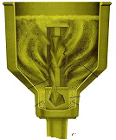
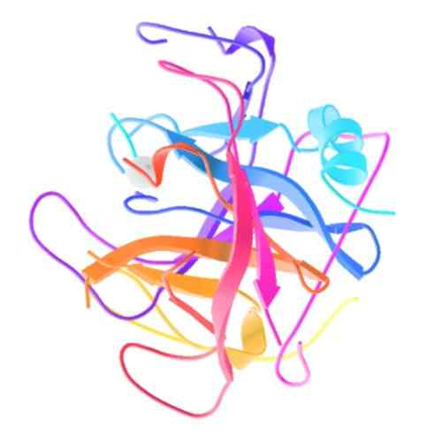
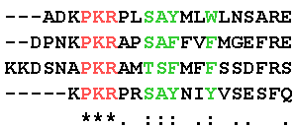
Bioinformatics and Chemoinformatics
The Questions
Bioinformatics:
Target
Chemoinformatics
Lead
Compound
Database
Target
Site

Slide 14
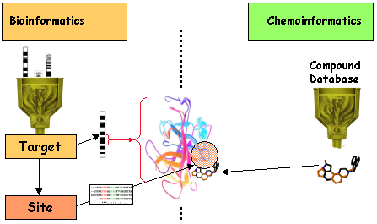
Bioinformatics and Chemoinformatics
The Questions
Evolutionary
Trace
Chemical
Modelling

Slide 15
Bioinformatics and Chemoinformatics
The Questions
Bioinformatics:
Function
Chemoinformatics
QSAR
Comparative Genomics
Quantitative
Structure-Activity
Relationship
Function
Activity/Toxicity

Slide 16
Bioinformatics and Chemoinformatics
The Questions
Bioinformatics:
Target
Chemoinformatics
Lead
Comparative Genomics
Molecular Dynamic
2D/3D QSAR
Molecular Dynamic
Docking
In Silico Screening

Slide 17
Bioinformatics and Chemoinformatics
The Algorithms
Bioinformatics:
Target
Chemoinformatics
Lead
Graph Theory
Neural Networks
Genetic Algorithms
Dynamic Programming
Backtrace
Hidden Markov Models

Slide 18

Bioinformatics/
Chemoinformatics
Where Do They Meet

Slide 19
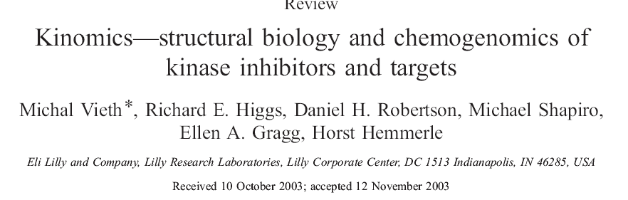

Homology based SAR predictions

Slide 20
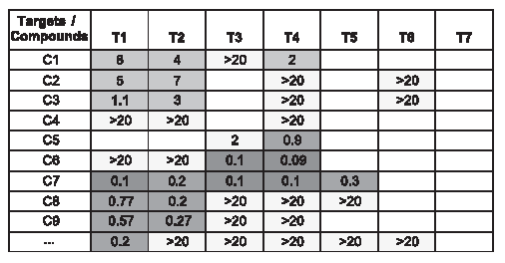
Homology based SAR predictions
SAR Matrices contain affinity Data

Slide 21
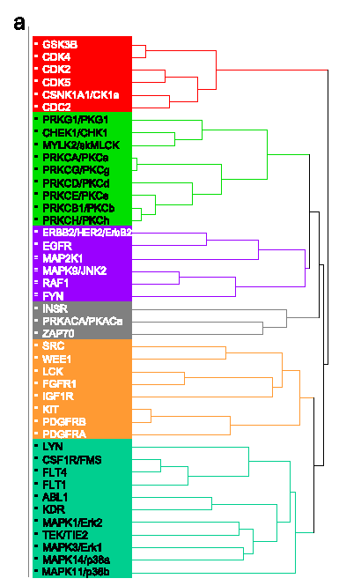
Homology based SAR predictions
Targets can be clustered from the SAR Data

Slide 22
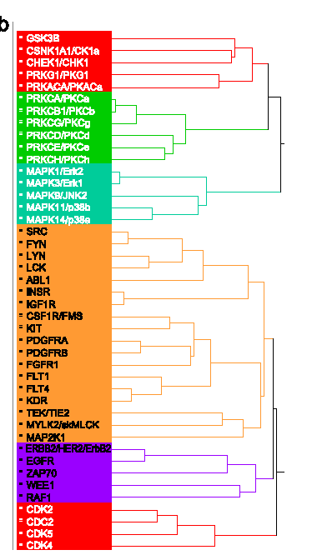

Homology based SAR predictions
Targets can be clustered using similarity

Slide 23
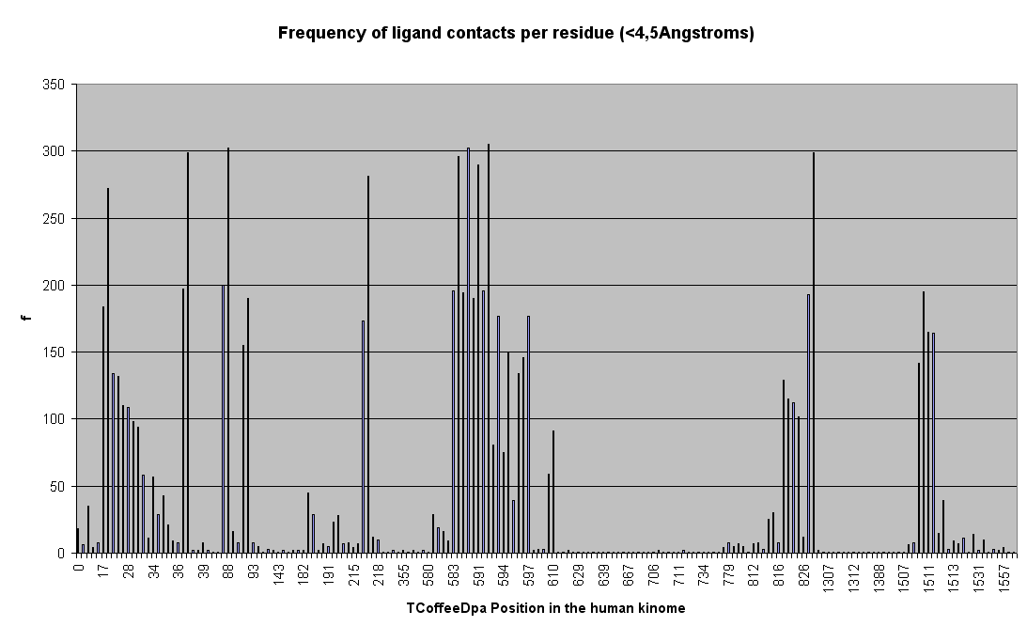
Homology based SAR predictions
Sequence Clustering Can be done using Key positions

Slide 24
Homology based SAR predictions
Sequence Clustering Can be done using Key positions

Slide 25
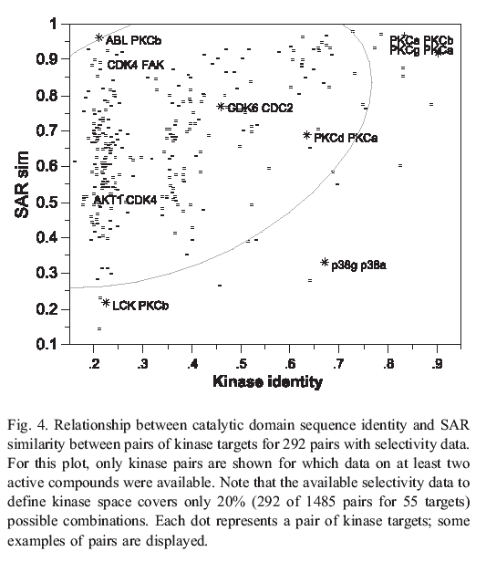
Homology based SAR predictions
Does it Work ???
  Clustering Based
  on Active Site
  Residues

Slide 26
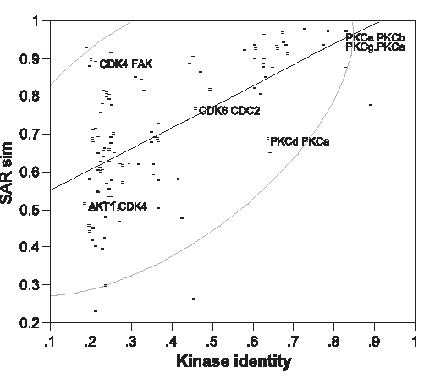

Homology based SAR predictions
  Pairs of
  Comparable Kinases

Slide 27

Bioinformatics/
Chemoinformatics
Main Differences ?

Slide 28
Bioinformatics and Chemoinformatics
Bioinformatics:
Chemoinformatics
Macro-molecules
Small Molecules
Evolutionary Signal
Chemical Modelling

