Slide 1

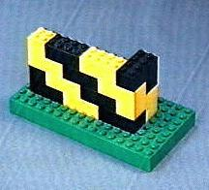
An Introduction to
Multiple Sequence Alignments
Cédric Notredame

Slide 2

chite ---ADKPKRPLSAYMLWLNSARESIKRENPDFK-VTEVAKKGGELWRGLKD
wheat --DPNKPKRAPSAFFVFMGEFREEFKQKNPKNKSVAAVGKAAGERWKSLSE
trybr KKDSNAPKRAMTSFMFFSSDFRS----KHSDLS-IVEMSKAAGAAWKELGP
mouse -----KPKRPRSAYNIYVSESFQ----EAKDDS-AQGKLKLVNEAWKNLSP
***. ::: .: .. . : . . * . *: *
chite AATAKQNYIRALQEYERNGG-
wheat ANKLKGEYNKAIAAYNKGESA
trybr AEKDKERYKREM---------
mouse AKDDRIRYDNEMKSWEEQMAE
* : .* . :

Slide 3
Manguel M, Samaniego F.J.,
Abraham Wald’s Work on Aircraft Suvivability,
J. American Statistical Association. 79, 259-270, (1984)

Slide 4

How Can I Use A Multiple Sequence Alignment?
chite ---ADKPKRPLSAYMLWLNSARESIKRENPDFK-VTEVAKKGGELWRGLKD
wheat --DPNKPKRAPSAFFVFMGEFREEFKQKNPKNKSVAAVGKAAGERWKSLSE
trybr KKDSNAPKRAMTSFMFFSSDFRS----KHSDLS-IVEMSKAAGAAWKELGP
unknown -----KPKRPRSAYNIYVSESFQ----EAKDDS-AQGKLKLVNEAWKNLSP
***. ::: .: .. . : . . * . *: *
chite AATAKQNYIRALQEYERNGG-
wheat ANKLKGEYNKAIAAYNKGESA
trybr AEKDKERYKREM---------
unknown AKDDRIRYDNEMKSWEEQMAE
* : .* . :
Less Than 30 % id
BUT
Conserved where it MATTERS
Extrapolation Beyond The Twilight Zone
Homology?
SwissProt
Unkown Sequence

Slide 5
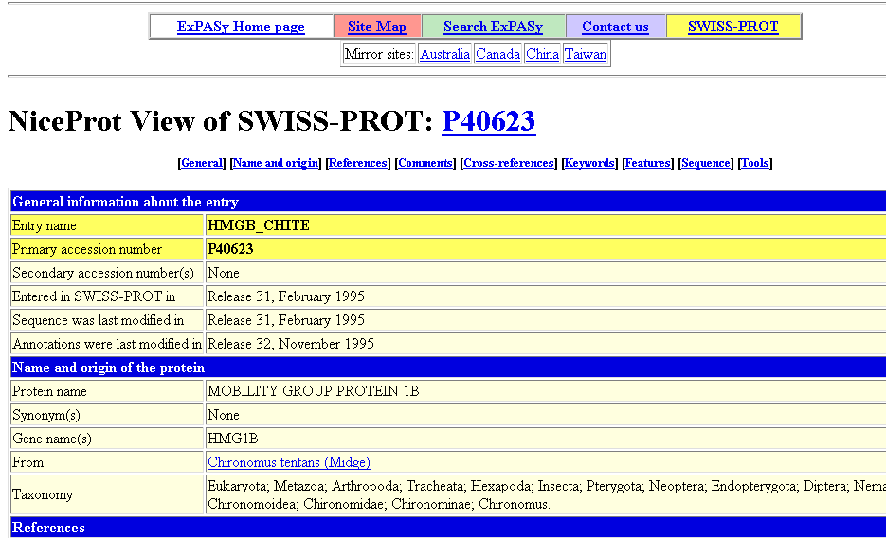
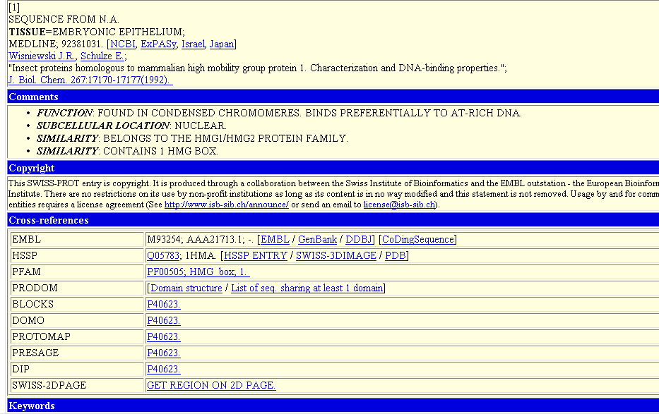
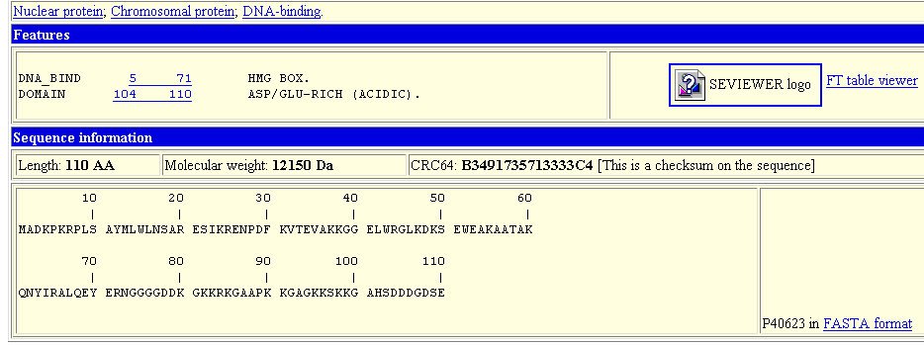

Slide 6
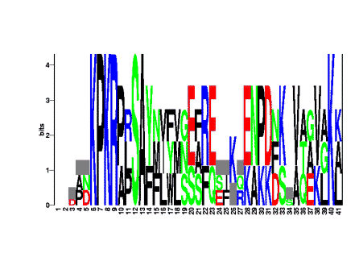
How Can I Use A Multiple Sequence Alignment?
chite ---ADKPKRPLSAYMLWLNSARESIKRENPDFK-VTEVAKKGGELWRGLKD
wheat --DPNKPKRAPSAFFVFMGEFREEFKQKNPKNKSVAAVGKAAGERWKSLSE
trybr KKDSNAPKRAMTSFMFFSSDFRS----KHSDLS-IVEMSKAAGAAWKELGP
mouse -----KPKRPRSAYNIYVSESFQ----EAKDDS-AQGKLKLVNEAWKNLSP
***. ::: .: .. . : . . * . *: *
chite AATAKQNYIRALQEYERNGG-
wheat ANKLKGEYNKAIAAYNKGESA
trybr AEKDKERYKREM---------
mouse AKDDRIRYDNEMKSWEEQMAE
* : .* . :
Extrapolation
Prosite Patterns

Slide 7
How Can I Use A Multiple Sequence Alignment?
chite ---ADKPKRPLSAYMLWLNSARESIKRENPDFK-VTEVAKKGGELWRGLKD
wheat --DPNKPKRAPSAFFVFMGEFREEFKQKNPKNKSVAAVGKAAGERWKSLSE
trybr KKDSNAPKRAMTSFMFFSSDFRS----KHSDLS-IVEMSKAAGAAWKELGP
mouse -----KPKRPRSAYNIYVSESFQ----EAKDDS-AQGKLKLVNEAWKNLSP
***. ::: .: .. . : . . * . *: *
chite AATAKQNYIRALQEYERNGG-
wheat ANKLKGEYNKAIAAYNKGESA
trybr AEKDKERYKREM---------
mouse AKDDRIRYDNEMKSWEEQMAE
* : .* . :
Extrapolation
P-K-R-[PA]-x(1)-[ST]…
Prosite Patterns

Slide 8
How Can I Use A Multiple Sequence Alignment?
chite ---ADKPKRPLSAYMLWLNSARESIKRENPDFK-VTEVAKKGGELWRGLKD
wheat --DPNKPKRAPSAFFVFMGEFREEFKQKNPKNKSVAAVGKAAGERWKSLSE
trybr KKDSNAPKRAMTSFMFFSSDFRS----KHSDLS-IVEMSKAAGAAWKELGP
mouse -----KPKRPRSAYNIYVSESFQ----EAKDDS-AQGKLKLVNEAWKNLSP
***. ::: .: .. . : . . * . *: *
chite AATAKQNYIRALQEYERNGG-
wheat ANKLKGEYNKAIAAYNKGESA
trybr AEKDKERYKREM---------
mouse AKDDRIRYDNEMKSWEEQMAE
* : .* . :
Extrapolation
Prosite Patterns
SwissProt
Uncharacterised Signature
Match?

Slide 9
How Can I Use A Multiple Sequence Alignment?
chite ---ADKPKRPLSAYMLWLNSARESIKRENPDFK-VTEVAKKGGELWRGLKD
wheat --DPNKPKRAPSAFFVFMGEFREEFKQKNPKNKSVAAVGKAAGERWKSLSE
trybr KKDSNAPKRAMTSFMFFSSDFRS----KHSDLS-IVEMSKAAGAAWKELGP
mouse -----KPKRPRSAYNIYVSESFQ----EAKDDS-IQGKLKLVNEAWKNLSP
***. ::: .: .. . : . . * . *: *
chite AATAKQNYIRALQEYERNGG-
wheat ANKLKGEYNKAIAAYNKGESA
trybr AEKDKERYKREM---------
mouse AKDDRIRYDNEMKSWEEQMAE
* : .* . :
L?
K>R
Extrapolation
A
F
D
Prosite Patterns
E
F
G
H
Q
Profiles And HMMs
I
V
L
W
-More Sensitive
-More Specific

Slide 10
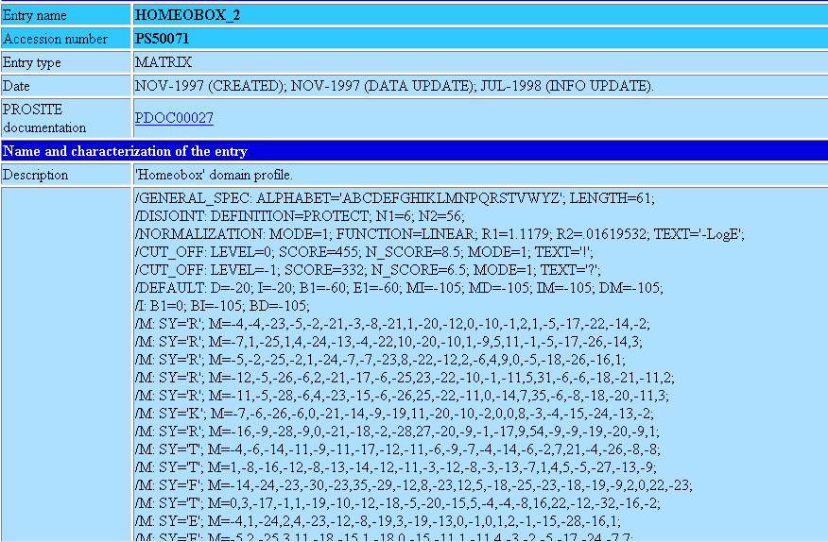
A PROSITE PROFILE
A Substitution Cost For Every Amino Acid, At Every Position

Slide 11
How Can I Use A Multiple Sequence Alignment?
chite ---ADKPKRPLSAYMLWLNSARESIKRENPDFK-VTEVAKKGGELWRGLKD
wheat --DPNKPKRAPSAFFVFMGEFREEFKQKNPKNKSVAAVGKAAGERWKSLSE
trybr KKDSNAPKRAMTSFMFFSSDFRS----KHSDLS-IVEMSKAAGAAWKELGP
mouse -----KPKRPRSAYNIYVSESFQ----EAKDDS-AQGKLKLVNEAWKNLSP
***. ::: .: .. . : . . * . *: *
chite AATAKQNYIRALQEYERNGG-
wheat ANKLKGEYNKAIAAYNKGESA
trybr AEKDKERYKREM---------
mouse AKDDRIRYDNEMKSWEEQMAE
* : .* . :
Extrapolation
chite
wheat
Motifs/Patterns
trybr
Profiles
mouse
-Evolution
-Paralogy/Orthology
Phylogeny

Slide 12
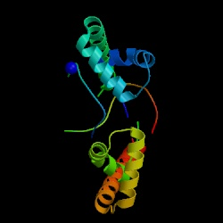
How Can I Use A Multiple Sequence Alignment?
chite ---ADKPKRPLSAYMLWLNSARESIKRENPDFK-VTEVAKKGGELWRGLKD
wheat --DPNKPKRAPSAFFVFMGEFREEFKQKNPKNKSVAAVGKAAGERWKSLSE
trybr KKDSNAPKRAMTSFMFFSSDFRS----KHSDLS-IVEMSKAAGAAWKELGP
mouse -----KPKRPRSAYNIYVSESFQ----EAKDDS-AQGKLKLVNEAWKNLSP
***. ::: .: .. . : . . * . *: *
chite AATAKQNYIRALQEYERNGG-
wheat ANKLKGEYNKAIAAYNKGESA
trybr AEKDKERYKREM---------
mouse AKDDRIRYDNEMKSWEEQMAE
* : .* . :
Extrapolation
Column Constraint
⬄
Evolution Constraint
⬄
Structure Constraint
Motifs/Patterns
Profiles
Phylogeny
Struc. Prediction

Slide 13
How Can I Use A Multiple Sequence Alignment?
chite ---ADKPKRPLSAYMLWLNSARESIKRENPDFK-VTEVAKKGGELWRGLKD
wheat --DPNKPKRAPSAFFVFMGEFREEFKQKNPKNKSVAAVGKAAGERWKSLSE
trybr KKDSNAPKRAMTSFMFFSSDFRS----KHSDLS-IVEMSKAAGAAWKELGP
mouse -----KPKRPRSAYNIYVSESFQ----EAKDDS-AQGKLKLVNEAWKNLSP
***. ::: .: .. . : . . * . *: *
chite AATAKQNYIRALQEYERNGG-
wheat ANKLKGEYNKAIAAYNKGESA
trybr AEKDKERYKREM---------
mouse AKDDRIRYDNEMKSWEEQMAE
* : .* . :
Extrapolation
PsiPred OR PhD For secondary
Structure Prediction:
75% Accurate.
Motifs/Patterns
Profiles
Threading: is improving
but is not yet as good.
Phylogeny
Struc. Prediction

Slide 14


How Can I Use A Multiple Sequence Alignment?
chite ---ADKPKRPLSAYMLWLNSARESIKRENPDFK-VTEVAKKGGELWRGLKD
wheat --DPNKPKRAPSAFFVFMGEFREEFKQKNPKNKSVAAVGKAAGERWKSLSE
trybr KKDSNAPKRAMTSFMFFSSDFRS----KHSDLS-IVEMSKAAGAAWKELGP
mouse -----KPKRPRSAYNIYVSESFQ----EAKDDS-AQGKLKLVNEAWKNLSP
***. ::: .: .. . : . . * . *: *
chite AATAKQNYIRALQEYERNGG-
wheat ANKLKGEYNKAIAAYNKGESA
trybr AEKDKERYKREM---------
mouse AKDDRIRYDNEMKSWEEQMAE
* : .* . :
Automatic Multiple
Sequence Alignment methods
are not always perfect…
You know better…
With your big BRAIN

Slide 15
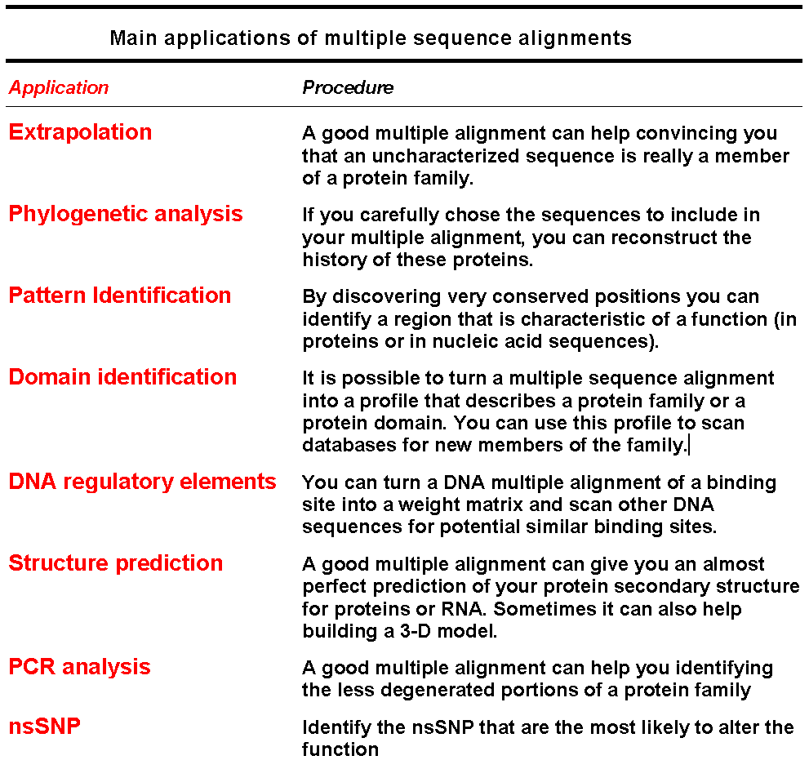

Slide 16


Why Is It Difficult To Compute A multiple Sequence Alignment?
A CROSSROAD PROBLEM
BIOLOGY:
What is A Good Alignment
COMPUTATION
What is THE Good Alignment
chite ---ADKPKRPLSAYMLWLNSARESIKRENPDFK-VTEVAKKGGELWRGLKD
wheat --DPNKPKRAPSAFFVFMGEFREEFKQKNPKNKSVAAVGKAAGERWKSLSE
trybr KKDSNAPKRAMTSFMFFSSDFRS----KHSDLS-IVEMSKAAGAAWKELGP
mouse -----KPKRPRSAYNIYVSESFQ----EAKDDS-AQGKLKLVNEAWKNLSP
***. ::: .: .. . : . . * . *: *

Slide 17
Why Is It Difficult To Compute A multiple Sequence Alignment ?
BIOLOGY
COMPUTATION
CIRCULAR PROBLEM....
Good
Good
Sequences
Alignment

Slide 18
The Progressive Multiple Alignment Algorithm
(Clustal W)

Slide 19
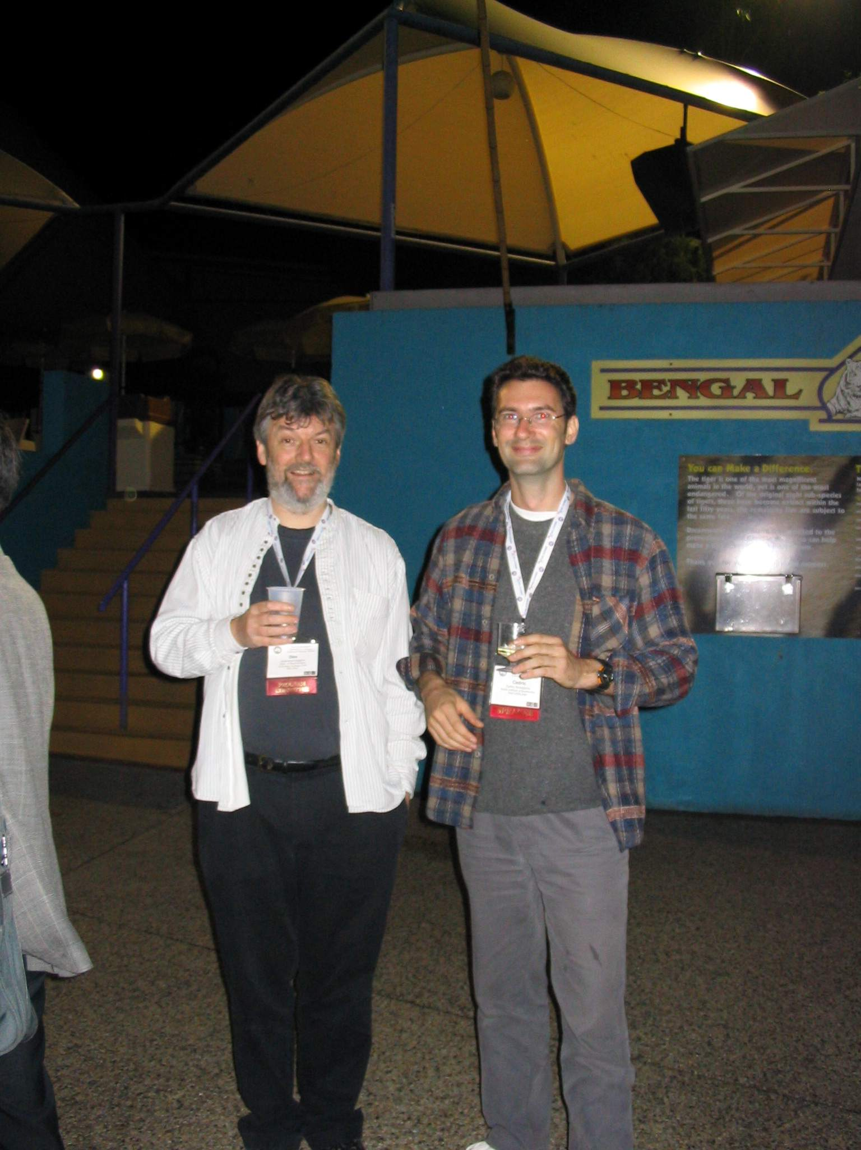

Slide 20
Making An Alignment
Any Exact Method would be TOO SLOW
We will use a Heuristic Algorithm.
Progressive Alignment Algorithm is the most Popular
-ClustalW
-Greedy Heuristic (No Guarranty).
-Fast

Slide 21

Progressive Alignment
Feng and Dolittle, 1988; Taylor 1989
Clustering

Slide 22
Progressive Alignment
Dynamic Programming Using A Substitution Matrix

Slide 23
Progressive Alignment
-Depends on the CHOICE of the sequences.
-Depends on the ORDER of the sequences (Tree).
-Depends on the PARAMETERS:
        Substitution Matrix.
        Penalties (Gop, Gep).
        Sequence Weight.
        Tree making Algorithm.

Slide 24
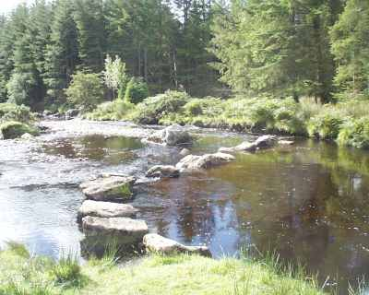
Progressive Alignment
When Does It Work
Works Well When Phylogeny is Dense
No outlayer Sequence.
Image: River Crossing

Slide 25
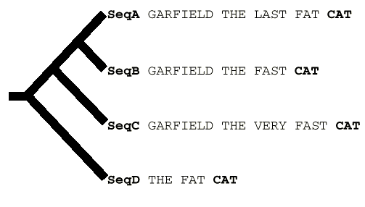
Progressive Alignment
When Doesn’t It Work
CLUSTALW (Score=20, Gop=-1, Gep=0, M=1)
SeqA GARFIELD THE LAST FA-T CAT
SeqB GARFIELD THE FAST CA-T ---
SeqC GARFIELD THE VERY FAST CAT
SeqD -------- THE ---- FA-T CAT
CORRECT (Score=24)
SeqA GARFIELD THE LAST FA-T CAT
SeqB GARFIELD THE FAST ---- CAT
SeqC GARFIELD THE VERY FAST CAT
SeqD -------- THE ---- FA-T CAT

Slide 26
GARFIELD THE LAST FAT CAT
GARFIELD THE LAST FAT CAT
GARFIELD THE FAST CAT ---
GARFIELD THE FAST CAT
GARFIELD THE LAST FA-T CAT
GARFIELD THE FAST CA-T ---
GARFIELD THE VERY FAST CAT
-------- THE ---- FA-T CAT
GARFIELD THE VERY FAST CAT
GARFIELD THE VERY FAST CAT
-------- THE ---- FA-T CAT
THE FAT CAT

Slide 27
Consistency
Based
Alignments
With
T-Coffee

Slide 28
T-Coffee and Concistency…
SeqA GARFIELD THE LAST FAT CAT Prim. Weight =88
SeqB GARFIELD THE FAST CAT ---
SeqA GARFIELD THE LAST FA-T CAT Prim. Weight =77
SeqC GARFIELD THE VERY FAST CAT
SeqA GARFIELD THE LAST FAT CAT Prim. Weight =100
SeqD -------- THE ---- FAT CAT
SeqB GARFIELD THE ---- FAST CAT Prim. Weight =100
SeqC GARFIELD THE VERY FAST CAT
SeqC GARFIELD THE VERY FAST CAT Prim. Weight =100
SeqD -------- THE ---- FA-T CAT

Slide 29
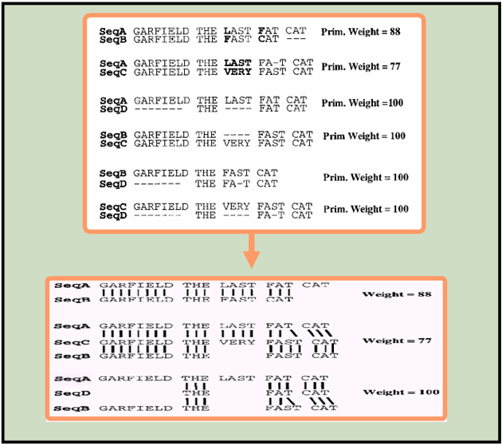
T-Coffee and Concistency…
SeqA GARFIELD THE LAST FAT CAT Prim. Weight =88
SeqB GARFIELD THE FAST CAT ---
SeqA GARFIELD THE LAST FA-T CAT Prim. Weight =77
SeqC GARFIELD THE VERY FAST CAT
SeqA GARFIELD THE LAST FAT CAT Prim. Weight =100
SeqD -------- THE ---- FAT CAT
SeqB GARFIELD THE ---- FAST CAT Prim. Weight =100
SeqC GARFIELD THE VERY FAST CAT
SeqC GARFIELD THE VERY FAST CAT Prim. Weight =100
SeqD -------- THE ---- FA-T CAT
SeqA GARFIELD THE LAST FAT CAT Weight =88
SeqB GARFIELD THE FAST CAT ---
SeqA GARFIELD THE LAST FA-T CAT Weight =77
SeqC GARFIELD THE VERY FAST CAT
SeqB GARFIELD THE ---- FAST CAT
SeqA GARFIELD THE LAST FA-T CAT Weight =100
SeqD -------- THE ---- FA-T CAT
SeqB GARFIELD THE ---- FAST CAT

Slide 30
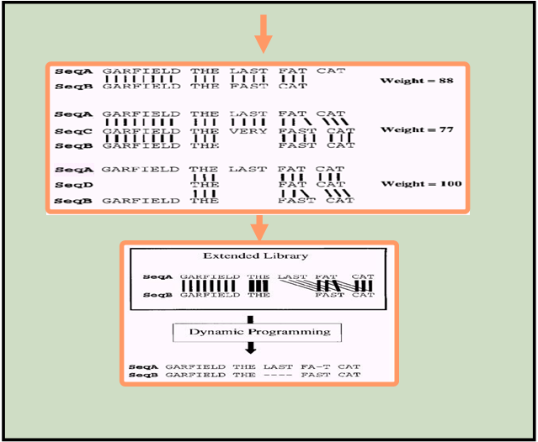
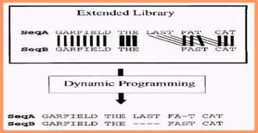
T-Coffee and Concistency…
SeqA GARFIELD THE LAST FAT CAT Weight =88
SeqB GARFIELD THE FAST CAT ---
SeqA GARFIELD THE LAST FA-T CAT Weight =77
SeqC GARFIELD THE VERY FAST CAT
SeqB GARFIELD THE ---- FAST CAT
SeqA GARFIELD THE LAST FA-T CAT Weight =100
SeqD -------- THE ---- FA-T CAT
SeqB GARFIELD THE ---- FAST CAT

Slide 31
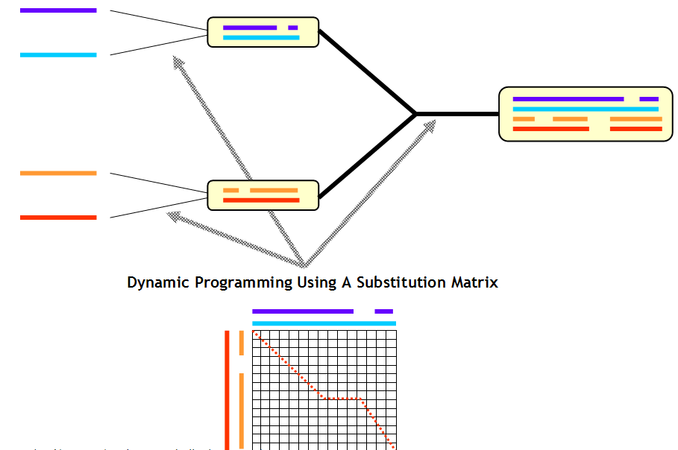
T-Coffee and Concistency…

Slide 32
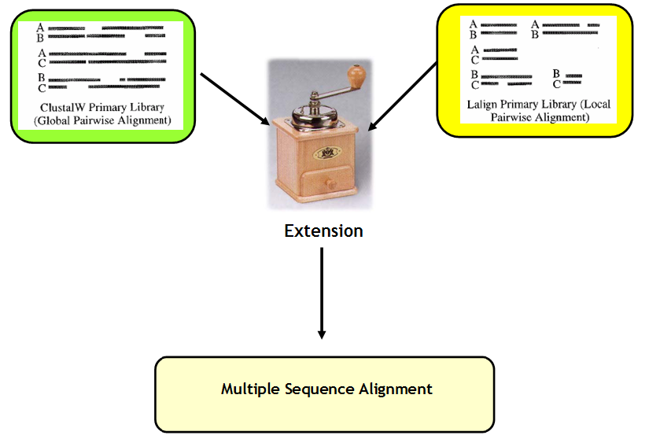
T-Coffee and Concistency…

Slide 33
Mixing Methods
With
T-Coffee

Slide 34
Choosing the right modeling method
M-Coffee

Slide 35
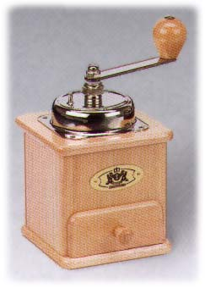
Combining Many MSAs into ONE
ClustalW
MAFFT
T-Coffee
MUSCLE
???????

Slide 36
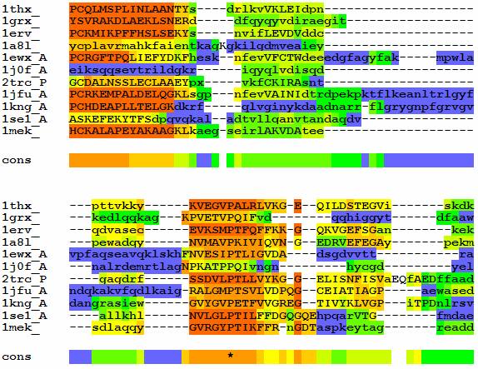
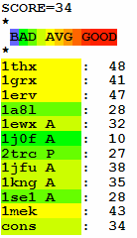
Consistency and Accuracy

Slide 37
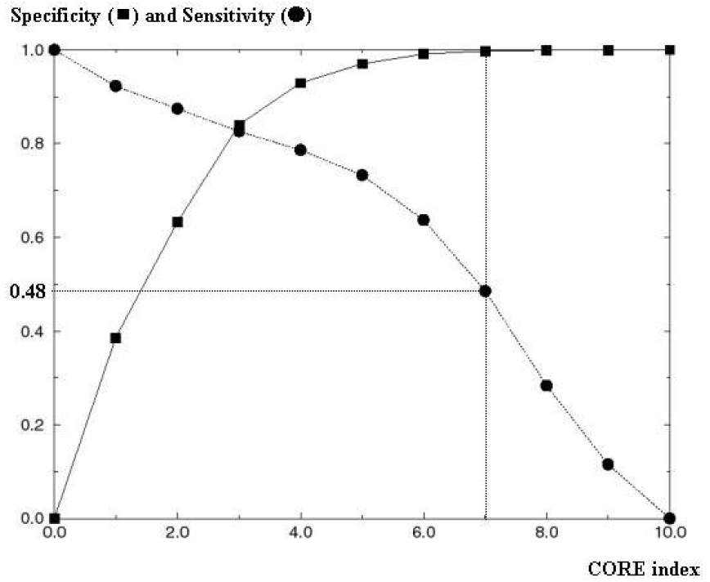
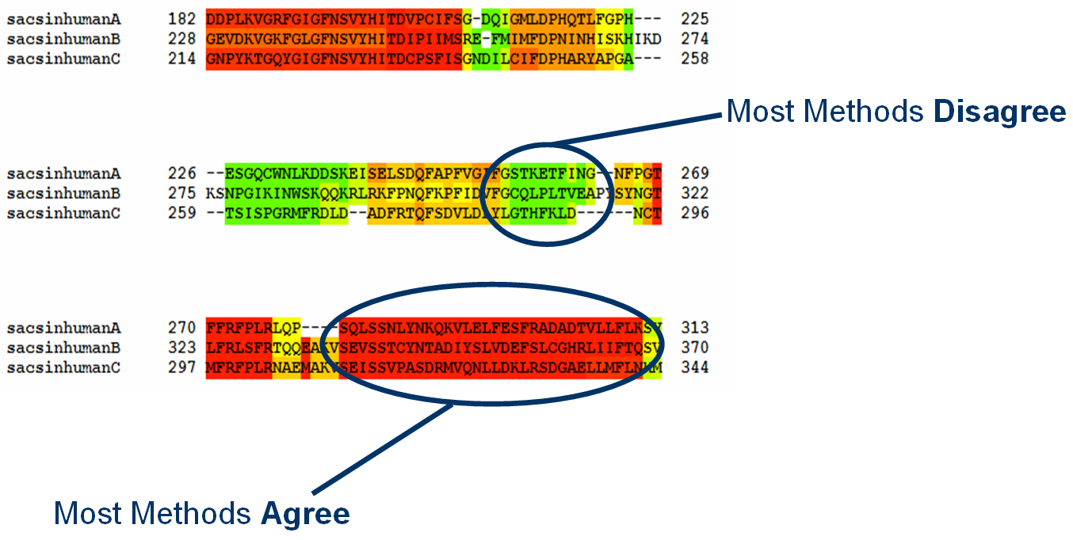
What To Do Without Structures

Slide 38
Integrating New Types of Data
Template Based Sequence
Alignments

Slide 39
Templates
Templates
Template
Aligner
TARGET
TARGET
TARGET
Experimental
Data
…
Experimental
Data
…
Template Alignment
Template-Sequence Alignment
Template based Alignment
of the Sequences
Primary Library

Slide 40
Exploring The Template World
Template | Generator | Alignment Method
RNA Structure | Prediction | RNA Aligner
Protein Structure | BLAST vs PDB | 3D Aligner
Profile | BLAST vs NR | Profile/Profile Alignment
Gene Structure | ENSEMBL | Genome Aligner
Promoter | Transfac | Meta-Aligner

Slide 41
Exploring The Template World
Template | Generator | Alignment Method | Mode
RNA Structure | Prediction | RNA Aligner | R-Coffee
Protein Structure | BLAST /PDB | 3D Aligner | 3D-Coffee
Profile | BLAST/NR | Profile/Profile | PSI-Coffee
Gene Structure | ENSEMBL | Genome Aligner | Exoset
Promoter | Transfac | Meta-Aligner | Meta-Coffee

Slide 42
3D-Coffee/Expresso
Incorporating
Structural Information

Slide 43
Expresso: Finding the Right Structure
Sources
BLAST
BLAST
SAP
Templates
Templates
Template Alignment
Source Template Alignment
Remove Templates
Library

Slide 44
PSI-Coffee
Homology Extension

Slide 45
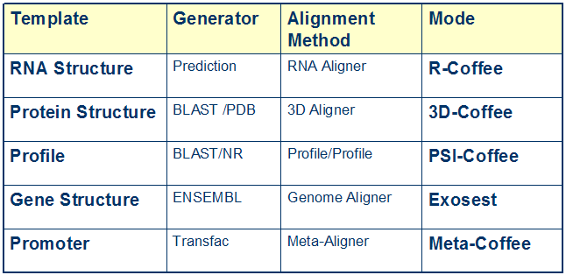
Exploring The Template World

Slide 46
What is Homology Extension ?
-Simple scoring schemes result in alignment ambiguities
L
?
L
L

Slide 47
What is Homology Extension ?
L
L
L
Profile 1
L
L
L
L
L
L
L
L
L
L
I
L
V
L
Profile 2
I
L
L
L

Slide 48
What is Homology Extension ?
L
L
L
Profile 1
L
L
L
L
L
L
L
L
L
L
I
L
V
L
Profile 2
I
L
L
L

Slide 49
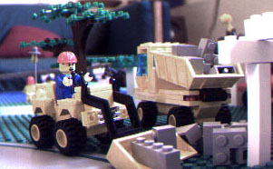
Building the Right Multiple Sequence Alignment.

Slide 50
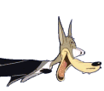
Recognizing The Right Sequences When you Meet Them…

Slide 51
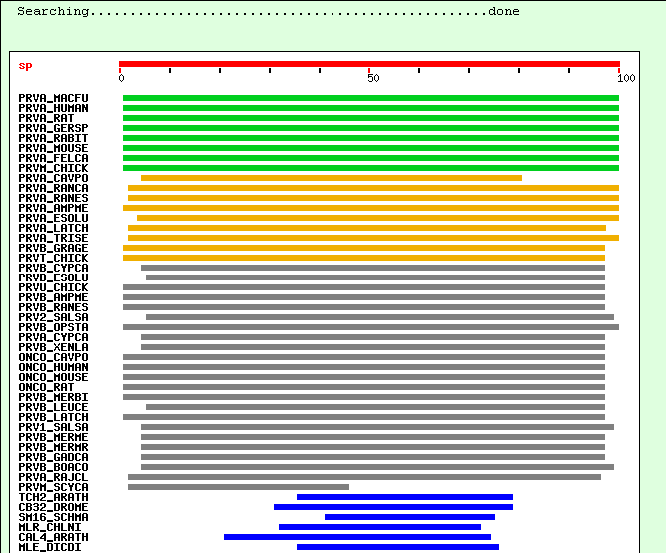
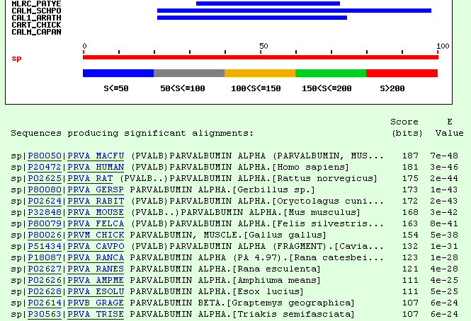
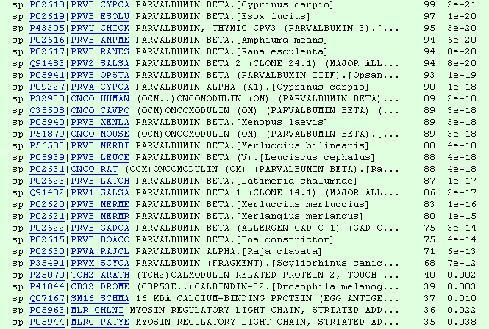
Gathering Sequences: BLAST

Slide 52
Common Mistake:
Sequences Too Closely Related
PRVA_MACFU SMTDLLNAEDIKKAVGAFSAIDSFDHKKFFQMVGLKKKSADDVKKVFHILDKDKSGFIEE
PRVA_HUMAN SMTDLLNAEDIKKAVGAFSATDSFDHKKFFQMVGLKKKSADDVKKVFHMLDKDKSGFIEE
PRVA_GERSP SMTDLLSAEDIKKAIGAFAAADSFDHKKFFQMVGLKKKTPDDVKKVFHILDKDKSGFIEE
PRVA_MOUSE SMTDVLSAEDIKKAIGAFAAADSFDHKKFFQMVGLKKKNPDEVKKVFHILDKDKSGFIEE
PRVA_RAT SMTDLLSAEDIKKAIGAFTAADSFDHKKFFQMVGLKKKSADDVKKVFHILDKDKSGFIEE
PRVA_RABIT AMTELLNAEDIKKAIGAFAAAESFDHKKFFQMVGLKKKSTEDVKKVFHILDKDKSGFIEE
:**::*.*******:***:* :****************..::******:***********
PRVA_MACFU DELGFILKGFSPDARDLSAKETKTLMAAGDKDGDGKIGVDEFSTLVAES
PRVA_HUMAN DELGFILKGFSPDARDLSAKETKMLMAAGDKDGDGKIGVDEFSTLVAES
PRVA_GERSP DELGFILKGFSSDARDLSAKETKTLLAAGDKDGDGKIGVEEFSTLVSES
PRVA_MOUSE DELGSILKGFSSDARDLSAKETKTLLAAGDKDGDGKIGVEEFSTLVAES
PRVA_RAT DELGSILKGFSSDARDLSAKETKTLMAAGDKDGDGKIGVEEFSTLVAES
PRVA_RABIT EELGFILKGFSPDARDLSVKETKTLMAAGDKDGDGKIGADEFSTLVSES
:*** ******.******.**** *:************.:******:**
-IDENTICAL SEQUENCES BRING NO INFORMATION FOR THE MULTIPLE SEQUENCE ALIGNMENT
-MULTIPLE SEQUENCE ALIGNMENTS THRIVE ON DIVERSITY…

Slide 53
Selecting Diverse Sequences (Opus II)

Slide 54
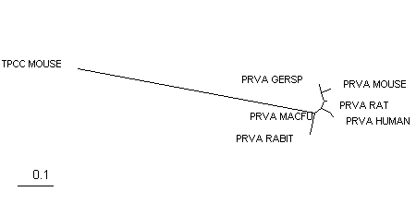
Respect Information!
PRVA_MACFU ------------------------------------------SMTDLLN----AEDIKKA
PRVA_HUMAN ------------------------------------------SMTDLLN----AEDIKKA
PRVA_GERSP ------------------------------------------SMTDLLS----AEDIKKA
PRVA_MOUSE ------------------------------------------SMTDVLS----AEDIKKA
PRVA_RAT ------------------------------------------SMTDLLS----AEDIKKA
PRVA_RABIT ------------------------------------------AMTELLN----AEDIKKA
TPCC_MOUSE MDDIYKAAVEQLTEEQKNEFKAAFDIFVLGAEDGCISTKELGKVMRMLGQNPTPEELQEM
: :*. .*::::
PRVA_MACFU VGAFSAIDS--FDHKKFFQMVG------LKKKSADDVKKVFHILDKDKSGFIEEDELGFI
PRVA_HUMAN VGAFSATDS--FDHKKFFQMVG------LKKKSADDVKKVFHMLDKDKSGFIEEDELGFI
PRVA_GERSP IGAFAAADS--FDHKKFFQMVG------LKKKTPDDVKKVFHILDKDKSGFIEEDELGFI
PRVA_MOUSE IGAFAAADS--FDHKKFFQMVG------LKKKNPDEVKKVFHILDKDKSGFIEEDELGSI
PRVA_RAT IGAFTAADS--FDHKKFFQMVG------LKKKSADDVKKVFHILDKDKSGFIEEDELGSI
PRVA_RABIT IGAFAAAES--FDHKKFFQMVG------LKKKSTEDVKKVFHILDKDKSGFIEEEELGFI
TPCC_MOUSE IDEVDEDGSGTVDFDEFLVMMVRCMKDDSKGKSEEELSDLFRMFDKNADGYIDLDELKMM
This Alignment Is not Informative about the relation Betwwen TPCC MOUSE and the rest of the sequences.
-A better Spread of the Sequences is needed

Slide 55
Selecting Diverse Sequences (Opus II)

Slide 56
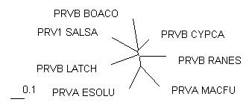
Selecting Diverse Sequences (Opus II)
PRVB_CYPCA -AFAGVLNDADIAAALEACKAADSFNHKAFFAKVGLTSKSADDVKKAFAIIDQDKSGFIE
PRVB_BOACO -AFAGILSDADIAAGLQSCQAADSFSCKTFFAKSGLHSKSKDQLTKVFGVIDRDKSGYIE
PRV1_SALSA MACAHLCKEADIKTALEACKAADTFSFKTFFHTIGFASKSADDVKKAFKVIDQDASGFIE
PRVB_LATCH -AVAKLLAAADVTAALEGCKADDSFNHKVFFQKTGLAKKSNEELEAIFKILDQDKSGFIE
PRVB_RANES -SITDIVSEKDIDAALESVKAAGSFNYKIFFQKVGLAGKSAADAKKVFEILDRDKSGFIE
PRVA_MACFU -SMTDLLNAEDIKKAVGAFSAIDSFDHKKFFQMVGLKKKSADDVKKVFHILDKDKSGFIE
PRVA_ESOLU --AKDLLKADDIKKALDAVKAEGSFNHKKFFALVGLKAMSANDVKKVFKAIDADASGFIE
: *: .: . .* .:*. * ** *: * : * :* * **:**
PRVB_CYPCA EDELKLFLQNFKADARALTDGETKTFLKAGDSDGDGKIGVDEFTALVKA-
PRVB_BOACO EDELKKFLQNFDGKARDLTDKETAEFLKEGDTDGDGKIGVEEFVVLVTKG
PRV1_SALSA VEELKLFLQNFCPKARELTDAETKAFLKAGDADGDGMIGIDEFAVLVKQ-
PRVB_LATCH DEELELFLQNFSAGARTLTKTETETFLKAGDSDGDGKIGVDEFQKLVKA-
PRVB_RANES QDELGLFLQNFRASARVLSDAETSAFLKAGDSDGDGKIGVEEFQALVKA-
PRVA_MACFU EDELGFILKGFSPDARDLSAKETKTLMAAGDKDGDGKIGVDEFSTLVAES
PRVA_ESOLU EEELKFVLKSFAADGRDLTDAETKAFLKAADKDGDGKIGIDEFETLVHEA
:** .*:.* .* *: ** :: .* **** **::** **
-A REASONABLE Model Now Exists.
-Going Further:Remote Homologues.

Slide 57
Aligning Remote Homologues
PRVA_MACFU ------------------------------------------SMTDLLNA----EDIKKA
PRVA_ESOLU -------------------------------------------AKDLLKA----DDIKKA
PRVB_CYPCA ------------------------------------------AFAGVLND----ADIAAA
PRVB_BOACO ------------------------------------------AFAGILSD----ADIAAG
PRV1_SALSA -----------------------------------------MACAHLCKE----ADIKTA
PRVB_LATCH ------------------------------------------AVAKLLAA----ADVTAA
PRVB_RANES ------------------------------------------SITDIVSE----KDIDAA
TPCS_RABIT -TDQQAEARSYLSEEMIAEFKAAFDMFDADGG-GDISVKELGTVMRMLGQTPTKEELDAI
TPCS_PIG -TDQQAEARSYLSEEMIAEFKAAFDMFDADGG-GDISVKELGTVMRMLGQTPTKEELDAI
TPCC_MOUSE MDDIYKAAVEQLTEEQKNEFKAAFDIFVLGAEDGCISTKELGKVMRMLGQNPTPEELQEM
: ::
PRVA_MACFU VGAFSAIDS--FDHKKFFQMVG------LKKKSADDVKKVFHILDKDKSGFIEEDELGFI
PRVA_ESOLU LDAVKAEGS--FNHKKFFALVG------LKAMSANDVKKVFKAIDADASGFIEEEELKFV
PRVB_CYPCA LEACKAADS--FNHKAFFAKVG------LTSKSADDVKKAFAIIDQDKSGFIEEDELKLF
PRVB_BOACO LQSCQAADS--FSCKTFFAKSG------LHSKSKDQLTKVFGVIDRDKSGYIEEDELKKF
PRV1_SALSA LEACKAADT--FSFKTFFHTIG------FASKSADDVKKAFKVIDQDASGFIEVEELKLF
PRVB_LATCH LEGCKADDS--FNHKVFFQKTG------LAKKSNEELEAIFKILDQDKSGFIEDEELELF
PRVB_RANES LESVKAAGS--FNYKIFFQKVG------LAGKSAADAKKVFEILDRDKSGFIEQDELGLF
TPCS_RABIT IEEVDEDGSGTIDFEEFLVMMVRQMKEDAKGKSEEELAECFRIFDRNADGYIDAEELAEI
TPCS_PIG IEEVDEDGSGTIDFEEFLVMMVRQMKEDAKGKSEEELAECFRIFDRNMDGYIDAEELAEI
TPCC_MOUSE IDEVDEDGSGTVDFDEFLVMMVRCMKDDSKGKSEEELSDLFRMFDKNADGYIDLDELKMM
: . .: .. . *: * : * :* : .*:*: :** .
PRVA_MACFU LKGFSPDARDLSAKETKTLMAAGDKDGDGKIGVDEFSTLVAES-
PRVA_ESOLU LKSFAADGRDLTDAETKAFLKAADKDGDGKIGIDEFETLVHEA-
PRVB_CYPCA LQNFKADARALTDGETKTFLKAGDSDGDGKIGVDEFTALVKA--
PRVB_BOACO LQNFDGKARDLTDKETAEFLKEGDTDGDGKIGVEEFVVLVTKG-
PRV1_SALSA LQNFCPKARELTDAETKAFLKAGDADGDGMIGIDEFAVLVKQ--
PRVB_LATCH LQNFSAGARTLTKTETETFLKAGDSDGDGKIGVDEFQKLVKA--
PRVB_RANES LQNFRASARVLSDAETSAFLKAGDSDGDGKIGVEEFQALVKA--
TPCS_RABIT FR---ASGEHVTDEEIESLMKDGDKNNDGRIDFDEFLKMMEGVQ
TPCS_PIG FR---ASGEHVTDEEIESIMKDGDKNNDGRIDFDEFLKMMEGVQ
TPCC_MOUSE LQ---ATGETITEDDIEELMKDGDKNNDGRIDYDEFLEFMKGVE
:: .. :: : :: .* :.** *. :** ::

Slide 58
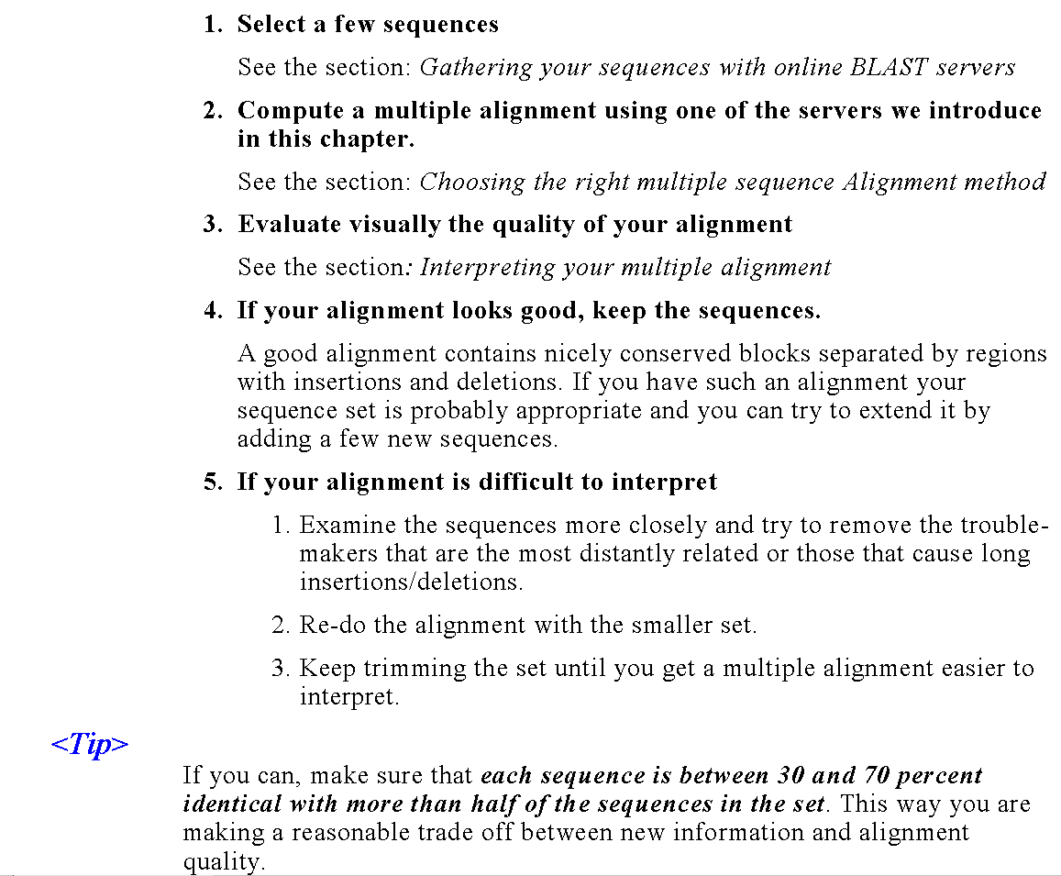
Some
Guidelines
…

Slide 59
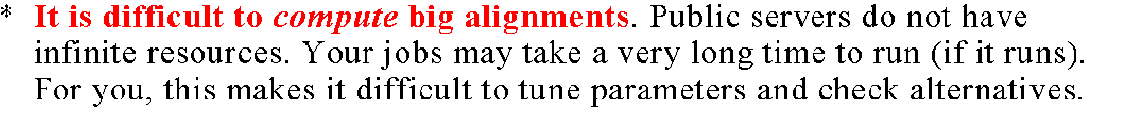
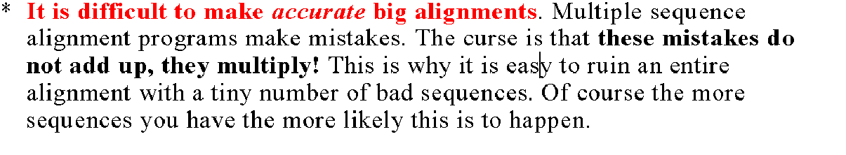
Do Not Use Two Many Sequences…

Slide 60
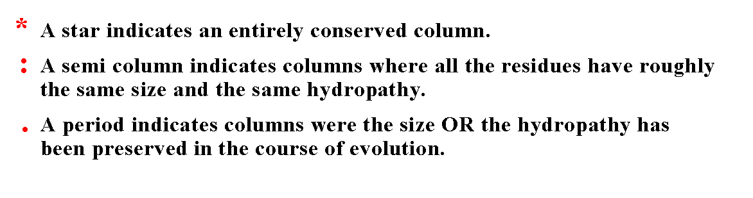
Reading Your Alignment

Slide 61
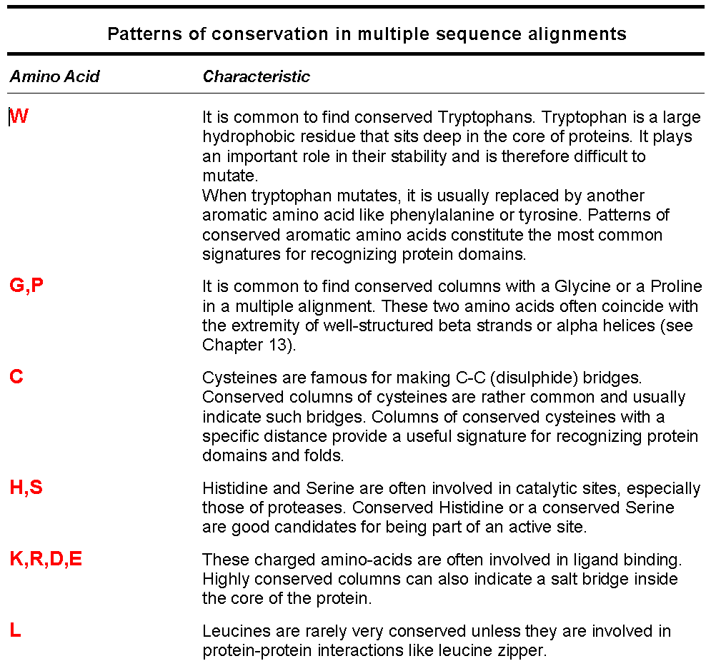
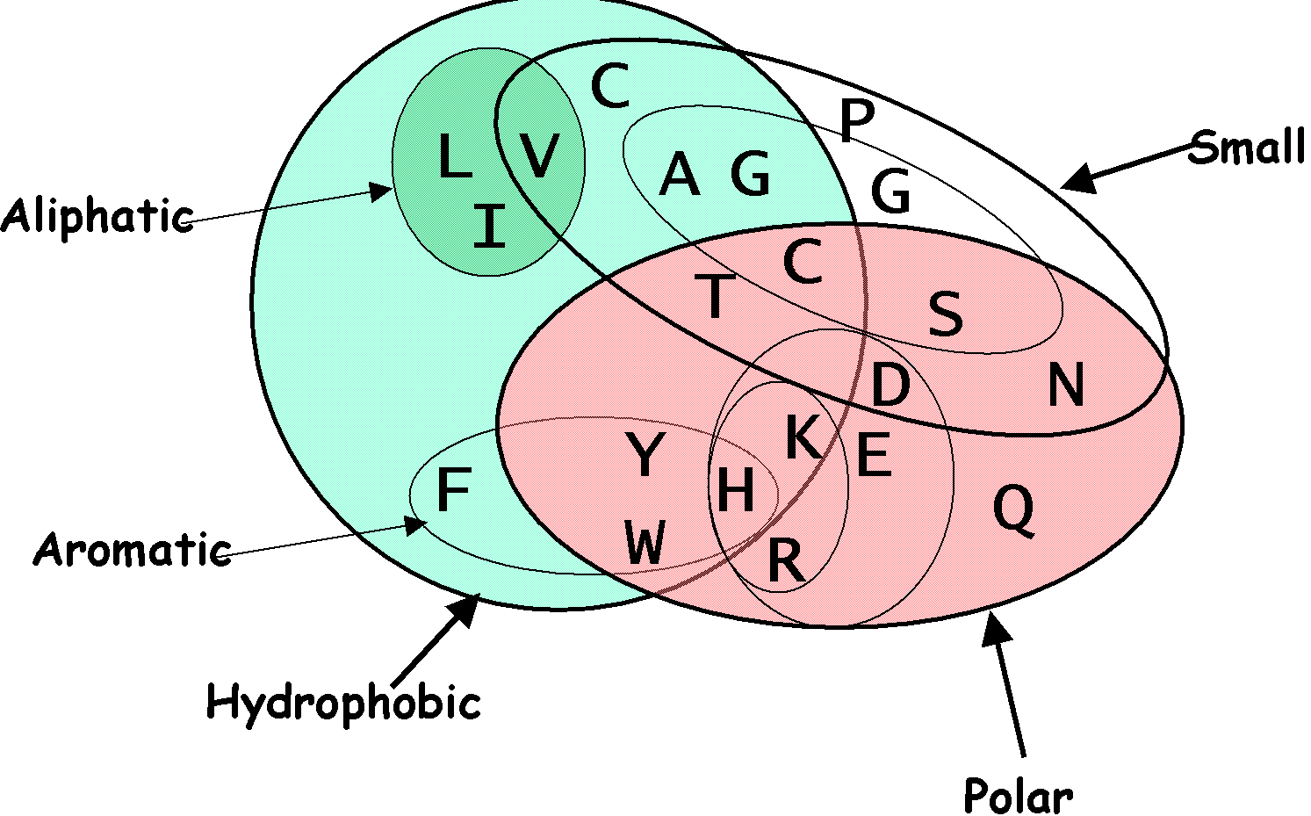

Slide 62
Choosing the right method

Slide 63
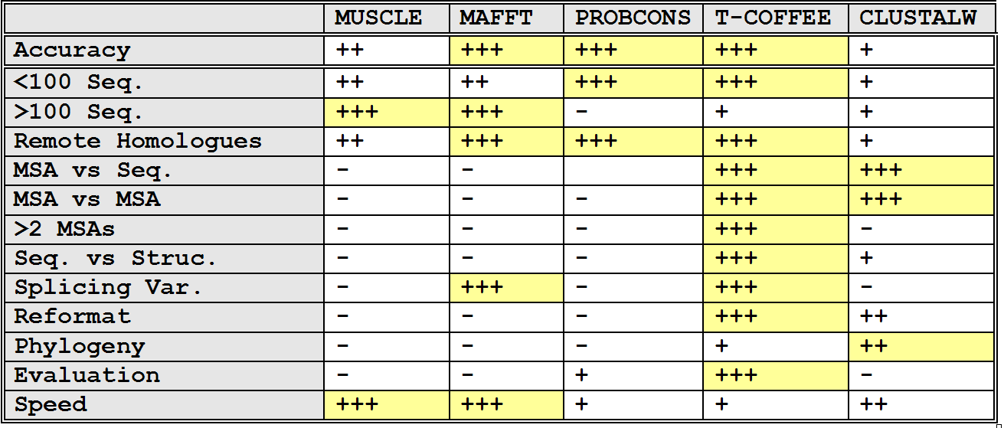
Situation ⬄ Solution

Slide 64
Priority ⬄ Solution
Method Priority | Trees | Profile | 2D –Pred | 3D-Pred | Func-Pred
Accuracy
Speed

Slide 65
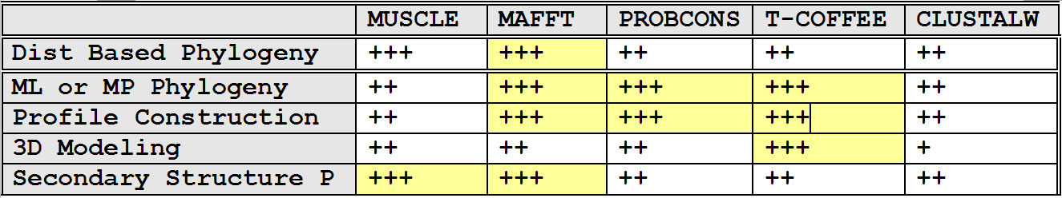
Purpose ⬄ Solution

Slide 66
Conclusion

Slide 67

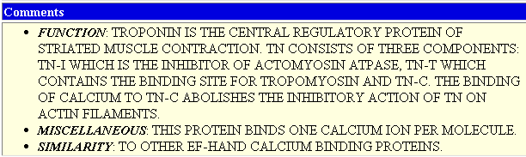
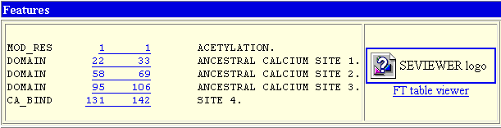

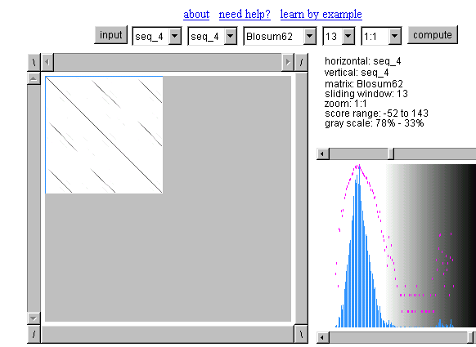

Multiple Alignment
-The BEST alignment Method:
Your Brain
The Right Data
-The Best Evaluation Procedure:
Experimental Data (SwissProt)
-Choosing The Sequences Well is Important
-Beware of repeated elements

Slide 68
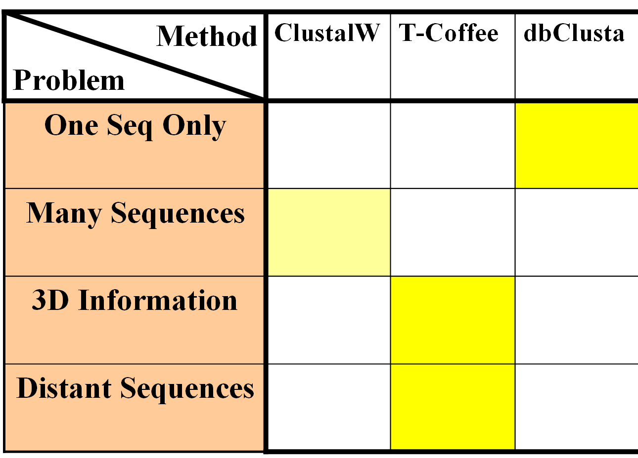
Multiple Alignment
Know Your Problem: What do you want to do with your MSA

Slide 69
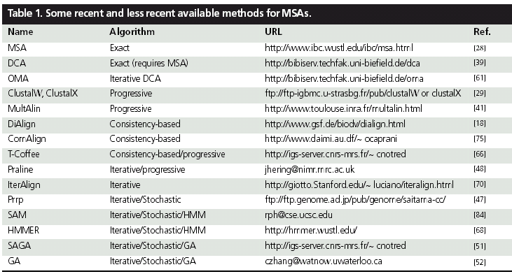
Addresses
MAFFT | Progressive/iterative | www.biophys.kyoto-u.jp/katoh
POA | Progressive/Simultaneous | www.bioinformatics.ucla.edu/poa
MUSCLE | Progressive/Iterative | www.drive5.com/muscle

