Slide 1

Using the T-Coffee Multiple Sequence Alignment Package
I - Overview
Cédric Notredame
Comparative Bioinformatics Group
Bioinformatics and Genomics Program

Slide 2
What is T-Coffee ?
Tree Based Consistency based Objective Function for Alignment Evaluation
  Progressive Alignment
  Consistency

Slide 3

Progressive Alignment
Feng and Dolittle, 1988; Taylor 1989
Clustering

Slide 4
Progressive Alignment
Dynamic Programming Using A Substitution Matrix

Slide 5
Progressive Alignment
-Depends on the CHOICE of the sequences.
-Depends on the ORDER of the sequences (Tree).
-Depends on the PARAMETERS:
        Substitution Matrix.
        Penalties (Gop, Gep).
        Sequence Weight.
        Tree making Algorithm.

Slide 6
Consistency?
Consistency is an attempt to use alignment information at very early stages

Slide 7
T-Coffee and Concistency…
SeqA GARFIELD THE LAST FAT CAT Prim. Weight =88
SeqB GARFIELD THE FAST CAT ---
SeqA GARFIELD THE LAST FA-T CAT Prim. Weight =77
SeqC GARFIELD THE VERY FAST CAT
SeqA GARFIELD THE LAST FAT CAT Prim. Weight =100
SeqD -------- THE ---- FAT CAT
SeqB GARFIELD THE ---- FAST CAT Prim. Weight =100
SeqC GARFIELD THE VERY FAST CAT
SeqC GARFIELD THE VERY FAST CAT Prim. Weight =100
SeqD -------- THE ---- FA-T CAT

Slide 8
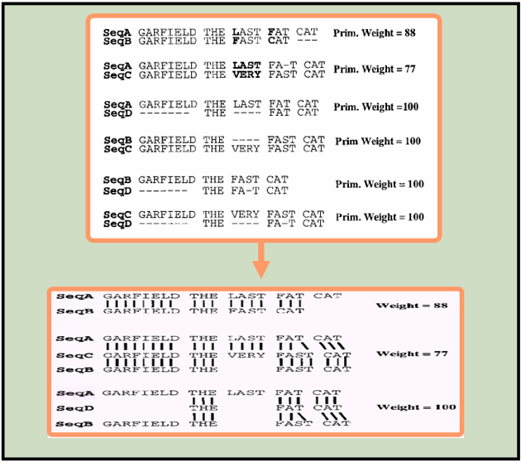
T-Coffee and Concistency…
SeqA GARFIELD THE LAST FAT CAT Prim. Weight =88
SeqB GARFIELD THE FAST CAT ---
SeqA GARFIELD THE LAST FA-T CAT Prim. Weight =77
SeqC GARFIELD THE VERY FAST CAT
SeqA GARFIELD THE LAST FAT CAT Prim. Weight =100
SeqD -------- THE ---- FAT CAT
SeqB GARFIELD THE ---- FAST CAT Prim. Weight =100
SeqC GARFIELD THE VERY FAST CAT
SeqC GARFIELD THE VERY FAST CAT Prim. Weight =100
SeqD -------- THE ---- FA-T CAT
SeqA GARFIELD THE LAST FAT CAT Weight =88
SeqB GARFIELD THE FAST CAT ---
SeqA GARFIELD THE LAST FA-T CAT Weight =77
SeqC GARFIELD THE VERY FAST CAT
SeqB GARFIELD THE ---- FAST CAT
SeqA GARFIELD THE LAST FA-T CAT Weight =100
SeqD -------- THE ---- FA-T CAT
SeqB GARFIELD THE ---- FAST CAT

Slide 9
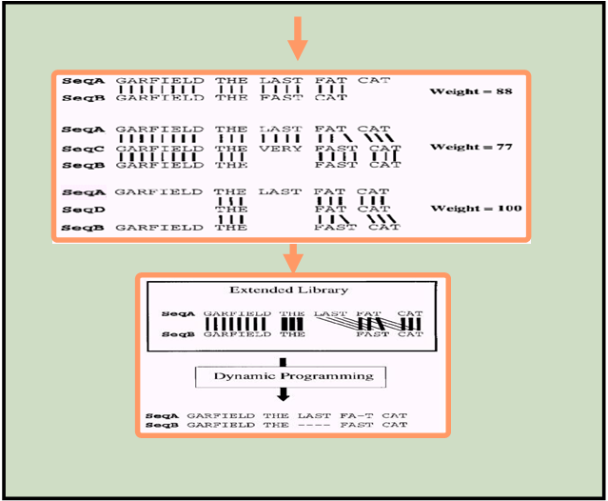
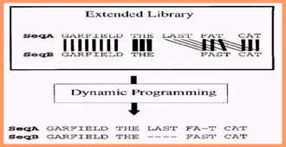
T-Coffee and Concistency…
SeqA GARFIELD THE LAST FAT CAT Weight =88
SeqB GARFIELD THE FAST CAT ---
SeqA GARFIELD THE LAST FA-T CAT Weight =77
SeqC GARFIELD THE VERY FAST CAT
SeqB GARFIELD THE ---- FAST CAT
SeqA GARFIELD THE LAST FA-T CAT Weight =100
SeqD -------- THE ---- FA-T CAT
SeqB GARFIELD THE ---- FAST CAT

Slide 10
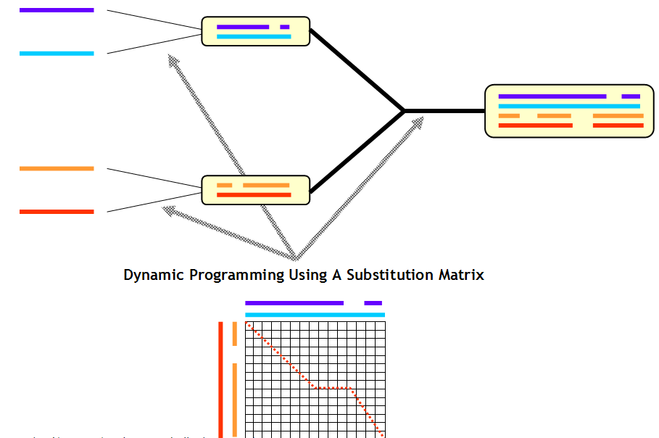
T-Coffee and Concistency…

Slide 11
Where Do The Primary Alignments Come From?
Primary Alignments
  Primary Library
Source
  Any valid Third Party Method

Slide 12
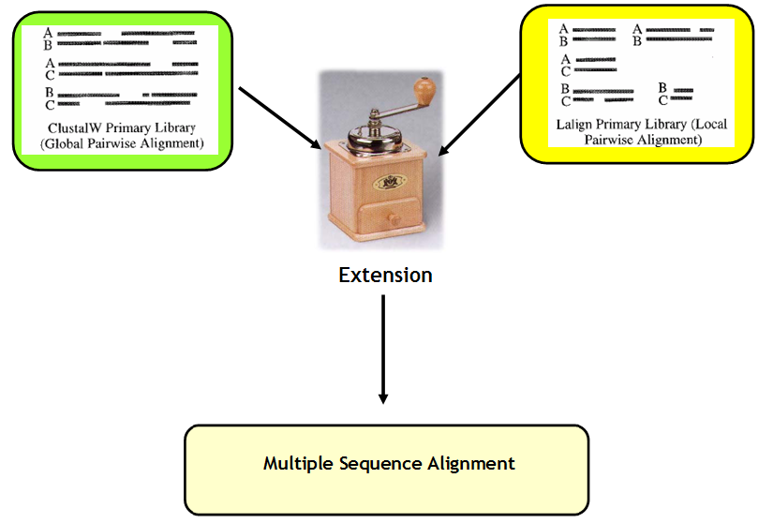
T-Coffee and Concistency…

Slide 13
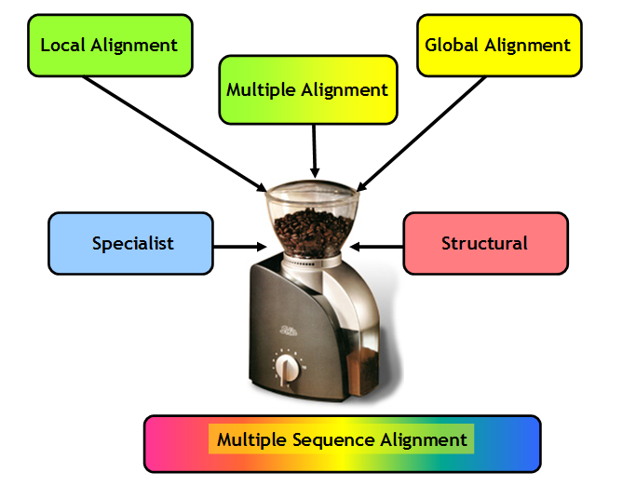
T-Coffee and Concistency…

Slide 14
Using the T-Coffee Multiple Sequence Alignment Package
II – M-Coffee
Cédric Notredame
Comparative Bioinformatics Group
Bioinformatics and Genomics Program

Slide 15
What is the Best MSA method ?
More than 50 MSA methods
Some methods are fast and inacurate
  Mafft, muscle, kalign
Some methods are slow and accurate
  T-Coffee, ProbCons
Some Methods are slow and inacurate…
  ClustalW

Slide 16
Why Not Combining Them ?
All Methods give different alignments
Their Agreement is an indication of accuracy
t_coffee –method mafft_msa, muscle_msa

Slide 17
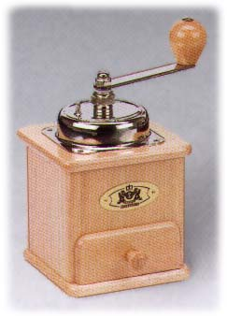
Combining Many MSAs into ONE
ClustalW
MAFFT
T-Coffee
MUSCLE
???????

Slide 18
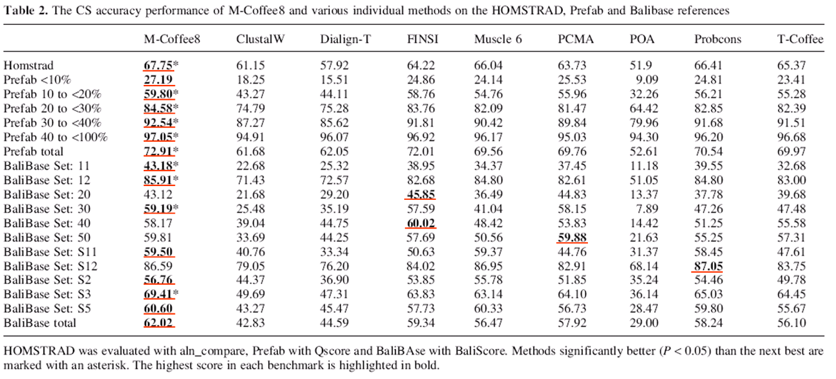

Slide 19
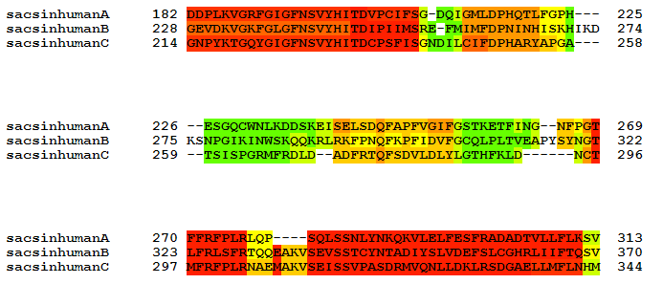
Where to Trust Your Alignments
Most Methods Disagree
Most Methods Agree

Slide 20
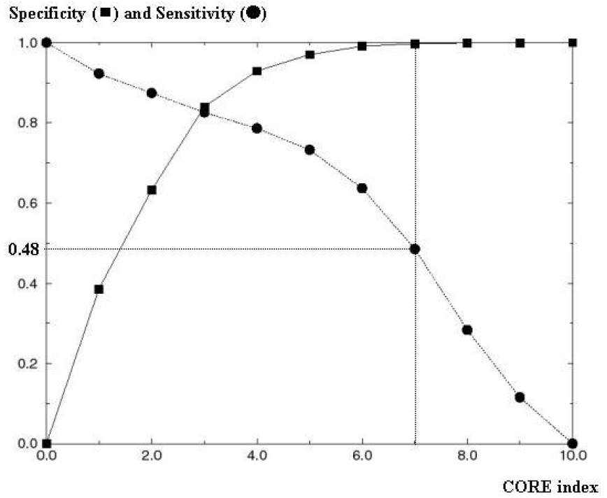
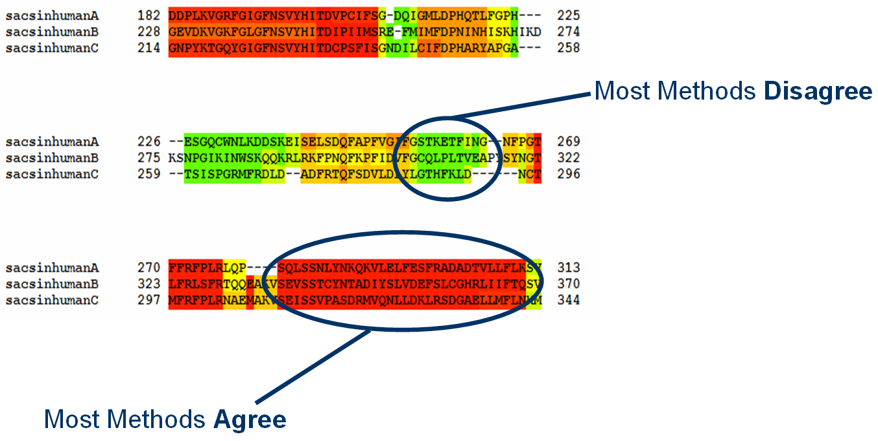
What To Do Without Structures

Slide 21
Using the T-Coffee Multiple Sequence Alignment Package
III – Template Based Alignments
Cédric Notredame
Comparative Bioinformatics Group
Bioinformatics and Genomics Program

Slide 22
Sometimes Sequences are Not Enough
Sequence based alignments are limited in accuracy
  30% for proteins
  70% for DNA
It is hard to align correctly sequences whose similarity is below these values
  Twilight zone

Slide 23
One Solution: Template Based Alignment
Replace the sequence with something more informative
  PDB Structure Expresso
  Profile PSI-Coffee
  RNA-Structure R-Coffee

Slide 24
Template Based Multiple Sequence Alignments
Sources
-Structure
-Profile
-…
Template
Aligner
-Structure
-Profile
-…
Templates
Templates
Template Alignment
Source Template Alignment
Remove Templates
Library

Slide 25
Expresso: Finding the Right Structure
Sources
BLAST
BLAST
SAP
Templates
Templates
Template Alignment
Source Template Alignment
Remove Templates
Library

Slide 26
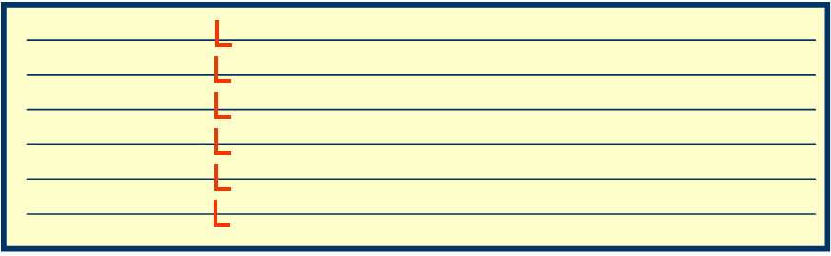
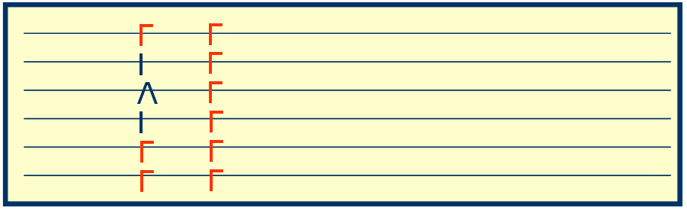
PSI-Coffee: Homology Extension
Sources
BLAST
BLAST
Templates
Profile Aligner
Templates
Template Alignment
Source Template Alignment
Remove Templates
Library

Slide 27
What is Homology Extension ?
-Simple scoring schemes result in alignment ambiguities
L
?
L
L

Slide 28
What is Homology Extension ?
L
L
L
Profile 1
L
L
L
L
L
L
L
L
L
L
I
L
V
L
Profile 2
I
L
L
L

Slide 29
What is Homology Extension ?
L
L
L
Profile 1
L
L
L
L
L
L
L
L
L
L
I
L
V
L
Profile 2
I
L
L
L

Slide 30
Method | Method | Template | Score | Comment
ClustalW-2 | Progressive | NO | 22.74
PRANK | Gap | NO | 26.18 | Science2008
MAFFT | Iterative | NO | 26.18
Muscle | Iterative | NO | 31.37
ProbCons | Consistency | NO | 40.80
ProbCons | MonoPhasic | NO | 37.53
T-Coffee | Consistency | NO | 42.30
M-Coffe4 | Consistency | NO | 43.60
PSI-Coffee | Consistency | Profile | 53.71
PROMAL | Consistency | Profile | 55.08
PROMAL-3D | Consistency | PDB | 57.60
3D-Coffee | Consistency | PDB | 61.00 | Expresso
Score: fraction of correct columns when compared with a structure based reference (BB11 of BaliBase).

Slide 31
Templates
Templates
Template
Aligner
TARGET
TARGET
TARGET
Experimental
Data
…
Experimental
Data
…
Template Alignment
Template-Sequence Alignment
Template based Alignment
of the Sequences
Primary Library

Slide 32
Using the T-Coffee Multiple Sequence Alignment Package
IV – RNA Alignments
Cédric Notredame
Comparative Bioinformatics Group
Bioinformatics and Genomics Program

Slide 33
ncRNAs Comparison
And ENCODE said…
“nearly the entire genome may be represented in primary transcripts that extensively overlap and include many non-protein-coding regions”
Who Are They?
  tRNA, rRNA, snoRNAs,
  microRNAs, siRNAs
  piRNAs
  long ncRNAs (Xist, Evf, Air, CTN, PINK…)
How Many of them
  Open question
  30.000 is a common guess
  Harder to detect than proteins
.

Slide 34
ncRNAs Can Evolve Rapidly
C
A
C
A
C
A
C
A
A
A
G
C
G
C
G
G
G
G
A
G
A
G
C
G
A
C
G
A
G
G
GAACGGACC
CTTGCCTGG
CTTGCCTCC
GAACGGAGG
CCAGGCAAGACGGGACGAGAGTTGCCTGG
CCTCCGTTCAGAGGTGCATAGAACGGAGG
**-------*--**---*-**------**

Slide 35
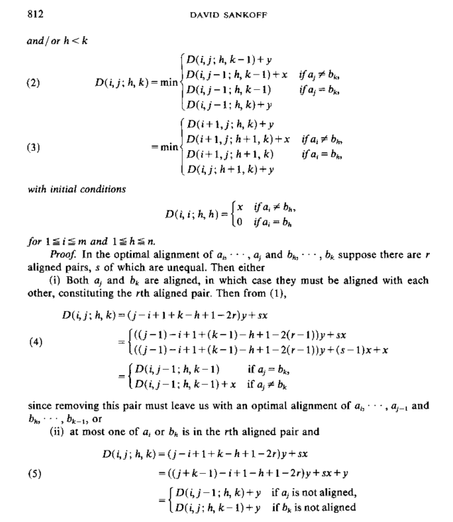
The Holy Grail of RNA Comparison:
Sankoff’ Algorithm

Slide 36
The Holy Grail of RNA Comparison
Sankoff’ Algorithm
Simultaneous Folding and Alignment
  Time Complexity: O(L^{2n})
  Space Complexity: O(L^{3n})
In Practice, for Two Sequences:
  50 nucleotides: 1 min. 6 M.
  100 nucleotides 16 min. 256 M.
  200 nucleotides 4 hours 4 G.
  400 nucleotides 3 days 3 T.
Forget about
  Multiple sequence alignments
  Database searches

Slide 37
RNA Sequences
RNAplfold
Consan
or
Mafft / Muscle / ProbCons
Primary Library
Secondary
Structures
R-Coffee
Extension
R-Coffee Extended
Primary Library
R-Score
Progressive Alignment
Using The R-Score

Slide 38
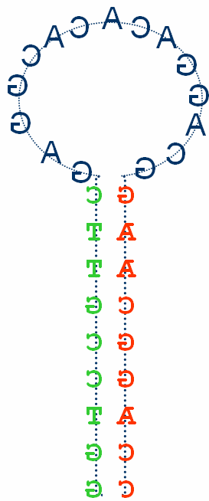
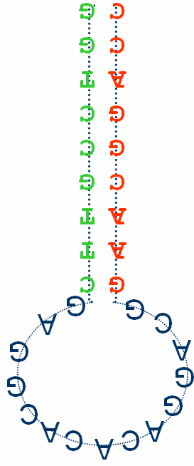
R-Coffee Extension
TC Library
C
G
G G Score X
C C Score Y
C
G
C
G
C
G
Goal: Embedding RNA Structures Within The T-Coffee Libraries
The R-extension can be added on the top of any existing method.

Slide 39
R-Coffee + Regular Aligners
Method Avg Braliscore Net Improv.
direct +T +R +T +R
-----------------------------------------------------------
Poa 0.62 0.65 0.70 48 154
Pcma 0.62 0.64 0.67 34 120
Prrn 0.64 0.61 0.66 -63 45
ClustalW 0.65 0.65 0.69 -7 83
Mafft_fftnts 0.68 0.68 0.72 17 68
ProbConsRNA 0.69 0.67 0.71 -49 39
Muscle 0.69 0.69 0.73 -17 42
Mafft_ginsi 0.70 0.68 0.72 -49 39
-----------------------------------------------------------
Improvement= # R-Coffee wins - # R-Coffee looses

Slide 40
RM-Coffee + Regular Aligners
Method Avg Braliscore Net Improv.
direct +T +R +T +R
-----------------------------------------------------------
Poa 0.62 0.65 0.70 48 154
Pcma 0.62 0.64 0.67 34 120
Prrn 0.64 0.61 0.66 -63 45
ClustalW 0.65 0.65 0.69 -7 83
Mafft_fftnts 0.68 0.68 0.72 17 68
ProbConsRNA 0.69 0.67 0.71 -49 39
Muscle 0.69 0.69 0.73 -17 42
Mafft_ginsi 0.70 0.68 0.72 -49 39
-----------------------------------------------------------
RM-Coffee4 0.71 / 0.74 / 84

Slide 41
R-Coffee + Structural Aligners
Method Avg Braliscore Net Improv.
direct +T +R +T +R
-----------------------------------------------------------
Stemloc 0.62 0.75 0.76 104 113
Mlocarna 0.66 0.69 0.71 101 133
Murlet 0.73 0.70 0.72 -132 -73
Pmcomp 0.73 0.73 0.73 142 145
T-Lara 0.74 0.74 0.69 -36 -8
Foldalign 0.75 0.77 0.77 72 73
-----------------------------------------------------------
Dyalign --- 0.63 0.62 --- ---
Consan --- 0.79 0.79 --- ---
-----------------------------------------------------------
RM-Coffee4 0.71 / 0.74 / 84

Slide 42
Using the T-Coffee Multiple Sequence Alignment Package
V – DNA Alignments
Cédric Notredame
Comparative Bioinformatics Group
Bioinformatics and Genomics Program

Slide 43
Aligning Genomic DNA
Main problem
  Tell a good alignment from a bad one
Strategy:
  Tuning on Orthologous Promoter Detection
  Evaluation on ChIp-Seq Data

Slide 44
Aligning Genomic DNA
Main problem
  Tell a good alignment from a bad one
Strategy:
  Tuning on Orthologous Promoter Detection
  Evaluation on ChIp-Seq Data

Slide 45
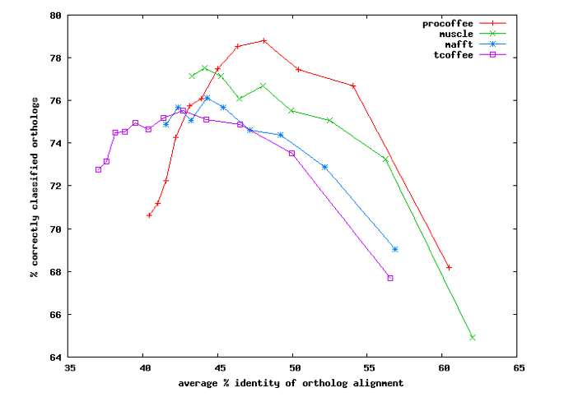
Aligning Genomic DNA
Tuning of Gap Penalties
Design of a di-nucleotide substitution matrix

Slide 46
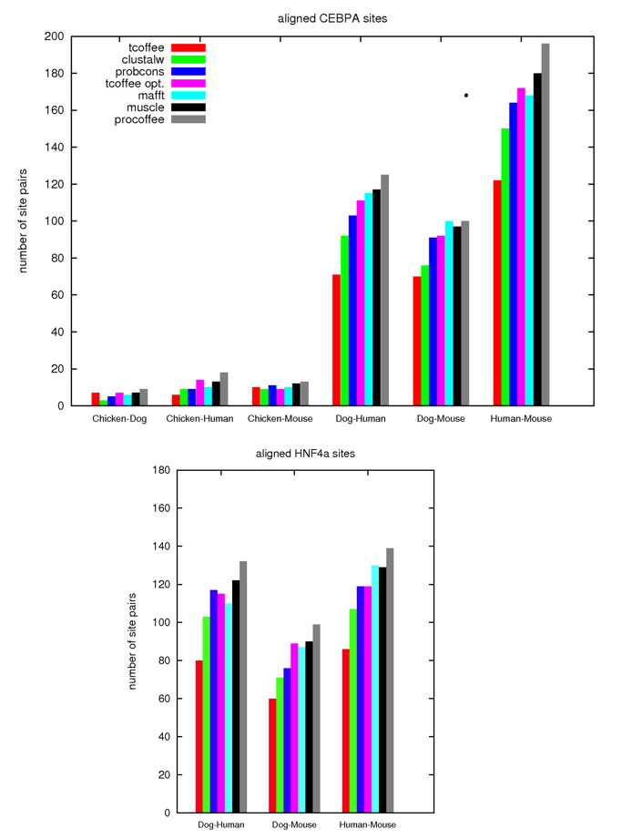
Aligning Genomic DNA

Slide 47
Aligning Genomic DNA
gDNA is very heterogenous
Each genomic feature requires its own aligner
Aligning non-orthologous regions with a global aligner is impossible
Pro-Coffee is designed to align orthologous promoter regions

Slide 48
Using the T-Coffee Multiple Sequence Alignment Package
VI – Wrap Up
Cédric Notredame
Comparative Bioinformatics Group
Bioinformatics and Genomics Program

Slide 49
Which Flavor?
Fast Alignments
  M-Coffee with Fast Aligners: mafft, muscle, kalign
Difficult Protein Alignments
  Expresso
  PSI-Coffee
RNA Alignments
  R-Coffee
Promoter Alignments
  Pro-Coffee

Slide 50
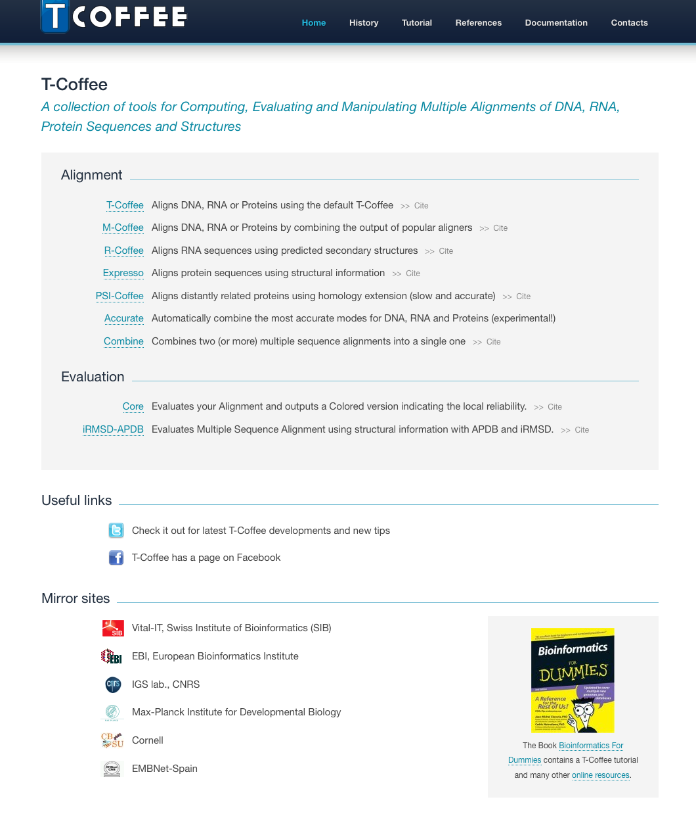
www.tcoffee.org

