Slide 1

Classifying MSA Packages
Multiple Sequence Alignments in the Genome Era
Cédric Notredame
Information Génétique et Structurale
CNRS-Marseille, France

Slide 2
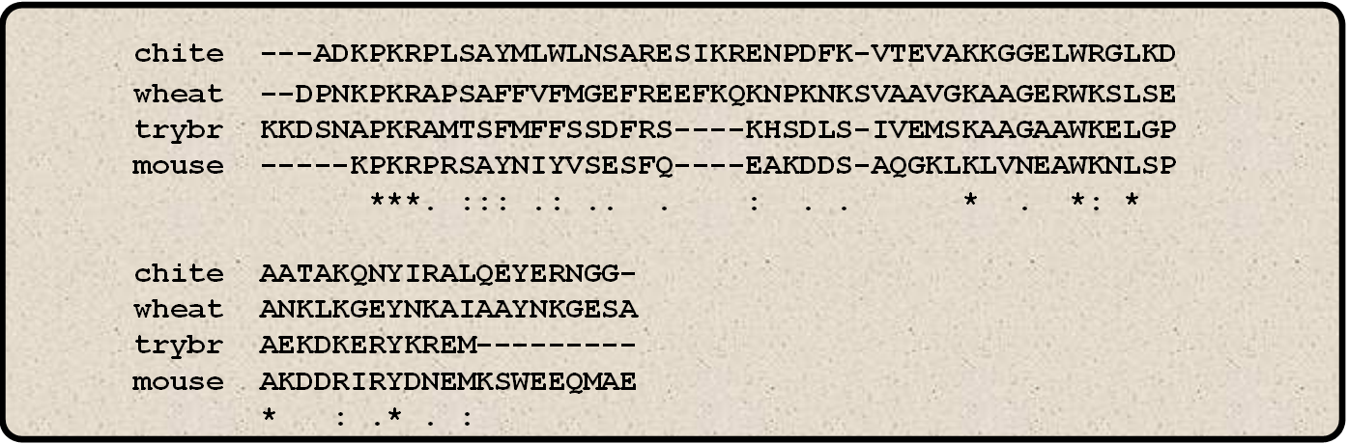
What’s in a Multiple Alignment?
Structural Criteria
  Residues are arranged so that those playing a similar role end up in the same column.
Evolutive Criteria
  Residues are arranged so that those having the same ancestor end up in the same column.
Similarity Criteria
  As many similar residues as possible in the same column

Slide 3
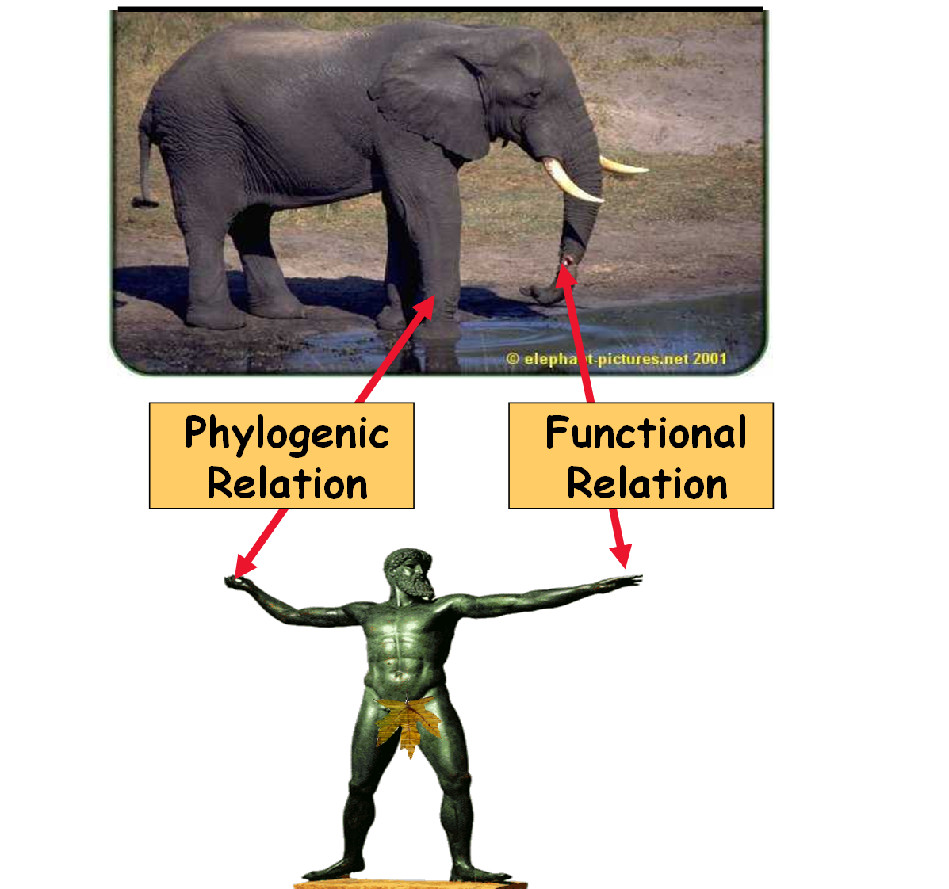
What’s in a Multiple Alignment?

Slide 4
What’s in a Multiple Alignment?
The MSA contains what you put inside…
You can view your MSA as:
  A record of evolution
  A summary of a protein family
  A collection of experiments made for you by Nature…

Slide 5
What’s in a Multiple Alignment?

Slide 6
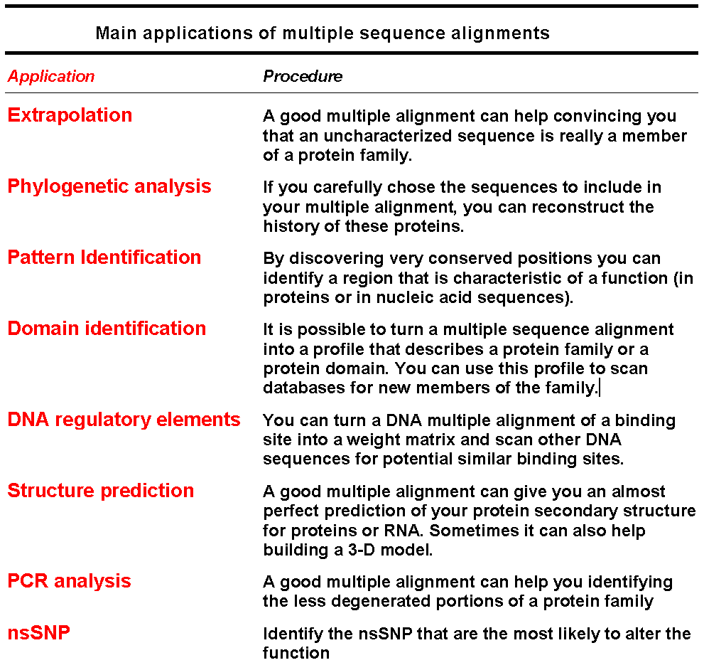
Multiple Alignments:
What Are They Good For???

Slide 7
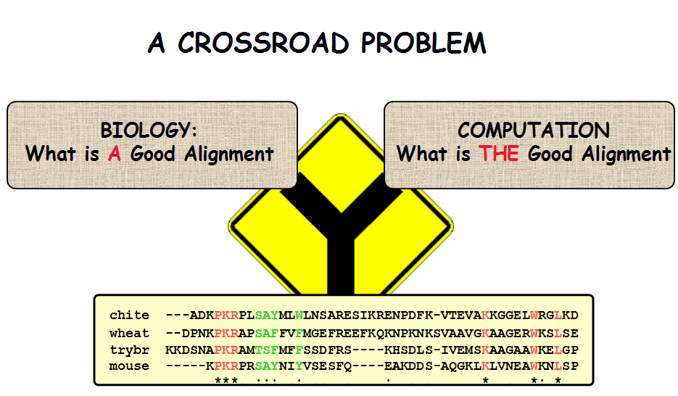
Computing the Correct Alignement is a Complicated Problem

Slide 8
A Taxonomy of Multiple Sequence Alignment Packages
Objective Function
Assembly Algorithms

Slide 9
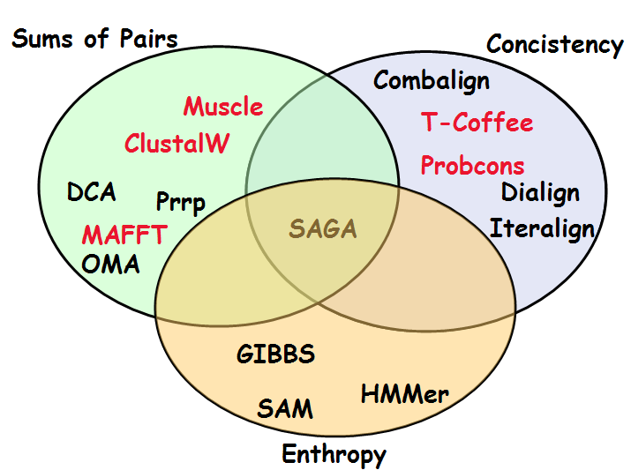
The Objective Function

Slide 10
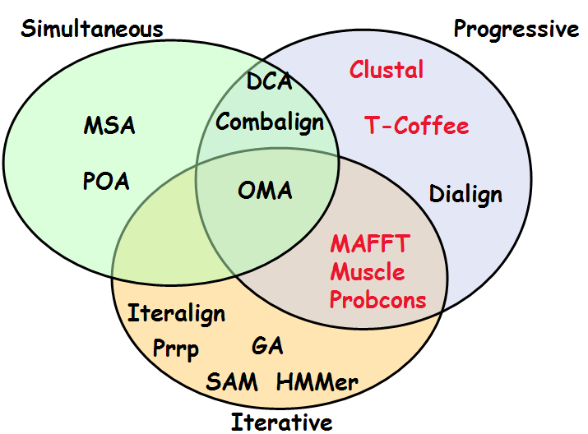
The Assembly Algorithm

Slide 11
A Tale of Three Algorithms
Progressive: ClustalW
Iterative: Muscle
Concistency Based: T-Coffee and Probcons

Slide 12
ClustalW Algorithm
Paula Hogeweg: First Description (1981)
Taylor, Dolittle: Reinvention in 1989
Higgins: Most Successful Implementation

Slide 13
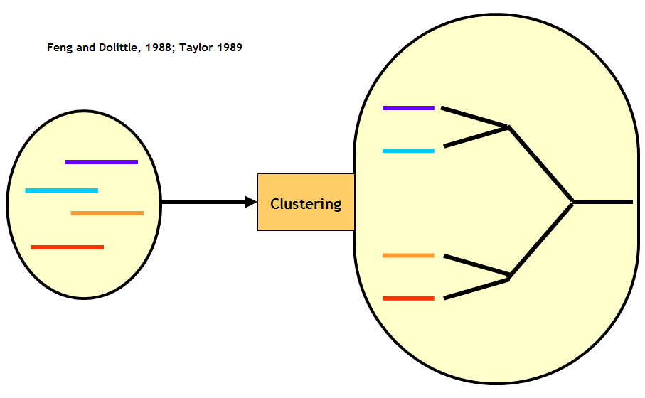
ClustalW

Slide 14
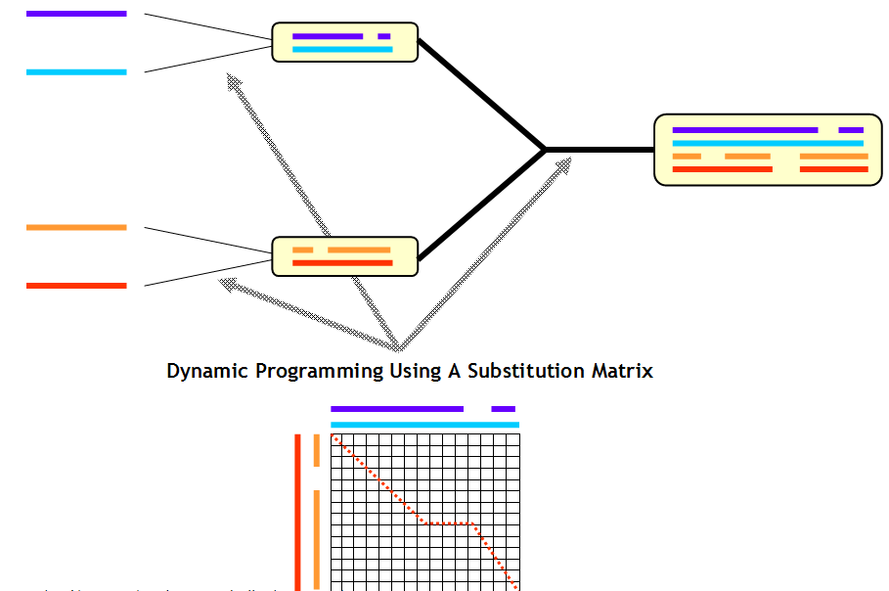
ClustalW

Slide 15
Muscle Algorithm: Using The Iteration
AMPS: First iterative Algorithm (Barton, 1987)
Stochastic methods: Genetic Algorithms and Simulated Annealing (Notredame, 1995)
Prrp: Ancestor of MUSCLE and MAFT (1996)
Muscle: the most succesful iterative strategy to this day

Slide 16
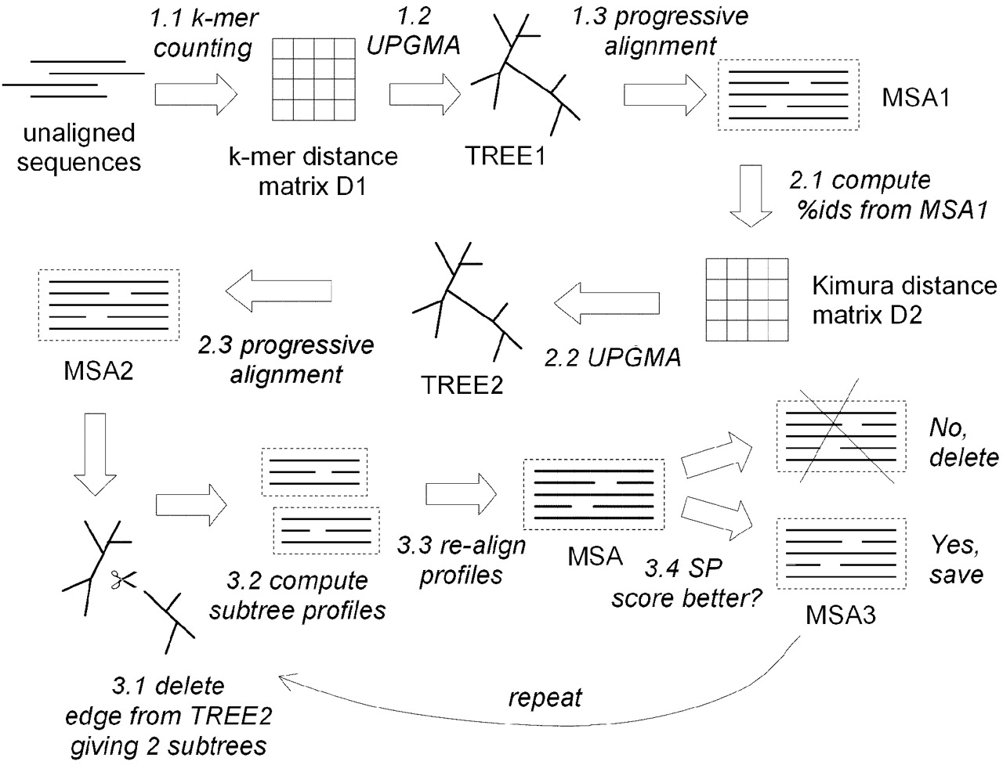
Muscle Algorithm: Using The Iteration

Slide 17
Concistency Based Algorithms
Gotoh (1990)
  Iterative strategy using concistency
Martin Vingron (1991)
  Dot Matrices Multiplications
  Accurate but too stringeant
Dialign (1996, Morgenstern)
  Concistency
  Agglomerative Assembly
T-Coffee (2000, Notredame)
  Concistency
  Progressive algorithm
ProbCons (2004, Do)
  T-Coffee with a Bayesian Treatment

Slide 18
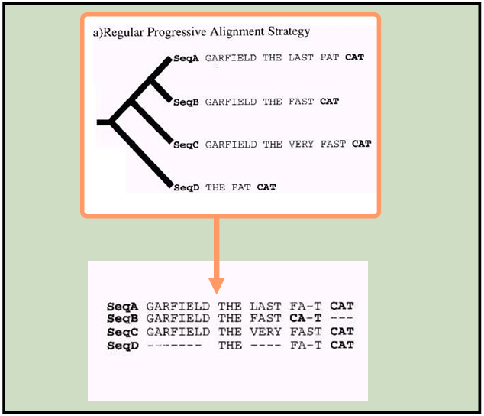
T-Coffee and Concistency…

Slide 19
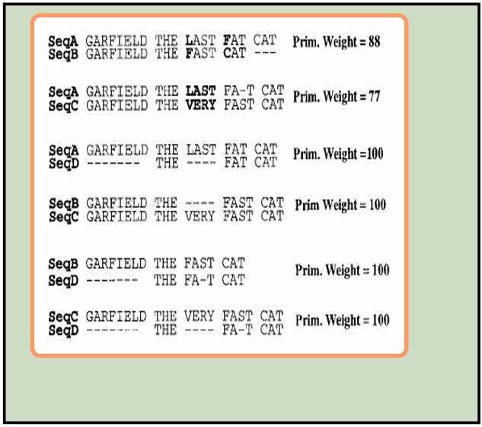
T-Coffee and Concistency…

Slide 20
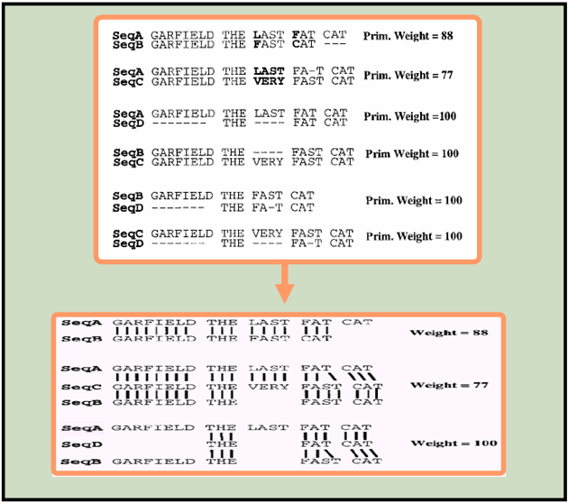
T-Coffee and Concistency…

Slide 21
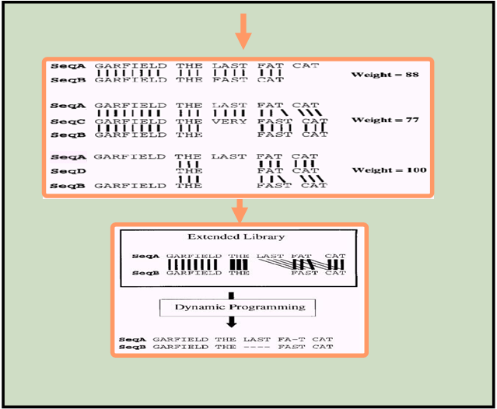
T-Coffee and Concistency…

Slide 22
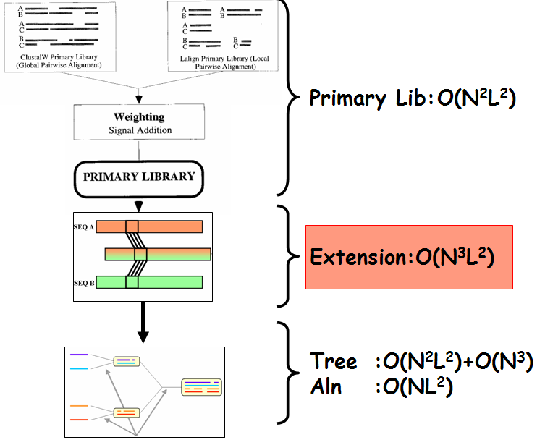
T-Coffee and Concistency…

Slide 23
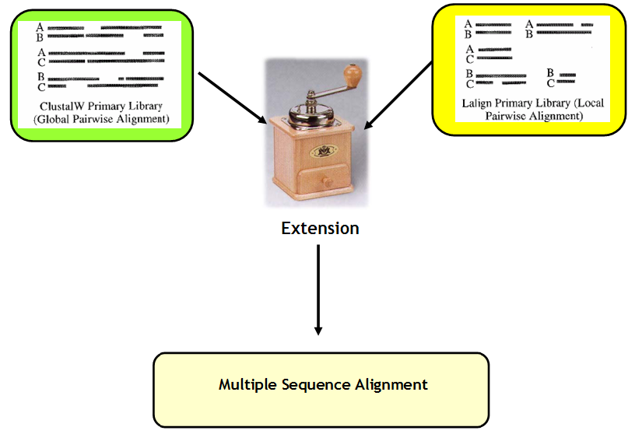
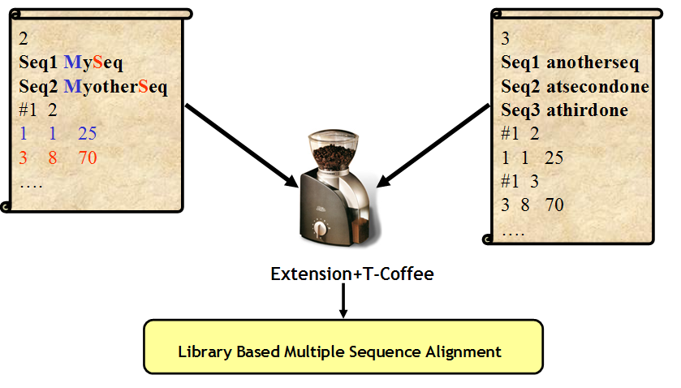
T-Coffee and Concistency…

Slide 24
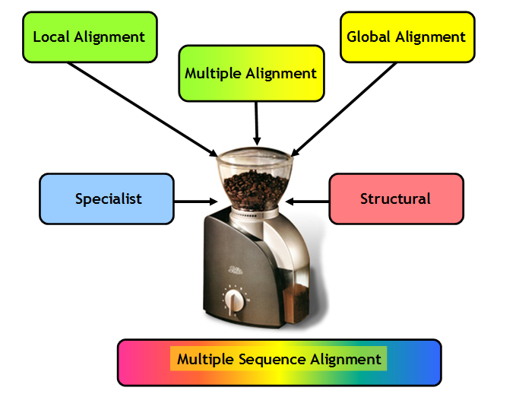
T-Coffee and Concistency…

Slide 25
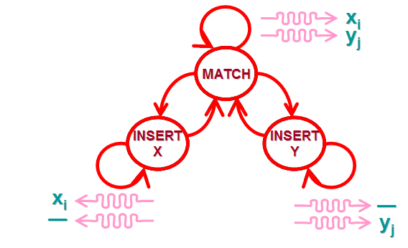
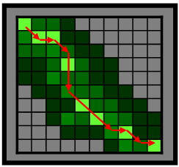
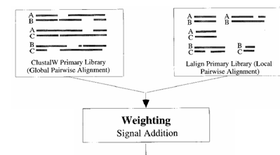
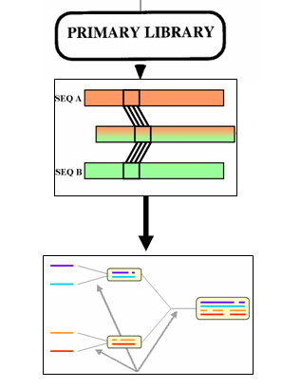
Probcons: A bayesian T-Coffee
Score(xi ~ yj | x, y, z)
⬄
∑k P(xi ~ zk | x, z) P(zk ~ yj | z, y)
Score=Σ (MIN(xz,zk))/MAX(xz,zk)

Slide 26
Evaluating Methods…
Who is the best?
Says who…?

Slide 27
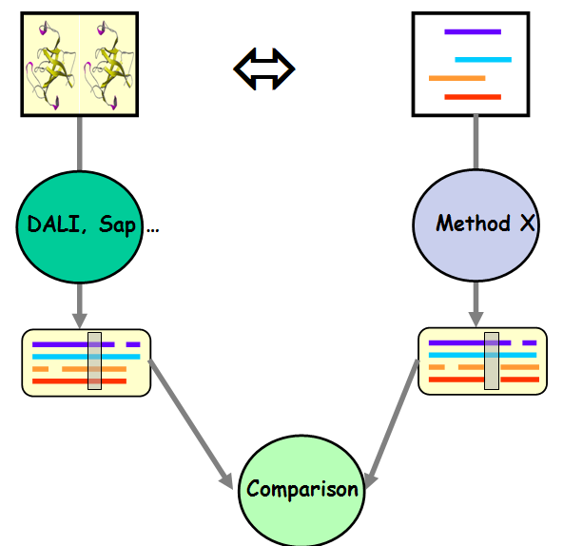
Structures Vs Sequences

Slide 28
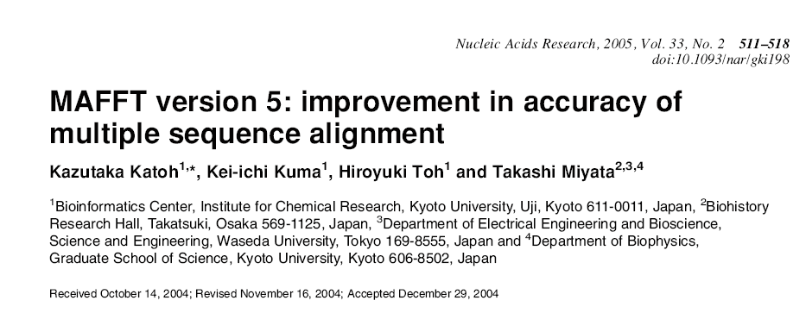
Evaluating Alignments Quality:
Collections and Results

Slide 29
Evaluating Alignments Quality
Collections
Homstrad: The most Ancient
SAB: Yet Another Benchmark
Prefab: The most extensive and automated
BaliBase: the first designed for MSA benchmarks (Recently updated)

Slide 30
Homstrad
(Mizuguchi, Blundell, Overington, 1998)
Hand Curated Structure Superposition
Not designed for Multiple Alignments
Biased with ClustalW
No CORE annotation
Hom +0
Hom +3
Hom +8

Slide 31
Homstrad: Known issues
Thiored.aln
1aaza ------------------------mfkvygydsnihkcvycdnakrlltvkk-----qpf
1ego -----------------------mqtvifgrs----gcpycvrakdlaeklsnerddfqy
1thx skgviti-tdaefesevlkae-qpvlvyfwaswcgpcqlmsplinlaantys---drlkv
2trxa sdkiihl-tddsfdtdvlkad-gailvdfwaewcgpckmiapildeiadeyq---gkltv
3trx --mvkqiesktafqealdaagdklvvvdfsatwcgpckmikpffhslsekys----nvif
3grx -----------------------anveiytke----tcpyshrakallsskg-----vsf
: .
1aaza efinimpekgvfddekiaelltklgrdtqigltmpqvfapd----gshigg---fdqlre
1ego qyvdirae-----gitkedlqqkagkp---vetvpqifv-d----qqhigg---ytdfaa
1thx vkleid---------pnpttvkkykve-----gvpalrlvkgeqildstegviskdklls
2trxa aklnid---------qnpgtapkygir-----giptlllfkngevaatkvgalskgqlke
3trx levdvd---------dcqdvasecevk-----ctptfqffkkgqkvgefsgan-keklea
3grx qelpidgn-----aakreemikrsgr-----ttvpqifi-d----aqhigg---yddlya
: : . * . . * .:

Slide 32

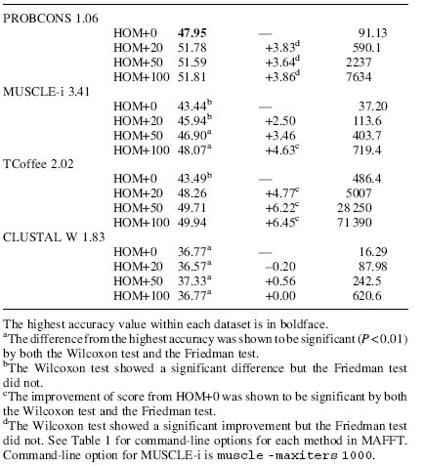
Homstrad

Slide 33
SAB
(Wale, 2003)
Multiple Structural Alignments of distantly related sequences
TWs: very low similarity (250 MSAs)
TWd: Low Similarity (480 MSAs)
SABs +0
TWs +3
TWs +8

Slide 34
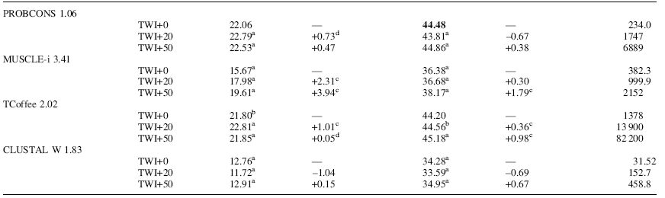
SAB

Slide 35
Prefab
(Edgar, 2003)
Automatic Pairwise Structural Alignments
Align Pairs of Structures with Two Methods to define CORES
Add 50 intermediate sequences with PSI-BLAST
Large dataset (1675 MSAs)
Align with CE and FSSP
Add Intermediate Sequences
with Psi-Blast
Prefab

Slide 36

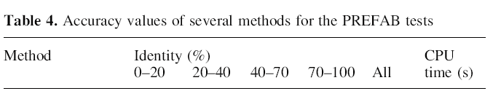
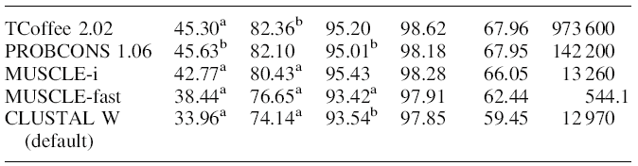
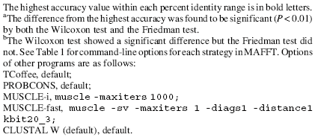
Prefab (MUSCLE Reference Dataset)

Slide 37
Who is the Best???
 | N. MSAs | T-Coffee | Probcons | Muscle
Hom+50 | 40 | 49.71 | 51.59 | 46.90
SABs+50 | 209 | 21.85 | 22.53 | 19.61
SABf+50 | 425 | 45.18 | 44.85 | 38.17
Prefab | 1675 | 67.96 | 67.95 | 66.05

Slide 38
A Case for reading papers
The FFT of MAFFT

Slide 39
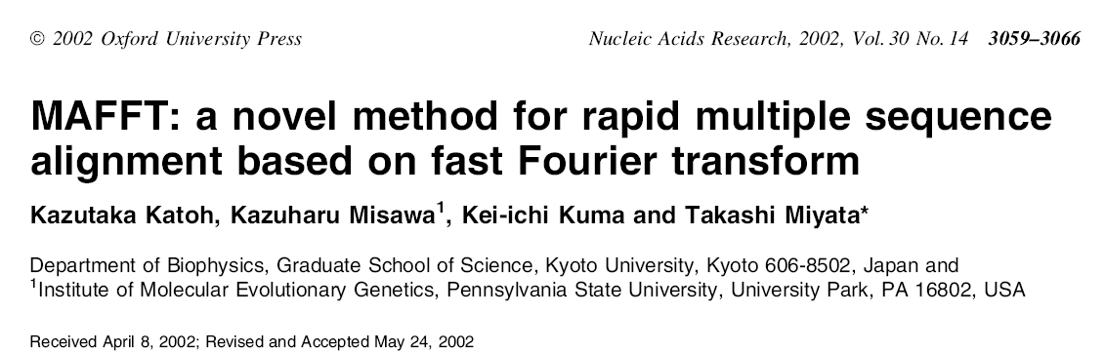
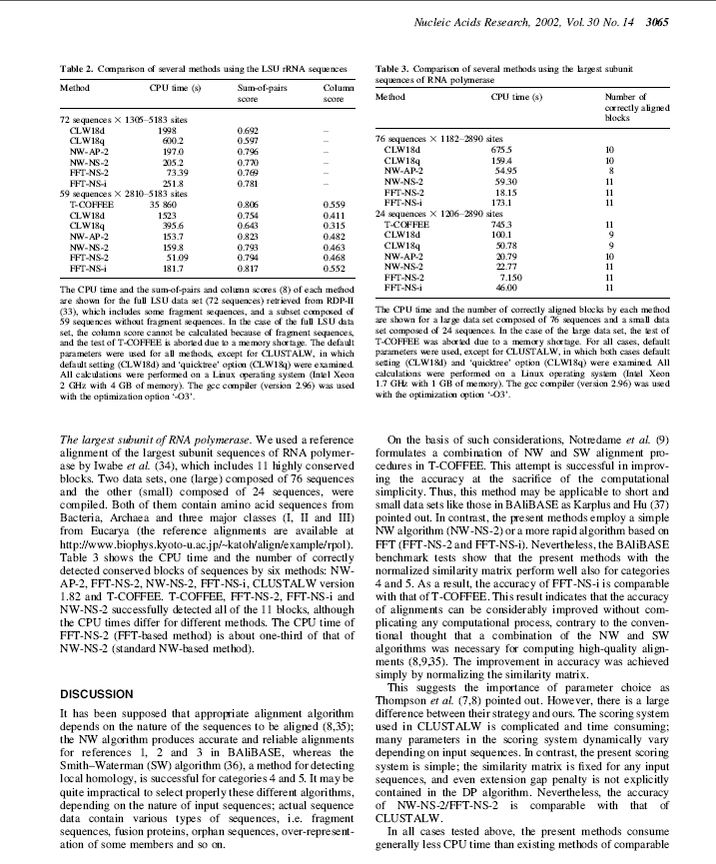
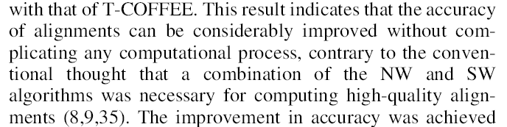

Slide 40
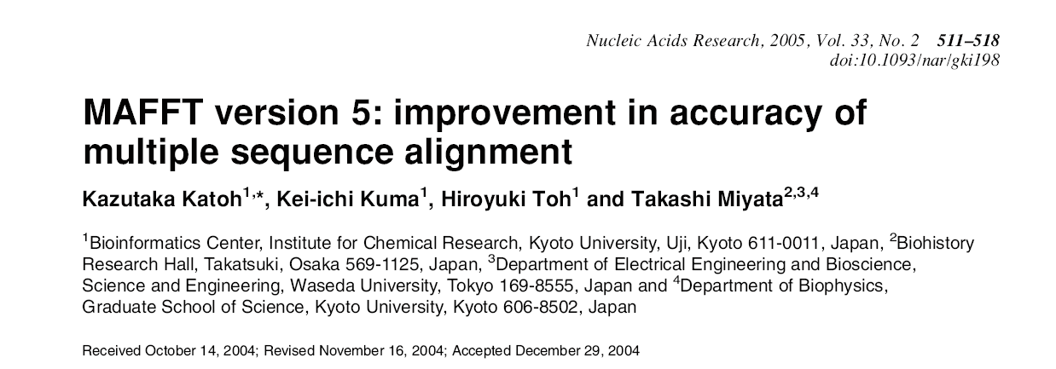
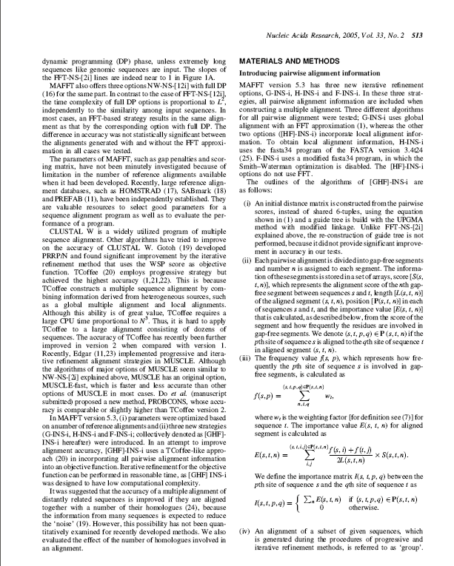
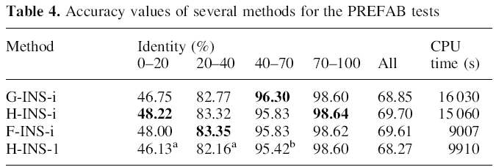
G-INS-i, H-INS-i and F-INS-i use pairwise alignment information when constructing a multiple alignment. The two options ([HF]-INS-i) incorporate local alignment information and do NOT USE FFT.

Slide 41
Improving T-Coffee
Ease The Use Heterogenous Information
  3DCoffee
Speed up the algorithm
  T-CoffeeDPA (Double Progressive Algorithm)
  Parallel T-Coffee (collaboration with EPFL)

Slide 42
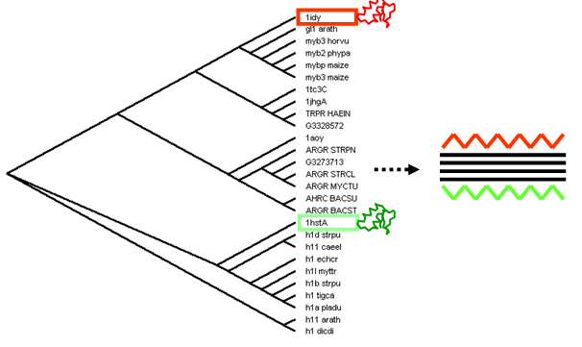
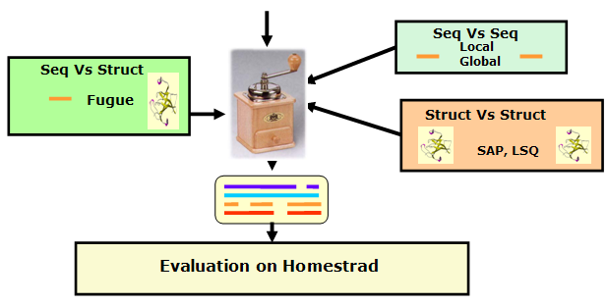
3D-Coffee:
Combining Sequences and Structures Within Multiple Sequence Alignments

Slide 43
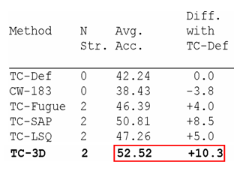
3D-Coffee:
Combining Sequences and Structures Within Multiple Sequence Alignments

Slide 44
T-Coffee-DPA
DPA: Double Progressive ALN
Target: 1000-10.000 seq
Principle: DC Progressive ALN
Application: Decreasing Redundancy

Slide 45
Who is the Best ???
Most Packages claim to be more accurate than T-Coffee, few really are…
None of the existing packages is concistently the best:
  The PERFECT method does not exist

Slide 46
Conclusion
Concistency Based Methods Have an Edge over Conventional
  Better management of the data
  Better extension possibilities
Hard to tell Methods Appart
  Reference databases are not very precise
  Algorithms evolve quickly
Sequence Alignment is NOT a solved problem
  Will be solved when Structure Prediction is solved

Slide 47
Conclusion

Slide 48
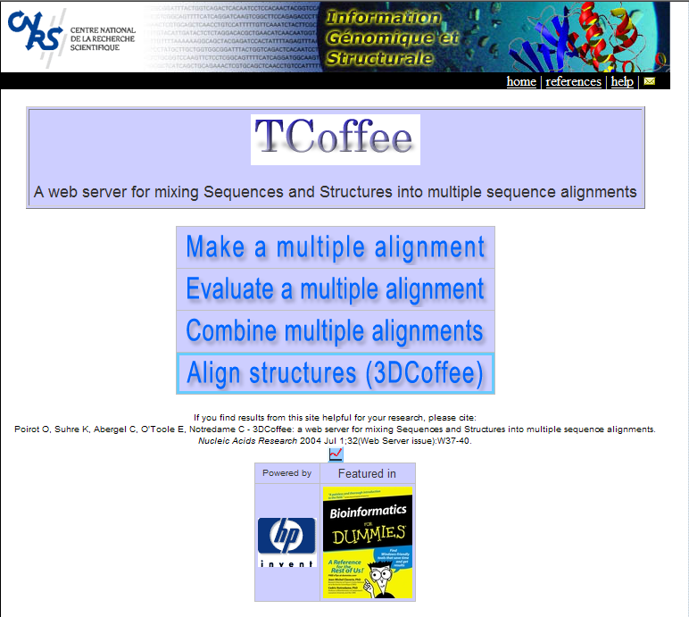
http://igs-server.cnrs-mrs.fr/Tcoffee
Fabrice Armougom
Sebastien Moretti
Olivier Poirot
Karsten Sure
Chantal Abergel
Des Higgins
Orla O’Sullivan
Iain Wallace
cedric.notredame@europe.com

Slide 49
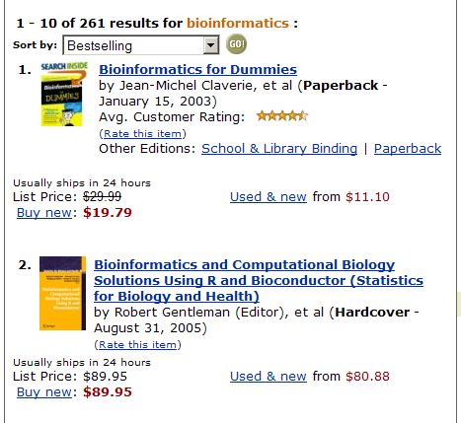
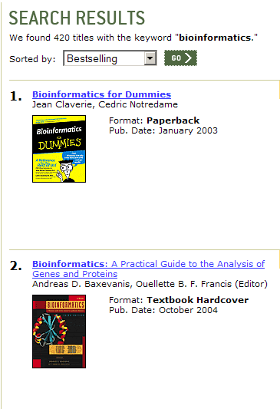
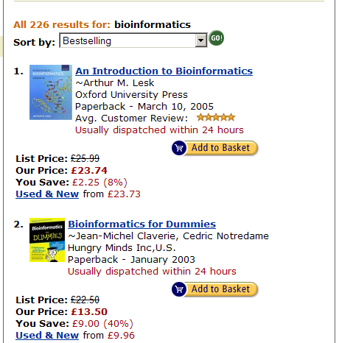
Dissemination: The right Vector
Amazon.com: 12/11/05
Barnes&Noble (US): 12/11/05
Amazon.co.uk: 12/11/05

Slide 50
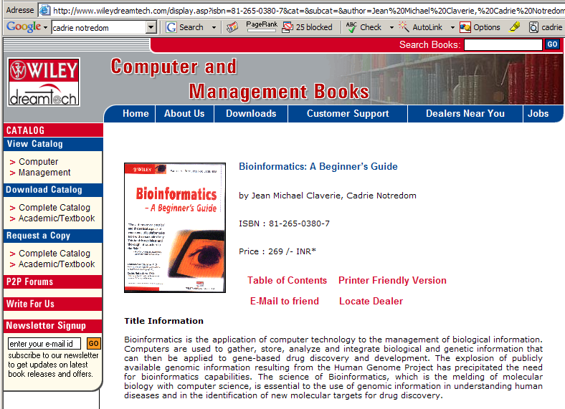
Cadrie Notredom et Michael Claverie

Slide 52
T-Coffee-DPA
T-Coffee-DPA is about 20 times faster than the Standard T-Coffee
Preliminary tests indicate a slightly higher accuracy
Beta-Test versions will be available by September but can will be sent on request.

Slide 53
3D TCoffeeDPA
Vs
The Human Kinome…
521 sequences
46 structures having 80% or more sequence identity with other kinome structures
Use of 3D-CoffeeDPA (unpublished) developped especially for the kinome analysis

Slide 54
Structure Based Evaluation
Include Sequences with Known Structures
  Do Not use Structural Information Score 1
  Use Structural Information: Score 2
Score1 Vs Score 2
  Evaluates the accuracy of reconstruction strategy
  Estimates accuracy of alignment for sequences Without a known structure

Slide 55
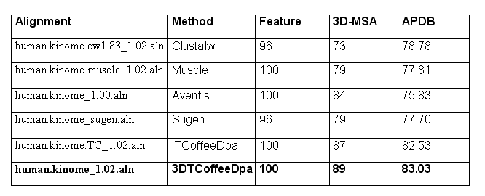
How Good is Our Kinome Alignment
???

Slide 56
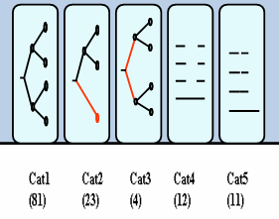
BaliBase
(Thompson, 1999)
Hand Made Structure Superposition
All the sequences do not have Structures
Comparisons are made on CORE blocks
Different categories for different types of problems

Slide 57


Most Reference Databases Have problems: BaliBase
Balibase 1abo Reference 1
1aboA -NLFVALYDFVASGDNTLSITKGEKLRVLGYNHN--------------GEW
1ycsB KGVIYALWDYEPQNDDELPMKEGDCMTIIHREDE------------deIEW
1pht GYQYRALYDYKKEREEDIDLHLGDILTVNKGSLVALGFSDGQEARPeeIGW
1ihvA -NFRVYYRDSRD------PVWKGPAKLLWKG-----------------EGA
* : * :
1aboA CEAQT--KNGQGWVPSNYITPVN------
1ycsB WWARL--NDKEGYVPRNLLGLYP------
1pht LNGYNETTGERGDFPGTYVEYIGRKKISP
1ihvA VVIQD--NSDIKVVPRRKAKIIRD-----
Balibase 1abo Reference 2
1aboA -NLFVALYDFVASGDNTLSITKGEKLRVLGYNHN--------------GEW
1ycsB KGVIYALWDYEPQNDDELPMKEGDCMTIIHREDEDE------------IEW
1pht GYQYRALYDYKKEREEDIDLHLGDILTVNKGSLVALGFSDGQEARPEEIGW
1ihvA -NFRVYYRDSRD------PVWKGPAKLLWKG-----------------EGA
* : * :
1aboA CEAQTK--NGQGWVPSNYITPVN------
1ycsB WWARL--NDKEGYVPRNLLGLYP------
1pht LNGYNeTTGERGDFPGTYVEYIGRKKISP
1ihvA VVIQD--NSDIKVVPRRKAKIIRD-----

Slide 58
3D TCoffeeDPA
Vs
The Human Kinome…
Sequences in our Kinome MSA dataset have been provided by Aventis
Do not inlude the Alpha Kinases
Assembling an exhaustive Kinome Dataset remains a target (c.f. Projects)

