Slide 1


Our Scope
Look once Under the Hood
Pairwise Alignment methods are POWERFUL
Pairwise Alignment methods are LIMITED
If You Understand the LIMITS they Become VERY POWERFUL

Slide 2
Outline
-WHY Does It Make Sense To Compare Sequences
-HOW Can we Compare Two Sequences ?
-HOW Can we Align Two Sequences ?
-HOW can I Search a Database ?

Slide 3
Why Does It Make Sense To Compare Sequences ?
Sequence Evolution

Slide 4

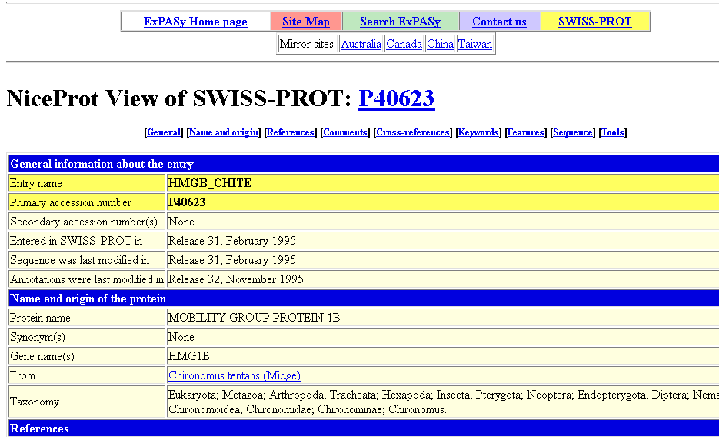
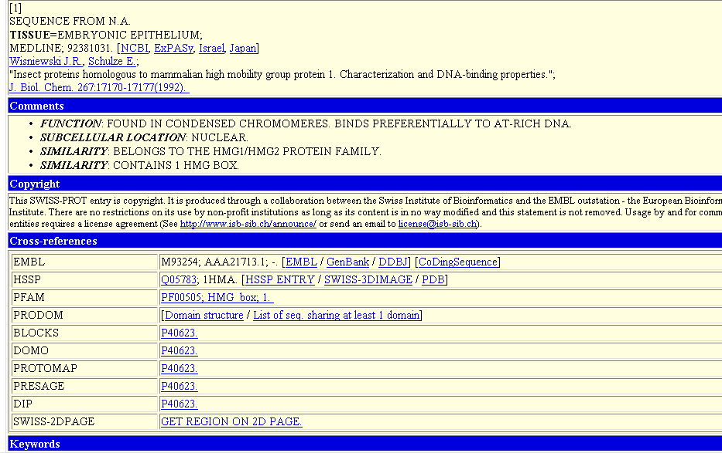
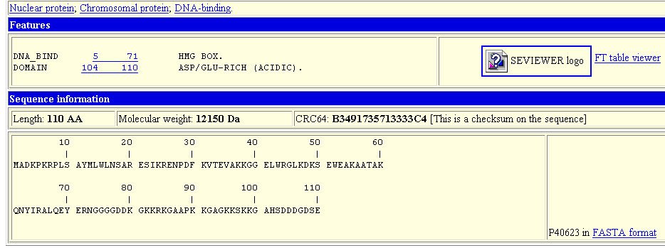
Why Do We Want To Compare Sequences
wheat --DPNKPKRAMTSFVFFMSEFRSEFKQKHSKLKSIVEMVKAAGER
| | |||||||| || | ||| ||| | |||| ||||
????? KKDSNAPKRAMTSFMFFSSDFRS----KHSDL-SIVEMSKAAGAA
EXTRAPOLATE
Homology?
SwissProt
??????

Slide 5
Why Do We Want To Compare Sequences

Slide 6
Why Does It Make Sense To Align Sequences ?
-Evolution is our Real Tool.
-It is easier and therefore more likely for nature to
Re-use Things than to Create them de novo.
-Consequence: Evolution is mostly DIVERGEANT
Same Sequence ⬄ Same Ancestor

Slide 7
Why Does It Make Sense To Align Sequences ?
Same
Sequence
Same
Origin
Same
Function
Same
3D Fold
Many
Counter-examples!

Slide 8
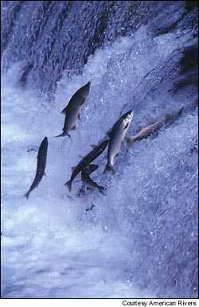
Comparing Is Reconstructing Evolution

Slide 9


An Alignment is a STORY
ADKPKRPLSAYMLWLN
ADKPKRPLSAYMLWLN
ADKPKRPLSAYMLWLN
Mutations
+
Selection
ADKPKRPKPRLSAYMLWLN
ADKPRRPLS-YMLWLN
Notes:
Mutations, deletions are the engines of evolution, but selection does the steering…
As shown here it is often impossible to tell appart insertions and deletions, hence their generic name: indels.
Next: Homology

Slide 10
An Alignment is a STORY
ADKPKRPLSAYMLWLN
ADKPKRPLSAYMLWLN
ADKPKRPLSAYMLWLN
Mutations
+
Selection
ADKPKRPKPRLSAYMLWLN
ADKPRRPLS-YMLWLN
Insertion
Deletion
ADKPRRP---LS-YMLWLN
ADKPKRPKPRLSAYMLWLN
Mutation
Notes:
Mutations, deletions are the engines of evolution, but selection does the steering…
As shown here it is often impossible to tell appart insertions and deletions, hence their generic name: indels.
Next: Homology

Slide 11


Evolution is NOT Always Divergent…
Chen et al, 97, PNAS, 94, 3811-16
AFGP with (ThrAlaAla)n
Similar To Trypsynogen
N
S
AFGP with (ThrAlaAla)n
NOT
Similar to Trypsinogen

Slide 12
Evolution is NOT Always Divergent
AFGP with (ThrAlaAla)n
Similar To Trypsynogen
N
S
AFGP with (ThrAlaAla)n
NOT
Similar to Trypsinogen
SIMILAR Sequences
BUT
DIFFERENT origin

Slide 13
Evolution is NOT always Divergent…
But in MOST cases, you may assume it is…
Similar Function
DOES NOT REQUIRE
Similar Sequence
Same
Sequence
Same
Origin
Same
Function
Similar Sequence
⬄
Historical Legacy
Same
3D Fold

