Slide 1

How Can We Compare Sequences ?
Substitution Matrices

Slide 2
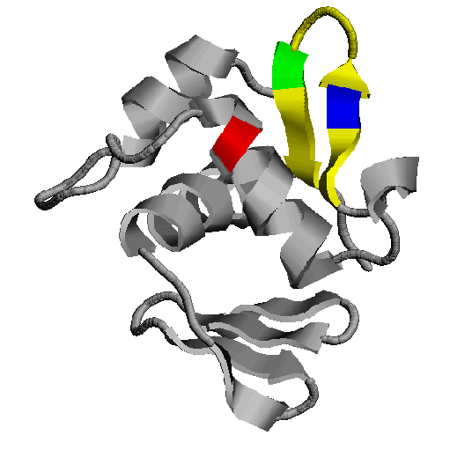
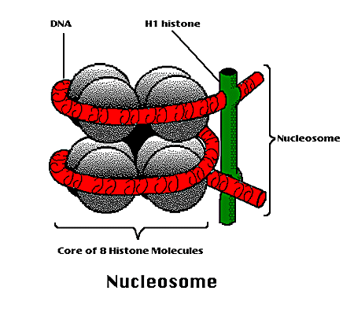
How Can We Compare Sequences ?
To Compare Two Sequences, We need:
Their Structure
We Do Not
Have Them !!!
Their Function

Slide 3
How Can We Compare Sequences ?
We will Need To Replace Structural Information With Sequence Information.
Same
Sequence
Same
Origin
Same
Function
Same
3D Fold
It CANNOT Work ALL THE TIME !!!

Slide 4

How Can We Compare Sequences ?
To Compare Sequences, We need to Compare Residues
We Need to Know How Much it COSTS to SUBSTITUTE
an Alanine into an Isoleucine
a Tryptophan into a Glycine
…
The table that contains the costs for all the possible substitutions is called the SUBSTITUTION MATRIX
How to derive that matrix?

Slide 5
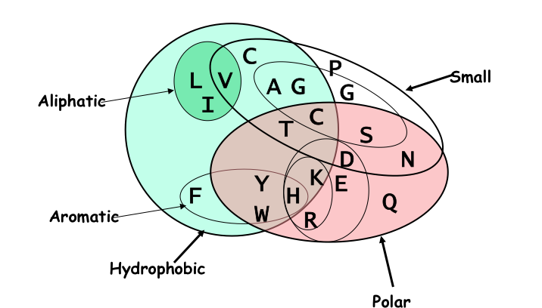
How Can We Compare Sequences ?
Using Knowledge Could Work
C
P
Small
L
V
A
G
G
Aliphatic
I
C
T
C
S
D
N
Y
K
E
F
H
Q
Aromatic
W
R
Hydrophobic
Polar
But we do not know enough about Evolution and Structure.
Using Data works better.

Slide 6


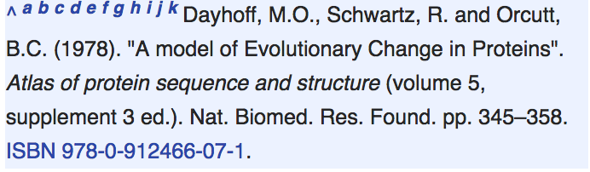
How Can We Compare Sequences ?
Substitution Matrices
-Take 71 nice pairs of Protein Sequences,
easy to align (85% identical).
-Align them…
-Count each mutations in the alignments
-25 Tryptophans into phenylalanine
-30 Isoleucine into Leucine
…
-For each mutation, set the substitution score to the log odd ratio:
Observed
Log
Expected by chance

Slide 7
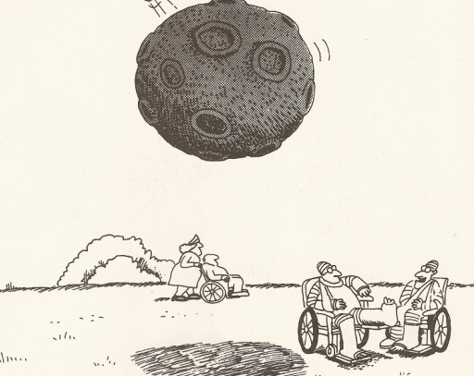
You’re kidding! … I was struck by a lightning twice too!!
Garry Larson, The Far Side

Slide 8

How Can We Compare Sequences ?
Substitution Matrices
-Take 71 nice pairs of Protein Sequences,
easy to align (85% identical).
-Align them…
-Count each mutations in the alignments
-25 Tryptophans into phenylalanine
-30 Isoleucine into Leucine
…
-For each mutation, set the substitution score to the log odd ratio:
Observed
Log
Expected by chance

Slide 9
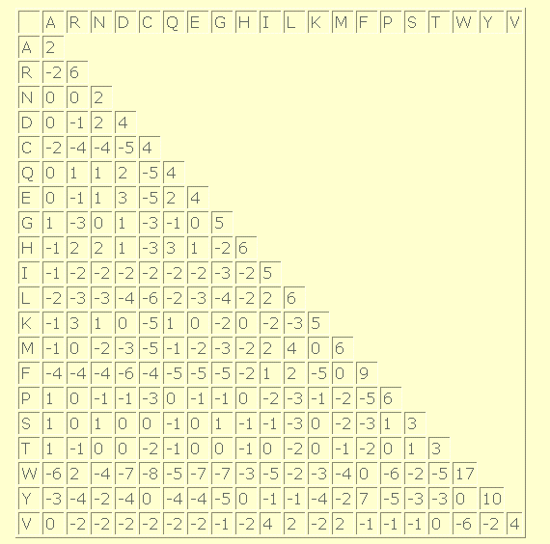
How Can We Compare Sequences ?
Making a Substitution Matrix
The Diagonal Indicates How Conserved a residue tends to be.
W is VERY Conserved
Some Residues are Easier To mutate into other similar
Cysteins that make disulfide bridges and those that do not get averaged

Slide 10
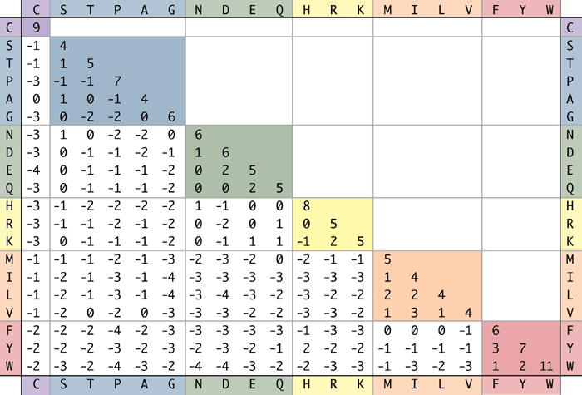
How Can We Compare Sequences ?
Making a Substitution Matrix

Slide 11
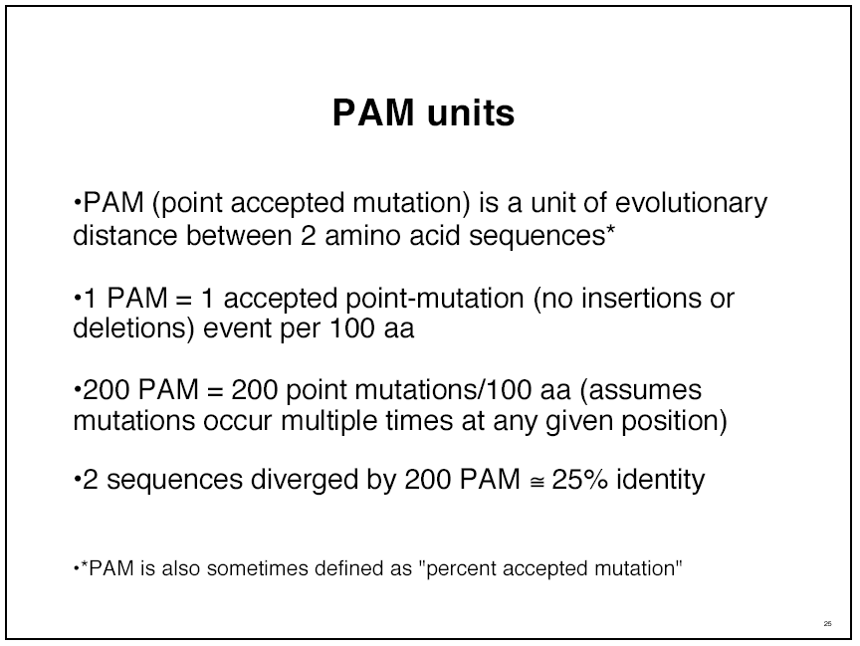
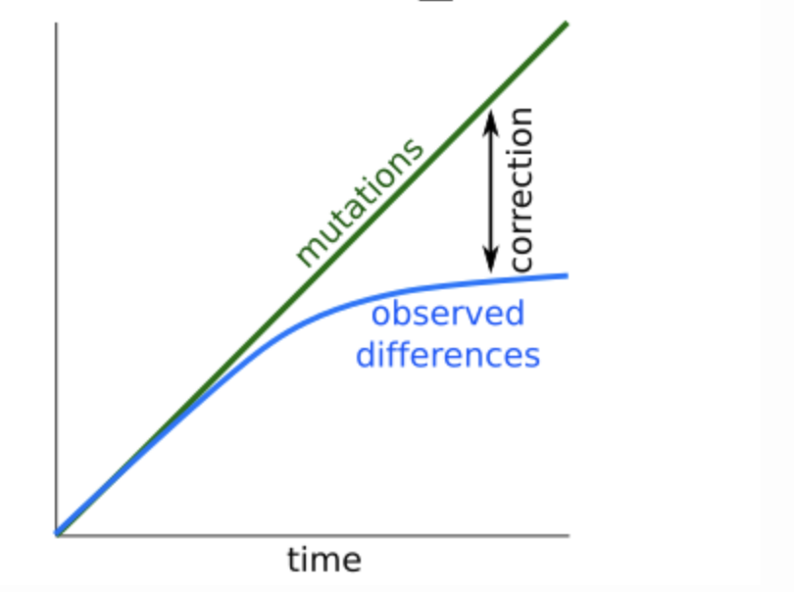
200
75

Slide 12
How Can We Compare Sequences ?
Using Substitution Matrix
Given two Sequences and a substitution Matrix,
We must Compute the CHEAPEST Alignment
Insertion
Deletion
ADKPRRP---LS-YMLWLN
ADKPKRPKPRLSAYMLWLN
Mutation

Slide 13
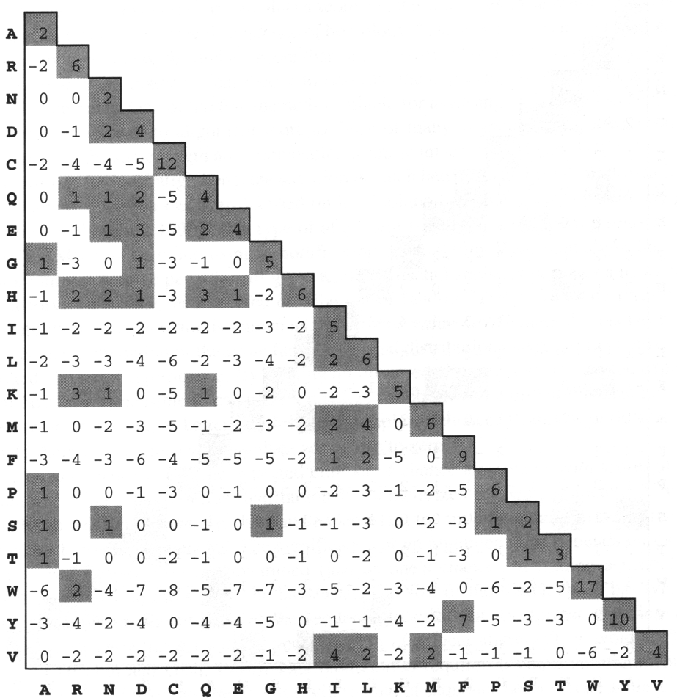
Scoring an Alignment
Most popular Subsitution Matrices
  PAM250
  Blosum62 (Most widely used)
Raw Score
TPEA
¦| |
APGA
Score =
1
+
6
+
0
+
2
= 9
  Question: Is it possible to get such a good alignment by chance only?

Slide 14


How Can We Compare Sequences ?
Limits of the substitution Matrices
They ignore non-local interactions and Assume that identical residues are equal
ADKPKRPLSAYMLWLN
They assume evolution rate to be constant
ADKPKRPLSAYMLWLN
ADKPKRPLSAYMLWLN
Mutations
+
Selection
ADKPRRPLS-YMLWLN
ADKPKRPKPRLSAYMLWLN

Slide 15
How Can We Compare Sequences ?
Limits of the substitution Matrices
Substitution Matrices Cannot Work !!!

Slide 16

How Can We Compare Sequences ?
Limits of the substitution Matrices
I know… But at least, could I get some idea of when they are likely to do all right

