Slide 1

Using Dynamic Programming To Align Sequences
Cédric Notredame

Slide 2
Our Scope
Understanding the DP concept
Coding a Global and a Local Algorithm
Aligning with Affine gap penalties
Saving memory
Sophisticated variants…

Slide 3
Outline
-Coding Dynamic Programming with Non-affine Penalties
-Turning a global algorithm into a local Algorithm
-Adding affine penalties
-Using A Divide and conquer Strategy
-Tailoring DP to your needs:
-The repeated Matches Algorithm
-Double Dynamic Programming

Slide 4
Global Alignments Without Affine Gap penalties
Dynamic Programming

Slide 5
How To align Two Sequences With a Gap Penalty, A Substitution matrix and Not too Much Time
Dynamic Programming

Slide 6
A bit of History…
-DP invented in the 50s by Bellman
-Programming ⬄ Tabulation
-Re-invented in 1970 by Needlman and Wunsch
-It took 10 year to find out…

Slide 7
The Foolish Assumption
The score of each column of the alignment is independent from the rest of the alignment
It is possible to model the relationship between two sequences with:
-A substitution matrix
-A simple gap penalty

Slide 8
The Principle of DP
If you extend optimally an optimal alignment of two sub-sequences, the result remains an optimal alignment
X
-
Deletion
X-XX
XXXX
+
?
?
X
X
Alignment
-
X
Insertion

Slide 9
Finding the score of i,j
-Sequence 1: [1-i]
-Sequence 2: [1-j]
-The optimal alignment of [1-i] vs [1-j] can finish in three different manners:
-
X
X
X
X
-

Slide 10
Finding the score of i,j
1…i
1…j-1
+
-
j
Three ways to build
the alignment
1…i
1…j
1…i-1
1…j-1
+
i
j
1…i-1
1…j
+
i
-

Slide 11
Finding the score of i,j
1…i
1…j
In order to Compute the score of
All we need are the scores of:
1…i-1
1…j
1…i-1
1…j-1
1…i
1…j-1

Slide 12
Formalizing the algorithm
1…i
1…j-1
+
-
X
F(i,j-1) + Gep
F(i,j)= best
F(i-1,j-1) + Mat[i,j]
1…i-1
1…j-1
+
X
X
F(i-1,j) + Gep
1…i-1
1…j
+
X
-

Slide 13
Arranging Everything in a Table
-
F
A
T
-
F
1…I-1
1…J-1
1…I
1…J-1
A
1…I-1
1…J
1…I
1…J
S
T

Slide 14
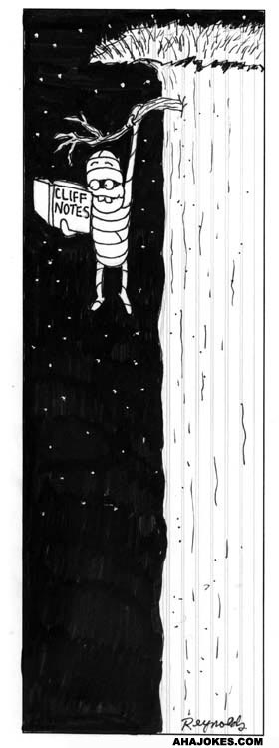
Taking Care of the Limits
The DP strategy relies on the idea that ALL the cells in your table have the same environment…
This is NOT true of ALL the cells!!!!
In a Dynamic Programming strategy, the most delicate part is to take care of the limits:
-what happens when you start
-what happens when you finish

Slide 15
Taking Care of the Limits
F
-
FA
--
FAT
---
-
F
A
T
-
0
-1
-2
-3
F
-
F
-1
FA
--
A
-2
FAS
---
S
-3
Match=2
MisMatch=-1
Gap=-1
T
-4

Slide 16


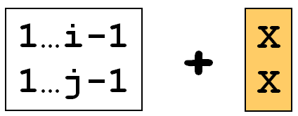
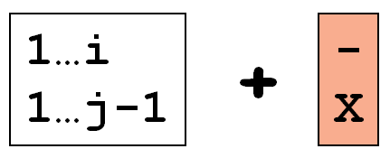
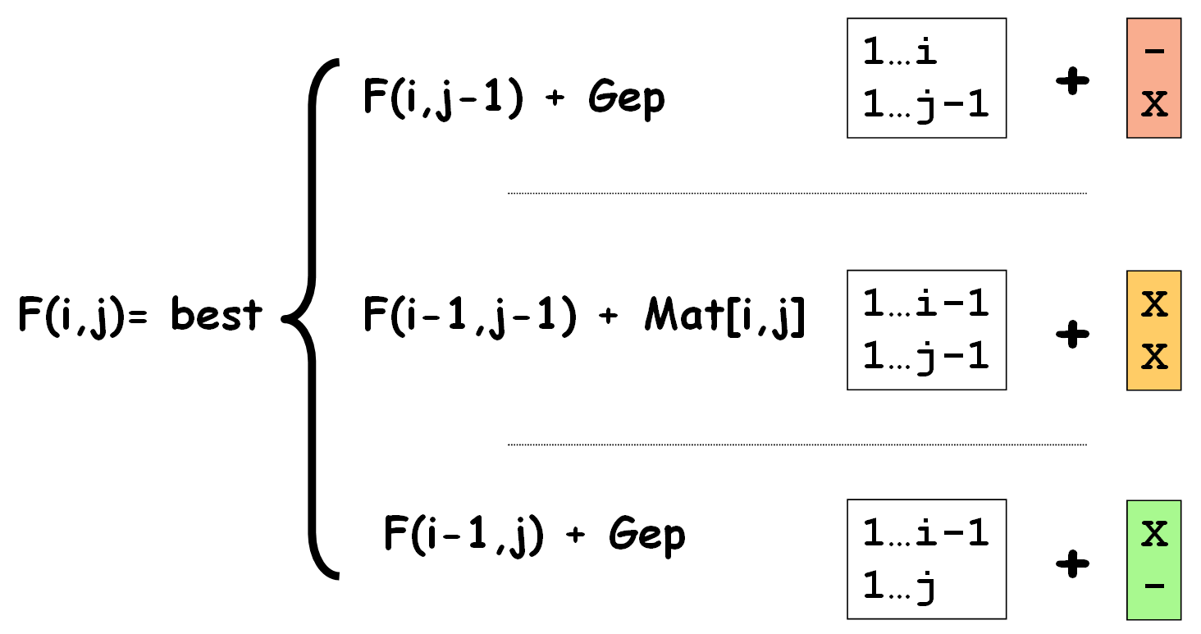
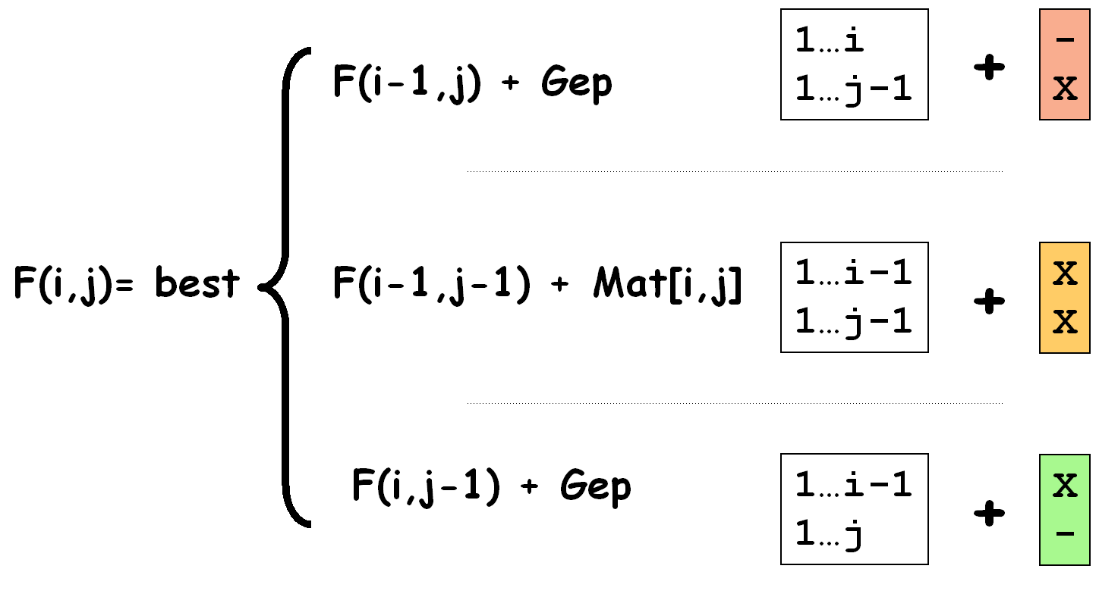



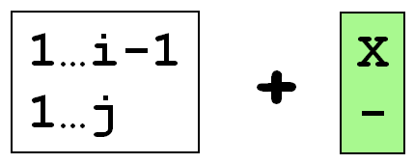


Filing Up The Matrix

Slide 17
-
F
A
T
-
-1
-2
-3
0
F
-1
-2
-3
-4
+2
-2
-3
+2
+1
0
-2
+1
0
A
-2
+1
-2
0
-1
+1
+4
0
-3
+4
+3
0
+3
S
-3
0
+3
+2
-3
0
+3
0
+3
+3
-4
-1
+2
T
-4
-1
+2
+2
-4
-1
+5
-1
+2
+5
-5
-2
+1

Slide 18
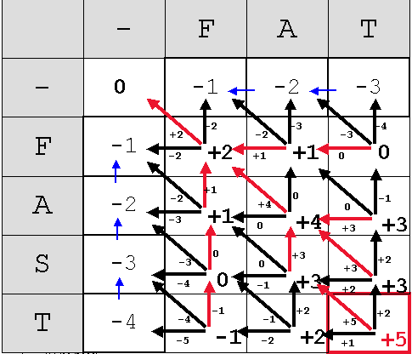
Delivering the alignment: Trace-back
T
T
S
-
A
A
F
F
Score of 1…3 Vs 1…4
⬄
Optimal Aln Score

Slide 19
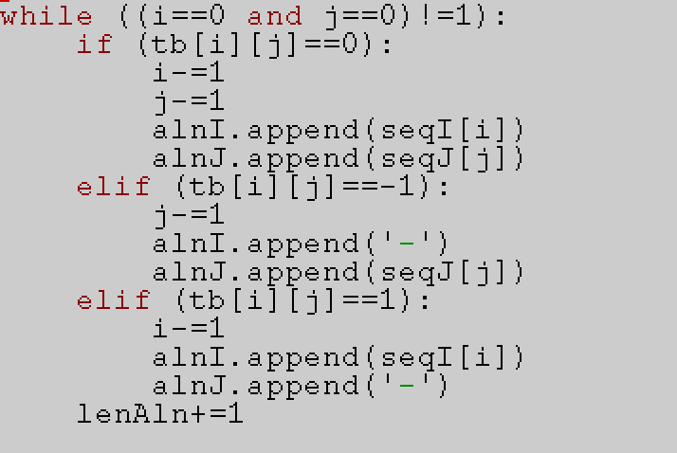
Trace-back: possible implementation

