Slide 1

Local Alignments Without Affine Gap penalties
Smith and Waterman

Slide 2
Getting rid of the pieces of Junk between the interesting bits
Smith and Waterman

Slide 3
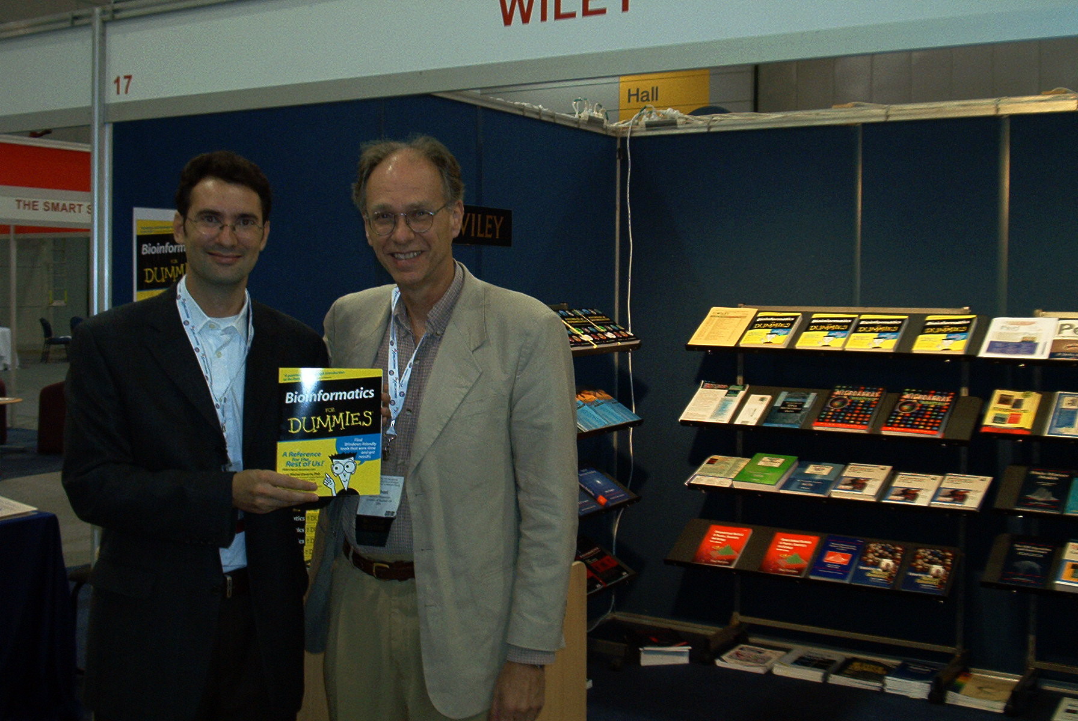

Slide 4
The Smith and Waterman Algorithm
1…i
1…j-1
+
-
X
F(i-1,j) + Gep
F(i-1,j-1) + Mat[i,j]
1…i-1
1…j-1
+
X
X
F(i,j)= best
F(i,j-1) + Gep
1…i-1
1…j
+
X
-
0

Slide 5
The Smith and Waterman Algorithm
F(i-1,j) + Gep
F(i-1,j-1) + Mat[i,j]
F(i,j)= best
F(i,j-1) + Gep
0

Slide 6
The Smith and Waterman Algorithm
0
⬄
Ignore The rest of the
Matrix
⬄
Terminate a local Aln

Slide 7


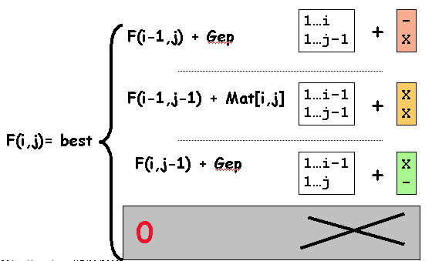
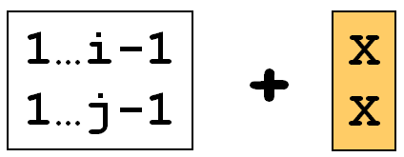
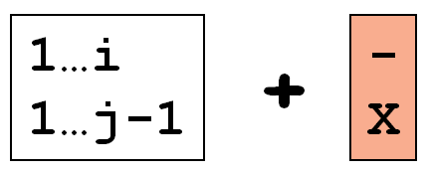



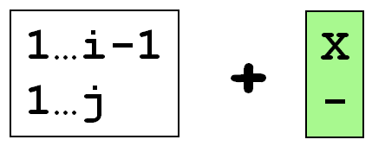


Filing Up a SW Matrix
0

Slide 8
Filling up a SW matrix: borders
* - A N I C E C A T
- 0 0 0 0 0 0 0 0 0
C 0
A 0
T 0
A 0
N 0
D 0
O 0
G 0
Easy:
Local alignments NEVER start/end with a gap…

Slide 9
Filling up a SW matrix
* - A N I C E C A T
- 0 0 0 0 0 0 0 0 0
C 0 0 0 0 2 0 2 0 0
A 0 2 0 0 0 0 0 4 0
T 0 0 0 0 0 0 0 2 6
A 0 2 0 0 0 0 0 0 4
N 0 0 4 2 0 0 0 0 2
D 0 0 2 2 0 0 0 0 0
O 0 0 0 0 0 0 0 0 0
G 0 0 0 0 0 0 0 0 0
Best Local score
⬄
Beginning of the trace-back

Slide 10
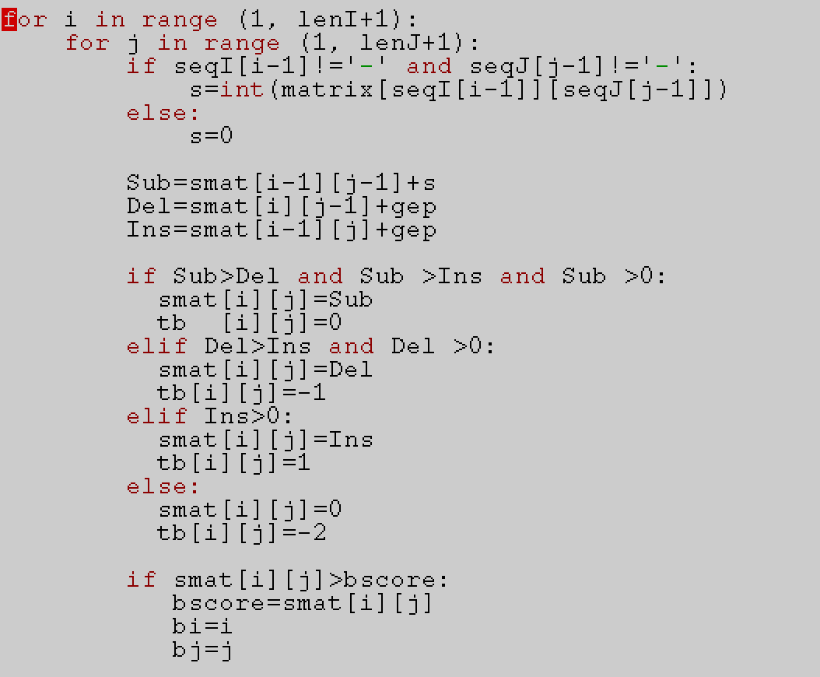
Turning
NW
into
SW
Prepare
Trace
back

Slide 11
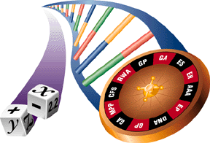
A few things to remember
SW only works if the substitution matrix has been normalized to give a Negative score to a random alignment.
Chance should not pay when it comes to local alignments !

Slide 12
More than One match…
-SW delivers only the best scoring Match
If you need more than one match:
      SIM (Huang and Millers)
      Or
      Waterman and Eggert (Durbin, p91)

Slide 13
Waterman and Eggert
Iterative algorithm:
  1-identify the best match
  2-redo SW with used pairs forbidden
  3-finish when the last interesting local extracted
Delivers a collection of non-overlapping local alignments
Avoid trivial variations of the optimal.

Slide 14
Adding Affine Gap Penalties
The Gotoh Algorithm

Slide 15
Forcing a bit of Biology into your alignment
The Gotoh Formulation

Slide 16
Why Affine gap Penalties are
Biologically better
Cost
GOP
GOP
GEP
GOP
GOP
L
Cost=gop+L*gep
Afine Gap Penalty
Or Cost=gop+(L-1)*gep
Parsimony:
Evolution takes the simplest path
(So We Think…)

Slide 17
But Harder To compute…
More Than 3 Ways to extend an Alignment
Opening
X
-
Deletion
Extension
X-XX
XXXX
+
?
?
X
X
Alignment
Opening
-
X
Insertion
Extension

Slide 18
More Questions Need to be asked
For instance, what is the cost of an insertion ?
1…I-1 ??X
1…J-1 ??X
1…I ??-
1…J-1 ??X
GOP
GEP
1…I ??-
1…J ??X

Slide 19
Solution:Maintain 3 Tables
Ix: Table that contains the score of every optimal alignment 1…i vs 1…j that finishes with an Insertion in sequence X.
Iy: Table that contains the score of every optimal alignment 1…I vs 1…J that finishes with an Insertion in sequence Y.
M: Table that contains the score of every optimal alignment 1…I vs 1…J that finishes with an alignment between sequence X and Y

Slide 20
The Algorithm
M(i-1,j-1) + Mat(i,j)
1…i-1
1…j-1
+
X
X
M(i,j)= best
Ix(i-1,j-1) + Mat(i,j)
Iy(i-1,j-1) + Mat(i,j)
M(i-1,j) + gop
1…i-1 X
1…j X
+
X
-
Ix(i,j)= best
Ix(i-1,j) + gep
1…i-1 X
1…j -
+
X
-
M(i,j-1) + gop
1…i X
1…j-1 X
+
-
X
Iy(i,j)= best
Iy(i,j-1) + gep
1…i -
1…j-1 X
+
-
X

Slide 21
Trace-back?
Ix
M
Iy
M(i,j)
Start From BEST
Ix(i,j)
Iy(i,j)

Slide 22
Trace-back?
Ix
M
Iy
Navigate from one table to the next, knowing that a gap always finishes with an aligned column…

Slide 23
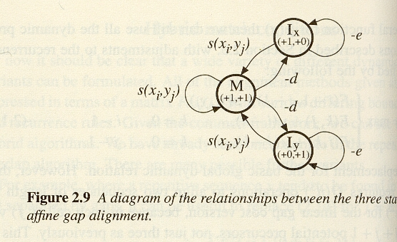
Going Further ?
With the affine gap penalties, we have increased the number of possibilities when building our alignment.
CS talk of states and represent this as a Finite State Automaton (FSA are HMM cousins)

Slide 24
Going Further ?

Slide 25
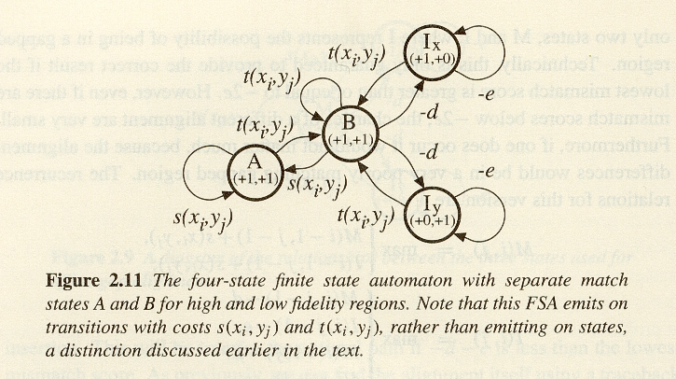
Going Further ?
In Theory, there is no Limit on the number of states one may consider when doing such a computation.

Slide 27
Going Further ?
Imagine a pairwise alignment algorithm where the gap penalty depends on the length of the gap.
Can you simplify it realistically so that it can be efficiently implemented?

Slide 28
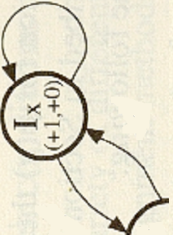
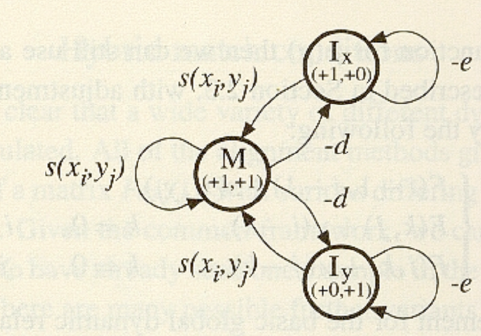

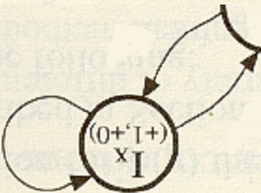
Lx
Ly

