Slide 1

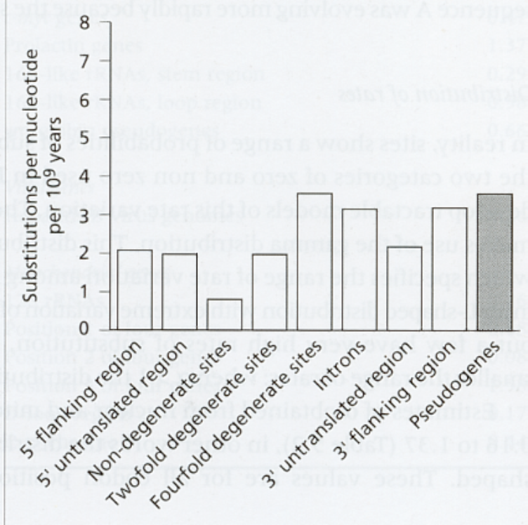
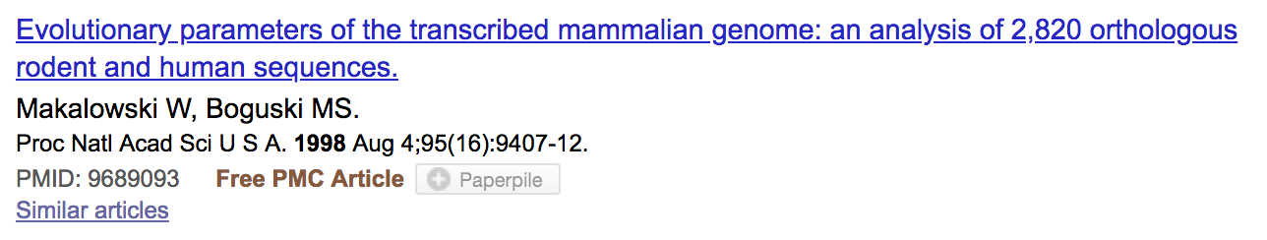
How Do Sequences Evolve
Each Portion of a Genome has its own Agenda.

Slide 2
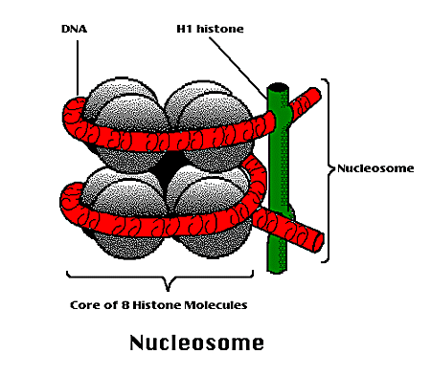
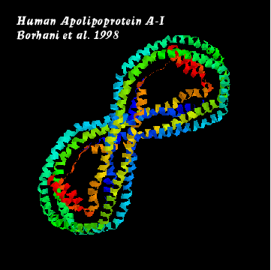
How Do Sequences Evolve ?
CONSTRAINED Genome Positions Evolve SLOWLY
EVERY Protein Family Has its Own Level Of Constraint
Family K_{S} K_{A}
Histone3 6.4 0
Insulin 4.0 0.1
Interleukin I 4.6 1.4
α−Globin 5.1 0.6
Apolipoprot. AI 4.5 1.6
Interferon G 8.6 2.8
Rates in Substitutions/site/Billion Years as measured on Mouse Vs Human (80 Million years)
Ks Synonymous Mutations, Ka Non-Neutral.

Slide 3
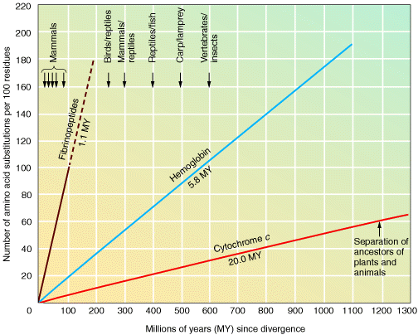
Different molecular clocks for different proteins--another prediction
Notes:
The Neutral Theory also makes another prediction about molecular clocks--namely that different types of proteins will have different clock rates?
In particular, proteins whose structures are such that a small change in the amino acid sequence can impair the function of that protein, should evolve at the slowest rates, whereas proteins whose amino acid sequences can be modified fairly dramatically WITHOUT impairing function, should evolve at the fastest rates?
Do we, in fact, see evidence of this?
Yes. Consider the fibrinopeptide class of protein. These proteins are involved in blood clotting. They can perform this function even when there are numerous amino acid changes. They evolve at a relatively rapid rate, as the slode of the line relating aa substitutions to time shows (slide).
On the other hand, cytochrome c, a protein involved in respiration metabolism, cannot tolerate many changes to its aa sequence without losing function. As the slide shows, it evolves (“its clock ticks at”) a much slower rate.

Slide 4
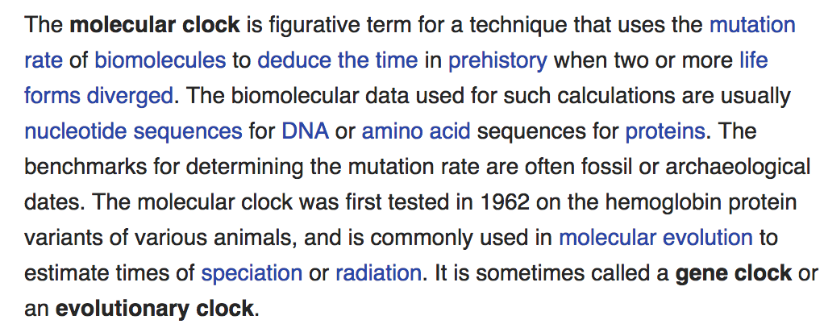
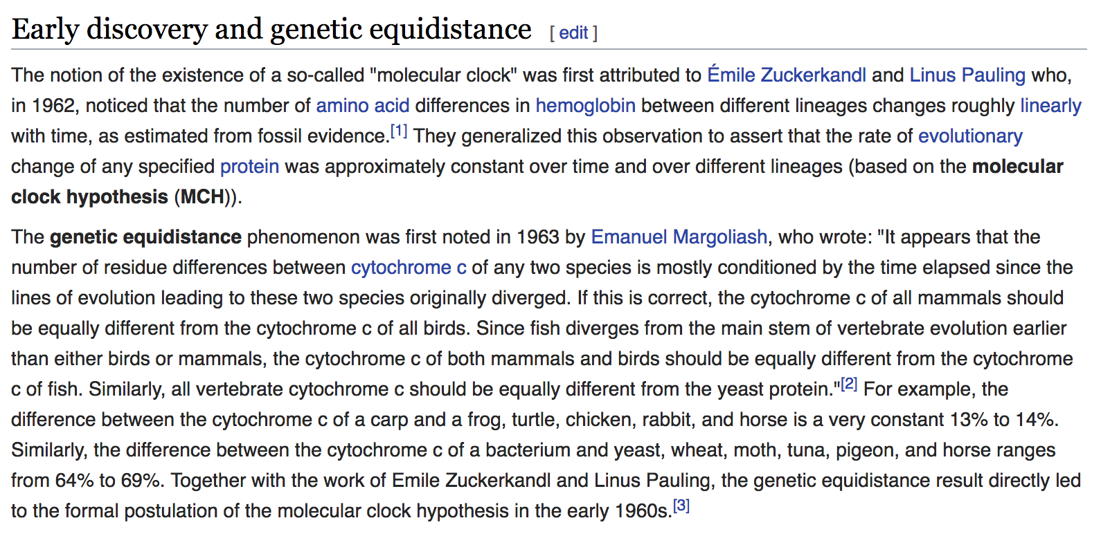


Slide 5
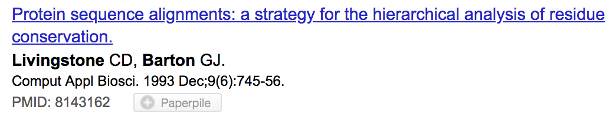
How Do Sequences Evolve ?
The amino Acids Venn Diagram
To Make Things Worse, Every Residue has its Own Personality
C
P
L
V
A
G
Small
G
Aliphatic
I
C
C
T
S
D
N
Y
K
E
F
H
Q
Aromatic
W
R
Hydrophobic
Polar

Slide 6
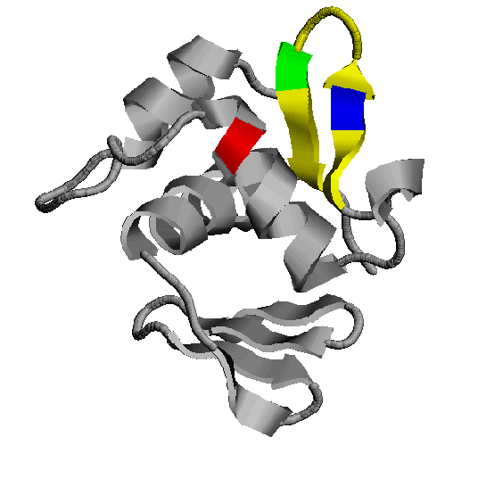
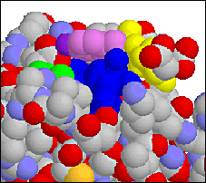
How Do Sequences Evolve ?
In a structure, each Amino Acid plays a Special Role
-
+
-
On the surface,
CHARGE MATTERS
In the core,
SIZE MATTERS
OmpR, Cter Domain

Slide 7
How Do Sequences Evolve ?
Accepted Mutations Depend on the Structure
Big -> Big
Small ->Small
NO DELETION
-
+
-
Charged -> Charged
Small <-> Big or Small
DELETIONS

